Slide 1
Quadriceps Functions and
Mobility Performance in Individuals after Total Knee Arthroplasty
Yuri Yoshida, PT, PhD
Assistant Professor
Dept of Physical Therapy
University of Evansville
Notes:
First of all, I would like to thank you for the generous opportunity for me present here.
I will present some historical data from my dissertation project, two projects conducted at U of Utah, and my ideas to pursue in my future in academic Physical Therapy.

Slide 2

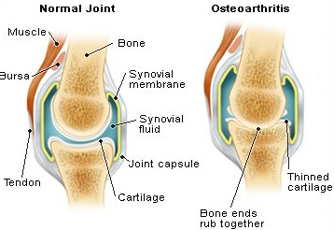
Osteoarthritis
The most common arthritis
  27 million people are affected
  80% of the population over 65 y.o.
Chronic inflammatory conditions
      Damaged joint surface
      Effusion
      Pain
      Instability/Stiffness
      Muscle Weakness
http://carollissimo.files.wordpress.com/2007/08/oa.jpg?w=468
Notes:
As all know, OA is the most common arthritis that limits daily activity.
It is a chronic inflammatory conditions that leads to…

Slide 3
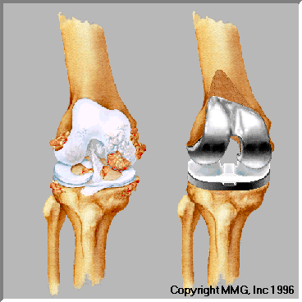
Total Knee Arthroplasty
Most common surgery
  600,000 people in the US (AAOS 2012)
  Patients < 60 y.o. requiring TKA have increased.
One of the Most Successful Surgeries
  ~80% patients are satisfied with their functional outcomes.
  (Beaupre 04, Conditt 04, Noble 05)
  >95% of prosthetics can survive over 10 to 12 years
    (Rand, Trousdale et al. 2003)
  Functional recovery????
    (Mizner 05, Kennedy 06)
Notes:
Total knee arthroplasty is often applied to reduce arthritic pain and restore the damaged joint surface.
It has been known as one of successful orthopedic surgeries.

Slide 4
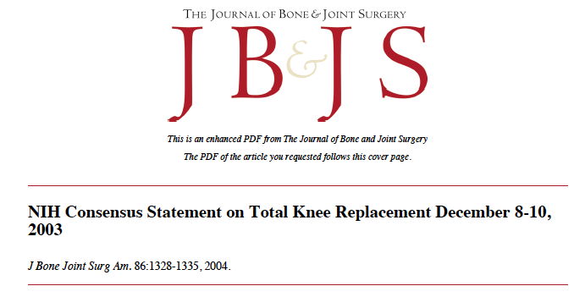
What is Missing?
“Despite the wide-spread use of TKR, there is a notable lack of consensus regarding which medical and rehabilitative perioperative practices should be employed, mostly because of the lack of well-designed studies testing the efficacy and effectiveness of such practices.”
Notes:
However, unfortunately, we don’t have adequate evidence regarding the effectiveness of rehabilitation including physical therapy.

Slide 5
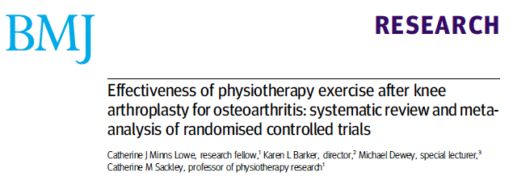
“Effect sizes are small to moderate, with no long term benefit”
Notes:
To answer the consensus, Minns-Lowe and her colleagues reported the results of meta-analysis.
They concluded as “------”, however, I wonder if this is not adequate enough for me to convinced.
Systematic review: Literature review focused on a research question.
Meta-analysis: is often used to conduct on several clinical trials of a medical treatment, in an effort to obtain a better understanding of how well the treatment works.
a meta-analysis combines the results of several studies that address a set of related research hypotheses.

Slide 6

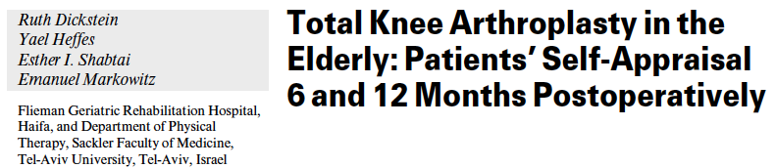
“… and to the limitations in using stairs as the variables which significantly affected the levels of dissatisfaction 1 year postoperatively.”

Slide 7
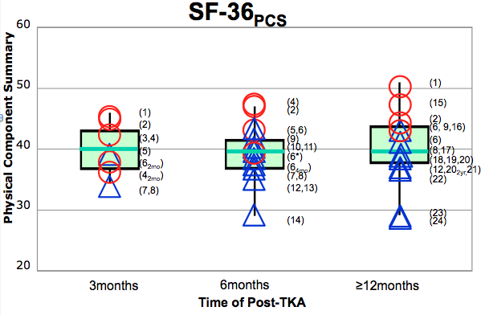
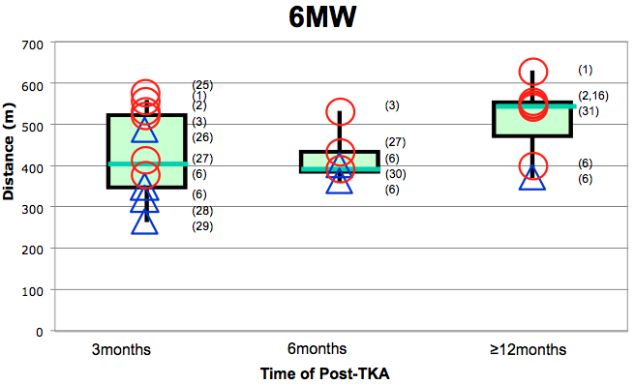
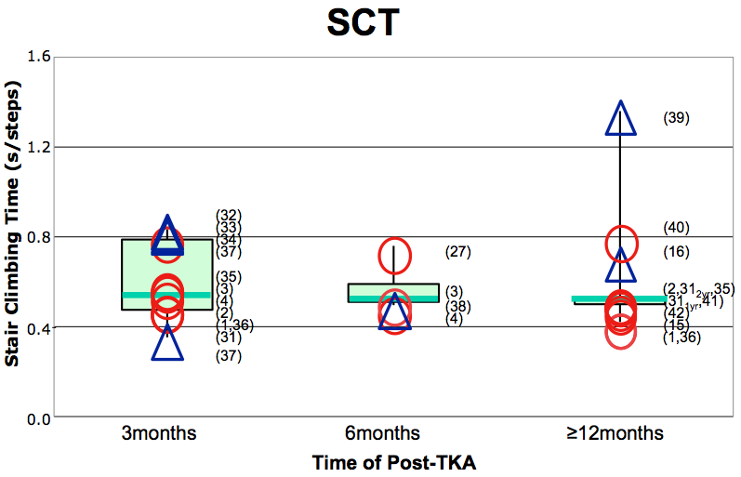
Physical Therapy Does Work!
With outpatient PT
Without outpatient PT
    1.Yoshida, Y., et al., Clin Biomech, 2008. 23(3).
    2.Petterson, S.C., et al., Arthritis Rheum, 2009. 61(2).
    3.Stevens-Lapsley, J.E., et al., J Arthroplasty, 2009.
    4.Mizner, R.L., et. al, JOSPT, 2005. 35(7).
    5.Shields, R.K., et. al., Arch Phys Med Rehabil, 1999. 80(5).
    6.Moffet, H., et al. Arch Phys Med Rehabil, 2004. 85(4).
    7.Beaupre, L.A., et al. Phys Ther, 2001. 81(4).
    8.Beaupre, L.A., et al. J Rheumatol, 2004. 31(6).
    9.Marx, R.G., et al. J BJS, 2005. 87(9).
    10.Mahomed, N.N., et al. J Rheumatol, 2002. 29(6).
    11.Quintana, J.M., et al. Arch Intern Med, 2006. 166(2).
    12.Heck, D.A., et al. Clin Orthop Relat Res, 1998(356).
    13.Jones, C.A., et. al. Phys Ther, 2003. 83(8).
    14.Ayers, D.C., et al. J Arthroplasty, 2004. 19(7 Suppl 2).
    15.Mizner, R.L., et al. J Rheumatol, 2005. 32(8).
    16.LaStayo, P.C., et al. Clin Orthop Relat Res, 2009. 467(6).
    17.Ayers, D.C., et al. Clin Orthop Relat Res, 2005. 440.
    18.Stickles, B., et al. Obes Res, 2001. 9(3).
    19.Anderson, P.A., et. al. Spine, 2009. 34(2).
    20.Rampersaud, Y.R., et al. Spine J, 2008. 8(2).
    21.Polly, D.W., et al. Spine, 2007. 32.
    22.Rowe, P.J., et al. J Orthop Surg, 2005. 13(2).
    23.Singh, J.A. et. al.. Rheumatology, 2008. 47(12).
    24.Singh, J.A. Clin Rheumatol, 2009. 28(9).
    25.Mizner, R.L. et al. J Orthop Res, 2005. 23(5).
    26.Kennedy, D.M., et al. BMC, 2005. 6.
    27.Bade, M.J., et. al. JOSPT, 2010. 40(9).
    28.Parent, E. et alt. Arch Phys Med Rehabil, 2002. 83(1).
    29.Ouellet, D. et al. 2002. 47(5).
    30.Harmer, A.R., et al. Arthritis Rheum, 2009. 61(2).
    31.Farquhar, S. et al.. Clin Orthop Relat Res, 2009.
    32.Kennedy, D.M., et al. BMC, 2006. 7.
    33.Almeida, G.J., et al. Arch Phys Med Rehabil, 2010. 91(6).
    34.Bruun-Olsen, V., et. al. Disabil Rehabil, 2009. 31(4).
    35.Zeni, J.A., Jr et al. JBJS, 2010. 92(5).
    36.Farquhar, S.J., et. al. Phys Ther, 2008. 88(5).
    37.Topp, R., et al. PM R, 2009. 1(8).
    38.Valtonen, A., et al. Phys Ther, 2009. 89(10).
    39.Walsh, M., et al. Phys Ther, 1998. 78(3).
    40.Zeni, J.A., Jr., et al.. BMC, 2010. 11(1).
    41.Zeni, J.A., Jr. et al.. Phys Ther, 2010. 90(1).
    42.Zeni, J.A., Jret al.. J Arthroplasty, 2009.
Notes:
This is my poster presentation at CSM 2011. I had a systematic review to answer the question whether outpatient PT is beneficial for individuals after TKA.
(Graph orientation).

Slide 8
Post-TKA Impairment
Post-surgery inflammatory conditions
Quadriceps weakness
  Is the primary impairment related to mobility level over time
  Never reaches the level of healthy control
(Mizner 05, Petterson 08, Farquhar 09)
Notes:
Physical Therapy addresses varied post-TKA conditions, but the primary post-op impairment after TKA is Quadriceps weakness.
Mizner et al reported that quadriceps strength is persistently and high correlation to the mobility level, but not pain and range of motion.
From the studies from U of Delaware, we know that quadriceps strength of the operated limb increase to be greater than the pre-op strength and also to match the non-operated; however, they did not reach the level of age matched healthy controls that is represented by the red line.

Slide 9
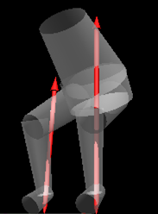
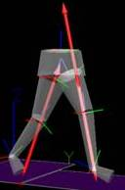
Quadriceps Strength
and Functional Performance
  3 months: Asymmetrical functional performance related to asymmetrical quadriceps strength by relying on the non-operated limb.
  (Mizner 05)
Notes:
As corresponded, functional performance also altered from normal patterns.
When individuals in early phase of post operated had greater asymmetrical quadriceps strength between limbs, they demonstrated asymmetrical functional performance.
Mizner et al reported that asymmetrical quadriceps strength between limbs 3 months after TKA altered functional performance such as standing up from a chair and walking. In short, individuals after TKA demonstrated to shift their weight to the nonoperated limb and use the hip extensor to stand up from a chair, and they also demonstrated asymmetrical knee flexion motion during loading response due to asymmetrical quadriceps strength between limbs.

Slide 10
Research Questions
How does enhanced quadriceps strength affect the altered gait performance for individuals after TKA over time ?
Why does quadriceps weakness in the operated limb remain?

Slide 11

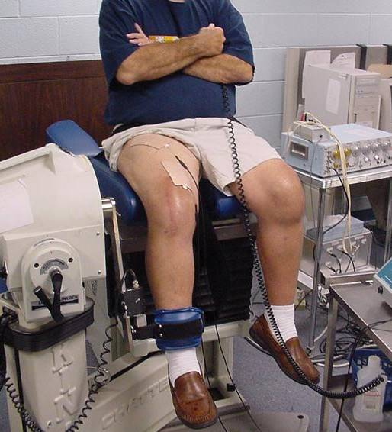
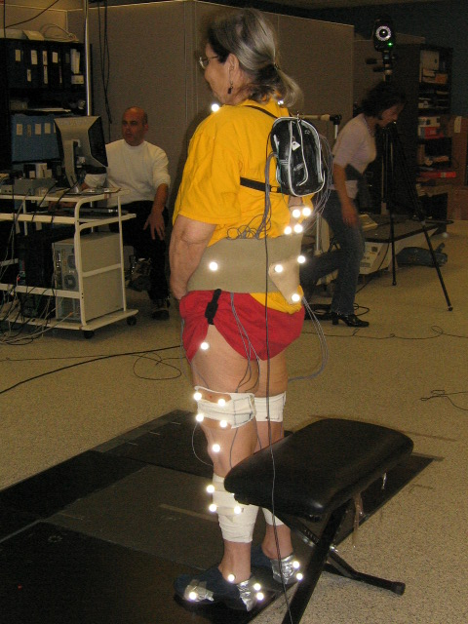
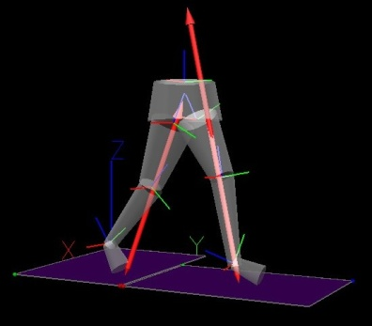
Project
13 subjects with UTKA
13 age-matched healthy controls
Delaware OA profile
    KOS-ADLS, SF-36
    ROM, Knee girth
    TUG, SCT, 6MW
    MVIC, CAR
Motion Analysis
    Vicon workstation
    2 Bertec Force plates
    Motion analysis EMG system
  Loading Response: Knee flexion excursion, peak knee flexion, v-GRF, knee extensor moment, EMG)
Notes:
This project conducted at U of Delaware, was longitudinal observational study.
We captured clinical demographic that is based on the same information when a PT gathered at clinical setting as well as kinematics and kinetics during gait.

Slide 12
Improvements in Clinical Assessments
 |  | TKA (N=13) |  |  |  |  |  |  | Age-matched Healthy (N=13)
 |  | 3 months |  | 2-3 years |  |  |  |  | Baseline |  |  |  | Follow-up
Height _{(m)} |  | 1.7 | ± | 0.1 |  |  |  |  | 1.8 | ± | 0.1
Weight _{(kg)} |  | 90.4 | ± | 11.6 | 88.6 | ± | 10.7 |  | 93.0 | ± | 17.2 |  | 91.7 | ± | 15.9
BMI _{(kgm2)} |  | 30.8 | ± | 4.0 | 30.3 | ± | 3.9 |  | 30.6 | ± | 5.7 |  | 29.9 | ± | 4.9
SF-36 PCS |  | 45.7 | ± | 7.8 | 46.9 | ± | 9.0 |  | 52.3 | ± | 5.7 |  | 49.9 | ± | 7.5
SF-36 MCS |  | 58.2 | ± | 5.1 | 56.5 | ± | 4.3 |  | 58.1 | ± | 1.9 |  | 56.9 | ± | 4.1
KOS-ADLS |  | 0.79 | ± | 0.11 §§ | 0.88 | ± | 0.01 | * | 0.99 | ± | 0.02 |  | 0.94 | ± | 0.09 | *
TUG _{(s)} |  | 7.5 | ± | 1.3 | 7.1 | ± | 1.1 |  | 6.8 | ± | 1.0 |  | 7.2 | ± | 1.1
SCT _{(s)} |  | 11.5 | ± | 3.0 § | 10.5 | ± | 2.3 |  | 9.1 | ± | 1.2 |  | 10.3 | ± | 1.3 | **
6MW _{(m)} |  | 577.7 | ± | 105.9 | 610.6 | ± | 110.7 |  | 652.5 | ± | 129.9 |  | 629.3 | ± | 104.8
e-ROM _{(º)}¶ ¶ |  | 1.5 | ± | 2.4 | -1.9 | ± | 3.6 |  | -0.4 | ± | 2.1 |  | -2.2 | ± | 3.1
f-ROM _{(º)} |  | 119.1 | ± | 8.7 §§ | 126.8 | ± | 9.4 | * | 133.6 | ± | 8.2 |  | 131.9 | ± | 8.4
MVIC _{(N/BMI)} (op) |  | 18.5 | ± | 7.1 §§ | 20.0 | ± | 7.2 | ** | k28.8 | ± | 7.5 |  | 22.4 | ± | 8.4 | **
¶ (non-op) |  | 27.8 | ± | 9.3 | 21.8 | ± | 8.5 |  | 27.8 | ± | 5.8 |  | 23.2 | ± | 7.6
CAR _{(%)} (op) |  | 93.2 | ± | 4.6 | 91.1 | ± | 9.6 |  | 91.5 | ± | 6.4 |  | 88.8 | ± | 8.9
(non-op) |  | 92.2 | ± | 6.1 | 89.4 | ± | 8.6 |  | 90.0 | ± | 6.2 |  | 88.1 | ± | 11.6
* p<0.05 A significant difference compared to the previous session within a group
** p<0.01 A significant difference compared to the previous session witnhin a group
§ p<0.05 A significant difference compared the healthy control group.
¶: p<0.05 A significant change over time in both groups.
¶¶: p<0.01 A significant change over time in both groups.
Notes:
Clinical demographic improved to similar level of age-matched healthy controls.

Slide 13
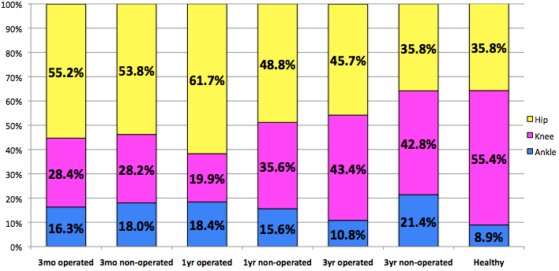
Individuals after TKA can achieve symmetrical gait patterns
but, it is significantly different from healthy controls.
  (Clinical Biomech 07, JOSPT 12
**
*
*
**
*
* p<0.05
** p<0.01
Notes:
Primary gait improvement occurs between 3 and 12 months after TKA, but not expected further improvements beyond 1 year after TKA.
At the follow-up, individuals after TKA can demonstrate similar gait patterns to the age-matched healthy individuals.
What do you think as the next step??

Slide 14

The Best Case Scenario!
Typically, individuals after TKA
  Walk slower, and abnormal gait patterns
    (e.g. lower knee extensor moment).
There is a potential to improve their functional performance to the level of age-matched healthy controls.
(Andriacchi 1993, 1994,Wilson 1997)

Slide 15
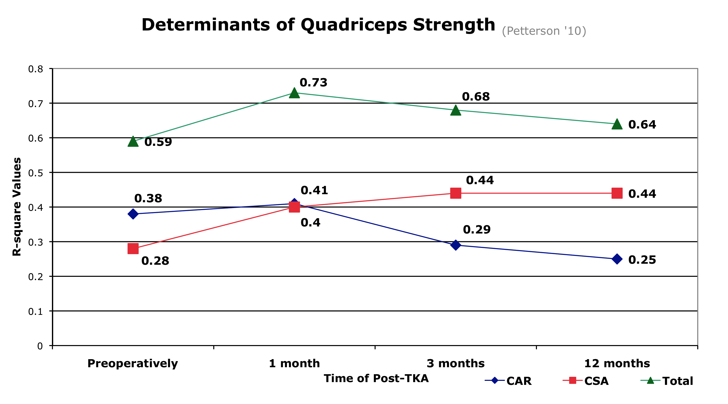
Research Questions
“What are the most effective intervention protocols?”
Determinants of Quadriceps Strength of the op limb
  Voluntary Activation v.s. Lean Cross Sectional Area
Notes:
Now, I need to back to muscle physiology. This is the graph indicating the contributors of quadriceps strength in individuals after TKA.
(Graph orientation)
Generally, outpatient PT with intensive quadriceps strengthening applies during this yellow period. While individuals after TKA receive PT during this phase, the relationship in contributors of strength are changed.

Slide 16
Muscle Activation Deficit
Is impaired maximum capability to activate available muscle fibers in a muscle.
    i.e. Central Activation Ratio
Contributes to muscle weakness in clinical populations with/without muscle atrophy.
      HIV (Scott 2007), ACL Injury (Snyder-Mackler 1994&1995), Knee OA (Hurley 1993, Lewek 2004, Fitzgerald 2004, Stevens 2003)
      Post-TKA (Stevens 2003, Mizner 2003&2005, Meier 2009, Petterson 2009)
        The primary predictor of quadriceps weakness in acute phase for individuals following TKA.
How does it occur?
Notes:
In this presentation, the word ‘muscle activation’ is used to indicate the maximum capability to activate available muscle fibers in a muscle.
The ability of full muscle activation is impaired by varied conditions such as HIV, ACL injury and knee OA.

Slide 17
Intramuscular Adipose Tissue (IMAT)
Increased by:
    Inflammatory conditions (Stump 2006, Beasley 2009, Cheema 2010, Ioozo 2011)
    Lower mobility level (Manini 2007, Goodpaster 2008, Reid 2011)
    Aging (Goodpaster 2001, Song 2004,Vettor 2009)
Related to muscle weakness
    Yet independent from lean tissue (Delmonino 2009, Reid 2011)
“IMAT may inhibit muscular force production
in older adults as a potential modulator
of central activation.”
IMAT is inversely related with central activation of quadriceps femoris.
Notes:
The other muscle composition that affects muscle function is intramuscular adipose tissue (IMAT).
IMAT increases by inflammatory conditions, lower mobility level and aging, and IMAT is also related to muscle weakness.
However, studies reported the relationship between IMAT and muscle strength is independently established from lean tissue
Unfortunately, we do not know how IMAT decreases muscle force production. The factors of increasing IMAT seem to be the same as the factors of impaired muscle activation.
Therefore, we think that IMAT will be related to the quality of force production, muscle activation.

Slide 18
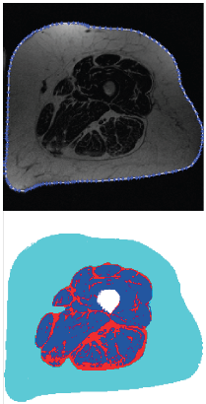
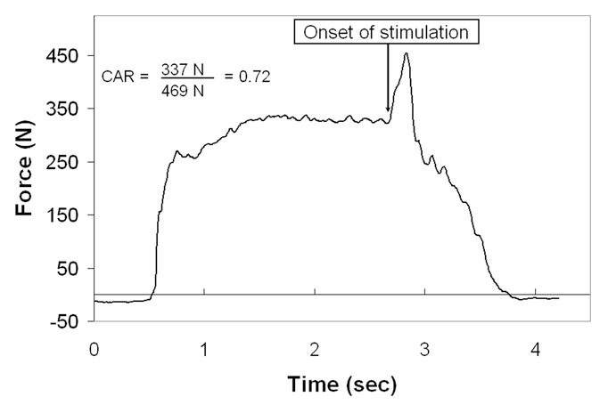
Project 2
15 older adults (N=29 legs, 70.5 ± 10.6 y.o, BMI 28.3 ± 6.6 kg/cm2)
MRI
  3-point Dixon Water Analysis
    MatLab and Labview
    High reliability and validity
    (Elder 2004, Dibble 2006, Gorgey 2007)
Muscle Activation
  Supraimposed technique
    KinCom 500H,Grass Stimulator
  Central Activation Ratio
Notes:
All scans were performed on one 3-Tesla whole body MR imager with a TSE weighted sequence.
The midpoint of thigh determined by a half way between the superior margin of the femoral head and the inferior margin of the femoral condyles was scanned.
A custom written software is identified from the displayed images, and manually traced using a computer mouse, allowing overall IMAT to be automatically computed. This technique has been established with high test-retest reliability and validity.
Muscle activation is assessed using the burst-supraimposition methods while the subjects were sitting with knee 60 degree.
We used a specific criteria to deliver the electrical stimulation.
The electrical stimulation should be delivered when the two conditions are fulfilled:
The force output have to pass over 90% of MVIC captured during practice trials
The force output should be stable defined as the fluctuation of output is less than 5% for one second.
The center activation ratio was calculated by dividing the maximum voluntary contraction into the supraimposed force output.

Slide 19
Results
IMAT (cm²/BMI)
(rho=0.068, p=0.724)
(rho=-0.511, p=0.005)
      CAR 0.91 (± 0.11)
      Lean Tissue 3.58 (± 1.57) cm²/BMI
      IMAT 0.57 (± 0.16) cm²/BMI
Notes:
The results show that there is a significant relation in IMAT with central activation ratio, but not muscle lean tissue.

Slide 20

Exploratory Question
Do individuals with high IMAT have lower muscle activation?
http://farm6.staticflickr.com/5217/5471047557_4dc13f5376.jpg
Notes:
The results lead us to another question: Is there any clinical differences in muscle activation between individuals with higher IMAT and lower IMAT?

Slide 21
160 images from SMERF lab at U of Utah.
    low-IMAT 11.4% (25th)
    high-IMAT 15.4% (75th)
Sub-group
  High-IMAT (N=6)
    CAR 0.87(± 0.11)
  Low-IMAT (N=9)
    CAR 0.95(± 0.04)
(Yoshida et al In Review)
Notes:
160 images from participants in research projects conducted at Skeletalmusculor Exercise Research Facility at University of Utah were assed the distribution.
The 25th and 75th percentile was used to define the lower and higher IMAT group.
6 out of 15 participants in this study were assigned in the higher IMAT group, and other 9 participants are in the lower IMAT group.
Due to the small sample size, we tested the differences between groups by using Mann-Whitney U test.
There is no significant differences detected in CAR between groups, yet the higher IMAT group showed clinically lower muscle activation compared to the high IMAT group.

Slide 22


Now, What Can We Do?
http://www.myjewishlearning.com/blog/rabbis-without-borders/files/2011/11/thinking-man.jpg
http://1.bp.blogspot.com/-TAMfJs0VL4o/TfFXrgIwr_I/AAAAAAAACJg/o7AlGQW71OI/s1600/Killing+Two+Birds+with+One+Stone.jpg

Slide 23
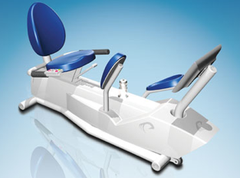
Eccentric Contraction
Effective Strength Gain
  A function of the magnitude of the force produced.
  Ecc exercise = “More for Less” (LaStayo 2003)
  Decrease IMAT (Marcus 2010)
Used with patients with varied conditions.
    Frail elderly, patients w/ impaired central nervous disorders system, aging cancer survivors, metabolic Issues, pulmonary Disease, musculoskeletal Injury (i.e. late stage of TKA)
  (LaStayo 2003, 2009, 2010, Marcus 2008, 2009, Dibble 2006, 2009, Gerber 2007, 2009)
Eccentron©
Notes:
I would like to know a ‘super’ strengthening protocol that resolve muscle activation deficits as well as increase lean tissue effectively.
Eccentric contraction exercise seems to be beneficial to address these two points.

Slide 24
Project 3
TKA Surgery
13 participants after UTKA
  Age: 56.8 y.o.
  Height 1.70cm
  BMI (IE:31.5, BMI: 31.8 kg/cm²)
2wks
Recruitment
3-4 wks
Pre-PT Evaluation
2 staged bilateral TKA > 6 months post-TKA from the 1st TKA
6wks
(12 visit)
RENEW
Inclusion Criteria
Primary TKA for knee OA
Enable to commute UOC for outpatient PT
Enable to attain 90 degree of knee flexion at the time of recruitment (2wks post-TKA)
Without any perceptive restrictions on daily activity
11-12 wks
Post-PT Evaluation
A Year Follow-up
Notes:
Thirteen patients participated in the project.
We recruited the participants at 2 weeks follow-up at the orthopedic surgeon’s office based on the inclusion criteria, and the next week, we evaluated their baseline conditions.
(animation)
Following the 6 weeks outpatient physical therapy, the participants were re-evaluated for their post-treatment conditions.
Currently, we are also asking them to return for a year follow-up.

Slide 25

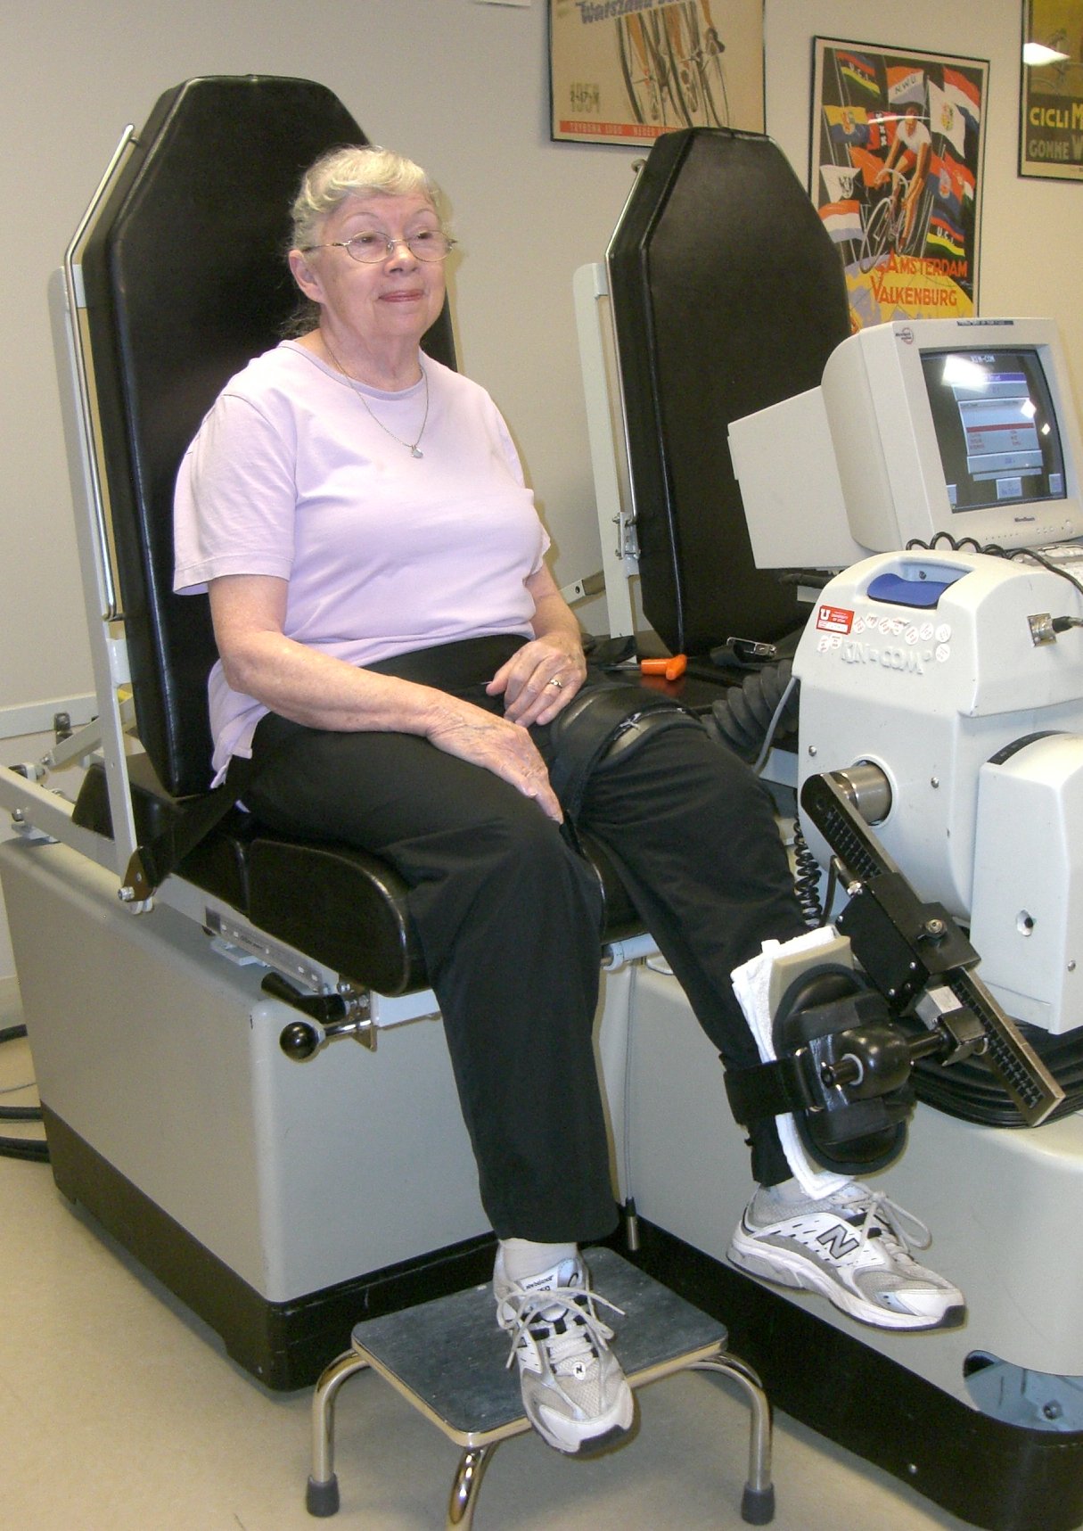
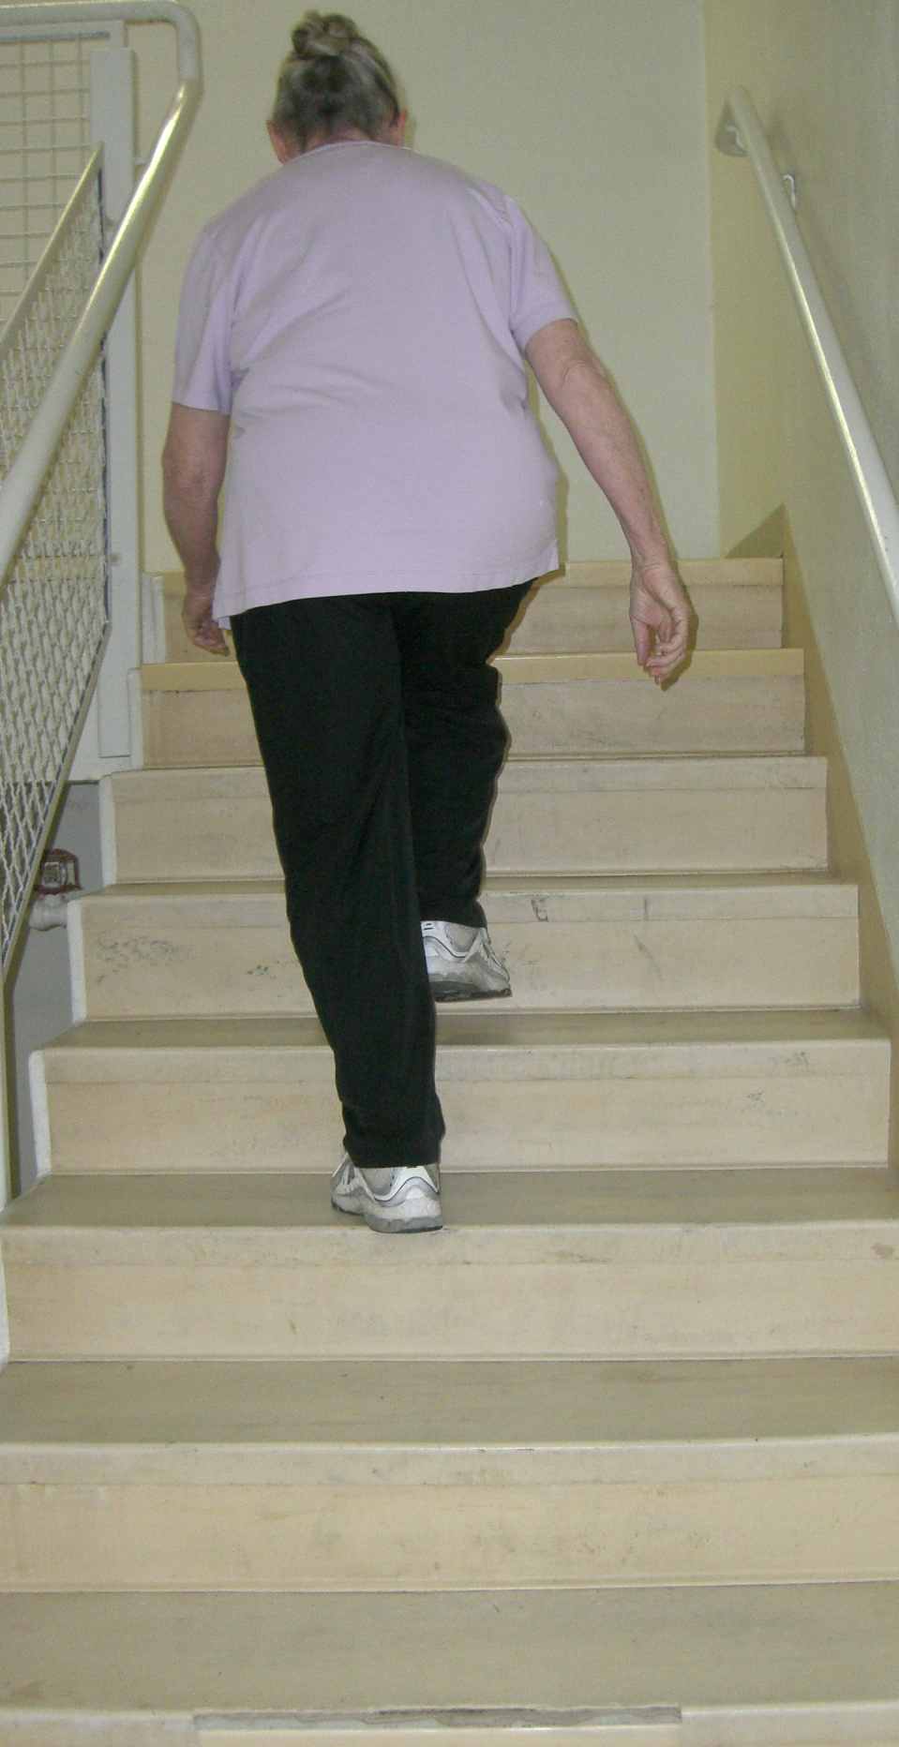
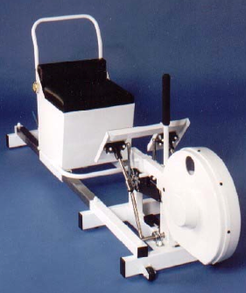
Methods
Self-report Questionnaires
  SF-36 Physical Component Summary
  The Lower Extremity Functional Scale
Mobility Tests
  Stair Climbing Test
  The 6-minute Walk
Muscle Strength Tests
  Power Output
  MVIC of Quadriceps (Knee flexion @ 60°)
Notes:
The outcome measures are ….
Paired t-test was applied to detect significant differences between pre- and post-treatment.

Slide 26
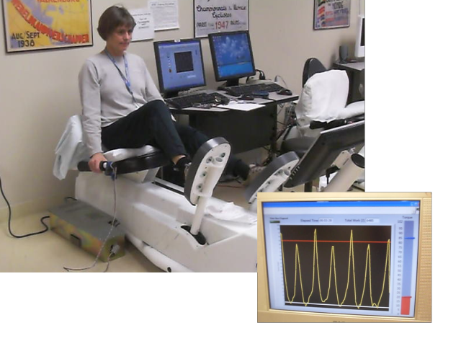
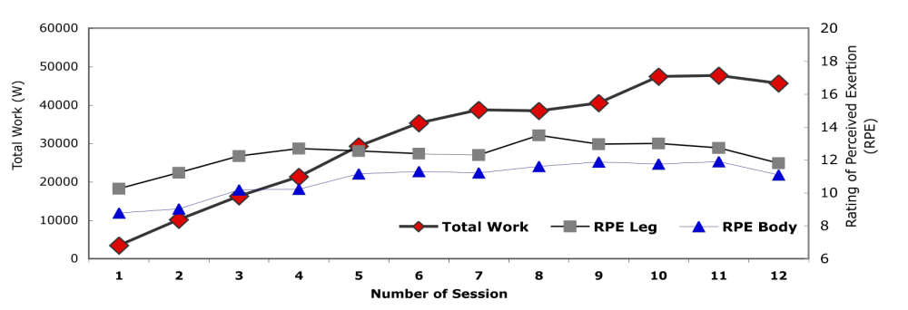
Physical Therapy Protocols
‘U of U’ Outpatient PT protocols (Meier 2008)
Eccentric exercise protocols (LaStayo 2009)
Training Wk | Duration (min) | RPE
1 | 5 | 7 (very, very light)
2 | 6-10 | 9 (very light)
3 | 11-15 | 11 (fairly light)
4 | 16-20 | 11-13 (fairly light to somewhat hard)
5 | 20 | 13 (somewhat hard)
6 | 20 | 13 (somewhat hard)
Notes:
After regular exercise protocols based on Meier’s paper, patients ride the eccentron in each session.
They started to ride with light resistance at 5 minutes first, and we increased the riding time and encouraged them to increase their perceptive effort.
The progression protocols are in this table, and the plot showed the average progressions from our participants.

Slide 27
Results
Non-operated
Muscle Strength
Operated
**
*
1mos
**
3mos
12mos
*:p<0.05, **:p<0.01
Time (Post-TKA)

Slide 28
Results
**
SCT
Norm (Walsh ‘98)
**
6MW
Norm (Petterson ‘09)
**
Gait Speed
Norm (Bohanon ‘97)
1mos
3mos
12mos
**:p<0.01
Time (Post-TKA)
Notes:
Clinical meaningful differences
5.49 seconds for 9 steps of SCT
61.3m for 6MW

Slide 29
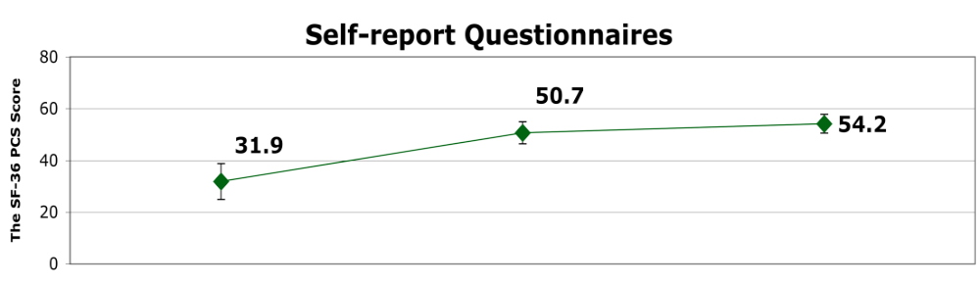
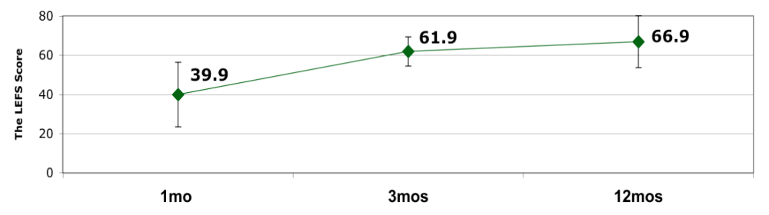
Results
**
**
Time (Post-TKA)
**:p<0.01
Notes:
Clinical meaningful differences
SF-36 =5
LEFS =9
LEFS 84% recovery of norm

Slide 30
The potential impact on best-practice rehabilitation following TKA
  May be capable of optimizing outcomes.
Notes:
This is the first report to apply the eccentric strengthening exercise producing high forces with lower exertion level to patients in the early phase of post-TKA.
The results suggested that the eccentric exercise can amplify quadriceps strength and physical function.
The potential impacts on best-practice PT following TKA is still far-reaching, yet the eccentric exercise may be capable to optimizing outcomes.

Slide 31
Findings
Individuals after TKA demonstrated abnormal loading patterns during gait related to quadriceps weakness of the operated limb.
Impaired quadriceps function has been related to muscle structure (ie. IMAT v.s. CAR).
Eccentric exercise which seems beneficial to increase lean tissue and decrease IMAT resulting in mobility improvement.
  → Repetitive eccentric loadings might improve functional performance…

Slide 32
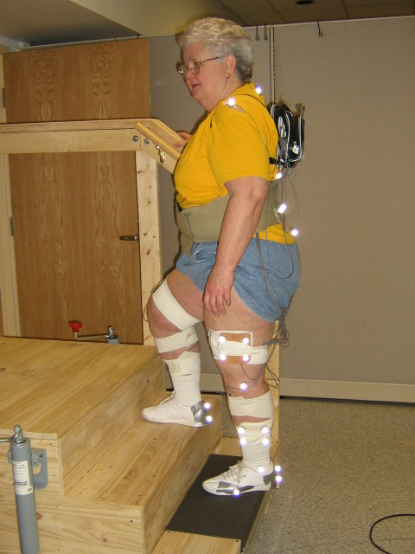
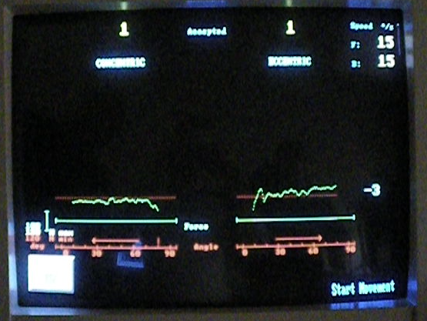
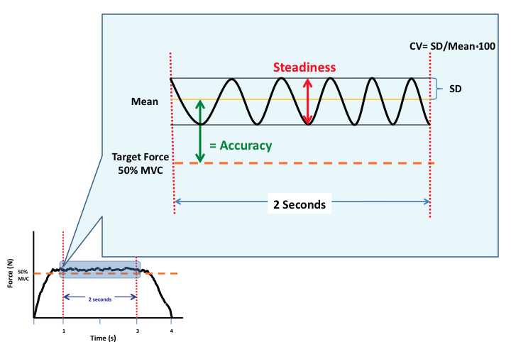
Future Plan
Muscle Physiology
  IMAT and CAR at the end stage of OA.
(Accepted by Intention letter by Deseret Foundation)
  Ecc vs Con in force fluctuation
    Specific contraction type exists in stair function
Gait Training
  (Funded by Japanese PT Association)

Slide 33
Thank You
Any Questions?

Slide 34
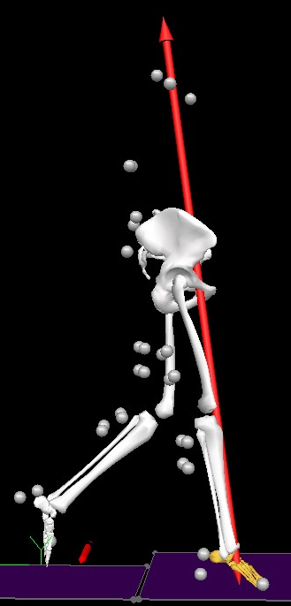
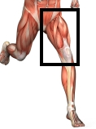
Outcome of Abnormal Gait Patterns
Less physical stress of musculoskeletal structure of the knee.
Persistent abnormal gait patterns may be related to persistent quadriceps weakness.
&
3mo
3mo
1 yr
http://www.abs-exercise-advice.com/images/knee-anatomy-pictures.jpg
Notes:
What will happen in my patients if I can resolve abnormal gait patterns at the discharge of PT?

Slide 35
Altered muscle recruitment patterns during gait are related to future weakness.
(In Review)
TKA |  |  | NMIVC_op 3mos |  | NMVIC_op 1yr
Knee Function of the Operated Limb |  |  | R | p | R | p
Hamstrings NEMG |  | % MVIC | -0.491 | 0.024* | -0.48 | 0.028*
Quadriceps NEMG |  | % MVIC | -0.071 | 0.759 | -0.375 | 0.094
Co-contraction |  |  | -0.438 | 0.047* | -0.543 | 0.011*
Knee Extensor Moment |  | Nm/BW*HT | -0.168 | 0.467 | -0.069 | 0.766
Peak Knee Angle |  | degree | 0.312 | 0.168 | 0.154 | 0.504
Knee Flexion Excursion |  | degree | 0.415 | 0.061 | 0.199 | 0.386
Notes:
Unfortunately, the persistent altered gait patterns with abnormal muscle recruitments is related to persistent quadriceps weakness of the operated limb.
How can we, as Physical Therapists, address these issues? Is there no potentials to address quadriceps weakness and lower mobility level in individuals after TKA?

