Slide 1
About OMICS Group
OMICS Group is an amalgamation of Open Access publications and worldwide international science conferences and events. Established in the year 2007 with the sole aim of making the information on Sciences and technology ‘Open Access’, OMICS Group publishes 500 online open access scholarly journals in all aspects of Science, Engineering, Management and Technology journals. OMICS Group has been instrumental in taking the knowledge on Science & technology to the doorsteps of ordinary men and women. Research Scholars, Students, Libraries, Educational Institutions, Research centers and the industry are main stakeholders that benefitted greatly from this knowledge dissemination. OMICS Group also organizes 500 International conferences annually across the globe, where knowledge transfer takes place through debates, round table discussions, poster presentations, workshops, symposia and exhibitions.

Slide 2
About OMICS International Conferences
OMICS International is a pioneer and leading science event organizer, which publishes around 500 open access journals and conducts over 500 Medical, Clinical, Engineering, Life Sciences, Pharma scientific conferences all over the globe annually with the support of more than 1000 scientific associations and 30,000 editorial board members and 3.5 million followers to its credit.
OMICS Group has organized 500 conferences, workshops and national symposiums across the major cities including San Francisco, Las Vegas, San Antonio, Omaha, Orlando, Raleigh, Santa Clara, Chicago, Philadelphia, Baltimore, United Kingdom, Valencia, Dubai, Beijing, Hyderabad, Bengaluru and Mumbai.

Slide 3
Telomere-Telomerase and Radiosensitivity
Wang wenbo, Zhou yunfeng
Dept.Radiation & Medical Oncology,Zhongnan Hospital of Wuhan University
Clinical Cancer Study Center of Hubei Province
Key Laboratory of Tumor Biological Behavior of Hubei Province
2015.8.5
Valencia. Spain

Slide 4
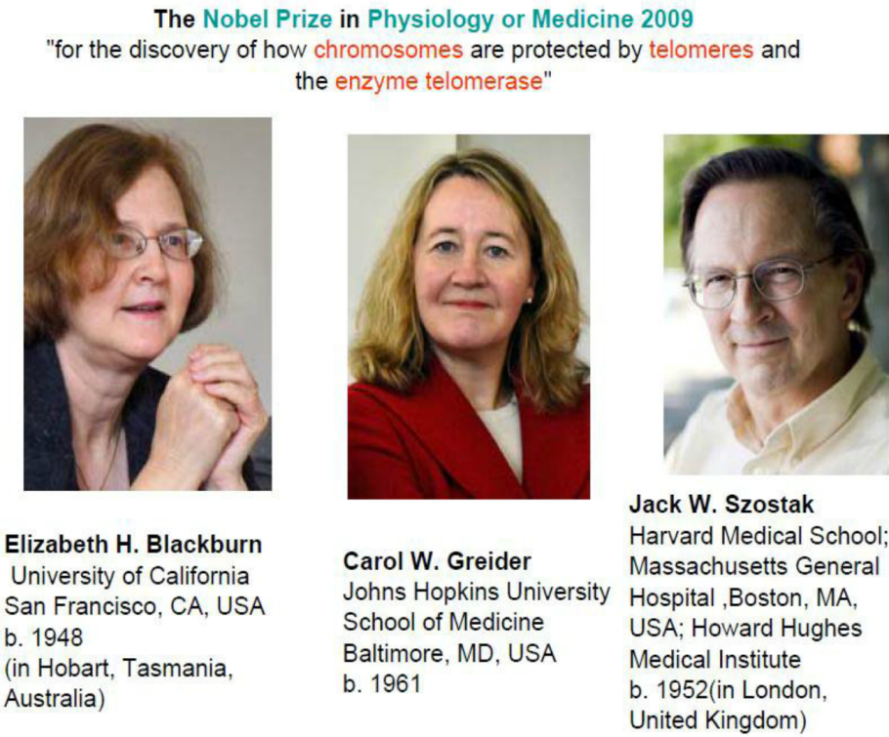
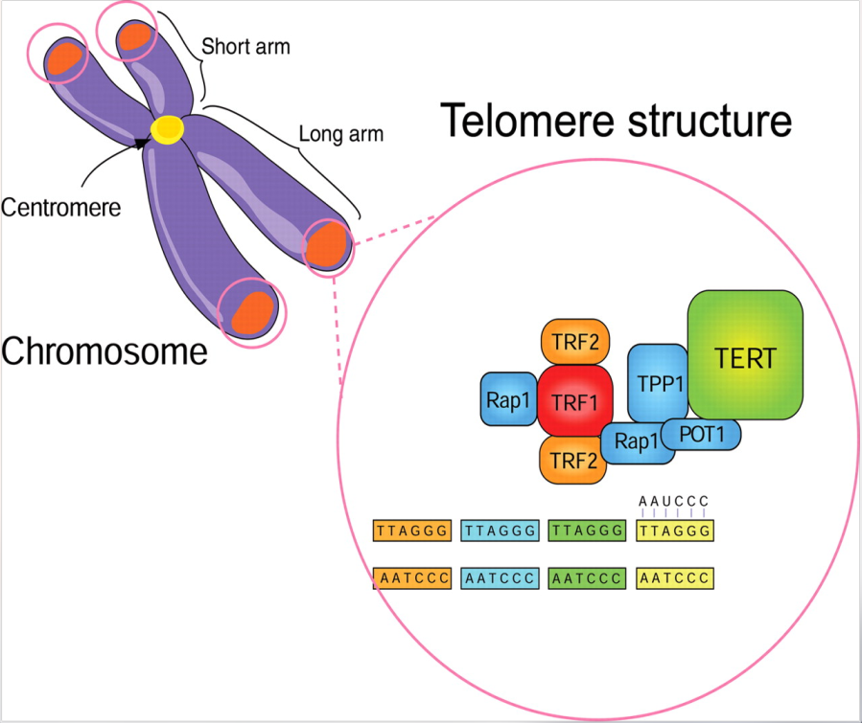
Telomere
CANCER
Genetic
Aging
New Targets
Telomeres, which are regions at the termini of chromosomes, are composed of TTAGGG repetitive DNA sequences and a variety of binding proteins

Slide 5
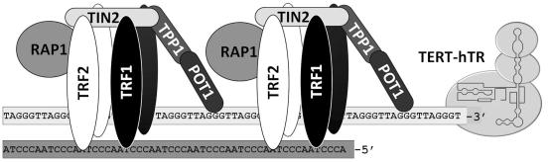
Telomerase Structure
Human telomerase RNA(hTR)
Telomerase
Human telomerase
reverse transcriptase (hTERT)
Telomere-associated proteins
activated in 90% of human tumor cells
Notes:
Telomerase, which are activated in 90% of human tumor cells but are seldom activated in normal somatic cells, is composed of two components, human telomerase RNA(hTR) and hTERT. The expression of hTERT, closely correlates with telomerase activity and serves as an indicator of telomerase activation

Slide 6
Telomerase Function
Telomere Length
Aging
Telomerase
Stable chromosome structure
Cancer
Cancer Cells’ Radiosensitivity

Slide 7
Combined-modality Therapy
Surgery
Chemotherapy
Cancer
Radiotherapy
Biotherapy Immunotherapy

Slide 8
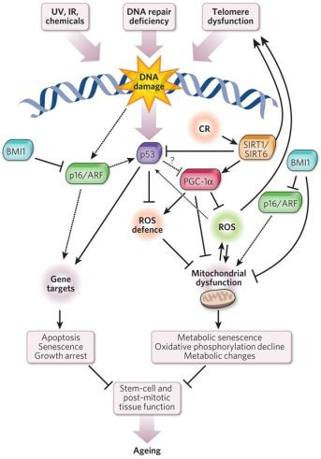
Telomerase and radiosensitivity
Radiation Therapy
Treatment failure
Radioresistance

Slide 9
Can we modify the radiosensitivity by :
Telomerase activity 、Telomere Length and Radiosensitivity
Telomerase
&
Radiosensitivity
The mechanism of Telomerase adjustment radiosensitivity
Telomere-binding protein on radiosensitivity

Slide 10
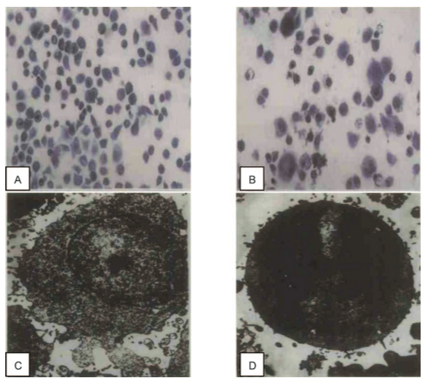
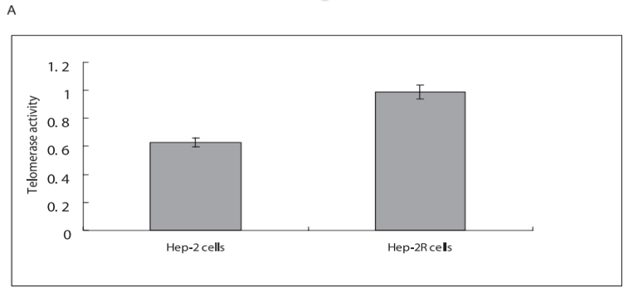
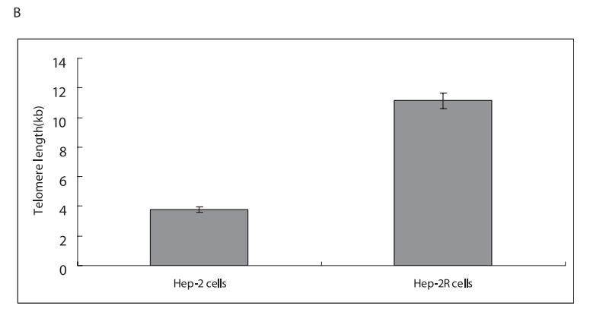
The establishment of human laryngeal carcinoma radioresistant strain model
Changes in cell morphology. Hep-2R cells (panels B, D) demonstrated morphological changes compared to parental Hep-2 cells (panel A, C). Photomicrographs were taken at a magnification of 4003 by a light microscope (panels A, B) and at a magnification of 50003 by a transmission electron microscope (panels C, D).
Zhou FX, Xiong J, Zhou YF*. Radiat Res.2010.

Slide 11
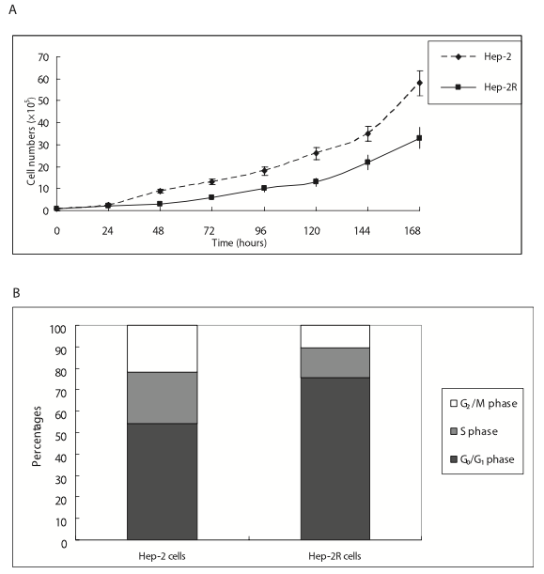
Biological behavior of two cell lines
Panel A: Growth curves of Hep-2 and Hep-2R cells were determined by counting cells 24–168 h after seeding. Panel B: Cell cycle distributions of Hep-2 and Hep-2R cells were assayed by flow cytometry
Zhou FX, Xiong J, Zhou YF*. Radiat Res.2010.
Liao Z, Huang C, Zhou YF*. Cancer Lett.2009.

Slide 12
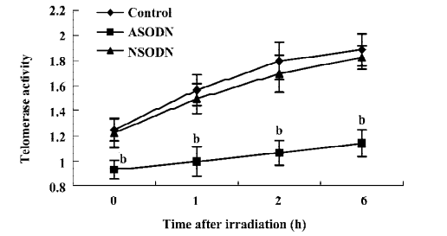
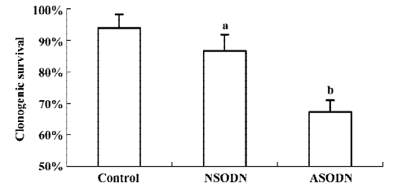
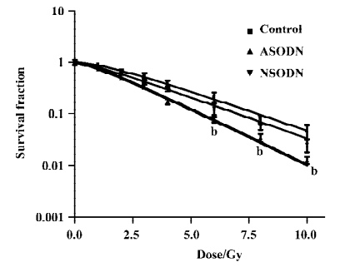
Telomerase and radiosensitivity : Targeting hTR
ASODN interfere telomerase subfraction hTR
Telomerase activity of Human glioma U251 cells decreased, DNA damage reduced and radiosensitivity increased
Notes:
Zidovudine (AZT, 30-azido-30-deoxythymidine) is a member of the class called nucleoside-analog reverse transcriptase inhibitors. Previous reports have shown that AZT may be viewed as a telomerase inhibitor with potential anticancer properties. Our previous report have indicated that AZT increases radiosensitivity in tumor cells which may be associated with a decreased TA

Slide 13
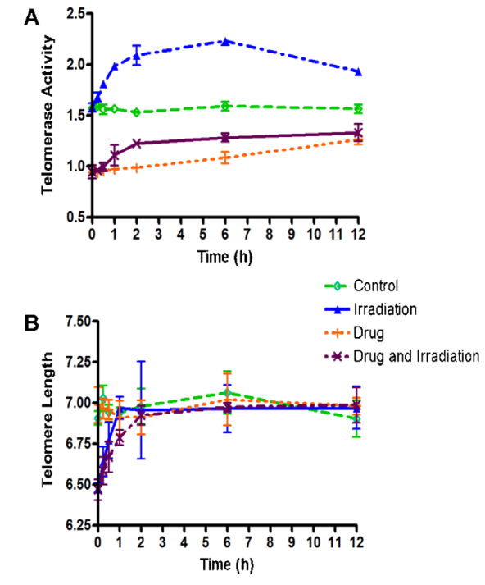
Telomerase and radiosensitivity : Targeting hTERT
AZT interfere telomerase subfraction hTERT
Effect of drug (AZT) and/or irradiation on U251 cells. (A) Telomerase activity in cells were increased by irradiation and decreased by AZT treatment; (B) the recover is of telomere length (kb) in cells were inhibited by AZT. Cells in different groups were collected at 0 min, 15 min, 30 min, 1 h, 2 h, 6 h, and 12 h after different treatments.
FX. Zhou,YF Zhou* et al. BBRC. 2007.
Xiong J, Sun WJ, Zhou YF* . Cancer. 2012.

Slide 14
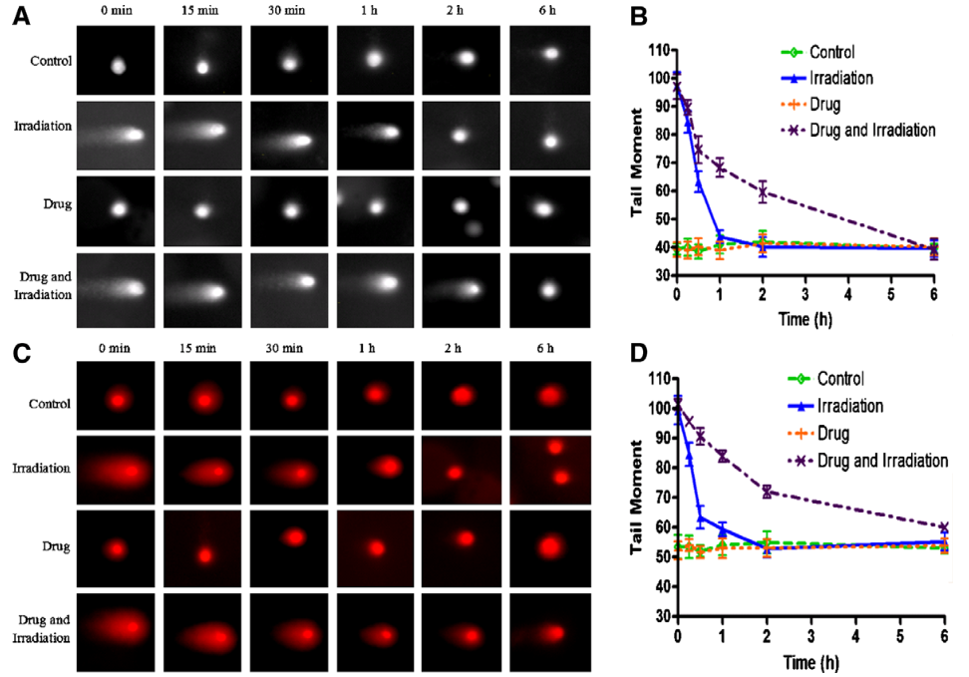
Telomerase and radiosensitivity : Targeting hTERT
Down-regulation of DNA damage repair by drug (AZT) incubation. Cells were harvested at 0 min, 15 min, 30 min, 1 h, 2 h, and 6 h postirradiation. DNA SSB was determined by alkaline comet assay (A) and DNA DSB was determined by neutral comet assay (C). Fluorescence microphotographs were shown. TM was obtained to quantify DNA SSB by alkaline comet (B) and neutral comet (D).
FX. Zhou,YF Zhou* et al. BBRC.2007.

Slide 15
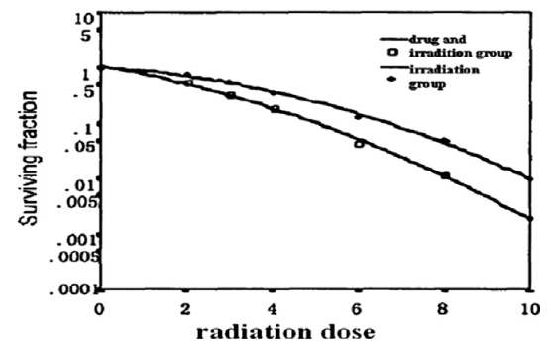
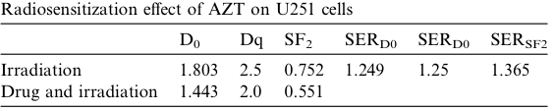
Telomerase and radiosensitivity : Targeting hTERT
AZT could increase the radiosensitivities of U251 cells. Cells in two groups were irradiated with 1, 2, 3, 4, 6, 8, 10Gy 60Co c-rays. Cell survival curves were normalized for the plating efficiency of non-irradiated cells with/without AZT incubation.

Slide 16
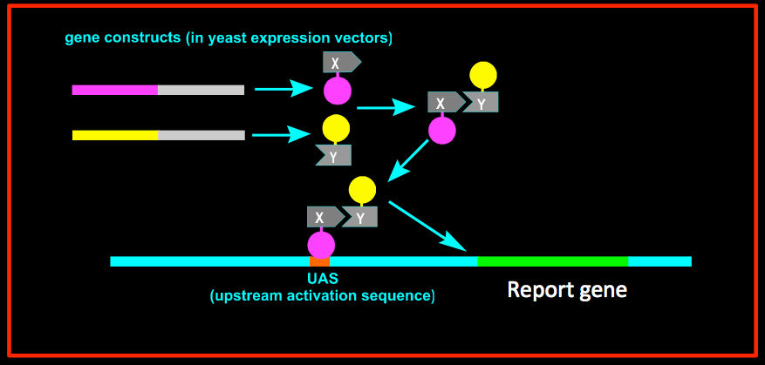
The mechanism of Telomerase adjustment radiosensitivity
Radiosensitivity
Hep-2/Hep-2R
2-DIGE/MALDI-TOF-MS
UBE2D3
UBE2N
Hep2R cDNA library
hTERT
Yeast Two-hybrid

Slide 17
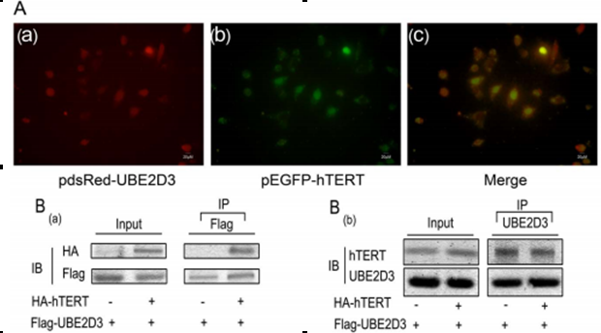
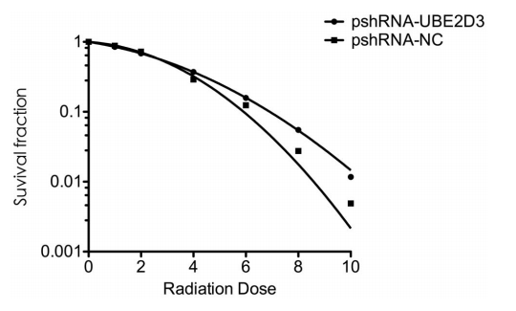
UBE2D3/hTERT and Radiosensitivity
hTERT interacts with UBE2D3 proteins
Inhibition of UBE2D3 reduced the Radiosensitivity of MCF-7 cell
Wang W, Yang L, Hu L, Zhou Y*. PLoS One. 2013.

Slide 18
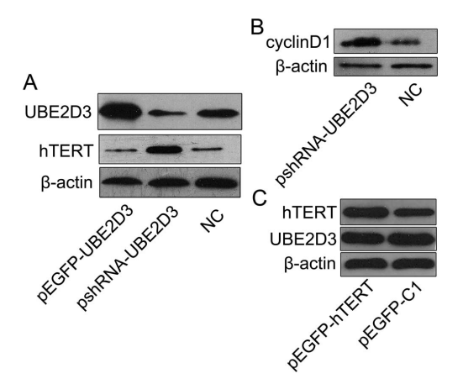
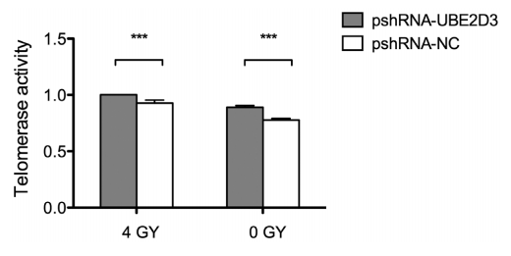
UBE2D3/hTERT and Radiosensitivity
UBE2D3 was suggested to modulate MCF-7 cell radiosensitivity by acting as a regulator for hTERT and cyclin D1 protein expression
Wang W, Yang L, Hu L, Zhou Y*. PLoS One.

Slide 19
Long Term Fraction Radiation
+/-
DSBs、DNA/PK、AKT/PKB
GSK3B-mediated cyclinD1 degradation
Cyclin D1
RAD51
UBE₂D₃(si)
hTERT
Cyclin D1
UBE₂D₃(si)
hTERT
？
？
DNA damage
DNA damage
Yeast-two hybrid
Yeast-two hybrid
Activating DNA damage checkpoint
Activating DNA damage checkpoint
Efficient DNA repair
Efficient DNA repair
Radio resistance
Radio resistance

Slide 20
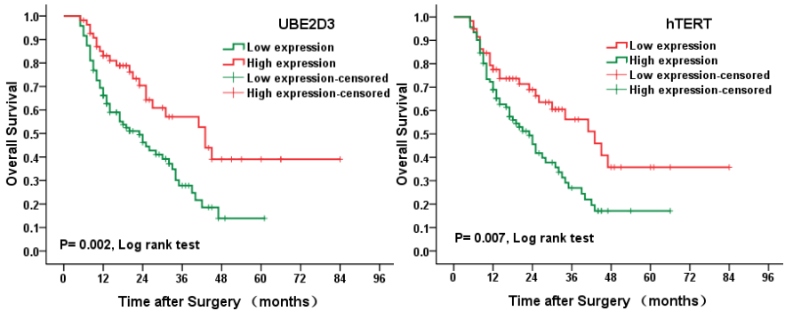
UBE2D3 Protein expressin and Esophageal Cancer Prognosis
hTERT and UBE2D3 expression were negatively correlated with each other. hTERT and UBE2D3 proteins appear to be involved in the development of esophageal cancer, that UBE2D3 may a positive prognostic factor for esophageal cancer, and that UBE2D3 and hTERT expression levels are inversely correlated.
GG Guan, WB Wang, YF Zhou*. ONCOLOGY LETTERS 2015.

Slide 21
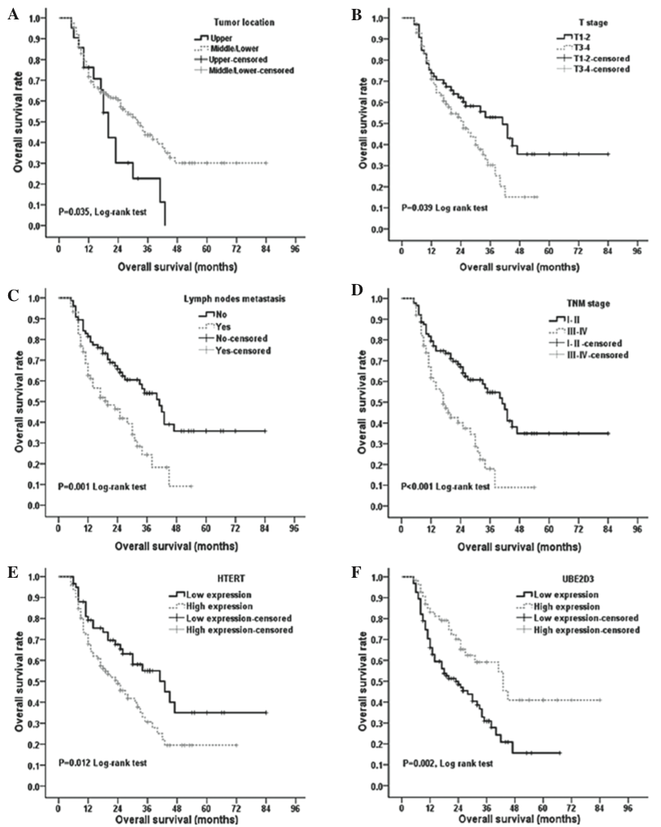
UBE2D3 Protein expressin and Esophageal Cancer Prognosis
Cumulative overall survival (OS) of esophageal cancer patients. (A) A higher tumor location was associated with poorer OS. (B-D) Advanced T stage, lymph node status and TNM stage were associated with poor OS. (E) Patients in the high hTERT expression group were at a higher risk of mortality. (F) Patients in the UBE2D3 low expression group were at a higher risk of mortality.
GG Guan, WB Wang, YF Zhou*. ONCOLOGY LETTERS 2015.

Slide 22
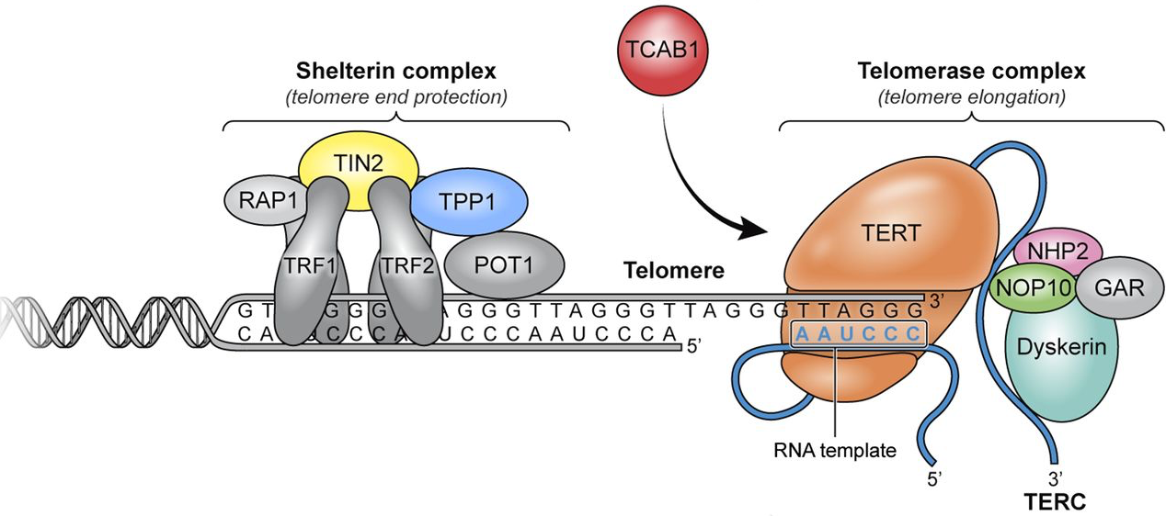
Telomere-binding protein
Telomere maintenance relies on multiple elements. One of the critical players is a six-protein complex, known as the telosome, which is composed of TRF1, TRF2, RAP1, TIN2, TPP1 and POT1

Slide 23
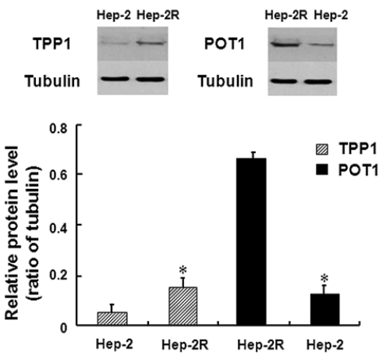
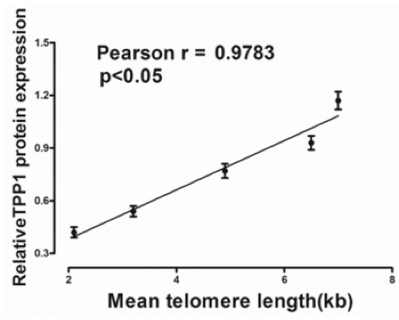
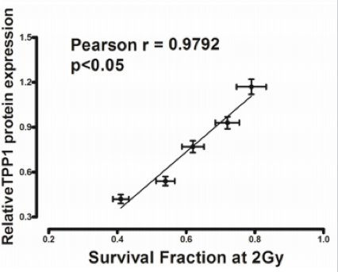
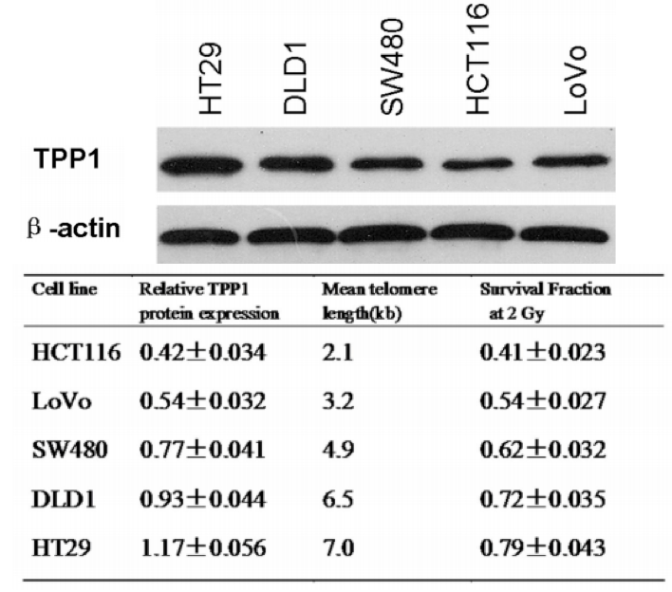
Telomere-associated proteins and Radiosensitivity：Targeting TPP1（Overexpression）
we found that there was a significant correlation between TPP1 expression, telomere length and cell intrinsic radiosensitivity in colorectal cancer cells.
Yang L, Wang W, Zhou Y*, et al. PLoS One. 2013.

Slide 24
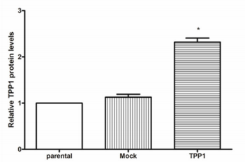
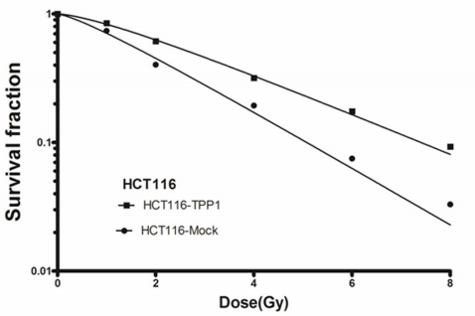
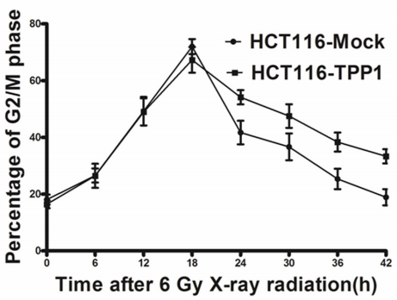
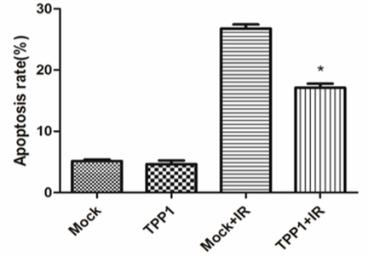
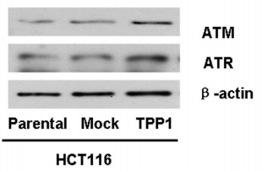
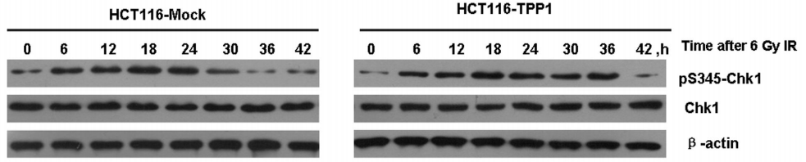
Telomere-associated proteins and Radiosensitivity：Targeting TPP1（Overexpression）
TPP1 overexpression decreases sensitivity of HCT116 cells to radiation by inhibiting apoptosis and prolonging G2/M arrest mediated by ATM/ATR-Chk1 signal pathway after ionizing radiation.
Yang L, Wang W, Zhou Y*, et al. PLoS One. 2013.

Slide 25
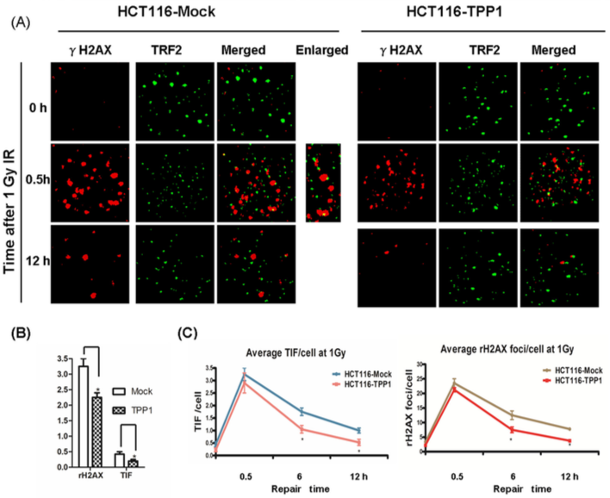
Telomere-associated proteins and Radiosensitivity：Targeting TPP1（Overexpression）
TIF: Telomere dysfunction-induced foci
Telomere dysfunction
γ-H2AX
53BP1
TPP1 overexpression promotes repair of DNA damage and telomere dysfunction induced by irradiation.(inhibited the spontaneous TIFs )
Yang L, Wang W, Zhou Y*, et al. PLoS One. 2013.

Slide 26
Telomere binding proteins
DDR proteins
DNA damage/repair
Telomere
homeostasis
Telomere
homeostasis
dysfunction
Telomerase activity
Telomere length
hTR/hTERT
Radiosensitivity

Slide 27
Research outcomes
We chose ASODN and AZT to interfere telomerase subfraction hTR and hTERT. The results showed that telomerase activity of Human glioma U251 cells and Hela cells decreased, DNA damage reduced and radiosensitivity increased .
There was a significant negative correlation of telomere length and radiosensitivity and telomere length may be used as a promising tool to predict the radiosensitivity of human carcinomas .
UBE2D3 was suggested to modulate MCF-7 cell radiosensitivity by acting as a regulator for hTERT and cyclinD1 protein expression.
TPP1 overexpression in human colorectal cancer cell could protect telomere from DNA damage and confer radioresistance.

Slide 28

Thank you

Slide 29
Let Us Meet Again
We welcome you all to our future conferences of OMICS International
Please Visit:
http://integrativebiology.conferenceseries.com/
http://conferenceseries.com/
http://www.conferenceseries.com/genetics-and-molecular-biology-conferences.php

