Slide 1

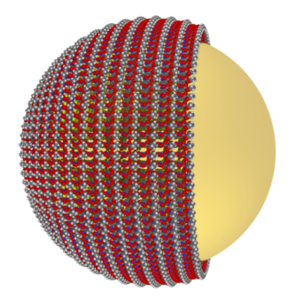
An Innovative Platform for Rapid and Multiplexed Cancer Biomarker Detection with Surface-enhanced Raman Scattering Nanotags
Dr. Yuling Wang (ARC DECRA Fellow)
Australian Institute for Bioengineering and Nanotechnology (AIBN)
The University of Queensland, Australia

Slide 2
Outline
Introduction to surface-enhanced Raman scattering (SERS)
Applications
a. DNA methylation analysis
b. Protein biomarker detection
Summary
Acknowledgment

Slide 3



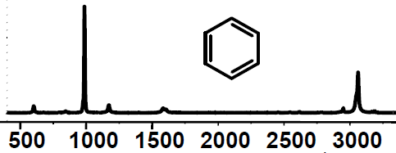
Introduction to SERS
Laser
SH
SERS
SH

Slide 4
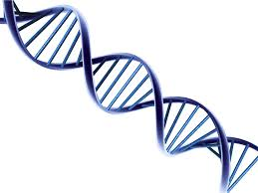
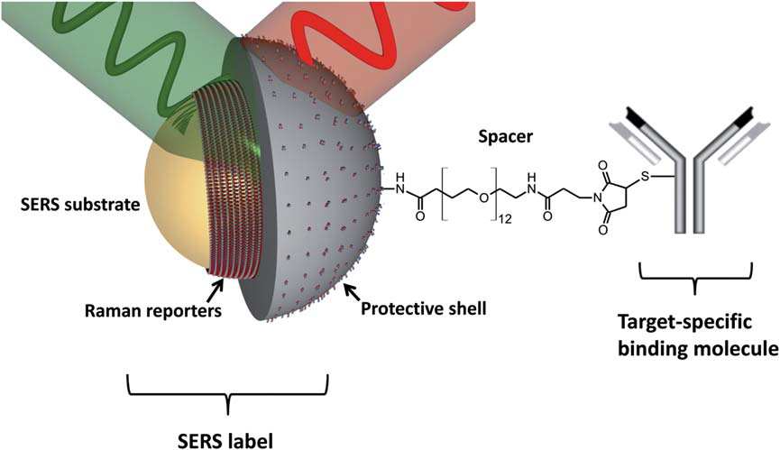
SERS Nanotags
Metal nanoparticles
Silica shell
Polymer
nanotags
Wang et al, Analyst, 2013, 138, 2224

Slide 5
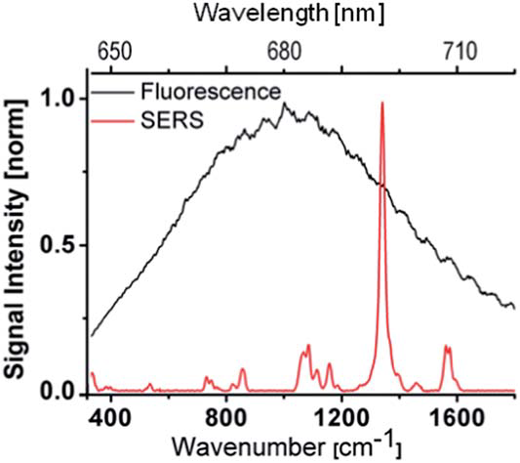
Fluorescence vs. SERS
SERS properties
Narrow peaks
2. One single laser excitation
3. Photostability
40 nm
<2 nm
Salehi et al, Nanoscale, 2014, 6, 2361

Slide 6
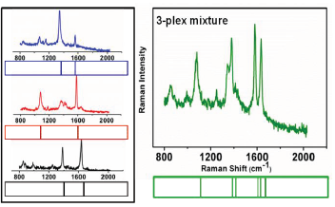

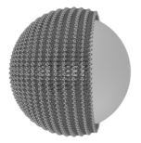
Multiplexing capability
SERS spectra with barcodes
With one single laser excitation, multiple signals can be generated simultaneously.
Wang et al, Analyst, 2013, 138, 2224

Slide 7
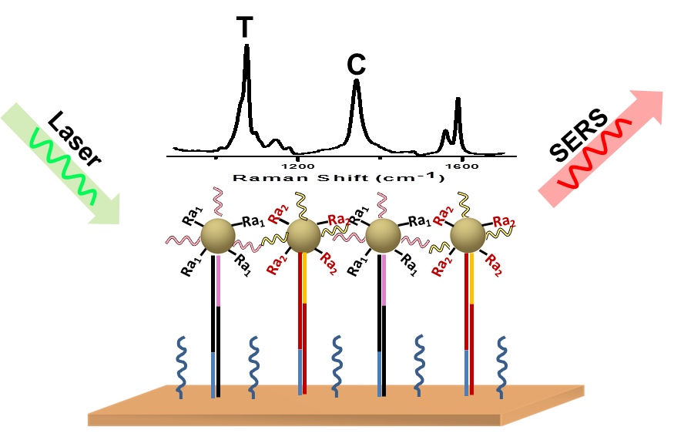
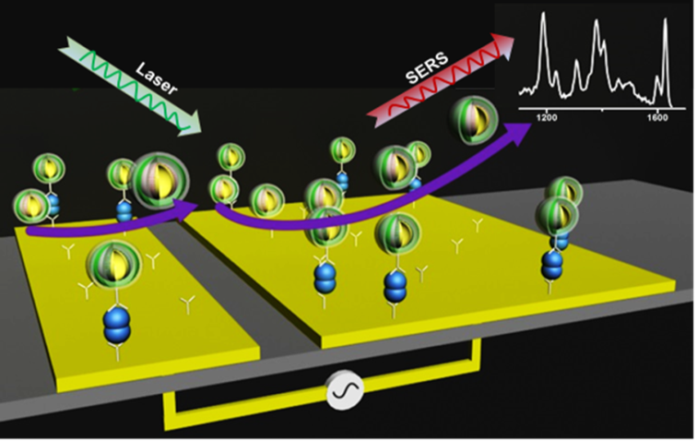
Applications
Duplex Single Base Mismatch Detection and Highly Sensitive DNA Methylation Analysis at CpG Resolution by SERS via Ligase Chain Reaction
ChemComm, 2015, 51, 10953
Enabling Rapid and Specific SERS Immunoassay Using Nano-scaled Surface Shear Forces
ACS Nano, 2015, 9, 6354

Slide 8
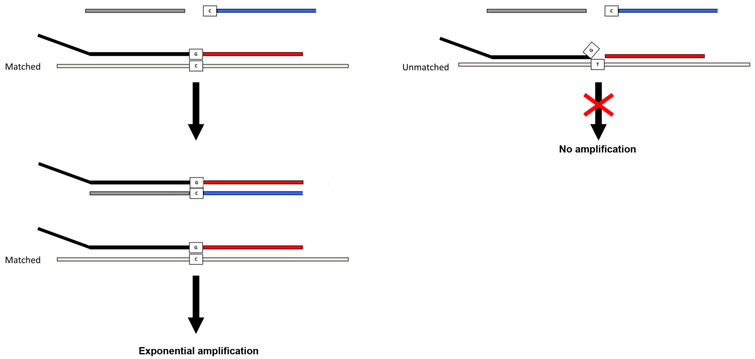
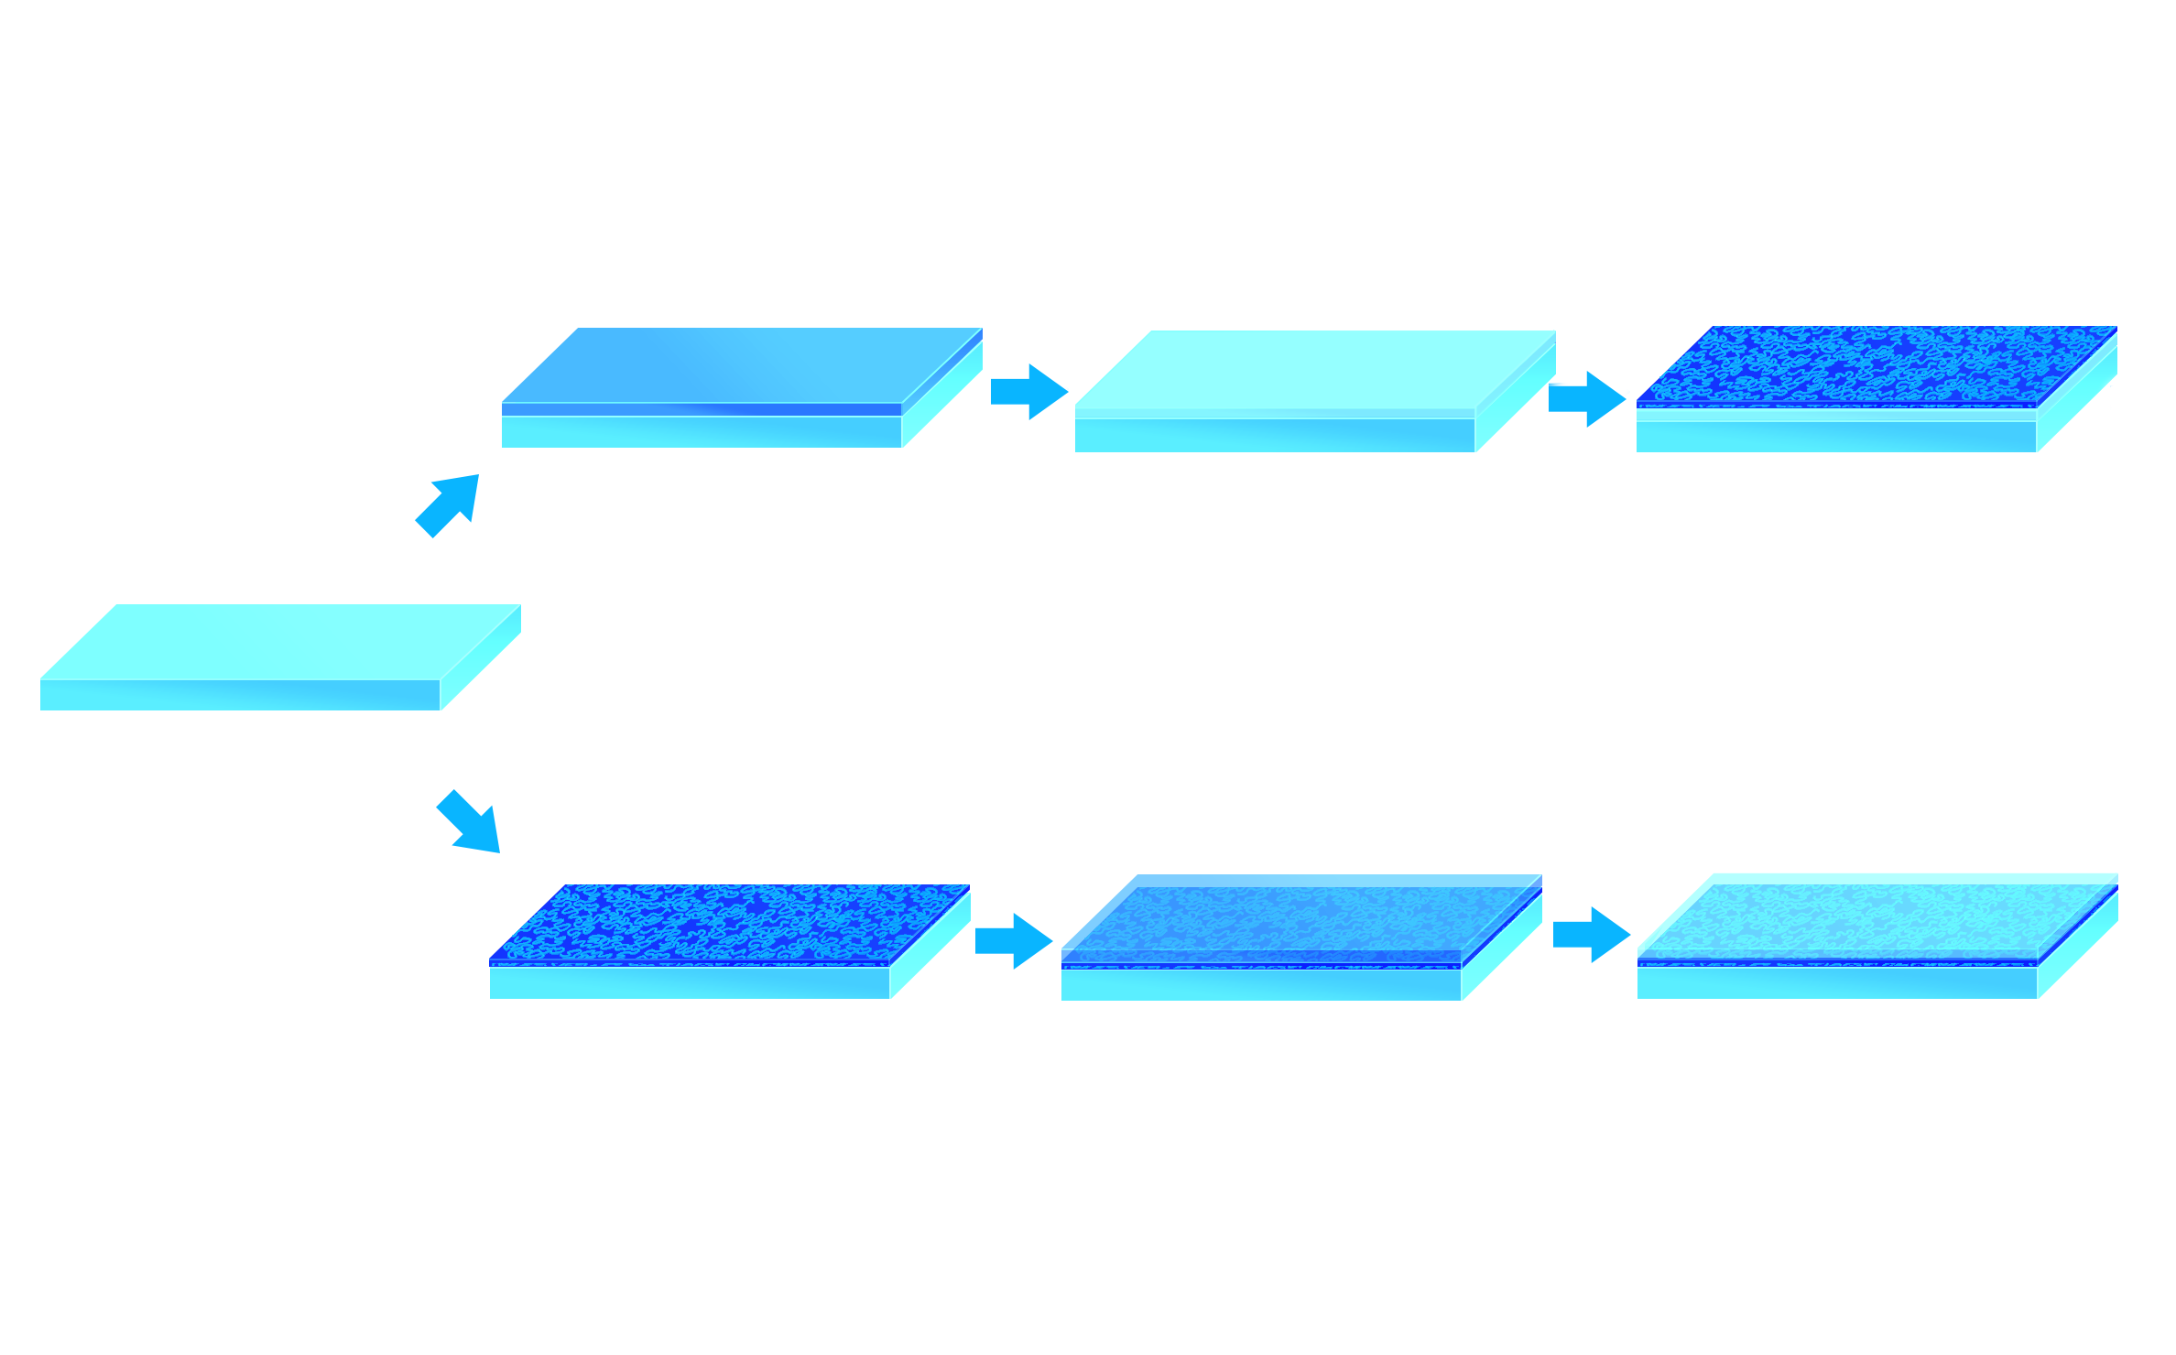

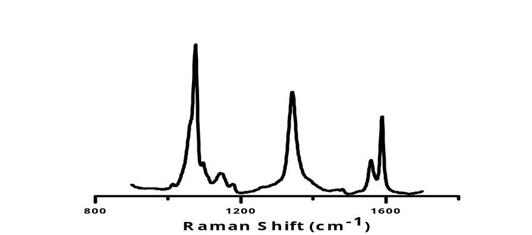
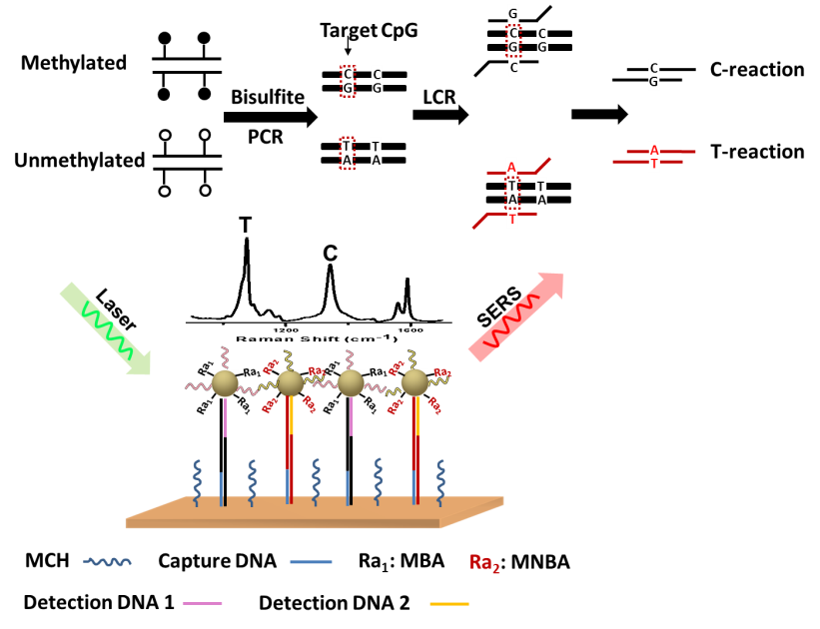
LCR&SERS for Single DNA Base Mismatch Detection
No Signal
Ra₁
Ra₁
Ra₁
Ra₁
Ra₁
Ra₁
Ra₁
Ra₁
SERS
Wang, Y. ; Wee, E.J.H. M.; Trau, M. Chem.Commun, 2015, 51, 10953

Slide 9
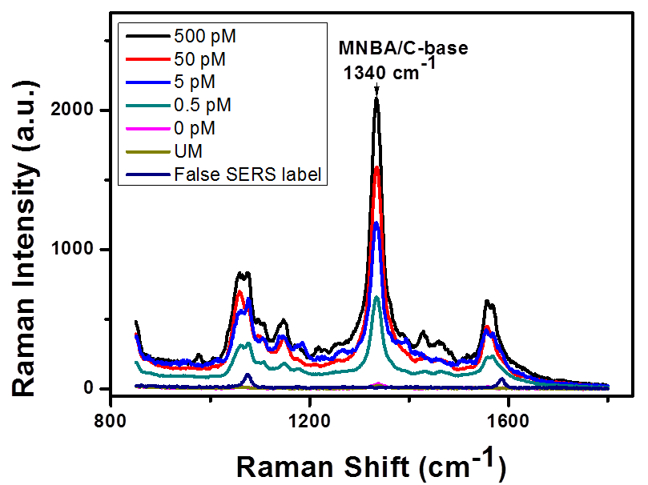
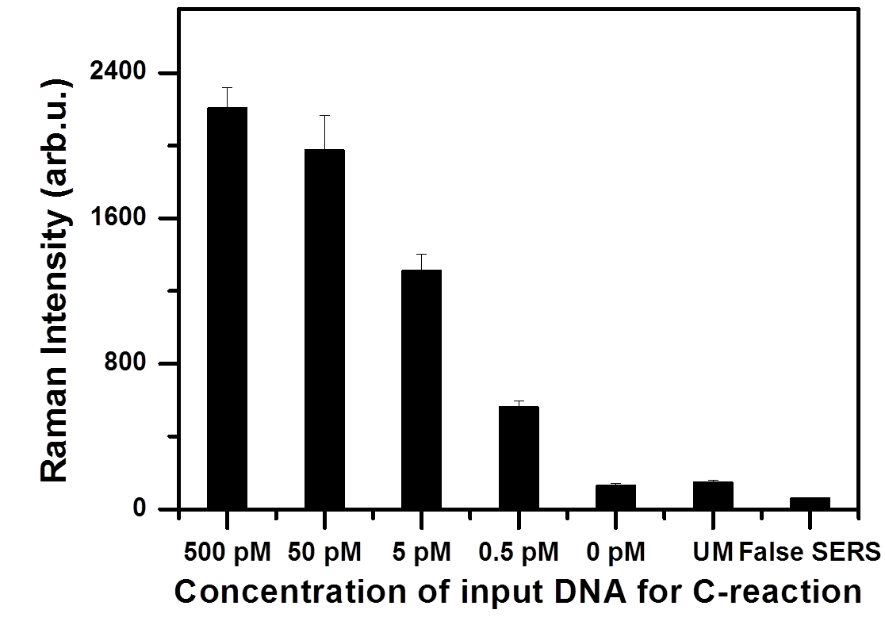
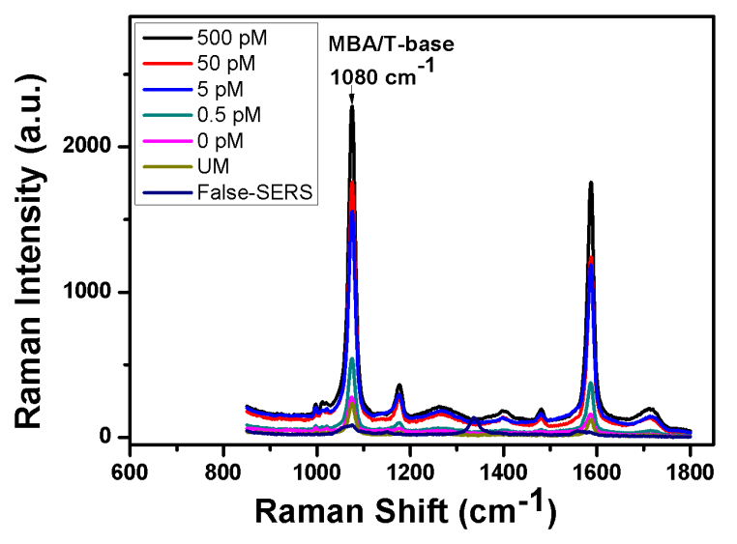
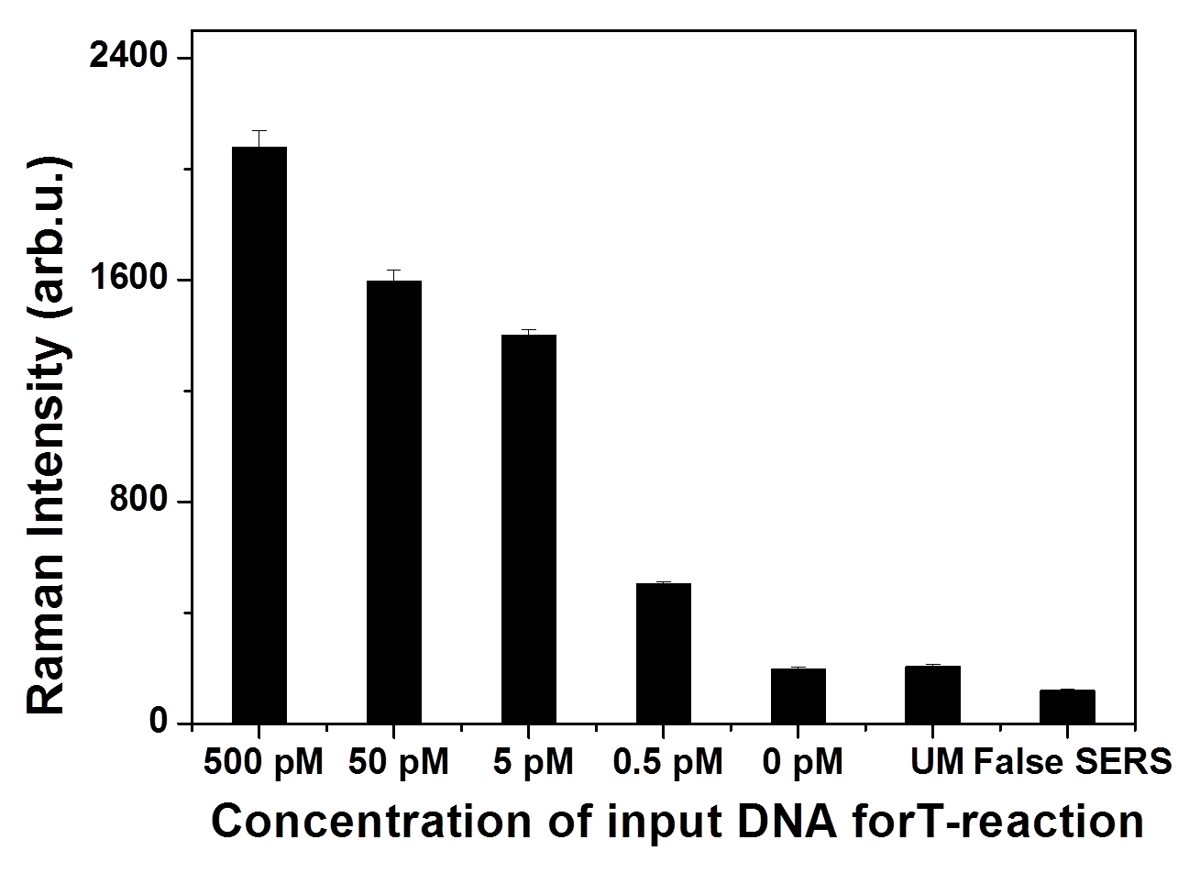
Sensitivity for single DNA base mismatch detection
C-base detection
T-base detection
Sensitivity: 0.5 pM input DNA

Slide 10
DNA Methylation Analysis at CpG Resolution
LCR reaction
T
DNA methylation analysis

Slide 11
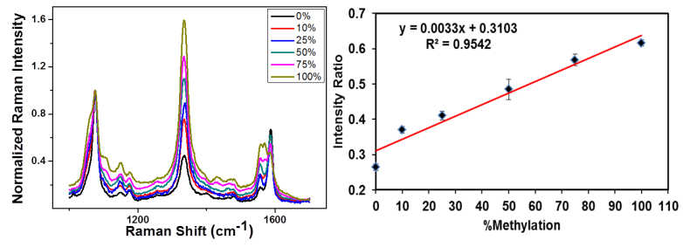
DNA Methylation Analysis for synthetic DNA
%DNA Methylation=I_{C}/ (I_{T}+I_{C})
SERS spectra and intensity response to methylation level
Sensitivity for DNA methylation analysis: 10%

Slide 12
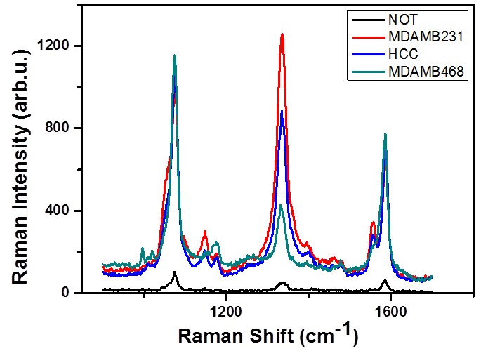
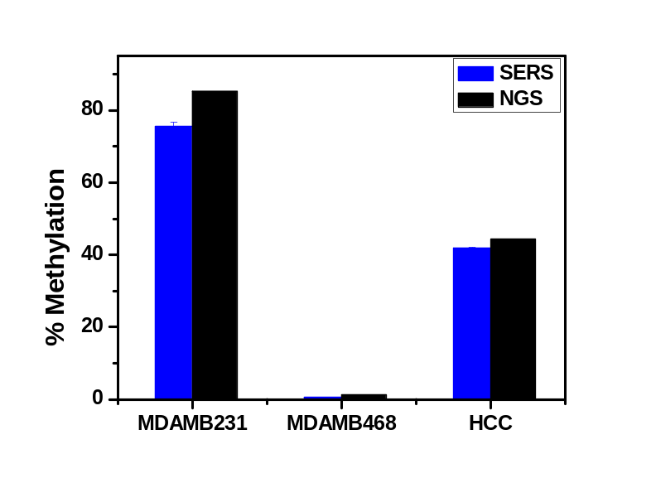
DNA Methylation Analysis for Cell-lines
A
B
Typical SERS spectra for a panel of cell lines detection (A) and comparison of estimated methylation in three breast cancer cell lines with SERS-LCR assay.

Slide 13
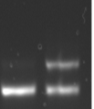
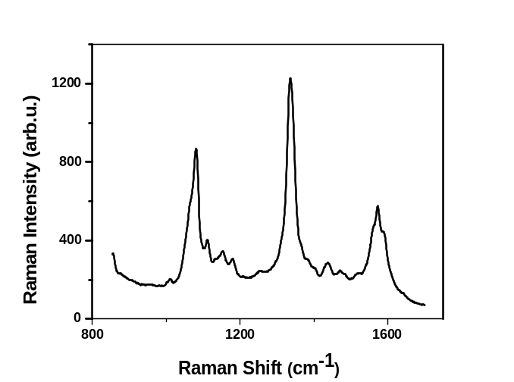
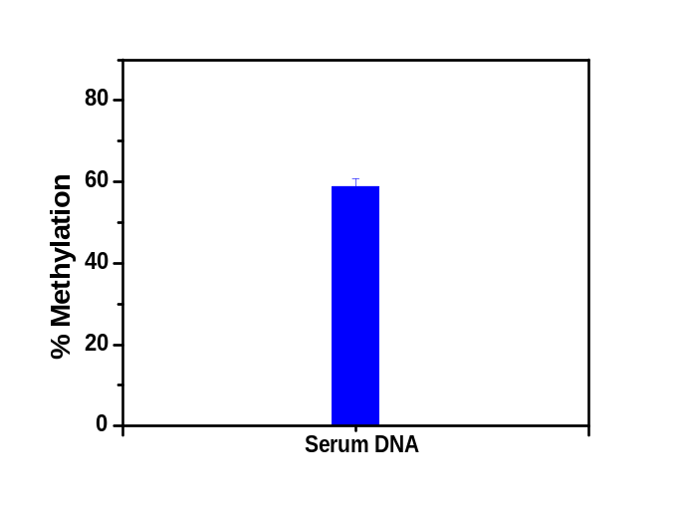
DNA Methylation Analysis for Patient Serum DNA
A
B
C
NoT Serum DNA
Image of DNA agarose gel electrophoresis of LCR reaction with a no template control (NoT) and a serum DNA sample (A), corresponding SERS spectra (B) and estimated methylation level (C).

Slide 14
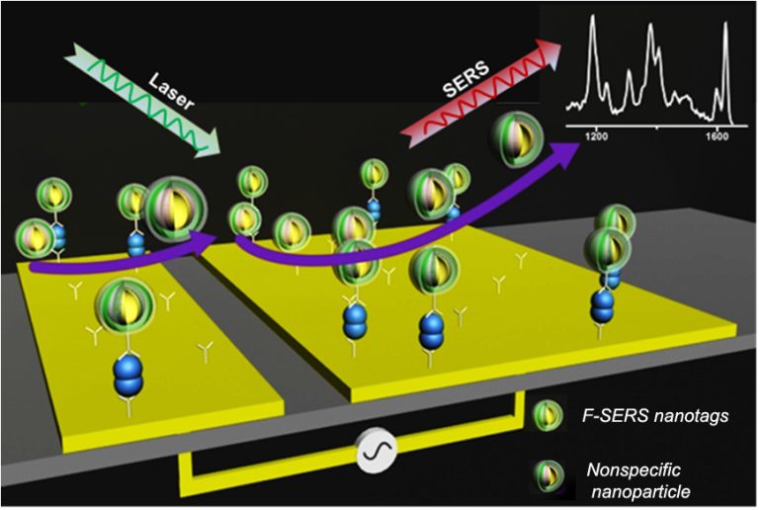
Enabling Rapid and Specific Protein Biomarker Detection
Scheme for alternative current electrohydrodynamic (ac-EHD) SERS immunoassay for HER 2 detection
Wang, Y. ; Vaidyanathan, R.; Shiddiky, M.; Trau, M. ACS Nano, 2015, 9, 6354

Slide 15

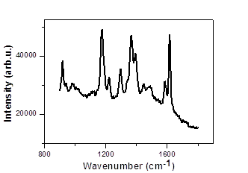
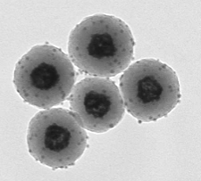
Rational designed SERS nanotags
silica-coated Au/Ag nanoshells
TEM image and SERS spectrum of the as-prepared SERS nanotags

Slide 16
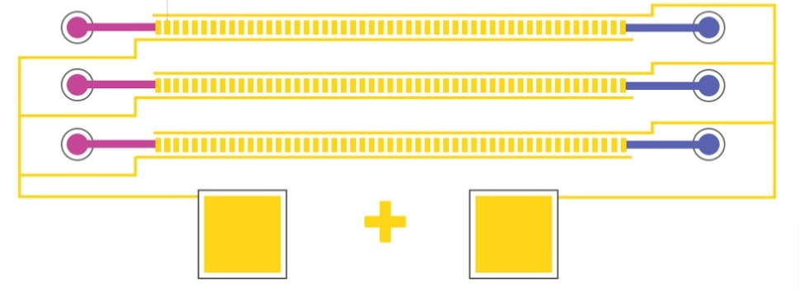
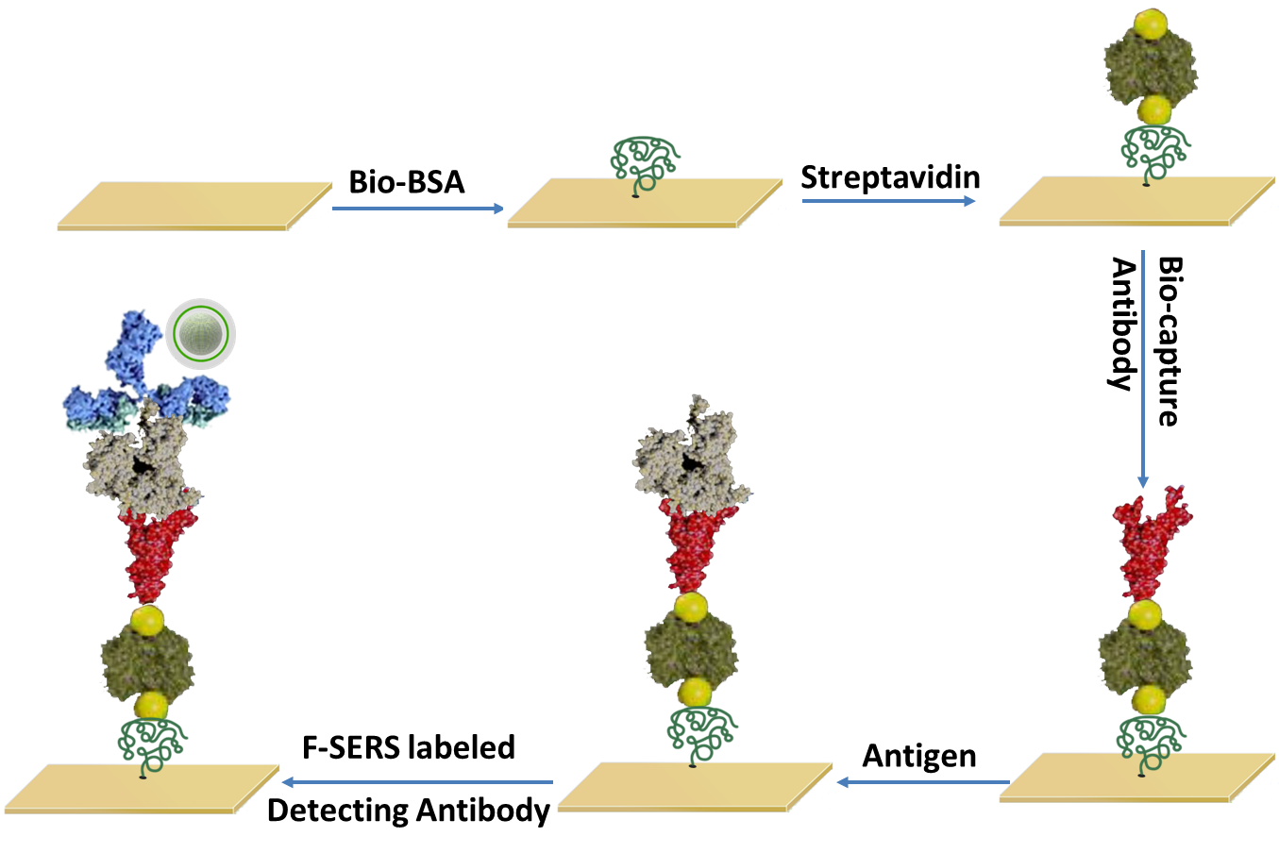
Device and the assay
SERS Nanotags
Schematic illustration of the device and the assay for HER2 detection

Slide 17
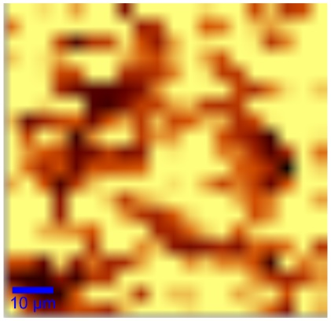
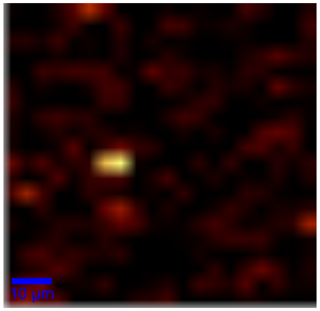
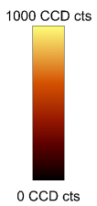
Specific study
With EHD
Without EHD
SERS images for target detection at 1 ng/mL with and without EHD

Slide 18
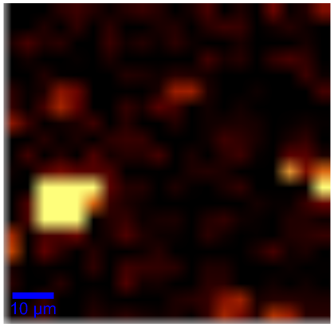
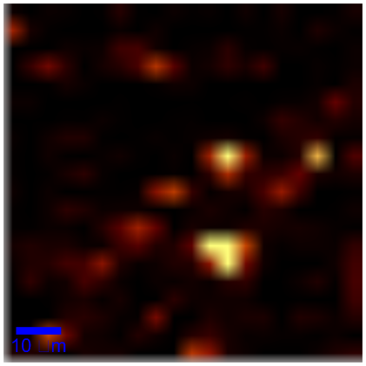
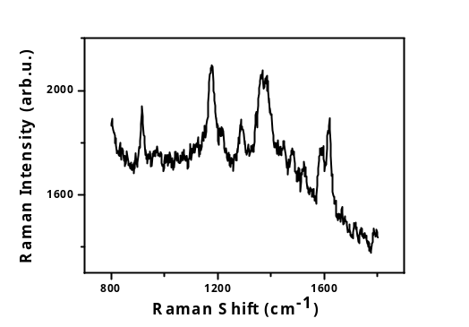
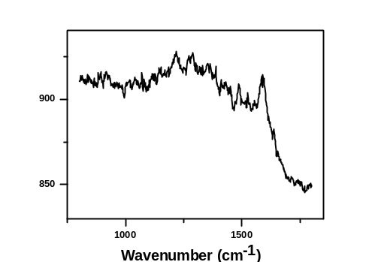
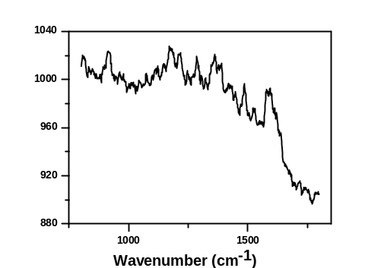
Specific study
With 1 ng/mL antigen
Without antigen
Without detection antibody
a
b
False-colour SERS images (a) and SERS spectra (b) for HER 2 detection with 1 ng/mL antigen; without antigen (0 ng/mL) and SERS particles without detection antibody under ac-EHD.

Slide 19


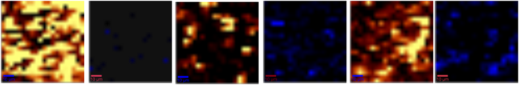
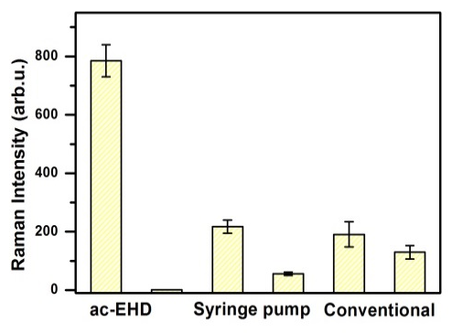
Comparison of different immunoassays
a
ac-EHD Syringe Pump Conventional
b
(a) SERS images, (b) SERS intensity from positive and reference nanoparticles in ac-EHD SERS immunoassay, syringe pump immunoassay and conventional SERS immunoassay

Slide 20
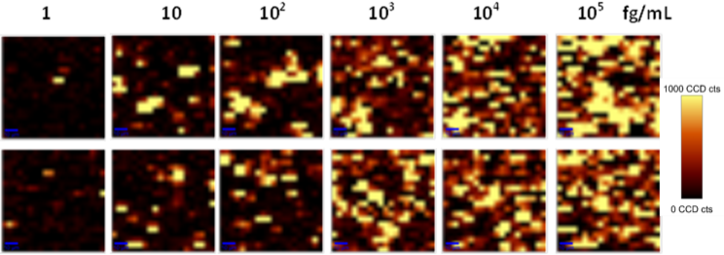
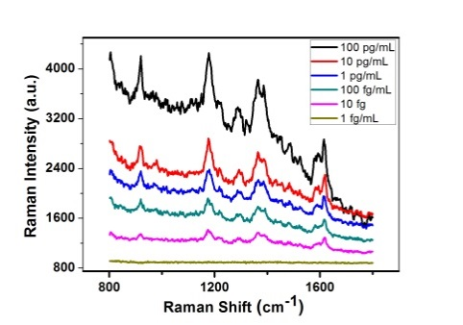
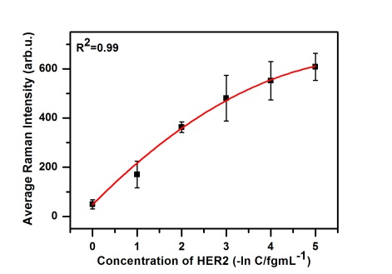
Sensitivity study
a
b
c
Sensitivity: 10 fg/mL

Slide 21
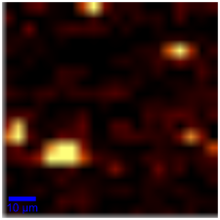
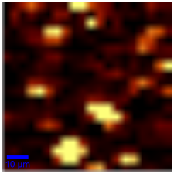
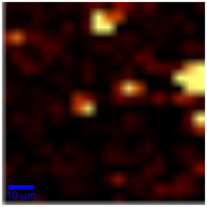
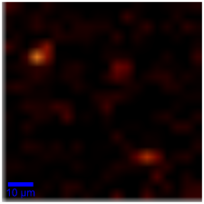
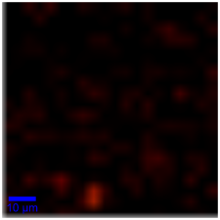
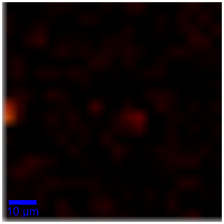
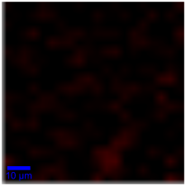
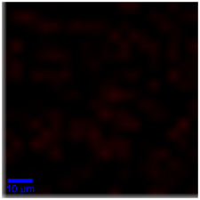
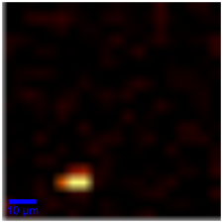
Patient Samples
HER 2 positive
HER 2 negative
Healthy
False-colour SERS images of ac-EHD SERS immunoassay for HER 2 positive, HER 2 negative and Healthy clinic patient analysis

Slide 22
Table 1. ac-EHD SERS immunoassay analysis of clinical serum samples from 9 different patients using the proposed method
Samples | Average SERS intensity | Approximate concentration range
HER 2 positive | 170.902 | ~10 fg/mL
HER 2 positive | 207.789 | 10~100 fg/mL
HER 2 positive | 167.771 | ~10 fg/mL
HER 2 negative | 36.021 | ~1 fg/mL
HER 2 negative | 10.646 | <1 fg/mL
HER 2 negative | 7.341 | <1 fg/mL
Healthy | 6.225 | <1 fg/mL
Healthy | 3.734 | <1 fg/mL
Healthy | 19.984 | <1 fg/mL

Slide 23
Summary
Duplex single DNA base change detection and DNA methylation analysis:
a. down to 0.5 pM sensitivity with high specificity;
b. as low as 10% difference in DNA methylation
2. A rapid and highly specific SERS immunoassay for breast cancer biomarker detection:
a. rational designed silica-coated gold/silver nanoshells as SERS nanotags
b. alternative current electrohydrodynamic force to significantly reduce the assay time and non-specific binding
c. sensitivity at 10 fg/mL for rapid (40 min) HER 2 detection with highly specificity

Slide 24



Acknowledgement
Prof. Matt Trau
Dr. Eugene Wee
Dr. Muhammad J. A. Shiddiky
Ramanathan Vaidyanathan
Trau’s group members

Slide 25
Thanks for Your Attention and Questions!

