Slide 1

THALASSEMIA MINOR DIAGNOSTICS
BY A COMPUTATIONAL METHOD
Yulia Einav
Holon Institute of Technology
Israel

Slide 2
Outline
Introduction
System design
Results
Summary & Conclusions
Acknowledgements

Slide 3
Introduction
Thalassemia Major (homozygous genotype) is particularly prevalent in the Mediterranean region, Middle East, Southeast Asia and some regions of Africa
α and β thalassemia are the most common types
Thalassemia Minor (TM) is often unrecognized and undiagnosed

Slide 4
Introduction
Artificial Neural Networks (ANNs) - mathematical model, which is widely used in diagnosis, medical image analysis and medical data mining
ANN resembles the biological cluster of neurons and they learn through experience
ANN output could supply a prediction about the patterns and behavior of the studied system

Slide 5
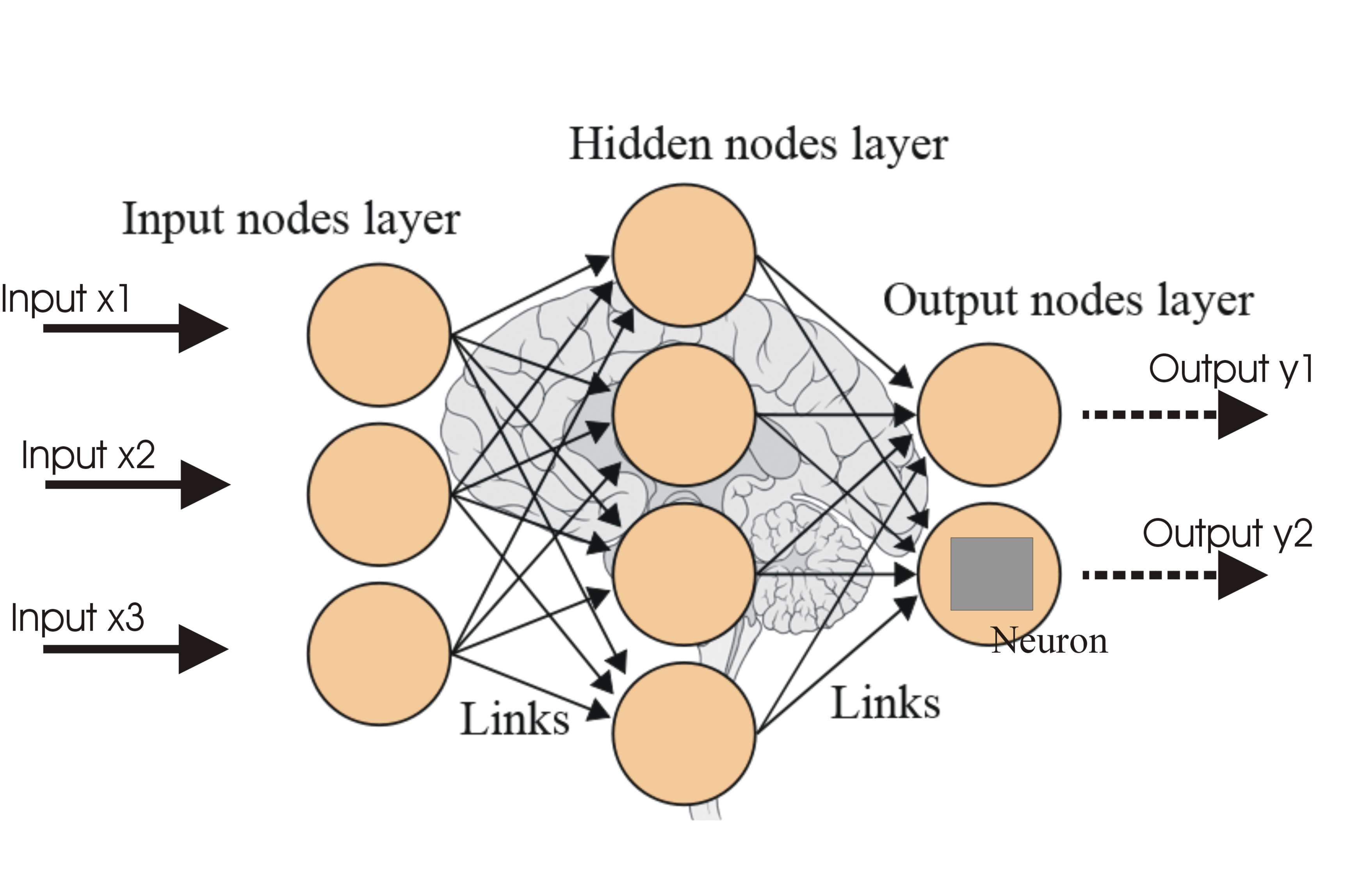
Study objective: To identify thalassemia minor patients from a general population using ANN modeling

Slide 6
Outline
Introduction
System design
Results
Summary & Conclusions
Acknowledgements

Slide 7
Patients composition inside the database
Group Name | Number of Patients
Healthy | 229
Myelodysplastic Syndrome (MDS) | 58
Iron Deficient Anemia (IDA) | 54
α and β Thalassemia Minor (TM) | 185

Slide 8
System design regarding stages
and CBC parameters
Stage | Groups | CBC parameters
1 | TM vs. Healthy group | MCV, RDW, RBC
2 | TM vs. Healthy and MDS group
3 | TM vs. Healthy, MDS and IDA
4 | TM vs. Healthy group | MCV, RDW, RBC, HB, MCH, PLT
5 | TM vs. Healthy and MDS group
6 | TM vs. Healthy, MDS and IDA

Slide 9
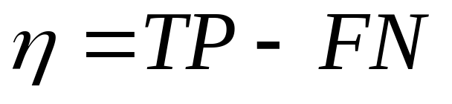

Formulas
- Accuracy
- True Positive
- False Negative
Accuracy in statistics measures the closeness of the output of the model to the true data

Slide 10
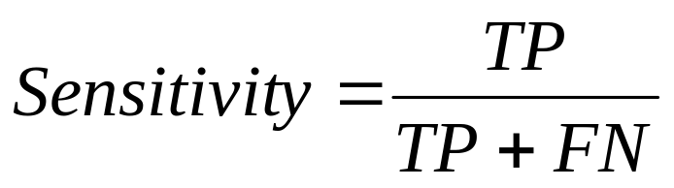
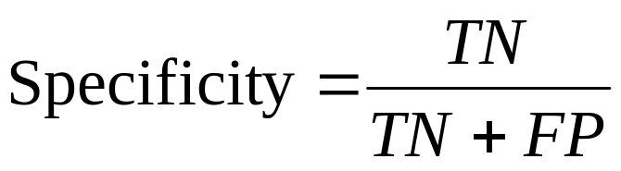
Formulas
TN - True Negative
FP - False Positive
TP - True Positive
FN - False Negative
Sensitivity - the ability to correctly detect the TM condition
Specificity - the ability to correctly detect the healthy cases

Slide 11
Outline
Introduction
System design
Results
Summary & Conclusions
Acknowledgements

Slide 12
Accuracy Value
Thalassemia Minor vs. healthy group
A
3 CBC parameters
6 CBC parameters

Slide 13
Accuracy Value
Thalassemia Minor vs. healthy + MDS
B
3 CBC parameters
6 CBC parameters

Slide 14
Accuracy Value
Thalassemia Minor vs. healthy + MDS + IDA
C
3 CBC parameters
6 CBC parameters

Slide 15
Best ANN at each stage of the study
Compared groups | Specificity | Sensitivity
1. TM vs. Control group | 0.958 | 1
2. TM vs. Control and MDS group | 0.967 | 1
3. TM vs. Control, MDS and IDA | 0.968 | 0.902
4. TM vs. Control group | 0.958 | 1
5. TM vs. Control and MDS group | 0.967 | 1
6. TM vs. Control, MDS and IDA | 0.968 | 0.897
3 CBC parameters
6 CBC parameters

Slide 16
Outline
Introduction
System design
Results
Summary & Conclusions
Acknowledgements

Slide 17
Summary
The study enrolled 526 patients database, which included 185 verified α and β TM cases and control groups
Above 1500 ANNs models were created and the highest accuracy networks were selected for the analysis

Slide 18
Conclusions:
Separation of TM patients from the control group with specificity of 0.967 and sensitivity of 1 (all TM patients are correctly diagnosed)
Separation of TM patients from the control group combined with IDA patients with specificity of 0.968 and sensitivity of 0.9
Calculations based on MCV, RBC and RDW performed better than on 6 parameters (MCV, RDW, RBC, HB, MCH, PLT)

Slide 19
Future Perspectives:
A novel broad approach of creating numerous ANNs and selecting the best performing model
ANN-based TM diagnostics could be used for broad automatic screening of general population
Possible application for the screening of other diseases that change any CBC parameters

Slide 20
Outline
Introduction
System design
Results
Summary & Conclusions
Acknowledgements

Slide 21
Acknowledgements
Holon Institute of Technology, Israel
Guy Barnhart-Magen
Victor Gotlib
Clalit Community Clinic, Israel
Rafael Marilus

