Slide 1

翁育靖
Yujing Weng
生物质催化转化实验室
Biomass Catalytic Conversion Laboratory
Education
  B.S. Taiyuan University of Technology Chemical Engineering 2008
  M.S. Guangzhou institute of energy UCAS Chemical Engineering 2012
  Ph.D. Guangzhou institute of energy UCAS Chemical Engineering 2014
学习经历
  本科 太原理工大学 化学工程与工艺 2008
  硕士研究生（代培） 中国科学技术大学 化学工程 2012
  硕士研究生 广州能源研究所 中科院大学 化学工程 2013
  博士 研究生 广州能源研究所 中科院大学 化学工程 2014

Slide 2
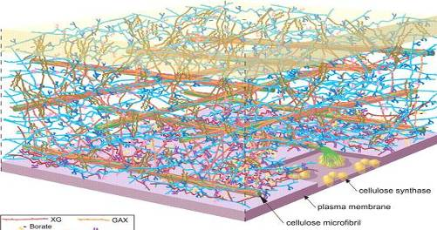
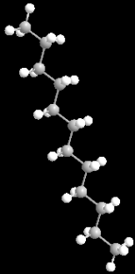
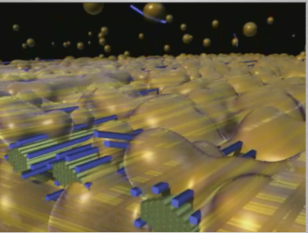
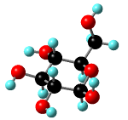
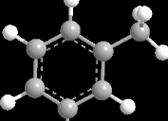
Jet-Fuel Range Hydrocarbons from Biomass-Derived Sorbitol over Ni-HZSM-5/SBA-15 Catalyst
生物质多元糖醇水相催化合成生物航油
生物质催化转化实验室
Biomass Catalytic Conversion Laboratory
2016.12-Guangzhou
Presenter: Yujing Weng
Tutor：Tiejun Wang
Guangzhou Institute of Energy Conversion
Aqueous catalysis
Pretreatment
hydrolysis
Lignocellulosic biomass
Pretreated biomass
Monomeric sugar
Aromatic and alkane

Slide 3

Outline
1
Background
2
Research Approach
3
Result & Discussion
4
Conclusion

Slide 4
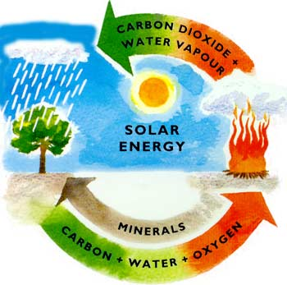

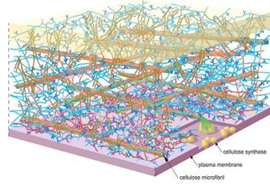
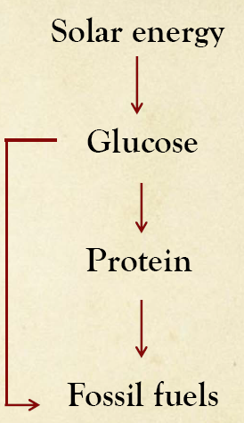

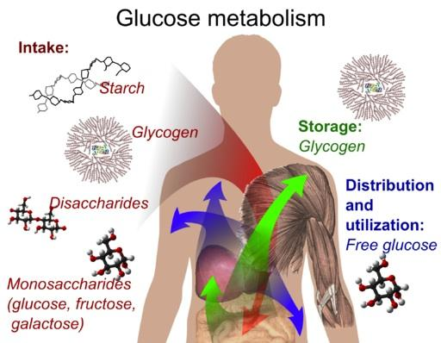
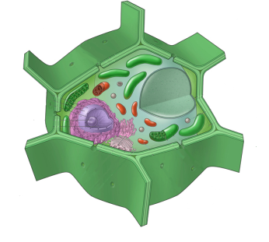
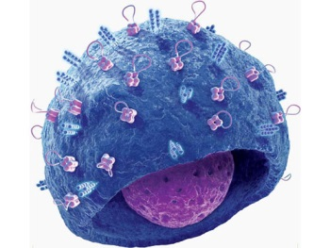
Background
Oil
Coal
Gas
Biomass
Notes:
在自然界的生物物质中，糖类化合物约占3/4，从植物，微生物到高等动物都含有糖类物质。植物体中的糖类化合物约占干重的50-90%，其中纤维素是自然界最丰富的糖物质。纤维素是由葡萄糖残基以β—（1→4）—糖苷键连接组成的不分支的直链葡聚糖。它是植物中最广泛存在的骨架多糖，是植物细胞壁及其他支持组织的主要成分，几乎占有整个植物界碳素的一半，是地球上最为丰富的有机化合物。

Slide 5

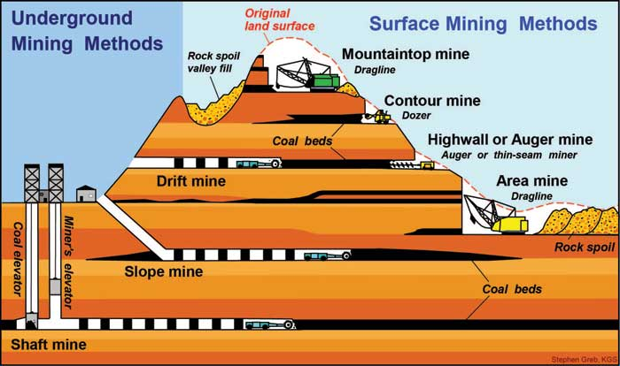
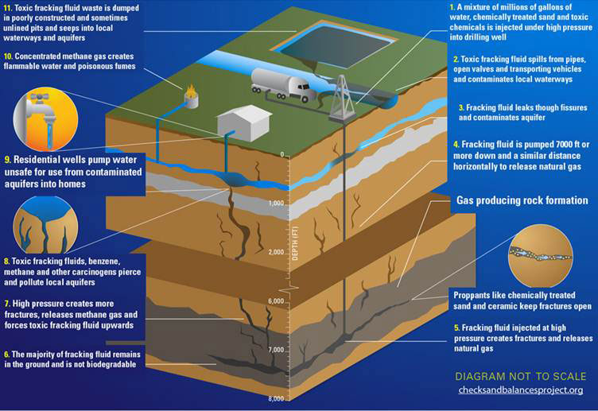


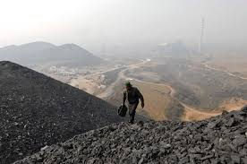
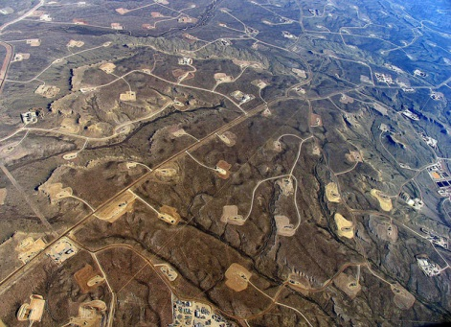



Notes:
传统能源的实际开采和利用方面和理性还是有很大不同的，特别是其不完善的开采利用造成了很多资源环境的危害

Slide 6
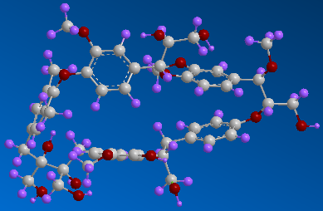
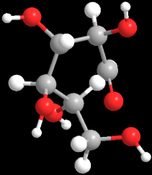

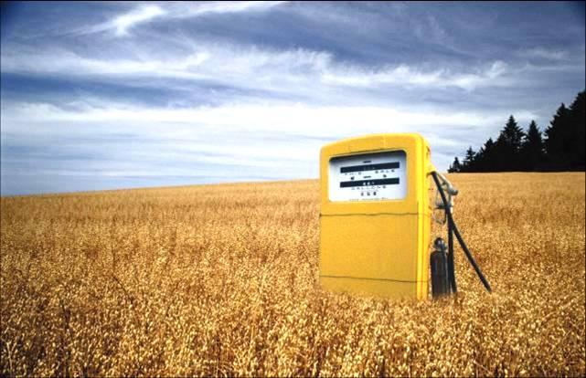


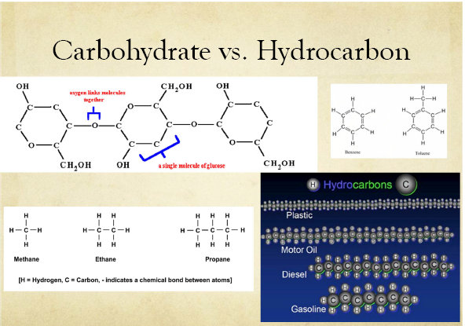
HDO，90% energy retained
carbohydrate
hydrocarbon

Slide 7
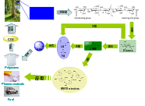
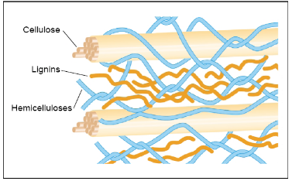
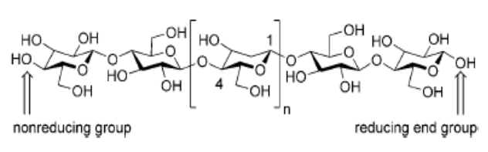
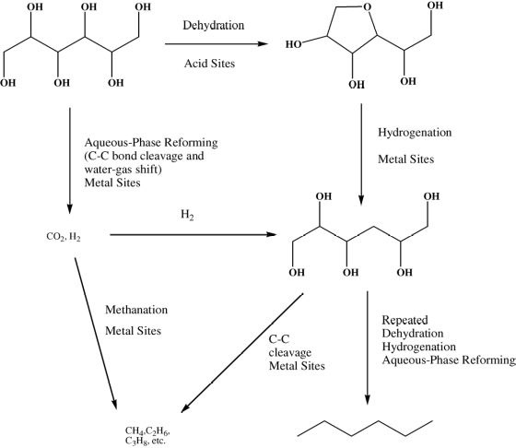
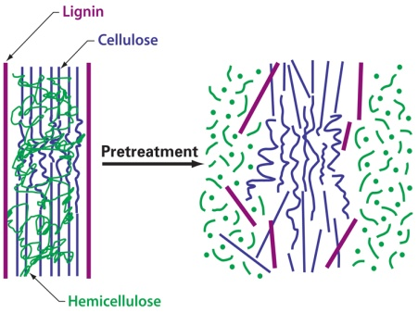
（1）biomass property
hydrophilic property
Thermo sensitivity
Highly functionalized
Aqueous phase hydrodeoxygenation of sugar alcohol into alkane included dehydration reaction on acid catalytic sites and hydrogenation on metal catalytic sites.
hydrothermal stable porous materials with high catalytic activity were strong required

Slide 8
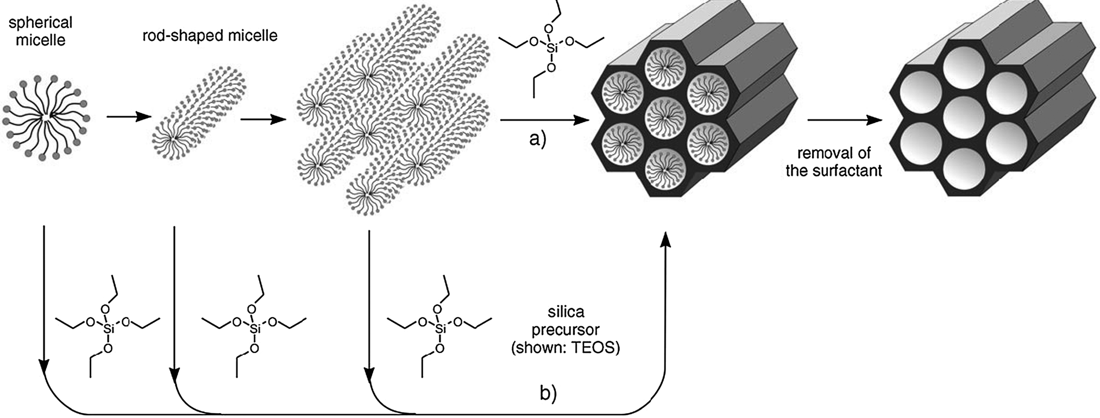
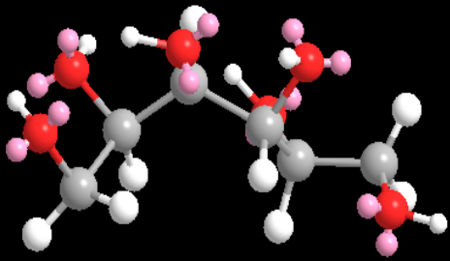
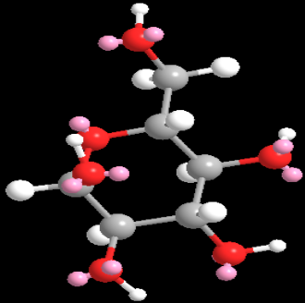
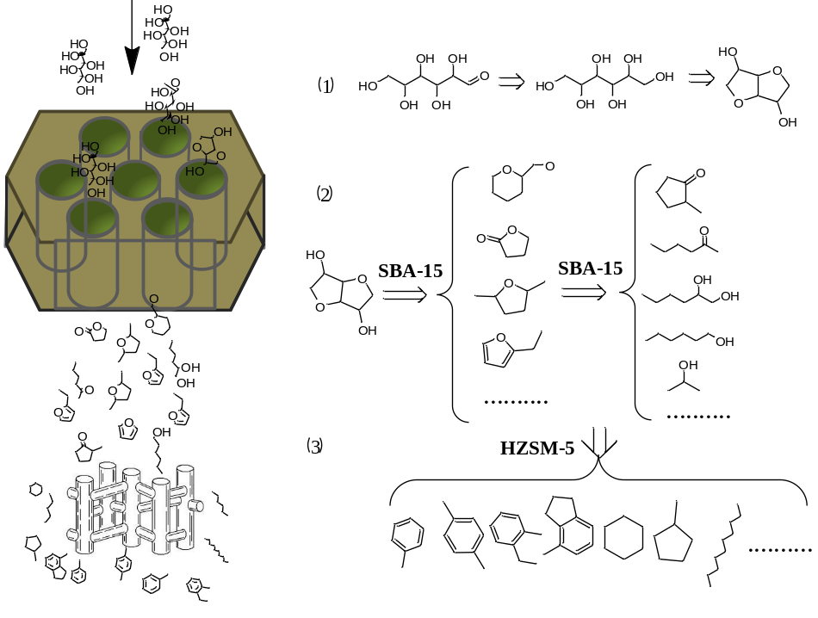
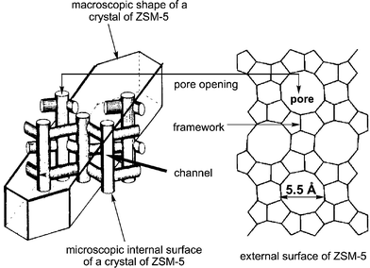
Result & Discussion
Mesoporous material:
Sorbitol: 8.0*9.7 Å
a-D-glucose: 8.4*8.6 Å
Β-D-glucose: 8.5*8.6 Å
ZSM-5: 5.1 – 5.6 Å
Notes:
Table 1 summarizes the physicochemical properties of applied catalysts. HZSM-5 contained
1.0 nm elliptical straight channels (0.51 nm × 0.55 nm) and 1.2 nm circular sinusoidal channels
(0.53 nm × 0.56 nm) that perpendicularly intersect, which leads to the shape selectivity for cyclic and branched hydrocarbons such as aromatics and cycloalkanes (Figure S1) [10,11]. SBA-15, ordered mesoporous silica material, was mainly a hexagonal array of cylindrical pores (diameter: 7–9 nm) and high BET surface areas (506 m2/g). The obtained Ni-HZSM-5/SBA-15 catalyst presented two kinds of pores: micropores of HZSM-5 and mesopores of SBA-15, respectively.

Slide 9
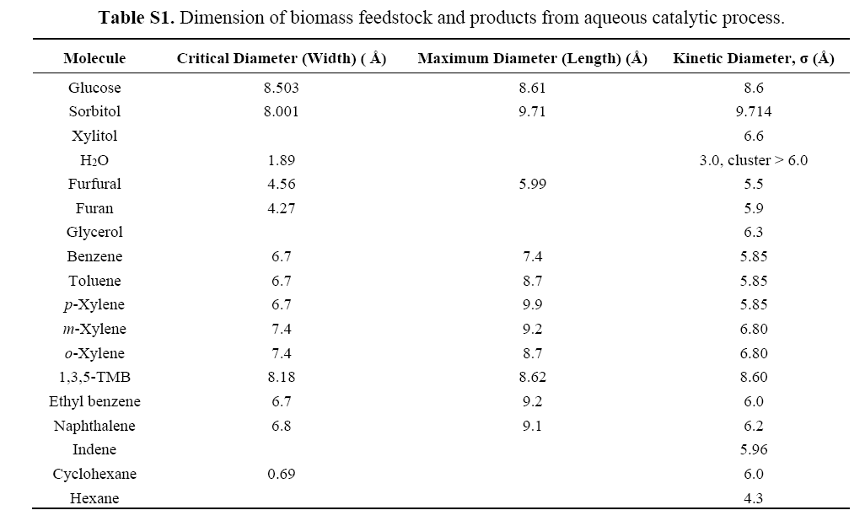

Slide 10
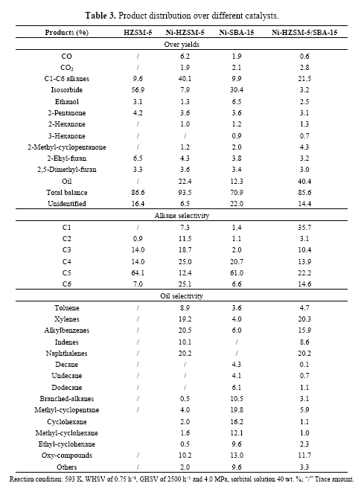

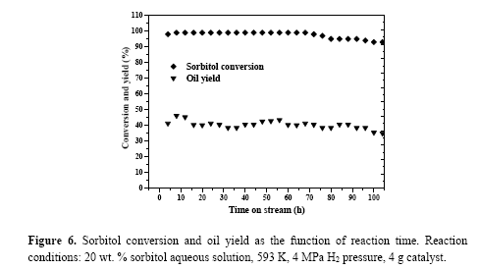
Notes:
Single HZSM-5 obtained high isosorbide yield (56.9%) in the aqueous-phase and small amount alkane (9.6%) in the gas-phase. However, isosorbide yield decreased to 7.9% for Ni-HZSM-5 with increasing yield of alkane (40.1%) and oil-phase production (22.4%). The main products in the
oil-phase were aromatics (78.9%), in accordance with previous reports about Ni-HZSM-5 [16,19,25]. Ni-SBA-15 was tested with high isosorbide yield (30.4%) and a low amount (12.3%) of oil production, which were mainly cycloalkanes and branched-alkanes, indicating the high reforming performance of catalyst.
Elemental analysis of oil samples with vario EL III elemental analyzer were showed in Table 4. Comparing with the oxygen content (O%) of Ni-HZSM-5 (8.5%), the content of Ni-HZSM-5/SBA-15 (3.4%) decreased greatly, indicating the fact that the HDO performance of catalyst was increased by the addition of SBA-15. The C/H weight ratio (8.6) of oil over
Ni-HZSM-5/SBA-15 is lower than that (8.9) over Ni/HZSM-5. This could be explained by the fact that the main products of Ni-HZSM-5/SBA-15 were not only aromatics, but also more saturated alkanes, whose C/H ratio is lower than that of unsaturated aromatics.

Slide 11
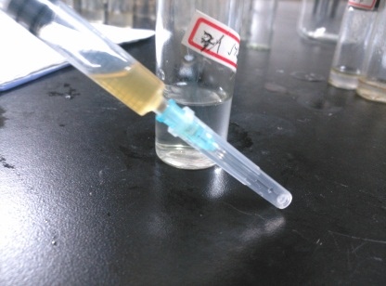
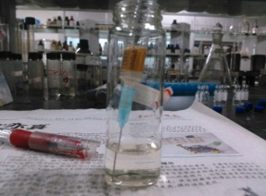

Slide 12
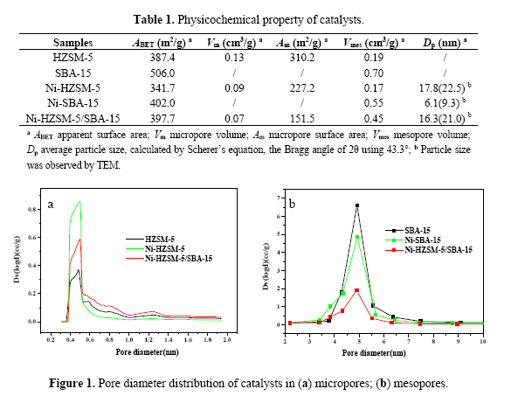
N₂ adsorption-desorption
The micropore pore diameter range was 0.4–0.8 nm and mesoporous pore diameter range was 3.5–6.0 nm. For micropore distribution, the Ni loading expanded the pore volume with high signal intensity , but no change in pore diameter range. There was also no significant change in the distribution of mesoporous pore diameter with only a slight decrease of intensity after Ni loading comparing with the fresh SBA-15. This demonstrated that the impregnation, drying and calcination steps during the preparation of the catalysts had no significant effect on the micropore and mesoporous distribution of HZSM-5 and SBA-15.

Slide 13
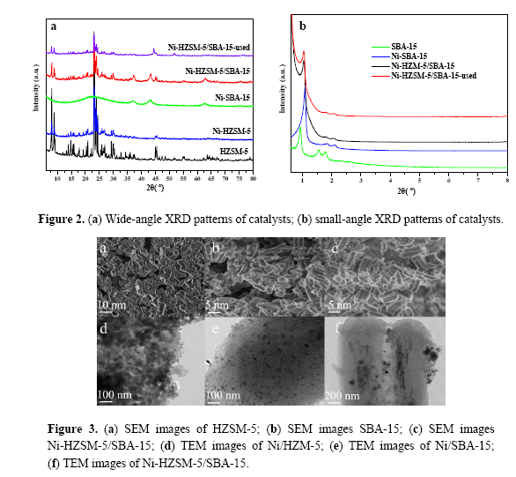
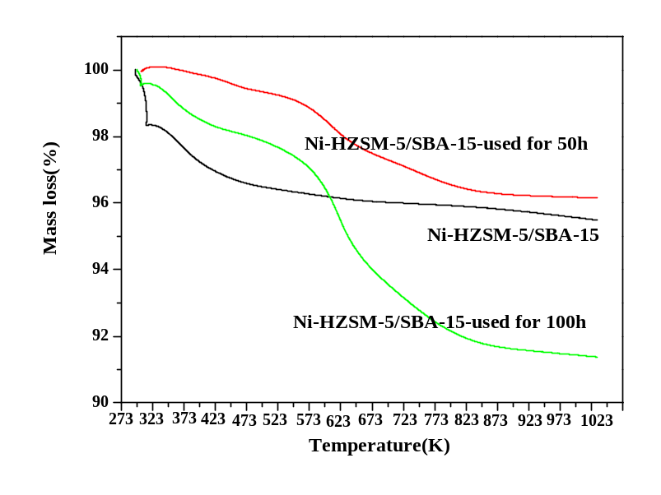
In small-angle XRD patterns (Figure 2b), SBA-15 presented three peaks, indexed as (100), (110) and (200) reflections associated with P6mm hexagonal symmetry [18]. Intensities of diffraction peaks were increased and the peak positions were shifted to higher 2θ value for Ni-SBA-15 in comparison to the parent SBA-15. The representative SEM and TEM images of catalysts were shown in Figure 3. The dark spots presented in the images indicated good dispersion of NiO nanoparticles on the supports.
Figure S2. TG analysis of tested catalysts
Notes:
In small-angle XRD patterns (Figure 2b), SBA-15 presented three peaks, indexed as (100), (110) and (200) reflections associated with P6mm hexagonal symmetry [18]. Intensities of diffraction peaks were increased and the peak positions were shifted to higher 2θ value for Ni-SBA-15 in comparison to the parent SBA-15. The representative SEM and TEM images of catalysts were shown in Figure 3. The dark spots presented in the images indicated good dispersion of NiO nanoparticles on the supports.

Slide 14
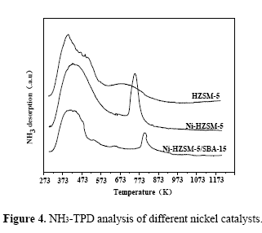
NH₃-TPD profiles for the tested catalysts (Figure 4) showed strong and weak acid sites with different acid strengths. The one at
373–550 K could be attributed to the weak adsorption of the NH₃ on the Brønsted acid sites and NH₃ association with Si–OH group [15,19], and the other peak at 550–820 K could be ascribed to strong desorption of NH₃ adsorbed on the acidic Al–OH, Al–OH–Si in the surface and structure [12,15]. The amount of NH₃ adsorption over Ni-HZSM-5 was less than that over HZSM-5, but the doping of Ni strengthened the strong acid sites. Moreover, the addition of SBA-15 decreased the total acid amount of Ni-HZSM-5

Slide 15
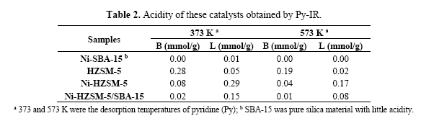
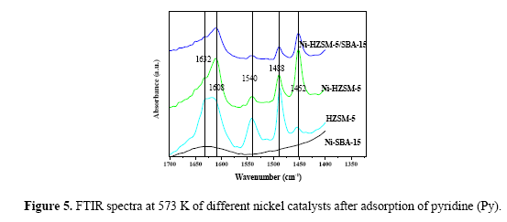
Brønsted and Lewis acid sites detected at low temperature (373 K) are attributed to the weak acid sites, and those observed at high temperature (573 K) are assigned to the strong acid sites [23]. From the results obtained by Py-IR for a series of catalyst samples, it can be indicated that the doping of Ni
improved the amount of Lewis acid sites of catalyst (Ni-HZSM-5) in relation to original zeolite
(HZSM-5). Moreover, the addition of SBA-15 decreased the ratio of B acid sites to L acid sites of
Ni-HZSM-5/SBA-15 in relation to Ni-HZSM-5.

Slide 16
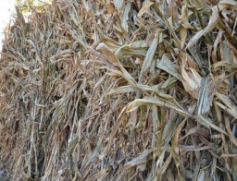
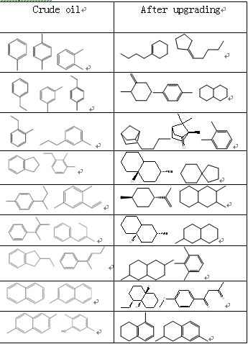
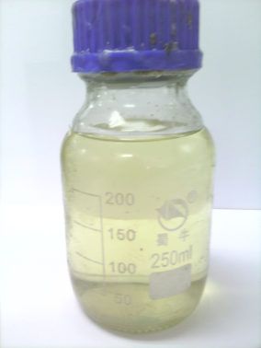
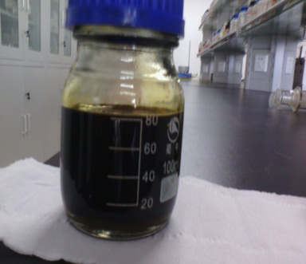
A potential biofuel production method
Main compositions of biofuel
Carbohydrates
in aqueous phase
Biomass
Hydrogenation
Aromatization
Hydrogenation
Upgrading
Crude oil
Mixed aromatics
Refined biofuel

Slide 17
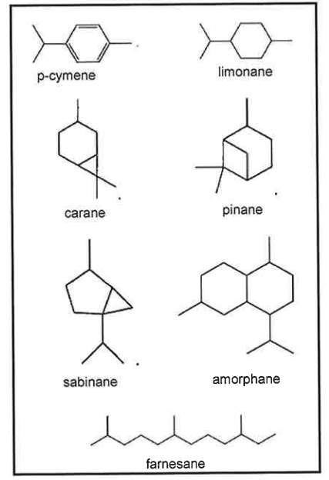
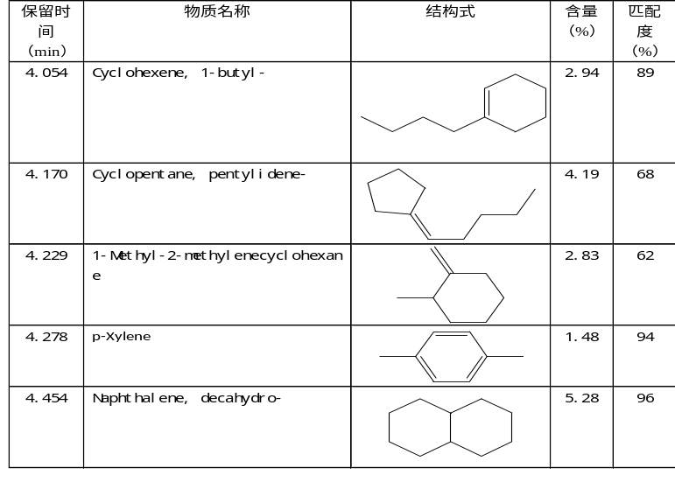

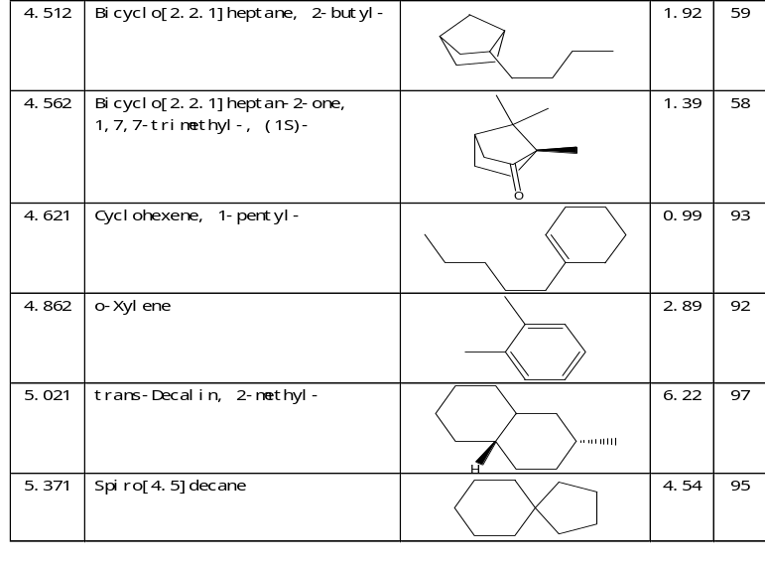
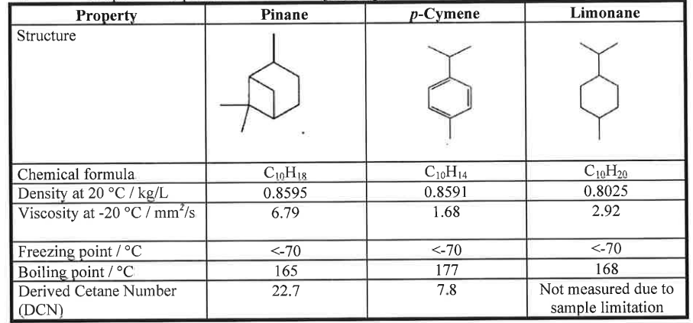
Jet fuel has high energy density to maximize aircraft range and a low freezing point to avoid the formation of crystalline wax particles during high-altitude flight. Fortunately, these requirements are readily met by branched and cyclic hydrocarbons, and, consequently, these types of fuel are not likely to be displaced for air transportation.
Biofuel
Aromatics and cycolparaffin of jet-fuel

Slide 18
Conclusions
In this work, renewable liquid fuels with high content of aromatics and cyclic-hydrocarbons were obtained by aqueous phase catalytic conversion of biomass sorbitol over the Ni@HZSM-5/SBA-15 catalyst. The catalyst presented bimodal pore structure and efficient performance in the conversion of biomass large-molecule sorbitol (e.g., sorbitol, diameter: 8.7 nm) into small-molecule hydrocarbons. Maximum oil hydrocarbons yield of 40.4 wt. % with aromatics and cyclic-hydrocarbons content of
80.0 % was obtained at 593 K, which was lower than that (623–773 K) of traditional aromatization. The produced hydrocarbons are mainly cycloalkanes, branched-alkanes and aromatics, which are wonderful crude oils to be used as jet fuel after being hydrogenated to improve quality (deep deoxygenation/chemical bond saturation).

Slide 19
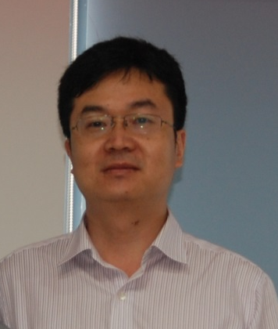
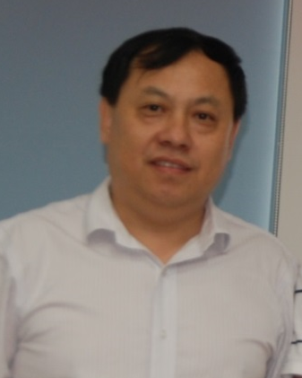

Acknowledgments
This work was supported by grants from the National Natural Science Foundation of China
(No. 51476176&21306195), the National 863 Plan (No. 2012AA101806) and China-EU SMEs Cooperation Fund for energy conservation research project (NO. SQ2013ZOB000002).
T.W.
L.M.
Author Contributions
Y.W., S.Q., L.M. and T.W. designed the experiments. Y.W., S.Q., and Q.Z. conducted the experiments. S.Q., Q.L., and M.D. analyzed the data. Y.W. wrote the first draft of the manuscript which was then revised by all other authors.

Slide 20



4
Q/A
中国科学院广州能源研究所
Guangzhou Institute of Energy Conversion, Chinese Academy of Sciences

