Slide 1

The Correlation between
Malondialdehyde Concentration Level in Seminal Fluid Analysis and Asthenozoospermia among Infertile Males
Faculty of Medicine, Universitas Indonesia
Debora Roselita Karo Sekali
Kuala Lumpur, 10 October 2016
Notes:
Good morning honorable professors, lecturers, and all of my fellow young researchers. My name is Debora Roselita Karo Sekali. I am a medical student in Universitas Indonesia and in this occasion I would like to present you my research paper, entitled the correlation between malondialdehyde concentration level in seminal fluid analysis and asthenozoospermia among infertile males. Astheno is slow movement or asthenozoospermia is a medical term for reduced sperm motility

Slide 2
Curriculum vitae
Personal Information
Debora Roselita Karo Sekali
17 Kings Court, Oakleigh East, Victoria
+61410357778
Debora.rose@yahoo.com
dkar0001@student.monash.edu
Formal education
2016 – present : Honours research, Bachelor in Medical Science, Monash University
2013 – 2016 : Bachelor in Medicine, Universitas Indonesia
Research
Clinical biochemistry / The Correlation between Malondialdehyde Concentration and Asthenozoospermia
Physiology / Understanding Mechanism of Failure in Labor
Faculty of Medicine, Universitas Indonesia. Debora Roselita Karo Sekali
Notes:
According to WHO, infertility is inability to get pregnant after one year regular unprotected sexual intercourse.
The problem is not only from the woman but it can also be caused by male infertility. Or both of them cause it.
Talking about the developing countries, we might see there is a dramatic growth of population in developing countries like in Indonesia.

Slide 3
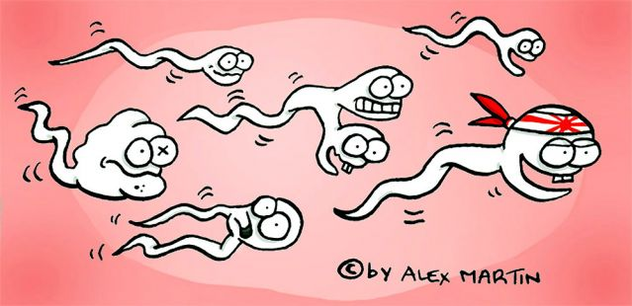
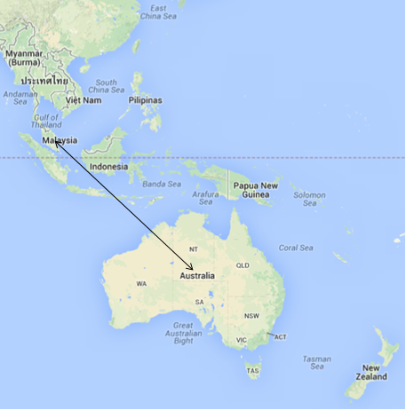
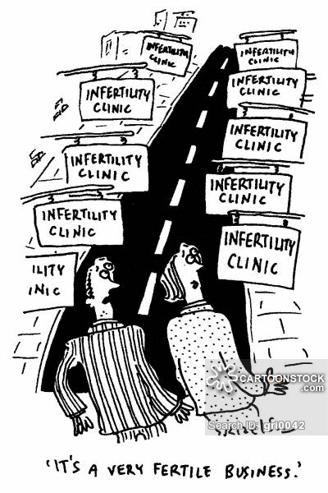
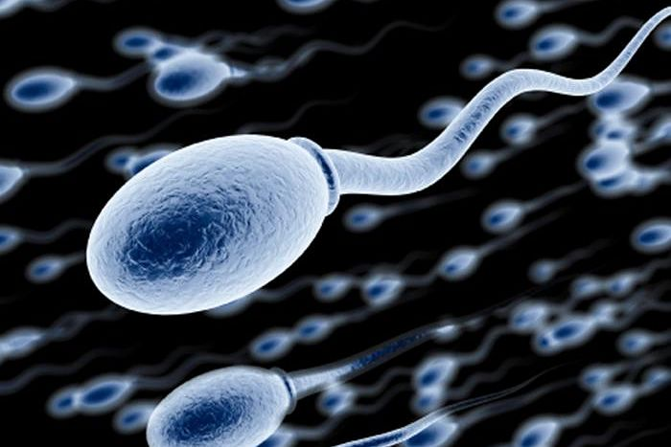


The journey to the waiting egg
4000 Miles
Notes:
Before I talk about the infertility problem, I would like to tell you a very fascinating information to you about sperm. Sperm is very small and in one ejaculation, there are many sperms out to vagina. Out of millions sperm ejaculated the vagina, only a few thousand or hundred make successfully complete the journey to the waiting egg in fallopian tube. In fact, sperm have superhero-like power. Sperm are very tiny, only about 50 micrometers from the head to the tail. However, the distance between the cervix to the fallopian tubes is about 4 inches. For a cell the size of a sperm to travel this distance is equivalent to an adult human swimming from Malaysia to Australia. Can you imagine the distance? It’s almost 4000 miles or 8 hours flight distance. Isn’t it amazing?

Slide 4

What’s the issue?
Infertility
(WHO)
Inability to conceive after one year regular unprotected sexual intercourse
Problem in male and/or female
Is it really a problem in developing countries?
Faculty of Medicine, Universitas Indonesia. Debora Roselita Karo Sekali
Notes:
According to WHO, infertility is inability to get pregnant after one year regular unprotected sexual intercourse.
The problem is not only from the woman but it can also be caused by male infertility. Or both of them cause it.
Talking about the developing countries, we might see there is a dramatic growth of population in developing countries like in Indonesia.

Slide 5


Global Prevalence of Infertility
WHO 2014
1 in 4 couples in developing countries is infertile
Aitken RJ etal. WHO laboratory manual for the examination of human semen and sperm-cervical mucus interaction. 1999.
Faculty of Medicine, Universitas Indonesia. Debora Roselita Karo Sekali
Notes:
Most married couple normally wants to have their own biological child. Unfortunately, not all wishes of having child can be fulfilled. 1 in 4 couples in developing countries is infertile.

Slide 6

Infertility in Indonesia
Barten J. Screening for infertility in Indonesia. Results of examination of 863 infertile couples. NCBI. 1978
Faculty of Medicine, Universitas Indonesia. Debora Roselita Karo Sekali
Notes:
How about in Indonesia? Unfortunately, almost a quarter of married couples unable to have a child.

Slide 7
Factors of Infertility
10% Unknown
40 %
By Man
40 %
By Woman
10% Both
Aitken RJ etal. WHO laboratory manual for the examination of human semen and sperm-cervical mucus interaction. 1999.
Faculty of Medicine, Universitas Indonesia. Debora Roselita Karo Sekali
Notes:
So, why is it so important to know all those facts? In fact, they are still many married couples who struggle to have a child. And this is the problem in every country and increase year by year.
I’ll talk more about the man factor causing infertility

Slide 8

Semen Analysis: Sperm Quality
Total numbers
Vitality and motility
Morphology
80% male infertility → impaired sperm motility (Asthenozoospermia)
10% of cases of infertile couples is unexplainable
Barten J. Screening for infertility in Indonesia. Results of examination of 863 infertile couples. NCBI. 1978.
Faculty of Medicine, Universitas Indonesia. Debora Roselita Karo Sekali
Notes:
One of important thing to know the quality of sperm is by doing semen analysis. It analyzes the total numbers of sperm in one semen ejaculation, vitality and motility of the sperm. Sperm has to travel long distances to unite with the oocyte
Sperm motility→ crucial for natural fertilization , and morphology of the sperm from head to the tail.
80% male infertility is associated with impaired sperm motility or called asthenozoospermia.
Asthenozoospermia is a term coined when sperm motility of a patient is below the reference standard value of WHO.
What cause the less sperm motility? Why it happens?

Slide 9

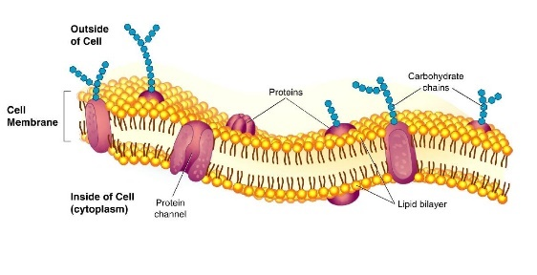
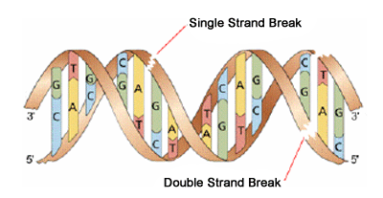
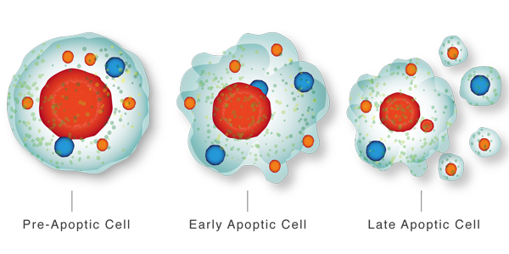
Balance or Imbalance
Pathological Roles:
Lipid peroxidation
DNA damage
Apoptosis
Physiological Roles:
Capacitation
Acrosome reaction
Hyperactivation
Sperm-oocyte binding
Antioxidant Defense
ROS
Agarwal etal. Effect of Oxidative Stress on Male Reproduction. World J Mens Health. 2014.
Faculty of Medicine, Universitas Indonesia. Debora Roselita Karo Sekali
Notes:
Oxidative stress (OS) has been identified as one of the many mediators of male infertility by causing sperm dysfunction. OS is a state related to increased cellular damage triggered by oxygen and oxygen-derived free radicals known as reactive oxygen species (ROS). While small amounts of ROS are required for normal sperm functioning, disproportionate levels can negatively impact the quality of spermatozoa and impair their overall fertilizing capacity. OS has been identified as an area of great attention because ROS and their metabolites can attack DNA, lipids, and proteins; alter enzymatic systems; produce irreparable alterations; cause cell death; and ultimately, lead to a decline in the semen parameters associated with male infertility. “OS is a condition that reflects an imbalance between the systemic manifestation of reactive oxygen species (ROS) and a biological system’s ability to readily detoxify (antioxidant defenses) the reactive interm1ediates or to repair the resulting damage” [4,5]. In a healthy body, pro-oxidants and antioxidants remain in balance. Spermatozoa are equipped with antioxidant defense mechanisms and are likely to quench ROS, thereby protecting gonadal cells and mature spermatozoa from oxidative damage [6]. However, under pathological conditions, the uncontrolled production of ROS exceeds the antioxidant capacity of the seminal plasma, resulting in OS [1,6]

Slide 10
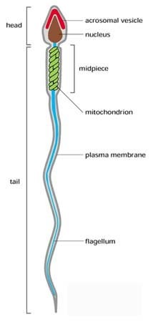
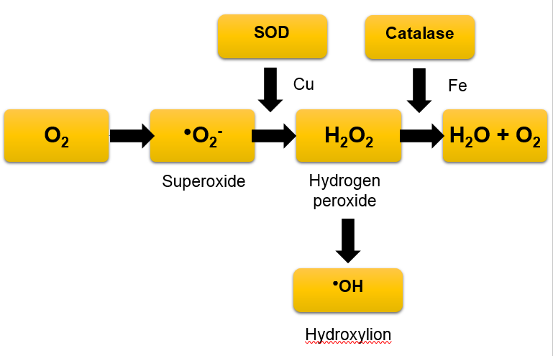
Generation of Reactive Oxygen Species
1. Mithocondrial NADH-dependent oxido-reductase reaction
Main source of ROS
2. NADPH Oxidase system
Agarwal etal. Effect of Oxidative Stress on Male Reproduction. World J Mens Health. 2014.
Faculty of Medicine, Universitas Indonesia. Debora Roselita Karo Sekali
Notes:
The generation of ROS in spermatozoa may occur via two methods: (1) the nicotinamide adenine dinucleotide phosphate oxidase system at the level of the sperm plasma membrane and/or (2) the nicotinamide adenine dinucleotide-dependent oxido-reductase reaction at the mitochondrial level. The latter mechanism appears to be the main source of ROS. Spermatozoa are rich in mitochondria because a constant supply of energy is required for their motility. Therefore, the presence of dysfunctional spermatozoa in the semen significantly elevates the production of ROS, which in turn affects its mitochondrial function and subsequently, sperm function such as motility. A majority of ROS generated in human spermatozoa is O2 - . This electron-reduced product of O2 - reacts with itself via dismutation to generate H2O2. In the presence of transition metals such as iron and copper, H2O2 and O2 - undergo the Haber-Weiss reaction to generate the extremely reactive and destructive OH- (Fig. 1). OH- radicals are exceptionally potent initiators of the LPO cascade and can lead to a loss of sperm function from the disruption of membrane fluidity

Slide 11
Low Sperm Motility
Asthenozoospermia
WHO 1999: less than 50% are motile, OR less than 25% of progressive motility (grade a) within 60 minutes of ejaculation
Increase in ROS can be one factor of impaired sperm motility
Disrupts cytoskeletal proteins + ⬆Lipid peroxidation + ⬇Intracellular ATP
Malondialdehyde
Aitken RJ etal. WHO laboratory manual for the examination of human semen and sperm-cervical mucus interaction. 1999.
Faculty of Medicine, Universitas Indonesia. Debora Roselita Karo Sekali

Slide 12
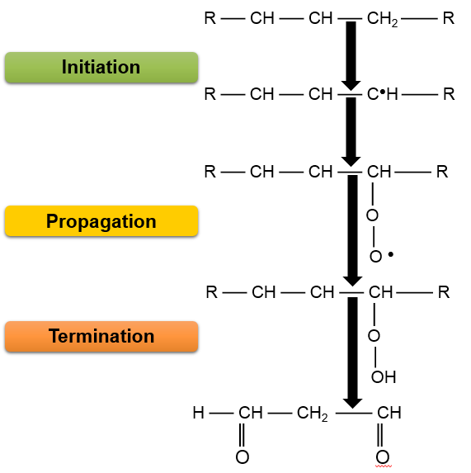
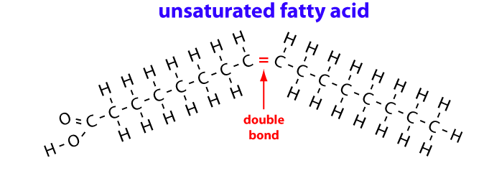
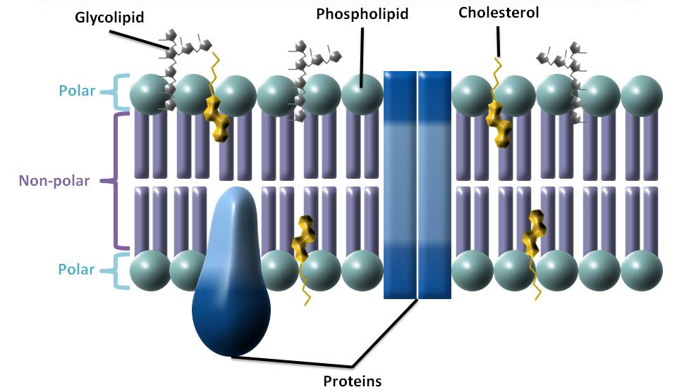
I. PUFA
II. Lipid free radical
III. Lipid peroxyl radical
Unstable
IV. Lipid peroxyl radical
V. Malondialdehyde
Grotto etal. Importance of the lipid peroxidation biomarkers and methodological aspects FORmalondialdehyde quantification. 2009.
Faculty of Medicine, Universitas Indonesia. Debora Roselita Karo Sekali

Slide 13
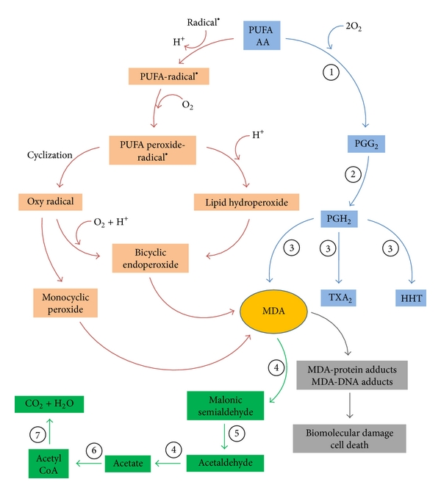

Slide 14
Male Infertility
Semen Analysis
Asthenozoospermia
(motile less than 50%)
Biochemical aspect
(Not routine, discriminatory ranges not clearly defined)
Malondialdehyde
(indicator of toxic lipid peroxide)
Faculty of Medicine, Universitas Indonesia. Debora Roselita Karo Sekali

Slide 15
Problem Identification
The controversies and lack of studies regarding malondialdehyde concentration in seminal plasma and asthenozoospermia
Research Question
Is there any significant difference in the seminal plasma malondialdehyde concentration between normozoospermic and asthenozoospermic infertile males?
Faculty of Medicine, Universitas Indonesia. Debora Roselita Karo Sekali

Slide 16
Hypothesis
There is a significant difference in seminal plasma malondialdehyde concentration between normozoospermic and asthenozoospermic infertile males.
Faculty of Medicine, Universitas Indonesia. Debora Roselita Karo Sekali

Slide 17
Research Objectives
General Objective
To understand about oxidative stress and its contributory factor to male infertility
Specific Objective
To evaluate the relationship between MDA and sperm parameters
To provide basic information in order to choose the best prevention and management related to oxidative stress
Faculty of Medicine, Universitas Indonesia. Debora Roselita Karo Sekali

Slide 18
Research Benefits
… For the society
To enhance society’s knowledge about infertility
… For the institution
To provide additional considerations in improving reproductive health of Indonesian people
To decrease the prevalence of infertility and asthenozoospermia in Indonesia
Faculty of Medicine, Universitas Indonesia. Debora Roselita Karo Sekali

Slide 19
ROS in the Male Reproductive System
⬆ generation
⬆ susceptibility
Disrupts cytoskeletal proteins + ⬆Lipid peroxidation + ⬇Intracellular ATP ≈ ⬇⬇⬇Motility
Both seminal plasma and spermatozoa have lipid
Faculty of Medicine, Universitas Indonesia. Debora Roselita Karo Sekali
Notes:
-⬆ generation→ spermatozoa are highly motile and mitotic, and thus rely heavily on mitochondrial activity. ROS Is a byproduct of mithocondrial activity, and thus the male reproductive system generate high levels of ROS
-⬆ susceptibility→ spermatozoa has a unique cell membrane that contains high levels of Polyunsaturated fatty acid or PUFA, and PUFA easilry reacts with ROS
-Spermatozoa contains very little cytoplasm, and therefore intracellular antioxidant concentrations there may be insufficent to protect them against high levels of ROS. Seminal plasma content has been found to be important in the defense against ROS

Slide 20
Conflicting Statements
MDA contributes in low sperm quality
MDA has no relationship with sperm motility
Naher etal:
  infertile group has significantly higher concentration of malondialdehyde (MDA) in seminal fluid analysis, an indicator of toxic lipid peroxides
Tavilani etal:
  MDA contributes in various impairments of sperm cells including sperm count, morphology, and motility
Suleiman etal:
  There is no correlation between MDA and asthenozoospermia
Jong etal:
  Smoking as a source of free radical contributes in the increase of MDA but does not correlate to infertility
Faculty of Medicine, Universitas Indonesia. Debora Roselita Karo Sekali

Slide 21
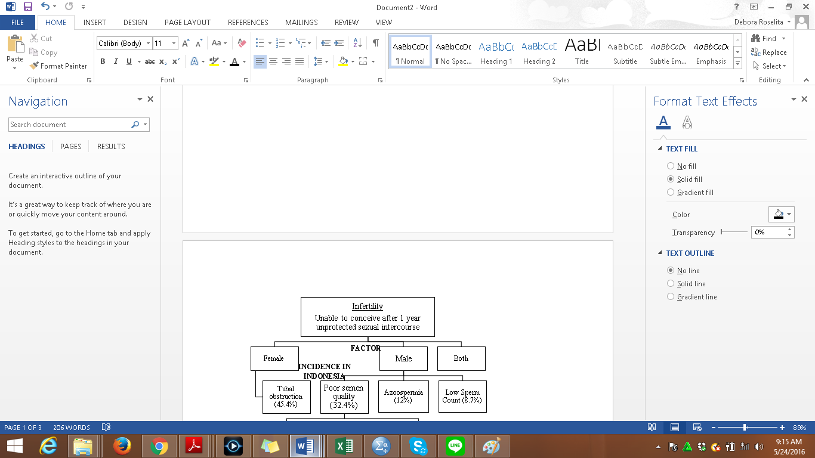
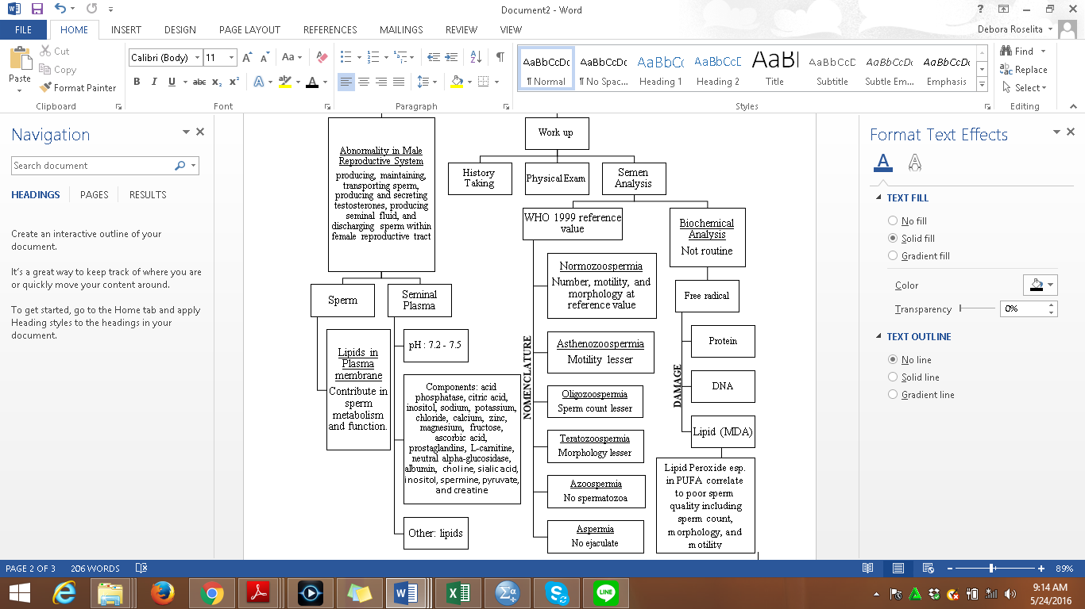
THEORETICAL FRAMEWORK
Figure 2. Theoretical Framework

Slide 22
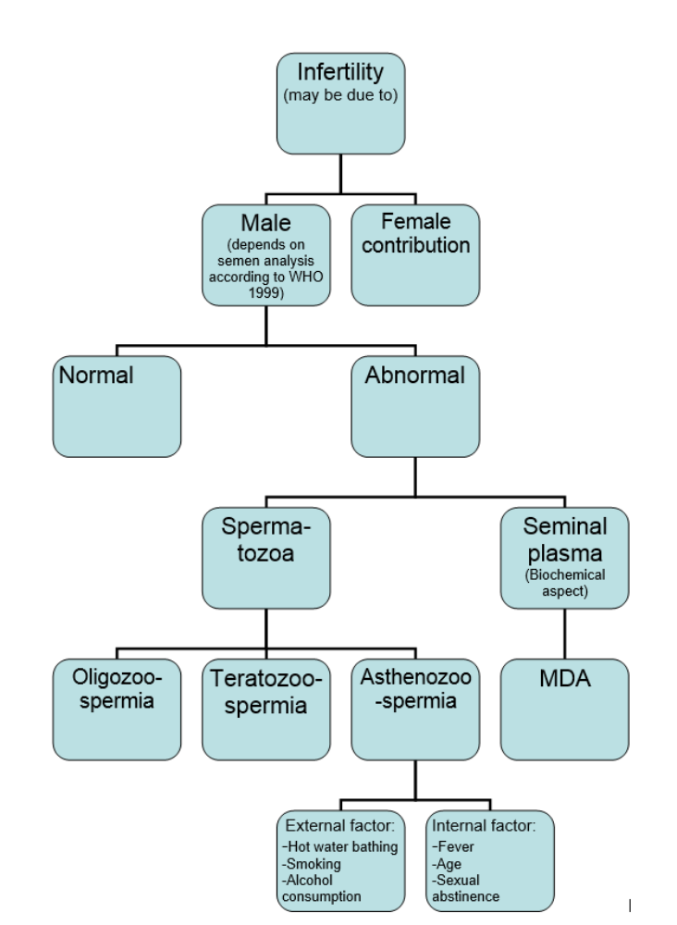
Theoretical Framework
Association ?
Faculty of Medicine, Universitas Indonesia. Debora Roselita Karo Sekali

Slide 23
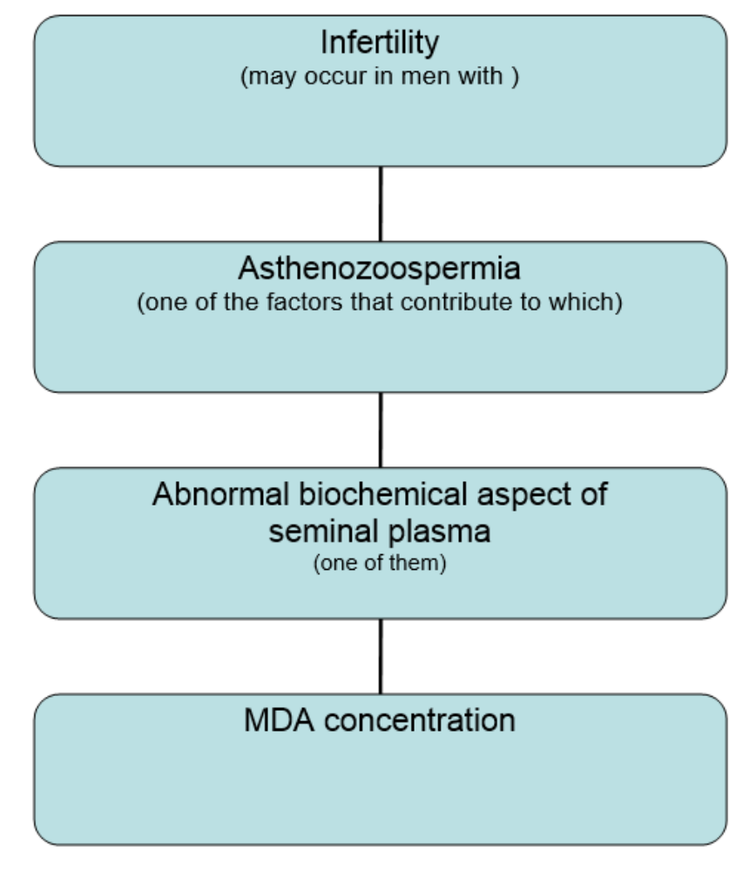
Conceptual Framework
Independent variable: Malondialdehyde concentration in Seminal plasma
Dependent variable: Semen classification:
  Normozoospermics→ control.
  asthenozoospermic → case.
Faculty of Medicine, Universitas Indonesia. Debora Roselita Karo Sekali

Slide 24
Research Design and Subjects
Research Design
Observational-analytical study
Subject involved
Control group : 20 Normozoospermic males
Comparative case-control design
Case group : 16 Asthenozoospermic males
Both groups are infertile
Faculty of Medicine, Universitas Indonesia. Debora Roselita Karo Sekali

Slide 25
Methods
Research Design | Observational analytical study, comparative case-control design
Time and Location | 12 months (June-protocol, Feb-May data collection) Laboratory of Biochemistry, FKUI
Data Source | Primary data (biochemical measurement using TBA method)
Population Sample | Target population: all adult males in Indonesia Reached population: male patients visit Laboratory of Andrology RSIA Sayyidah
Subjects involved | Control group: 20 Normozoospermics Case group: 15 Asthenozoospermics Both groups are infertile
Faculty of Medicine, Universitas Indonesia. Debora Roselita Karo Sekali

Slide 26
Location and Time
Location
RSIA Sayyidah, Infertility laboratory
Time
June 2015 – May 2016
Biochemistry laboratory in University of Indonesia
Faculty of Medicine, Universitas Indonesia. Debora Roselita Karo Sekali

Slide 27
Male
20-50 years old
Sexual abstinence for 2-7 days
New patients and have not had therapy before.
Exclusion Criteria
Smoke >20 cigarettes a day
Hot water spa in 2 weeks before examination
Drink alcohol more than 8 units per week.
Inclusion Criteria
High fever >39ºC before examination
Faculty of Medicine, Universitas Indonesia. Debora Roselita Karo Sekali

Slide 28
Exclusion Criteria: Explanation
Aging
  Decrease motility and oxidative stress-related damage
Smoking
  If >20 cigarretes→ Disrupts seminal quality and induce severe ROS production
Infection
  Causes decreased in seminal quality and a decreased antioxidant and a massive increase of ROS
Alcoholics
  >8 times per week→ decreased fecundity and increased ROS

Slide 29
Research Methods
1.
Selection of Subjects and Collection of Samples
(Done by Staff in RSIA Sayyidah Andrology Laboratory):
Requesting informed consent for new patients
Semen samples of the patients were collected by masturbation after 4 days of sexual abstinence and examined after liquefaction for 30 min at 37 °C.
Faculty of Medicine, Universitas Indonesia. Debora Roselita Karo Sekali

Slide 30
Research Methods
2.
Semen Analysis
(Done by Staff in RSIA Sayyidah Andrology Laboratory):
Volume, pH, concentration, and motility were evaluated according to WHO guidelines 2010
Determine normozoospermia or asthenozoospermia
Centrifuge semen for 20 min at 1600 rpm and get the seminal fluid
Sample is stored in -70ºc in RSIA Sayyidah
Faculty of Medicine, Universitas Indonesia. Debora Roselita Karo Sekali

Slide 31
Parameter | Reference value based on WHO 1999 | Reference value based on WHO 2010
Volume | 2.0 mL or more | 1.4 - 1.7 mL
Ph | 7.2 or more | 7.2 or more
Sperm concentration | 20 x 10⁶ spermatozoa/mL or more | 12 – 16 x10⁶ spermatozoa/Ml
Total sperm number | 40 x 10⁶ spermatozoa per ejaculate or more | 33 – 46 x 10⁶ spermatozoa per ejaculate
Motility | 50% or more motile (grades a + b) or 25% or more with progressive motility (grade a) within 60 minutes of ejaculation | Total motility (PR+NP): 38 - 42% Progressive motility (PR): 31 - 34%
Vitality (live spermatozoa) | 50% or more live, i.e., excluding dye | 55 – 63 %
Faculty of Medicine, Universitas Indonesia. Debora Roselita Karo Sekali

Slide 32
Research Methods
3.
Measurement of Lipid Peroxide
Thiobarbituric acid method
(Done in Lab of Biochemistry)
Preparation of MDA standard by TEP
TCA for precipitate protein
TBA attach to MDA and read the absorbance
4.
Statistical Analysis
Graph pad prisms
SPSS for Windows version 20.0
Descriptive statistical test
Saphiro-Wilk
Mann-Whitney U Test
Faculty of Medicine, Universitas Indonesia. Debora Roselita Karo Sekali
Notes:
TEP: 1,1,3,3 – tetraethoxypropane
TCA:

Slide 33
MEASUREMENT OF MDA
THIOBARBITURIC ACID METHOD
Procedure
Seminal fluid samples (200µL)
Aquadest
Prepared St. TEP
TCA 20%
TBA 0.67%
Water
Vortex
Centrifuge
Microtube
Tube
Micropipette
Water heater
Spectrophotometer
Prepare the standard MDA concentration by St. TEP, TCA, aquadest, and TBA
For samples, we take 100µL and aquadest 300µL to a microtube and add 200µL TCA 20%
Vortex until homogenous, centrifuge 5,000 rpm for 10 minutes, take supernatant and put into another microtube
Put 400µL TBA 0.67% to that microtube
Each sample has double measurement
Incubate for 10 minutes at 96-100^{O}C, cool down to the room temperature, and read the absorbance at 530 nm
Faculty of Medicine, Universitas Indonesia. Debora Roselita Karo Sekali

Slide 34
Table 1. Procedure of Measuring Malondialdehyde Concentration
Materials | Blank | 0.3125 M | 0.625 M | 1.25 M | 2.5 M | 5 M | Test 1a | Test 1b
Aquadest | 400 µL | 397.5 µL | 395 µL | 390 µL | 380 µL | 360 µL | 300 µL | 300 µL
St. TEP | - | 2.5 µL | 5 µL | 10 µL | 20 µL | 40 µL | - | -
Sample | - | - | - | - | - | - | 100 µL | 100 µL
TCA 20% | 200 µL | 200 µL | 200 µL | 200 µL | 200 µL | 200 µL | 200 µL | 200 µL
 |  |  |  |  |  |  | Vortex until homogenous, centrifuge 5,000 rpm for 10 minutes, take supernatant
TBA 0.67% | 400 µL | 400 µL | 400 µL | 400 µL | 400 µL | 400 µL | 400 µL | 400 µL
 | Incubate for 10 minutes at 96-100^{O}C, cool down to the room temperature, and read the absorbance at 530 nm

Slide 35
RESULT
No | Diagnosis | MDA (nmol/mL)
1 | Normo | 1.56552
2 | Normo | 1.43144
3 | Normo | 1.26421
4 | Normo | 1.59866
5 | Normo | 2.26756
6 | Normo | 0.99666
7 | Normo | 1.66555
8 | Normo | 1.49833
9 | Normo | 0.82982
10 | Normo | 0.82982
11 | Normo | 0.52188
12 | Normo | 0.53809
13 | Normo | 0.76499
14 | Normo | 0.36305
15 | Normo | 1.39708
16 | Normo | 0.40843
17 | Normo | 1.64019
18 | Normo | 0.31118
19 | Normo | 1.02431
20 | Normo | 1.12156
No | Diagnosis | MDA (nmol/mL)
21 | Astheno 35% | 2.06689
22 | Astheno 40% | 1.63211
23 | Astheno 40% | 2.301
24 | Astheno 40% | 2.16722
25 | Astheno 45% | 2.03344
26 | Astheno 47% | 2.301
27 | Astheno - | 2.86957
28 | Astheno 15% | 4.25752
29 | Astheno 40% | 0.35981
30 | Astheno 45% | 0.37277
31 | Astheno 45% | 0.40843
31 | Astheno 40% | 0.70016
32 | Astheno 45% | 0.31767
33 | Astheno 30% | 2.06689
34 | Astheno 42% | 18.22042
35 | Astheno 48% | 16.90762

Slide 36
Total Samples
(Period June 2015 – May 2016)
Faculty of Medicine, Universitas Indonesia. Debora Roselita Karo Sekali

Slide 37
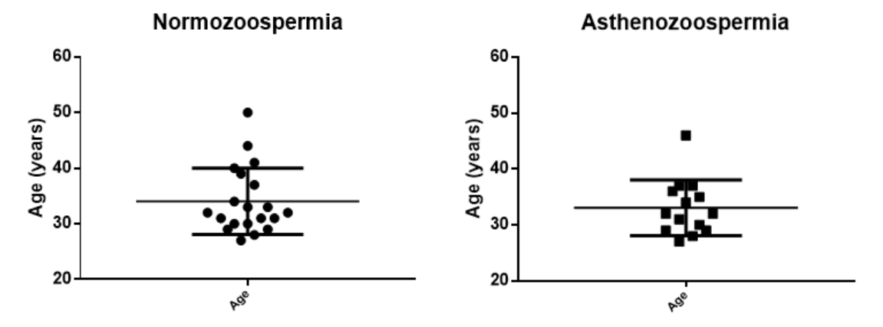
Age distribution
Groups | Total number | Age (years) (mean + SD) | p value
Control (Normozoospermia) | 20 | 34.1 + 6 | 0.62 (not significant)
Case (Asthenozoospermia) | 14 | 33.1 + 5
Faculty of Medicine, Universitas Indonesia. Debora Roselita Karo Sekali

Slide 38
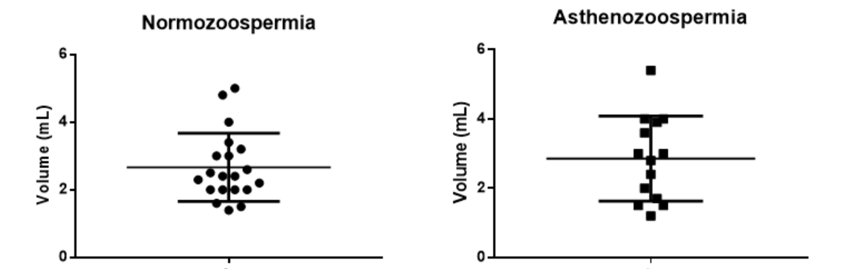
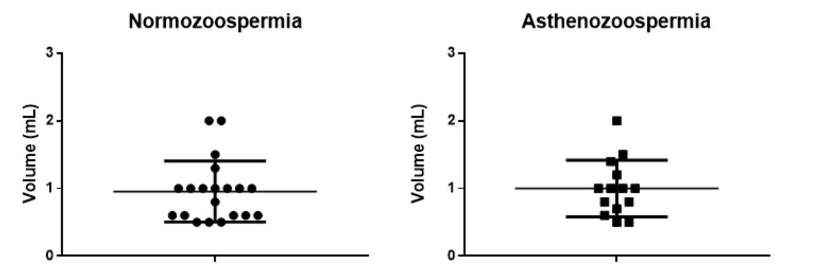
Semen volume
Seminal plasma volume
Faculty of Medicine, Universitas Indonesia. Debora Roselita Karo Sekali

Slide 39
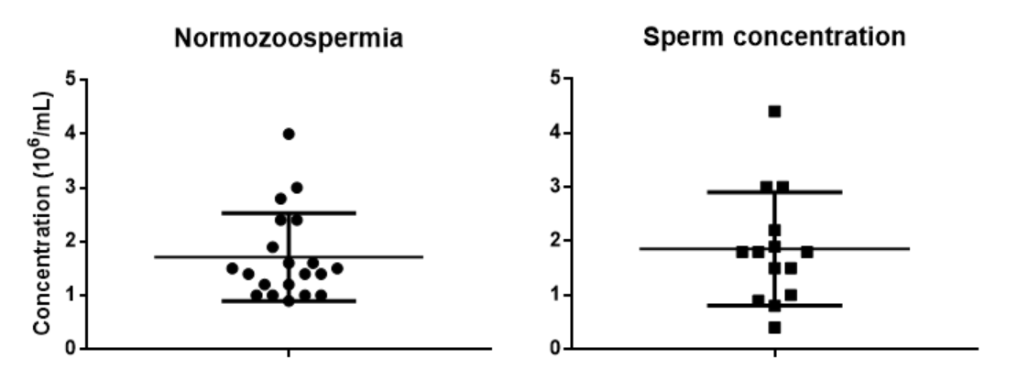
Distribution of Sperm Concentration
Groups | Median (10⁶/mL) (Range) | p value
Normozoospermia (n= 20) | 1.5 (0.9 – 4) | 0.65 (not significant)
Asthenozoospermia (n=14) | 1.8 (0.4 – 4.4)
Faculty of Medicine, Universitas Indonesia. Debora Roselita Karo Sekali

Slide 40
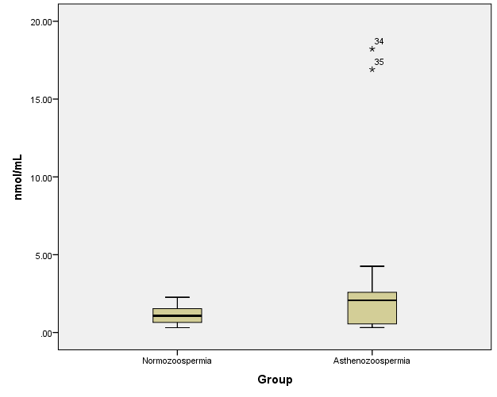

Slide 41
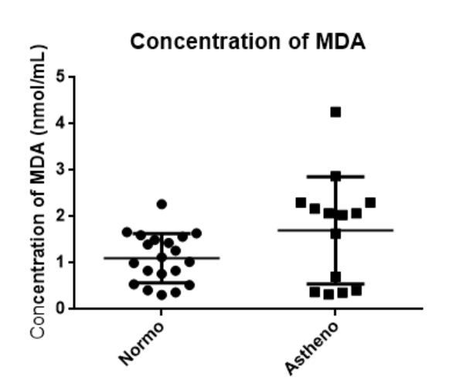
Result
p value = 0.488
Significantly correlated
Faculty of Medicine, Universitas Indonesia. Debora Roselita Karo Sekali

Slide 42
Analysis
Parameter | Normo (n = 20) * | Astheno (n = 14) * | p value
Age (years) | 34.1 + 6 | 33.1 + 5 | p > 0.05
Semen volume (mL) | 2.7 + 1 | 2.9 + 1.2 | p > 0.05
Seminal fluid volume (mL) | 1 + 0.5 | 1 + 0.4 | p > 0.05
Sperm concentration | 1.7 + 0.8 | 1.9 + 1.1 | P > 0.05
MDA concentration (nmol/mL) | 1.1 + 0.5 | 1.7 + 1.2 | p < 0.05
* Result are presented as mean + SD
Faculty of Medicine, Universitas Indonesia. Debora Roselita Karo Sekali

Slide 43
INITIAL HYPOTHESIS
There is association between concentration of malondialdehyde in seminal fluid and asthenozoospermia
RESULT OBTAINED
There is correlation between MDA Concentration in Seminal Fluid Analysis and Asthenozoospermia.
Faculty of Medicine, Universitas Indonesia. Debora Roselita Karo Sekali

Slide 44
Comparison with Other Similar Studies
Author | Seminal plasma MDA concentration (nmol/mL) |  | P-value | Method of measurement
 | Normozoospermia | Asthenozoospermia
Sekali (2016 -present study) | 1.1 + 0.5 * (Infertile normozoospermics) | 1.7 + 1.2 * | Significant (p = 0.048) | TBA with spectrophotometry
Zeba-Un-Naher (2011) | Median = 1.88 (0.5 – 5.37) (Fertile males) | Median = 3.17 (1.2 – 6.21) | P<0.001 | TBA with spectrophotometry
Colagar (2009) | 0.65 + 0.17 | 0.94 + 0.28 | P<0.001 | TBA with spectrophotometry
Tavilani (2005) | 1.2 + 0.3 * (normal healthy men) | 1.35 + 0.42 * | P<0.01 | TBA method with spectrofluorometry
Suleiman (1996) | 6.32 + 0.82 * | 6.62 + 0.65 * | Not significant | TBA with spectrophotometry
* Result are presented as mean + SD
Faculty of Medicine, Universitas Indonesia. Debora Roselita Karo Sekali
Notes:
It must be emphasized that these samples were assayed directly in the absence of promoters such as ferrous sulfate and ascorbate. The assay for sperm lipid peroxidation used in this study involves the measurement of MDA,

Slide 45
Discussion
  MDA correlates to POOR SPERM QUALITY including low motility.
  Supported by Colagar et al and Tavilani et al
    Lipid peroxidation affect the membrane transport activity and the surviving of sperm
    Lipid peroxidation and decreasing antioxidant capacity lead to low motility, morphology, and sperm count
Faculty of Medicine, Universitas Indonesia. Debora Roselita Karo Sekali
Notes:
It must be emphasized that these samples were assayed directly in the absence of promoters such as ferrous sulfate and ascorbate. The assay for sperm lipid peroxidation used in this study involves the measurement of MDA,

Slide 46
Discussion
2. PUFA is very susceptible to lipid peroxide and can be one of indicator of low sperm quality by damaging the sperm plasma membrane
Supported by by Vriese et al and Agarwal et al:
MDA is mainly attacking PUFA in sperm plasma membrane
MDA correlates with the sperm motility because peroxidative damage occur in the sperm membrane and axonemal proteins which cause the permanent impairment in sperm motility
Faculty of Medicine, Universitas Indonesia. Debora Roselita Karo Sekali
Notes:
It must be emphasized that these samples were assayed directly in the absence of promoters such as ferrous sulfate and ascorbate. The assay for sperm lipid peroxidation used in this study involves the measurement of MDA,

Slide 47
Discussion
3. There might be no significant correlation between semen volume, sperm concentration, and seminal plasma volume
Not supported by Pouramir et al stated that there is positive correlation between MDA and semen volume
  HOWEVER, it still needs higher samples to prove this finding and the control samples should be from fertile subjects
Faculty of Medicine, Universitas Indonesia. Debora Roselita Karo Sekali
Notes:
It must be emphasized that these samples were assayed directly in the absence of promoters such as ferrous sulfate and ascorbate. The assay for sperm lipid peroxidation used in this study involves the measurement of MDA,

Slide 48
Limitation
1. Selection of infertile males as the control group
2. Collection of only one seminal plasma sample for each subject
3. Prolonged storage time of the samples may decrease the concentration of MDA
4. Failure to collect 20 samples for each group
Faculty of Medicine, Universitas Indonesia. Debora Roselita Karo Sekali
Notes:
It must be emphasized that these samples were assayed directly in the absence of promoters such as ferrous sulfate and ascorbate. The assay for sperm lipid peroxidation used in this study involves the measurement of MDA,

Slide 49
Recommendation
1. Future research with the same topic should:
  choose healthy, fertile men as the control group.
  two or more samples for each subject should be taken.
  pay attention to the duration of storage
2. Research regarding the MDA in spermatozoa
3. Research regarding MDA and motility in bigger population size
Faculty of Medicine, Universitas Indonesia. Debora Roselita Karo Sekali
Notes:
It must be emphasized that these samples were assayed directly in the absence of promoters such as ferrous sulfate and ascorbate. The assay for sperm lipid peroxidation used in this study involves the measurement of MDA,

Slide 50
Acknowledgement
Professor dr. Mohamad Sadikin, D. Sc.
Faculty of Medicine, Universitas Indonesia,
Staff in Dept. of Biochemistry and Molecular Biology,
Dr. H. Indra G. Mansur, Sp.And.
Andrologists in RSIA Sayyidah and Budhi Jaya
Staff in Dept. of Biology in Faculty of Medicine, Universitas Indonesia
Faculty of Medicine, Universitas Indonesia. Debora Roselita Karo Sekali
Notes:
It must be emphasized that these samples were assayed directly in the absence of promoters such as ferrous sulfate and ascorbate. The assay for sperm lipid peroxidation used in this study involves the measurement of MDA,

Slide 51
THANK YOU

