Slide 1
Multiple Solutions for Genomics and Pharmacogenomics
Yuhua Li, MD., PhD.
Shanghai Biotechnology Corporation (SBC)
global_market@shbiochip.com

Slide 2


SBC, one of the most systematic high-throughput
-omics service providers in China
Shanghai Biochip Co., Ltd. / National Engineering Center for Biochip at Shanghai :
  Established in 2001 with $45 million seed fund, a leading biotech company located in the heart area of Zhangjiang Bio/Pharma valley; With 10 acres land, 300+ full time employee, 7 buildings with 220K SQF (20k m²) lab space with GMP, GCP and GLP compliance facilities.
Shanghai Biotechnology Corporation :
  Established in 2008, formerly known as “ShanghaiBio Corporation (SBC) in China”. Effective July 1, 2011, its name was officially changed to be “Shanghai Biotechnology Corporation (SBC)”.
  As a CRO subsidiary of Shanghai Biochip Co., Ltd. /National Engineering Center for Biochip at Shanghai, Shanghai Biotechnology Corporation provides lab services with cutting-edge -omics technologies, partnering in genomics/ pharmacogenomics, and discovering biomarker for preclinical to clinical with leading global pharmaceuticals and biotech.
The clinic testing laboratory at SBC is a certified clinical PCR testing lab and provides services for molecular diagnostics, target therapy, predictive medicine and companion diagnostics.

Slide 3

Shanghai Biochip Co. Ltd
Company Background
Shareholders:
  Shanghai Venture Capital Co. Ltd.
  Shanghai Institutes of Biological Sciences (SIBS), Chinese Academics of Sciences (CAS)
  National Human Genomics Center at Shanghai
  Fudan University
  Jiaotong University
  Institute of Microsystems and Information Technology, CAS
  Rujin Hospital
  East Hepatobiliary Surgery Hospital
  BioStar Biochip Co., Ltd.
  Zhangjiang High-Tech Park Co., Ltd.

Slide 4
Our Vision
Deliver the highest quality, cost effective R&D solutions and clinical lab testing services to accelerate drug discovery efforts of global pharmaceutical, biotech and CRO companies with integrity and excellence.

Slide 5
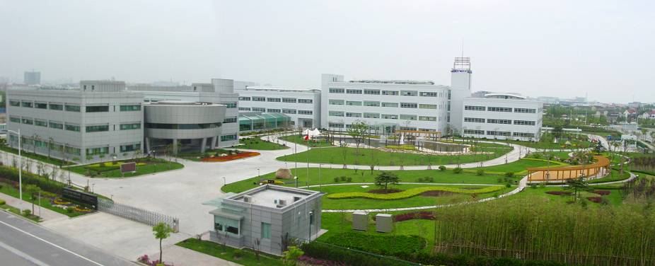
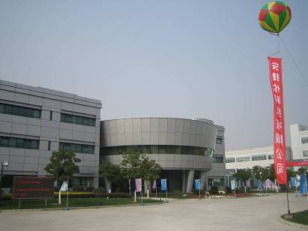
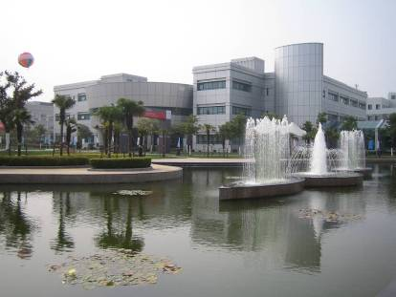

SBC Facilities

Slide 6
SBC Platforms
Microarray Platforms : SBC, Affymetrix, Agilent and Illumina
Next Generation Sequencing Platforms: Illumina HiSeq 2000/2500 and GAIIx, ABI Ion Torrent, Ion Proton, PacBio, SOLiD4 and 5500, and Roche 454
Biomarkers Testing and Validation Platforms: RT-qPCR, bDNA, sanger sequencing, luminex, protein microarray and ELISA etc.
Molecular Pathology Platforms: FISH, IHC, tissue microarray
Sample Quality Control Platforms: Agilent bioanalyzer, gel imaging and nanodrop
Bioinformatics/Biostatistics Platforms: SBC Analysis System (SAS) and commercial software

Slide 7
SBC Services and Capability
Microarray Analysis
Next Generation Sequencing
Biomarker Testing and Validation
Molecular Pathology and Clinical Lab Testing
Bioinformatics/ Biostatistics Analysis
Integrated Genomics and Pharmacogenomics Capabilities for Biomarker Discovery and Translational Medicine

Slide 8
Microarray Analysis Capability
Whole Genome SNP Genotyping
  Illumina Omni Whole-Genome Arrays
  Affymetrix Genome-Wide Human SNP 6.0 Array
  Affymetrix OncoScan™ FFPE Assay
Whole Genome Expression Array
  Affymetrix Human genome U133 Plus 2.0 array
  Affymetrix Human Transcriptome Array (HTA) 2.0
  Affymetrix GeneChip PrimeView Human Gene Expression Array
  Affymetrix Human Gene 2.0 ST Array
  Agilent Whole Human Genome Oligo Microarray
  Agilent SurePrint G3 Human Gene Expression Microarray 8x60K
  Illumina Whole-Genome DASL Ht-12 Assay-FFPE
miRNA Detection/Expression Microarray
  Agilent miRNA Microarray (human, mouse, rat), V19.0
  Affymetrix miRNA 4.0 Array (human, mouse, rat)
ADME/DMET Array
  Affymetrix DMET™ Plus Premier Pack
  Illumina VeraCode ADME Core Panel

Slide 9
Next Generation Sequencing Analysis Capability
Genome sequencing:
  Whole genome sequencing
  Whole exome sequencing
  Target gene capture sequencing
  Disease panel gene sequencing
Transcriptome sequencing:
  RNA sequencing (with or without reference genome)
  miRNA sequencing
Epigenome sequencing:
  ChIP sequencing
  MeDIP sequencing

Slide 10
Biomarkers Testing and Validation Capability
  RT-qPCR and genotyping using ABI 7900, ABI 7500, ABI 3730 xl and Roche COBAS
  Multiplex gene expression (bDNA ) assays using Panomics technology
  Sanger Sequencing on ABI 3730 xl
  FISH using Abbott ThermoBrite
  Protein biomarker assays using Luminex and ELISA
  Protein Microarray
  SiRNA screening for biomarker pathway validations

Slide 11
Clinical Molecular Testing Capability
  Early diagnostics
  Molecular tests for target disease therapy
  Companion diagnostics
  Biomarker discovery and validation including but not limited to: ALK, BCR/ABL1, BRAF, BRCA1, CYP2D6, CYP2C9, CYP2C19, del (5q), DPYD, EGFR, ERBB2, ESR1, PGR, ESR1, FIP1L1/PDGFRA, Her2, HLA-B, IFNL3, KIT, KRAS, Ph Chromosome, PI3K-AKT, PML/RARA, PTEN, TPMT, SERPINC1, UGT1A1, NAT1-2, VKORC1

Slide 12
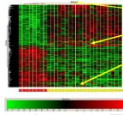

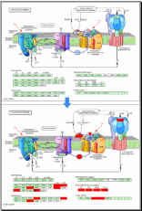
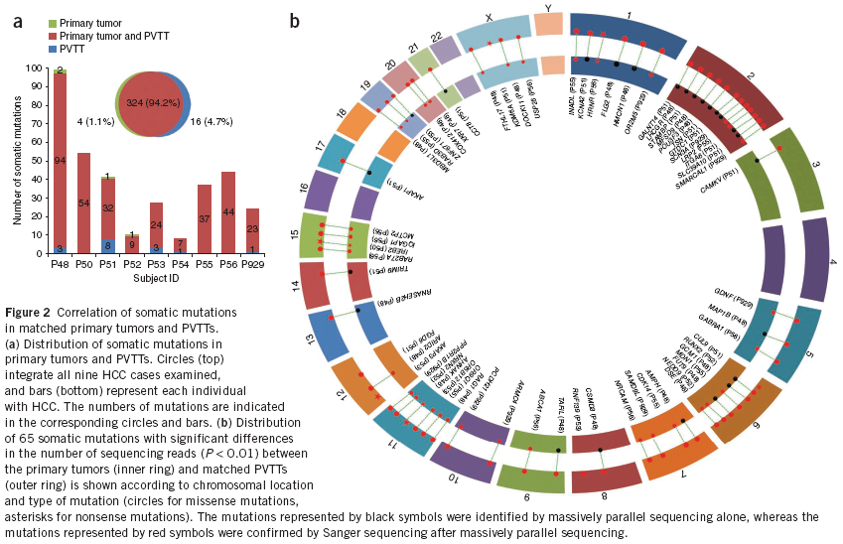
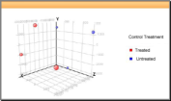
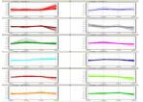

Bioinformatics Analysis Capability
Microarray data analysis
Online SBC Analysis System (SAS)
Gene expression microarray data analysis
miRNA microarray data analysis
lncRNA microarray data analysis
Methylation microarray data analysis
SNP microarray data analysis
aCGH microarray data analysis
NGS data analysis
Whole exome seq data analysis
RNAseq data analysis with reference genome
RNAseq data analysis without reference genome
miRNA seq data analysis
Methylation seq data analysis
Nature Genetics 2012

Slide 13
Distinguishing features of the biotechnical services at SBC
Integrated and high-throughput:
Genomics-Transcriptomics-Epigenomics-Proteomics
Flexibility: multiple platforms, species, formats and forms
Multiple platforms : Affymetrix、Agilent、Illumina、Life Technologies、Roche、SBC ……
A variety of Technologies：NGS, Microarray, qPCR, FISH, IHC…….
A variety of species : Animals, plants , Microorganisms……
A variety of applications: Human diseases，animal and plant diseases and breeding…….
A variety of formats：1×，2×，4×，8×，12× ……
A variety of forms： Commercial products + custom products
Integrated
and
High-throughput
Flexible
Stable
Stability: More than 10 years established technology platforms,
engaged technical services with well trained staff, custom supports, marketing/sales network and QA systems.
Since 2004, SBC and its clients have published >500 papers with total impact factor >2000

Slide 14
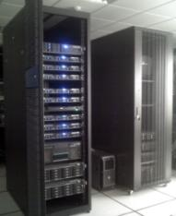
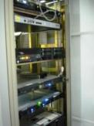
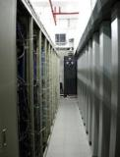
IT Support
Hardware - high performance computing system + high speed network + efficient data storage
Data mining, storage, backup, and transfer under secured controls
Part 11 like compliance
Data Backup Facility
China Telecom in WuXi, (Jiangsu)
IT Center in SBC

Slide 15
Sample Logistics
Origin of samples – inside and outside China
Sample import, green channel permit logistics
Samples are shipped at customer specified temperatures
All outside China sample shipments – World Courier
Anonymization or de-identification of samples
Well established sample handling protocols in the laboratories
Specific freezer operation and maintenance
Documentation of storage and withdrawal
Sample destruction logistics

Slide 16
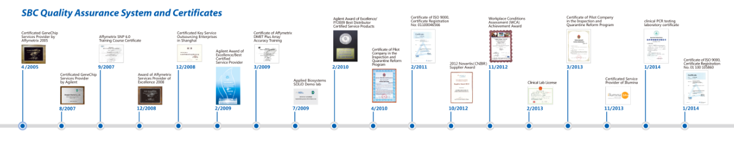
Quality Assurance System in SBC
Strict quality standards: we monitor sample management, project processes and lab tests strictly following 128 SOPs.
Complete experimental records: ensure all the records available for backtracking.
Multiple quality controls (3-step QC): QC on lab test, data analysis and project management, to ensure high quality data.

Slide 17
Certificates and Accreditations (selected)
Certificate of ISO 9001:2008
Business License
Clinical lab License
Certified Clinical PCR Testing Lab
Trade License
Custom Import and Export Business Certificate
Custom Clearance Certificate
Certificate of High-tech Enterprises
Certificated Key Service Outsourcing Enterprises in Shanghai
Certificate of Shanghai Pathogenic Microbiology Laboratory
Certificate of Pilot Company in the Inspection and Quarantine Reform Program
Certificate of Affymetrix DMIT Array Accuracy Training
Applied Biosystems SOLiD Demo lab
Certificated GeneChip Services Provider by Agilent
Certificated GeneChip Services Provider by Affymetrix
Certified Service Provider (CSPro) by Illuminas
Supplier Award by Novartis 2012
Award of Excellence/Agilent Best Certified Service Provider in Genomics
Award of Affymetrix Service Provider of Excellence
Award of Excellence/Agilent Best Distributor for Certified Service Products

Slide 18
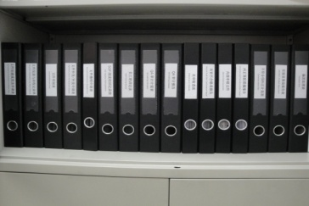
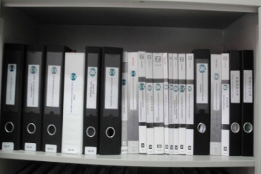
Quality Control on Experiment
Strict quality standards:
Perform lab tests strictly following 128 Chinese-English bilingual SOPs.
Selected Administration SOPs
S0001 Quality Objective
S0002 Quality Assurance
S0003 Document Control
S0004 Format and Guidelines for Standard Operating Procedures
S0005 Document Control Numbering
S0006 QA Auditing Procedures
S0007 Security Assurance
S0008 Staff Training Management
S0009 QA Management Archival Process and Security
S0010 Records Management
S0011 Deviation Management
S0012 Laboratory Incidents Reports
S0013 Preparation for Quality Assurance Audits and Responding to Audit Reports
S0014 Supplier Assessment and Management
S0015 Management of Customer Complaints
S0016 Proficiency Testing
S1017 Business Continuity/Recovery Plan
S0018 Outsourcing Project Management
S0019 Handling of Fraud
S0021 Customer Satisfaction Survey
S0024 Quality Assurance and Performance Improvement
S1044 Procedures for Sample Receiving, Storage, Delivery and Destroy
SOP (ADM)
SOP (LAB)
SOP (IT)
Record of Documentation
Development/Revision
Record of Document Review
Record of Deviation Report
Record of Laboratory
Incident Report
Records of ADM Document
Record of Equipment Calibration
SOP Reading Training Record
SOP Distribution and Return Record
Internal Audit Document
QA Audit Report
Corrective Action Plan
Customer Complaints Form
Complete experimental records:
Ensure all the records available for backtracking.
Multiple quality controls (3-step QC):
QC on lab test, data analysis and project management, to ensure high quality data deliverable to clients

Slide 19



Data Management and Report
Data backup in our secured servers
Data management following Part11 guidelines
Data upload through our secured FTP or sponsors secured FTP
External hard disks/DVDs/CDs locked with pass code
Email for small size data files with pass code
Our IT system strictly protect data and ensure analysis, storage, backup and transportation safety
Test report（e-copy）
Project summary report (hard copy)
upload to secured FTP
following SOPs to ensure account and data safety
Data and test report
Notes:
19

Slide 20







Publications
Since 2004, SBC and its clients have published more than 500 papers with total impact factor >2000
Number of Papers
Year
Impact Factors
Year

Slide 21
Case Study (1)
Consortium Project Collaborating with ACRG (Asian Cancer Research Group) members (Pfizer, Merck and Lilly)
  SBC’s responsibilities:
    Inviting and coordinating three pharmas to plan the ACRG project since 2008
    Writing SOPs for sample collections, clinical info and follow-up data collections, and all analysis platforms
    Microarray analysis using Affymetrix U133 plus 2.0, SNP 6.0 for 2000 samples from lung and gastric Asian cancer patients with full clinical info and follow-up data
    TMA constructions and biomarker assays (IHC, etc) for selected target genes

Slide 22
Case Study (2)
Integrated sample collections, Omics , and biomarker analysis for top large pharmas’ biomarker discovery projects
  SBC’s responsibilities:
    Custom sample collections from hospitals or search matched samples from our tissue bank
    Generate Omics data using combined array platforms of gene expression, SNP, microRNA, DNA methylation, etc
    Generate Next-Gen sequencing and data analysis
    qPCR/genotyping/mutation sequencing for selected target genes
    Protein biomarker analysis using Luminex for selected Cytokine analytes
    Make TMAs and IHC/FISH for selected biomarkers
    Submit raw data and QC report to sponsors
    Advanced data analysis for sponsors if needed

Slide 23
Case Study (3)
Real-time clinical biomarker service, screen patients for global Phase III clinical trial in China
  SBC’s responsibilities:
    Collect FFPE samples from multi-centers of hospitals in China
    Train pathologists in multi-centers to prepare blocks and FFPEs following the SOPs
    Conduct validation project, results are consistent with other global testing centers
    Receive FFPE blocks or slides from multi-centers in China and log into LIMS (Day 1)
    Macrodisection tumor samples from FFPE slides (Day 1-2)
    RNA extractions for samples from FFPE and QC/QA (Day 3)
    RT-PCR (Day 4)
    RT-PCR data report to sponsor's database for Sponsor to make therapy decision (Day 5)

Slide 24
Why SBC?
  Well-known CRO service provider in China and great facility in the heart area of Zhangjiang Pharma Valley in Shanghai
  More than 10 years experience in preclinical and clinical testing for domestic and global customers
  Integrated Microarray/PGx/NGS/Biomarker analysis platforms
  GLP/GCP Central lab capability for clinical sample testing, biobanking and clinical trial sample storage
  Comprehensive quality assurance system and QC procedures
  Data management following Part11 guidelines
  Green channel for sample import logistics
  high quality output, low service cost and short turnaround time
  Strong support from shareholders of top academic institutes and hospitals in China for extended capabilities

Slide 25
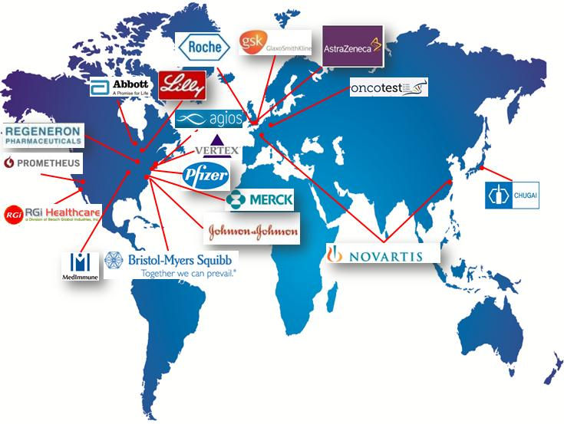
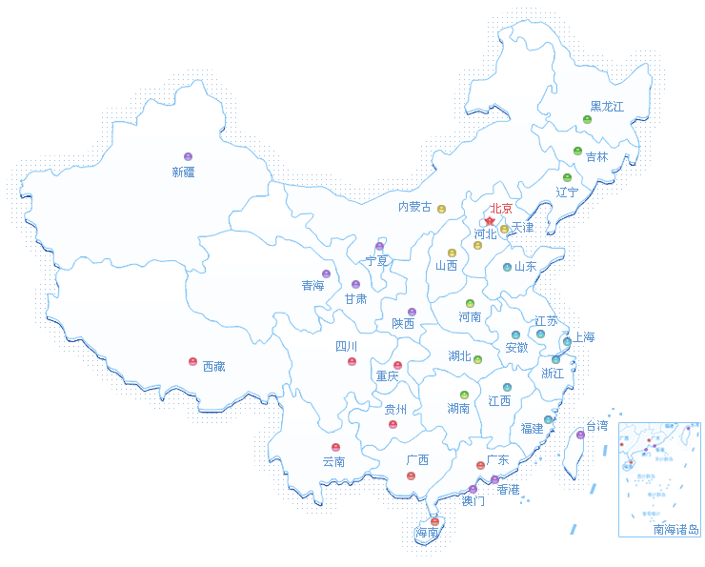
Client Locations
The services and data quality from SBC’s technical platforms have been widely recognized by domestic researchers and international Pharmaceutical companies.

Slide 26
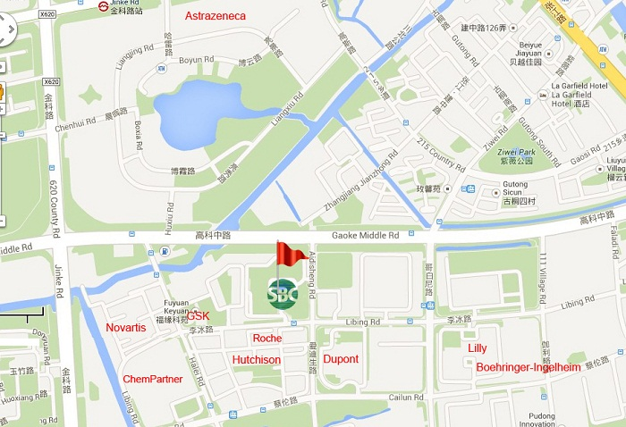
Contact SBC
Shanghai Biotechnology Corporation (SBC)
Shanghai Biochip Co., Ltd. /National Engineering Center for Biochip at Shanghai
151 Libing Road, Zhangjiang Hi-Tech Park, Pudong, Shanghai 201203, China
Tel:+86 800-820-5086 (China) / 404-276-8201(USA)
Email: global_market@shbiochip.com
http://www.shbiotech.org
http://www.shanghaibiotech.com

Slide 27
Thanks for your support!
We are looking forward to a successful collaboration with you.

