Slide 1
About Omics Group
OMICS Group International through its Open Access Initiative is committed to make genuine and reliable contributions to the scientific community. OMICS Group hosts over 400 leading-edge peer reviewed Open Access Journals and organize over 300 International Conferences annually all over the world. OMICS Publishing Group journals have over 3 million readers and the fame and success of the same can be attributed to the strong editorial board which contains over 30000 eminent personalities that ensure a rapid, quality and quick review process.

Slide 2
About Omics Group conferences
OMICS Group signed an agreement with more than 1000 International Societies to make healthcare information Open Access. OMICS Group Conferences make the perfect platform for global networking as it brings together renowned speakers and scientists across the globe to a most exciting and memorable scientific event filled with much enlightening interactive sessions, world class exhibitions and poster presentations
Omics group has organised 500 conferences, workshops and national symposium across the major cities including SanFrancisco,Omaha,Orlado,Rayleigh,SantaClara,Chicago,Philadelphia,Unitedkingdom,Baltimore,SanAntanio,Dubai,Hyderabad,Bangaluru and Mumbai.

Slide 3
Gold Nanorods
in Biological Imaging and Sensing
Y Chen
Department of Physics
University of Strathclyde, Glasgow, UK

Slide 4
Content
Introduction
Two-photon luminescence of gold nanorods in biological imaging
Surface plasmon enhanced energy transfer in biomedical sensing

Slide 5
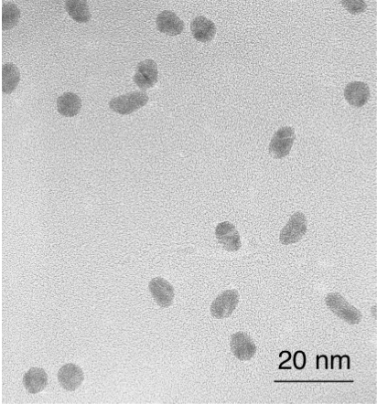
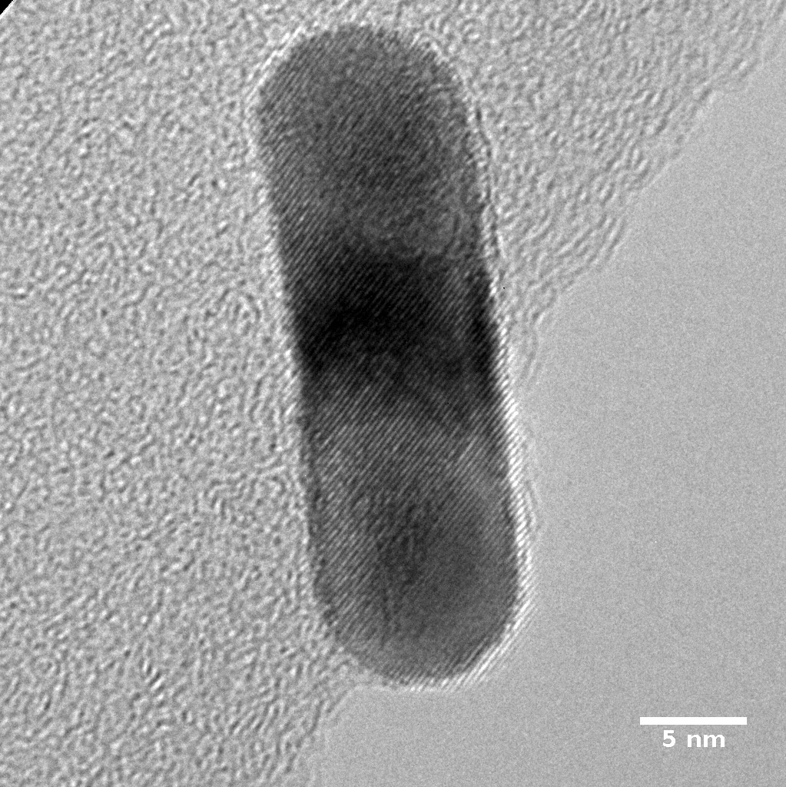

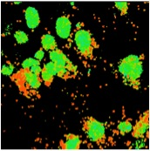
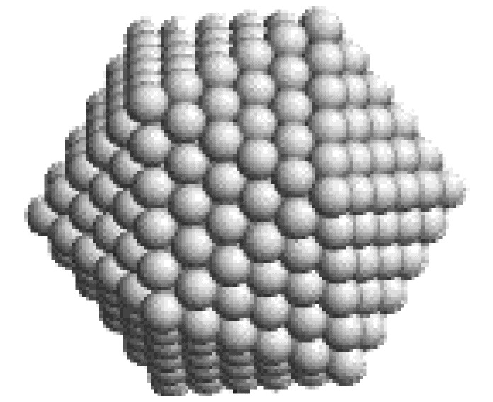
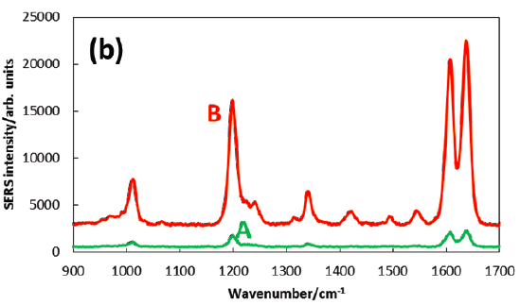
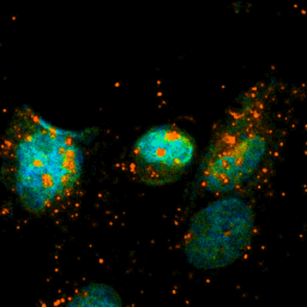
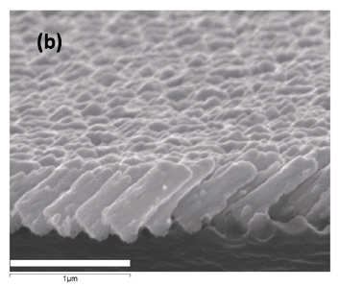
Synthesis
Luminescence
Bio-imaging
SERS
(a)
Noble Metal NP
Bio-sensing
0.05 ns-3.5ns
Toxicity
Toxicity
10 μm

Slide 6
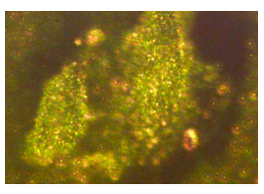
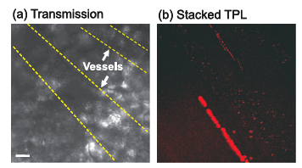
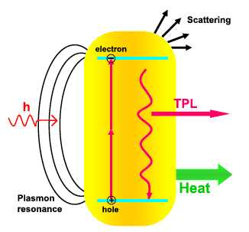
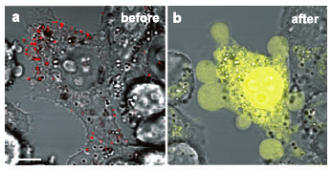
Biomedical Applications
Imaging
Advantages:
Easily prepared
Low toxicity
Readily attached to biomolecules
Unique optical properties
No photobleach problems
Sensing
Enhanced Raman Scattering
Surface energy transfer
Contrast agent for cellular imaging by darkfield microscopy
In – vivo two- photon imaging
Photothermal
therapy
Notes:
Strong and tunable absorption at visible and near – infrared dependent on size, shape and dielectric environment.
Strong two-photon luminescence due to plasmon-enhanced two-photon absorption
Intense photothermal properties resulting from nonradiative electron relaxation
Enhanced scattering for large nanoparticles.contrast for darkfield microscopy and

Slide 7
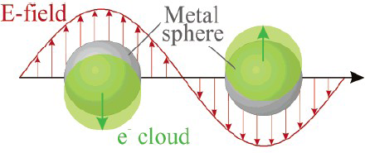
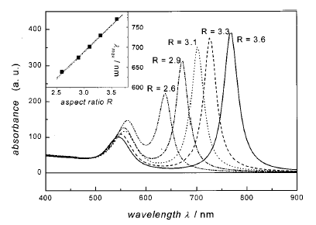
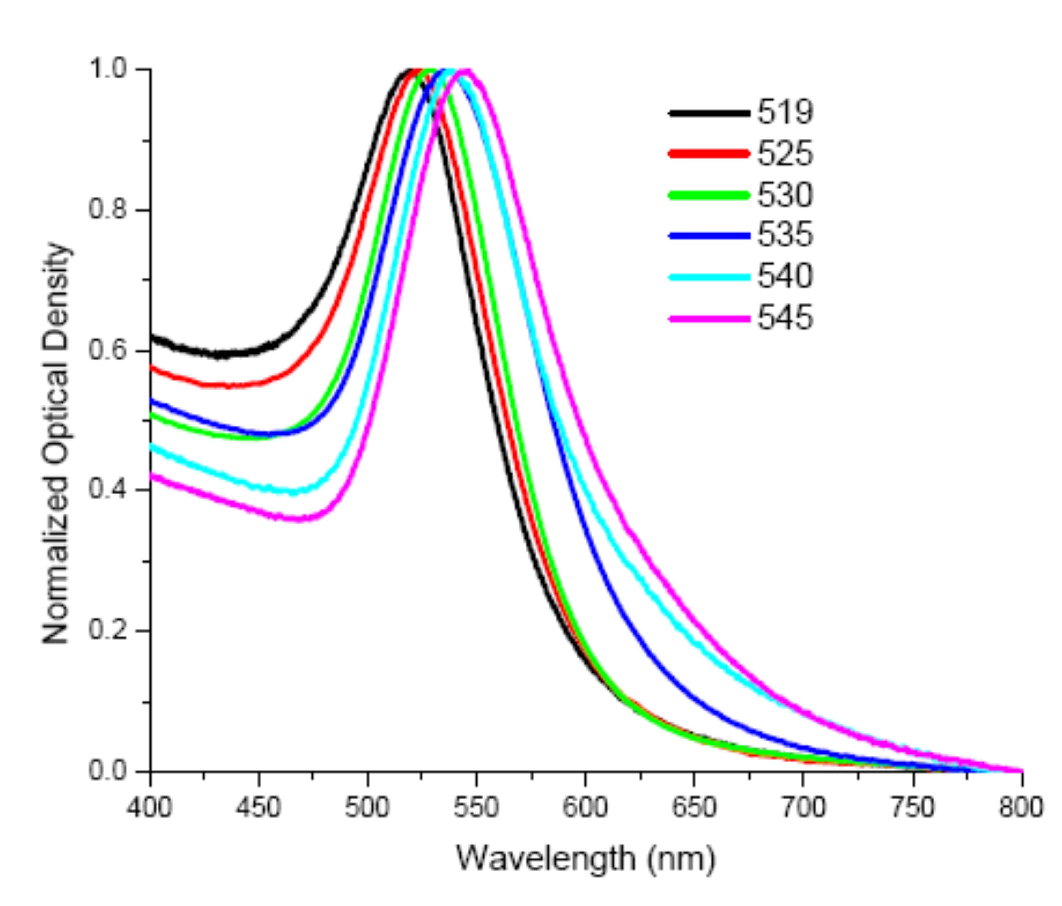
Surface Plasmon
Calculated absorption spectrum of elongated ellipsoids with varying aspect ratios R [from S. Link, et al, J. Phys. Chem. B, 103, 3073 (1999)].
Value of asymmetric nanoparticles (nanorods):
Tunable wavelength
Enhancement in the local electromagnetic field
PL enhancement
Polarization
Surface plasmon absorption spectra of spherical gold nanoparticles in different sizes.

Slide 8
Two Photon Luminescence (TPL) of Gold Nanorods
A quadratic dependence
scanning area 133µm x 133µm
Ex 800nm, 80MHz
Bandpass filter 535 – 560nm
400 500 600 700 800 900 1000 1100
Notes:
LSM 510, Carl Zeiss, TCSPC (SPC-830, Becker & Hickl GmbH) A femtosecond Ti:Sapphire laser (Chameleon, Coherent
Emission was collected by a 60x water-immersion objective (N.A.=1.0) and a bandpass filter with a transmission window from 535nm to 560nm
incident pulse power from 6.5 to 11mW

Slide 9
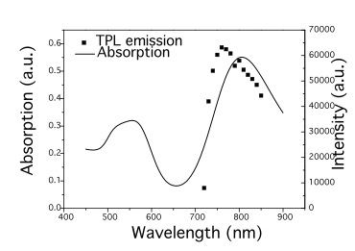
Two Photon Luminescence – shape
0 10 20 30 40
Incidence Power (mW)

Slide 10
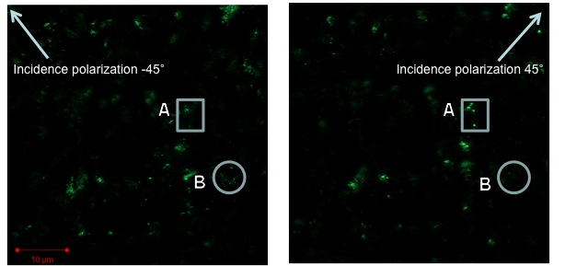
Two Photon Luminescence - polarization

Slide 11
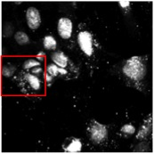
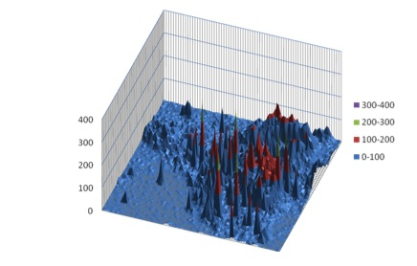
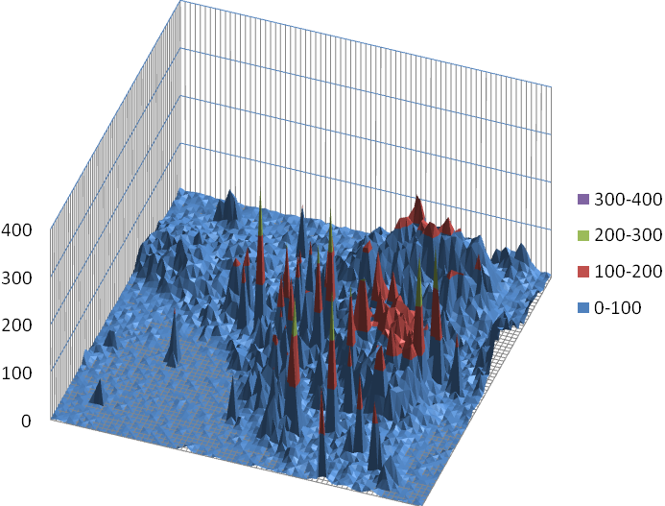
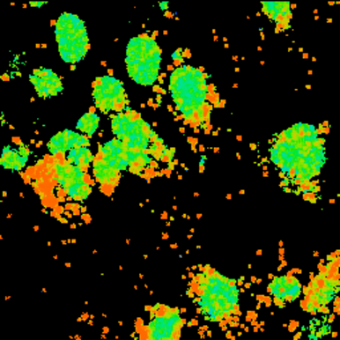
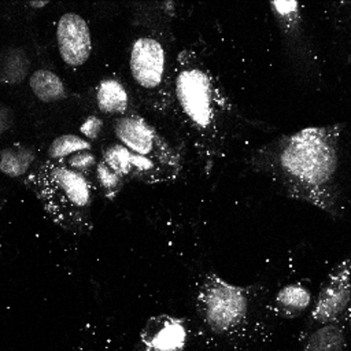
TPL - AuNRs in MDCK Cells
MDCK cells were treated with AuNRs
Incubated for 3 hrs
Washed and fixed
Stained with DAPI
67µm x 67µm
FLIM
FLIM
Intensity
Intensity
FLIM
Intensity
Notes:
elliptical shapes correspond to nuclei stained by DAPI. MDCK cells were treated with 100 μl of gold nanorods solution and incubated for 3 hours, washed thoroughly with phosphate buffered saline (PBS) to remove excess nanorods and fixed with 3.7% paraformaldehyde. staining with 4'-6-Diamidino-2-phenylindole (DAPI),

Slide 12
Fluorescence Lifetime Imaging Microscopy (FLIM)
- AuNRs in MDCK cells
0
0 2 4 6 8 10
4.8 ns
0.0
1.0
2.0
3.0
4.0
5.0
Y. Zhang, J. Yu, D. J. S. Birch and Y. Chen, J. BioMed. Opt. 15, 020504 (2010)
67µm x 67µm
Notes:
Emission overlap, lifetime of AuNR, far away from DAPI. Better contrast, more information.
12

Slide 13
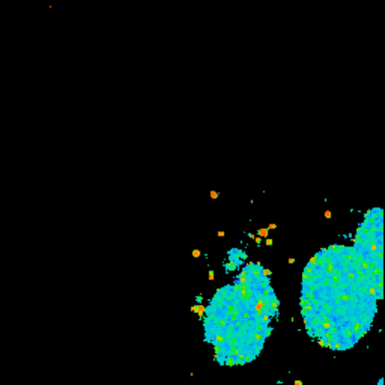
FLIM - AuNR in MDCK cells
C
GNR
A
B
DAPI+GNR
DAPI
Notes:
B can be fitted by bi-exponential model, ~100ps, 3 ns, overlay of emission from AuNR and DAP, suggesting the uptaken of AuNR by MDCK cells.
13

Slide 14
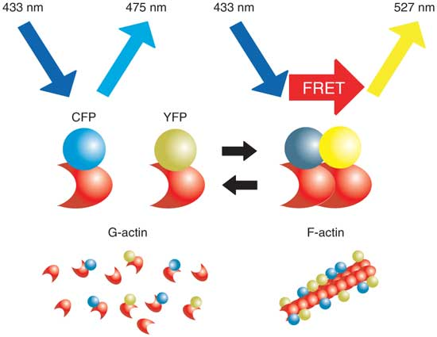
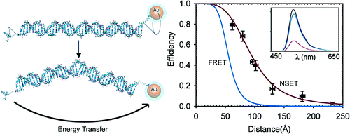
Energy Transfer as Molecular Ruler
Förster Resonance Energy Transfer (FRET)
Surface Energy Transfer (SET)
Notes:
great potential in biological imaging and sensing because of its dramatically extended length scale as the distance dependence scales at less than the inverse 6th power of dipole-dipole interactions

Slide 15
Surface Energy Transfer under Two-Photon Excitation
DAPI in solution, 1.7ns
DAPI in S1, 1.55ns (1ml GNR)
DAPI in S2, 0.9ns (1.4ml GNR)
Notes:
2ml 4.3μM DAPI solution was mixed with 1ml GNRs (S1), 1.4ml GNRs (S2), 1ml GNSs (S3), 1.4ml GNSs (S4) and 2.8ml GNSs (S5) solution.

Slide 16
SET from DAPI to GNR in Cells
0.05 ns-3.5ns
A
B
10 μm
DAPI in cells, 2.5ns
DAPI in A, 2.5ns
DAPI in B, 0.9ns
Y. Zhang, D. J. S. Birch and Y. Chen, Appl. Phys. Lett. 99, 103701 (2011)
Notes:
Two areas – AuNR close to DAPI.

Slide 17
SET from DAPI to GNR in Cells
0.05 ns-3.5ns
A
B
10 μm
DAPI in cells, 2.5ns
DAPI in A, 2.5ns
DAPI in B, 0.9ns
Y. Zhang, D. J. S. Birch and Y. Chen, Appl. Phys. Lett. 99, 103701 (2011)
Notes:
Two areas – AuNR close to DAPI.

Slide 18
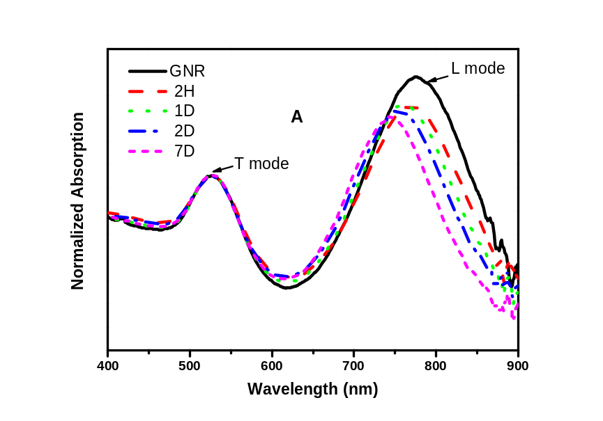
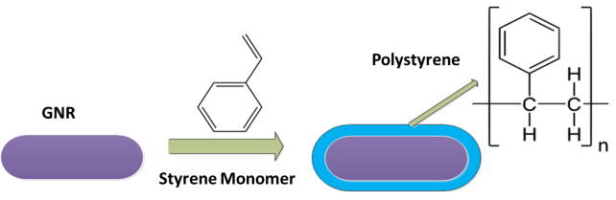
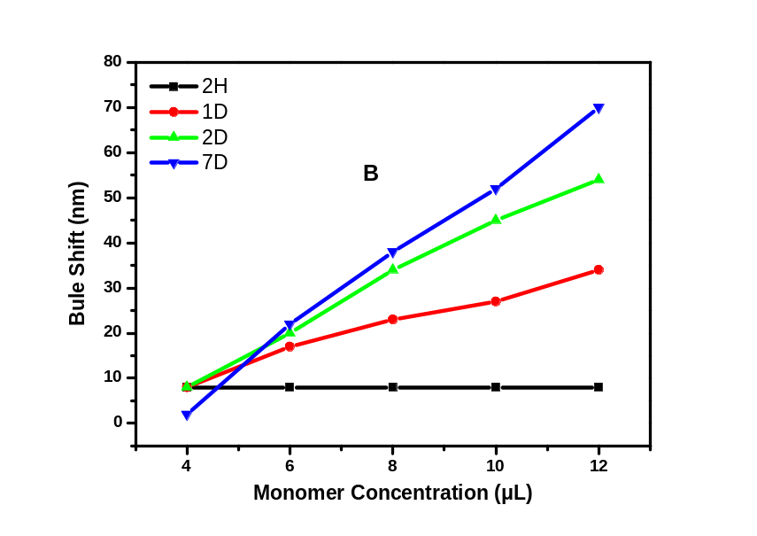
Dye-dope Polystyrene-coated Gold Nanorods
Scheme of polystyrene coating
P, Gu, D. J. S. Birch and Y. Chen, Methods Appl. Fluoresc. 2, 024004 (2014)
Notes:
Normalized UV-vis extinction spectra of PS-coated GNRs with monomer concentration of 12 µl after growth for 2 hours, 1 day, 2 days, 1 week, and original GNRs (all normalized against T modes); (B) and (C) the blue shift of L modes as a function of monomer concentration and time during PS-coated GRNs growth, respectively.

Slide 19
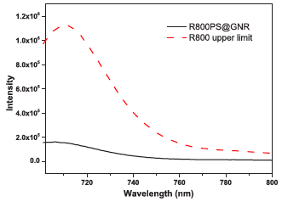
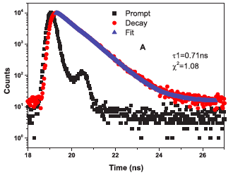
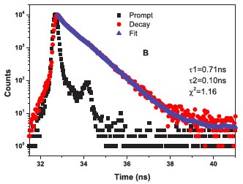
Surface Plasmon Energy Loss Compensation
A, 0.71ns
B, 0.71ns (85.8%); 0.10ns (14.2%)
Notes:
PDDAC

Slide 20
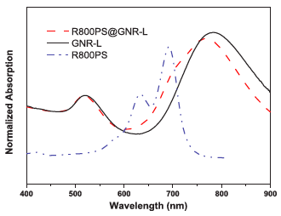
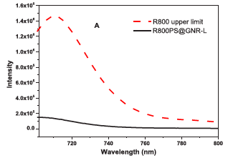
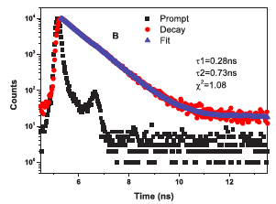
Influence of Surface Plasmon on Energy Transfer
A, 0.71ns
B, 0.73ns (95.8%); 0.28ns (4.2%)
Notes:
PDDAC

Slide 21
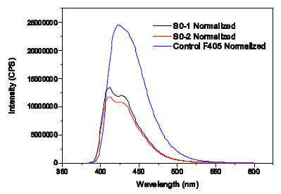
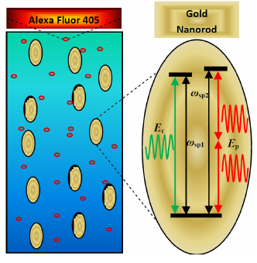
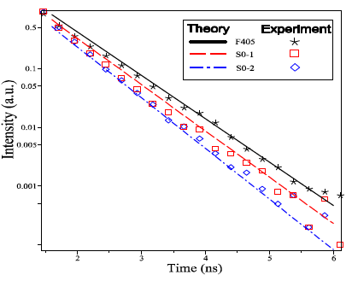
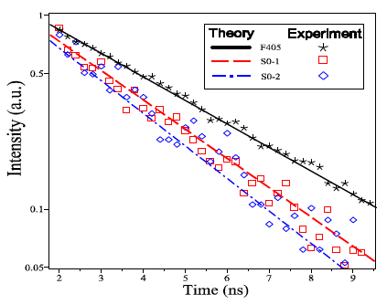
Alex Fluor405 – GNR Hybrid System
S01, AFD/GNR 3000:1
S02, AFD/GNR 6000:1
C. Racknor, M. R. Singh, Y. Zhang, D. J. S. Birch and Y. Chen, Methods Appl. Fluoresc. 2, 015002 (2014)
Notes:
S01, 500μl 0.21nM GNR+150μl AFD AFD/GNR 3000:1; S02, 500μl 0.21nM GNR+300μl AFD AFD/GNR 6000:1
Excitation 385nm. Lifetime measurement, one-photon 374nm with longpass filter 405nm; two-photon, excitation, 810nm
SET model, 1D metal – dipole; GNR, plasomon localized in 3D. Density matrix method. ET via diploe-dipole interaction

Slide 22
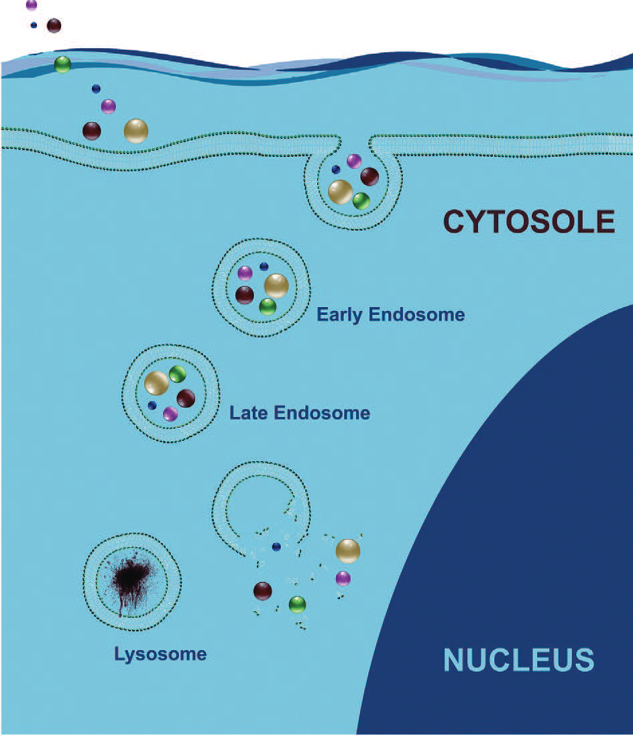
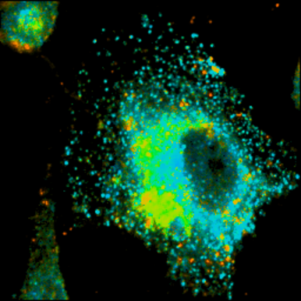
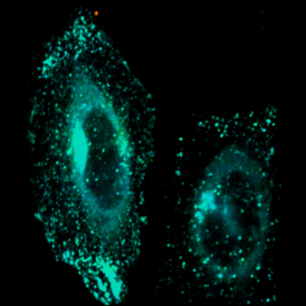
Intra-cellular Pathway
Early endosomes -- GFP
FLIM image of two-photon excited GFP stained HeLa cells, incubated with AuNRs for 60mins.
Notes:
Endocytosis Pathway

Slide 23
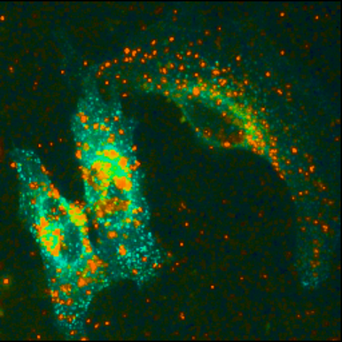
GNR Cellular Uptake - Endocytosis Pathway
10 μm
Multilayer coated gold nanords in HeLa cells, incubate time 60min
Notes:
PDDAC

Slide 24
GNR Cellular Uptake - Endocytosis Pathway

Slide 25
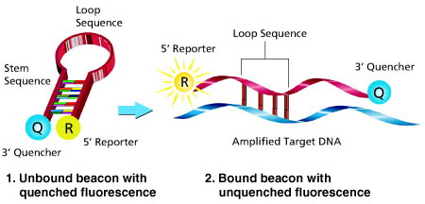
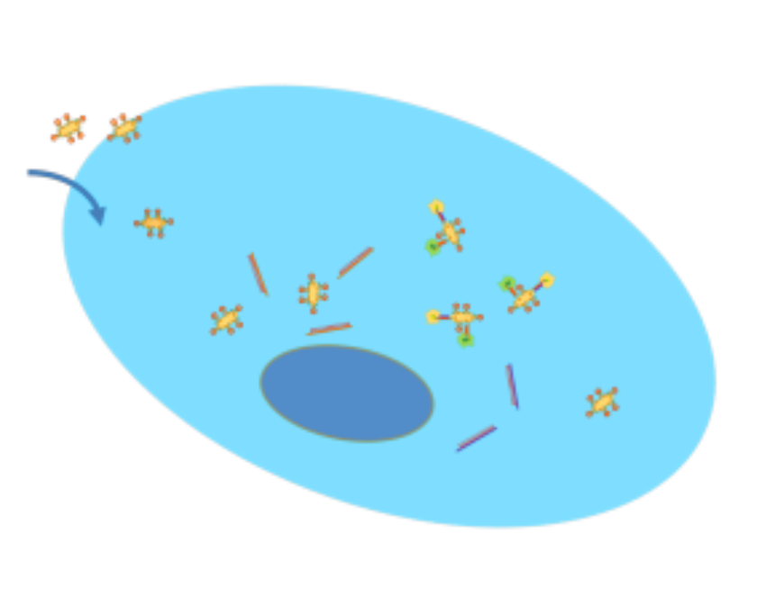
GNR Based RNA Nanoprobes
Molecular beacon
Disadvantages:
The quenching efficiencies of traditional organic quenchers usually vary significantly from one dye to another.
Require additional agents for cellular internalization.
GRN based RNA nanoprobe
Advantages:
Strong quenching
Long interaction range
Photostable
No need of transfection agent
TPL to trace nanoprobe
Multiple targeting
Potential for multifunctional platform

Slide 26
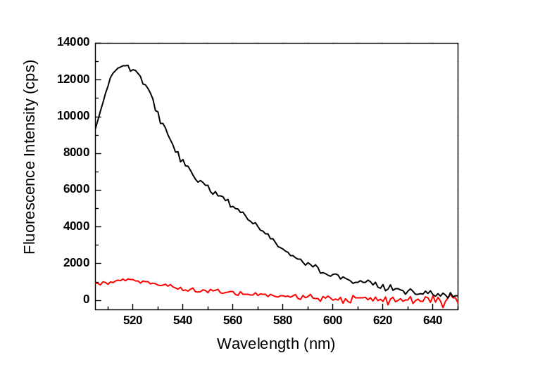
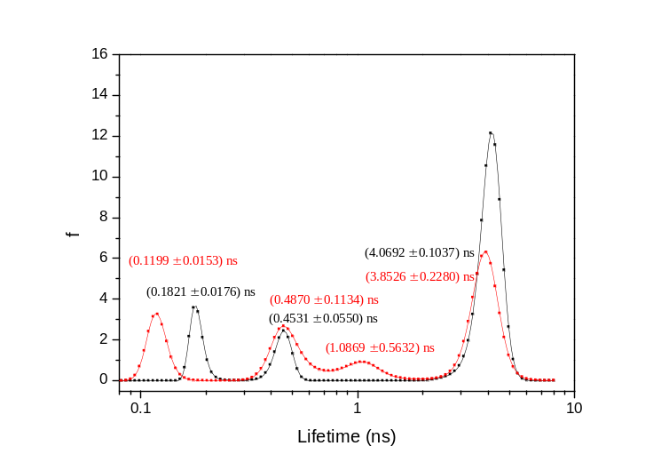
GNR Based RNA Nanoprobes
DNA design,
HS-5’TTTTTTTaaagttaacTTGGTGAAGCTAACGTTGAGGgttaacttt 3’ -Fluorescein
after
before
(a)
(b)
(c)
after
before
(d)
Notes:
Two-photon FLIM images of gold nanoprobes in (c) glioma (brain cancer) and (d) A549 cells (lung cancer). . A thiolated hairpin DNA (hpDNA) with a 6-carboxyfluorescein (FAM) label in the 3’ end (5’-HS-(CH₂)₆-TTTTT GCGAG TTG GTG AAG CTA ACG TTG AGG CTCGC-FAM-3

Slide 27
GNR Based RNA Nanoprobes
(B)
(c)
(d)
Kinetic measurements of hybridization of GNR-hpDNA (0.22 nM) with cDNA (880 nM )
Dose response of the nanoprobes (0.22 nM) with different surface packing densities of hpDNA.
Notes:
Two-photon FLIM images of gold nanoprobes in (c) glioma (brain cancer) and (d) A549 cells (lung cancer).

Slide 28
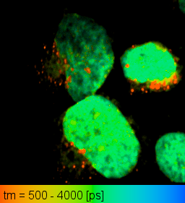
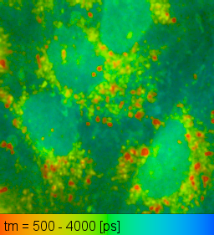
Uptaken of Nanoprobes by Tumor cells
(a)
(b)
(c)
(d)
Brain cancer cell
Lung cancer cell
Notes:
Two-photon FLIM images of gold nanoprobes in (c) glioma (brain cancer) and (d) A549 cells (lung cancer). . A thiolated hairpin DNA (hpDNA) with a 6-carboxyfluorescein (FAM) label in the 3’ end (5’-HS-(CH₂)₆-TTTTT GCGAG TTG GTG AAG CTA ACG TTG AGG CTCGC-FAM-3

Slide 29

GNR based RNA Nanoprobes
(c)
(d)
hpDNA
3.866
hpDNA+cDNA
3.929
GNR-hpDNA200
0.834
GNR-hpDNA200+cDNA
3.658
/ns
Notes:
Excitation wavelength: 485 nm; emission peak: 517 nm.

Slide 30
Summary
We have studied gold nanorods as luminescence label in MDCK cells by FLIM, which provides a better contrast and more detailed features than with that intensity imaging.
The characteristic short lifetime together with polarization of TPL from gold nanorods can be a promising imaging contrast agent for use in luminescence microscopy in biology.
Two-photon excited surface plasmon enhanced energy transfer between DAPI and AuNRs is observed in both solution phase and cell culture.
With comparable size and concentration, gold nanorods are shown to provide more efficient energy transfer than gold nanospheres. We attribute this transfer enhancement effect to the longitudinal surface plasmon mode of GNRs overlapping with the excitation wavelength.
The energy transfer provides more detailed information in biological studies using GNRs as fluorescence probes, especially when combined with the advantages of two-photon excitation microscopy and more intense TPL from GNRs, as demonstrated here in the study of intra-cellular trafficking of GNRs in HeLa cells via GFP labelled early endosome and mRNA sensing at single cell level.

Slide 31


Acknowledgements
Strathclyde University, UK
G. Wei
Y. Zhang,
D. B. J. Birch
J. Sutter
R. Martin
P. Edwards
Strathclyde Institute of Pharmacy and Biomedical Science
J. Yu
N. McGinely
Birmingham University
M. Di Vece
N. Lidgi
R. E. Palmer
CSIRO Materials and Engineering, Australia
A. S. Barnard
Western University, Canada
C. Racknor
M. R. Singh
Science and Innovation Award

Slide 32
Let Us Meet Again
We welcome all to our future group conferences of Omics group international
Please visit:
www.omicsgroup.com
www.Conferenceseries.com
http://optics.conferenceseries.com/

