Slide 1

Topical application of Jaungo in atopic dermatitis patients: Clinical Phase II study to explore new indications
Younghee Yun
CEO, CY Pharmaceutical Co., Ltd., Seoul, Republic of Korea
Cheong Yeon Medical Institute
Email: younghee.yun@cypharm.kr
Notes:
1
Thank you for the kind introduction,
Good morning everyone,
It¯s a great honor to make a presentation in this wonderful conference.
I am Yun Young Hee, CEO of CY, a Korean herbal pharmaceutical company
Today, I’m going to talk about a project which I have been involved with for the past three years.
The project is to perform a clinical trial to explore new indication of Jaungo, a herbal medicinal ointment.
Jaungo is previously licensed for other indications, our study is not a clinical trial that confirms the effectiveness of Jaungo on approved indiciations .
This is an exploratory clinical phase II study to explore the efficacy and safety of Jaungo on AD.
Therefore, through this presentation, I will be able to share with you the research design and progress of a phase 2a clinical study.

Slide 2
1
Introduction
2
Study setting and design overview
3
4
Study results
Discussion
Notes:
My presentation today consists of the following topics

Slide 3
1
Introduction
2
Study setting and design overview
3
4
Notes:
In introduction, I will talk about atopic dermatitis and previous researches of Jaunfo on AD briefly.

Slide 4
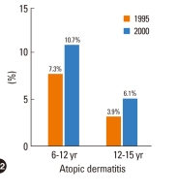
Atopic dermatitis
Atopic dermatitis (AD) is a common pruritic inflammatory skin disease.
The prevalence is increasing. It affects more than 10-20% of children in South Korea.
Major causes of atopic dermatitis
AD
Increased exposure to exogenous, endogenous antigens
Reduced barrier function
Altered immunity
Notes:
Now, I'd like to go into detail about atopic dermatitis.
Atopic dermatitis (AD) is a common pruritic inflammatory skin disease.
The prevalence is increasing. It affects more than 10-20% of children in South Korea.
The causes of atopic dermatitis are known as:
Altered immunity and reduced barrier function are fundamental to the development of AD.

Slide 5
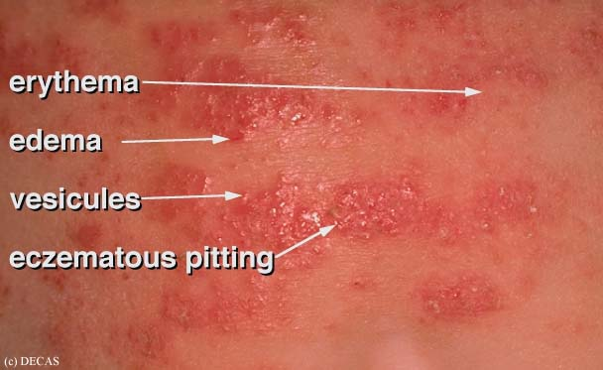
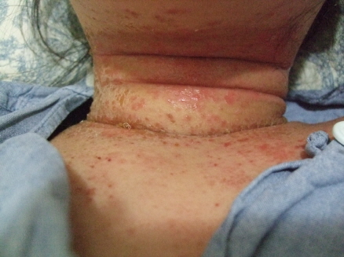
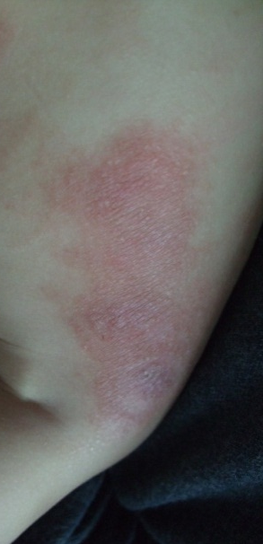
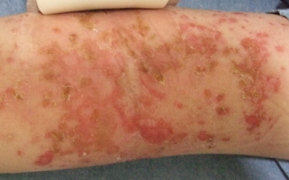
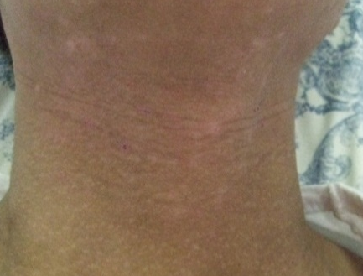
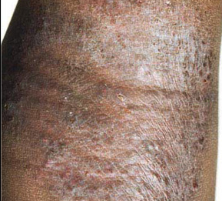
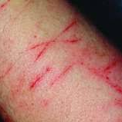
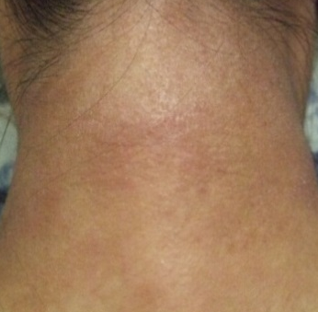
Atopic dermatitis symptoms
Symptoms of Atopic dermatitis vary significantly depending on the stage
Acute stage of AD
Chronic stage of AD
Dryness, Lichenification, Excoriation, Pigmentation
Notes:
Symptoms of Atopic dermatitis vary significantly depending on the e.
In the acute phase, AD manifests as erythema, edema, blisters, exudation, and crusting. and inflammation of acute stage is much more severe than chronic stage.
However, in the chronic stage, patient’s symptoms change. the main symptoms of AD include dryness, Lichenification, excoriation and pigmentation.

Slide 6
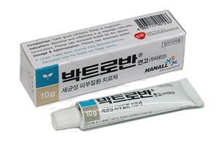
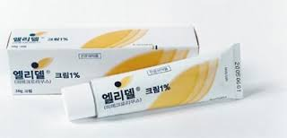
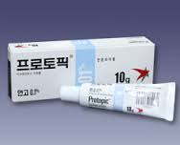
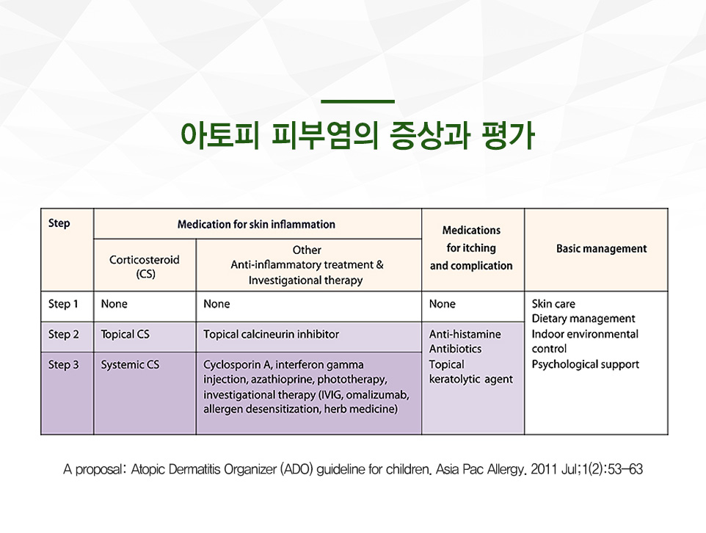
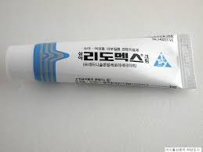
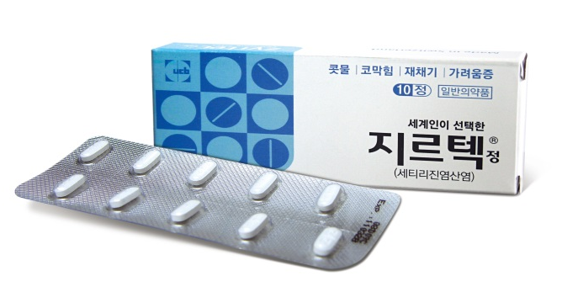
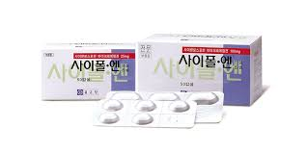
Standard treatment of atopic dermatitis
Notes:
To move on to the standard treatment of AD,
Topical anti-inflammatory steroidal agents are currently the most basic treatment.
In addition, topical calcineurin inhibitor, anti histamines, antibiotics and others can be prescribed according to the symptoms.
However, steroid ointment is still the core of therapy, and patients with chronic atopic dermatitis will use it for a long time.
Long-term use of steroidal agents carries the risk of side effects leading to the need for development of a new topical agents.

Slide 7
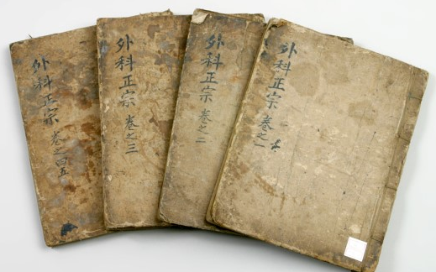
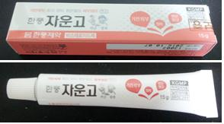
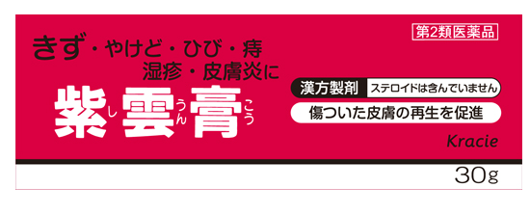
Jaungo
Jaungo was derived from the book ‘Orthodox Lineage of External Medicine' of the Ming Dynasty of China in 1617.
It composed of two herbs (Lithospermi radix, Angelica gigantis radix) and three carrier oils(sesame seed oil, bees wax, and swine oil).
It is approved by the KFDA for xerosis cutis, frostbite, miliaria, anal fissures, and rhus dermatitis.
Notes:
Now I'd like to briefly describe Jaungo.
Jaungo was derived from the book ‘Orthodox Lineage of External Medicine' of the Ming Dynasty of China in 1617.
It composed of two herbs and three carrier oils.
Both herbs have anti-inflammatory and anti-allergic effects, while the carrier oils have a moisturizing effect.
It is approved by the Korea Food and Drug Administration (KFDA) for xerosis cutis, frostbite, miliaria, anal fissures, and rhus dermatitis.
Currently, it is widely used in countries such as Korea and Japan.
Looking at the pictures below, the left side is Jaungo, which is manufactured by Han pung Pharma in Korea, and the right side is also Jaungo which is marketed in Japan by Kracie

Slide 8
Jaungo (紫雲膏, Shiunko)’s use on AD
Clinical Use of Jaungo in Patients with chronic AD
  dry skin, pigmentation, lichenification.
Previous studies of Jaungo in in vitro and in vivo AD models
  A (S)-(+)-decursin derivative, (S)-(+)-3-(3,4-dihydroxy-phenyl)-acrylic acid 2,2-dimethyl-8-oxo-3,4-dihydro-2H,8H-pyrano[3,2-g]-chromen-3-yl-ester, attenuates the development of atopic dermatitis-like lesions in NC/Nga mice. Mol Biol Rep. 2013;40(3):2541–8.
  Decursin and decursinol from Angelica gigas inhibit the lung metastasis of murine colon carcinoma. Phytother Res. 2011;25(7):959–64.
  Protective effects of decursin and decursinol angelate against amyloid beta-protein-induced oxidative stress in the PC12 cell line: the role of Nrf2 and antioxidant enzymes. Biosci Biotechnol Biochem. 2011;75(3):434–42.
Notes:
Jaungo is used for patients with atopic dermatitis, although it is not an approved indication.
Jaunggo is not effective for all atopic dermatitis symptoms, and is said to be particularly effective for chronic symptoms.
Previous studies of Jaungo in in vitro and in vivo AD models have demonstrated the anti-inflammatory and antiallergic effects.

Slide 9
Previous studies of Jaungo (紫雲膏, Shiunko) on AD
Previous studies of Jaungo in AD or dermatitis patients
  a case series in 1999 reported the effect of Jaungo on AD
  two clinical trials reported the effects of Jaungo on both radiation dermatitis in breast cancer patients and cutaneous leishmaniasis.
  However, there are few relevant randomized controlled clinical trials on Jaungo for the treatment of AD
    Efficacy of Shiunko for the treatment of atopic dermatitis. J Int Med Res. 1999;27(3):143–7.
    The efficacy and safety of Jaungo, a traditional medicinal ointment, in preventing radiation dermatitis in patients with breast cancer: a prospective, single-blinded, randomized pilot study. Evid Based Complement Alternat Med. 2016;2016:9481413.
    Exploratory, phase II controlled trial of Shiunko ointment local application twice a day for 4 weeks in Ethiopian patients with localized cutaneous leishmaniasis. Evid Based Complement Alternat Med. 2016;2016:5984709.
Notes:
To move on the human studies of Jaungo,
these is a case series,
two clinical trials of Jaungo on ad patients or other ad like dermatitis patients.
However, relevant RCT has not been conducted,
For these reasons, we have been conducting a clinical trial for the review of the clinical efficacy of Jaungo in atopic dermatitis.

Slide 10
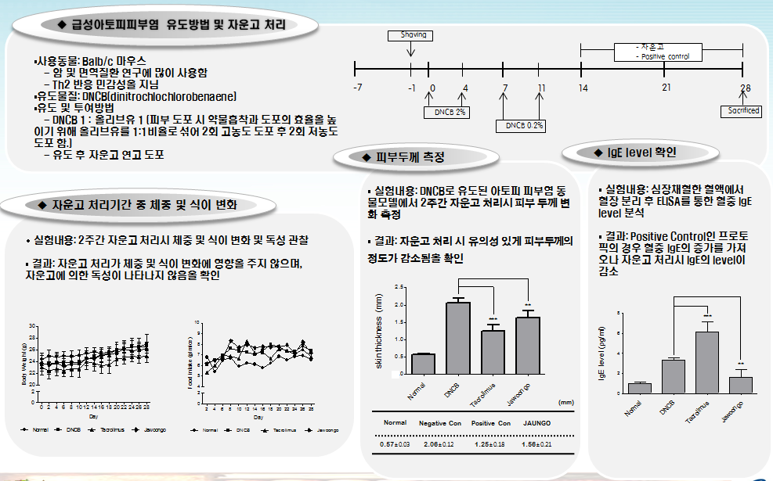
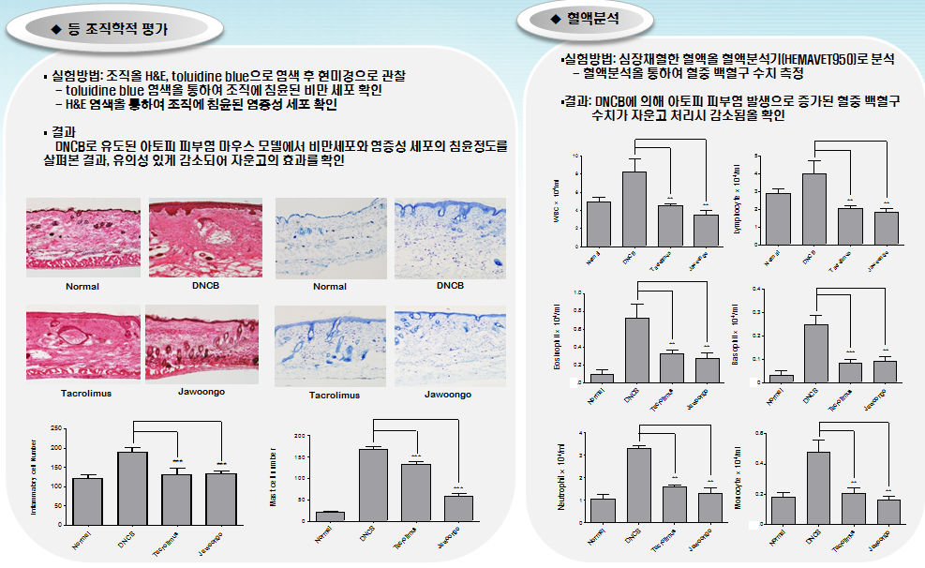
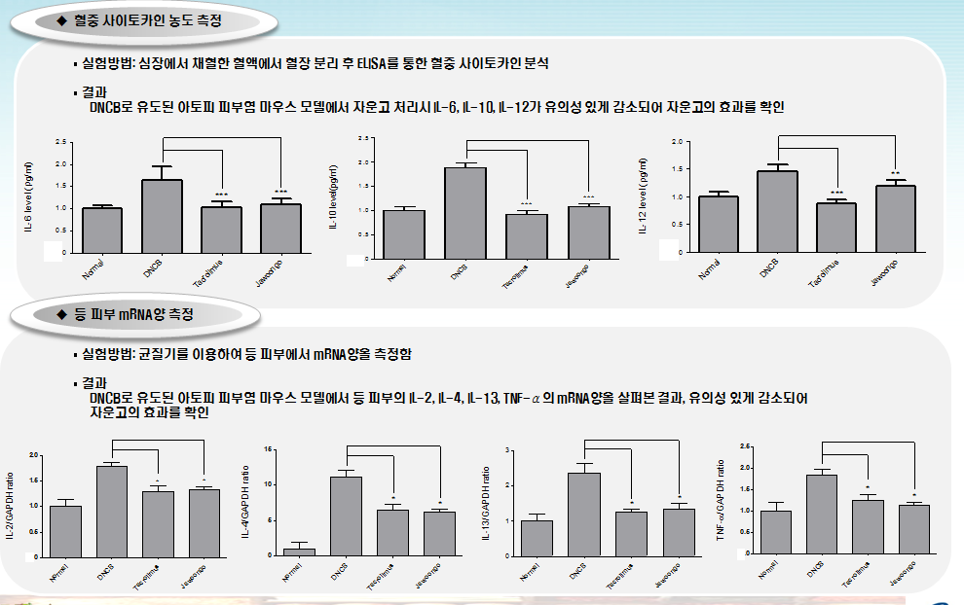
2차년도 연구성과 요약_비임상_자운고
The results of our research on animal models
Analysis of blood leukocyte count, IgE level, skin thickness, inflammatory cytokines and histologic changes revealed that Jaungo effectively alleviated the inflammation in animal models of atopic dermatitis.
Notes:
Since I am presenting the results of clinical trials today, I will not explain results of in vivo and in vitro studies in detail.

Slide 11
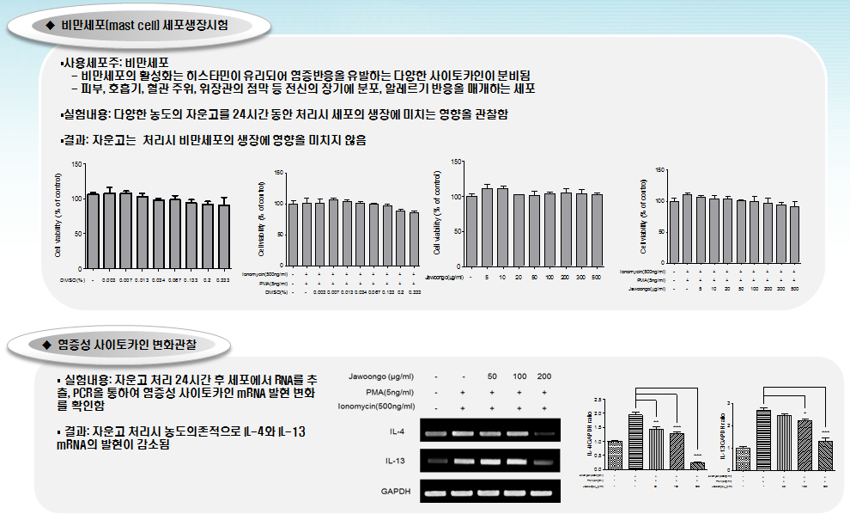
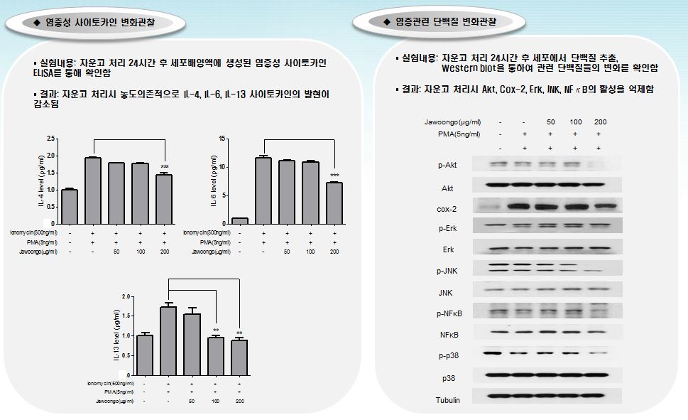
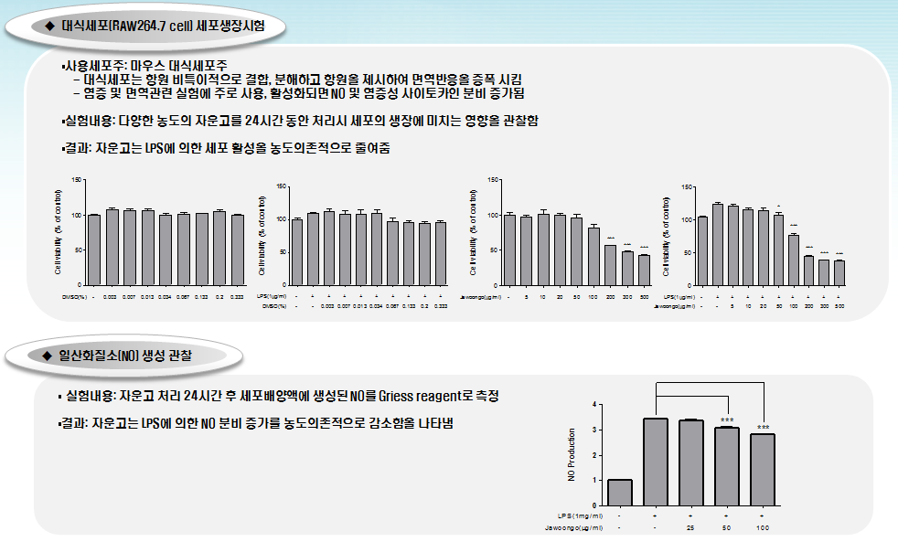
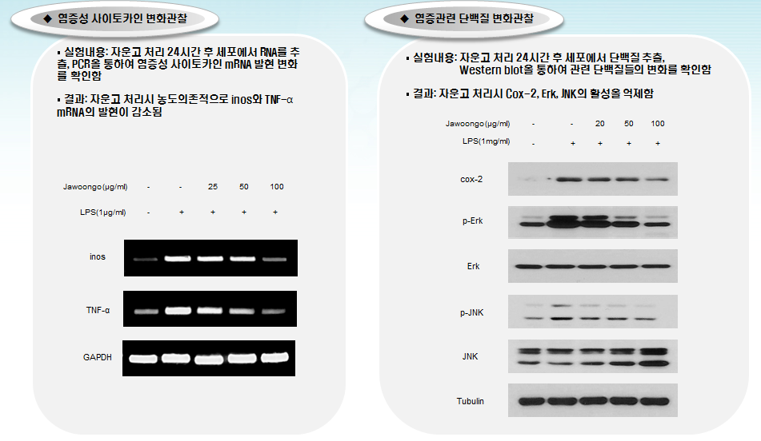
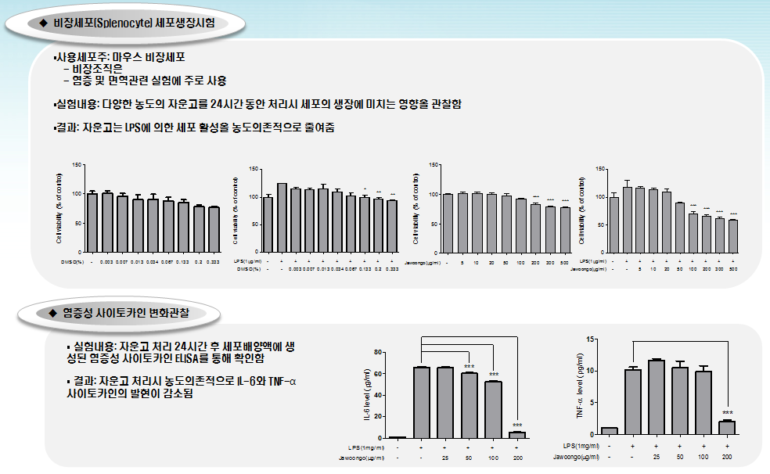
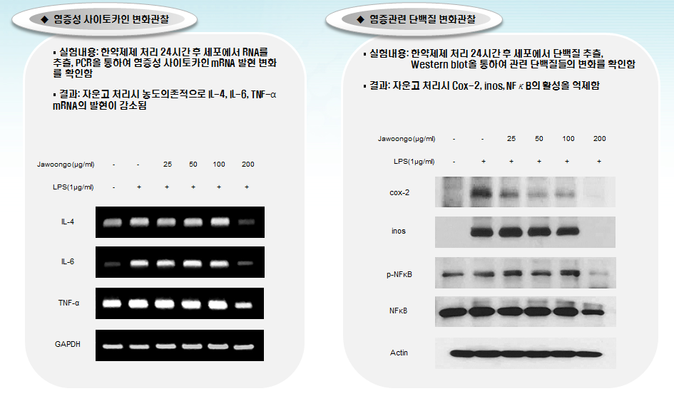
2차년도 연구성과 요약_비임상
The results of our research on animal models
HMC-1 cell line
RAW264.7 cell line
In the HMC-1 cell line, RAW264.7 cell line, spleen cells, it was confirmed that the level of cytokine and inflammation-related protein were decreased.
Splenocyte cell line
Notes:
human mast cell line is

Slide 12
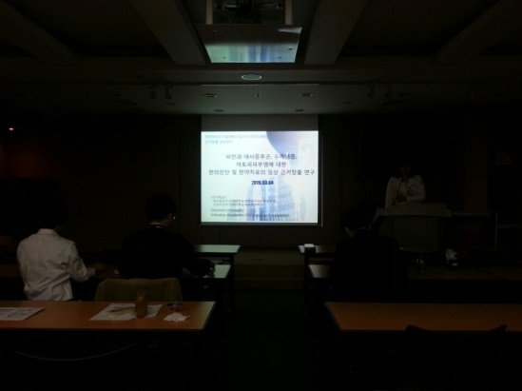
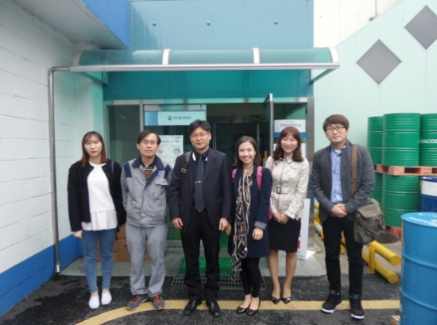
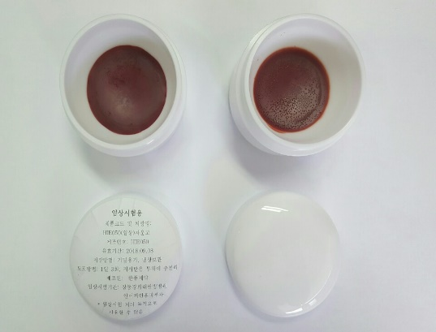
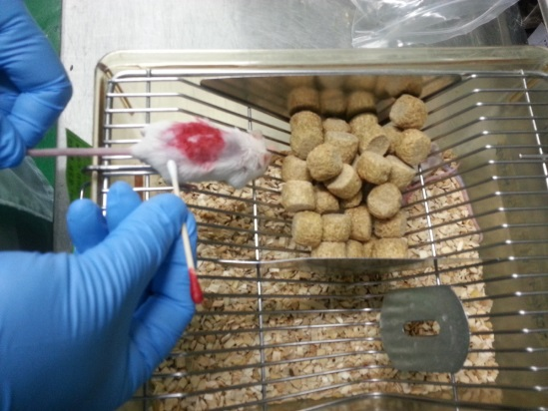
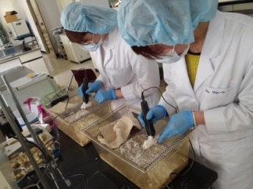
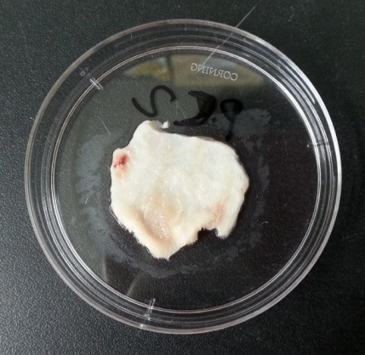

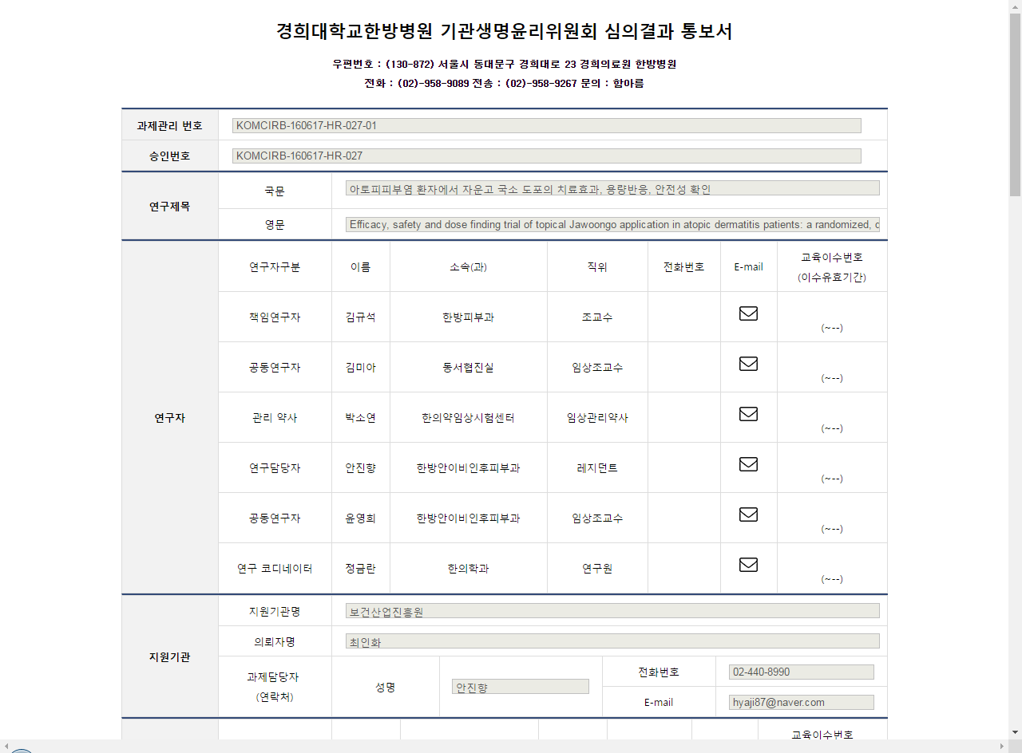
Steps
before clinical trials begin.
Notes:
Before moving on to the next slide, I am going to tell you the steps performed before the clinical trial.
- Reviewing the off-label use of Jaungo in AD patients among 5 hospitals
- manufacturing of placebo medication
- Performing animal and cell studies
- Application and getting approval of IND from KFDA, and getting IRB approval from a hospital.
were conducted prior to the clinical trial.

Slide 13
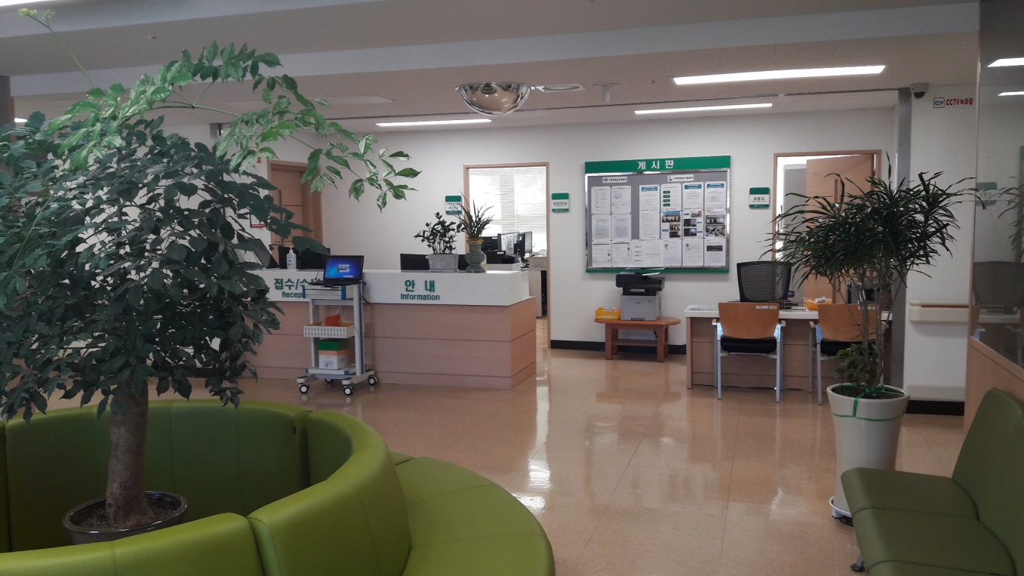
1
Introduction
2
Study setting and design overview
3
4
Notes:
Now let’s move on to the second part on the study setting and design overview

Slide 14
  Study design overview
Atopic dermatitis
Study site: Kyung Hee University Korean Medicine Hospital in Seoul, Korea.
Study design: a randomized, double-blind, placebo-controlled, single-center, phase IIa clinical trial
Study purpose: to investigate the safety, preliminary efficacy, and dose response of Jaungo for treatment of AD
Study period: September 2016 ~ March 2017
Expected participants number: 12 patients per group, 36 in total.
Julious SA. Sample size of 12 per group rule of thumb for a pilot study. Pharm Stat. 2005;4(4):287–91. doi: 10.1002/pst.185
Notes:
The number of participants to be recruited was 36, and the rationale was based on the following reference . We also considered the feasibility of the study.

Slide 15
Study participants
Inclusion criteria
  diagnosed with AD according to Hanifin’s and Rajka’s criteria
  men or women aged 5 years to below 65 years
  have mild-to-moderate AD symptoms according to the objective SCORing Atopic Dermatitis (SCORAD) Index (score ≤40)
  have scores of excoriation, lichenification, and dryness in the SCORAD Index of at least 1 each, or a sum of 3 or more.
Exclusion criteria
  lesions with oozing
  oral administration of corticosteroids, immunosuppressants, or antibiotics 4 weeks prior to study entry
  administration of topical GCs, immunosuppressants, or antibiotics, or phototherapy, 2 weeks prior to study entry
  burn or trauma on the lesions
  allergic to Jaungo, or its components
  active skin diseases without AD
  renal or liver dysfunction
  other uncontrolled chronic diseases
  pregnancy or breastfeeding
  participation in other clinical trials within 1 month of enrollment,
  inability to understand the written consent or to engage in this study due to mental impairment or other emotional or mental problems
  judgment by experts that the potential subject’s participation is inappropriate.
Notes:
We recruited patients with the following criteria: To summarize, people with chronic atopic dermatitis symptoms and also, have not used any medication that affects the our study.

Slide 16
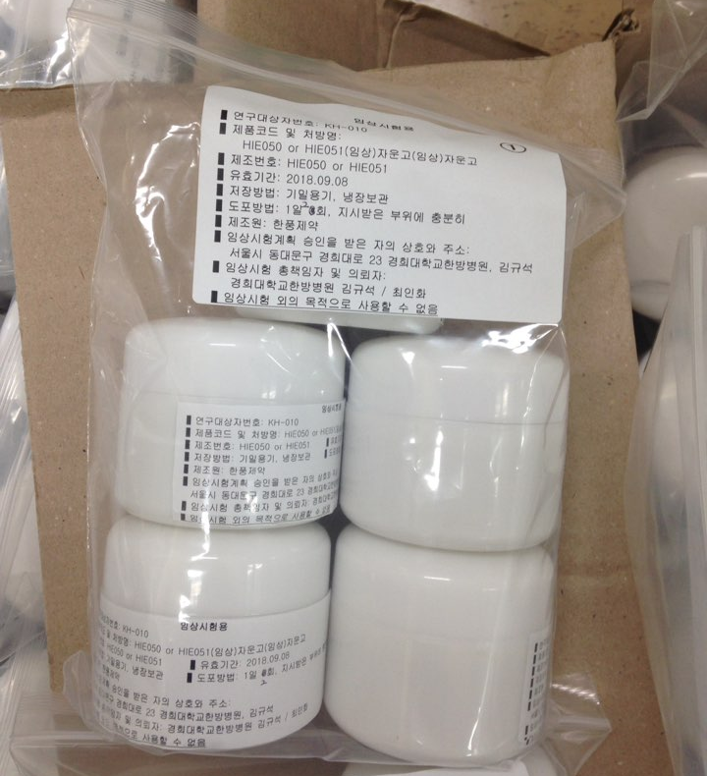
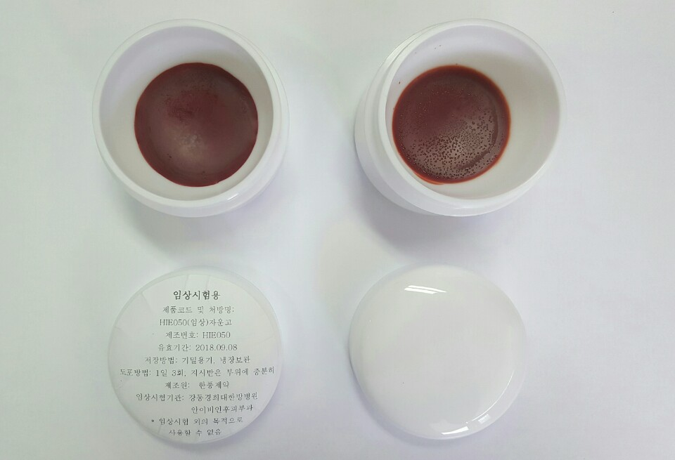
Study medication and Placebo medication
Notes:
The upper part of the left side is the figure of Jaungo which is currently on the market. The lower part is the placebo medicine of Jaungo and Jaungo itself which manufactured for this study. The placebo is manufactured to have the same shape, color, and scent as jaungo. When supplied to the patient, they are kept in the same container so that the patient can not be identified.

Slide 17
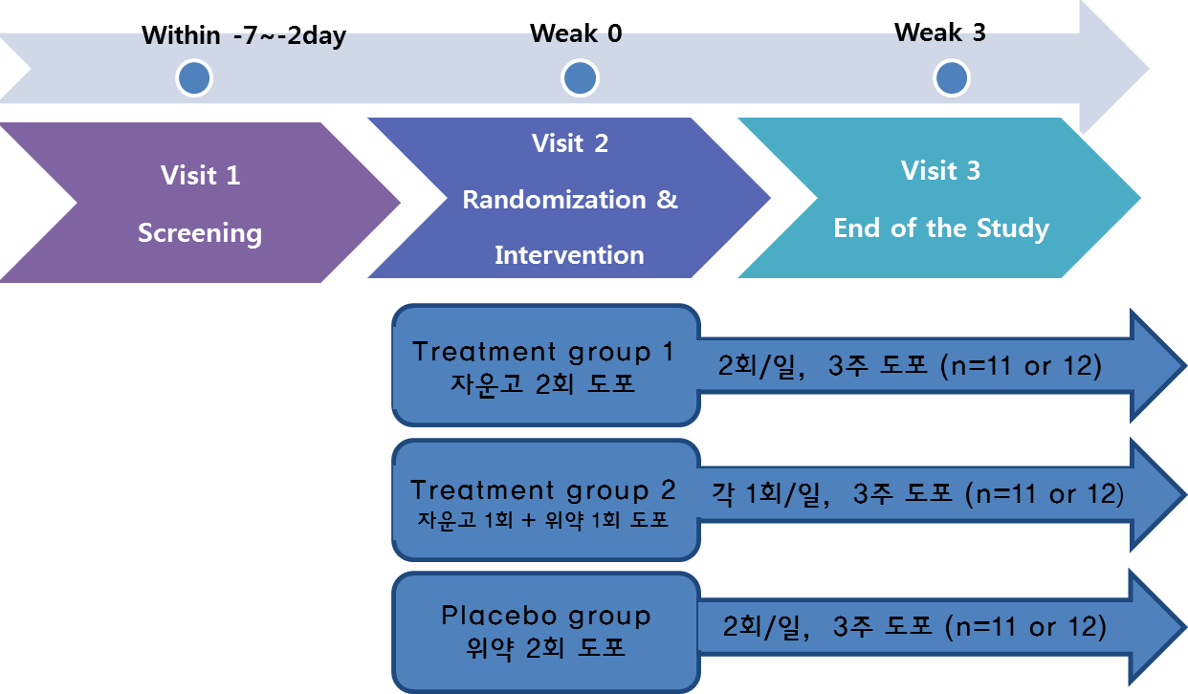
Intervention
Jaungo Twice/day
3 weeks
3 weeks
Jaungo 1 + Placebo 1
3 weeks
Placebo twice/day
Notes:
Here's an overview of the process: After a one-week screening period to determine if the participant is eligible, all eligible patients were enrolled.
Patients were randomly assigned to three groups. Treatment group 1 applied jaungo twice a day, treatment group 2 applied Jaungo and placebo one time a day each, and placebo group applied placebo ointment twice a day for 3 weeks.

Slide 18
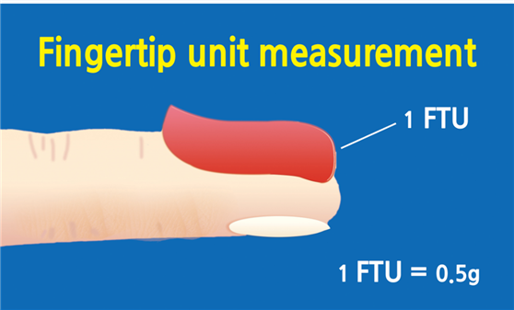
Intervention: Fingertip unit measurement
Area of skin to be treated | Palm-sized | FTUs each dose (adults) | FTUs each dose (child)
A hand and fingers (front and back) | About 2 palms | 2 FTUs (1 g) | 1 FTUs (0.5 g)
Front of chest and abdomen | About 14 palms | 14 FTUs (7 g) | 7 FTUs (3.5 g)
Back and buttocks | About 14 palms | 14 FTUs (7 g) | 10 FTUs (5 g)
Face and neck | About 5 palms | 5 FTUs (2.5 g) | 4 FTUs (2 g)
An entire arm and hand | About 8 palms | 8 FTUs (4 g) | 5 FTUs (2.5 g)
An entire leg and foot | About 16 palms | 16 FTUs (8 g) | 9 FTUs (4.5
Notes:
Clinical studies about topical medication are somewhat more different from orally administered medication.
First In patients with atopic dermatitis, the range of involved lesions is too different. The amount of medication that should be paid for each patient is different, and compliance should be assessed on a patient-by-patient basis.
Secondly, It is also not easy to educate patients to use a certain amount of medication per each lesion. Because each lesion has different size.
In this study, we presented fingertip unit measurements to patients and educated them the amount of each lesion to be applied using this table.

Slide 19
2
Study setting and design overview
3
4
Study results
1
Introduction
Notes:
Now let me explain the results of the study. The results of the study have been analyzed recently and some are still being analyzed.

Slide 20
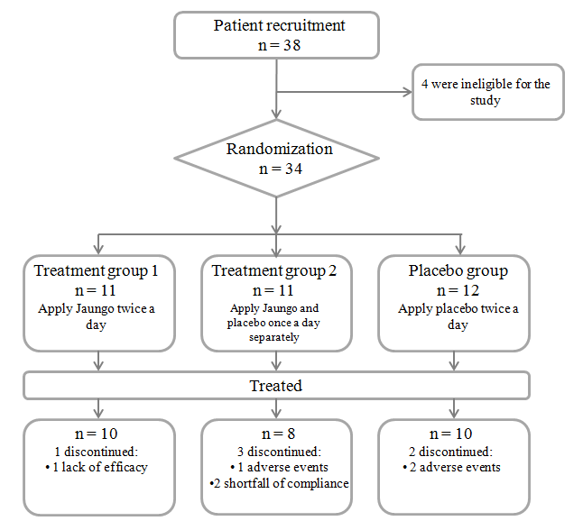
Study participants
Notes:
A total of 34 patients were enrolled in this study, except for the 4 patients who did not meet the selection criteria.
Patients randomly assigned to three groups.
11 participants were assigned to the Treatment1 group, and 10 participants completed the study. In Treatment group 2, 11 participants were registered and 8 participants were completed. Two were excluded from the analysis. Because I did not apply the medicine properly. In the placebo group, 12 participants were registered and 10 participants were completed.

Slide 21
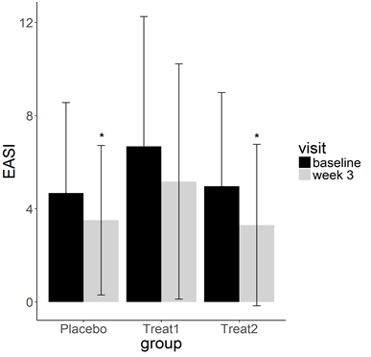
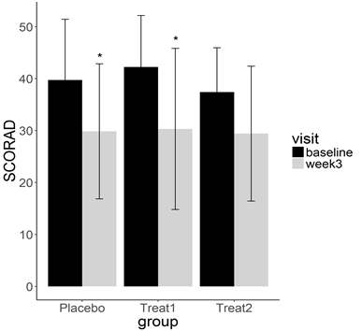
Study Result : EASI and SCORAD score
* The mean difference before and after the test was compared by paired t-test.
Notes:
Easi and scorad index are the most frequently used outcome in clinical trials of patients with atopic dermatitis.
These two measurements are based on the severity of atopic dermatitis symptoms and the extent of affected lesions.
Let’s take a look at the figures. In EASI and SCORAD both, all three groups showed a decrease in score compared to before treatment
Statistical significance was found in placebo and treatment groups 2 in the easi evaluation and in the treatment 1 and placebo group in the scorad evaluation.
The mean difference before and after the test was compared by paired t-test.

Slide 22
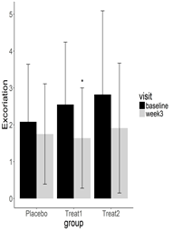
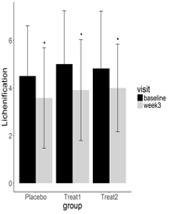
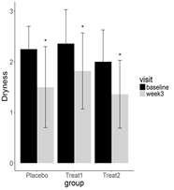
Study Result : Changes in detailed symptoms
Notes:
Scorad and easi include an assessment of acute phase symptoms in addition to chronic stage symptoms.
Therefore, these two outcome measurements may not be appropriate for the purpose of this study to explore the efficacy in chronic symptoms.
So we further assessed the changes in the chronic symptoms.
As a result, in both the placebo and treatment groups, chronic symptoms improved.
statistically significant improvement was observed all groups in dry skin and lichenification and in the treatment group in the excoriation.

Slide 23
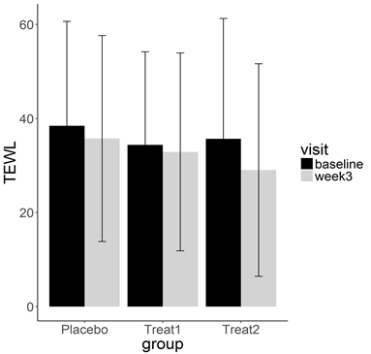
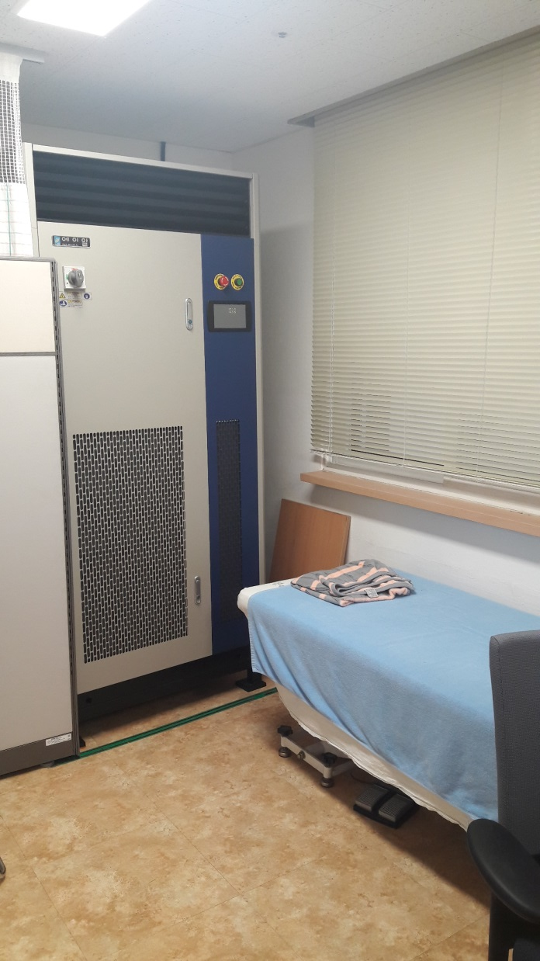
Study Result : Changes in TEWL
Notes:
We also measured the patient's transdermal water loss in an environment with constant temperature and humidity maintained.
TEWL values ​​showed a critical condition in all three groups before the study, but decreased in all groups after the study.
However, there was no statistical significance.

Slide 24
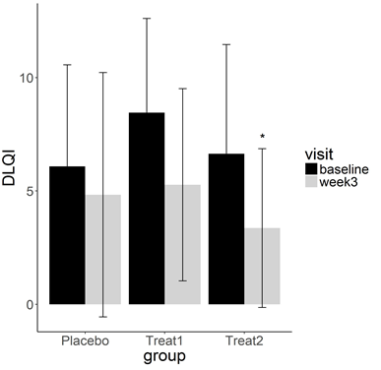
  Study Result : Changes in Dermatology Quality of Life Index
Notes:
Now, will you look at the results of evaluating the quality of life?
The evaluation of Dermatology Quality of Life Index before and after treatment showed that the scores improved in all groups
and statistically significant changes were observed in the treatment group 2.

Slide 25
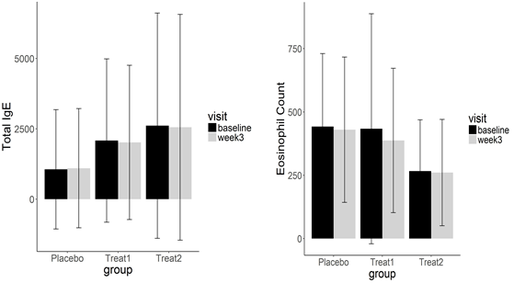

  Study Result : Changes in Hematological test results
Notes:
To move on to the changes in hematological test results.
The levels of total IgE, eosinophil count, and interleukin (IL)-17 were measured before and after 3 weeks ’ application of Jaungo or placebo.
In total Ige level, levels of treatment group 1 and 2 were decreased, while level of placebo group was increased without statistical significance.
Eosinophil count values ​​were decreased in all three groups but not statistically significant.
IL-17 was decreased in all three groups with statistically significant. IL-17 has been implicated in the chronic inflammatory state of atopic dermatitis.

Slide 26
Study Result : Adverse events
Notes:
Lastly, let's look at the adverse events report.
A total of three patients reported side effects. Mild itching occurred in one patient in treatment group 2, mild itching and urticarial occured in two patients in placebo group. However, all of them were evaluated as a mild side effect with loss of symptoms with discontinuation of drug.

Slide 27
1
Introduction
2
Study setting and design overview
3
4
Study results
Discussion
Notes:
So far I have told you the background, method and results of the study.
Is the result very confusing?
I was really confused when I started analyzing with much anticipation.
However, I recalled the aim of this study is to explore the indications and to look at the dose before performing the next phase of confirmatory clinical trials.
After analyzing the results of the study, we have identified the most likely indications and analyzed why this study is so confusing.

Slide 28


Discussion: The most effective symptoms?
Statistical significance was found in excoriation and dryness in treatment group 1.
The total SCORAD score decreased most in treatment group 1.
In treatment group 1, the hematological changes of IgE, Eosinophil count, and IL-17 most obvious. Statistically significant changes were observed only in IL-17.
Taken together, these results suggest that Jaungo may effective for chronic atopic dermatitis symptoms such as excoriation, and dryness.
Notes:
What is the most effective symptom?
The evaluation of Dermatology Quality of Life Index before and after treatment showed that
the scores improved in all groups and statistically significant changes were observed in the treatment group.
As shown in the picture below, the scratching of the patient, wrinkles caused by dry skin, and the extent of pigmentation are reduced.

Slide 29
Discussion: Considering research design aspect
Research results showed no dose response.
There were also many symptoms that were not statistically significant before and after treatment.
A certain effect was also observed in the placebo group.
- Increase the application volume
- increase the application frequency
- Increase application period
The application may not be sufficient to confirm the effect.
Placebo contains active ingredient
- Redevelopment of placebo drug
-Research design with no treatment group
Notes:
I have considered research design aspects.
In accordance with KFDA regulations, there were no two herbs in the placebo, but three oils contained. This was the decision of the KFDA.

Slide 30


















Introductions of the Project team
KMD/PhD Inhwa Choi
한의학박사/ 한방안이비인후피부과 전문의
경희대학교 한의과대학 한방안이비인후피부과 교수
강동경희대학교병원 한방안이비인후피부과 과장
한방안이비인후피부과학회 정회원
Clinical Study
Validation Study
중앙대학교
김범준 교수
경희대학교
김규석 교수
Basic Research & CRC
부산대학교
서형식 교수
동국대학교
홍승욱 교수
경희대학교
장보형 교수
부산대학교
김남권 교수
경희대학교
윤영희 교수
가천대학교
김경준 교수
한방안이비인후피부과학회
경희대학교
구진모 연구원
경희대학교
홍세향 연구원
경희대학교
김요인 연구원
고유미 연구원
Notes:
That brings me to the end of my presentation.
On this slide I introduce the principle researcher of this the project, our research team. I am glad to present today on behalf of our research team, and I hope that my presentation will be of little help to your research progress.
Thank you very much for your patience this morning.

Slide 31
PRESENTATION
Q&A
Younghee.yun@cypharm.kr
VIP - Valuable Information Presenter

