Slide 1
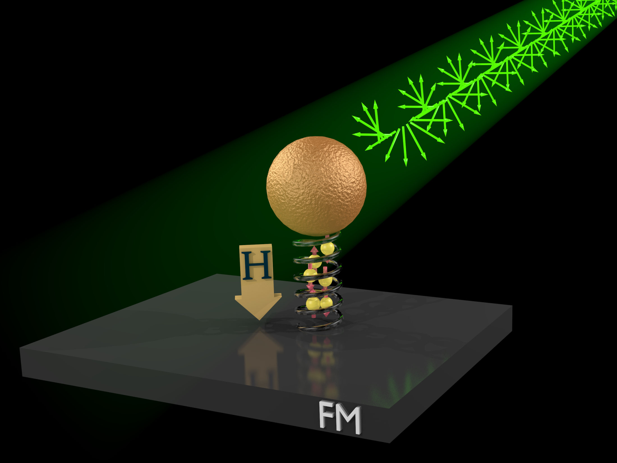


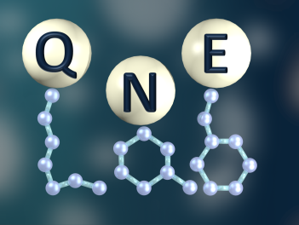
Chiral-based simple spin devices
Yossi Paltiel
Applied Physics Department
Center for nano science
and nano technology,
HUJI, Israel
30.11.14
Quantum Nano-Engineering Lab

Slide 2
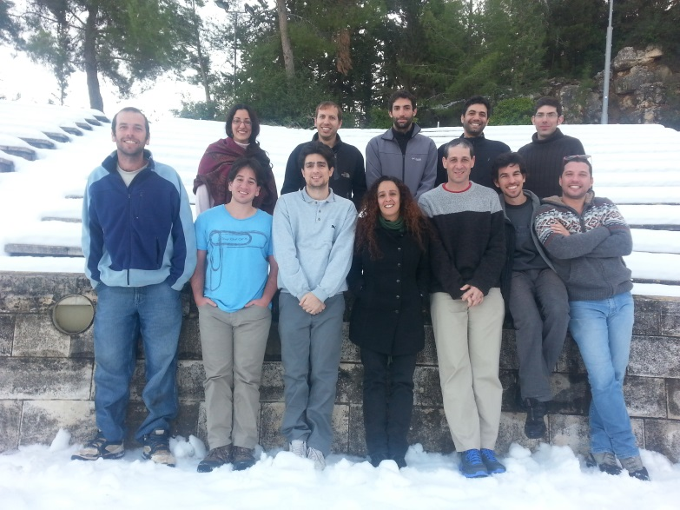

Many thanks to
Our Group: Dr. Shira Yochelis, Eyal Cohen, Eran Katzir, Avner Neubauer, Guy Koplovitz, Oren Ben Dor, Ido Eisnberg, Ohad Westrich, Matan Galanty. Nir Peer, Chen Alpern; Amir Ziv, Aviya Perlman Illouz, Kuti Uliel
And
Grzegorz Jung
Physics department , Ben Gurion University Beer Sheva Israel
Ron Naaman
Department of Chemical Physics, Weizmann Institute, Rehovot 76100, Israel
Nadav Katz, Yaov Kalcheim, Oded Millo ,
Racah Institute of Physics, Hebrew University, Jerusalem 91904, Israel
Uri Banin
Department of physical chemistry , Hebrew University, Jerusalem 91904, Israel
Financing:, ISF, ISF-BICORA, DARPA, MOD, Israel Taiwan, Magneton
Capital Nature , FTA , Peter Brojde center, Volkswagen, Leverhulme
Notes:
2

Slide 3
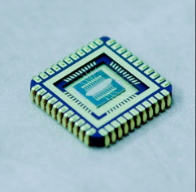
Lecture Synopsis
Quantum effects at room temperature ?
Chiral induced spin selectivity effect (CISS)
CISS based devices
Majority Spin
Addition
Minority Spin
Reduction
E_{F}
Au

Slide 4
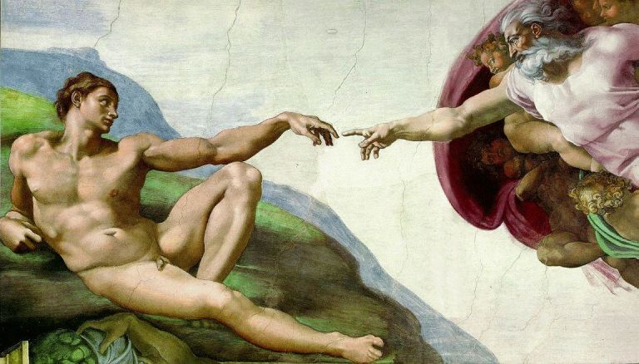
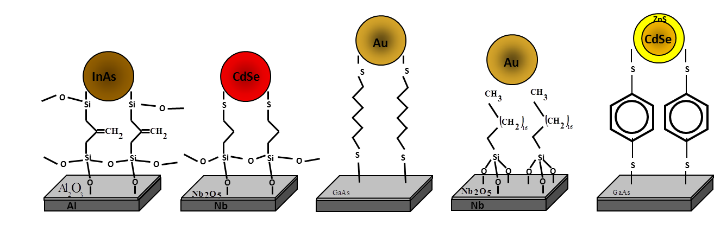
Toward RT Quantum Machines
Implementation of room temperatures quantum devices
Room temperature quantum coherence
Very hard to achieve but we can use a mix of quantum and classical approach
Meeting between Top-down
to Bottom -up
Controlled Coupling

Slide 5
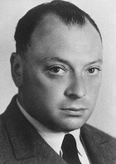
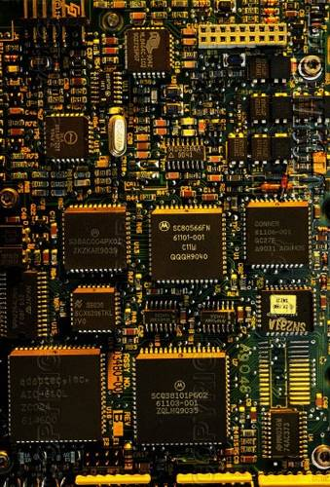
Spin Electronics
Electrons have charge and spin 1/2
Conventional electronic devices ignore the spin property and rely strictly on the transport of the electrical charge of electrons
Adding the spin degree of freedom provides new effects, new capabilities and new functionalities

Slide 6
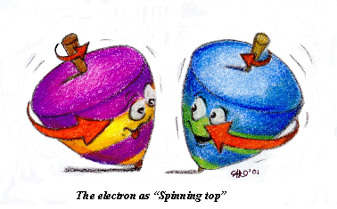
Why Spin?
Energy and heat- For Spintronics, less energy
Quantum effects -It may be a way for introducing the spin properties to our tool arsenal.

Slide 7
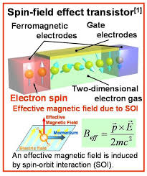
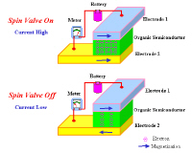
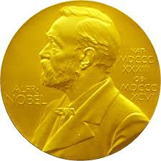
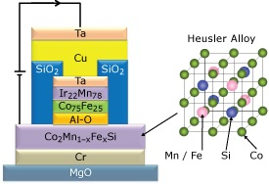
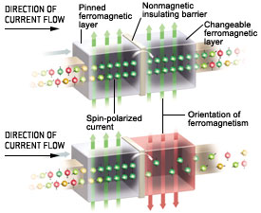
Spintronics Devices
The 2007 Nobel Prize in Physics was awarded to :
Albert Fert and Peter Grünberg for the discovery of GMR

Slide 8
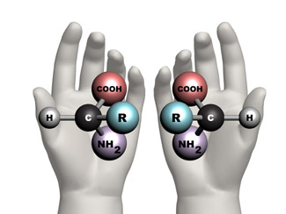
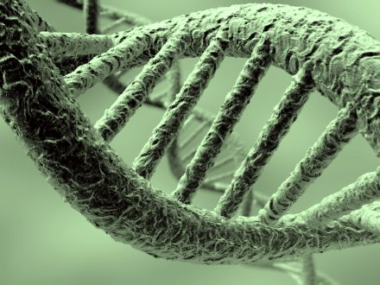
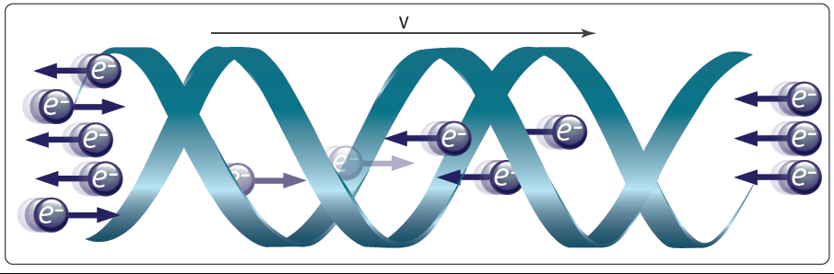
Chiral based spintronics

Slide 9
What do we have to contribute
Simple and easy to process
Small
Cheep
Si compatible
From industrial point of view lets take existing magnetic devices and improve them with our CISS effect

Slide 10

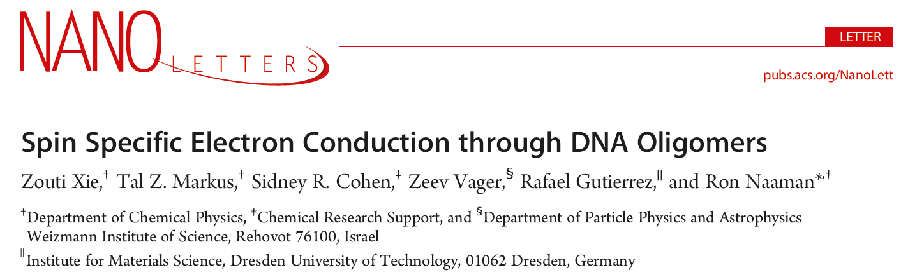
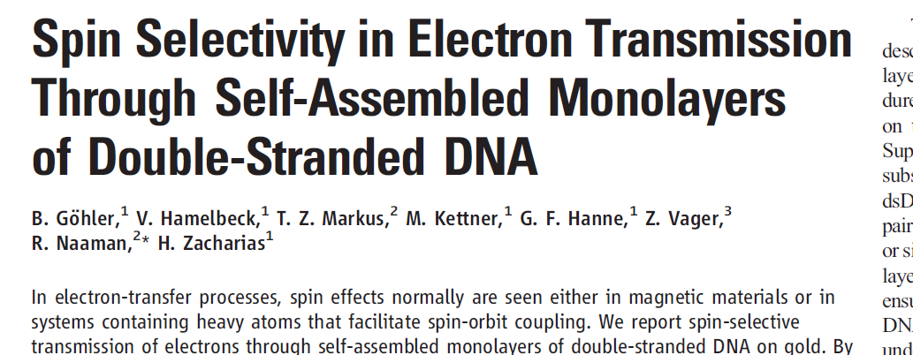
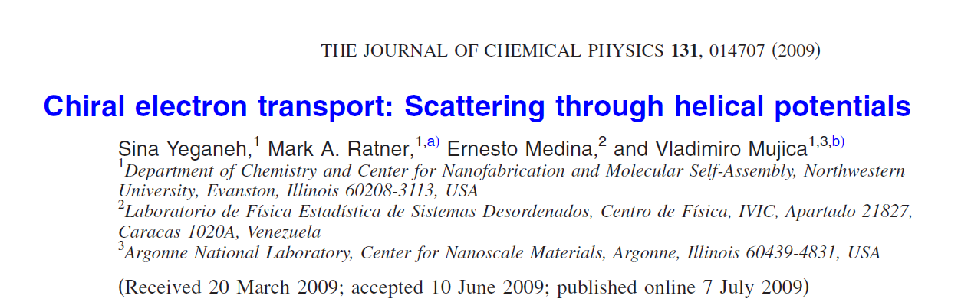
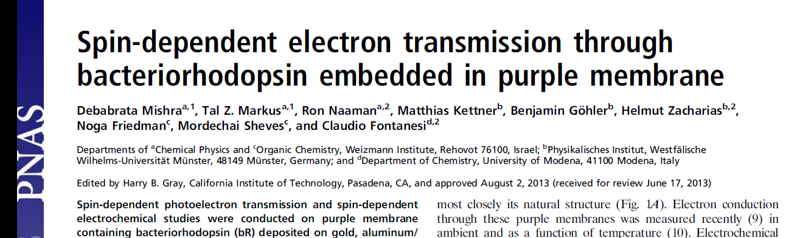
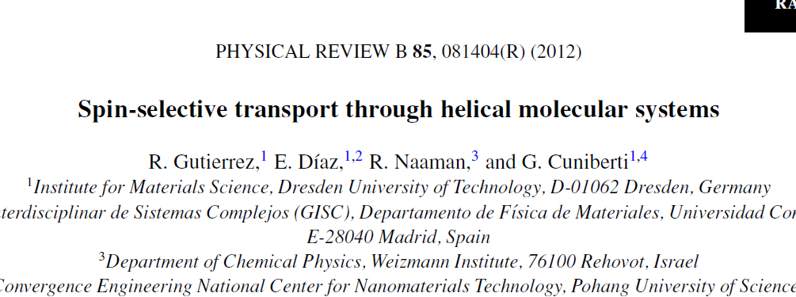
The CISS effect
SOC is the main cause for CISS

Slide 11
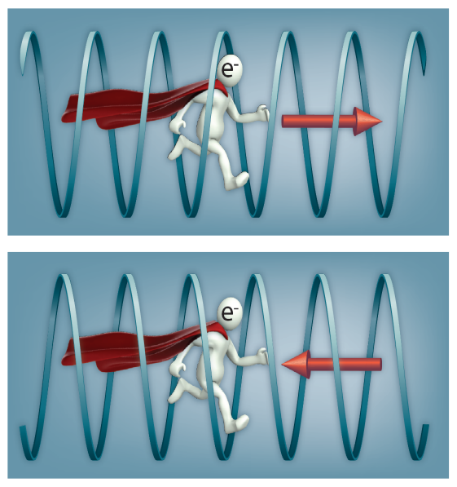
The CISS effect
The CISS effect- Chiral induced Spin Selectivity.
P
P
Left Handed
Right Handed
S
S

Slide 12
Transport Vs Optics
Chirality Induced Spin-selectivity (CISS) effect
SC NCs
Minority Spin
Reduction
Majority Spin
Addition
Chiral Molecules
FM
E_{F}
E_{F}
M_{z}

Slide 13
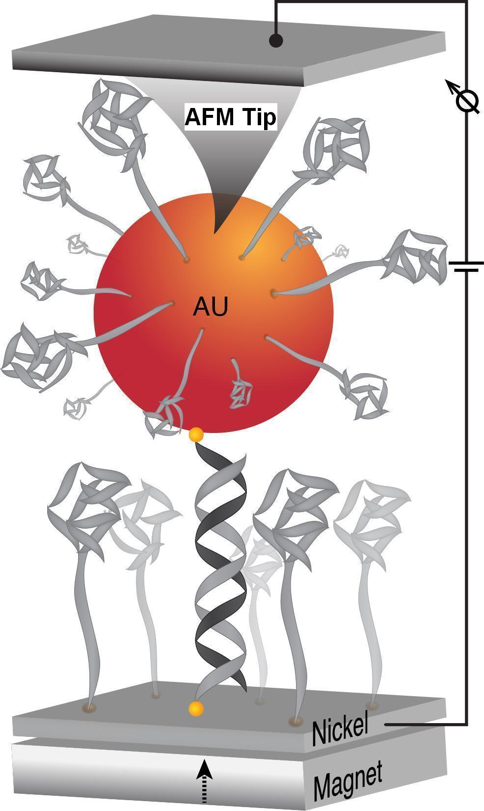
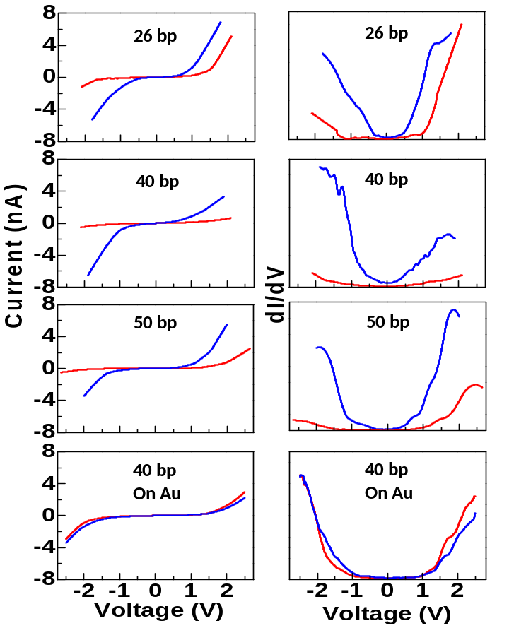
Zuoti Xie, Tal Markus, Sidney Cohen, Zeev Vager,
Rafael Gutierrez, Nano Letters, 11, 4652–4655 (2011).
Spin dependent transport through double stranded DNA
Chiral Induced Spin Selectivity - CISS
.

Slide 14
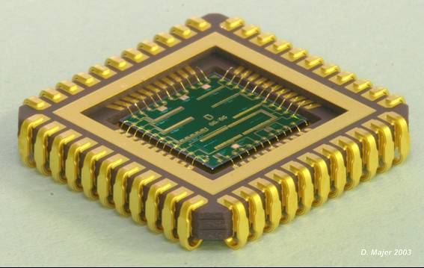
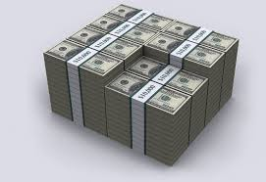
Magnetic Memory without a Magnet

Slide 15
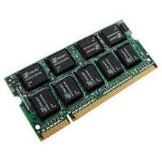
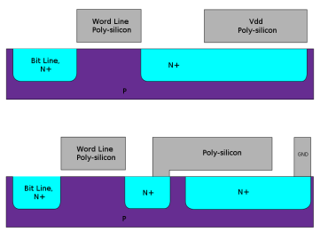
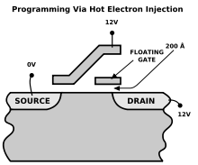
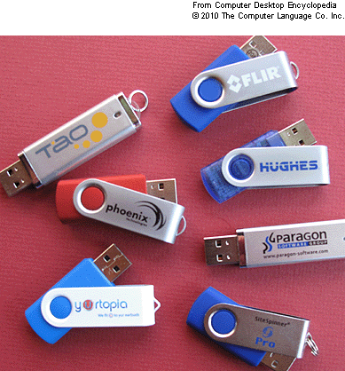
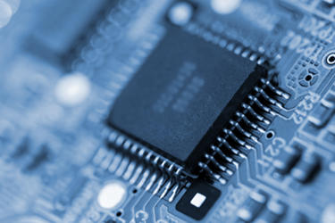
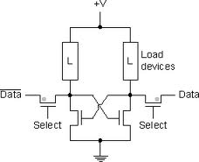
Memory devices
Fast but need constant power
Slow last for 10 years
DRAM - Dynamic random-access memory
Flesh memory
refreshed periodically
SRAM- Static random-access memory
Does not need to be periodically refreshed
All existing memory technologies challenged when critical size is smaller than 45 nm
We want:
No constant power, long lived, fast, standard technology

Slide 16
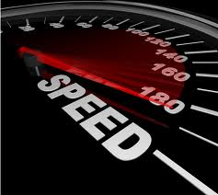
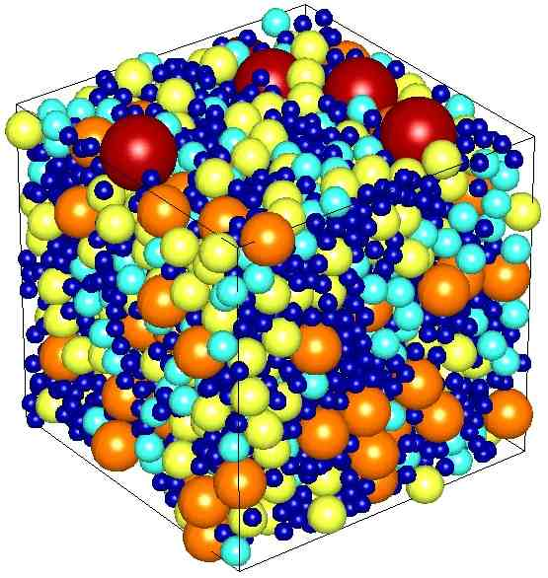
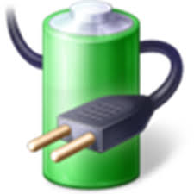
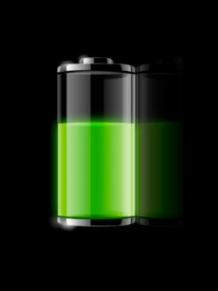
The Charily Molecular based Universal memory
Non-Volatile
Power efficient
Fast
Dense
nm size transport
Unit size 10nm
stable
No back scattering
The industry needs are met without compromising in cost, compatibility to standard Si process & complexity of design

Slide 17
Method
Sample Preparation
Pre-adsorption
Optical lithography
Au
Adsorption
Ni
1/5/10mM on 40x50 um² adsorption areas
SiO2 (PECVD)
Al2O3
SiO2
Si
Au
Post-adsorption
Au
Al₂O₃ is evaporated in
two sessions: 4-5nm followed by 2nm →
reduces pinholes
Evaporation of Ni 30nm

Slide 18
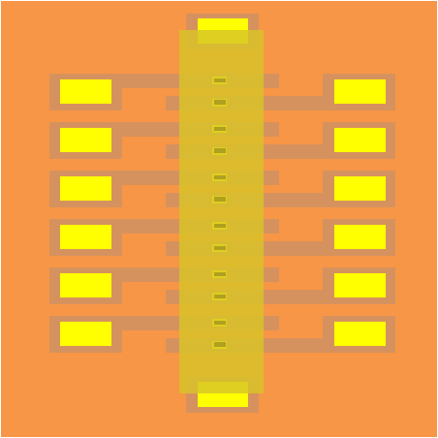
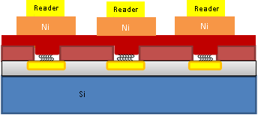
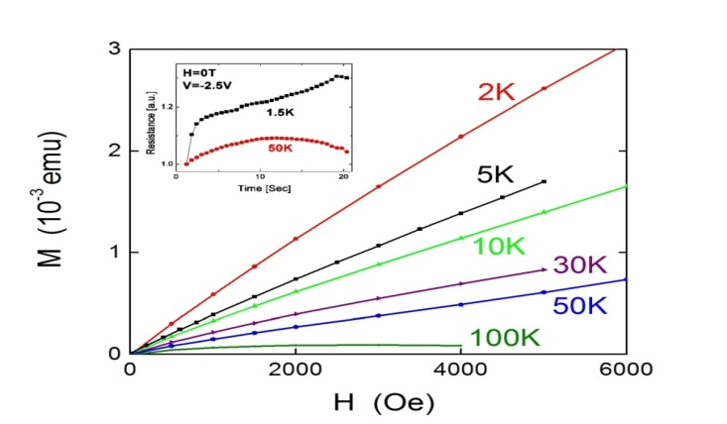
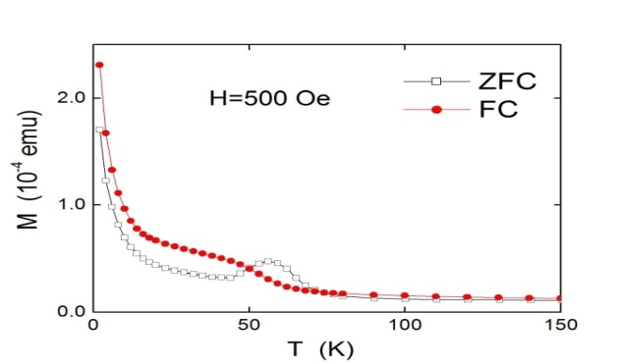
Si based CISS devices
Low-power silicon based spintronic transistors with chiral molecular spin filter
Potential difficulty- pin-holes in the organic monolayer.
The problem was solved by evaporating thin layer (3-5 nm) of AlOx on top of the
organic monolayer.
Nature Communications 4, 2256 DOI: 10.1038 (2013).
(a)
(b)

Slide 19
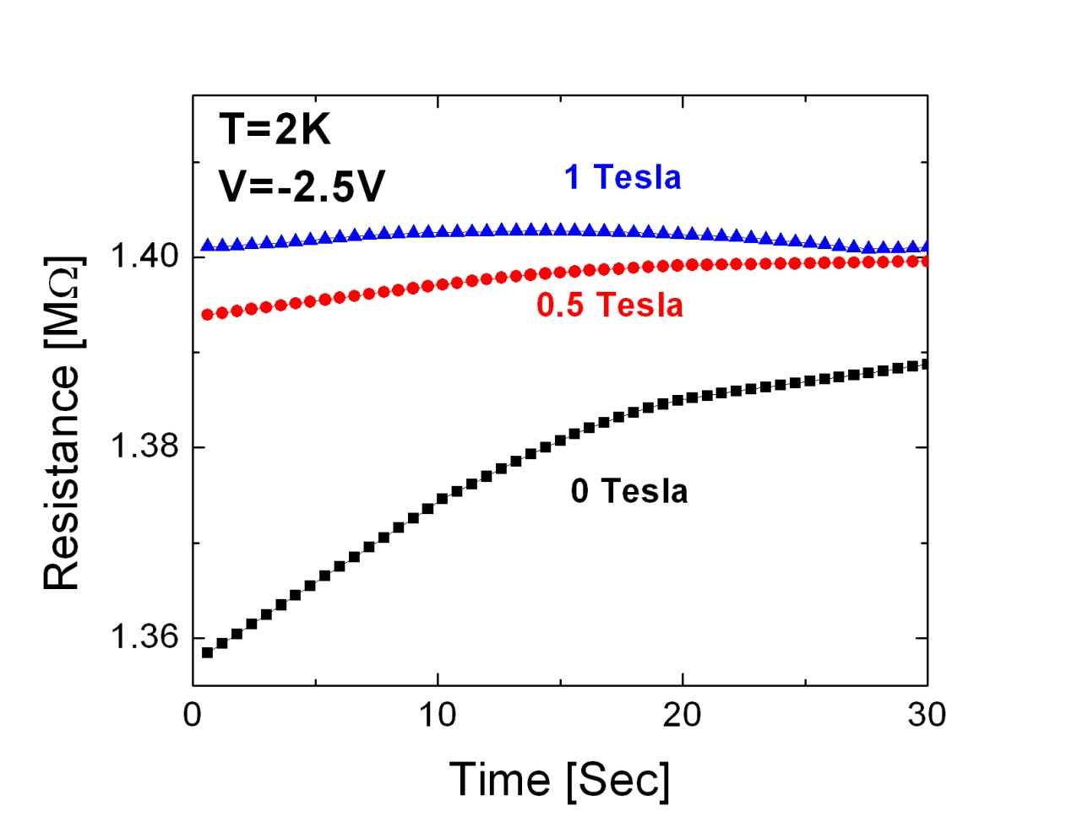
Memory writing at low temperatures
Nature Communications 4, 2256 DOI: 10.1038 (2013).
Highlighted in Nature "Nanotechnology: A memory device with a twist" 7.8.2013 http://www.natureasia.com/en/research/highlight/8613
Magnetization of the device at 2K

Slide 20
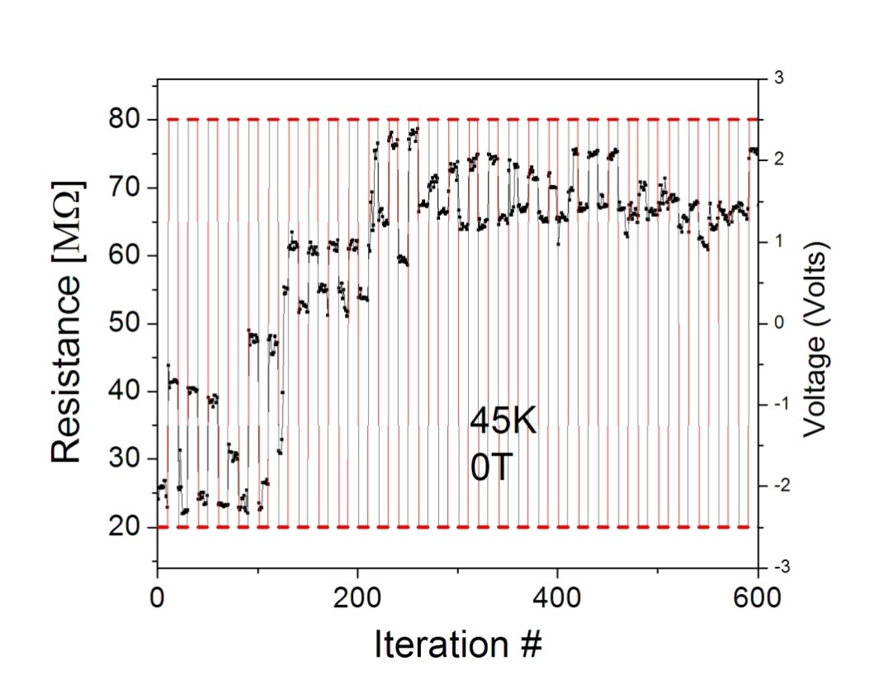
Dual direction writing
Spin filter not spin polarizer?
Majority Spin
Addition
Minority Spin
Reduction
E_{F}
Au

Slide 21
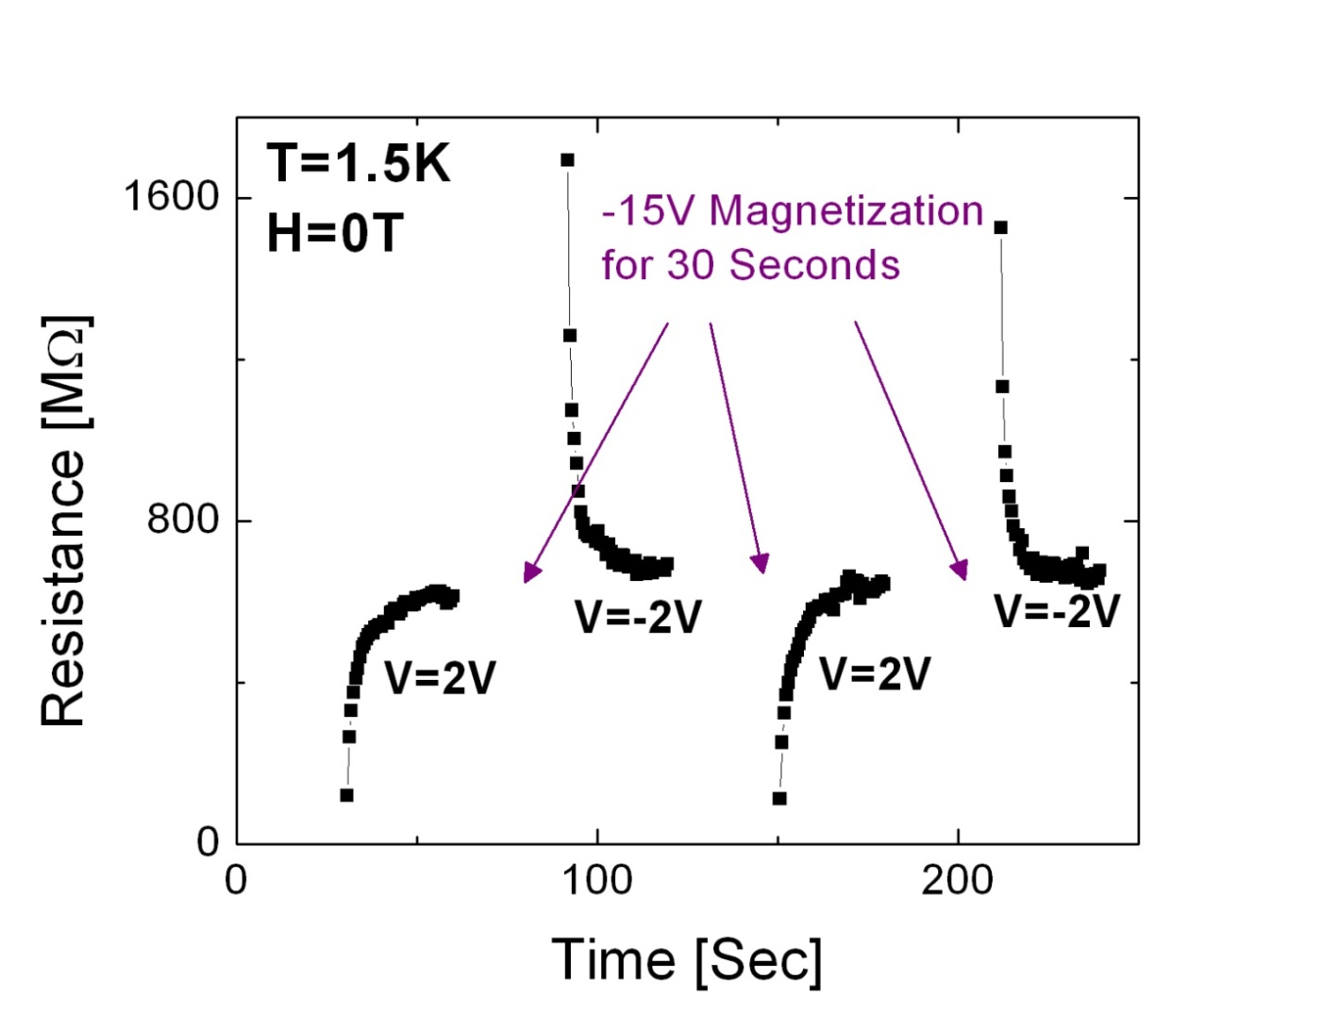
Memory effect on a Real Device
Nature Communications 4, 2256 DOI: 10.1038 (2013).
Highlighted in Nature "Nanotechnology: A memory device with a twist" 7.8.2013 http://www.natureasia.com/en/research/highlight/8613
Memory effect. Writing the at -15V reading at lower voltage. For the same direction of current the resistance is high and low for the opposite direction of current
Breakthrough in memory technologies could bring faster computing, smaller memory device -http://phys.org/news/2013-08-breakthrough-memory-technologies-faster-smaller.html

Slide 22
Light induced device

Slide 23
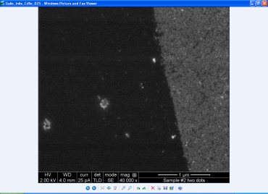
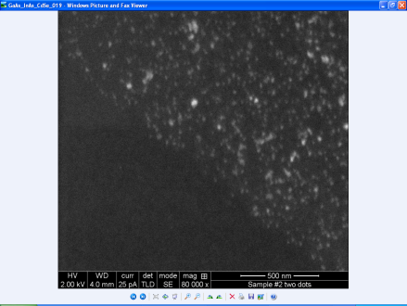
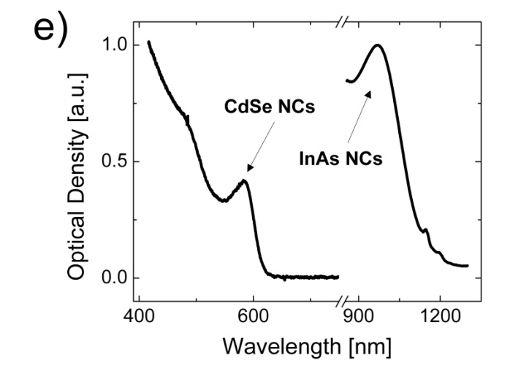
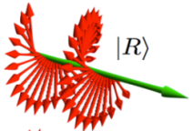
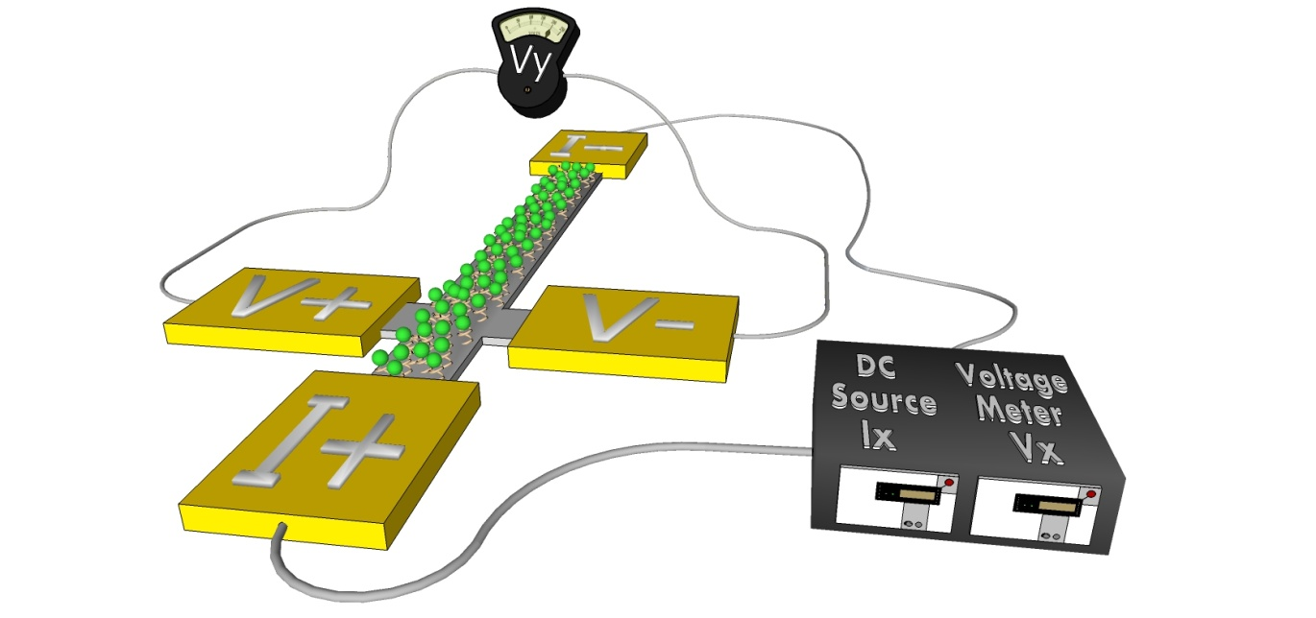
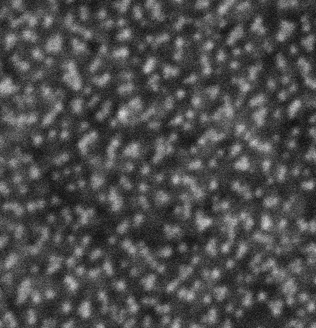

Methods
5 µm
Optically induced charge transfer device
500nm nm
Ni-based Hall effect device (anomalous HE)
532nm
Circular
Polarized Beam
CdSe QD (610nm)
α-Helix L-Polyalanine 36C

Slide 24

Calibration
t
B_{(t)}
Paper under review

Slide 25


Optical CISS
Comparing the right hand circular polarization and left hand circular polarization with the same linear polarization
One order of magnitude difference – Spin detector

Slide 26


Results
Nano letters 2014
Dark
Light
Dark
Light

Slide 27


Results
Dark
Light
Dark
Light
Li Ye et al. Physical Review B 85, 240403(R) (2012)
Paper under review

Slide 28

Methods
Optically induced charge transfer device
Highly localized magnetization device
(measured with MFM)
532nm
Circular
Polarized Beam
CdSe QD (610nm)
α-Helix L-Polyalanine 36C
5nm Au
1.5nm Co

Slide 29













Results
Nano letters 2014
Topography
Magnetism
Z [nm]
Z [Deg]
Illuminated area
in illuminated sample
X [μm]
X [μm]
Unilluminated area
in illuminated sample
Z [nm]
Z [Deg]
X [μm]
X [μm]
Illuminated area
in reference sample
(no Molecules & no NC)
Z [Å]
Z [Deg]
X [μm]
X [μm]

Slide 30
CISS Future Applications
Source
Gate
Drain
Magnetic memory
Spin transistors
3D spin logic
Local EMR
Ferromagnetic
Electrical gating
A scheme of the XOR MSM device
Contact 3
Ferromagnetic nano structure
Chiral R
Chiral S
Contact 1
Contact 2

Slide 31


Changing the world of memory device as we know

