Slide 1
The Role of Liver Detoxification in PCOS women
Yoojin Lee-Sedera, N.D.
RED ROCK NATURAL MEDICINE
Las Vegas, NV

Slide 2
Introduction
A naturopathic doctor (N.D.) licensed in California, practicing in Las Vegas, NV
Graduated National College of Natural Medicine in Portland, OR
At present:
  A medical director at Red Rock Natural Medicine located in Summerlin Hospital Medical Center, Las Vegas
  A vice president of Nevada Association of Naturopathic Physicians (NVANP)
  A 3rd year student of Wongu University of Oriental Medicine pursuing a master degree in Oriental Medicine & Acupuncture

Slide 3
Liver Disease & PCOS
“Non-Alcoholic Fatty Liver Disease (NAFLD) is considered as the hepatic manifestation of metabolic syndrome while PCOS is considered the ovarian manifestation of metabolic syndrome.”
        Baranova et al., J Transl Med 2013; 11: 133
Significantly higher prevalence of NAFLD in PCOS women (27.4-62%) compared to women of reproductive age without PCOS.
  71% prevalence of PCOS amongst reproductive aged women with NAFLD
The prevalence of advanced liver disease (NASH with fibrosis) in women with PCOS is remarkably higher than otherwise.

Slide 4
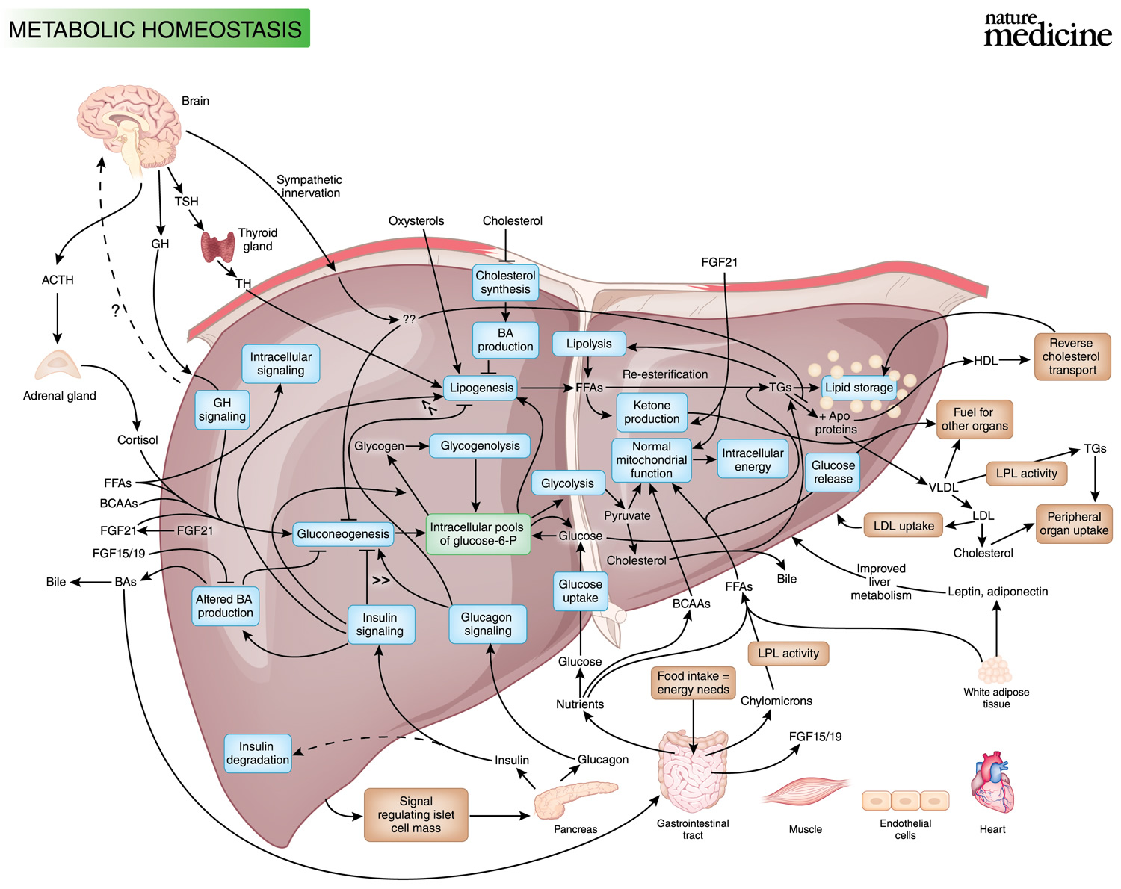
Liver & Metabolic Homeostasis

Slide 5
Insulin Resistance & Liver
Insulin Resistance → Increased FFA flux from the adipocytes to the liver → Hepatic de novo lipogenesis (DNL)
  Both hyperinsulinemia and a low-fat, high-carb diet increase hepatic DNL, and that DNL contributes to hypertriglyceridemia.
The significant independent factor to NAFLD in PCOS and has a key role in liver disease progression
  The main predictor for the progression from simple steatosis to NASH

Slide 6
So, Chicken or Egg?
Mutual influence between Liver disease & Insulin resistance (IR)
  As in Liver disease & PCOS
Peripheral IR → Reactive hyperinsulinemia & un-inhibited lipolysis → Influx of FFA to the liver → Hepatic “de novo lipogenesis” → Increased hepatic TG → Hepatic IR superimposed on peripheral IR
      Bugianesi et al., Hepatol Nov 2005; 42 (5): 987-1000
Liver’s role to the increased visceral fat is closely associated with insulin resistance
  Visceral adiposity (lipotoxicity) is causally related to IR

Slide 7
Liver & Hormones
Hyperandrogenism has been associated with increased risk of insulin resistance and visceral adiposity in women.
  It may contribute to the development of NAFLD as well as PCOS.
The metabolism of testosterone and dihydrotestosterone takes place for 90% in the liver.
  Oral contraceptives and many other medications are metabolized in the liver as well.

Slide 8
Current Medical Approach to NAFLD/NASH
At present, there is no approved or proven effective medication to treat NAFLD/NASH.
Lifestyle modifications including diet, weight loss and exercise are the most appropriate initial therapeutic interventions for PCOS patients with NAFLD and when pharmacologic therapy is to be considered, Metformin may be used.

Slide 9
PCOS Treatments & Liver
Current pharmaceutical treatment options for PCOS
  Oral contraceptives
  Clomiphene citrate (Clomid)
  Metformin
  Steroids (low-dose prednisone or dexamethasone)
  **All of these medications are metabolized via liver, except for Metformin.
“Existing treatment strategies for PCOS have limited success, side effects are costly giving rise to a curiosity in women to seek alternative therapies..”
        from the abstract of “Natural Approach to Coexisting NAFLD and PCOS” by Xianqin Qu, Endo Metabol Syndr. July 2015

Slide 10
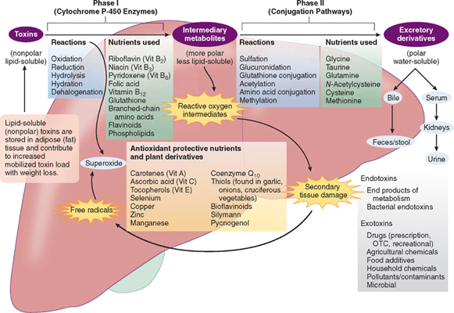
Liver’s Detoxification Pathway

Slide 11
Detoxification of the Liver
Correct low micronutrient intake – for oxidative imbalance and optimize the enzymatic functions
  Antioxidants: Vit E, C, A, Beta carotene, Se, Cu, CoQ10, Thiols, Bioflavonoids, GSH
  Phase I: Vit B complex with folate**, NAC/Cysteine, Flavonoids, Phospholipids, AA, I3C/DIM, …
  Phase II: Glycine, Taurine, Glutamine, NAC/Cysteine, Methionine (methyl donor), Se, Bioflavonoids, Curcumin, Limonene, …
  And more: Chromium, EFA, ALA, Zn, Mn

Slide 12
Detoxification of the Liver
Botanicals
  Western herbs: Gymnema, Momordica, Cinnamon, Camellia, Silybum, Taraxacum, Schisandra, Bupleurum, Glyciyrrhiza, Arctium, Eleuthrococcus, etc.
  Chinese herbs: Salvia, Crataegus, Gardenia, Angelica, Coptis, Tumeric, etc.
  Herbs to be avoided:
    Grapefruits (naringenin), Kava kava, St. John’s wort, Calendula

Slide 13
Detoxification of the Liver (and more!)
Minimize the triggers!!
  Dietary change – Modified elimination diet
  Minimize the exposure to the environmental toxins as much as possible
Exercise
Sleep habits
Hydration
Emotional health
Manage your stress!!
Other therapeutic options:
  Homotoxicology/ Homeopathy
  Traditional Chinese/Oriental Medicine & Acupuncture
  Hydrotherapy
  Bodyworks

Slide 14

Any Possible Side Effects?

Slide 15

It’s a Matter of Balance

Slide 16
References
Schwarz, Am J Clin Nutr Jan 2003;77(1): 43-50
Kelley et al., World J Gastroenterol. Oct 2014; 20 (39); 14172-14184
      Baranova et al., J Transl Med 2013; 11: 133
      Brozozowska et al. J Gastroenterol Hepatol 2009; 24: 243-247
      Bugianesi et al., Hepatol Nov 2005; 42 (5): 987-1000
Kandaraki et al., J Clin Endo Metabol Mar 2011; 96(3):E480 –E484
Vassilatou, World J Gastroenterol. Jul 2014; 20(26): 8351–8363
Scheen, Clinical Pharmacokinetics May 1996; 30(5): 359-71
Jiang, Wang, Kong, Int’l J Clin Pharm Therap 2010; 48(3): 224-229
Cheng et al., Food Chem Toxicology May 2013; 55: 234-240
http://emedicine.medscape.com
http://mthfr.net
Eric Yarnall, Natural Approach to Gastroenterology, 2nd ed., 2010
Jacquline Krohn, The Whole Way to Natural Detox, 1996

Slide 17
Contact Information
Yoojin Lee-Sedera, N.D.
RED ROCK NATURAL MEDICINE, LLC
653 N. Town Center Dr. Suite 400
Las Vegas, NV 89144
Ph. 702.708.2207
LeeYoojin.ND@gmail.com
http://RedRockNaturalMedicine.com
http://facebook.com/RedRockNaturalMedicine

