Slide 1
About OMICS Group
OMICS Group is an amalgamation of Open Access publications and worldwide international science conferences and events. Established in the year 2007 with the sole aim of making the information on Sciences and technology ‘Open Access’, OMICS Group publishes 500 online open access scholarly journals in all aspects of Science, Engineering, Management and Technology journals. OMICS Group has been instrumental in taking the knowledge on Science & technology to the doorsteps of ordinary men and women. Research Scholars, Students, Libraries, Educational Institutions, Research centers and the industry are main stakeholders that benefitted greatly from this knowledge dissemination. OMICS Group also organizes 500 International conferences annually across the globe, where knowledge transfer takes place through debates, round table discussions, poster presentations, workshops, symposia and exhibitions.

Slide 2
About OMICS International Conferences
OMICS International is a pioneer and leading science event organizer, which publishes around 500 open access journals and conducts over 500 Medical, Clinical, Engineering, Life Sciences, Pharma scientific conferences all over the globe annually with the support of more than 1000 scientific associations and 30,000 editorial board members and 3.5 million followers to its credit.
OMICS Group has organized 500 conferences, workshops and national symposiums across the major cities including San Francisco, Las Vegas, San Antonio, Omaha, Orlando, Raleigh, Santa Clara, Chicago, Philadelphia, Baltimore, United Kingdom, Valencia, Dubai, Beijing, Hyderabad, Bengaluru and Mumbai.
.

Slide 3
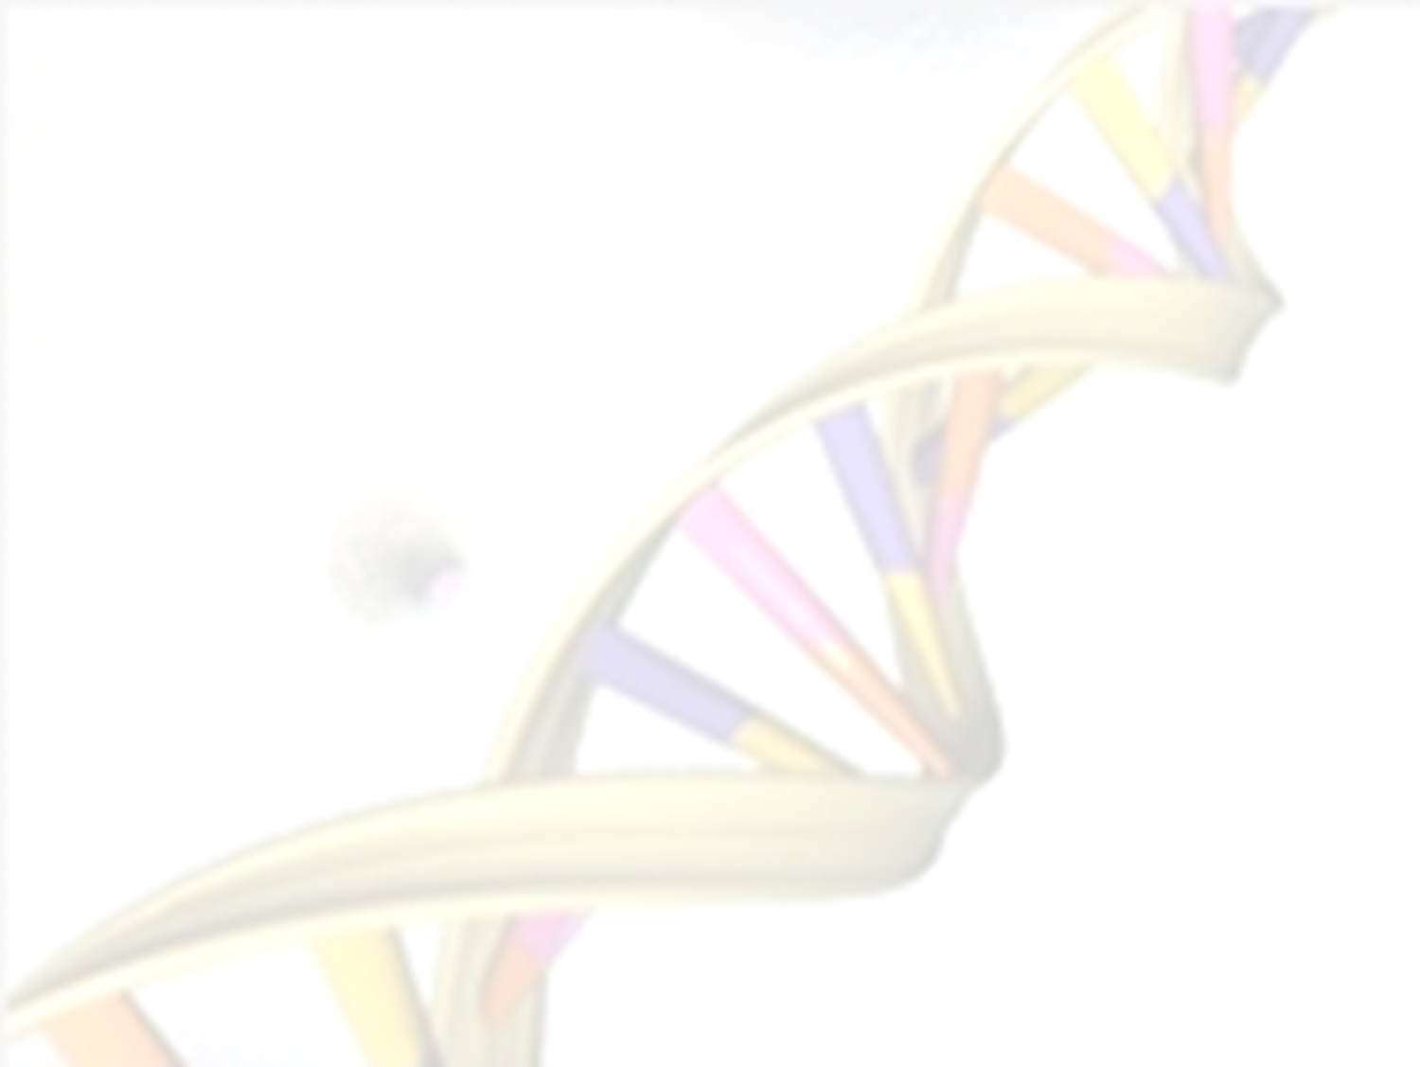

Genome-Wide Transcriptomes Integrate Animal Intra- and Inter-Organism Processes and Evoke the Ecoimmunological Concept in Animal Health
Yongming Sang, D.Sc., Ph.D.
College of Veterinary Medicine
Kansas State University, Manhattan, KS 66506, USA
(07/28/2015, Transcriptome-2015)
Notes:
Thanks for the introduction and invitation from the committee. I appreciate for this opportunity, and the exchange with committee and colleagues here so far today.
I come from Kansas State University College of Veterinary Medicine, the college and other federal institutes including USDA Center for Grain and Animal Health Research, and National Bio and Agro-Defense Facility of the Homeland Security there concentrate a national research center for animal diseases.
Viral diseases are a major threat of animal and human health. Similar to diseases caused by other classes of pathogens such as bacteria, fungi and parasites, the etiology underlying viral diseases are integrative of various factors from environment, host-pathogen genetic background, and primarily pathogen-host interaction. For viral diseases, the etiology is essential to integrate both pathogens and host because all viruses obligate to host cells for their life cycle. Actually, you even can consider viruses are not living things if they are not inside cells. I will use two emerging and epidemic disease models to demonstrate the specialties of our laboratory to carry out studies for etiology-based dissection, diagnosis and therapeutic designs.

Slide 4
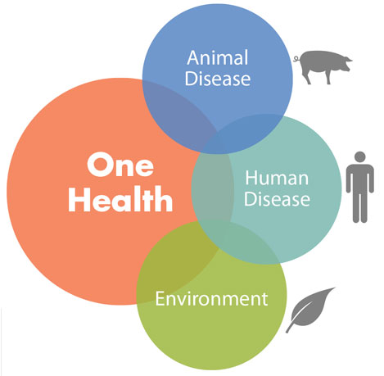



III. Integrative Strategy in Animal Health and Nutrition: Current Projects
USDA: (1) Immunogenetics and immunoreagent development ($48,000, 2014-2018) (2) Macrophage-based antiviral regulation ($499,436, 2013-2017); (3) Molecular and functional diversity of interferons (USDA pending)
Antiviral regulation model (PRRSV, PEDV, SIV, DCoV, CSFV, ASFV)
Metabolism Immunity
= Two Facets of
One task of animal
health & nutrition
Obesity model (Had-36)
NIH: Rat obesity induced by high-fat-diet plus Had-36 infection (NIH pilot: $50,000; and R15 pending)
Google images

Slide 5
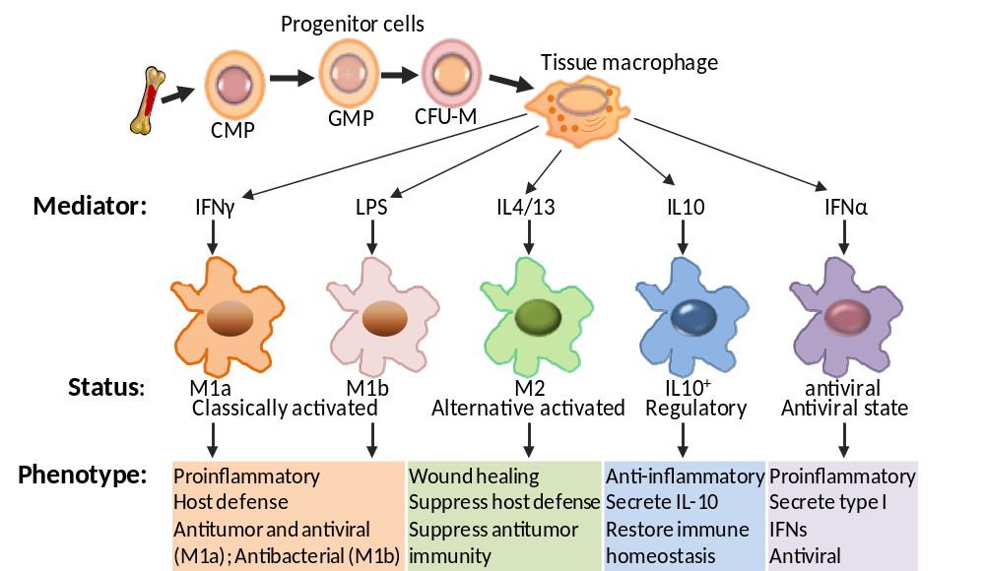

Our Macrophage Polarization and RNA-seq Procedure
RNA from pooled cells
PRRSV 5h
mRNA selection
Library preparation
Cluster preparation
Illunima sequencing
Read quality control
Mapping clean reads
Data analysis and DEG confirmation

Slide 6
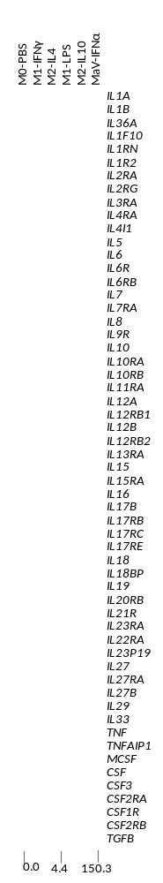
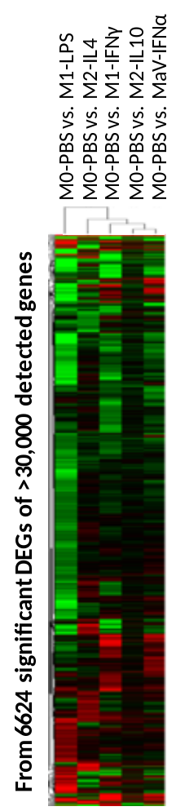
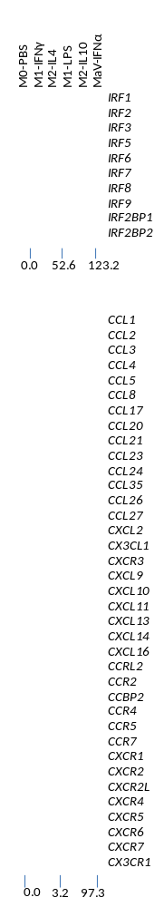
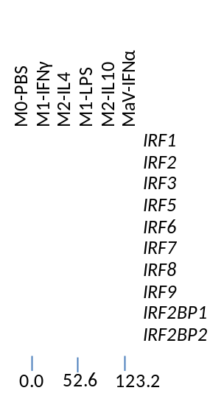
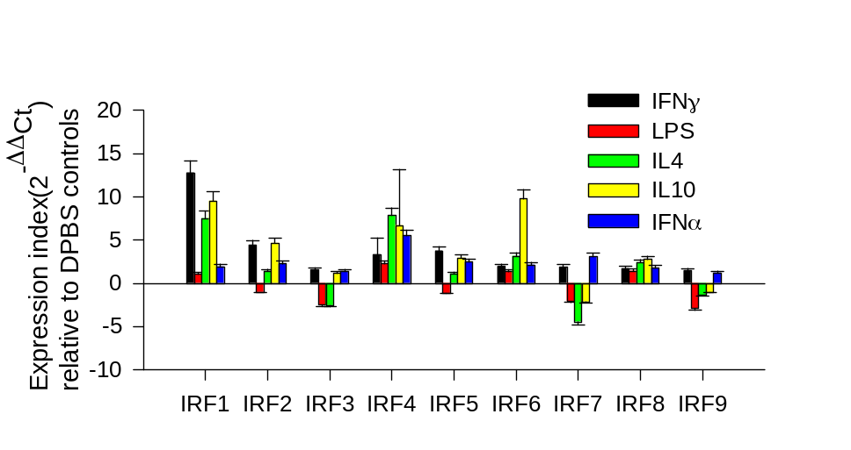
DEGs Related to Cytokines, Chemokines and IRFs, and RT-PCR Confirmation

Slide 7
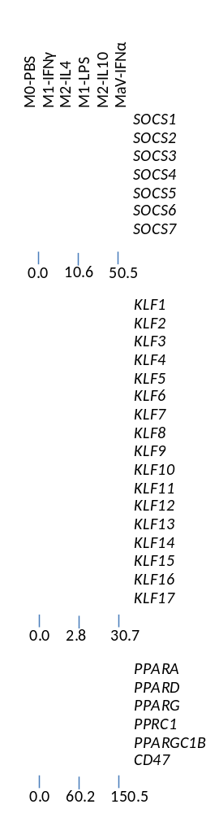
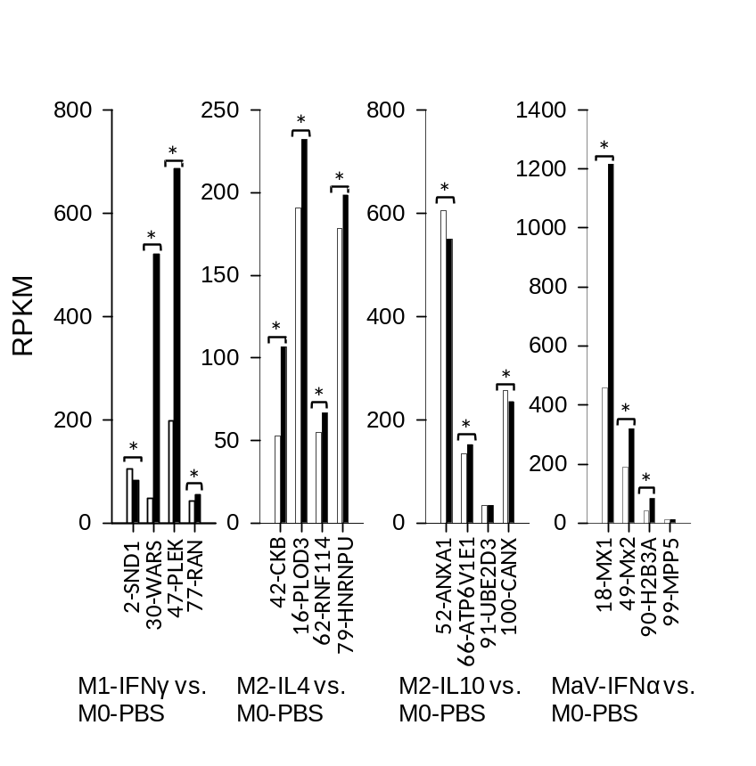
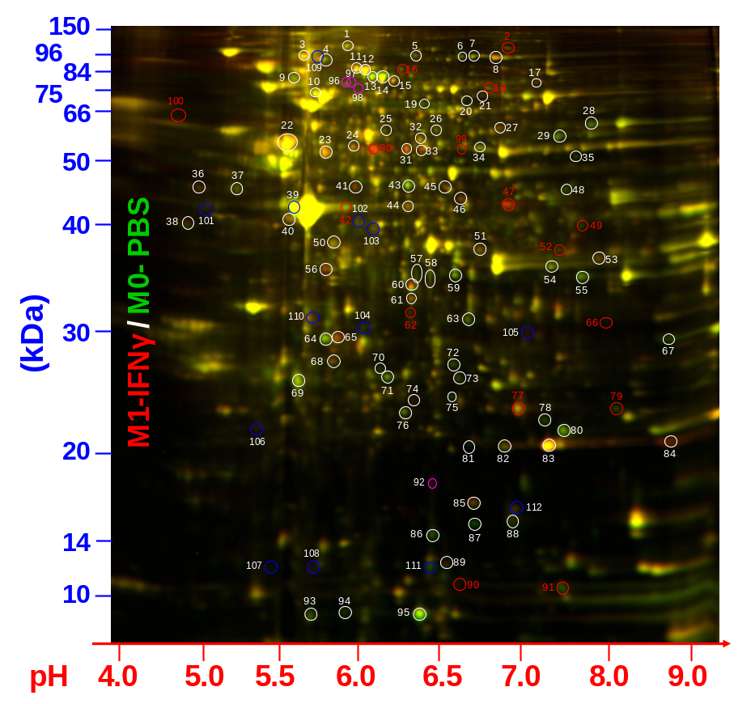
DEGs Related to Transcription Factors that are Important for Macrophage Activation, and Proteomic Confirmation
Spence S, et al., Immunity. 2013 Jan 24;38(1):66-78.
Alder JK, et al. J Immunol. 2008 Apr 15;180(8):5645-52.

Slide 8
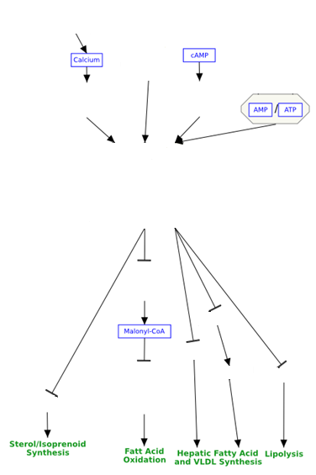
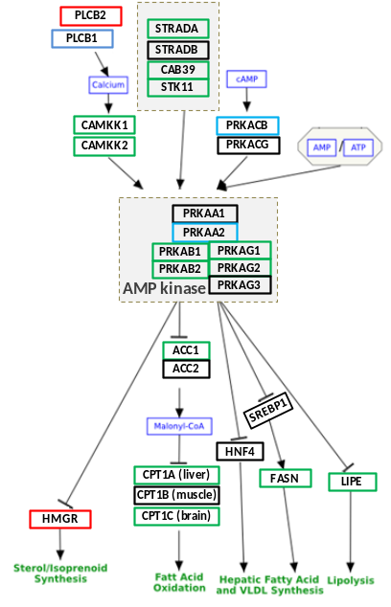
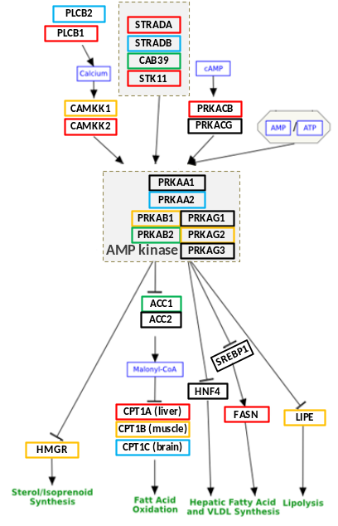
DEGs in AMPK Pathway in Mediation of Lipid Metabolism
M0-PBS
M1-IFNγ
M2-IL4
M1-LPS
M2-IL10
MaV-IFNα
PLCB2
STRADA
PLCB1
STRADB
CAB39
PLCB1
PLCB2
CAMKK1
CAMKK2
STRADA
STRADB
CAB39
STK11
PRKACB
PRKAA2
PRKAB1
PRKAB2
PRKAG1
PRKAG2
HMGR
ACC1
CPT1A
CPT1B
CPT1C
SREBP2
FASN
LIPE
STK11
CAMKK1
PRKACB
CAMKK2
PRKACG
PRKAA1
PRKAA2
PRKAB1
PRKAG1
PRKAB2
PRKAG2
IFNγ-M1 vs. PBS-M0
AMP kinase
PRKAG3
IFNγ-M1 vs. PBS-M0
IL4-M2 vs. PBS-M0
ACC1
ACC2
SREBP1
0.0
20.9
70.9
HNF4
CPT1A (liver)
FASN
LIPE
CPT1B (muscle)
HMGR
CPT1C (brain)

Slide 9
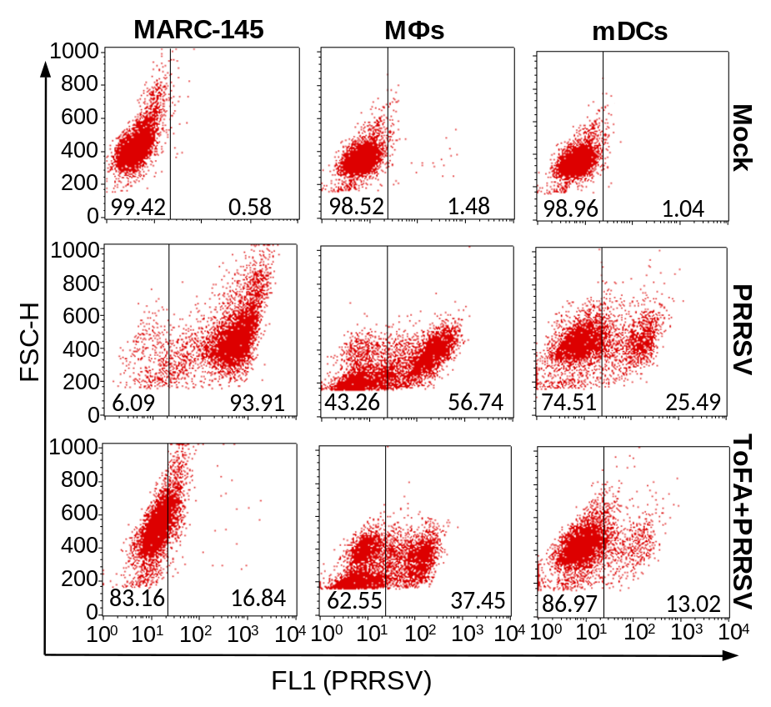
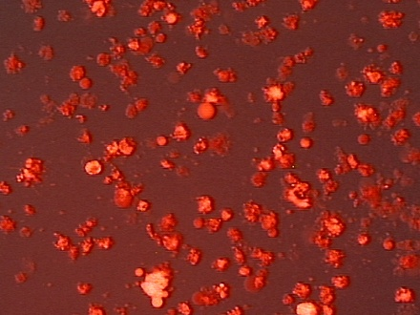
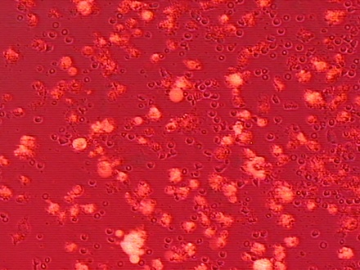
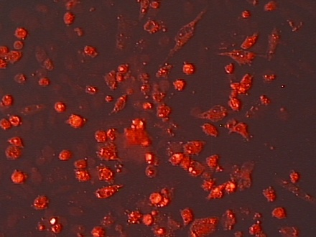
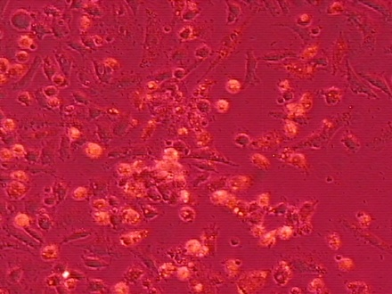
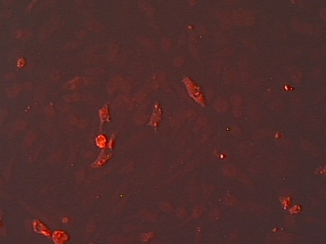
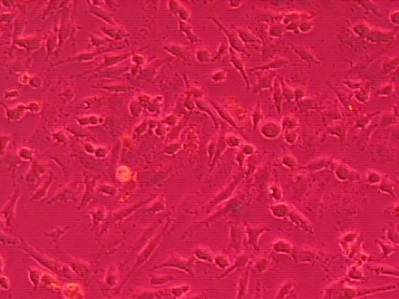
Regulation of PRRSV infection via AMPK Pathway and Lipid Metabolism
Fluorescent
Merged
CTRL
ToFA
(2.5 μg/ml)
ToFA
(5 μg/ml)
ToFA (5-(Tetradecyloxy)-2-furoic acid), a competitive inhibitor of acetyl-CoA carboxylase (ACC)
mDCs infected with DsRed-PRRSV for 48 h

Slide 10
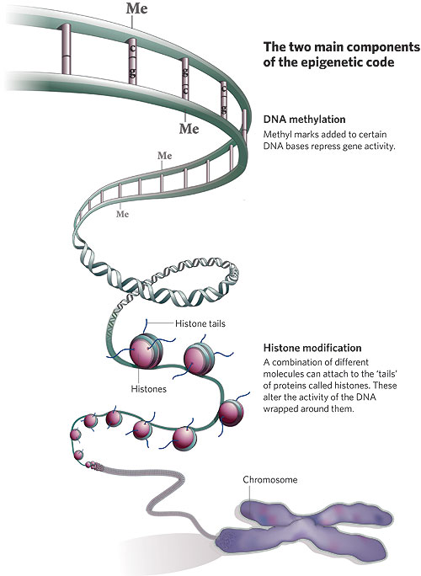
DEGs Critical for Epigenetic Regulation
M0-PBS
M1-IFNγ
M2-IL4
M1-LPS
M2-IL10
MaV-IFNα
M0-PBS
M1-IFNγ
M2-IL4
M1-LPS
M2-IL10
MaV-IFNα
MGMT
DMAP
DNMT1
DNMT1L
DNMT3A
DNMT3AL
DNMT3B
HADC1
HADC2
HADC3
HADC8
HADC5
HADC7
HADC9
HADC9L
HADC6
HADC10
HADC11
SIRT1
SIRT2
SIRT3
SIRT4
SIRT5
SIRT6
SIRT7
DNA methylatransferase
histone deacetylase
0.0
3.6
10.2
ASH1L
DOT1
EHMT1
EHMT2
EZH1
MLL1
MLL2
MLL3
MLL4
MLL5
NSD1
NSD3
SETD1A
SETD2
SETD8
SETDB1
SETDB2
SETMAR
SUV39H1
SUV420H2
WHSC1
0.0
6.7
42.9
KDM2A
KDM2B
KDM3A
KDM3B
KDM4A
KDM4B
KDM4C
KDM5A
KDM5B
KDM5C
KDM6A
KDM7
KDM8
NO66
Histone methyltransferase
Histone demethylase
0.0
13.9
19.1
0.0
11.0
21.0
http://www.eusem.com/main/CH/epi

Slide 11
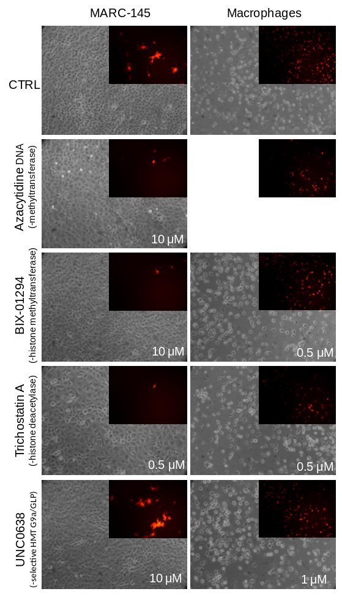
Regulation of PRRSV infection via Epigenetic Regulation

Slide 12
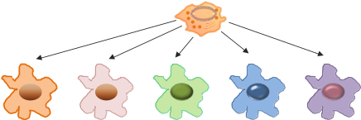
Summary
Porcine monocytic cells at different activation statuses, interact differentially with PRRSV
Key genes in the pathways such as lipid metabolism, epigenetics and interferon signaling are revealed among significant DEGs.
Signature genes revealed in PRRSV—infected macrophages at each activation status infer the mechanism of PRRSV-cell interaction.
Understanding and modulating cell activation status of monocytic innate immune cells provides a framework for optimizing antiviral immunity
Tissue macrophages
PRRSV
Differential activation statuses
Epigenetic regulation
Lipid metabolism
Interferon responses…
Routes for preventing
Deviation of activation statuses
Increase PRRSV permissiveness

Slide 13
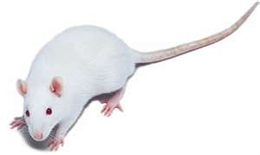
Objective and Approach
Male Wistar Rats: 6-wk old [Serum negative to Ad., Body Weight (BW): 125 5g]
Negative control: 12
Positive control-I: 24
Positive control-II: 24
Integrative induction: 24
Control diet (LF)*
High-fat diet (HF)*
Had-36*+LF
Had-36 + HF
(*human adenovirus 36
LF: LabDiet 5001 Fat 5.0%
HF: LabDiet 5SLA Fat 20.6%)
Body weight measured and blood samples taken weekly
Tissue samples taken at 8, 15, 30 wks
Aims:
Develop rat obesity model integratively induced by a high-fat diet and Had-36 infection
Validate obesity phenotypes including body weight, fat index, plasma leptin level, and parameters associated with gut/adipose inflammation
Extract ileal RNA from LF lean, Had-36+LF, HF and Had-36+HF obese groups
Perform transcriptomic analyses using 8-wk ileal and hypothalamus samples
Analyze gene ontology and pathway integration, and determine obesity-linked innate immune genes
de La Serre CB, et al., Am J Physiol Gastrointest Liver Physiol. 2010 Aug;299(2):G440-8.

Slide 14
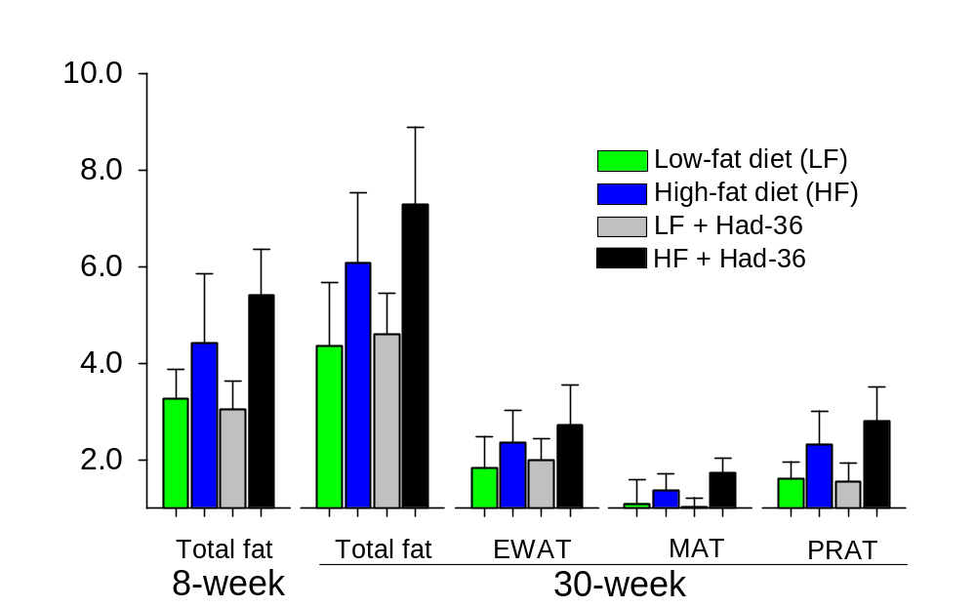
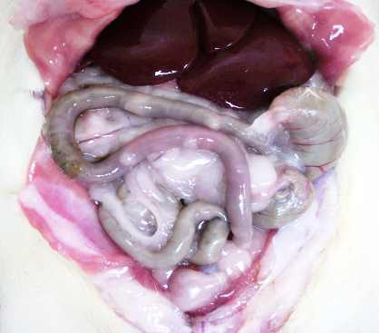
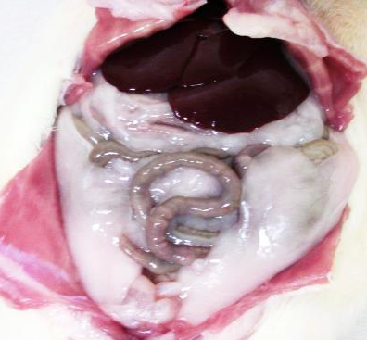
Results and Discussion
HF + Had-36 infection synergistically increased adiposity indexes in total fat or visceral fats in three adipose depots
**
*
**
*
*
p<0.05,
**
p<0.005, n=6-7
*
**
*
EWAT, MAT and PRAT: epididymal , mesenteric, and perirenal white adipose tissue
*
1. LF
4.HF+36

Slide 15
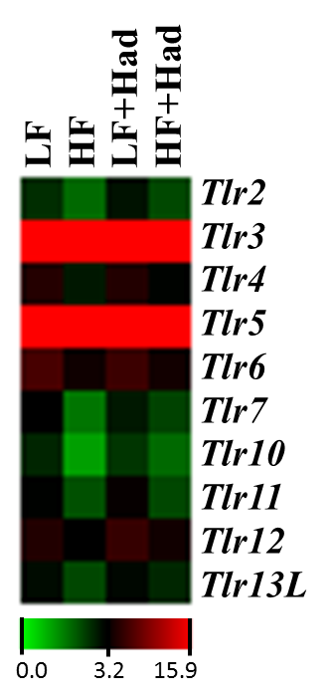
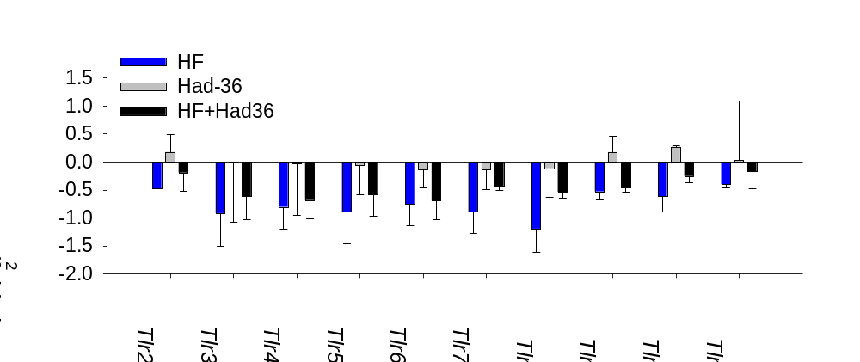
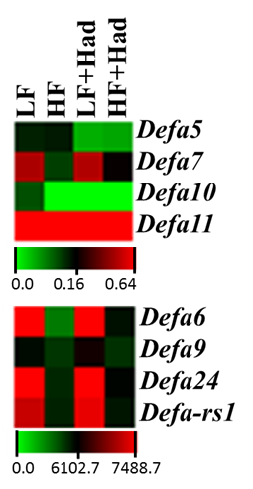
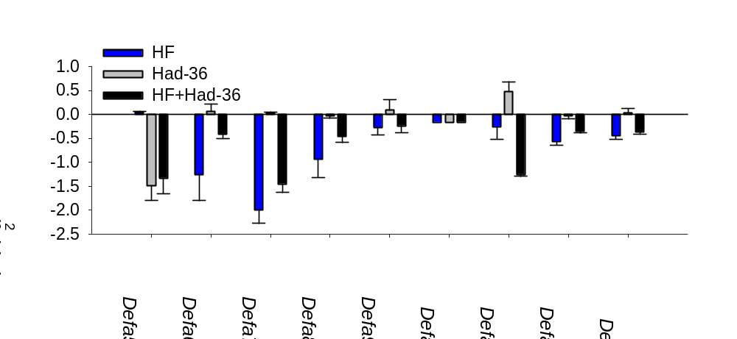
Results and Discussion
Profiling of Significant Differential Expression Genes
* p<0.05
*
*
*
*
*
*
*
*
*
*
*
*
*

Slide 16
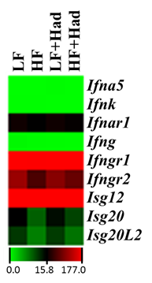
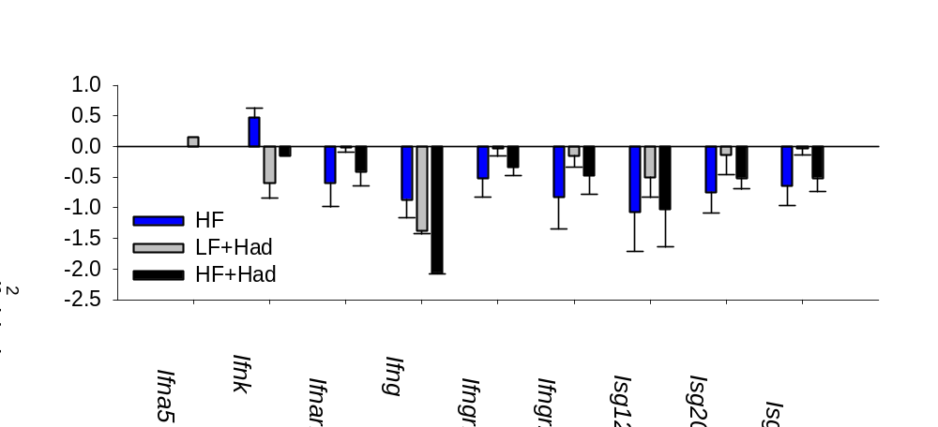
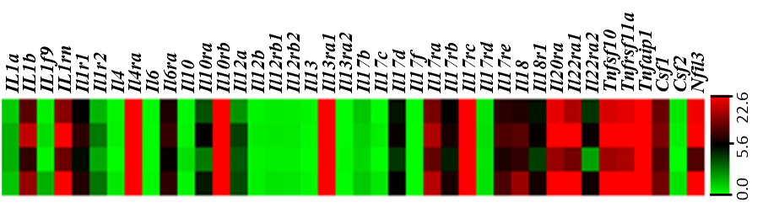
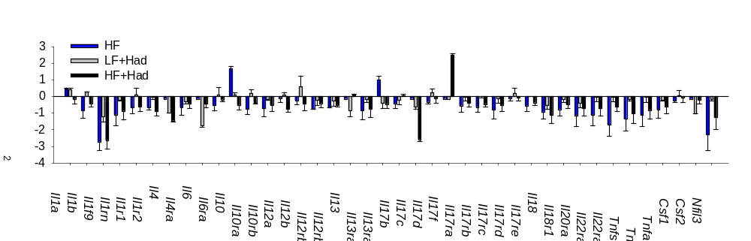
Results and Discussion
Profiling of Significant Differential Expression Genes
* p<0.05
*
*
*
*
*
*
*
*
*
*
HF+Had
LF+Had
HF
LF
*
*
* p<0.005
*
*
*
*
*
*
*
*
*
*
*
*
*
*
*
*
*
*
*
*
*
*

Slide 17
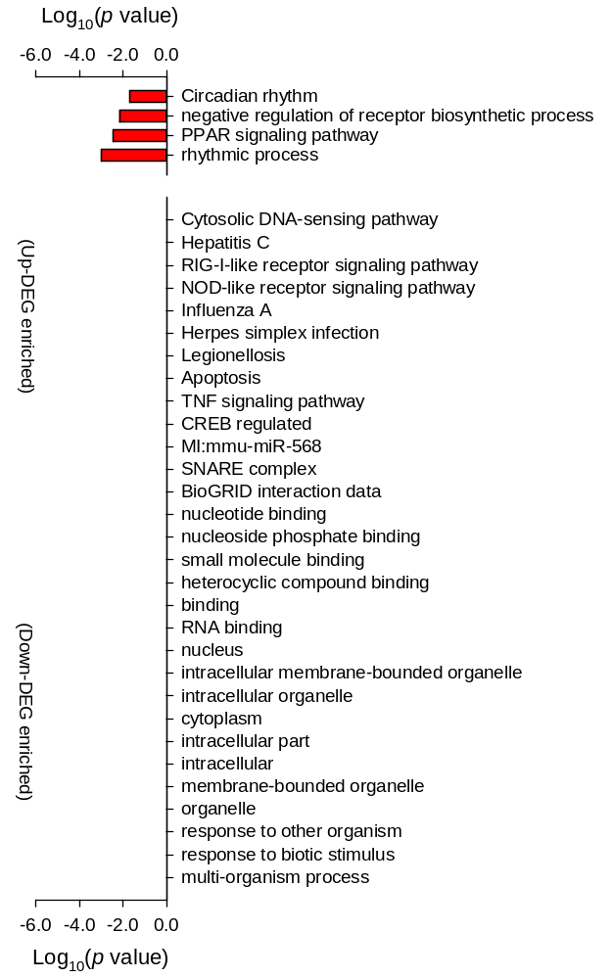
Results and Discussion
Pathway analysis and gene ontology (GO) analysis
HF + Had-36 infected group compared with control group
All 30, including 10 disease/immunity related (highlighted), pathways show little direct relation with lipid metabolic pathways but are highly relevant to intracellular and inter-organism communication (p<0.05)
Notes:
Nuclear hormone receptors are transcription factors that bind DNA and regulate transcription in a ligand-dependent manner. PPARs (Peroxisome Proliferator-Activated Receptors) are ligand-inducible transcription factors that belong to the nuclear hormone receptor superfamily, together with the receptors for thyroid hormone, retinoids, steroid hormones and vitamin D that act as ligand-activated transcription factors. PPARs regulate gene expression by binding with RXR (Retinoid X Receptor) as a heterodimeric partner to specific DNA sequence elements termed PPRE (Peroxisome Proliferator Response Element) (Ref.1). This heterodimeric transcription factor complex then binds to cognate sequences in promoter regions of target genes involved in the catabolism of fatty acids (Ref.2). PPAR ligands can be either synthetic, such as peroxisome proliferators, hypolipidaemic drugs, anti-inflammatory or insulin-sensitizing drugs, or endogenous, most of them being fatty acids or their derivatives. PPARs have been implicated in many normal and disease-related biologic processes relevant to the heart and vasculature including lipid and energy metabolism, inflammation, embryo implantation, diabetes and cancer.
There are 3 main isotypes of PPARs, PPAR-Alpha (NR1C1), PPAR-Beta (also called PPAR-Delta, NUC1 or FAAR), and PPAR-Gamma (NR1C3), which are distinguished by tissue- and developmental-specific patterns of expression and by the distinct, overlapping nature of lipid and eicosanoid ligands capable of activating each receptor (Ref.3). Although all three isotypes of PPARs have been shown to modulate lipid metabolism, each isotype also has specific functions (Ref.4). PPAR-Alpha is highly expressed in tissues with high rates of mitochondrial fatty acid oxidation, such as liver, heart, muscle, kidney and cells of the arterial wall (such as monocyte-derived macrophages, smooth muscle and endothelial cells), and it is activated by fibrates, fatty acids and eicosanoids, 15-d Ptg (15-Deoxy-Delta Prostaglandin-J2), and oxidized fatty acids (Ref.5). It regulates the expression of genes involved in lipoprotein metabolism, raising levels of apolipoprotein A-1, a major apolipoprotein of HDL (High-Density Lipoprotein). PPAR-Gamma is found in adipose tissues, and is activated by fatty acids or their derivatives, that plays a role in insulin sensitivity, adipogenesis and placental function. It activates transcription in concert with coactivators including SRC1 (Steroid Receptor Coactivator-1), and has also been implicated in a variety of neoplastic processes, including colorectal cancer. This receptor is the molecular target of TZD (Thiazolidinedione) class of antidiabetic drugs, which include rosiglitazone and pioglitazone (Ref.6). PPAR-Beta is found in most tissues, and is only weakly activated by fatty acids, Ptgs and leukotrienes and has no known physiologically relevant ligand (Ref.4). Once activated, PPARs bind to DNA and regulate gene transcription.

Slide 18
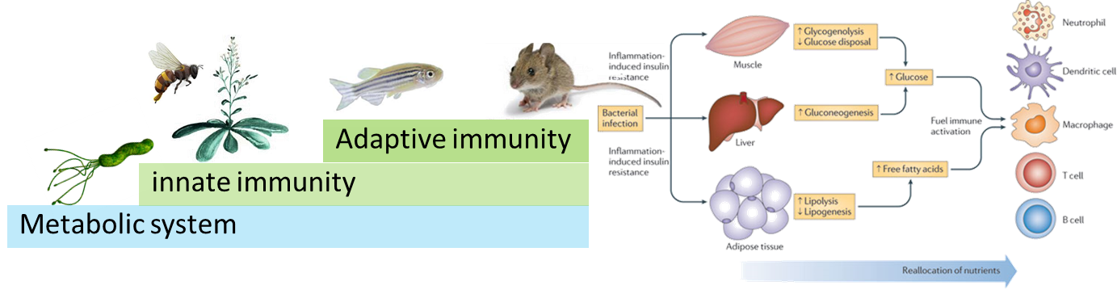
Summary
Infection of Had-36 synergizes with the induction of obesity by high-fat diet in rats; however, Had-36 infection has little effect in obesity induction in rats fed the control diet.
Either high-fat diet or Had-36 infection increases gut permeability and inflammation but has no synergistic effect (actually having antagonistic effect)
At 8-wk post treatment, rat ileal transcriptome shows significant down-regulation of multiple families of immune and metabolic genes in the HF and HF+Had-36 groups, as well as reprograming of circadian rhythm pathway.
Chawla A, et al. Nat Rev Immunol. 2011, 11:738-49.
Notes:
We adopt a lipid nanoparticle to combine the antiviral regulatory role of some metabolic mediator and vaccine backbone. For example, we have developed procedure to incorporate ToFA, the lipid metabolism regulator, into a lipid nanoparticle, then the lipid nanoparticle will be used to encapsulate bioengineered vaccine backbone, as I showed you previously, we have validate the antiviral effect of most of these vaccine component in cells. My collaborator, Dr. Laura Miller in USDA, has validated anti-PRRSV effect of the virus expressed IFN, they showed that only timely an effective IFN alone could stimulate effective anti-PRRSV activity. We believe, the system of IFN-expressed PRRSV system, will provide better immune potentiation through introducing both IFN and viral antigens to mimic wide-type PRRSV infection timely and in situ. With this, I will deliver some messages of my research primarily presented so far. (Read out)

Slide 19
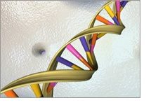






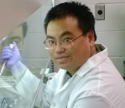





Acknowledgements
Laboratory colleagues:
Funding resources:
The studies are supported in part by (1) USDA-NIFA-COOP-2010-002475 (Co-PI: Sang, KSU); USDA NIFA AFRI 2015-67015-23216 (Co-PI: Sang, KSU), and in particular (3) USDA-NIFA-2013-67015-21236 (PI: Sang, KSU)
NIH 1R15HD066377-01 (Co-PI: Sang KSU), Pilot project (PI. Sang, KSU) of NIH NCRR-COBRE-P20-RR017686 (PD: Daniel Marcus, KSU)
Collaborators:
Dr. Frank Blecha, KSU
Dr. Raymond R. R. Rowland, KSU
Dr. Joan Lunney, USDA-ARS
Dr. Jishu Shi, KSU
Dr. Wenjun Ma, KSU
Dr. Laura Millar, USDA-ARS
Dr. Zhihua Jiang, WSU
Dr. Christopher Tuggle, ISU
Dr. Chris Netherton (Pirbright, UK)
Dr. Bryan Charleston (Pirbright, UK)
Dr. Linda Dixon (Pirbright, UK)
Dr. Ruth Welti (Kansas Lipdomics)
Dr. Robert Goodband (KSU, Animal Science)
and Mr. Frank Jennings Jr (KSU, Animal farms)
Joe Bergkamp
Wyatt Brichalli
Andrew Schade
Samantha Lyman
Lyndie Holmes
Lab manager:
Dr. Barbara Lutjemeier
Visiting Scholar:
Dr. Xiaorong Zhang
Qinfang Liu
Amy Hanson
Wenjing S. Fausnett
Jinhwa Lee
Luca Popescu
Immunophysilogy Lab
2011-2015

Slide 20
Thank You!

Slide 21
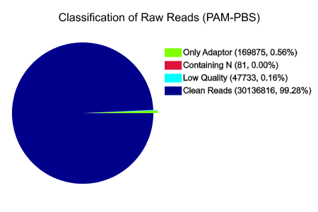
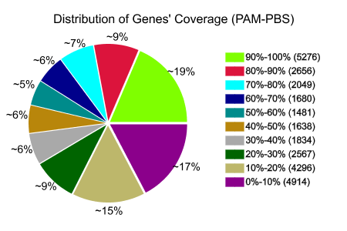
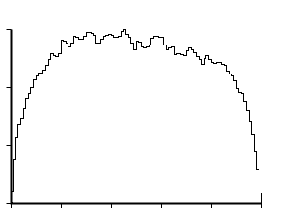
RNA-seq Data Quality Control and DEG Analysis
Classification of Raw Reads (M0: PAM-PBS)
30
20
10
0
Number of reads (×10³)
0.0 0.2 0.4 0.6 0.8 1.0
Relative Position in Gene (5’-3’, 100 windows)

Slide 22
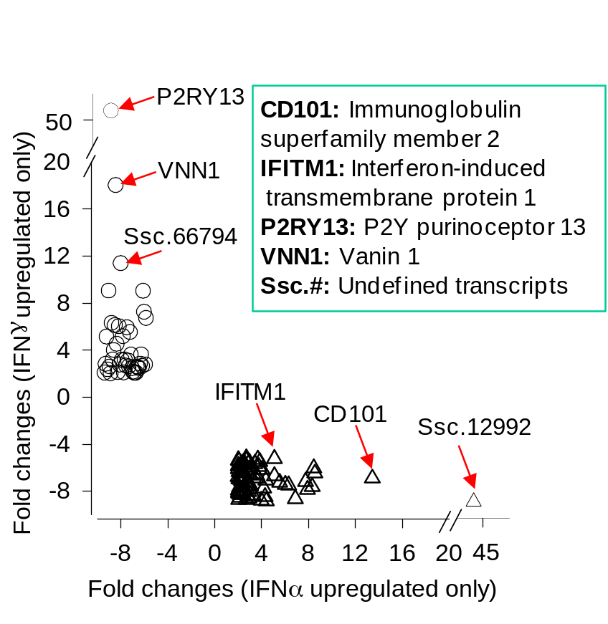
Profiling Signature Genes of Each Activation Status
Table 1: Numbers of potential gene makers identified in each activation status.
Status |  | DEG number
(1) IFNγ-M1 |  | 44
(2) IFNα-MaV |  | 72
(3) Co-IFNγ & IFNα |  | 88
(4) IL4-M2 |  | 234
(5) LPS-M1 |  | 72
(6) IL10-M2 |  | 9
Total |  | 519

Slide 23

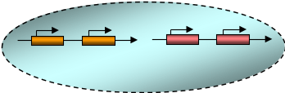


Background and Hypothesis
Hypothesis: Viral infection and high-fat diet can induce obesity independently, and in particular may contribute to prevalence of obesity synergistically.
High-fat diet
Gut bacteria
Mucosal antimicrobials, and cytokines
Bacterial and lipid sensors, eg. TLR4
Gut viruses
(endosome)
Viral sensors
Tight junction
Intestinal
epithelial
barrier
NF-κB
IRFs
Cytokines
IFN-α/β
?
Gut low-grade chronic inflammation
Peripheral circulation
Adipose low-grade chronic inflammation
Obesity
Mitra AK, Clarke K. Viral obesity: fact or fiction? Obes Rev. 2010 Apr;11(4):289-96.
Dhurandhar NV. Insulin sparing action of adenovirus 36 and its E4orf1 protein. J Diabetes Complications. 2013 Mar-Apr;27(2):191-9.
Notes:
High-fat diet, gut microbiota and gut viral infection are among major etiological factors causing obesity. Innate immune mechanisms that response to gut infection and gut microbiota changes, such as TLR4/5 for bacterial and PKR for viral infection, are critical in regulation of obesity. Emerging evidence shows that changes in gut inflammation/microbiota precede and correlate with obesity induced by high-fat diets. Although viral infections or high-fat diets can induce obesity independently, each agent may use different immunometabolic pathways to regulate gut microbiota/chronic inflammation and to induce obesity. In particular, these two agents may integratively contribute to natural prevalence of obesity

Slide 24
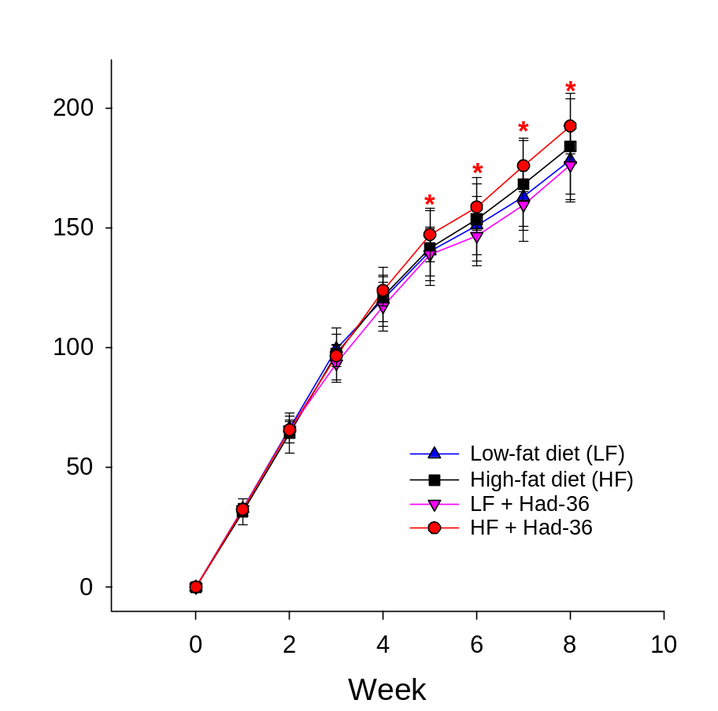
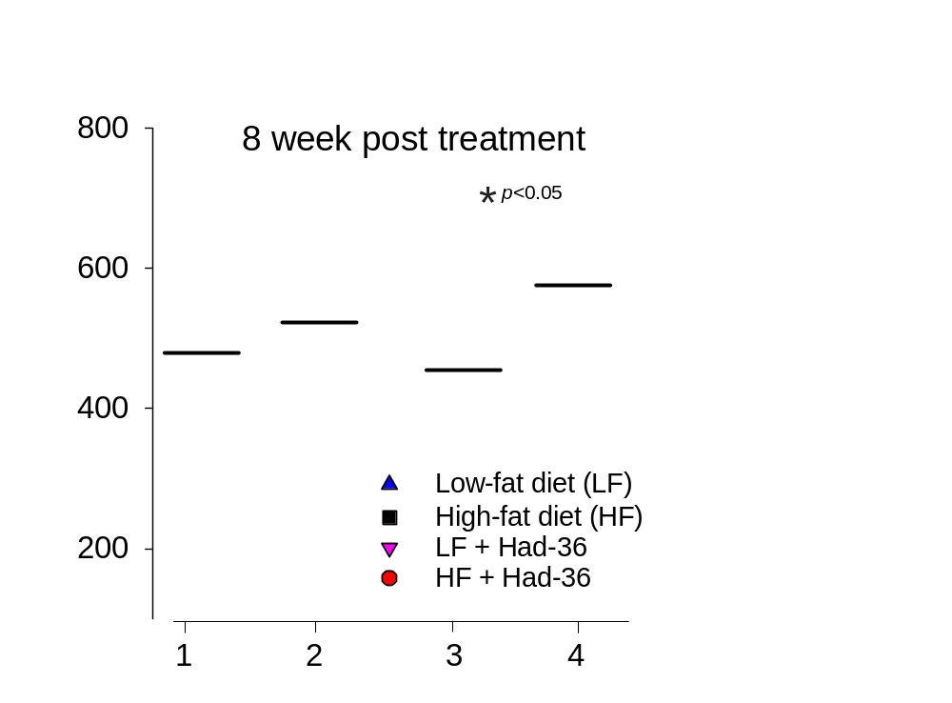
Results and Discussion
HF + Had-36 infection synergistically increased BW after 5 wk
Had-36 infection without HF had little effect
Ave. BW diff: 20-30 g between HF groups with LF groups
Vander Wal JS, Huelsing J, Dubuisson O, Dhurandhar NV. An observational study of the association between adenovirus 36 antibody status and weight loss among youth. Obes Facts. 2013;6(3):269-78.

Slide 25
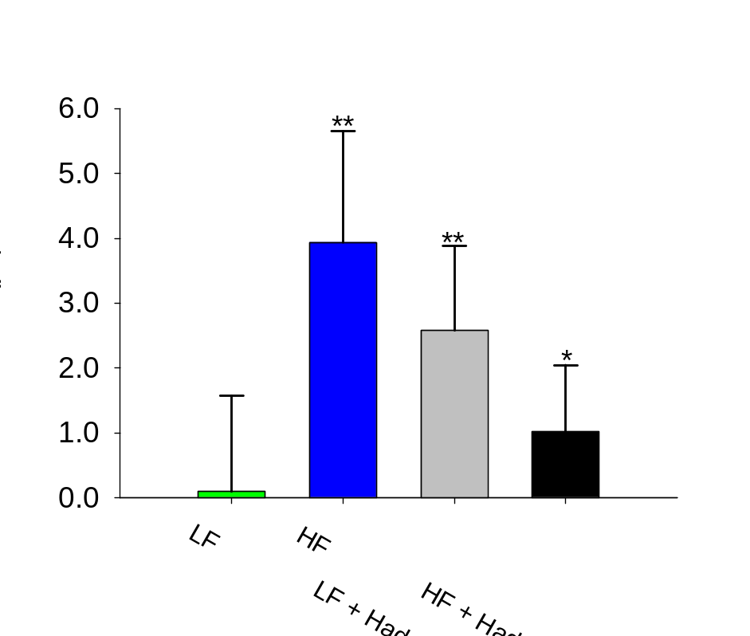
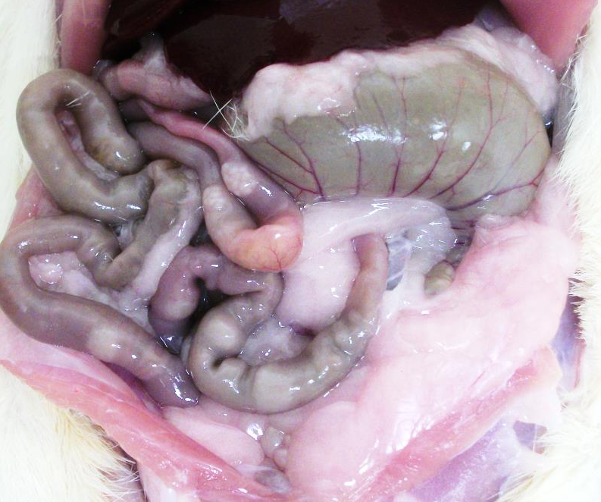
Results and Discussion
*
p<0.05,
**
p<0.005, n=6-7
2.HF
Either high-fat diet or Had-36 infection increases gut permeability but has no synergistic effect (actually having antagonistic effect) . Thus, the development of obesity is associated but may not proportionally correlated with an increase in gut permeability.

Slide 26
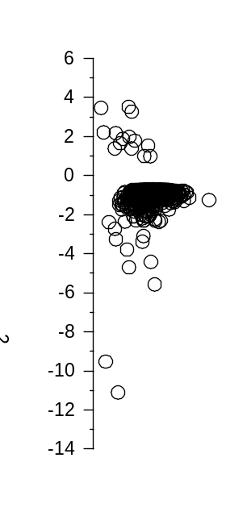


Results and Discussion
Profiling of Significant Differential Expression Genes
HF DEGs: Total: 1483, Up 15
HF+Had DEGs: Total: 626, Up 23
Had DEGs: Total: 118, Up 29

Slide 27
Let Us Meet Again
We welcome you all to our future conferences of OMICS International
Please Visit:
http://transcriptomics.conferenceseries.com/
http://conferenceseries.com/
http://www.conferenceseries.com/genetics-and-molecular-biology-conferences.php

