Slide 1

N-linked Glycan Characterization and Profiling: Combining the Power of a Novel Labeling Reagent and a Streamlined Analytical Workflow
Ying Qing Yu Ph.D
Waters Corporation
Glycobiology World Congress 2015

Slide 2
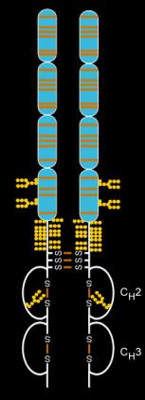
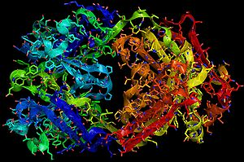
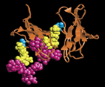
Glycosylation is a Key Critical Quality Attribute
The International Conference on Harmonization Guideline Q6B requires the analysis of carbohydrate content, structural profiles, and characterization of the glycosylation site(s) within the polypeptide chain(s).
Erythropoietin
3 N-linked sites
1 O-linked site
34 KDa
TrastuzumAb,
1 N-linked site
150 KDa
Entanercept
3 N-linked sites
13 O-linked sites
51 Kda
figures are from Wikipedia

Slide 3
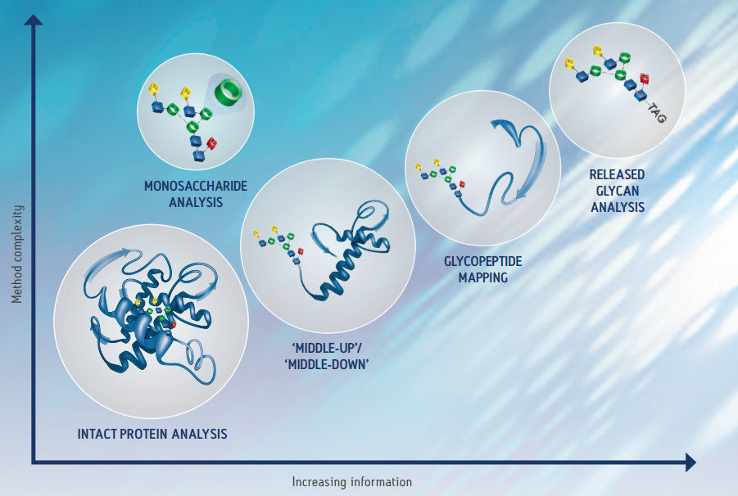
Glycoprotein Characterization
Multiple Strategies – Complementary Information
Notes:
And there are many strategies used in glycoprotein characterization, each involving methods of varying complexity and each providing complementary, albeit varying levels, of information.
Intact protein analysis is often employed to obtain a global view on glycan content, middle-up/down LC/MS strategies to obtain high resolution data and domain specific information, glycopeptide mapping to elucidate linkage sites, and monosaccharide analysis where compositional information about glycan modifications is obtained.
However, with little dispute, it could be said that the most important tool for obtaining glycan information is released glycan analysis.

Slide 4
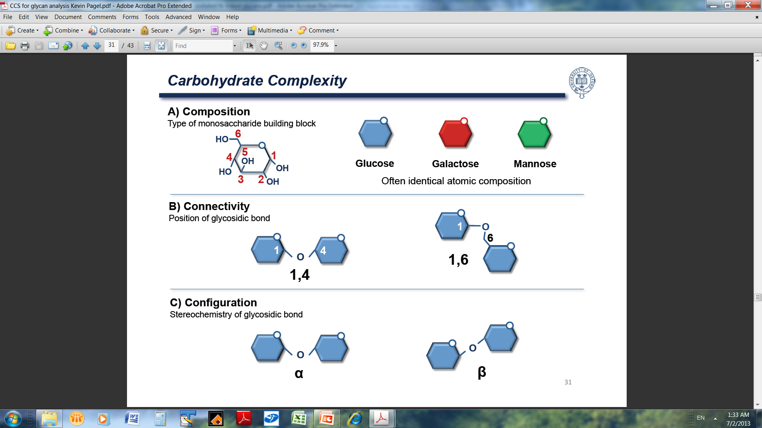
Carbohydrate Complexity

Slide 5
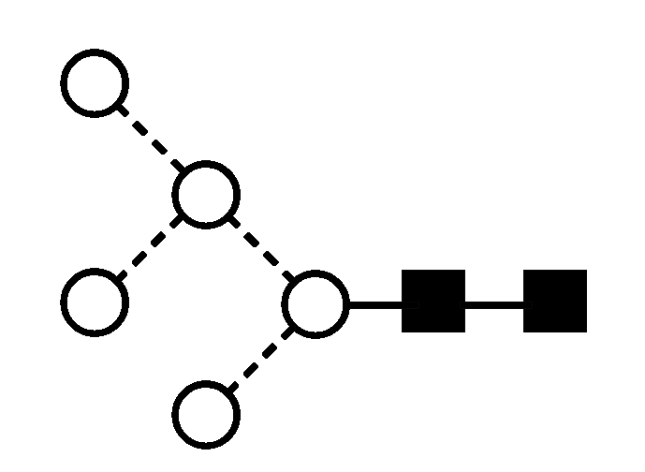
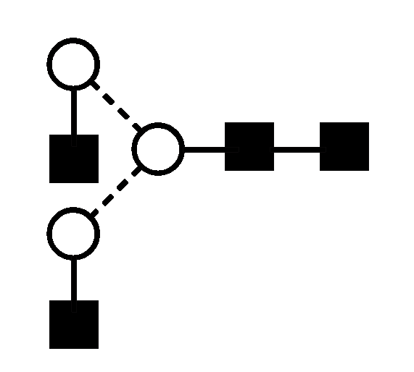
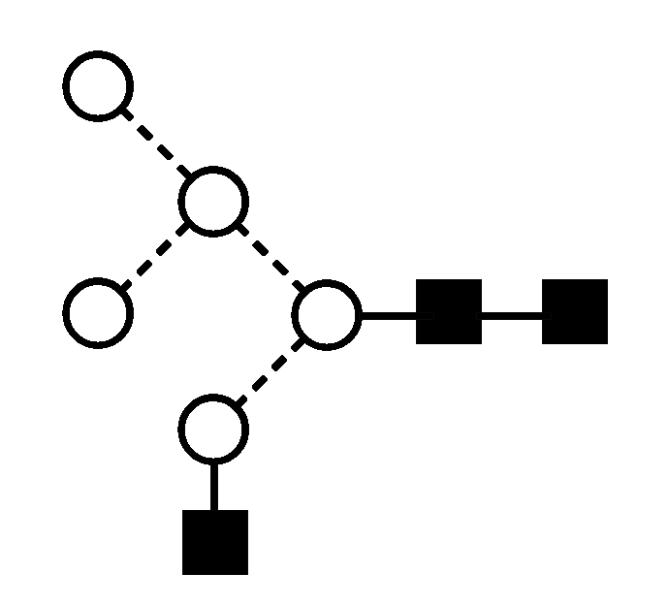
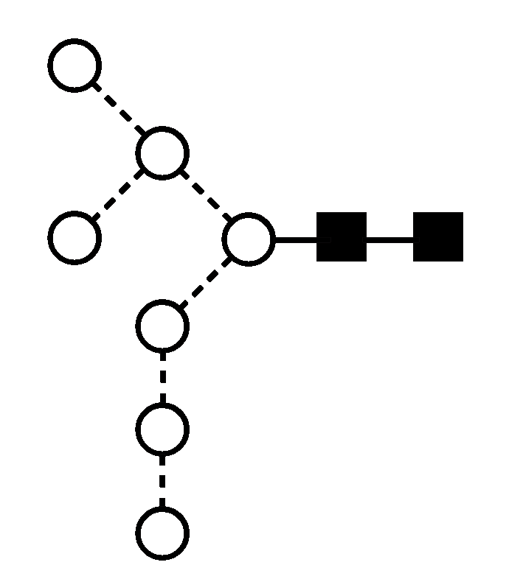
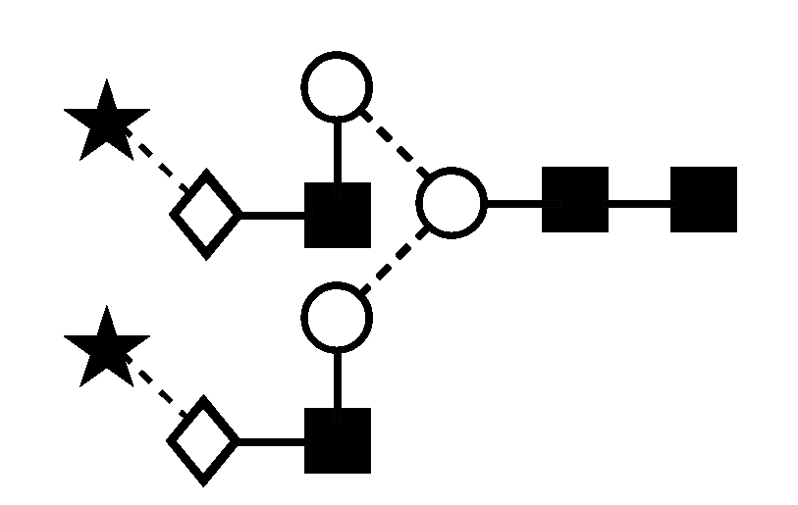
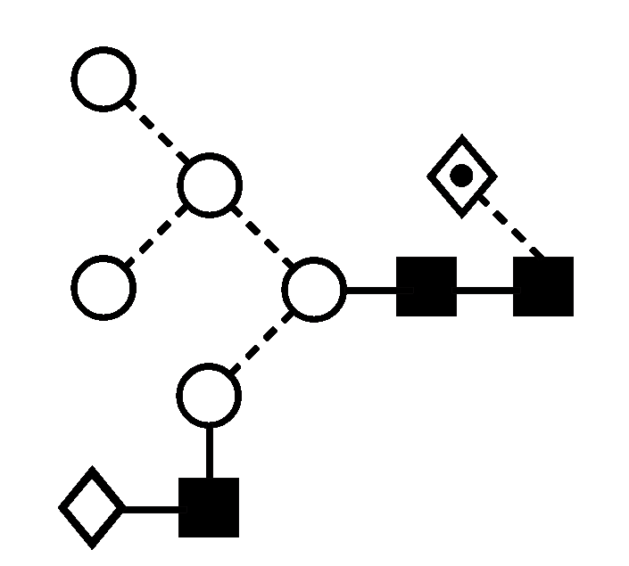
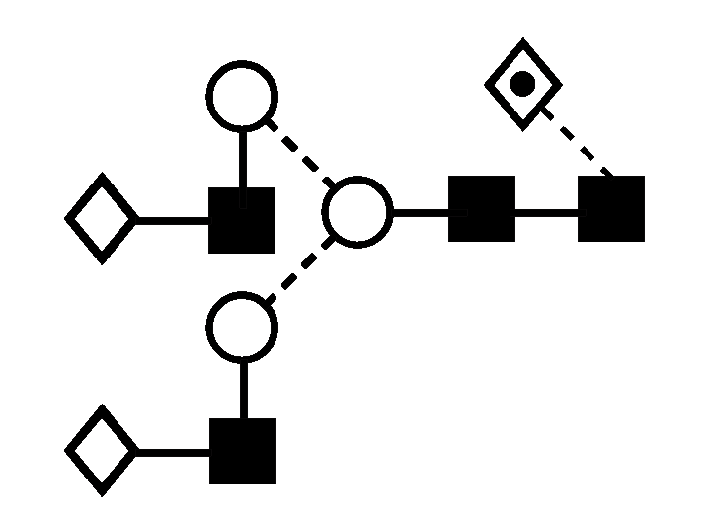
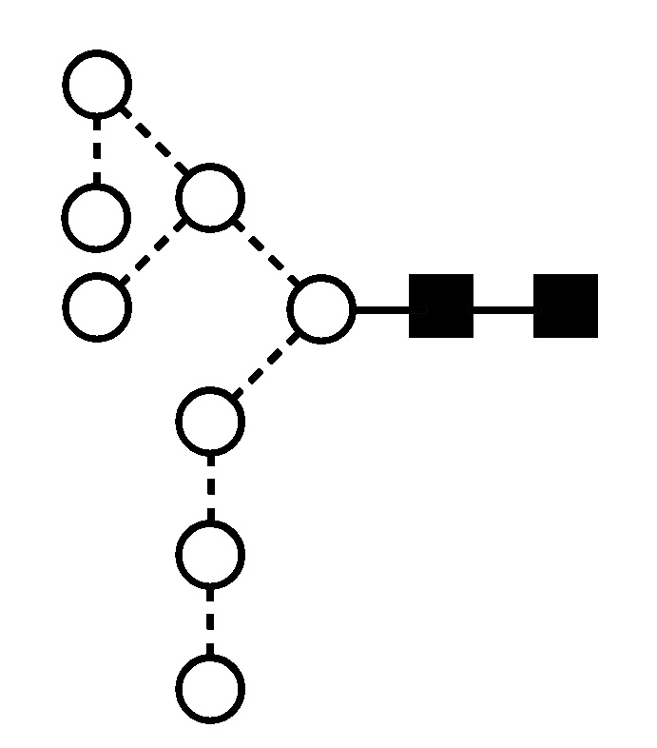
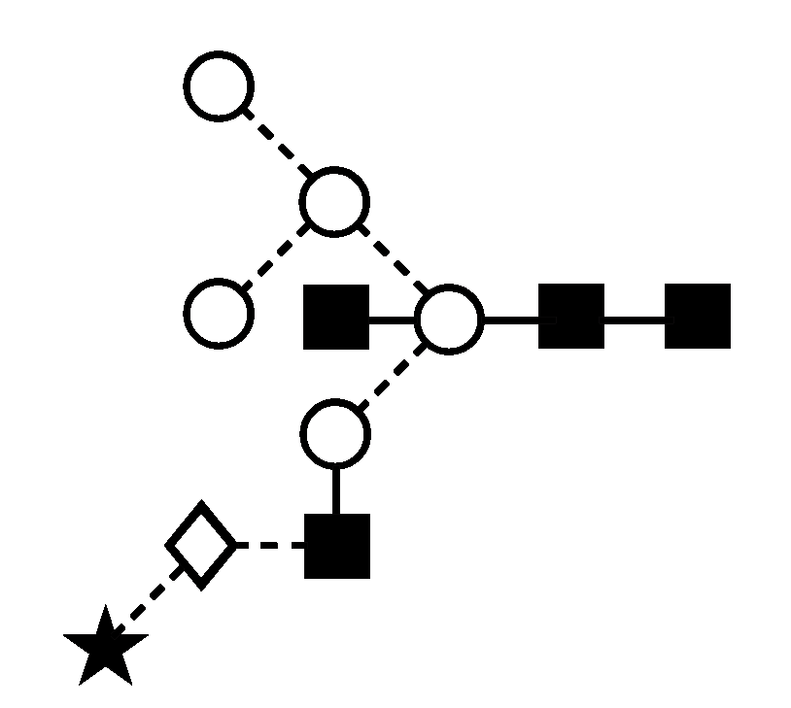
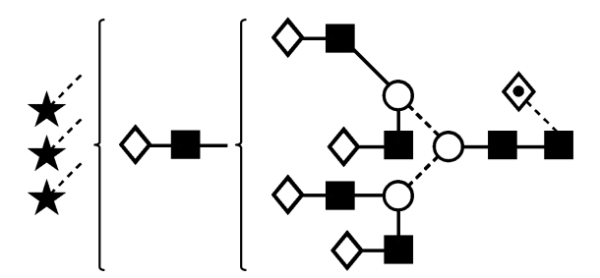
Classes of N-Linked Glycans
High Mannose
Complex
Hybrid

Slide 6
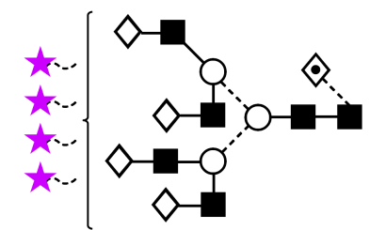
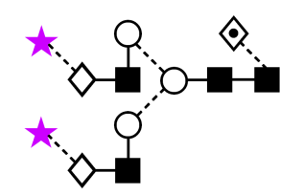
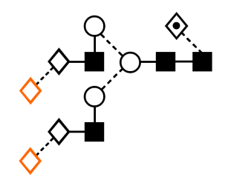
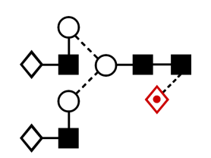
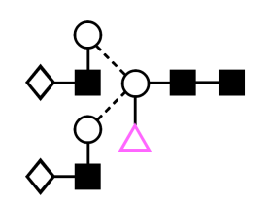
Influence on Biopharmaceutical Production
Loss of sialylation decreases EPO half-life from 2 h to 10 min
Fukuda et al (1989). Blood; 73(1): 84-89
Asn
Desialylation of intravenous immunoglobulin
abrogates its anti-inflammatory properties
Kaneko et al (2006). Science; 313(5787): 670-673
Asn
Asn
Presence of gal-α(1,3)-gal can induce anaphylaxis (shock) and can be present on biotherapeutics
Chung et al (2006). N Engl J Med; 358(11): 1109-1117
Asn
Half of all people contain antibodies against β(1,2)-xylose and α(1,3)-core fucose
Bardor et al (1995). Glycobiology; 13(6): 427-434
Asn

Slide 7
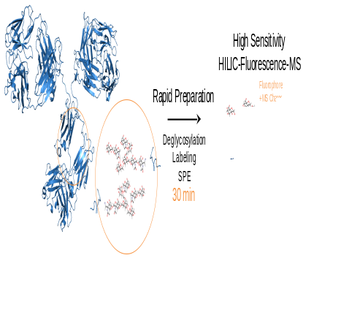
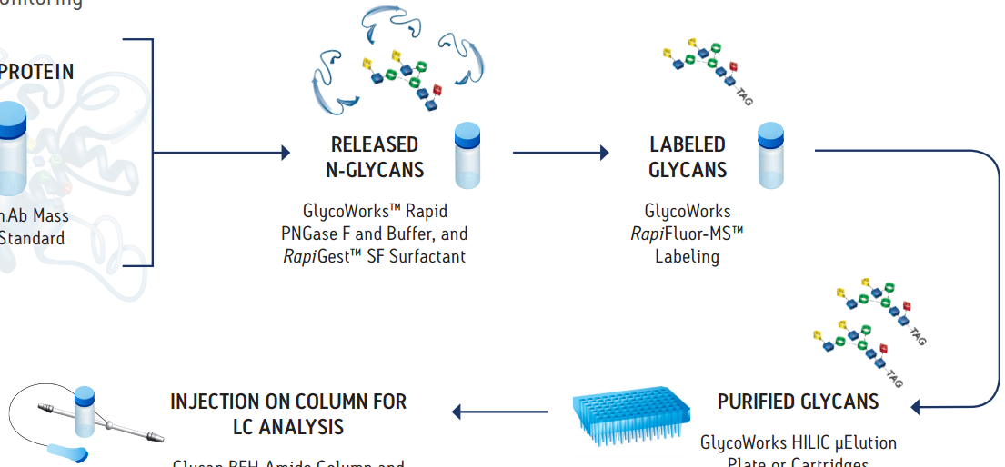
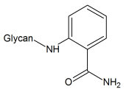
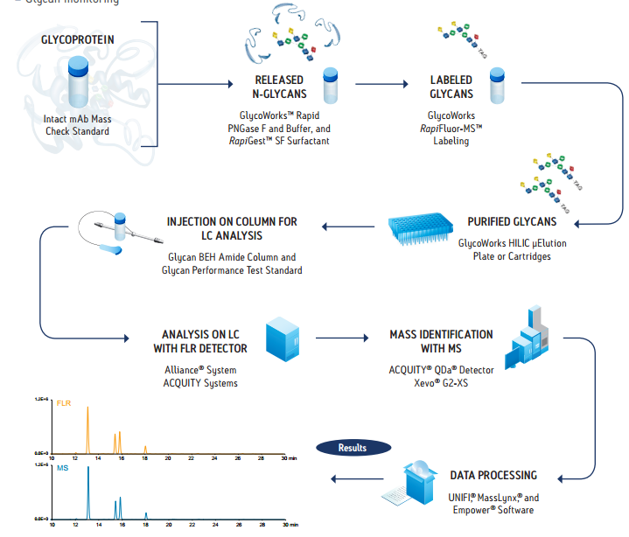
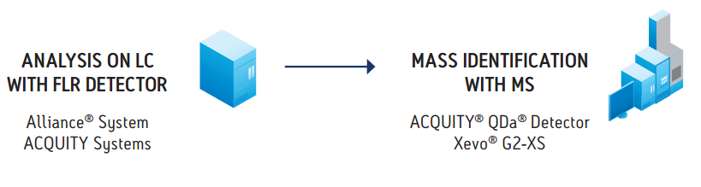
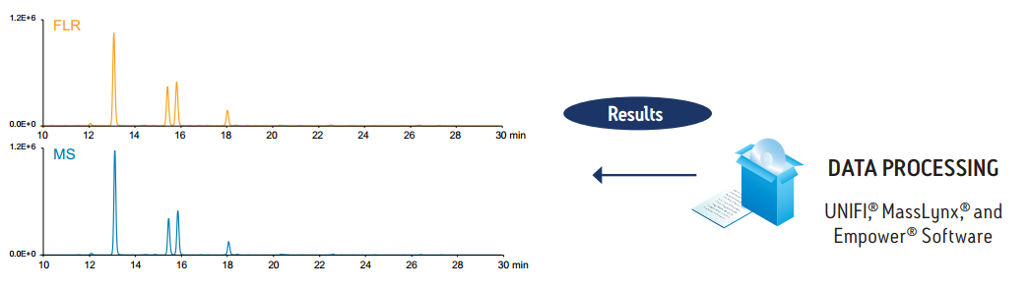
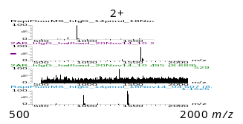
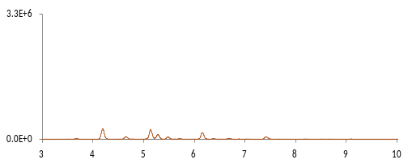
Released Glycan Analysis
HILIC Profiling
Conventional
2-AB
5 Hours
to
2 Days
MS
FLR
Notes:
Most analytical strategies for evaluating N-glycans from glycoproteins involve deglycosylation via PNGase F and the labeling of the resulting N-glycans with a chemical moiety that imparts a detectable attribute.
In one, highly effective approach, labeled glycans are separated by hydrophilic interaction chromatography (HILIC) and detected by fluorescence (FLR) and potentially even mass spectrometry (MS).
Unfortunately, current approaches to the preparation of N-glycans for HILIC-FLR-MS are either laborious and time-consuming or require compromises in sensitivity.
For instance, a conventional deglycosylation procedure often employs an overnight incubation and is then combined with a lengthy, 2 to 4 hour labeling based on reductive amination of aldehyde termini, which form on N-glycans only after they hydrolyze from their glycosylamine forms.
And in the case of one of the most frequently employed labeling compounds, 2-aminobenzamide (2-AB), the obtained glycans can be readily detected by fluorescence but be rather challenging to detect by MS due to their poor ionization efficiency.

Slide 8



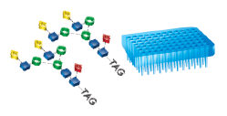
Conventional Workflow
Conventional
Glycoprotein
Deglycosylation
16 hrs
Released
N-Glycans
+ Protein
(Pre-Labeling Clean-Up)
(Drying)
1-3 hrs
Labeling
3 hrs
Labeled
N-Glycans
+ Reagents
Reaction
Byproducts
Clean-up
0.1 hrs
Labeled
Glycans
(Drying)
2 hrs
>24 HOURS
Analysis
LC-FLR
LC-FLR-MS

Slide 9
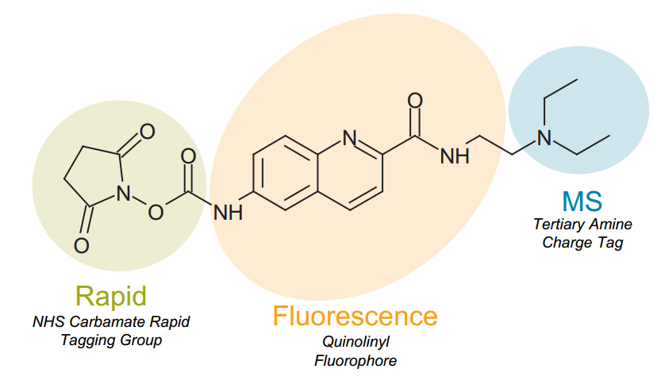
What is new?
Novel RapiFluor-MSTM (RFMS) Reagent
Patent Pending
Notes:
To develop this new reagent, we revisited Waters’ expertise in rapid, fluorescence labeling of amino acids
For 20 years, Waters has been providing a solution for amino acid labeling that uses the novel reagent, known as AccQ Fluor.
This molecule has 2 very important chemical characteristics; that it has a rapid tagging reactive group and that it has an efficient fluorophore for high sensitivity fluorescence detection.
To facilitate modern N-glycan analyses, AccQ Fluor was functionalized so as to have a third chemical property, an MS enhancing tertiary amine charge tag. This has produced a novel labeling reagent, that we are calling RapiFluor-MS.

Slide 10
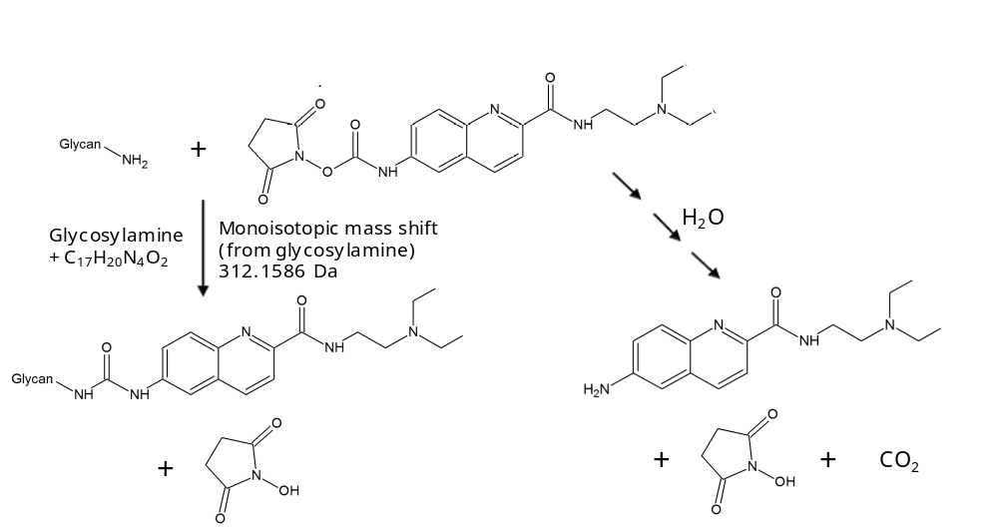

RapiFluor-MS Reagent
Rapid Reaction Kinetics
Tertiary Amine
MS-Active Charge Tag
NHS Carbamate
Rapid Tagging Group
Glycan
ΔMass
312 Da
Quinoline Fluorophore
Reaction Time = Seconds
Procedure Time:
Glycan
Highly stable urea linkage
Notes:
An NHS-carbamate reactive group was chosen for its rapid reaction kinetics.
Electrophilic reactive groups activated with NHS leaving groups have long been used to modify proteinaceous amine residues.
Here, the highly reactive NHS carbamate group of RFMS facilitates reactions with N-glycosylamines on the order of seconds.
Within a 5 minute procedural step, N-glycans are labeled with the new reagent under ambient, aqueous conditions to yield a highly stable urea linkage.

Slide 11


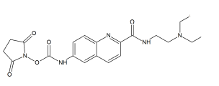

Simplified Sample Preparation
Conventional
GlycoWorks RapiFluor-MS N-Glycan Kit
Glycoprotein
Deglycosylation
16 hrs
Released
N-Glycans
+ Protein
<15 min
(Pre-Labeling Clean-Up)
(Drying)
1-3 hrs
Labeling
3 hrs
Labeled
N-Glycans
+ Reagents
5 min
Reaction
Byproducts
Clean-up
0.1 hrs
10 min
Labeled
Glycans
(Drying)
2 hrs
>24 HOURS
Analysis
30 min
LC-FLR
LC-FLR-MS
Patent Pending

Slide 12
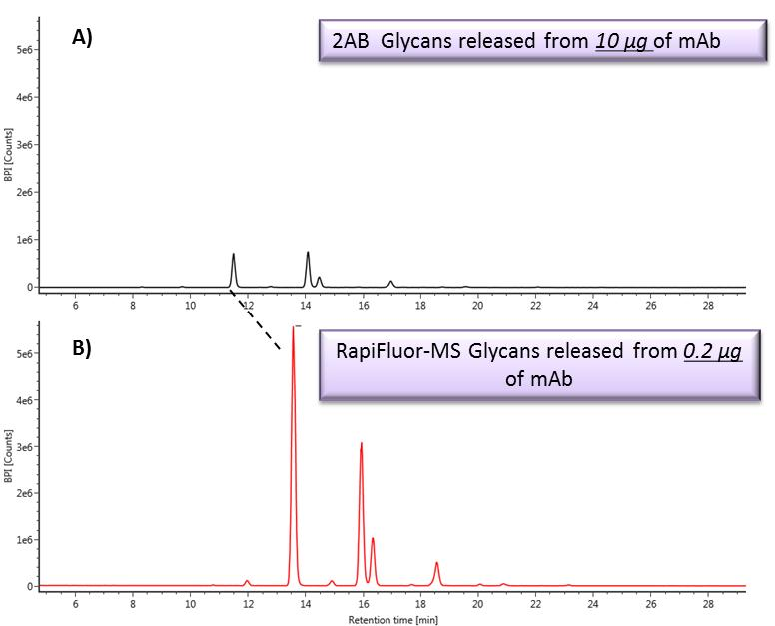
RFMS vs. 2AB for MS sensitivity comparison
Greater than 100x MS response over 2AB labeling
2AB
BPI MS
RFMS
Sample: NIST RM 8670 mAb lot #3F1b
Notes:
The first example is that of glycan characterization.
It should be pointed out that the new Xevo G2-XS QTof is ideally suited for glycan characterization. Specifically because the Xevo G2-XS QTof is constructed with a unique segmented, high transmission collision cell that produces very high sensitivity MS and MS/MS analyses.
Nevertheless, there is and will remain an issue with MS analysis of glycans prepared by conventional approaches. Specifically, there is a challenge to obtain sufficient MS information for all peaks observed in a high sensitivity fluorescence profile.
This is highlighted in this example. On the top chromatogram, the MS signal observed for glycans prepared by a conventional 2-AB approach is represented. The analysis was on glycans from 10 micrograms of glycoprotein and a sample prep procedure that took 1 and a half days to complete.
5) In contrast, the bottom chromatogram highlights results from rapiFluorMS labeled glycans. Here, glycans from 100x less glycoprotein and a 30 min sample prep were analyzed.
6) It is clear that compared to 2-AB, RapiFluorMS provides huge gains in MS sensitivity.
7) This means that for even low abundance species in the profile, glycans are detected with clean, interpretable mass spectra. Thorough characterization of a glycan profile is thereby made significantly easier.

Slide 13
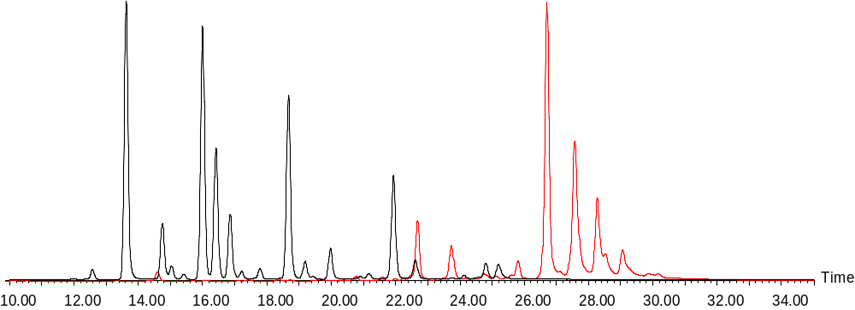
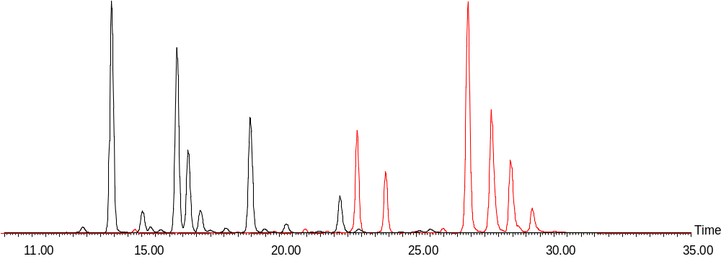
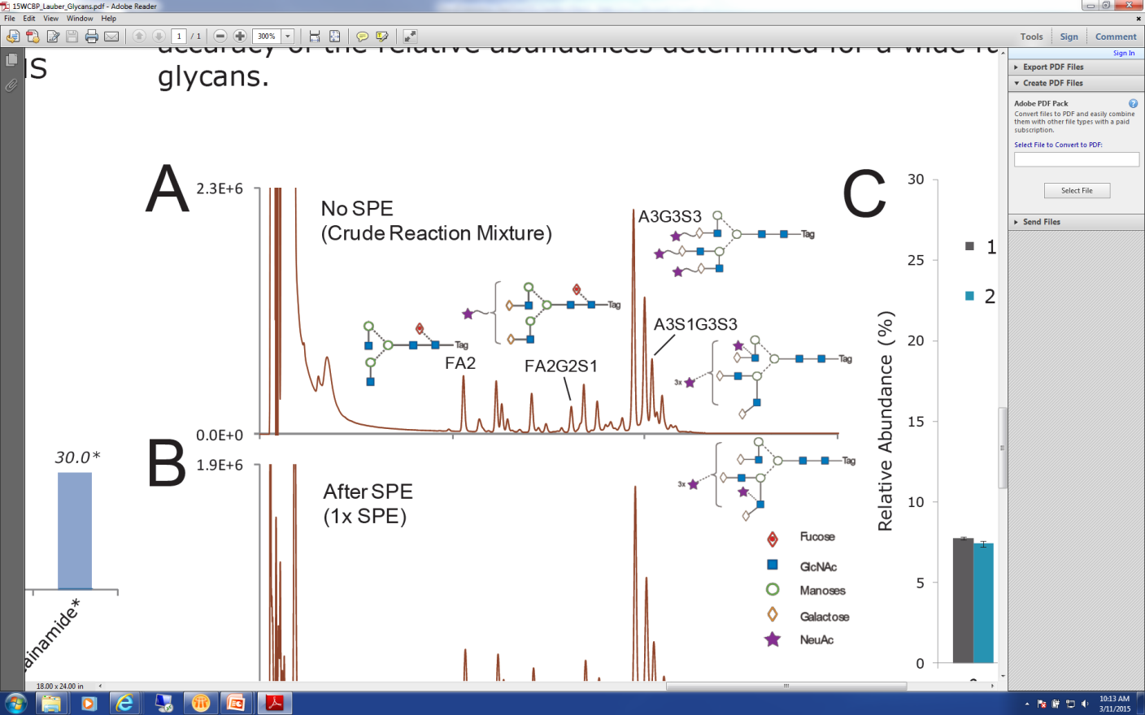


Glycan Characterization with RFMS Labeling
Comparable FLR and MS response across a broad range of glycans
IgG
Simple bi-antennery structures
Fetuin
Large, complex structures
FLR
FA2
A3G3S3
BPI MS
A3S1G3S3
FA2G2S1
Xevo G2-XS QTof
Notes:
So let’s look first at N-glycan detection with the RapiFluor-MS label using both a fluorescent detector and the Xevo G2-XS QTof. Represented on this slide are the combined chromatograms of released N-glycans from 2 different samples that were chosen to reflect a broad range of glycans that are typically seen and monitored in biotherapeutic development and production settings. These are 1) human IgG, which includes mainly simple bi-antennery glycan structures, 2) Bovine Fetuin, which includes many larger and more complex multi-antennary glycan structures. The chromatograms show FLR and MS comparable detection responses. Combining the RFMS labeling and highly sensitive Xevo G2-XS QTOF MS instrument, we are now able to detect minor glycoforms with high confidence. All glycan species detected by FLR are assigned with accurate mass which has never been achieved previously.
Additional experimental information:
Sample prep
Starting protein material: 15ug
Chromatogram was obtained from RFMS labeled released N-glycans from 0.5ug of protein per injection.
UPLC Settings
All Chromatographic mobiles are prepared using LC/MS compatible solvents and reagents.
Column: ACQUITY UPLC BEH Glycan Column, 2.1 × 150 mm, 1.7 um
Column temp: 60 °C
Mobile phase A: 50 mM Ammonium Formate (pH 4.4)
Mobile phase B: 100% Acetonitrile
UPLC HILIC LC gradient table:
Time FR %A %B Curve
0 0.4 25 75 6
40 0.4 49 51 6
41.5 0.2 100 0 6
44.5 0.2 100 0 6
48.1 0.2 25 75 6
52.6 0.4 25 75 6
0.4 25 75 6
FLR Settings:
Excitation: 265nm
Emission: 425nm
Xevo G2-XS QTOF MS:
ESI + in Sensitivity mode (Resolution ~ 30,000)
Capillary Voltage: 3.0 kV
Cone: 80 V
Source Temperature: 120
Desolvation Temperature: 300 ͦC
Desolvation Gas Flow: 800 L/h
LockSpray:
Capillary Voltage: 3.0 V
Cone V: 40 V
Scan Time: 0.5 s
Interval: 20 s
GFP solubilized in 0.1% Formic Acid with 50:50 (MeCN: H20) at 200 fmol/ul was infused, m/z = 785.8421 (z = 2) was used for lock mass calibration

Slide 14
10.00
15.00
20.00
25
.
0
0
30
.
0
0
35
.
0
0
40
.
0
0
Notes:
Let’s also take a closer look at the fetuin data. Futuin has both small neutral and large sialylated glycans present within wide dynamic range. The dominant glycan species in Fetuin are sialylated glycans whereas the neutral glycans are presented in much lower level. They can be well separated by our BEH amide glycan UPLC column and method with high resolution.
(Click, click) Zoom in the chromatogram area with low FLR/MS responses.
(Click) Now we can see that each of the minor FLR peaks can also be observed on BPI MS chromatogram. You can see it in FLR, you can see it in MS!

Slide 15
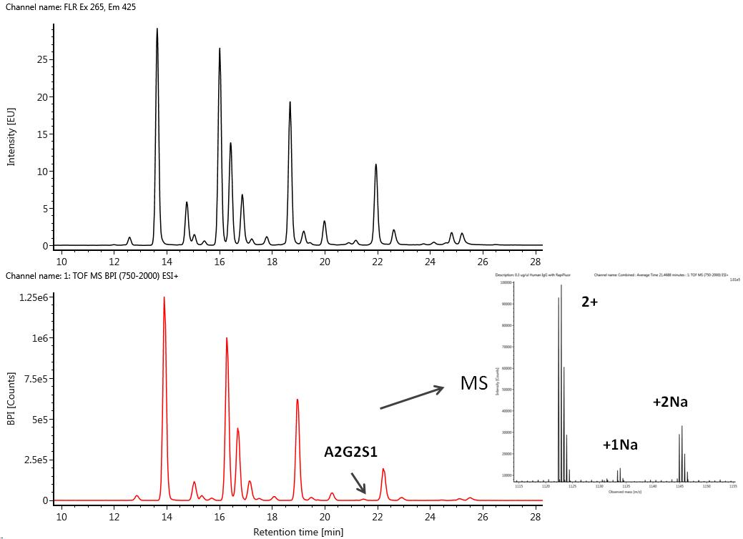
RFMS Labeling Enables MS Detection of Very Low Abundance Glycans
Human IgG
FLR
MS BPI
MSMS
Notes:
Next, Let’s also take another closer look at the Human IgG data, and the FLR and BPI MS chromatograms are shown here. A minor glycoform, A2G2S1, representing 0.1% total FLR signal is detected by Xevo G2 XS Qtof. The MS spectrum shows a doubly charged ions as the dominant ionized species of A2G2S1.
(Click) Very often, MSMS data will be needed to confirm the identity of the glycans and obtain structure information. In this experiment, Data Dependent Acquisition (DDA) was used for MS/MS analysis with CID to generate glycan fragmentation data.
Additional information:
Sample prep
Starting protein material: 15ug
Chromatogram was obtained from RFMS labeled released N-glycans from 0.5ug of protein per injection.
Collision Induced Dissociation
MS/MS analyses were performed in continuum mode from 100 - 2000 m/z with collision induced dissociation (CID) to generate glycan fragmentation data. Ions with 2+ and 3+ charge states were selected for fragmentation. Customized collision energy tables that were charge state and mass specific were used for optimized fragmentations; the approximated CE range was between 15 to 40 eV. Data Dependent Acquisition (DDA) was used with duty cycle times of 1.6 sec and 0.5 sec for MS and MS/MS modes. The two most abundant precursors were selected for fragmentation.

Slide 16
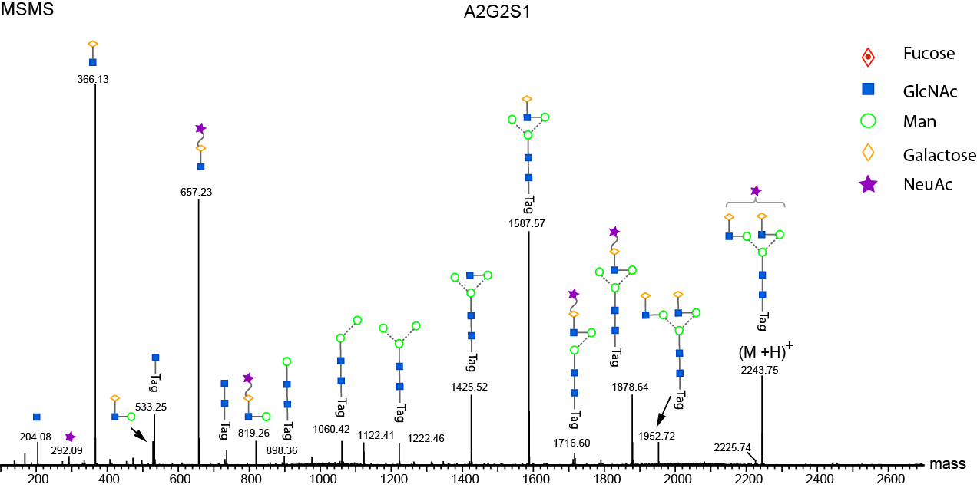
RFMS extends MS enhancement throughout the glycan fragmentation pattern
Notes:
The MSMS spectra of A2G2S1 showed very informative fragmentation pattern to elucidate the glycan structure.
The glycosidic bond cleavage from both reducing and non-reducing end was the dominant fragmentation pathway. The observed sequential neutral losses from the non-reducing end stops at the 1st GlcNAc residue at the reducing end with the RFMS label attached. Therefore, MS sensitivity enhancement with RFMS label extends throughout the glycan fragmentation pattern. Also, the counter fragment ions from the non-reducing end, oxonium ions, were readily observed. The overall fragments obtained using CID were structural informative for low abundant glycan species. Obtaining sequential tag-containing fragments simplifies the spectra interpretation.

Slide 17
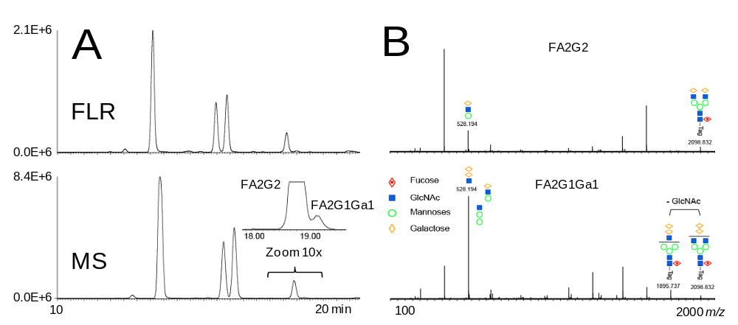
RFMS enables easy assignment of two isobaric glycans
RFMS labeled N-glycans from a murine IgG1 mAb
FLR
MS BPI
?
The two isobaric glycans, FA2G2 and a minor shoulder peak, partially resolved by HILIC
The minor peak represents only 0.7% of total FLR signal
Notes:
Here is a snap shot of a case study using RFMS labeled N-glycans from a murine (humanized) IgG1 mAb.
The BPI MS chromatogram shows its sensitivity matches with that of the FLR chromatogram, which was very useful to confidently assign glycans using accurate mass measurement. The magnified peaks in BPI MS chromatogram showed two isobaric glycans were chromatographically resolved. The first peak was known to be FA2G2 based on historic data from various mAb samples, the minor shoulder peak had the same m/z value as the FA2G2 peak, and it was 13 times less abundant, representing only 0.7% of total FLR signal. In the past, the 2AB-labeled glycan provides little information on this glycan.
Additional information:
Sample prep
Starting protein material: 15ug
Chromatogram was obtained from RFMS labeled released N-glycans from 0.9ug of protein per injection.

Slide 18
RFMS enables easy assignment of a minor shoulder peak of FA2G2 as FA2G1Ga1
RFMS labeled N-glycans from a murine IgG1 mAb
FLR
MS BPI
FA2G1Ga1
Loss of GlcNAc
0.04
The two isobaric glycans, FA2G2 and a minor shoulder peak, partially resolved by HILIC
The minor peak represents only 0.7% of total FLR signal
Structurally diagnostic ions: 1) predominant 528 m/z ion and 2) prominent GlcNAc loss
High sensitivity and information rich fragmentation data support the identification of the isobaric, lower abundance species as an α-Gal containing FA2G1Ga1.
Notes:
With the enhanced MS signal from RapiFluor-MS label, structurally informative fragmentation data was obtained for the minor shoulder peak. The side by side comparison of the fragment ions generated from FA2G2 and its shoulder peak is illustrated here. A 528 m/z ion was found to be prominent in the spectrum for the low abundance, isobaric species. High yields of such an ion have previously been reported as being diagnostic of an α-Gal configuration in glycans, wherein two galactose residues are linked through an α-1,3 bond. Also observed in the spectrum for the low abundance, isobaric species was a very prominent loss of GlcNAc (N-Acetylglucosamine), which is observed when an N-glycan branch terminates with a GlcNAc residue. Collectively, these high sensitivity, information-rich fragmentation data support the identification of the isobaric, low abundance species as an α-Gal containing FA2G1Gal glycan.
α-1,3-Galactose containing N-Glycans are known to have the potential to elicit an immunogenic response. Early detection and characterization of these glycans, even in trace level, are important for the development of therapeutic proteins expressed in murine or CHO cell lines.
By showing that low abundance α-1,3 Gal glycans from a pool of released N-glycans can be readily detected and characterized with minimal ambiguity, this case study underscores the significant promise that this integrated UPLC/FLR/MS(MS) workflow with RFMS labeling holds for N-glycan profiling and structure elucidation, making it an ideal ultrasensitive technique for rapid analysis of possible immunogenic residues.
Additional notes:
Reference:
Bosques, C. J.; Collins, B. E.; Meador, J. W., 3rd; Sarvaiya, H.; Murphy, J. L.; Dellorusso, G.; Bulik, D. A.; Hsu, I. H.; Washburn, N.; Sipsey, S. F.; Myette, J. R.; Raman, R.; Shriver, Z.; Sasisekharan, R.; Venkataraman, G., Nat Biotechnol 2010, 28 (11), 1153-6.
N-Acetylglucosamine (GlcNAc) loss

Slide 19
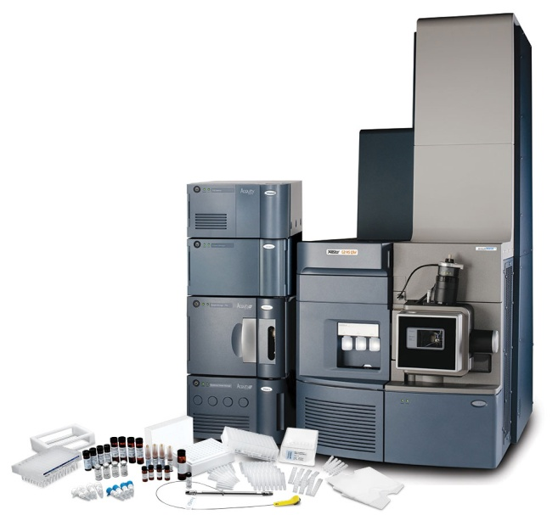
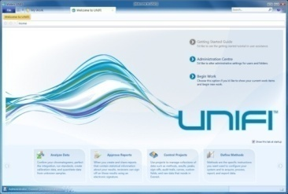
UNIFI Glycan Application Workflows
HILIC FLR
GU +Accurate Mass
HILIC FLR
DDA MS/MS
Automated
Data Acquisition
Glycan FLR+MS Confirmation
Glycan DDA
Processing
Calibrated RT and Accurate Mass
Deconvolute Fragment Ion
Review and
Reporting
Scientific Library
SimGlycan
Notes:
Now, let’s take a look at the UNIFI glycan application workflows.
Data acquisition, processing, bioinformatics, and reporting tools are integrated and automated within UNIFI Scientific Information System’s compliant-ready architecture.
The solution allows routine assignment of N-linked glycan structures using data from time-aligned FLR and MS channels along with database-driven assignment of glycans based on GU + Accurate mass. This enables the efficient profiling of released glycans for individual analysis or to facilitate multi-batch or biosimilar/ innovator comparability studies.
UNIFI also offers an alternative workflow for Glycan DDA. Data is acquired and processed in UNIFI. The processing is to de-convolute the charge and de-isotope all signals. Then the file can be converted and exported as .LCS format that is compatible with SimGlycan software for automating glycan identification.
The UNIFI glycan workflow support both conventional labels and the new Rapifluor-MS label.

Slide 20
The Utility of GU Values
What is a GU Value?
GU stands for Glucose Unit
A GU value is a normalized glycan structure retention time observed in HILIC for glycan peaks, obtained using a dextran ladder calibration
Why is the GU approach useful?
GU Values assist in normalizing glycan retention time across days, instruments and laboratories, so data can be compared and shared easily.
GU Values facilitate more routine glycan assignments by enabling the creation of a single glycan GU retention library.
Notes:
So What is a GU Value?
GU Value stands for glucose unit.
A GU value is a normalized glycan structure retention time observed in HILIC, obtained using dextran as a molecular weight ladder
Why is the GU approach useful?
GU Values assist in normalizing glycan retention time across days, instruments and laboratories, so data can be compared and shared easily.
GU Values facilitate more routine glycan assignments by enabling the creation of a single glycan GU retention library

Slide 21
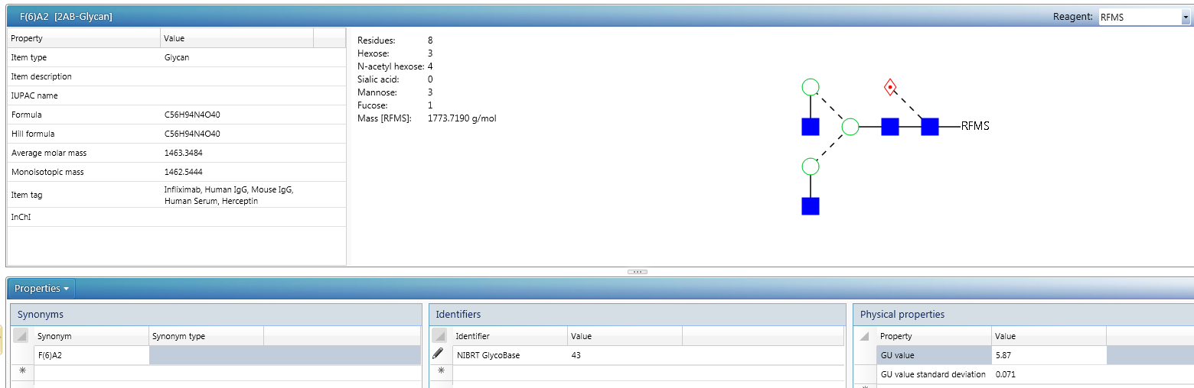
Generating Waters RFMS GU Glycan Libraries
FLR label
mass
Experimental GU value
Waters Glycan GU Library:
Experimentally derived GU Retention (>10 injections/protein)
Data from proteins representing spectrum of glycan diversity
All entries confirmed with exoglycosidase digestion
Notes:
Currently, there are a total of 308 common N-linked glycans in the scientific library to support 2-AB labeling. And we are working towards generating a RFMS glycan GU library, which is expected to be available in Q3 2015.
The N-Glycans released from a list of glycoproteins will be labeled with RFMS, analyzed by UPLC/FLR to generate GU retentions from over 10 injections per protein. Data from these proteins represents spectrum of glycan diversities. Each glycan entry will be characterized structurally using exoglycosidase array and mass confirmed using MALDI MS or ESI MS.

Slide 22
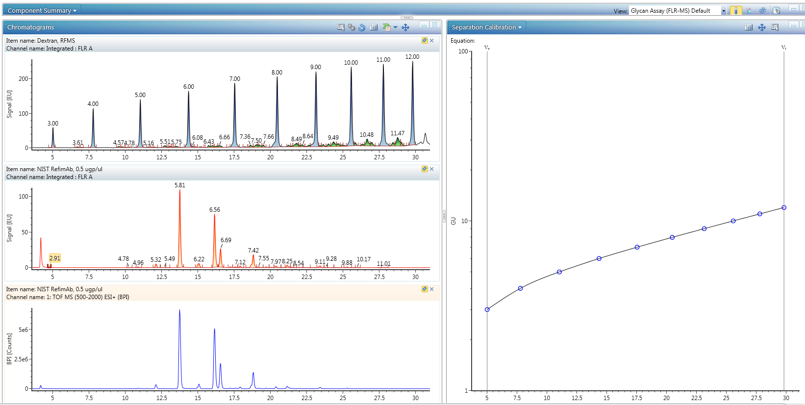
HILIC FLR GU + Accurate Mass Workflow
Method Robustness and Transferability, Confident Assignments
Labeled Dextran Ladder
Retention Time Calibration Curve
GU
Assign GU values to N-glycans
BPI MS for accurate mass confirmation
Notes:
We first run labeled Dextran Ladder Standard before running unknown samples. The labeled glucose homopolymer in this standard provide the “workable” GU value range from 2 to 30 Glucose Units, which is twice as much as the other commercially available dextran ladder standards. This feature improves the large glycan retention time assignment.
The labeled Dextran Ladder Standard is used to perform retention time calibration and for generating calibration curve. Then the calibration curve is automatically applied to the analytes of interest to generate GU values.
Both 2-AB and RFMS labeled Dextran Ladder are now available to support this workflow.

Slide 23
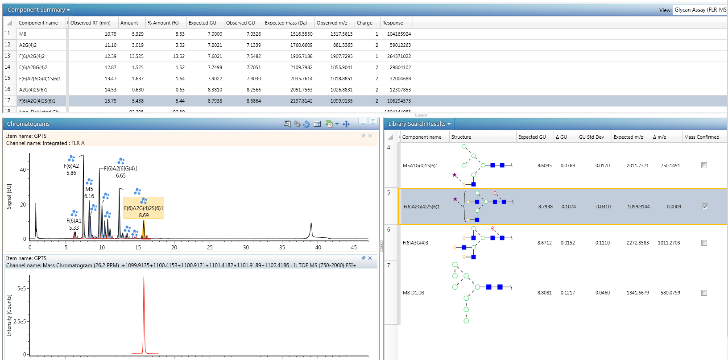
Glycan GU Scientific Library Search for Confident Glycan Assignments
Both 2-AB and RFMS labeled glycan performance test standards are now available to support this workflow
Notes:
GU values are searched in the Waters Glycan GU library and the assignments of released labeled glycans are made based on the GU value and m/z confirmation in UNIFI.
In this example, a 2-AB labeled glycan performance test standard was used, which contains 2-AB labeled released N-Glycans from human IgG . We recommend our customers to run this glycan performance test standard prior to their precious samples as a benchmarking standard and labeled, complex control. Now, RFMS labeled glycan performance test standard is also available to support this workflow.
As mentioned previously, “Unknown” glycan assignment is based on best matched experimental retention time that was converted to Glucose Unit (GU) value, and accurate mass measurement.
For example, in this figure, one Glycan, FA2G2S1 was selected in the component summary table, and the corresponding FLR peak is also highlighted. The XIC chromatogram of this glycan is also isolated and showed in the lower MS channel. Please pay attention to the library search result. There are 7 glycans in total having the similar GU retention within the delta GU tolerance window, and only FA2G2S1 was mass confirmed with the lowest delta mass and was checked as confident assignment. You can notice the check box under the “Mass Confirmed” column.
Anticipated questions:
1. What is the typical setting for error tolerance for GU retention:
Answer: Typical delta GU tolerance will be set +/- 0.15
2. Can I change the glycan assignment after UNIFI processing?
Answer: Yes. Assignment can be changed to an alternative assignment based on user’s interpretation of the data.

Slide 24
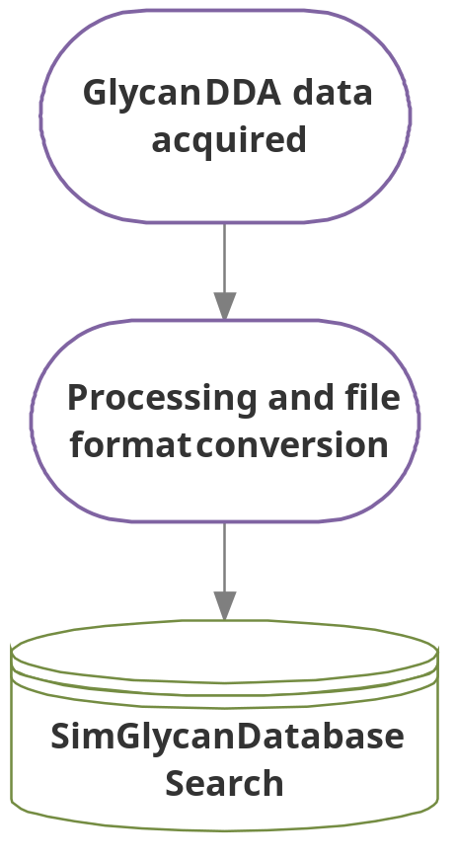

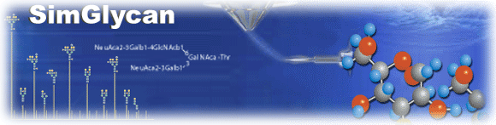
UNIFI Glycan DDA Workflow
Notes:
In addition to GU + Accurate mass workflow, UNIFI also support a Glycan DDA workflow. Data can be acquired and processed in UNIFI. The processing is to deconvolute the charge and deisotope all signals. Optionally, the file can be converted and exported as .LCS format that is compatible with SimGlycan software for automated MS and MSMS data interpretation and glycan identification.

Slide 25
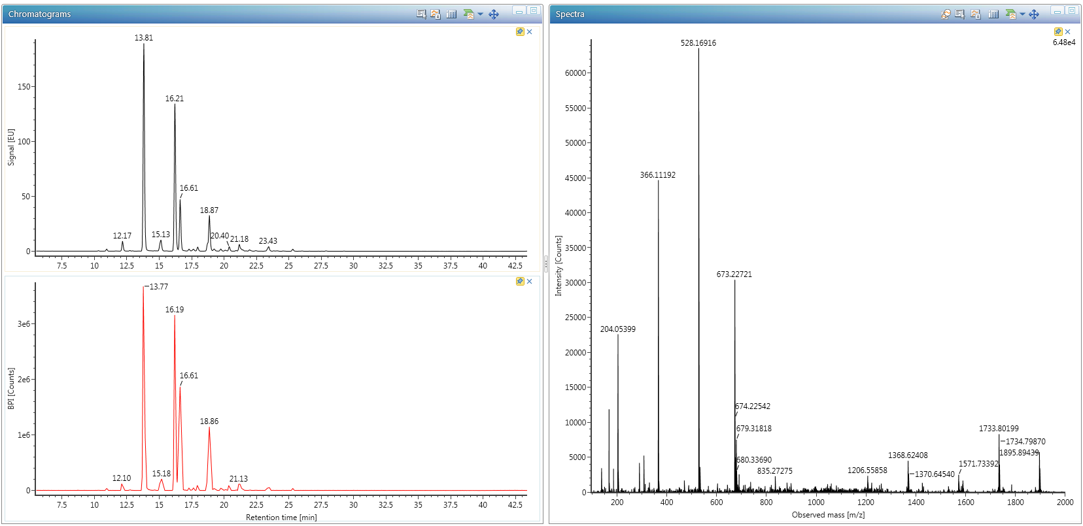
UNIFI Acquire and Process Glycan DDA Data
RFMS labeled N-glycans from mouse IgG
MSMS fragmentation of a highlighted minor glycoform was displayed
FLR
Raw MSMS Spectrum
~ 0.1% total FLR
BPI MS
Deconvolute & deeisotope
Export as .LCS (or mzml) format
Notes:
Here is an example of the Glycan DDA workflow. UNIFI acquired and processed Glycan DDA data of RFMS labeled N-glycans from mouse IgG, and the FLR and BPI MS chromatograms are shown here. A minor glycoform, representing 0.1% total FLR signal is detected by Xevo G2 XS Qtof and its raw MSMS spectrum was also displayed here.
Similarly to what we showed in the previous slides, with the enhanced MS and MSMS signal from RapiFluor-MS label, high quality fragmentation data was obtained for this minor glycoform.
(Click) UNIFI then process the MS and MSMS data by deconvoluting the charges and deisotoping the signals, and export as .LCS format.

Slide 26
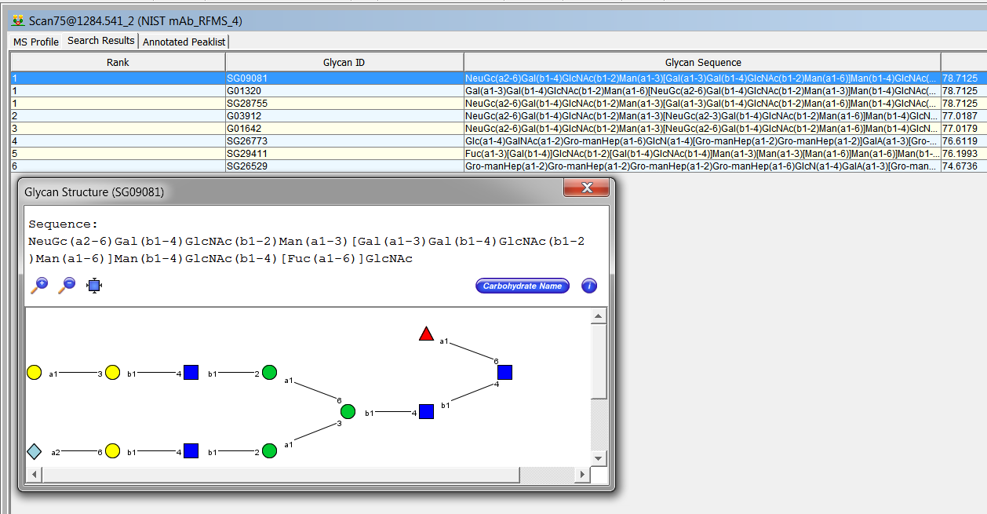
Automated Glycan Identification using .LCS Files with SimGlycan
The minor glycoform was correctly identified as FA2G2Ga1Sg1
alpha (1,3)-Gal (Ga1)
NeuGc (Sg1)
Notes:
SimGlycan can then process the .LCS files for automated database search. Here we show that the selected minor glycoform was correctly identified as FA2G2Ga1Sg1. FA2G2Ga1Sg1 Glycan contains immunogenic epitopes, alpha (1,3)-Gal (Ga1) and NeuGc (Sg1). This glycan is typically present at very low abundance in monoclonal antibody generated from murine cell lines and is very important to be well characterized and monitored during biotherapeutics development.

Slide 27
Work in progress
Developing a scientific library for RapiFluor-MS labeled glycans for automated glycan assignment
Applying RapiFluor-MS label for more complex glycosylated proteins

Slide 28




Acknowledgements
Waters
Matt Lauber PhD
New England Biolabs
Paula Magnelli PhD
Professor Pauline Rudd (COI)
  Mark Hilliard (UNIFI Glycan Scientific Library)
  Giogio Carta (UNIFI Glycan Scientific Library)

