Slide 1

Effect of COC, hypertension, dyslipidemia and susceptibility on the risk of female stroke in China
Dr.LI Ying
Nanjing Medical University
School of Public Health

Slide 2
BACKGROUND
Stroke has a large negative impact on society, with women disproportionately affected.
Oral contraceptives, pregnancy, menopause, and hormone replacement therapy, and genetic differences are unique to women’s risk of stroke.
Bushnell C, McCullough LD, Awad IA, et al. Guidelines for the Prevention of Stroke in Women: A Statement for Healthcare Professionals from the American Heart Association/American Stroke Association. Stroke. 2014; 45(5): 1545-88.

Slide 3
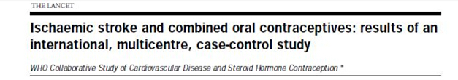
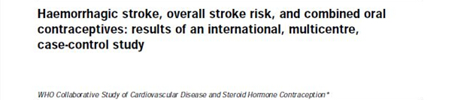
Reports appeared soon after the COC were marketed, that the risk of venous thromboembolism, stroke and myocardial infarction increased among COC users.

Slide 4
The data suggest that the incidence of stroke in China is about 240 per100000, of which the incidence rate of haemorrhagic stroke is about 40%, which is much higher than that of 10% ~ 15% of European and American countries.
The trend of female stroke in China are increased year by year.
PuiHing Chau, Jean Woo, William et al. Trends in Stroke Incidence in Hong Kong Differ by Stroke Subtype. Cerebrovase Dis. 2011; 31(2):138-146.
Huang Jiu-yi, Guan Ya- tai, Guo Ji-ping, et al. Monitoring of stroke morbidity and mortality in a rural communities of Shanghai from 2008-2010. chin J Cerebrovasc Dis. 2012; 9(1):5-9.

Slide 5
The absolute number of COC users is very large (7 million) per year.
As OTC COC were mainly delivered to women for free in Chinese communities.
The study on long term safety of COC is less than the recent research in China.
Most studies of COC use and stroke have used the case-control design.

Slide 6

Women know little about contraceptives
The information on the safety of COCs used in China has come from developed countries.
What kind of COC is suitable for Chinese women?
What adverse reaction/side effect will be caused? How do avoid ?
What are benefits or harms of use COC？

Slide 7


There were the association between COC exposure and multiple factors on the risk of female stroke in China.
    Hypertension
    dyslipidemia
    susceptibility
    Identified as a national key project in the Ninth Five-Year Plan Science & Technology Priority Program.

Slide 8
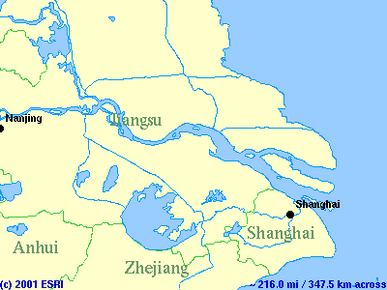

Slide 9
Study design and Method
Population Surveillance
160000 Women Under 65 Year of Age Who Lived in These Towns
Case-control Study
(Stroke cases and hospital, neighbor controls)
Prospective Cohort Study
COC and IUD Cohort
Cross-sectional Study
Continuous use of COC and
IUD with 5-15 years
Follow Up Annually
Contraception Use
Health Problems
Body Index
BP Measurement，
Lipid Metabolism，
Coagulation Factors
Clinic Examination
Lab Assay
Disease Diagnosis
Health Level
Social Behavior
Contraception Use
ACE/AGT Gene
Polymorphism
Risk-benefit Evaluation of
Women with Long-term Use COC

Slide 10

A prospective cohort study
COC cohort and an intrauterine device (IUD) cohort in 25 towns in two counties in Jiangsu Province, China were followed up for the incidence of stroke.
  IUD cohort: used IUD >3mos., never used COC total 75 230 women.
  COC cohort: used COC >3mos., total 44 408 women.

Slide 11
Case control study
Case of a first-ever stroke was identified by computerized tomography (CT) or nuclear magnetic resonance (NMR).
Two different controls including hospitalized patients and neighbourhood were matched to the cases according (i) age, ± 3 years; (ii) residence; (iii) similar date of admission for hospitalized patients.

Slide 12
Subjects and methods
Body weight, height, waist circumference (WC), blood pressure, serum lipids, and apolipoproteins were measured.
Polymerase chain reaction (PCR) was used to amplify polymorphic gene regions for the genotyping of ACE I/D and AGT A-20C.
Genotyping of 3 SNPs (rs700651, rs10958409, and rs1333040) by genome-wide association study(GWAS) was performed by the polymerase chain reaction assay with TaqMan probes.

Slide 13
Epidemiologic Measures and Analytic Methods
Incidence rate of Poisson person years
RR and OR with 95 % confidence interval(CI)
Adjustment rate by direct, indirect, Mantel-Haenszel
Multiple regression (Poisson)
Bonferroni correction was used for multiple.

Slide 14
Results

Slide 15
Duration of COC use and the incidence of haemorrhagic stroke
Contraception | Cases | Person years | RR*(95%CI)
IUD cohort | 23 | 216752 | 1
Current users of OCs | 14 | 44947 | 3.60（1.73，7.53）
Past use within 5 years(terminated) | 7 | 20400 | 3.09（1.26，7.57）
Past use longer than 5 years (terminated) | 10 | 39409 | 1.18（0.55，2.51）
The risk of haemorrhagic stroke increased among Chinese users of long-term low-dose oral contraceptives, which appears to persist long after discontinuation.

Slide 16
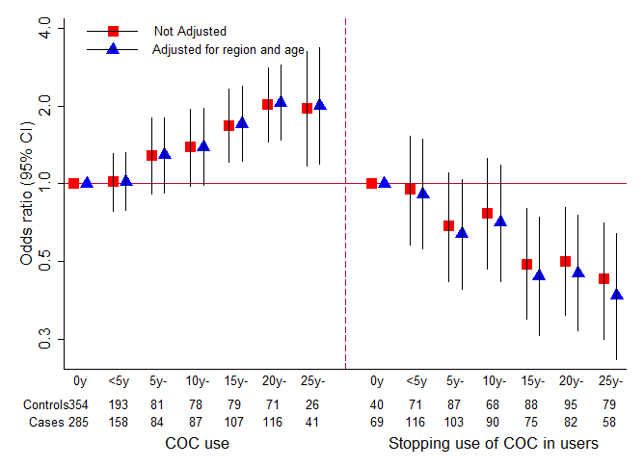
The risk of hypertension gradually increased with the increasing cumulative time of COC use

Slide 17
Hypertension, COC use and their joint effect increased the risk of stroke
 |  |  | Stroke | Haemorrhagic | Ischaemic
Hyperten | COC |  | OR* 95％CI | OR* 95％CI | OR* 95％CI
No | No |  | 1.00 | 1.00 | 1.00
Yes | No |  | 10.54 (6.39-17.38) | 6.59 (3.16-13.71) | 13.74 (6.92-27.28)
No | Yes |  | 1.13 (0.58-2.20) | 1.76 (0.72-4.28) | 0.66 (0.22-1.97)
Yes | Yes |  | 17.63 (10.38-29.95) | 19.20 (8.31-44.36) | 17.45 (8.61-35.37)

Slide 18
Hypertension, dyslipidaemia, and their interaction effect increased the risk of stroke
 |  |  | Stroke | Haemorrhagic | Ischaemic
Hyperten | Dyslipidaemia |  | OR* 95％CI | OR* 95％CI | OR* 95％CI
No | No |  | 1.00 | 1.00 | 1.00
No | Yes |  | 1.56 (0.79-3.07) | 1.17 (0.45-3.02) | 2.33 (0.90-6.05)
Yes | No |  | 11.29 (6.15-20.71) | 6.51 (2.93-14.46) | 17.92 (7.60-42.27)
Yes | Yes |  | 20.51 (11.27-37.33) | 11.39 (5.04-25.74) | 36.54 (15.81-84.41)

Slide 19
COC users ≥15 years carried the ID + DD genotype of ACE I/D that may further increase the risk of hemorrhagic stroke
Duration of use | Genotypes |  | Stroke | Haemorrhagic | Ischaemic
COC |  |  | OR* 95％CI | OR* 95％CI | OR* 95％CI
0-15 | II |  | 1.00 | 1.00 | 1.00
 | ID+DD |  | 1.75(0.87-3.53) | 1.84(0.66-5.12) | 1.60(0.60-4.26)
≥15 | II |  | 1.25(0.32-4.82) | 1.36(0.19-9.78) | 1.01(0.16-6.44)
 | ID+DD |  | 8.97(3.33-24.14) | 15.04(3.79-59.65) | 3.03(0.63-14.53)

Slide 20
COC users ≥15 years carried the AA genotype of AGT A-20C that may further increase the risk of hemorrhagic stroke
Duration of use | Genotypes |  | Stroke | Haemorrhagic | Ischaemic
COC |  |  | OR* 95％CI | OR* 95％CI | OR* 95％CI
0-15 | AA |  | 1.00 | 1.00 | 1.00
 | AC+CC |  | 1.22 (0.73- 2.04) | 0.92 (0.44-1.90) | 1.70 (0.78-3.68)
≥15 | AA |  | 3.27 (1.64-6.52) | 4.75 (1.95-11.58) | 1.26 (0.35-4.53)
 | AC+CC |  | 1.52 (0.39-5.91) | 1.98 (0.23-16.93) | 1.04 (0.17-6.38)

Slide 21
Joint effects of SNPs and COC use on stroke risk
COC use | Genotypes rs1333040 |  | Stroke | Haemorrhagic | Ischaemic
 |  |  | OR* 95％CI | OR* 95％CI | OR* 95％CI
No | CC |  | 1.00 | 1.00 | 1.00
 | CT/TT |  | 2.39 (0.98–5.82) | 6.42 (1.21–34.23) | 1.19 (0.40–3.51)
Yes | CC |  | 2.15 (0.66–6.98) | 8.26 (0.83–82.54) | 0.82 (0.19–3.49)
 | CT/TT |  | 4.24 (1.71–10.49) | 16.06 (2.95–87.56) | 1.69 (0.56–5.12)
Two GWAS SNPs：rs10958409 or rs1333040，COC use and their joint effects increased the risk of stroke.

Slide 22
Joint effects of SNPs and COC use on stroke risk
COC use | Genotypes rs1799889 |  | Stroke | Haemorrhagic | Ischaemic
 |  |  | OR* 95％CI | OR* 95％CI | OR* 95％CI
No | 4G4G |  | 1.00 | 1.00 | 1.00
 | 4G5G /5G5G |  | 0.79 (0.57–1.11) | 0.60 (0.36–1.00) | 0.68 (0.44–1.05)
Yes | 4G4G |  | 1.27 (0.86–1.88) | 0.67(0.37–1.23) | 0.83 (0.50–1.40)
 | 4G5G /5G5G |  | 1.03 (0.74–1.44) | 0.66(0.39–1.09) | 0.53 (0.34–0.83)
Genetic variants of plasminogen activator inhibitor type 1 (PAI-1) gene rs1799889 4G5G/5G5G genotype had a decreased risk of ischemic stroke.

Slide 23
CONCLUTION
    This study was the first prospective one of its kind in China.
    The research results have showed that COC，hypertension, dyslipidemia, susceptibility, and joint effects on the risk of Chinese female stroke
The research results provided evidence to formulate proper prevention measures for coping with the challenges of an increased incidence of female stroke.

Slide 24

Thank you

