Slide 1
About OMICS Group
OMICS Group International is an amalgamation of Open Access publications and worldwide international science conferences and events. Established in the year 2007 with the sole aim of making the information on Sciences and technology ‘Open Access’, OMICS Group publishes 400 online open access scholarly journals in all aspects of Science, Engineering, Management and Technology journals. OMICS Group has been instrumental in taking the knowledge on Science & technology to the doorsteps of ordinary men and women. Research Scholars, Students, Libraries, Educational Institutions, Research centers and the industry are main stakeholders that benefitted greatly from this knowledge dissemination. OMICS Group also organizes 300 International conferences annually across the globe, where knowledge transfer takes place through debates, round table discussions, poster presentations, workshops, symposia and exhibitions.

Slide 2
About OMICS Group Conferences
OMICS Group International is a pioneer and leading science event organizer, which publishes around 400 open access journals and conducts over 300 Medical, Clinical, Engineering, Life Sciences, Phrama scientific conferences all over the globe annually with the support of more than 1000 scientific associations and 30,000 editorial board members and 3.5 million followers to its credit.
OMICS Group has organized 500 conferences, workshops and national symposiums across the major cities including San Francisco, Las Vegas, San Antonio, Omaha, Orlando, Raleigh, Santa Clara, Chicago, Philadelphia, Baltimore, United Kingdom, Valencia, Dubai, Beijing, Hyderabad, Bengaluru and Mumbai.

Slide 3
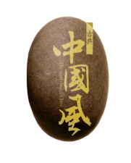
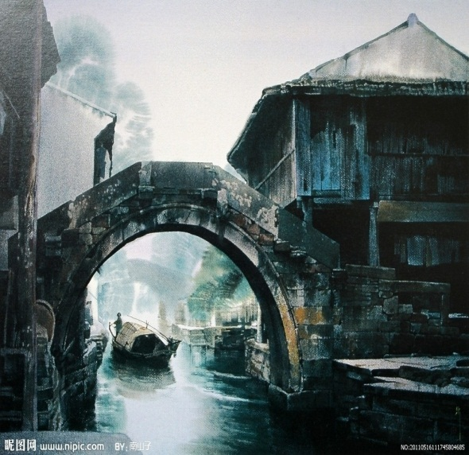
Mechanism of protective effects of
Salvia Miltiorrhiza (Danshen 丹參) against acute and chronic liver injury induced by iron overload
Ying Zhang
Hebei Medical University Shijiazhang,China

Slide 4
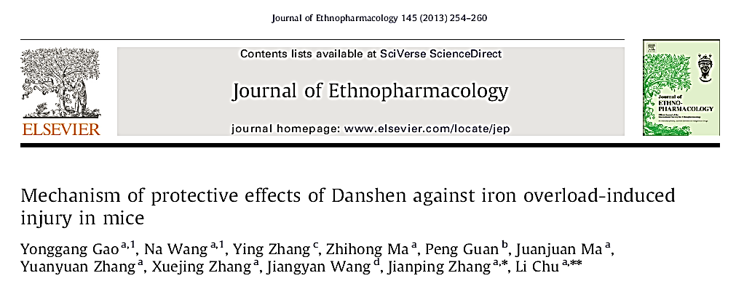
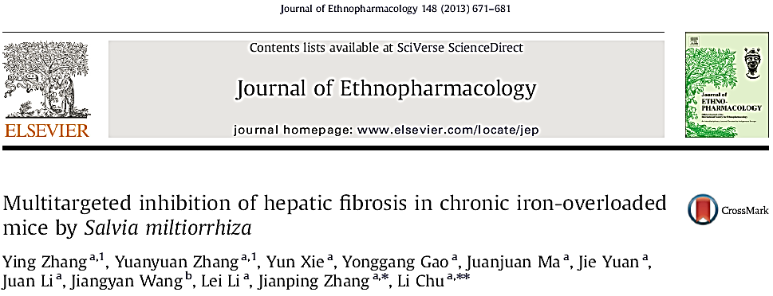
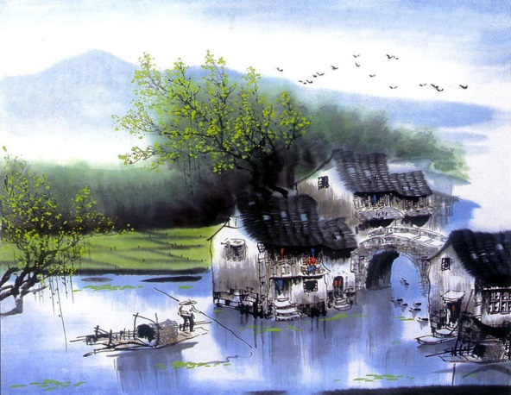
Introduction
Materials and methods
Results and Discussion
Conclusions

Slide 5
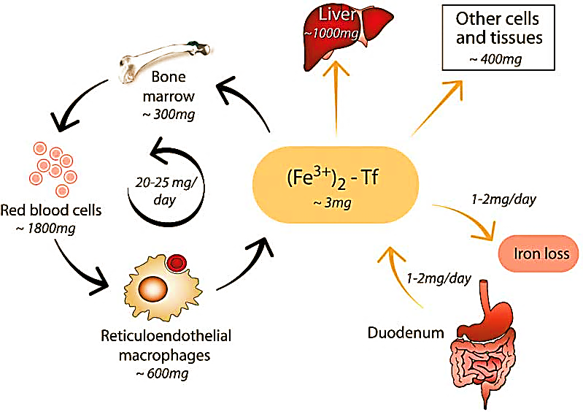
Introduction
Iron is both essential and toxic.
Liver is the most susceptible organ.
Patients develop acute liver injury, chronic hepatic fibrosis, and cirrhosis.
Systemic iron homeostasis
Adapted from Cell, Vol. 117, 290, April 30, 2004

Slide 6
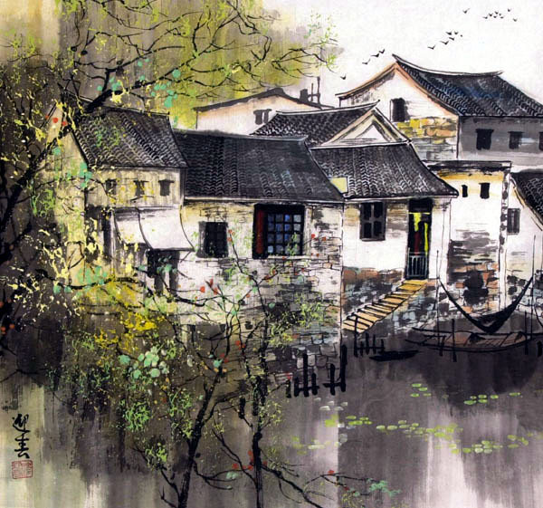
Introduction
Iron chelation
They are designed to promote whole-body iron removal. (e.g. deferoxamine, DFO)
The administration schedule and side effects lead to poor patient compliance.
Chelators cannot inhibit iron uptake into cells.

Slide 7
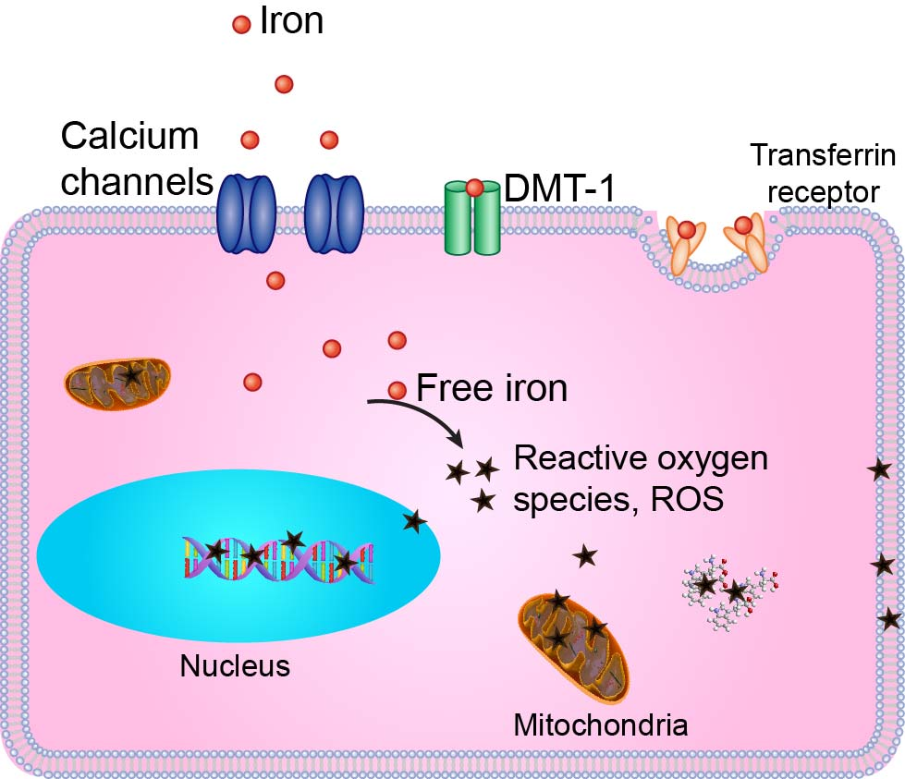
Introduction
Iron toxicity is mediated by oxidative stress - driven acute damage and chronic fibrogenesis.
Calcium channels provide a major pathway for iron uptake into cells.
Calcium channel blockers
Calcium channel blockers
Cellular iron transport
and oxidative stress

Slide 8
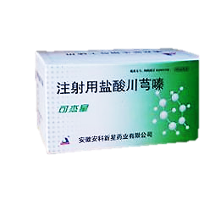
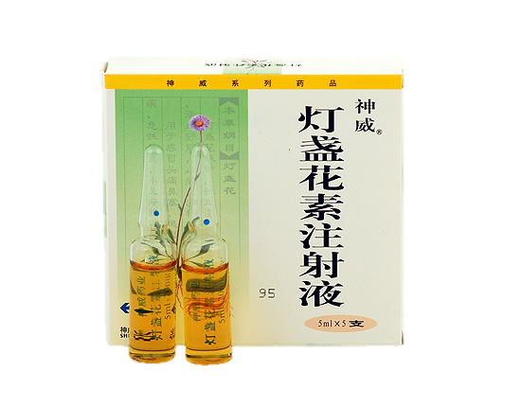
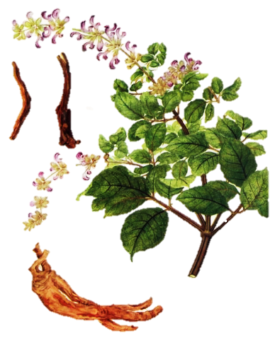
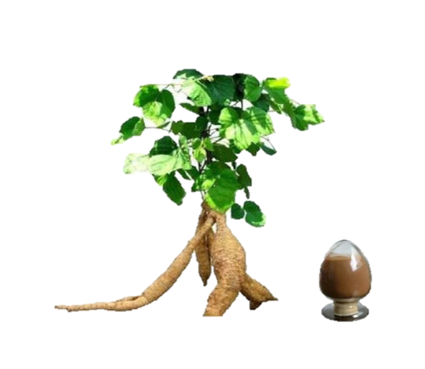
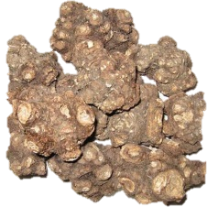
Introduction
Some of medicinal herb promoting blood circulation have anti-oxidation effects; They exhibit property of calcium channel blockers.
Medicinal herb were filtered in preliminary experiments.
Salvia Miltiorrhiza demonstrated signiﬁcant protective effects in iron-overloaded liver.
川穹嗪
Tetramethylpyrazine
葛根素
Puerarin
燈盞花素
Breviscapine
丹參
Salvia Miltiorrhiza

Slide 9
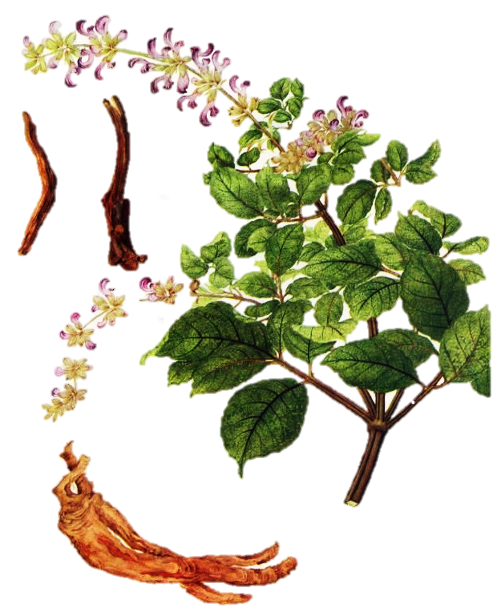
Introduction
Salvia Miltiorrhiza
(SM, or Danshen 丹參)
SM is a tonic herb of the nontoxic superior class for promoting blood circulation.
It has been used for more than two thousand years.

Slide 10
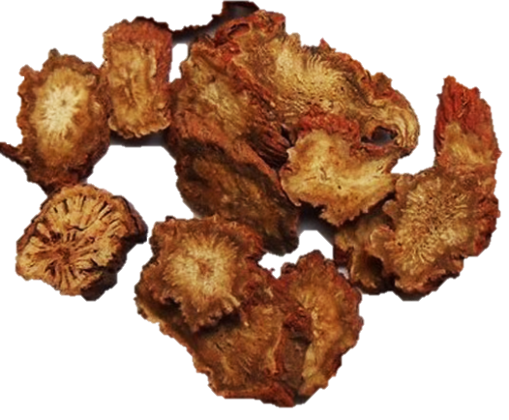
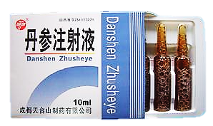
Introduction
SM shows versatile anti-fibrotic, anti-oxidative, anti-inflammatory and anti-apoptotic effects.
SM injection, an aqueous extract, is recommended and accepted treatments for liver disease.
Salvia Miltiorrhiza 丹參
Salvia Miltiorrhiza injection

Slide 11
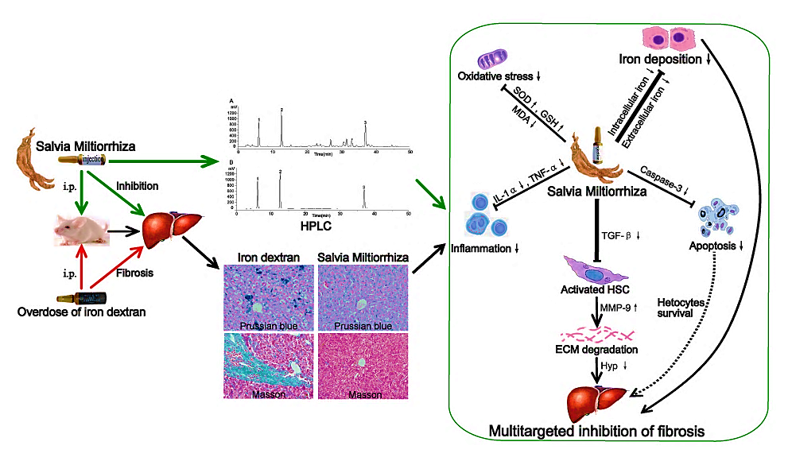
Graphical abstract
Present study was designed to investigate the effects of SM injection in preventing liver damage (acute injury) and hepatic fibrosis (chronic injury) caused by iron overload, and to explore the mechanism involved.

Slide 12
Materials and methods
Experimental protocol
Two weeks (acute injury)
Seven weeks (chronic injury)
i.p.
4h
i.p.
+ Saline
A. Saline
B. Saline
C. Low-dose SM
D. High-dose SM
E. Deferoxamine
A. Control
B. Iron overload
C. Low-dose SM
+ Iron dextran
D. High-dose SM
E. DFO

Slide 13
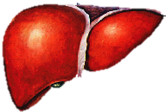
Materials and methods
Oxidative markers
HPLC-UV profiling
Liver function
Morphology
RT-PCR
Immunohistochemistry

Slide 14
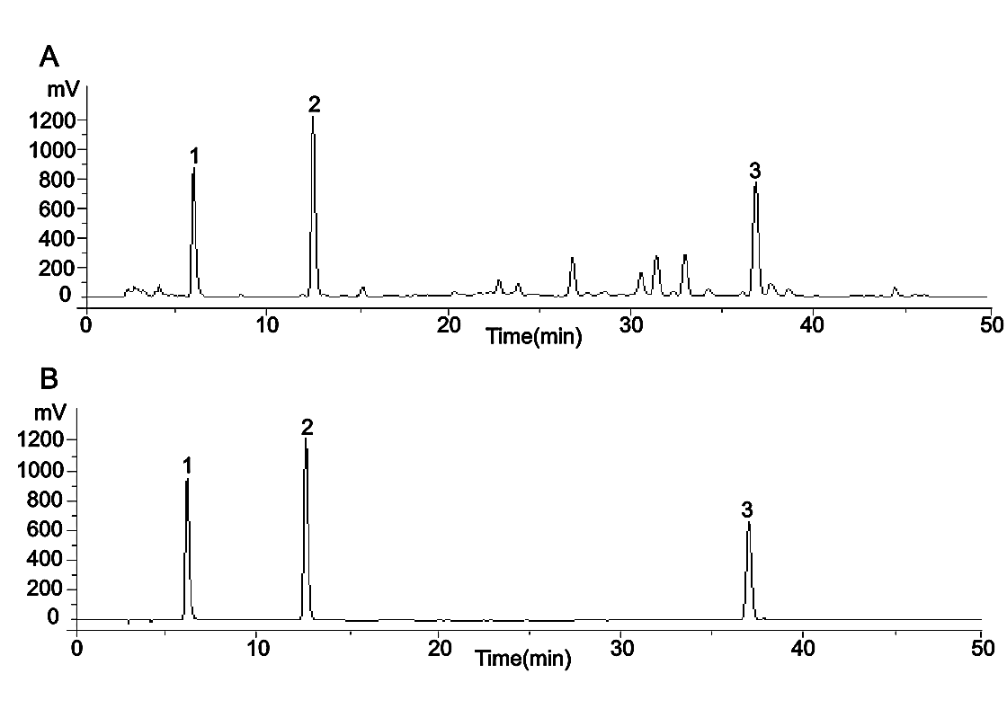

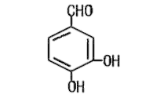
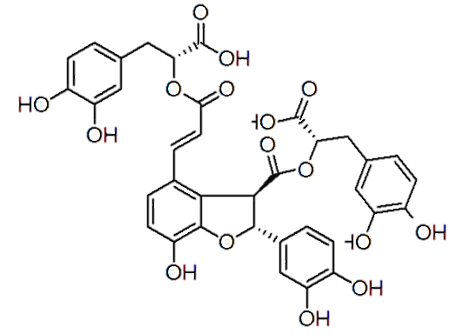
Results and Discussion
2.15 mg/ml
0.44 mg/ml
1.01mg/ml
1, Danshensu
2, protocatechuic
aldehyde
3, salvianolic acid B
Fig. 1. HPLC–UV profiles of SM injection (A) and standards (B)
Peaks represent: 1, Danshensu; 2, protocatechuic aldehyde; 3, salvianolic acid B.

Slide 15
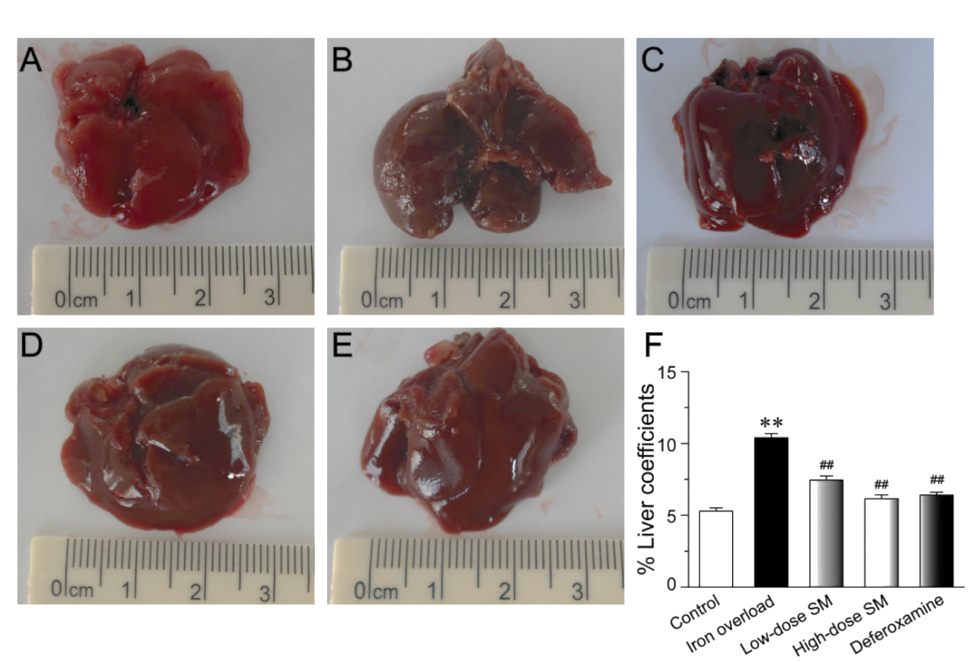
Control
Iron overload
Low-dose SM
High-dose SM
DFO
Liver coefficients,
Liver weight
body mass
Fig. 2. Effects of SM on gross appearances and coefficients in mouse livers.
Liver coefficients were calculated to determine the effects of SM (F).
Values are means ± SEM. **P < 0.01 vs. control; ## P < 0.01 vs. iron overload.

Slide 16
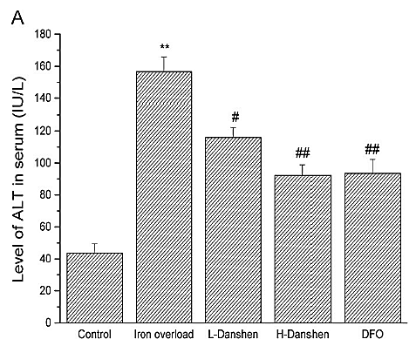
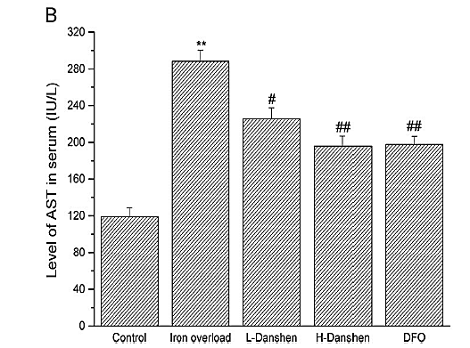
Low-dose SM
High-dose SM
Low-dose SM
High-dose SM
Fig. 3. Effects of Danshen on levels of alanine aminotransferase (ALT) and aspartate aminotransferase (AST) in serum.
Results are expressed as the mean ± SEM.
*P < 0.05, **P < 0.01 vs. control; # P < 0.05, ## P < 0.01 vs. iron overload

Slide 17
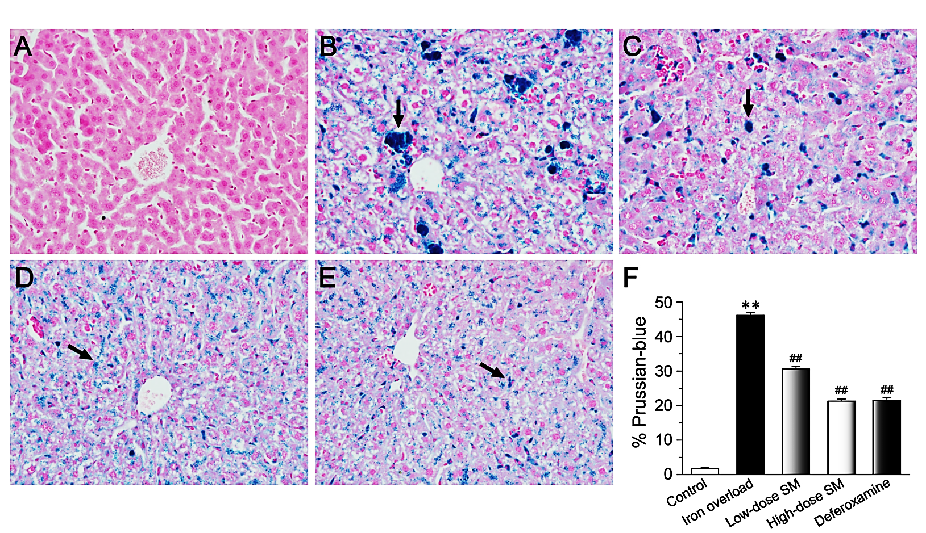
Control
Iron overload
Low-dose SM
High-dose SM
DFO
Fig. 4. Effects of SM treatment on iron deposition observed by Prussian blue staining in mouse livers (original magnification, 400×).
Values are means ± SEM. **P < 0.01 vs. control; ## P < 0.01 vs. iron overload.

Slide 18
Fig.6. Effects of SM on SOD (A), GSH (B) and MDA (C) in liver homogenates.
**P < 0.01, #P < 0.05 vs. control group; ## P < 0.01 vs. iron overload group.

Slide 19
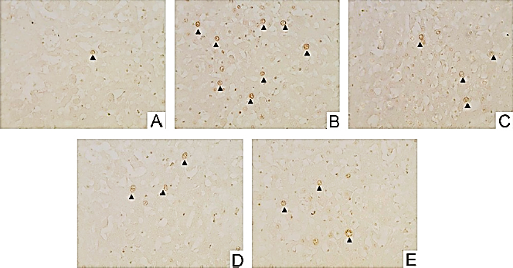
Fig. 7. Effects of SM on apoptosis of mouse hepatocytes.
Hepatocyte apoptosis was detected by the TUNEL assay (400 x), and brown stained positive nuclei are indicated by arrows.
Effects of SM on mRNA expression of caspase-3 in liver.
**P < 0.01 vs. control ;
#P < 0.05 , ## P < 0.01 vs. iron overload .

Slide 20
Acute liver injury (FIG. 2-7)
SM injection could decrease the liver coefﬁcient, restore abnormal function and improve the pathological changes.
The underlying Mechanism may be attributed partly to the decrease of iron deposition, inhibition of oxidative stress and apoptosis in hepatocytes.
丹參
Iron deposition ↓
Acute liver injury ↓
ROS ↓
Apoptosis ↓
20

Slide 21
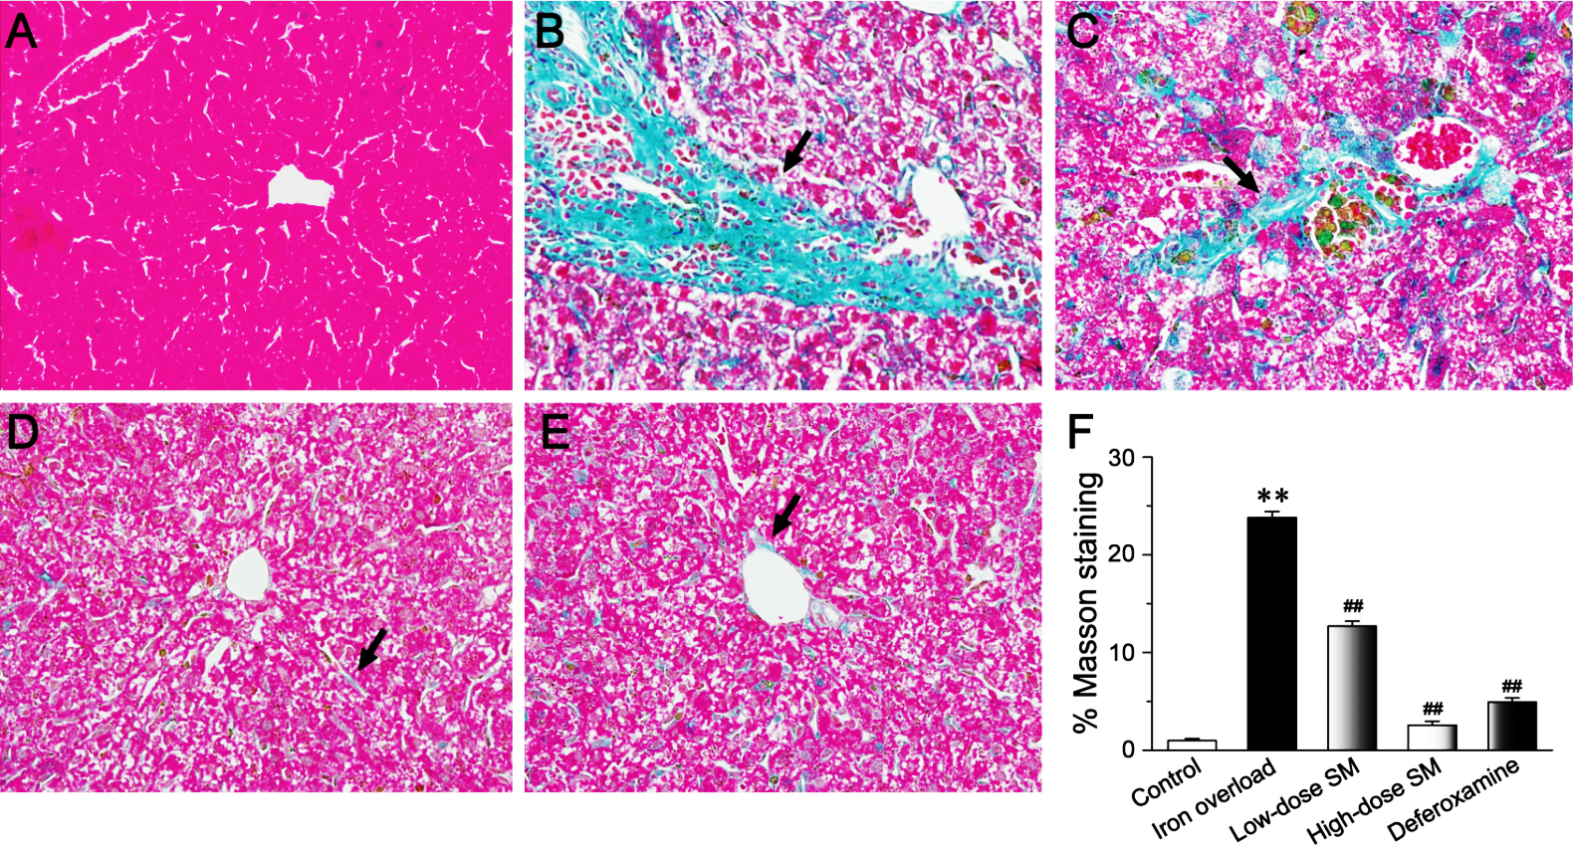
Control
Iron overload
Low-dose SM
High-dose SM
DFO
Fig. 8. Effects of SM treatment on hepatic fibrosis as observed by Masson's staining (original magnification, 400×).
The bright blue color represents the distribution of collagens (arrows).
The percentage area of Masson's staining in each group was calculated (F).
Values are means ± SEM. **P < 0.01 vs. control; ## P < 0.01 vs. iron overload.

Slide 22
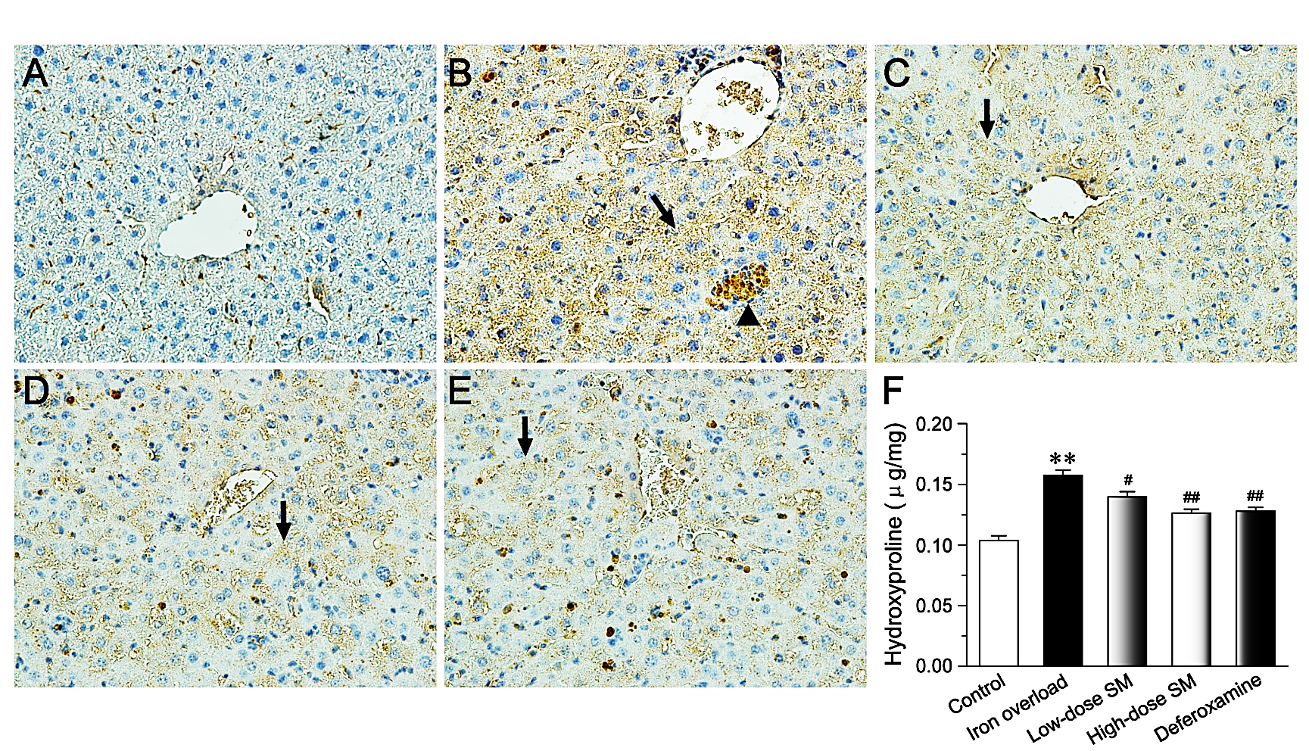
Control
Iron overload
Low-dose SM
High-dose SM
DFO
Fig. 9. Effects of SM on type III collagen in liver sections detected by immunohistochemistry and on Hyp content in liver homogenates.
Positive expression of type III collagen (arrows) or iron deposition (triangles) are indicated. The hepatic hydroxyproline content was calculated (F).
Values are means ± SEM. **P < 0.01 vs. control; #P < 0.01 , ## P < 0.01 vs. iron overload.

Slide 23
Fig. 10 . Effects of SM on mRNA expression of TGF-β (A) and MMP-9 (B) in livers. Intensities of TGF-β and MMP-9 were standardized to that of β-actin.
Values are means ± SEM. *P < 0.05 , **P < 0.01 vs. control; ## P < 0.01 vs. iron overload.

Slide 24
Chronic hepatic injury (FIG. 8-10)
SM injection decreased the hepatic fibrosis in iron overload liver.
The underlying mechanism may be involved in the decrease of collagens accumulation and regulation expression of fibrosis-related molecules (TGF-β and MMP-9).
丹參
Iron deposition ↓
Acute liver injury ↓
ROS ↓
Apoptosis ↓
Collagens ↓
Fibrosis degree↓
TGF-β ↓
MMP-9 ↑
24

Slide 25
Conclusions
SM play a protective role on iron-overloaded liver.
SM may be a therapeutic drug for iron overload diseases.

Slide 26
Thank you

Slide 27
Lets Meet again at Pharmacognosy-2015
3rd International Conference and Exhibition on Pharmacognosy, Phytochemistry and Natural Products
October 26-28, 2015 Hyderabad, India
Theme: Advanced trends for the future of Herbal Drugs and Products
Website: http://pharmacognosy-phytochemistry-natural-products.pharmaceuticalconferences.com/

