Slide 1

Folic Acid Induced Acute Kidney Injury And Recovery: Using HK2 Cells as Experimental Model
Yihe Li
Division of Nutritional Sciences
The University of Nottingham
Supervisors: Dr Simon Welham and Prof David Gardner

Slide 2
Content
Introduction
Acute Kidney Injury (AKI)
Nephrotoxicity
Acute Kidney Injury Recovery
Method
Cell Culture
Immunofluorescence
Western Blot
Results
Conclusion
Aristolochic Acid And Folic Acid Induced Injury
HMGB1 Expression After Folic Acid Induced Injury And During Recovery
The Change Of Reactive Oxygen Species Level During Damage And Recovery
The Activation Of Autophagy And Whether It Protected Cells From Damage

Slide 3
Introduction-Acute Kidney Injury
Definition and Categories of AKI
Acute kidney injury (AKI) is defined as acute deterioration in kidney function leading to the accumulation of waste products, such as creatinine, plasma urea and uric acid (Guarnieri, Situlin and Toigo, 2005).
AKI is now recognized as a major public health problem affecting millions of patients world-wide and leading to decreased survival, increased progression of underlying chronic kidney disease (Singbartl and Kellum, 2012).
Serum creatinine level and urine output are two main indicators to determine the severity of AKI.

Slide 4
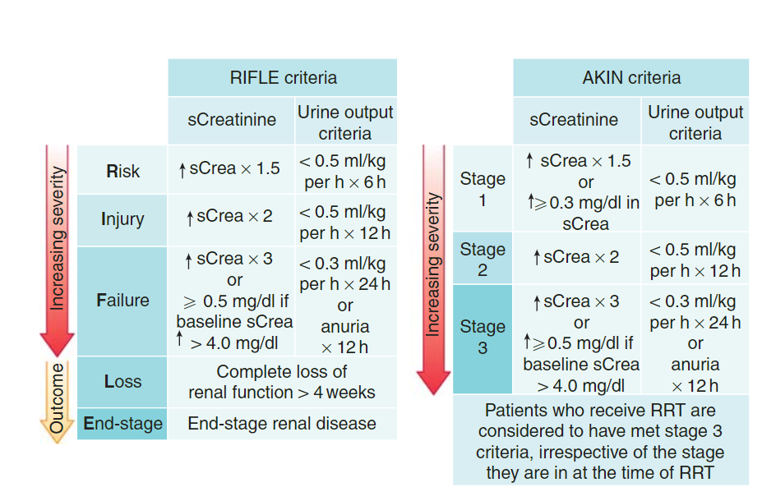
Normal serum creatinine level in healthy male is between 0.6-1.2 mg/dL, in healthy female is between 0.5-1.1 mg/dL.
Normal urine output for a healthy adult is between 800-2000 ml per 24 hours with normal intake fluid of 2L/day.
Singbartl, K. and Kellum, J. A. (2012) AKI in the ICU: Definition, epidemiology, risk stratification, and outcomes. Kidney International, 81, 819-825.

Slide 5
Classification and Cause of AKI
Classification | Consequences | Reversible or Not
Pre-renal AKI | Caused by the reduction of renal perfusion. It leads to the increase of serum creatine and plasma urea levels and the reduction of glomerular filtration rate. | Reversible
Post renal AKI | Caused by the obstruction of urinary system and kidneys, such as kidney stones or the obstruction of the collecting ducts. | Reversible
Intrinsic AKI | Mainly structural damage of nephrons, such as tubules, glomeruli, acute tubular necrosis. | Partly or need renal replacement therapy
Major causes of AKI are sepsis, nephrotoxic injury and ischaemia/reperfusion injury (Bonventre and Yang, 2011).

Slide 6
Introduction-Nephrotoxic Injury
When the kidneys are exposed to a toxic material, damage may occur in a number of ways. Some toxins directly kill cells in the glomerulus or the renal tubules. Other toxins create substances or conditions, such as allergic reactions, that cause cell death.
Nephrotoxic injury can lead to acute renal failure, in which the kidneys suddenly lose their ability to function, or chronic renal failure, in which kidney function slowly deteriorates (Liu and Chertow, 2008).
Nephrotoxins may account for approximately 50% of all cases of acute and chronic renal failure, radiocontrast media and aminoglycosides are the most common agents associated with nephrotoxic injury in hospitalized patients (Schnellman and Kelly, 1994).

Slide 7
Introduction-Nephrotoxic Injury
The tubular cells of the kidney are particularly vulnerable to toxicant-mediated injury due to their disproportionate exposure to circulating chemicals and transport processes that result in high intracellular concentrations (Schnellman and Kelly, 1994).
The direct tubular cell injury has been found to be associated with impairment of mitochondrial function and the generation of free radicals (Markowitz and Perazella, 2005).
The drugs identified to induce AKI includes some antibiotics, cyclosporine, herbal remedies containing aristolochic acid, or high dose expose to some non-toxic drugs (Debelle, Vanherweghem and Nortier, 2008)

Slide 8
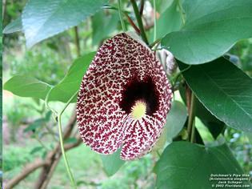
Introduction-Aristolochic Acid
Aristolochic acid first appeared in Chinese medicine in the fifth century AD. During ancient times, it was used to treat kidney and urinary problems, snakebites.
AA are naturally occurring compounds which were primarily found in herbs belonging to the Aristolochia.
Picture found from Floridata Plant Encyclopedia https://floridata.com/Plants/Aristolochiaceae/Aristolochia+elegans/135

Slide 9
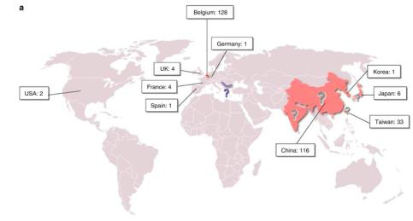
Introduction-Aristolochic Acid
Aristolochic acid nephropathy (AAN), a rapidly progressive interstitial nephritis leading to end-stage renal disease and urothelial malignancy, was originally reported in Belgium in 1992 in a group of patients who had ingested slimming pills containing powdered root extracts of Chinese herbs (Debelle, Vanherweghem and Nortier, 2008)

Slide 10
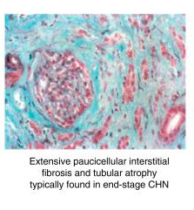
Introduction- Aristolochic Acid-Induced Nephropathy
Research found out that by administrating subcutaneously 10 mg AA per kg body weight per day to male Wistar rats, on day 35, AA-treated rats displayed functional and histological renal impairment as a significant increase of serum creatinine and foci of severe proximal tubular atrophy surrounded by interstitial fibrosis (de Prez EG et al., 2002).

Slide 11
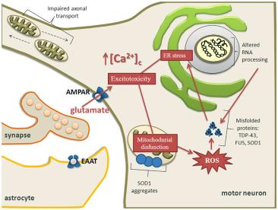
Introduction- Aristolochic Acid-Induced Nephropathy
As reported in several in vivo and in vitro studies, apoptosis is likely involved in the process of AA-induced proximal tubular atrophy. In an in vitro study, LLC-PK1 cells exposed to AA displayed a rapid increase in their intracellular calcium content leading to endoplasmic reticulum and mitochondrial stress, which in turn causes activation of the caspase pathway and finally apoptosis (Hsin YH et al., 2006).
Tadic V, Prell T, Lautenschlaeger J and Grosskreutz J (2014) The ER mitochondria calcium cycle and ER stress response as therapeutic targets in amyotrophic lateral sclerosis. Cell. Neurosci 8: 1-17.

Slide 12
Introduction-Folic Acid
Folic acid is a member of vitamin B family, it is also referred to as vitamin B₉, it is essential for numerous bodily functions.
Folic acid is found naturally in a wide variety of foods like including vegetables (particularly dark green leafy vegetables), fruits, nuts, beans, peas, dairy products, eggs, seafood, grains, and avocado etc. (Dietrich M 2005).
It is generally needed for cell replication and growth and helps forming building blocks of DNA, RNA. High concentration of folic acid has been found to be toxic to the various organs of the body especially kidneys.

Slide 13
Introduction-Folic Acid Induced AKI
The characteristics of folic acid induced AKI includes tubular cell apoptosis, as well as tubular cell proliferation, inflammatory cell infiltration, and mild fibrosis in the chronic phase (Ortega A et al., 2005; Doi K et al., 2006).
When given intraperitoneally at high doses (e.g. 250 mg/kg), folic acid (FA) causes acute kidney injury in rodents (Puri et al., 2012).

Slide 14
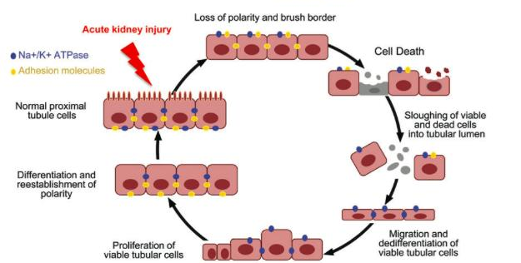
Cellular Repair Process
Bonventre, J. V. and Yang, L. (2011) Cellular pathophysiology of ischemic acute kidney injury. The Journal of Clinical Investigation, 121, 4210-4221.

Slide 15
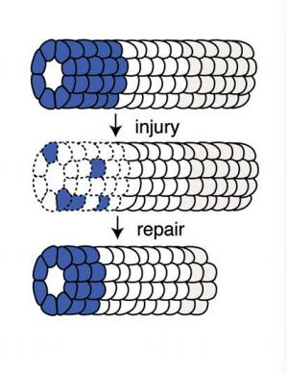
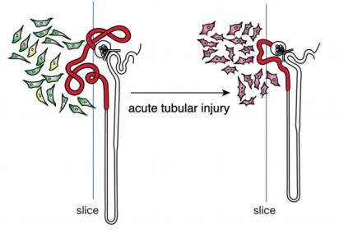
Endo T, Nakamura J, Sato Y et al. (2015) Exploring the origin and limitations of kidney regeneration. J Pathol; 236: 251–263.

Slide 16
Aim of the Project
The aim of this part of the project is to use in vitro model and make use of aristolochic acid and folic acid to mimic the damage of nephrotoxic injury on experimental model, thereby enable analysis on how models were affected during damage and recovery.

Slide 17
Materials and Methods
Cell culture: HK2 cells were incubated in DMEM (6546, Sigma-Aldrich) with 100μg/ml penicillin-streptomycin, 10% foetal bovine serum and and 1% L-glutamine. Cells were seeded in 96-well plates or 6-well plates according to experiments.
Immunofluorescence: Experiment performed according to the manufacture’s manual.
ROS measurement: The cellular oxidative stress was estimated by detecting intracellular ROS generation using fluorescent dye CM-H2DCFDA (C6827, Invitrogen, life technologies Ltd).
Western blot: Experiment performed according to the manufacture’s manual.

Slide 18
Materials and Methods
Primary Antibody | Company | Secondary Antibody | Company
HMGB1 | #6893 Cell Signalling | FITC | F0205, Dako UK Ltd
LC3B | #2775 Cell Signalling | FITC | F0205, Dako UK Ltd
Mitotracker Red | #9082 Cell Signalling | NA | NA
DAPI | Ab104139 Abcam | NA | NA
Immunofluorescence microcopy was carried out using a Leica CTR 5000 digital microscope (Leica Microsystem Ltd), and images were acquired using a Leica DFC420 microscope camera and Leica Application Suite v.3.8 software.
Data analysis was performed using SPSS software and wound healing data was performed using NIS-Elements D 4.12.04.

Slide 19
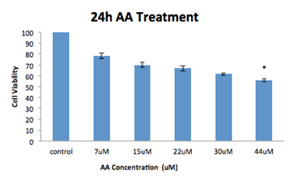
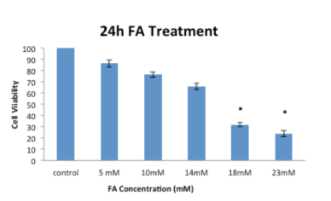
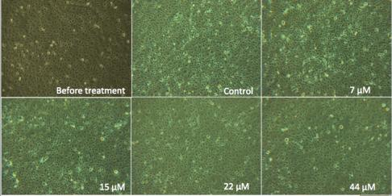
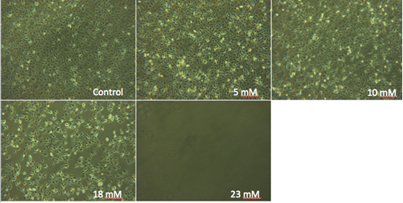
Cell Viability Reduced After 24h AA/FA Treatment on HK2 Cells

Slide 20
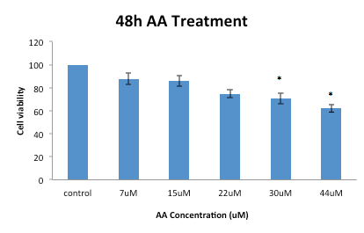
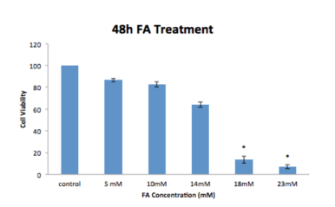
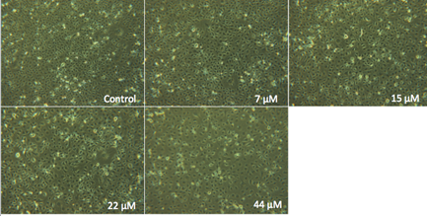
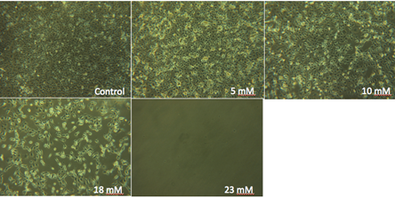
Cell Viability Reduced After 48h AA/FA Treatment on HK2 Cells

Slide 21
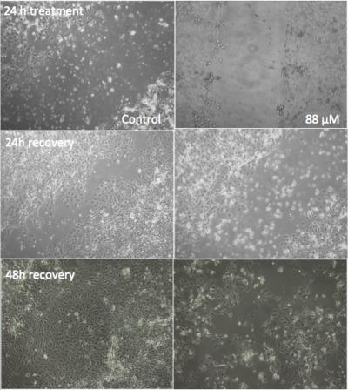
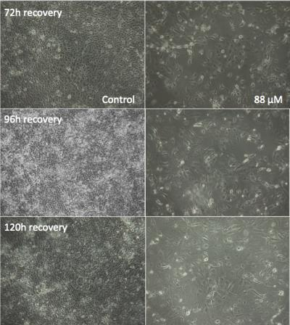
HK2 Cells Were Able To Recover After 24h AA Treatment Within 120 Hours

Slide 22
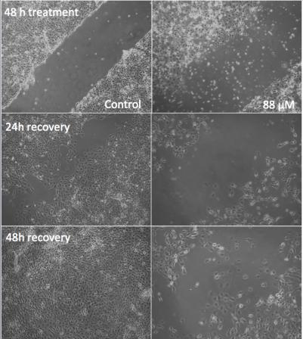
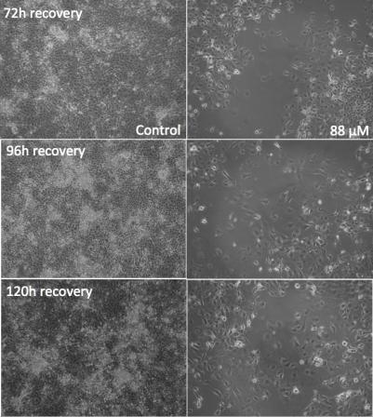
HK2 Cells Failed To Recover After 48h AA Treatment Within 120 Hours

Slide 23
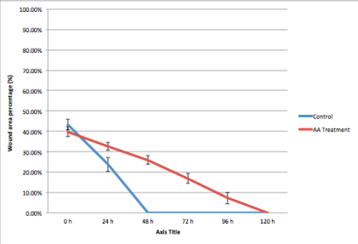
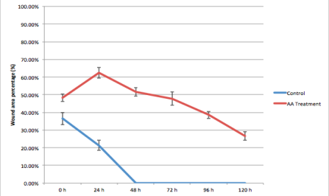
Wound Area Percentage of 24/48 Hour AA Treated Cells Reduced During 120 Hour Recovery
24 Hour AA
48 Hour AA

Slide 24
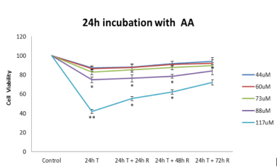
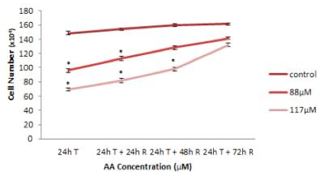
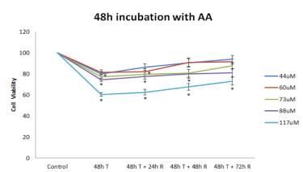
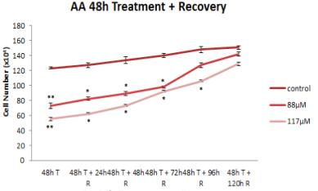
Cell Viability and Cell Number increased After 24 Hour/48 Hour AA Treatment

Slide 25
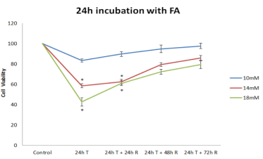
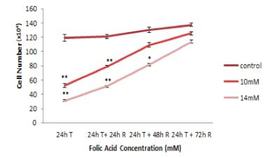
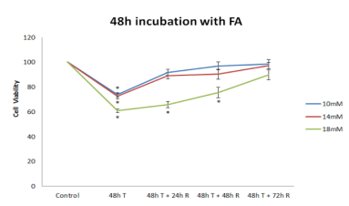
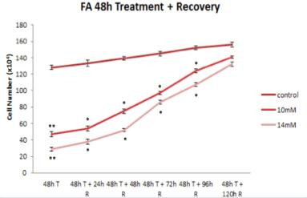
Cell Viability and Cell Number Increased After 24 Hour/48 Hour FA Treatment

Slide 26
High Mobility Group Box 1 (HMGB1)
High mobility group box 1 (HMGB1) is a nuclear protein that can bind to DNA and act as a co-factor for gene transcription. A cross-sectional study in patients with AKI showed an elevated serum HMGB1 level related to inflammatory parameters (Zakiyanov O et al, 2013).
A study in TLR4 deficient (TLR4-/-) mice with IRI of the kidney not only indicated an increased expression of HMGB1 in the kidney but also found serum creatinine and tubular injury were reduced after treatment with anti-HMGB1 antibodies (Wu HL et al, 2010).
In the cytoplasm, HMGB1 regulates cellular processes such as autophagy and apoptosis. Autophagy is a process associated with the degradation of intracellular organelles following sequestration within double-membrane delimited vacuoles. HMGB1 is important for oxidative stress–mediated autophagy.

Slide 27
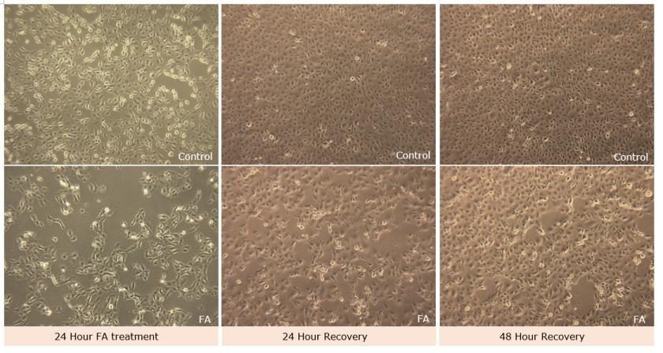
24 Hour FA Treated HK2 Cells Were Able to Recover Within 48 Hour

Slide 28
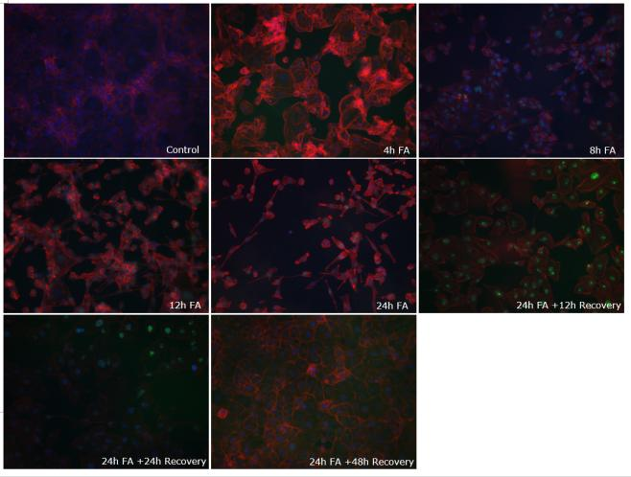
HMGB1 Appeared During Early FA Treatment and Disappeared During Recovery (With Phalloidin And DAPI)

Slide 29
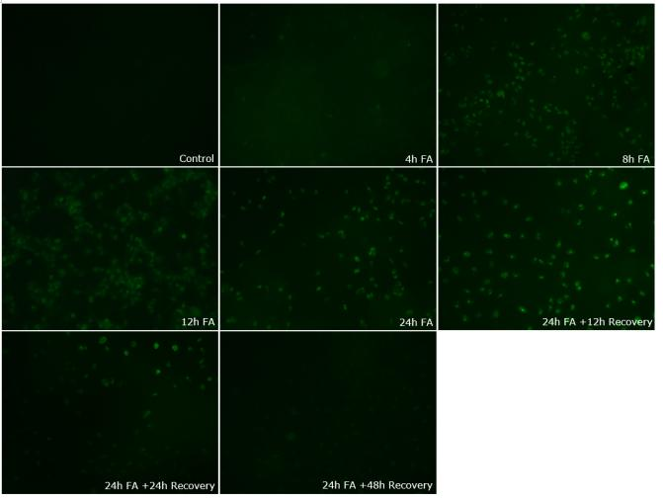
HMGB1 Appeared During Early FA Treatment and Disappeared During Recovery (HMGB1 Only)

Slide 30
Reactive Oxygen Species (ROS) Level Significantly Increased During FA Treatment and Slowly Decreased During Recovery

Slide 31
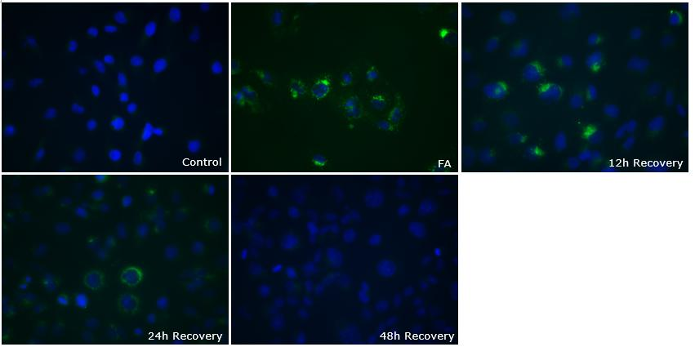
LC3B Appeared After 24 Hour FA Treatment and Decreased During Recovery (With DAPI)

Slide 32
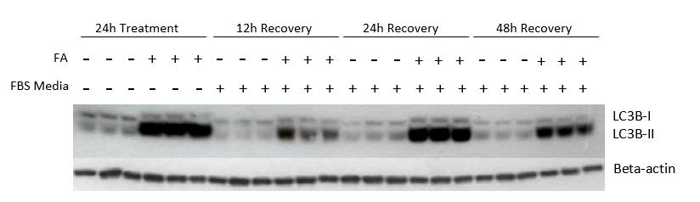
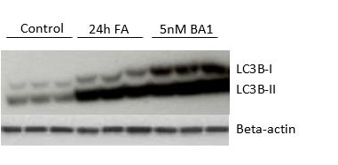
LC3B Expression Decreased During Recovery and Bafilomycin A1 (BA1) Inhibited Autophagy

Slide 33
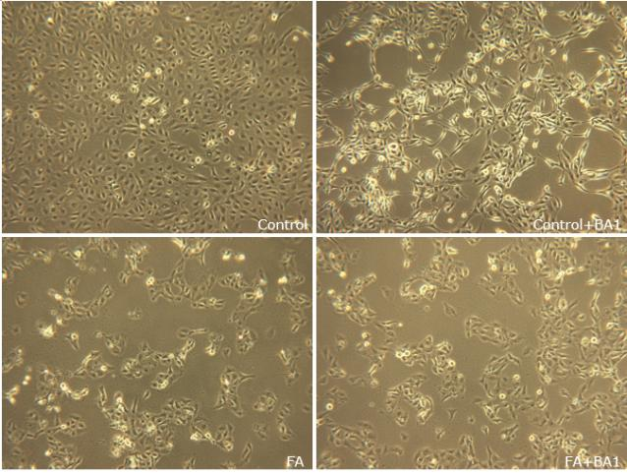
HK2 Cells Did Not Receive Further Damage by Inhibiting Autophagy with BA1 After 24 Hour FA Treatment

Slide 34
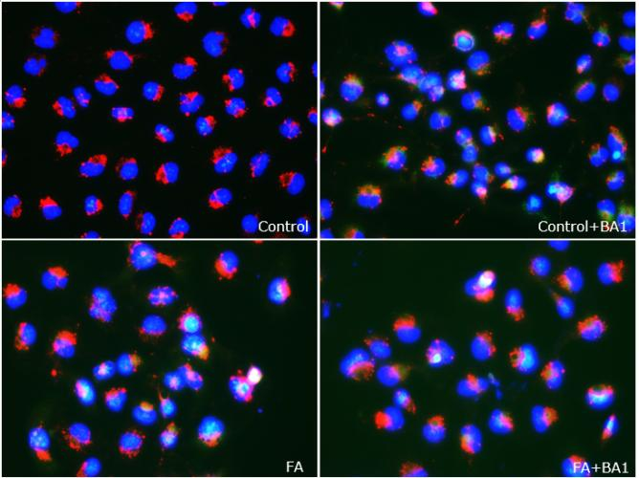
Autophagy Was Inhibited by BA1 (LC3B With DAPI and Mitotracker)

Slide 35
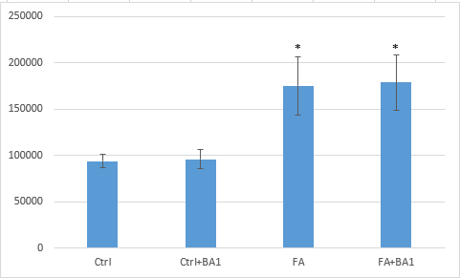
Inhibiting autophagy with BA1 did not increase ROS level in HK2 cells

Slide 36
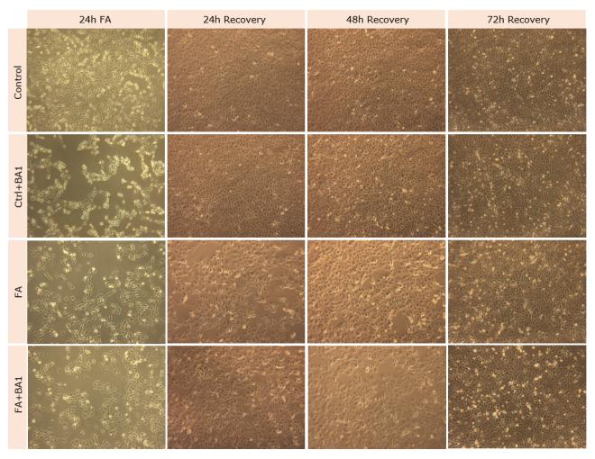
Autophagy Did Not Play a Key Role During Recovery and by Blocking Autophagy, HK2 Cells Were Still Able to Recover

Slide 37
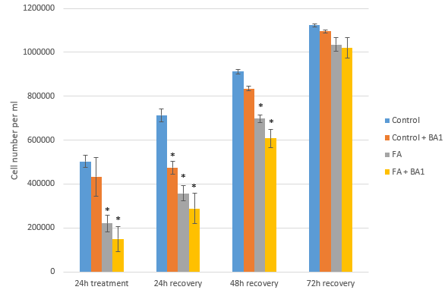
HK2 Cells Were Able to Recover After Inhibiting Autophagy

Slide 38
Conclusion
Aristolochic acid and folic acid caused significant damage on HK2 cells. The damage was proportional to dose of drugs and the time of incubation.
The ROS level of folic acid treated cells significantly increased after 4 hours of treatment, peaked at 24 hour treatment and slowly decreased during recovery.
The activation of autophagy did not have significant protection from FA damage; by blocking autophagy with BA1, FA treatment did not cause more damage to HK2 cells.
Autophagy was not the key of HK2 cell recovery after FA damage; by blocking of which, HK2 cells were able to recover.

Slide 39
References
Guarnieri G, Situlin R and Toigo G. (2005) Chapter 13. The kidney. In: Gibney MJ, Elia M, Ljungqvist O and Dowsett J (Eds.) Clinical nutrition. Oxford: Blackwell Science.
Singbartl K and Kellum JA. (2012) AKI in the ICU: Definition, epidemiology, risk stratification, and outcomes. Kidney International, 81, 819-825.
Bonventre JV and Yang L. (2011) Cellular pathophysiology of ischemic acute kidney injury. The Journal of Clinical Investigation, 121, 4210-4221.
Schnellman RG and Kelly KJ. (1994) Pathophysiology of Nephrotoxic Acute Renal Failure, Chapter 15.
Liu KD and Chertow GM. (2008) Chapter 10. Acute renal failure. In: Fauci AS, Braunwald E, Kasper DL, Hauser SL, Longo DL, Jameson JL and Loscalzo J. (Eds.) Harrison's principles of internal medicine. New York: McGraw-Hill.
Markowitz GS and Perazella MA. (2005) Drug-induced renal failure: A focus on tubulointerstitial disease. Clinica Chimica Acta, 351(1-2), 31-47.

Slide 40
References
Debelle FD, Vanherweghem JL and Nortier JL. (2008) Aristolochic acid nephropathy: A worldwide problem. Kidney International, 74, 158-169.
de Prez EG, Debelle FD, Nortier JL (2002) Aristolochic acids induce chronic renal failure with interstitial fibrosis in salt-depleted rats. J Am Soc Nephrol, 13: 431–436.
Hsin YH, Cheng CH, Tzen JT (2006) Effect of aristolochic acid on intracellular calcium concentration and its links with apoptosis in renal tubular cells. Apoptosis, 11: 2167–2177.
Ortega A, Ramila D, Izquierdo A, Gonzalez L, Barat A, Gazapo R, Bosch RJ, Esbrit P. (2005) Role of the renin-angiotensin system on the parathyroid hormone-related protein overexpression induced by nephrotoxic acute renal failure in the rat. J Am Soc Nephrol;16:939–49.
Doi K, Okamoto K, Negishi K, et al (2006). Attenuation of folic acid-induced renal inflammatory injury in platelet-activating factor receptor-deficient mice. Am J Pathol;168(5):1413–24.
Dietrich M; Brown CJ; Block G (2005). The effect of folate fortification of cereal-grain products on blood folate status, dietary folate intake, and dietary folate sources among adult non-supplement users in the United States. J Am Coll Nutr 24 (4): 266–274.

Slide 41
References
Puri S, Sharma R, Puri V and Gupta A (2010) Folic acid induces acute renal failure (ARF) by enhancing renal prooxidant state. Experimental and Toxicologic Pathology. doi:10.1016/j.etp.2010.08.010.
Wu HL, Ma J, Wang P, Corpuz TM, Panchapakesan U, Wyburn KR, et al (2010) HMGB1 contributes to kidney ischemia reperfusion injury. J Am Soc Nephrol.21:1878–90.
Zakiyanov O, Kriha V, Vachek J, Zima T, Tesar V, Kalousova M (2013) Placental growth factor, pregnancy-associated plasma protein a soluble receptor for advanced glycation end products, extracellular newly identified receptor for receptor for advanced glycation end products binding protein and high mobility group box 1 levels in patients with acute kidney injury: a cross sectional study. BMC Nephrol.14:245.

Slide 42
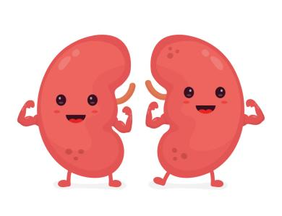
Thanks for your time!
Any questions?

