Slide 1
Thermal Conductivity of Amorphous Si and Ge Thin Films
Yibin Xu
National Institute for Materials Science, Japan

Slide 2
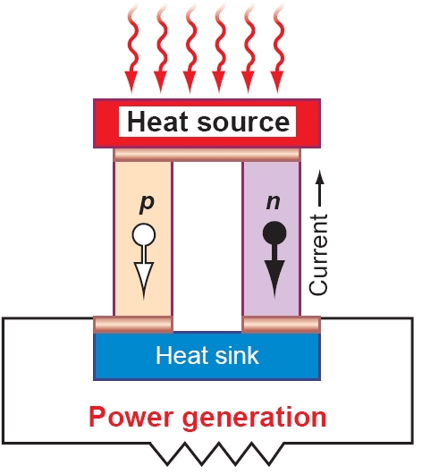
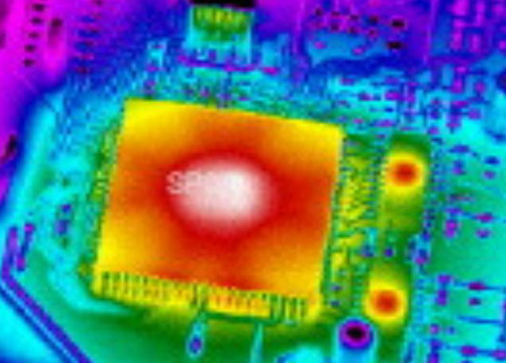
Thermal management issue for thin film
Thermoelectric devices
Thermal management
The transport forms of phonons has a great impact on the design of nanostructured thermoelectric materials with reduced thermal conductivity, as well as heat dissipation in electronic and photonic devices.

Slide 3
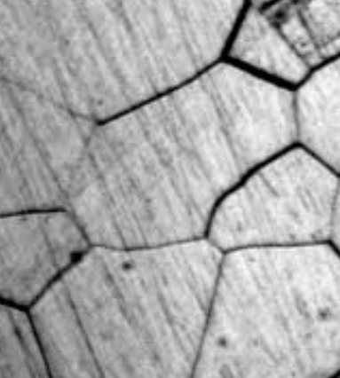
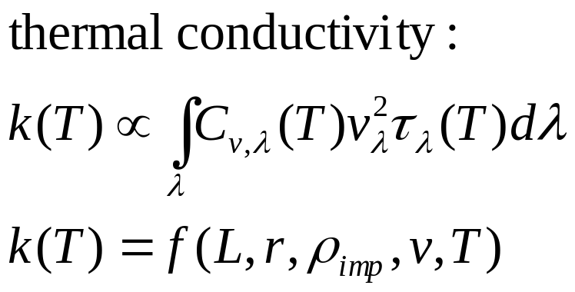
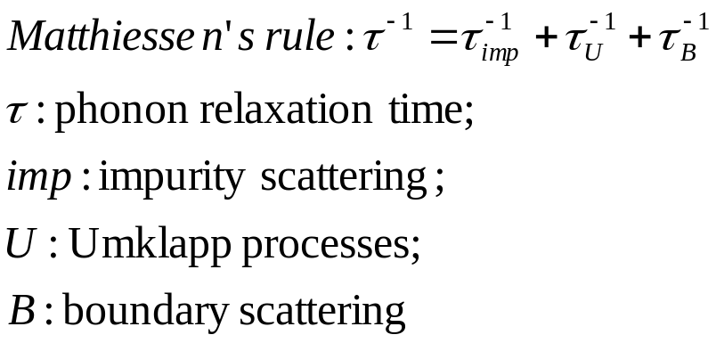
Phonon transportation in thin film
z, Cross-Plane
Diffuse Phonon Boundary Scattering
Phonon-Defect Scattering
L
x, In-Plane
r
Phonon-Phonon Scattering
Ballistic Phonon

Slide 4
Features of thermal conductivity of thin film
bulk
Thermal conductivity, λ
Thermal conductivity, λ
thin film
Temperature, T
Thickness, d
Film thickness dependence can be observed when $d≤10×l_{ph}$
How is amorphous thin film?
easily synthesized
extreme low thermal conductivity
little knowledge of phonon distribution, transportation, etc.

Slide 5
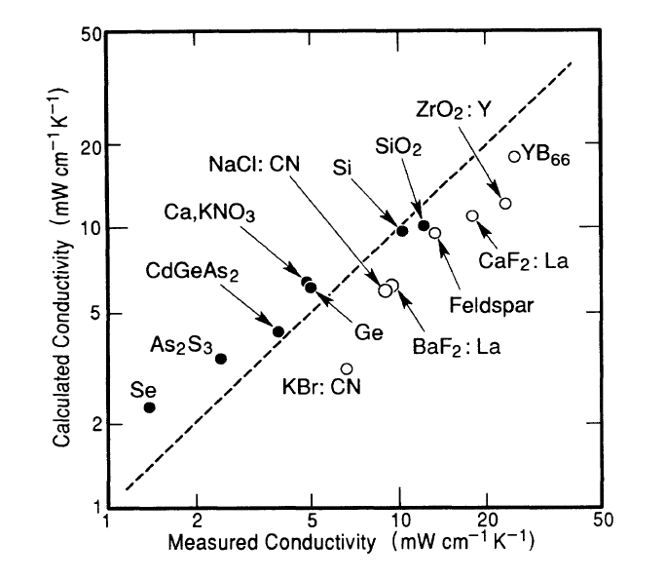
Classic models describing heat conduction in amorphous solids
[1] Einstein model^{[1]}: heat conduction in amorphous solids is described by a random walk of thermal energy between neighboring atoms vibrating with random phases.
[2] Minimum thermal conductivity model^{[2]}: the minimum thermal conductivity is reached when the distance between collisions of elastic waves equals the wavelength of Debye waves.
[1] A. Einstein, Ann. Phys. (Leipzig) 35, 679 (1911).
[2] G. A. Slack, in Solid State Physics: Advances in Research and Applications, edited by H. Ehrenreich et al. (Academic, New York, 1979), Vol. 34, p. 1.
[3] D. G. Cahill, S. K. Watson, and R.O. Pohl, Phys. Rev. B 46, 6131 (1992).
Phonon mean free paths in amorphous solids are several nm.
Fig. 1 Calculated minimum conductivity at 300 K versus the measured values for amorphous solids^{[3]}.

Slide 6
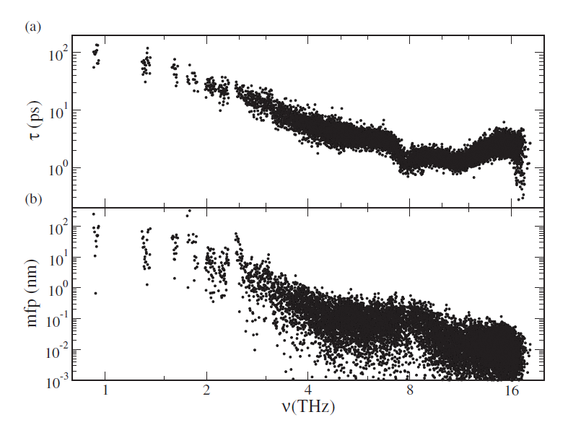
Existence of phonons with long mean free path predicted by MD simulation
Effective mean free paths of the vibrational modes of an a-Si in equilibrium MD simulations.
Y. P. He, D. Donadio, and G. Galli, Appl. Phys. Lett. 98, 144101 (2011).

Slide 7
Purpose of research
Investigate the dependence of thermal conductivity of amorphous Si and Ge films on thickness and deposition conditions, and explore the nature of phonon propagating in amorphous solids.

Slide 8
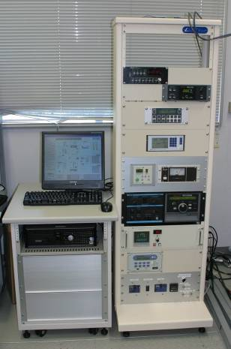
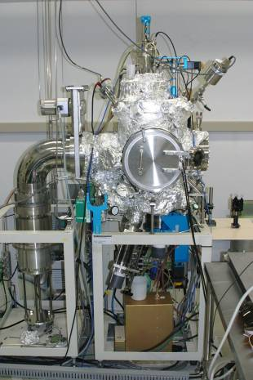
Synthesis of Si(Ge) thin films
Magnetron sputtering
Deposition temperature
Au sensing film (150 nm)
Si(Ge) thin film (15,100,250 nm)
25 ℃
300 ℃
500 ℃
600 ℃
Ge(Si) substrate
(single crystal, 0.5 mm)
Deposition conditions

Slide 9
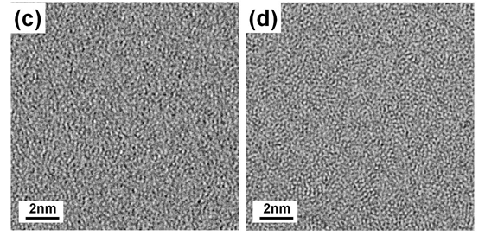
TEM image of Si and Ge thin film
Si 600°C
Ge 300°C
Ge 25°C

Slide 10
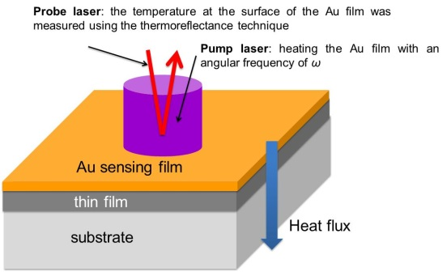
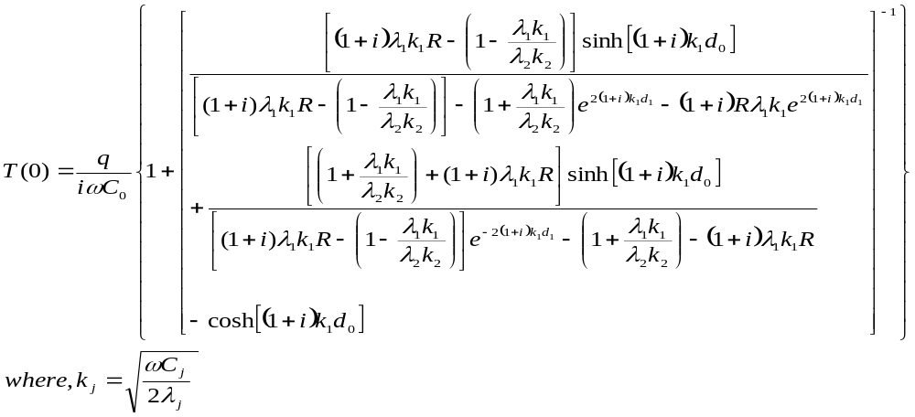
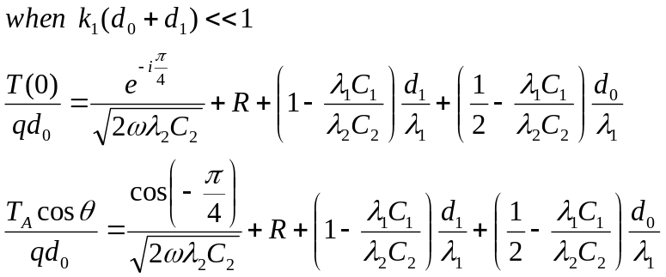
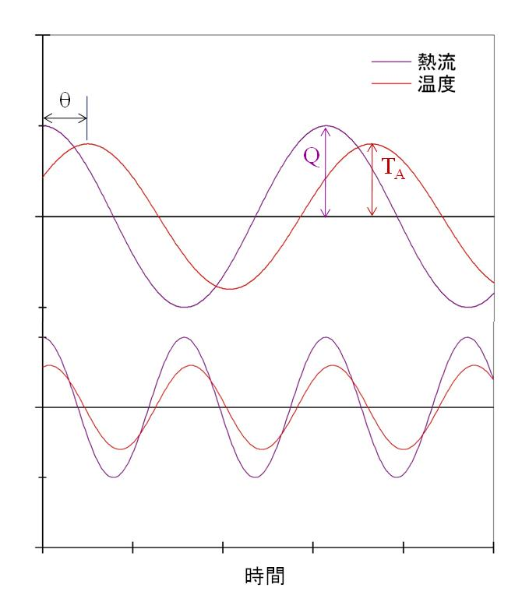
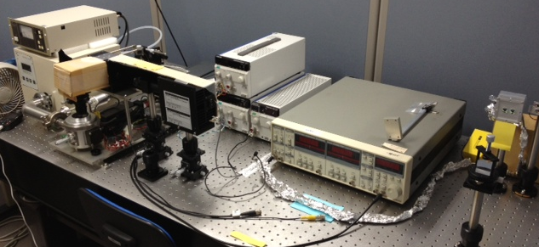
Cross-plane thermal conductivity measurement (FDTR method)
0
ΔRef
ΔT
R. Kato, Y. Xu, et. al. , Jpn. J. Appl. Phys, 50, 106602 (2011)
Notes:
Enter speaker notes here.

Slide 11
Thermal resistance of amorphous Si(Ge) films
as a function of thickness and deposition temperature
Si
Ge

Slide 12
Thermal conductivity of amorphous Si(Ge) film
as a function of thickness and deposition temperature
Si
Ge

Slide 13
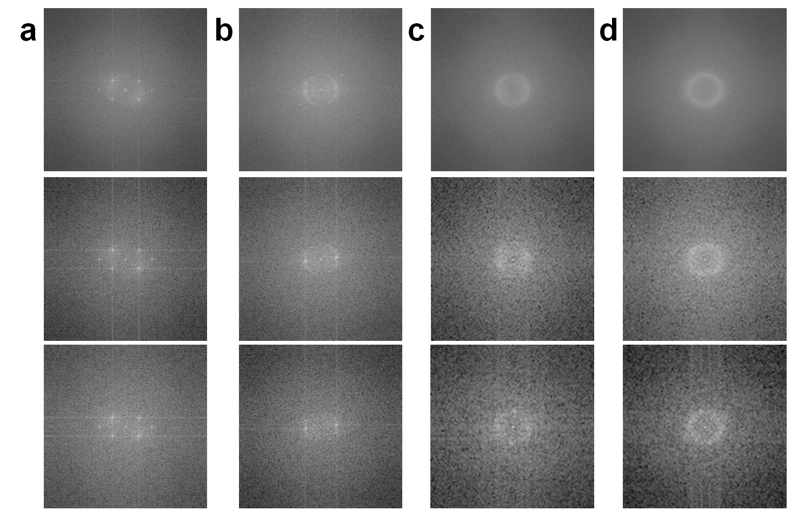
FFT patterns of different area sizes in Ge films
25 ºC
300 ºC
10×10 nm
3×3 nm
2×2 nm

Slide 14
Conclusion
Thermal conductivity of amorphous Si and Ge films shows thickness dependence. This result proves that long MFP (>100 nm) phonons exist in amorphous Si and Ge.
Thermal conductivity of amorphous Si and Ge films shows dependent on deposition temperature. The nano-scaled structural order is supposed to be the responsible for it.

