Slide 1

Medical discourse and professional identity in nursing
Yi-Ling Lu, EdD, RN.
National United University
The Department of Applied Foreign Languages

Slide 2
INTRODUCTION
Medical discourse courses in English have been obtaining increasing attention in recent years. Such specialised courses aim to prepare nurses to acquire language knowledge used in the nursing and medical field.
When nurses enter a nursing community in which specialist language is shared to produce knowledge and to engage in nursing practice, they develop certain beliefs regarding medical discourse in relation to their professional identity.

Slide 3
Research aim
This study aims to explore how the process of developing professional identity in relation to medical discourse occurs.
Why important?
This topic is worthy of investigation because nurses’ views may be far more complex than what we assumed as language instructors. Their views must be explored in that they are important to enable medical discourse courses more close to learner needs and to broaden our understanding of learners.

Slide 4
BACKGROUND-
(1) Language as a means to identity construction
Language is a powerful tool for proclaiming one’s connection with communities. Speaking or writing in particular ways announces one’s membership of the communities because the thing we say or write somehow shows who we are and demonstrates the image we wish to establish to others (Hyland, 2009, 2010, 2011)
Identity is thus constructed by employing community discourse that members in the same community make use of.

Slide 5
BACKGROUND
Tonkiss (2012, pp. 408) remarks that medical discourse has three functions:
1. marks out a field: medical discourse devotes to the domain of healthcare professionalism and is used to address issues in the healthcare field (Pogner, 2003, 2005).
2. confers membership: By speaking the same language, healthcare professionals proclaim their professionalism (Little et al., 2003).
3. bestows authority: medical discourse symbolises a form of expert knowledge. Individuals speaking in medical discourse are deemed to have such the knowledge so that they are heard as authoritative.

Slide 6
BACKGROUND-
(2) Cognitive apprenticeship learning in hospital settings
In the healthcare community, particularly, nursing community, cognitive apprenticeship, which refers to “learning through guided experience on cognitive and metacognitive, rather than physical, skills and process” (Collins et al., 1989, p. 456), is frequently employed for experienced members to teach new comers .
Four key concepts related to cognitive apprenticeship include:
1. community of practice (CoP):
Individuals learn from participating in social practice and develop situational understanding and expertise in relation to the community with which they connect themselves (Wenger, 1998).
For Wenger, CoP is the core of the healthcare community, and gives a legitimate status to the community .

Slide 7
BACKGROUND
Wenger (2009, p. vii) notes that “everyone knows that the actual practice cannot be fully learned in the classroom. Health and social care delivery remains a practice located in relationships, in interactions and in the improvisation inherent in situated intelligence.”
2. Situatedness:
In clinical practice, nurses are presented with opportunities to experience and to see the tacit elements which are difficult to explicate in a lecture and which lead to improved practice.

Slide 8
METHODOLOGY
3. Legitimate peripheral participation:
Nurses accumulate experience from the periphery, and eventually obtain the mastery of nursing
4. Guided participation :
New comers of nursing profession develop desired skills or learns new knowledge under the support and guidance of more experienced nurses. Novice nurses come to develop the ability and knowledge to fully engage in nursing (Dennen and Burner, 2008).

Slide 9
METHODOLOGY
A qualitative approach: semi-structured interview (July of 2017~present) with 6 nurses working in medical centres located in the north of Taiwan.
The inclusion sampling criteria for selecting participants was based on the following considerations:
1. Nurses have at least two years working experience at large-scale medical centres in Taiwan.
2. Nurses’ working experience must relate to patient care activities.

Slide 10
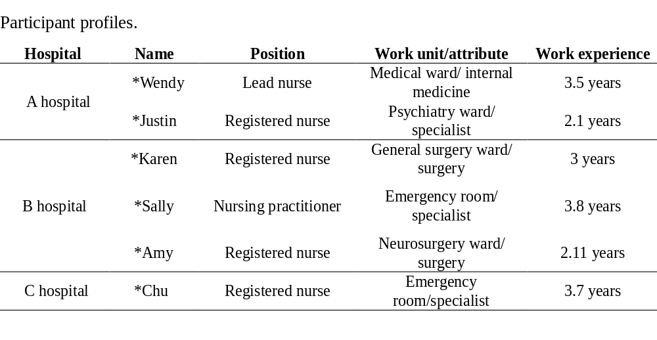
METHODOLOGY

Slide 11
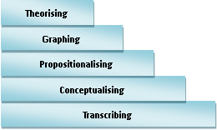
METHODOLOGY
The process of data analysis followed Chang’s (2010, p. 98) five steps of analysing qualitative data:

Slide 12
RESEARCH FINDINGS
Learning in practice:
When the participants were novice nurses, they learned medical discourse mainly from their mentors.
They observed how their mentors used medical discourse to shift reports and to report on their patients’ conditions to other healthcare professionals.

Slide 13
RESEARCH FINDINGS
The nurses believed that the image of professional nurses should resemble that of their mentors.
After the nurses accumulated confidence and competence, their mentors increased the responsibilities. The nurses started to shift reports (in person and on the phone) and discuss their patients’ conditions with doctors under the guidance of their mentors.
“I imitated my mentor’s way of doing nursing duties, for example, checking nursing kardex first and then shifting reports. And she started to make plans of shits based on information she obtained from shifting reports and kardex. She was my model at the time, and because of her I believed that a professional nurse should be good at medical discourse in English (Sally)”

Slide 14
RESEARCH FINDINGS
Summary: Through observing how their ideal models engaged in nursing and through learning how to function acceptably from peripheral participation towards full participation (see Lave & Wenger, 1991; Wenger, 1998), nurse participants developed a strong identification of medical discourse in relation to their professional career.

Slide 15
RESEARCH FINDINGS
Incorporating into the CoP:
The second important finding which also exerts an influence on the changing process is incorporating into CoP. All of the participants made a great effort to learn medical discourse to incorporate into CoP. They did this for two reasons,
-social acceptance
-professional recognition.

Slide 16
RESEARCH FINDINGS
2.1 Social acceptance
Whenever the participants talk about issues in relation to their professionalism, for example, patients’ treatment plans, medications, healthcare plans, etc. with the insiders of the nursing community and with other healthcare professionals, they use medical discourse in English.
They used English rather than Chinese because it is a tacit understanding among nursing professionals.
When they were novices, they were astonished by how much they needed to learn in order to “survive” in the hospital and encountered many difficulties.

Slide 17
RESEARCH FINDINGS
“ It [medical discourse] is a tacit understanding here. Of course, you don’t have to do this…I mean you can still use Chinese. But, I think as being a part of this big family, we influence and are influenced each other very naturally. We learn from each other. So it turns out that all of us use English to indicate medical terminology (May)”
“ It [medical discourse] is a part of our lives. It is nurses’ way of communication. Learning how to use it does take time at the beginning stage, and you need to figure out how to conquer all the learning difficulties, including how to correctly pronounce these words, how to use them in the right place and right time, how to immediately recognise them when you hear them. I mean, those are all your work because you need to use nurses’ way of communication to become a member of their group (Sally)”

Slide 18
RESEARCH FINDINGS
2.2 Professional recognition
Participants noted that speaking in medical discourse realises their professionalism.
Using it in a discussion made of a group of medical professionals, nurses demonstrate their specialisation and knowledge and show their confidence through using expert discourse.

Slide 19
RESEARCH FINDINGS
“ When speaking in medical discourse in English, I feel professional. For example, doctors always use it to give their orders to nurses or to ask about their patients’ conditions. If nurses don’t understand doctors’ questions or orders, it really shows that they are not knowledgeable enough. Understanding medical discourse is the affirmation of the ability and professionalism of nurses (Amy)”

Slide 20
RESEARCH FINDINGS
Working in different wards shapes nurses’ perspectives on medical discourse in relation to professional recognition.
For example, one nurse, Justin, from the psychiatric ward, although believing the close relationship between medical discourse and social acceptance, gave less importance to the role of medical discourse to his professionalism.
“ Professional consulting knowledge and skills are what constitute my professionalism. They are much more important than the ability to speak in medical discourse in English. The patients living in the ward where I am working now [the psychiatric ward] are, in the eyes of most people, abnormal. My job is to establish my patients’ insights and help them to be accepted by this society, and these realise my professionalism (Justin)”

Slide 21
RESEARCH FINDINGS
SUMMARY: Nurses entered the nursing community and learned how to use medical discourse to communicate with the established members and other healthcare professionals. When they speak in medical discourse, they feel that they are a member of the healthcare community. In addition, nurses’ professional identity can be displayed by the use of medical discourse and their professional image can be built by showing their good knowledge in medical discourse.

Slide 22
RESEARCH FINDINGS
Commitment to nursing
All nurses in this study have strong commitment to nursing. For them, their job is to care for patients and to improve patient well-being. Learning in clinical practice is particularly important to the nurses. It makes nurses more knowledgeable and competent―they know how to react, they have ability to deal with things happening around or to them, and they use proper language when talking to insiders.
Nurses’ involvement in clinical practice creates strong needs and pressures for learning because the meaning of medical discourse must be comprehended, no matter in oral or written communication, in order for nurses to function properly in the situation.
It is only when nurses understand the meaning expressed in communication could they know and decide what to provide to their patients.

Slide 23
RESEARCH FINDINGS
“ I think that nurses are seen as professional because we have professional knowledge and skills. But, knowledge and skills are changing so we have to continue to learn in order to keep abreast of medical and nursing knowledge. It is only when you are equipped with such knowledge could you provide quality nursing care to your patients (Karen)”.
Summary: All of the participants have a strong commitment to nursing. Being involved in the community devoted to the provision of quality nursing care, the nurses developed a belief that continuing learning in clinical practice is important.

Slide 24
CONCLUSIONS
Nurses’ connection with the nursing community leads them to developing beliefs regarding medical discourse to their role as a nursing professional. Three important elements contributing to the process of developing processional identity identified by this study include learning in practice, incorporating into CoP, and commitment to nursing.
Nurses’ voices are sending an important message, that is, they want to belong to the community, but they meet difficulties in the process of positioning themselves and being positioned in the community. Although the nurses in this study conquer all the difficulties and eventually become a full member in the community, there is a need to provide adequate preparation informed by the experience of nurses who have resided in the hospital so that novice nurses can adapt and familiar themselves in the nursing community.

Slide 25
Thank you for your attention

