Slide 1
Yi-Hao Yu, MD, PhD
Greenwich Hospital & Northeast Medical Group
Yale-New Haven Health System
Physiological basis for “Metabolic Obesity” & “Hedonic Obesity”
12/08/15 Atlanta

Slide 2
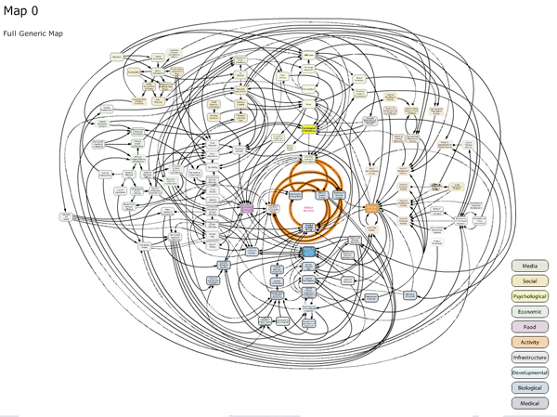
jessicacharlesworth.com

Slide 3
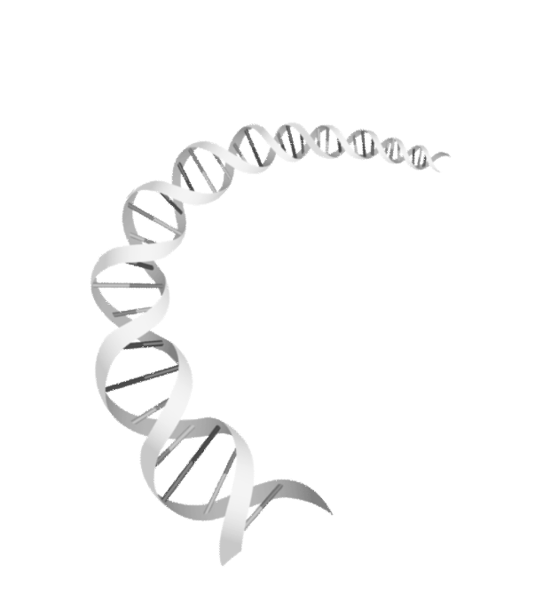

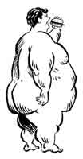
Complex interactions underlying polygenic obesity
Physical
activity
Viruses
Viruses
Nutrition
Nutrition
Social Status
hormones
Social Status
Peer pressure
Food
Peer pressure
Food
Abundance
Abundance
Psychology
Psychology
Technological
Psychology
Technological
Pollution
Pollution
Progress
Progress
Mutch D & Clement K, Plos Genetics 2006

Slide 4
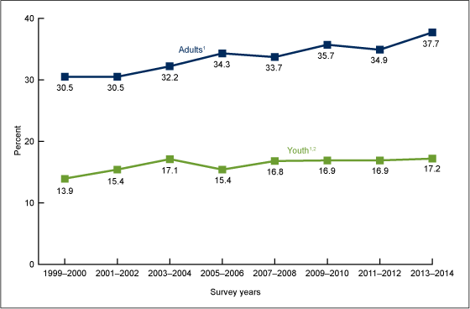
Trends in obesity prevalence among adults aged 20 and over (age-adjusted) and youth aged 2–19 years: United States, 1999–2000 through 2013–2014

Slide 5
Is obesity a reversible condition?
-What’s the pathophysiological basis?
How is obesity developed?
-How should it be treated?

Slide 6
- Metabolic obesity
- Hedonic obesity

Slide 7
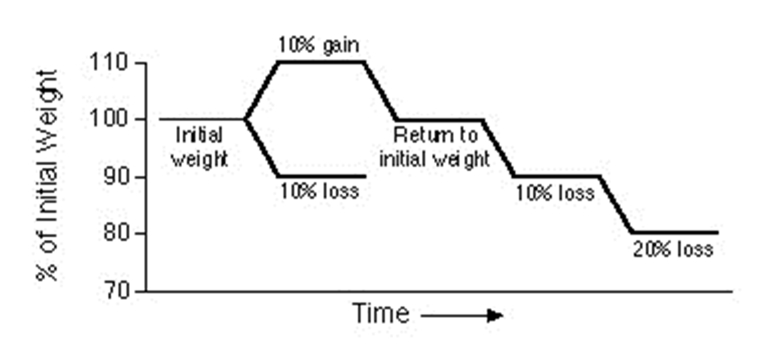

Metabolic regulation of energy fluxes – mechanism of compensatory changes
Energy expenditure
~15%
Energy expenditure - normal
Energy expenditure
Energy expenditure
~14%
Adapted from Leibel RL et al. N Engl J Med 1995;332:621-628.

Slide 8
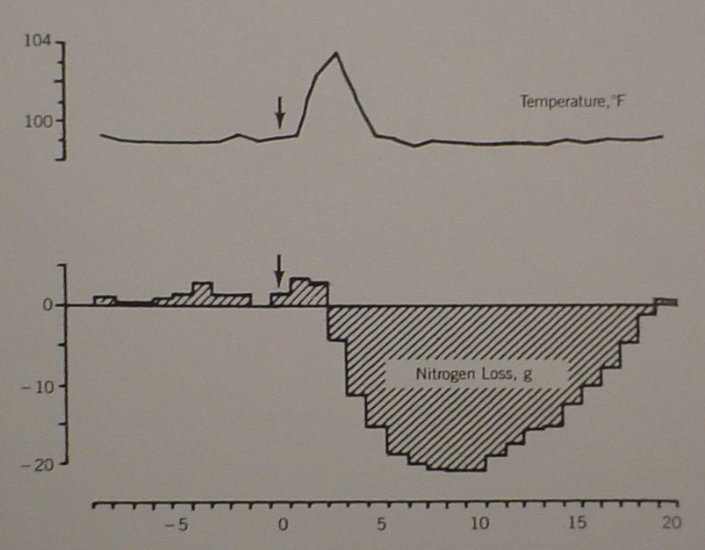
Modified from Beisel 1966. Fed Proc 25:1682-7
Temperature, ºF
Nitrogen loss, g
Cumulative nitrogen balance in young man with a minor febrile illness (typical sand fly fever)

Slide 9
Hypothalamic neural circuit for body weight set-point
lipostatic signals
leptin/insulin
>
<
+
-
POMC/CART
NPY/AGRP
+
-
Mc4R and other
secondary neurons
-
+
+
-
Energy expenditure
Food intake
-
+
Body weight
adiposity

Slide 10
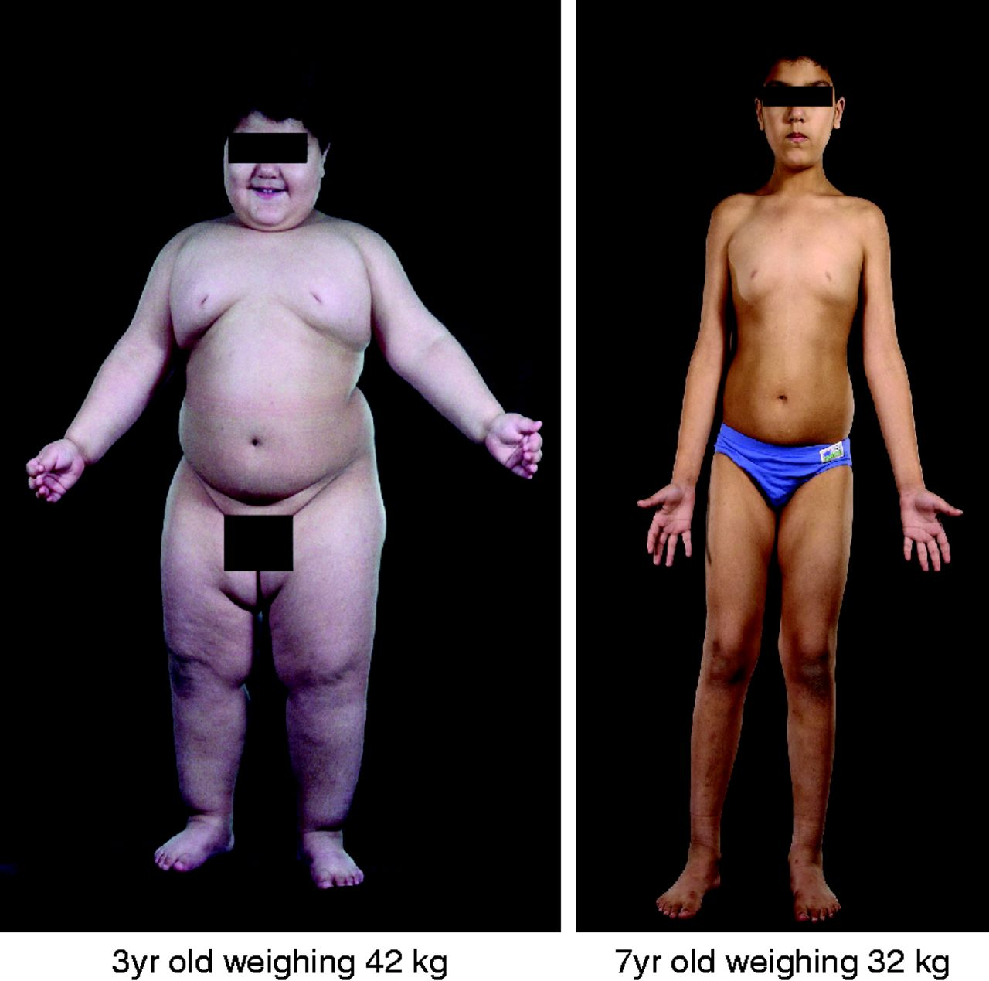
Congenital leptin deficiency: before and after leptin treatment
I Sadaf Farooqi, and Stephen O'Rahilly J Endocrinol 2014;223:T63-T70

Slide 11
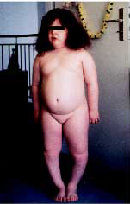

Congenital POMC deficiency: phenotypic triad of red hair, hypocortisolism, and childhood obesity
Krude H et al Nat Genet. 1998;19(2):155-7

Slide 12
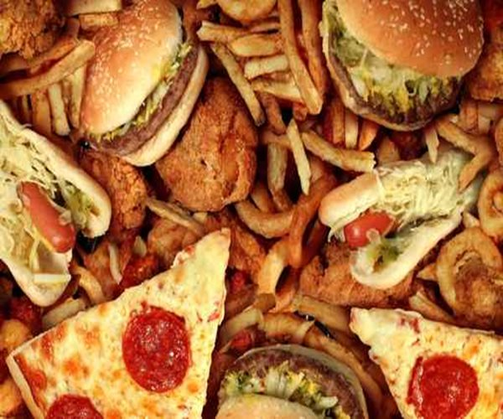
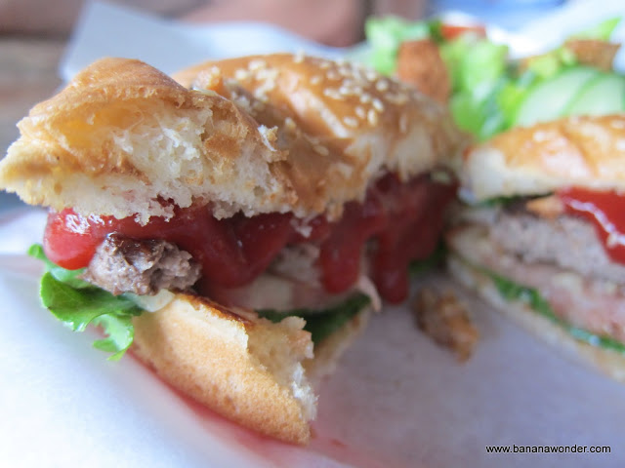
The culprit of the obesity epidemic
is our obesigenic environment
www.newsmax.com

Slide 13


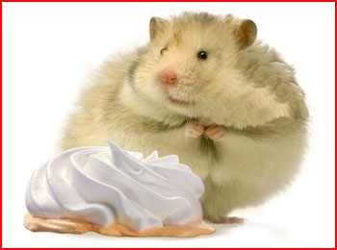
Common forms of obesity is polygenic in etiology…in humans and in animals
candidrd.com
www.takepart.com/article/2015/11/13/cdc-obesity-rate-report
www.atheistnexus.org

Slide 14
Temporarily elevated body weight
Metabolic signal to reduce food intake
“Adaptive changes”
Energy expenditure
Homeostatic regulation
Set-point body weight
Metabolic signal to increase food intake
“Adaptive changes”
Energy expenditure
Temporarily reduced body weight

Slide 15
“Metabolic obesity”
New Set-point body weight
Temporarily elevated body weight
Homeostatic regulation
Metabolic signal to reduce food intake
“Adaptive changes”
Energy expenditure
Weight gain
Elevation of set-point
Set-point body weight
Weight loss
Metabolic signal to increase food intake
“Adaptive changes”
Energy expenditure
Temporarily reduced body weight

Slide 16
Re-set of body weight set-point
lipostatic signals
leptin/insulin
Leptin resistance
>
<
+
-
POMC/CART
NPY/AGRP
+
-
Reactive gliosis, aging/inflammation
Mc4R and other
secondary neurons
-
+
+
-
Energy expenditure
Food intake
-
+
Body weight
adiposity

Slide 17
Now…
Hedonic obesity

Slide 18
“Hedonic obesity”
Elevated body weight kept above the set-point
Temporarily elevated body weight
Hedonic signal to sustain “overeating” despite metabolic abundance
Metabolic signal to reduce food intake
“Adaptive changes”
Energy expenditure
Weight gain
Set-point body weight
Homeostatic regulation
Metabolic signal to increase food intake
Weight loss
Energy expenditure
“Adaptive changes”
Temporarily reduced body weight

Slide 19
Overeating -Food addiction?

Slide 20
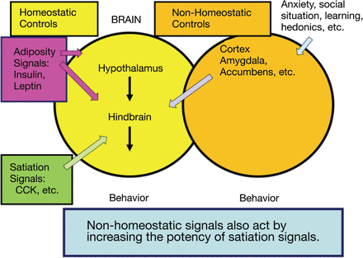
Two discernible neural circuits
nutritionreviews.oxfordjournals.org
hedonic
metabolic
Miguel Alonso-Alonso, et al
DOI: http://dx.doi.org/10.1093/nutrit/nuv002

Slide 21
Hedonic regulation of food intake
Prefrontal Cortex – Orbitofrontal Cortex
The brain’s corticolimbic structures
Dorsal Striatum
Thalamus
Nucleus Accumbens NAc
(ventral striatum)
Amygdala
Hippocampus
Lateral
Hypothalamus
Ventral Tegmental Area VTA
Hindbrain NTS
Mesolimbic dopaminergic transmission
Sensory
Input

Slide 22
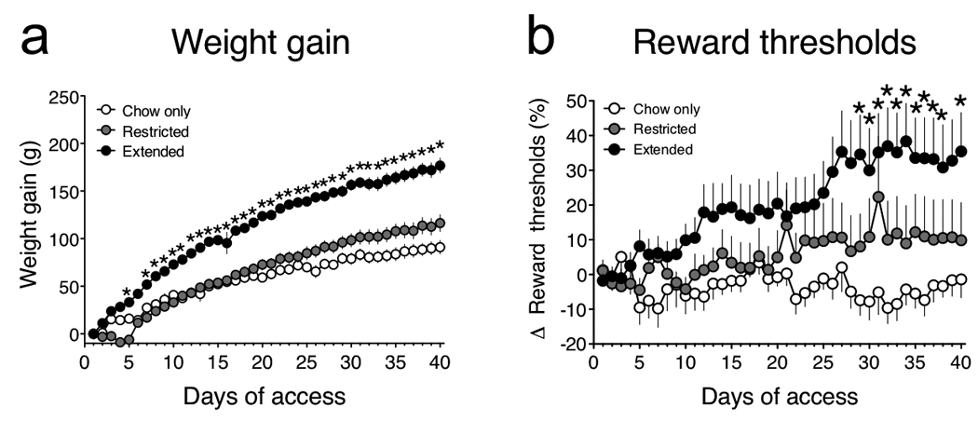
Hedonic obesity is sustained by persistent overeating in the presence of 24-hour available “cafeteria food” in Wistar rats
Paul M. Johnson and Paul J. Kenny*Nat Neurosci. 2010 May; 13(5): 635–641.

Slide 23
PLoS ONE 8(9): e74832. doi:10.1371/journal.pone.0074832, published Aug 10, 2013
Food Addiction: Its Prevalence and Significant
Association with Obesity in the General Population
Pardis Pedram1, Danny Wadden1, Peyvand Amini1, Wayne Gulliver1, Edward Randell2, Farrell Cahill1,
Sudesh Vasdev1, Alan Goodridge1, Jacqueline C. Carter3, Guangju Zhai4, Yunqi Ji1, Guang Sun1*
1 Discipline of Medicine, Faculty of Medicine, Memorial University of Newfoundland, St. John’s, Canada, 2 Discipline of Laboratory Medicine, Memorial University of
Newfoundland, St. John’s, Canada, 3 Department of Psychology, Faculty of Science, Memorial University of Newfoundland, St. John’s, Canada, 4 Discipline of Genetics,
Faculty of Medicine, Memorial University of Newfoundland, St. John’s, Canada

Slide 24
Hedonic weight
“Hedonic obesity”
Elevated body weight kept above the set-point
Temporarily elevated body weight
Extra weigh sustained by never- failed consistent overeating
Hedonic signal to sustain “overeating” despite metabolic abundance
Metabolic signal to reduce food intake
“Adaptive changes”
Energy expenditure
Weight gain
Set-point body weight
Homeostatic regulation
Set-point weight
Metabolic signal to increase food intake
Weight loss
Energy expenditure
“Adaptive changes”
Temporarily reduced body weight

Slide 25
How to Distinguish
Metabolic Obesity and
Hedonic Obesity

Slide 26
Hedonic obesity
EE-MM regression line
Pre-obese weight at set-point:
Energy expenditure (EE)
Metabolic obesity
Metabolic mass (MM)

Slide 27
Focus on future treatment of obesity:
Hedonic obesity: tailored behavioral therapy and/or medical intervention to achieve reward modification/balance
Metabolic obesity: medical/surgical intervention to alter body weight set-point

Slide 28
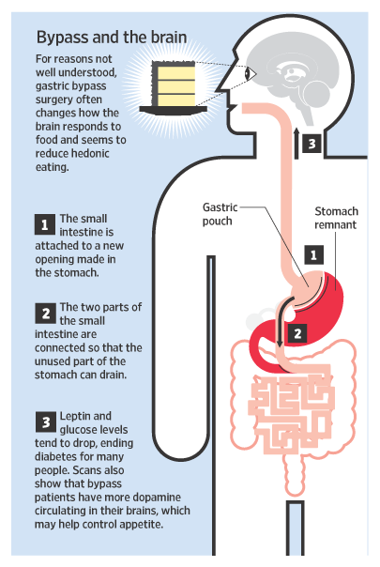
Bariatric surgery seems to be effective for both metabolic obesity and hedonic obesity
www.meltingmama.net

Slide 29
Conclusion:
Metabolic obesity
1, elevated body weight set-point
2, energy expenditure well within normal range
3, treatment to lower set-point
Hedonic obesity
1, persistent overeating overriding metabolic signals
2, energy expenditure above normal limits for unit metabolic mass
3, tailored therapy to modify hedonic neural circuit and achieve a desirable reward balance
Yu et al. Obes Rev. 2015 Mar;16(3):234-47

Slide 30
Acknowledgement
Joseph. R. Vasselli - Columbia University, USA
Yiying Zhang - Columbia University, USA
Jeffrey I. Mechanick – Icahn School of Med at Mount Sinai, USA
Judith Korner – Columbia University, USA
Ralph Peterli - University of Basel, Switzerland

