Slide 1

№1
South-West State University, Russia
ECOLOGICAL RESERVES FOR IMPROVING HEAT GENERATOR ECONOMIC EFFICIENCY
Vladimir Yezhov, D.Sc. in engineering, Professor of Heat and Gas Supply and Ventilation Department
(South West State University, Russia)
e-mail: vl-ezhov@yandex.ru

Slide 2
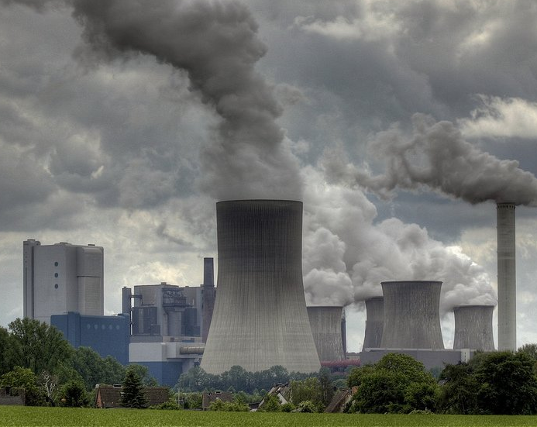
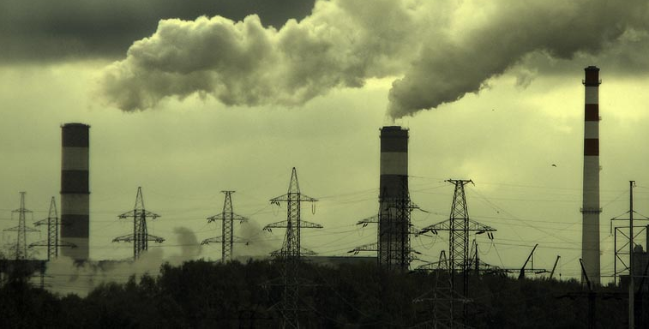
ECOLOGICAL RESERVES FOR IMPROVING HEAT GENERATOR
ECONOMIC EFFICIENCY
№2
Evaluation of the economic effect and operating quality of heat generation installations is carried out using production systems, economic, and regime indices. Recently, heat generator ecological safety indices have acquired more importance, and one of these indices is discharge of harmful components (nitrogen oxides, sulfur, and carbon) with flue gases.
Considerable additional expenditure is required in order to implement known overseas and domestic secondary methods for reducing harmful gaseous discharges, and this prevents their extensive application.

Slide 3
ECOLOGICAL RESERVES FOR IMPROVING HEAT GENERATOR
ECONOMIC EFFICIENCY
№3
Currently there is a possibility of creating production lines on the basis of heat generating installations for cleaning and utilization of the main harmful components (nitrogen oxides, sulfur, carbon, water vapor, etc.) within flue gas composition. These lines will make it possible to create ecologically safe and economically effective heat generation enterprises, whose thermal scheme includes: a heat generator (simultaneously functioning as a chemical reactor), and flue gas harmful component cleaning and utilization systems.

Slide 4
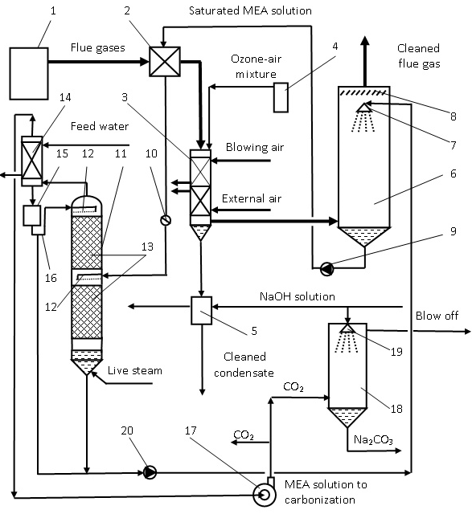
ECOLOGICAL RESERVES FOR IMPROVING HEAT GENERATOR
ECONOMIC EFFICIENCY
№4
: 1) gas conduit; 2) MEA heater; 3) heat exchanger; 4) ozone generator; 5) anionite filter; 6) carbonizer; 7, 19) liquid dispersers; 8) spray separator; 9, 20) circulation pumps; 10) throttle valve; 11) decarbonizer; 12) upper and lower liquid distributors; 13) packing; 14) evaporation cooler; 15) condensate collector; 16) hydraulic seal; 17) fan; 18) absorbtion tower.
Cleaning and utilization is accomplished as follows. Heat generator flue gases are fed to a monoethanolamine (MEA) heater 2, where they are cooled to a temperature close to the dew point, and the MEA solution is entering from carbonizer 6 under pressure Р₁, is heated to the saturation temperature. Then partly cooled flue gases enter the heat exchanger 3, mixed with an ozone–air mixture, cooled by air blast and external air, in which flue gases are cooled to 35–45°C with condensate formation, flowing down over tube walls. There is oxidation of nitrogen monoxide to dioxide, absorption by condensate and rapid acid formation. Condensate impregnated with acid components enters into the anionite filter 5 where it is cleaned from acid components and directed for water treatment for subsequent use. Anionite regeneration is performed with sodium hydroxide solution with preparation of NaNO₃ solution (used as a nitrogen fertilizer). Flue gases cooled and cleaned from nitrogen oxides enter the carbonizer 6 from heat exchange 3 where they are in contact with a counterflow of MEA solution sprayed from a disperser 7, which absorbs carbon dioxide. Flue gases cleaned from carbon dioxide are separated from entrained MEA droplets in a droplet collector 8 and discharged to atmosphere.
Fundamental technological layout of flue gas cleaning with utilization of heat, harmful impurities and carbon dioxide:

Slide 5
ECOLOGICAL RESERVES FOR IMPROVING HEAT GENERATOR
ECONOMIC EFFICIENCY
№5
.. From MEA heater 2 heated MEA solution enters throttle valve 10 where solution pressure is reduced to atmospheric Р₀, as a result of which it boils and in the form of a vapor and liquid mixture is fed through the lower liquid distributor 12 into decarbonizer 11, operating by a rectification principle. The light fraction from distributor 12 in a vapor condition is raised to the upper section, filled with packing (for example, Raschig rings), where in a counterflow with liquid it is enriched with CO₂, then enters vapor cooler 14, cooled by feed water, in which there is MEA solution condensation (entering into condensate collector 15) and separation of CO₂ from it, which is fed by fan 17 for packaging or to absorption tower 18, and decarbonized MEA solution through hydraulic valve 16 enters the upper section of decarbonizer 11 partly for irrigating, and partly for irrigation of carbonizer 6. In the packing section, there is cylinder filling with compressed CO₂, and in the absorption tower during reaction of CO₂ with particles of sodium hydroxide solution, sprayed by disperser 19, there is formation of sodium carbonate solution (calcined soda) by the reaction
СО₂ + NaOH = Na₂CO₃ + H₂O (1)
In order to provide unit continuous operation, the absorption tower is put into operation with a delay for dispatch of CO₂ to users.
The heavy fraction from distributor 12 in a vapor-liquid condition descends to the lower section, packed with filler 13, where in reflux with CO₂ it is enriched with water and enters the decarbonizer tube 11, which is heated by live steam (for example, steam from the continuous blowing separator), the amount of it (steam) is insignificant, since saturated MEA solution is brought to boiling in heater 2. After decarbonizing MEA solution by circulation pump 20 is fed for irrigation in carbonizer 6.

Slide 6
ECOLOGICAL RESERVES FOR IMPROVING HEAT GENERATOR
ECONOMIC EFFICIENCY
№6
Economic efficiency was determined as the additional expenditure connected with reducing the temperature of emerging gases with retention of the hot air temperature.
The cost of the flue gas cleaning unit with utilization of heat, harmful impurities, and carbon dioxide depends on the type of installation, individual (operating for one boiler), or group (operating for a group of boilers). An advantage of the individual version is the possibility of extensive control of productivity and other production parameters of the unit, and for the group version it is lower specific capital investment.
Calculation was performed for the individual version, for a DKVR–20–13 boiler operating on natural gas with an average flue gas flow rate V = 20000 m³/h, and average initial concentrations NO_{x} = 0.355 g/m³ (3·10^{–4} vol.%) and CO₂ = 200 g/m³ (10 vol.%).

Slide 7
ECOLOGICAL RESERVES FOR IMPROVING HEAT GENERATOR
ECONOMIC EFFICIENCY
№7
Additional expenditure, connected with equipping the enterprise with the proposed cleaning unit and utilizing flue gases, may be presented approximately in the form of the relationship
S_{ad} = ΔS₂ + ΔS₃ + ΔS₄ +ΔS₅ + ΔS₆ +S₉ + ΔS₁₁ +ΔS₁₄ + ΔS₁₇ + ΔS18 + ΔS₂₀, (2)
where expenditures, rubles: ΔS₂ for MEA heater 2; ΔS₃ for heat exchanger 3; ΔS₄ for ozonizer 4; ΔS₅ for anionite filter 5; ΔS₆ for carbonizer 6; ΔS₉ for pump 9; ΔS₁₁ for decarbonizer 11; ΔS₁₄ for evaporation cooler 14; ΔS₁₇ for high-pressure fan 17; ΔS₁₈ for absorption tower 18; and ΔS₂₀ for pump 20.

Slide 8
ECOLOGICAL RESERVES FOR IMPROVING HEAT GENERATOR
ECONOMIC EFFICIENCY
№8
Expenditure on operating a unit (electric power for additional drawing in the gas and air tract, for operating ozonizer 4, pumps 9, 20, and high-pressure fan 17) to a first approximation is taken as equal annual saving of heat due to a reduction in flue gas temperature and corresponding increase in boiler installation efficiency. It was also assumed that expenditure on cleaning condensate from nitric acid in anionite filter 5 is balanced by the value of NaNO₃ obtained and utilization of cleaned condensate.
In order to simplify calculation, no consideration was given to the reduction in capital expenditure on flue structure, whose height was reduced considerably in view of the reduction in harmful gaseous discharge concentration.
Results of the calculations are provided in Table.

Slide 9
ECOLOGICAL RESERVES FOR IMPROVING HEAT GENERATOR
ECONOMIC EFFICIENCY
№9
General and Specific Expenditure on Manufacture
and Assembly of Cleaning and Utilization Units
Expenditure item | Expenditure
 | total, ruble | specific, rubles/MW
MEA heater, ΔS₂ | 810,000 | 52,300
Heat exchanger, ΔS₃ | 940,000 | 60,700
Ozone generator, ΔS₄ | 685,000 | 44,200
Anionite filter, ΔS₅ | 460,000 | 29,800
Carbonizer, ΔS₆ | 91,600 | 5930
Pump 9, ΔS₉ | 171,000 | 11,500
Decarbonizer, ΔS₁₁ | 120,000 | 7800
Evaporation cooler, Δ^{S}₁₄ | 330,000 | 21,200
High-pressure fan, Δ^{S}₁₇ | 142,000 | 9600
Absorbing tower, ΔS₅ | 110,500 | 7150
Pump 20, ΔS₂₀ | 171,000 | 11,500
Total ^{S}_{ad} and specific ^{S}_{ad} additional expenditure on unit | 4,030,600 | 260,000
Total C_{ad} and specific ΔC_{ad} additional capital investment on unit | 6,450,000 ($196,000) | 417,000 ($12,700)

Slide 10
ECOLOGICAL RESERVES FOR IMPROVING HEAT GENERATOR
ECONOMIC EFFICIENCY
№10
The efficiency of flue gas cleaning from nitrogen oxides and carbon dioxide was assumed to be 70%, since in order to provide a better degree of cleaning it is necessary to increase significantly the area of heat exchange surfaces for the MEA heater 2 and heat exchanger 3. In order to simplify calculation, the economic efficiency of flue gas cleaning and utilization was only calculated for CO₂.
The average final concentration of nitrogen oxides is 0.105 g/m³ (1.05·10^{–4} vol.%), carbon dioxide 60 g/m³ (3 vol.%). Correspondingly, with boiler operating time ^{T} _{yr} = 8000 h/yr, the amount of nitrogen oxides captured and utilized ^{M}_{NOx} = 40 tons/yr, and for carbon dioxide M_{CO2} = 22400 tons/yr.

Slide 11
ECOLOGICAL RESERVES FOR IMPROVING HEAT GENERATOR
ECONOMIC EFFICIENCY
№11
The annual effect of selling CO₂ obtained from one boiler is calculated by the equation
E_{CO2} = M_{CO2}S_{CO2} = 280 million rubles/yr ($8.5 million/yr) (3).
The amount of heat produced was determined as
Qyear = G·10³ Tyr, (4)
where r is the saturated steam heat of condensation at pressure 1.4 MPa, kJ/kg.
Whence annual heat produced
Qyear = 460•10⁹ kJ/yr or 110,000 Gcal/yr.
The annual effect of the sale of heat (regional delivery cost of 1 Gcal heat in January 2013, S_{h} = 706 rubles) was found as
E_{h} = Q_{year}·S_{h} =88 million rubles/yr ($2.67 million/yr) (5)

Slide 12
ECOLOGICAL RESERVES FOR IMPROVING HEAT GENERATOR
ECONOMIC EFFICIENCY
№12
It is known from international experience that the introduction of selective catalytic recovery (SCR) technology for flue gas cleaning from nitrogen oxides costs 50000 $/MW, and the capital expenditure on SNCR-technology developed in Russia is less by a factor of 13. The specific capital investment ΔK_{ad} for introducing this technical solution is three and a half times less than capital investment for introducing the overseas method and five times more than for introducing SCNR-technology; however, the method in question makes it possible to resolve the question of flue gas cleaning comprehensively: it provides a reduction in heat discharge and utilization, reduction in water vapor concentration and utilization of condensate, removal and utilization of a greater part of nitrogen oxides and carbon dioxide.
Comparison of the economic efficiencies for E_{CO2} and E_{h} obtained from selling carbon dioxide and heat supplied to customers during heat generator operation equipped with a contemporary cleaning system and flue gas utilization shows that ecological safety of a heat generator may be provided with a simultaneous increase in its economic efficiency.

