Slide 1
The Fiber Fraction of Oil Palm Trunk Treated by Ligninase Termostable Produced from Thermophilic Bacteria
Yetti Marlida
Department of Animal Nutrition and Feed Technology, Faculty of Animal Science, Andalas University , Indonesia

Slide 2
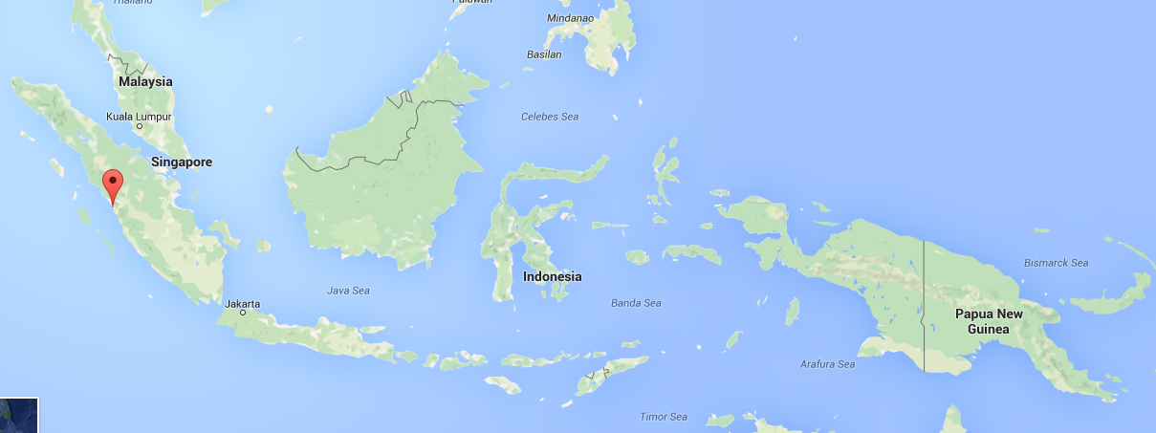
Map of Indonesia

Slide 3
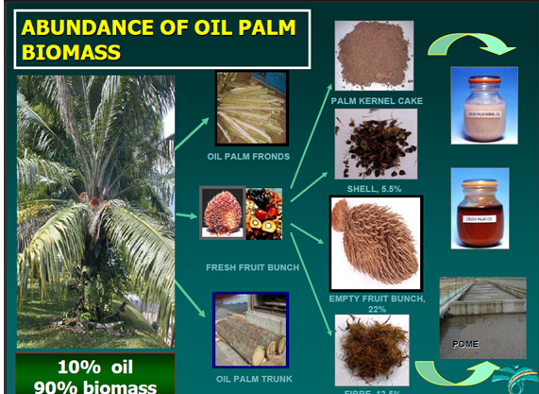
Background of Research
Indonesia is 2 nd country after Malaysia produced oil palm in the world
The main biomass of oil palm industry are : OPF, OPT, PPF, PKC and POME – as sources as animal feeding
OPT is only available after oil palms are felled for replanting at an age of about 25 years.
OPT are high fibrous materials which need further processing for better utilization in ruminant animals (lignin, cellulose and hemicellulose)

Slide 4
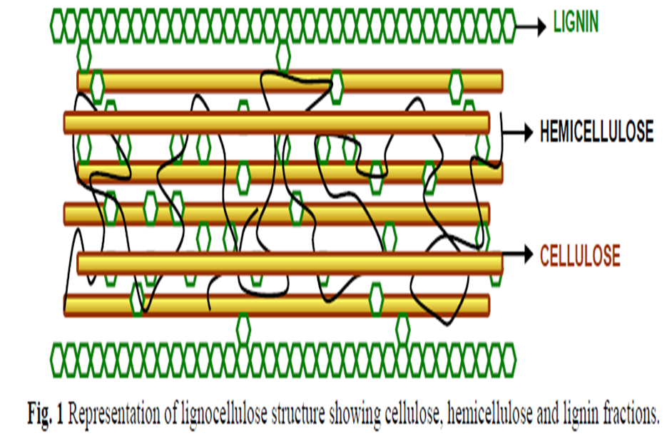
Background of Research
The OPT : lignin, cellulose, hemicellulose – complexs structure difficult to attack by MO
As animal feeding : OPT- 3 limiting Factors (Lignin protects of cellulose, hemicellulose: Low palatability: low protein content )
Lignin is indigestible by animal enzymes, but some fungi and bacteria are able to secrete ligninases which can biodegrade of the polymer

Slide 5
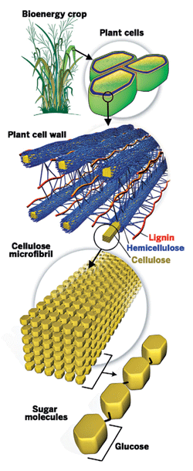
Purpose of Research
To find out interaction between oil palm trunk concentrations and ligninase doses to increase the fiber fractions of oil palm trunk before using as animal feeding
To get the future treatment of how to increase the palm oil trunk quality

Slide 6
Method of Research
Production of Ligninase Thermostable
Preparation of Oil Palm Trunk
Enzymatic Hydrolysis of Oil Palm Trunk
Research Methods
Data Analysis
(CRD) factorial using 2 factors:
A1 = 250 U/ kg; A2 = 500 U / kg; A3 = 750 U / kg. B1: 40%; B2: 60%, which was repeated 3 times.

Slide 7
Research finding
Table 1. Average ADF products hydrolysis of oil palm trunks (%)
A [Ligninase (U/kg)] | B [oil palm trunk (%)] |  | Average
 | B1 | B2
A1 | 64.00ª | 64.16ª | 64.08ª
A2 | 62.31^{b} | 64.44ª | 63.38ª
A3 | 60.75^{c} | 61.54^{bc} | 61.15^{b}
Average | 62.35^{b} | 63.38ª
Table 2. Average NDF products hydrolysis of oil palm trunks (%)
A [Ligninase (U/kg)] | B [oil palm trunk (%)] |  | Average
 | B1 | B2
A1 | 80.97^{b} | 77.18^{c} | 79.07^{b}
A2 | 81.58ª | 81.80ª | 81.69ª
A3 | 76.68^{d} | 76.76^{d} | 76.72^{c}
Average | 79.74ª | 78.58^{b}

Slide 8
Research finding
Table 3. Average ADF products hydrolysis of oil palm trunks (%)
A[Ligninase (U/kg)] | B[oil palm trunk (%)] |  | Average
 | B1 | B2
A1 | 16.98^{b} | 13.02^{d} | 15.00^{b}
A2 | 19.27ª | 17.36^{b} | 18.32ª
A3 | 15.93^{c} | 15.21^{c} | 15.57^{b}
Average | 17.39ª | 15.20ª
Table 4. Average NDF products hydrolysis of oil palm trunks (%)
A [Ligninase (U/kg)] | B [oil palm trunk (%)] |  | Average
 | B1 | B2
A1 | 56.41^{b} | 55.38^{bc} | 64.08ª
A2 | 54.13^{c} | 58.07ª | 63.38ª
A3 | 54.06^{c} | 52.43^{d} | 61.15^{b}
Average | 54.87ª | 55.29ª

Slide 9
Research finding
Table 5. Average ADF products hydrolysis of oil palm trunks (%)
A [Ligninase (U/kg)] | B [oil palm trunk (%)] |  | Average
 | B1 | B2
A1 | 7.31^{b} | 7.23^{bc} | 7.27ª
A2 | 7.09^{c} | 5.60e | 6.35^{c}
A3 | 6.07^{d} | 7.67ª | 6.87^{b}
Average | 6.82ª | 6.83ª

Slide 10
Conclusion
The treated of OPT with ligninase can be degraded the lignocellulose and hemicellulose linkage and make the availability of cellulose and hemisellulose as energy sources by ruminantia such as cow, buffalo, sheep and goat. The optimum concentration of oil palm trunks was 60% (v/w) and 750 U/kg of ligninase thermostable that improved of the fiber fractions quality to easily digested by animal.

Slide 11
Acknowledgement
Ministry of Research, Technology and Higher Education of the Republic of Indonesia for funding this research
Student and technician laboratorium of Industrial and Feed Technology who has supported the implementation of this research.

Slide 12
Thank You for your attention

