Slide 1
Use of Biologic Agents for Rheumatic Diseases in Pregnancy
Yesim Garip, MD
Pinar Physical Therapy and Rehabilitation Center
Ankara, TURKEY

Slide 2
The most common used biologic therapeutic agents in the treatment of inflammatory rheumatic diseases
Tumor necrosis factor (TNF) inhibitors (etanercept, infliximab, adalimumab, certolizumab pegol, and golimumab)
Interleukin (IL)-6 inhibitor (tocilizumab)
Anti-CD-20 antibody (rituximab)
IL-1 receptor antagonist (anakinra)
T cell co-stimulation modulator (abatacept)
Notes:
As you know, use of biologic agents in the late 1990s have inaugurated a new era in the treatment of inflammatory rheumatic diseases. In recent years, several biologic agents have been approved by Food and Drug Administration (FDA) and have offered an alternative treatment for the patients failing conventional therapy.

Slide 3
Although there is a tendency for clinical remission during pregnancy, in some cases, continuing with treatment throughout pregnancy may be necessary.

Slide 4
High disease activity in rheumatic diseases during pregnancy may lead to increased risks for
Preeclampsia
Cesarean delivery
Prematurity
Low birth weight
Intrauterine growth restriction
Skomsvoll JF, et al. Obstetrical and neonatal outcome in pregnant patients with rheumatic disease. Scand J Rheumatol Suppl 1998; 107: 109-12.
Wolfberg AJ, et al. Association of rheumatologic disease with preeclampsia. Obstet Gynecol 2004;103: 1190-93
de Man YA, et al. Association of higher rheumatoid arthritis disease activity during pregnancy with lower birth weight: results of a national prospective study. Arthritis Rheum 2009;60:3196-206.
Bowden AP, et al. Women with inflammatory polyarthritis have babies of lower birth weight. J Rheumatol 2001; 28:355-9.

Slide 5
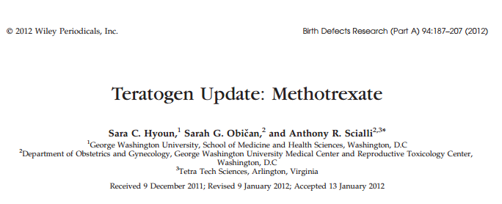
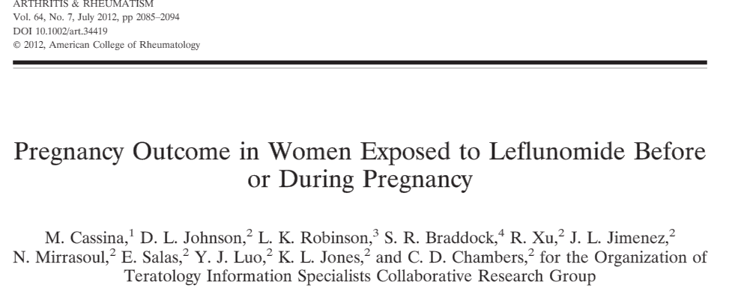
Owing to the fact that important antirheumatic agents such as methotrexate and leflunomide have teratogenic effects, the treatment options are limited and biologic agents may be therapeutic alternative in pregnant women with high disease activity.

Slide 6

Since no drug trials have been performed in pregnant women to assess the risk of administration of biologic agents, safety of these agents during pregnancy is still a matter of debate.

Slide 7
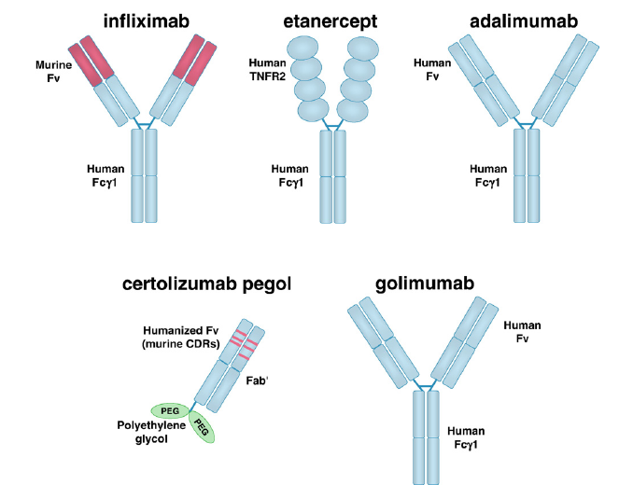
Tumor necrosis factor (TNF) inhibitors
Tracey D, et al. Tumor necrosis factor antagonists mechanisms of action: A comprehensive review. Pharmacology & Therapeutics 2008; 117 : 244–79.

Slide 8
TNF inhibitors have been rated as FDA category B (No evidence of a risk to the fetus was found in animal toxicity studies; however there are no controlled studies enrolled pregnant women).
TNF inhibitors do not actively cross the placenta during the first trimester and organogenesis, but they are transferred across the placenta during the late second and third trimester.

Slide 9
These can be found in newborn’s cord blood in levels that exceed those of the corresponding maternal serum. Additionally, they are detectable in blood of the infant for more than six months after the birth, reducing the safety of vaccination.
CERTOLIZUMAB does not contain Fc region, thus it does not actively cross the placenta.

Slide 10
Use of TNF inhibitors has been reported in almost 2000 pregnancies of the patients with rheumatic diseases, inflammatory bowel diseases and psoriasis.

Slide 11
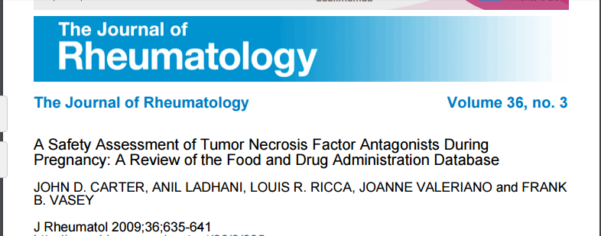
An FDA database review revealed 61 birth defects in 41 children born to mothers receiving TNF inhibitors.
Of mothers, 22 received ETA and 19 received INF.
The most common congenital anomalies were heart defects, spinal deformities, imperforate anus, tracheoesophageal fistula, renal anomalies and limb defects, which were the features of VACTERL association.
These anomalies were found to be linked with use of TNF antagonists and it was suggested that these agents should not be administered during pregnancy.
However in this review, time of exposure to these agents was not reported.

Slide 12

British Society for Rheumatology Biologics Register (BSRBR) is a database which keeps information about RA patients taking TNF antagonists.
Between 2005 and 2006, 11473 patients were registered with the BSRBR.
Of these patients, 17 received ETA, 3 received INF and 3 received ADA.
No congenital malformation was observed.

Slide 13
After this report, another BSRBR report which assesses the outcomes of 118 pregnancies in patients who exposed to TNF antagonists was published in 2008.

Slide 14
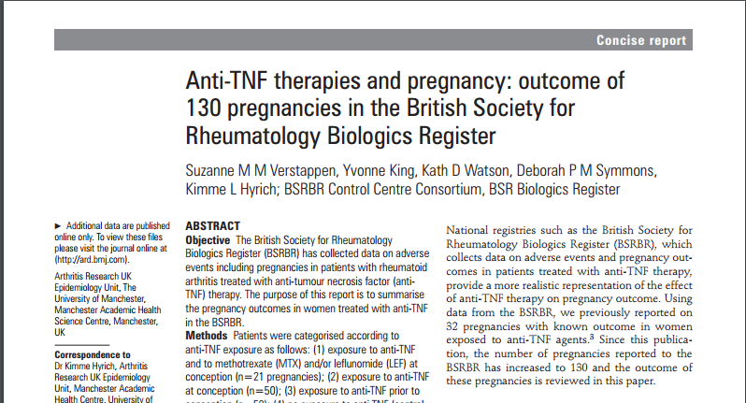
The rate of miscarriage was 27% in the patients who received anti-TNF at the time of conception (group 1), 17% in those with prior exposure to anti-TNF (group 2) and 10 % in those who never exposed to anti-TNF (group 3).
The rate of premature delivery was 26% in group 1, 17% in group 2, and 20% in group 3.
A perinatal death causing from hypoxia was reported in a patient who exposed to ETA at the time of conception.
Additionally 4 cases of congenital anomalies were reported.
In group 1, congenital hip dysplasia and pylorostenosis, and in group 2 Marcus Gunn syndrome and infantile hemangioma were observed.

Slide 15

The authors suggested that treatment with TNF inhibitors might be linked with an increased risk of spontaneous abortion, however the effects of disease activity and other antirheumatic agents could not be eliminated.

Slide 16
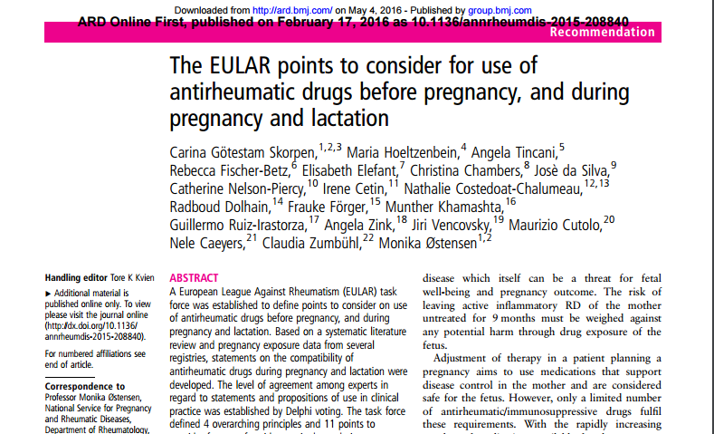
Notes:
The European League Against Rheumatism (EULAR) is the organisation which represents the people with arthritis/rheumatism, health professional and scientific societies of rheumatology of all the European nations. It was founded in 1947. The EULAR Secretariat is located in Switzerland.
The aims of EULAR are to reduce the burden of rheumatic diseases on the individual and society and to improve the treatment, prevention and rehabilitation of musculoskeletal diseases.

Slide 17
According to EULAR 2014 guidelines for use of biologic drugs in clinical practice in pregnant and lactating patients
INFLIXIMAB AND ADALIMUMAB
Current evidence indicates no increased rate of congenital malformations; it can be continued up to gestational week 20; if indicated, it can be used throughout pregnancy.
INF and ADA is compatible with breast feeding.
Götestam Skorpen C, et al. Ann Rheum Dis 2016; 0:1-16

Slide 18
According to EULAR 2014 guidelines for use of biologic drugs in clinical practice in pregnant and lactating patients
ETANERCEPT
Current evidence indicates no increased rate of congenital malformations; it can be continued up to gestational week 30-32; if indicated, it can be used throughout pregnancy.
ETA is compatible with breast feeding.
Götestam Skorpen C, et al. Ann Rheum Dis 2016; 0:1-16

Slide 19
CERTOLIZUMAB
Certolizumab is different from other TNF inhibitors, it does not contain Fc region, thus it is not actively transported through the placenta. It has only minimal transplacental transmission to newborn via passive diffusion during first, second and third trimesters.
Bortlik M, et al. Pregnancy and new born outcomes of mothers with IBD exposed to anti-TNF alpha therapy during pregnancy: three center study. Scand J Gastroenterol. 2013;48(8):951-8
Mahadevan U, et al. Placental transfer of anti-tumor necrosis factor agents in pregnant patients with inflammatory bowel disease. Clin Gastroenterol Hepatol 2013;11(3):286-92

Slide 20
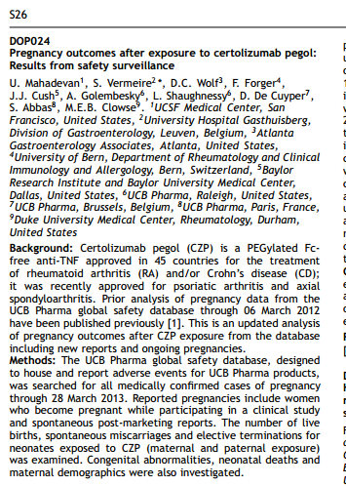
The UCB Pharma global safety database revealed 69.5% live birth rate in 190 pregnant women exposed to CZP.
The rates of spontaneous abortions and elective terminations were 18.9% and 11.6%, respectively. Five birth defects were observed in four infants among all live births: vesicoureteral reflux, congenital megacolon, congenital talipes equinovarus, aortic arch anomaly, and unilateral hydronephrosis.
Mahadevan U, et al. Pregnancy outcomes after certalizumab pegol: results from safety surveillance [abstract]. J Crohn’s Colitis 2014;8:S26

Slide 21
However these congenital anomalies were not thought to be associated with exposure to CZP.
These pregnancy outcomes were comparable to those reported for US general population (65% live births, 17% spontaneous abortions, and 18% elective abortions).
Ventura SJ, et al. Estimated pregnancy rates and rates of pregnancy outcomes for the United States 1990-2008. Natl Vital Stat Rep 2012;60(7):1-21

Slide 22
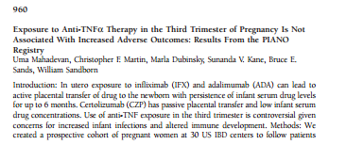
In PIANO study, where women with inflammatory bowel disease exposed to CZP in the third trimester of pregnancy were compared with unexposed group.
It was suggested that use of CZP in the third trimester was not associated with increase in infant infection rates.
Mahadevan U, et al. 960 Exposure to anti-TNF-alpha therapy in the third trimester of pregnancy is not associated with increased adverse outcomes: results from the PIANO registry [abstract]. Gastroenterology 2014;146(5):S170

Slide 23
According to EULAR 2014 guidelines for use of biologic drugs in clinical practice in pregnant and lactating patients
CERTOLIZUMAB
Current evidence indicates no increased rate of congenital malformations; CZP can be continued throughout pregnancy.
It is compatible with breast feeding.
Götestam Skorpen C, et al. Ann Rheum Dis 2016; 0:1-16.

Slide 24
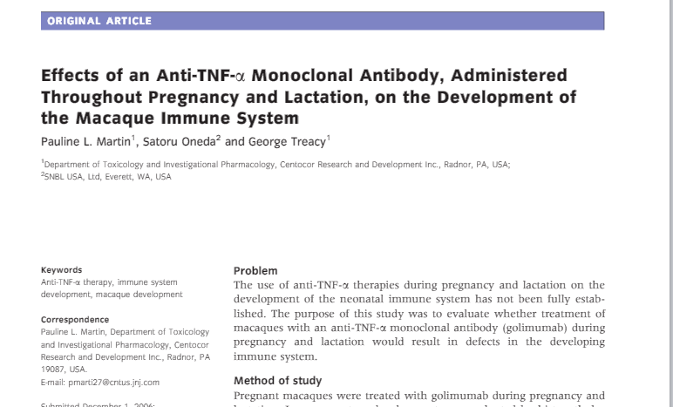
GOLIMUMAB
GOL is a newer TNF inhibitor and there is limited data on its use during pregnancy.
In a study by Martin et al. performed in cynomolgus monkeys received 25-50 mg/kg GOL twice weekly during pregnancy, no effect was observed on pregnancy outcomes or fetal immune system. Experience with use of GOL during pregnancy has been limited to conference abstracts.

Slide 25
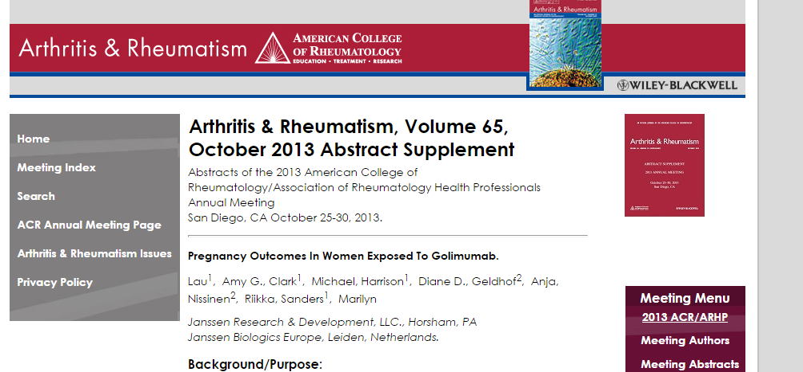
Lau et al. reported pregnancy outcomes of 40 women exposed to GOL at the ACR Meeting in 2013. Outcomes included one nonspecific congenital anomaly, 19 live births, 13 spontaneous abortions and 7 induced abortions. Of 13 mothers with spontaneous abortion, 4 had concomitant methotrexate use.

Slide 26
According to EULAR 2014 guidelines for use of biologic drugs in clinical practice in pregnant and lactating patients
GOLIMUMAB
Current evidence indicates no increased rate of congenital malformations because of limited evidence. Alternative medications should be considered for treatment throughout pregnancy.
It is compatible with breast feeding.
Götestam Skorpen C, et al. Ann Rheum Dis 2016; 0:1-16

Slide 27
Use of Other Biologic Agents for Rheumatic Diseases in Pregnancy

Slide 28
RITUXIMAB
RTX is a chimeric monoclonal antibody against the B cell surface antigen CD20.
It is indicated for the treatment of severe refractory RA with inadequate response to TNF inhibitors, certain types of vasculitis, non-Hodgkin’s lymphoma and chronic lymphoid leukemia.
Bogas M, Leandro MJ. Biologic treatment and pregnancy. A systematic literature review. Acta Reumatol Port 2011;36(3):219-32.

Slide 29
RITUXIMAB
It is classified as FDA category C, meaning "it has not been studied on pregnant women, however animal developmental toxicity studies have shown an adverse effect on the fetus".
It has no active transplacental passage during the first trimester and organogenesis, but actively crosses the placenta during the late second and third trimester and may affect fetal and neonatal B cell development, causing increased risk for infections.
Ostensen M, et al. Treatment with biologics of pregnant patients with rheumatic diseases. Curr Opin Rheumatol 2011;23(3):293-8.
Ton E, et al. Safety of rituximab therapy during twins' pregnancy. Rheumatology Oxford 2011;50(4):806-8

Slide 30
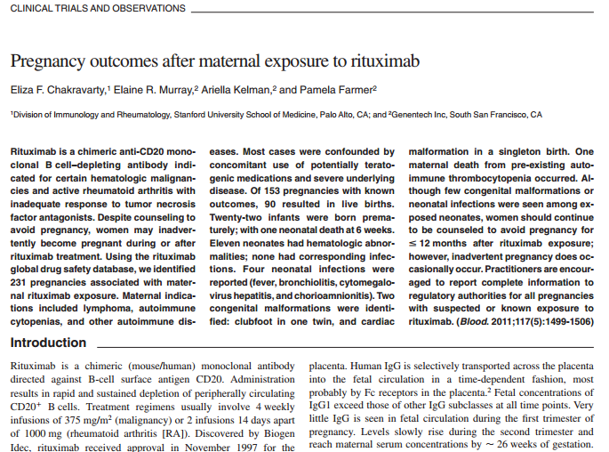
Chakravarty et al. reported pregnancy outcomes in 153 patients exposed to RTX.Of these pregnancies,
90 resulted in live births,
23 resulted in prematurity and
1 resulted in perinatal death.
11 infants had hematologic abnormalities at birth (peripheral B-cell depletion, neutropenia, lymphopenia, thrombocytopenia and anemia)
4 had perinatal infections.
2 infants had congenital defects (congenital talipes equinovarus and cardiac malformation).

Slide 31

Sangle et al. reported pregnancy outcomes in 5 patients with systemic lupus erythematosus exposed to RTX before conception.
One of the infants was born with esophageal atresia.

Slide 32
Preconception and first trimester exposure to RTX seems not to indicate an excess risk of adverse fetal outcomes. Exposure during second and third trimesters causes decrease in B cells in the fetus.
Further studies, especially prospective registries are needed to explore immune response to vaccines and perinatal infections in infants born to mothers received RTX during second and third trimesters.
Ostensen M. Safety issues of biologics in pregnant patients with rheumatic diseases. Ann N Y Acad Sci 2014;1317:32-8

Slide 33
According to EULAR 2014 guidelines for use of biologic drugs in clinical practice in pregnant and lactating patients
RITUXIMAB
Current evidence indicates no increased rate of congenital malformations. In exceptional cases it can be used early in gestation. However with use at later stages of pregnancy, clinicians should be aware of the risk of B cell depletion and other cytopenias in the neonate.
No data exist regarding RTX in breast milk, therefore RTX should be avoided in breast feeding.
Götestam Skorpen C, et al. Ann Rheum Dis 2016; 0:1-16

Slide 34
TOCILIZUMAB
TCZ is a humanized IL-6 receptor inhibitor used in the therapy of moderate to severe RA and polyarticular and systemic JIA.
It is categorized as FDA pregnancy category C.
TCZ should be discontinued three months before conception.
Ostensen M. Safety issues of biologics in pregnant patients with rheumatic diseases. Ann N Y Acad Sci 2014;1317:32-8

Slide 35
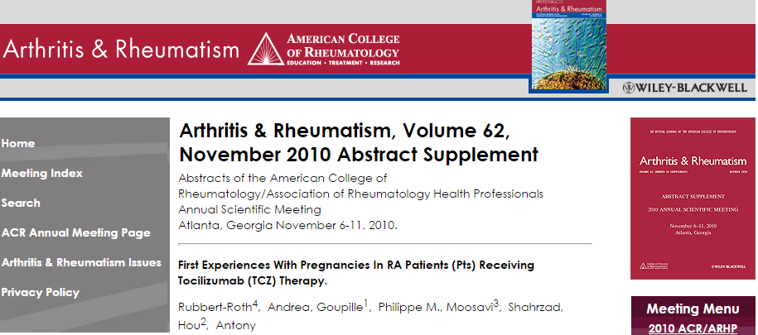
Experiences with use of TCZ during pregnancy were reported by Rubbert-Roth et al
at the ACR 2010.
Of 33 pregnancies
13 resulted in induced abortion
7 resulted in spontaneous abortion
11 resulted in live births
Of 7 mothers with spontaneous abortion, 5 had concomitant methotrexate use

Slide 36

Nakajima et al. reported outcomes of 50 pregnancies exposed to TCZ.
In 36 births, no congenital anomalia was observed
9 resulted in spontaneous abortion
5 terminated pregnancies included 1 case of caudal regression syndrome.
Spontaneous abortion rate was 18% , comparable to the rate in the general population.

Slide 37

Outcomes of 16 maternal cases from Pharmacovigilance Center Embryotox Berlin were:
11 live-born infants
4 spontaneous abortions
1 induced abortion for personal reasons
Congenital malformations were not recorded, but 1 spontaneous abortion
at week 15+3 days was complicated by hydrops fetalis of unknown origin.

Slide 38
According to EULAR 2014 guidelines for use of biologic drugs in clinical practice in pregnant and lactating patients
TOCILIZUMAB
No statement can be made in regard to safety during pregnancy due to scarce documentation; treatment with TCZ is therefore avoided.
No data exist regarding TCZ in breast milk, therefore TCZ should be avoided in breast feeding.
Götestam Skorpen C, et al. Ann Rheum Dis 2016; 0:1-16

Slide 39
ANAKINRA
Anakinra is a human IL-1 receptor antagonist certified by FDA for the therapy of RA patients with intermediate/high disease activity.
It has been rated as FDA pregnancy category B.
It has a half-life of 4-6 hours. Because of its short half-life, discontinuance of Anakinra before conception is not necessary.
Ostensen M. Safety issues of biologics in pregnant patients with rheumatic diseases. Ann N Y Acad Sci 2014;1317:32-8

Slide 40

Experiences with use of anakinra during pregnancy are limited.
Three pregnancies in patients received anakinra during for the treatment of adult onset Still’s disease resulted in term live births.

Slide 41
Chang et al. described outcomes of 15 pregnancies in 9 women receiving anakinra for the treatment of cryopyrin-associated periodic syndrome.
Outcomes included 14 healthy term infants and 1 intrauterine fetal demise resulting from renal agenesis.

Slide 42
According to EULAR 2014 guidelines for use of biologic drugs in clinical practice in pregnant and lactating patients
ANAKINRA
Current evidence indicates no increased rate of congenital malformations; it can be used before and during pregnancy when there are no other well studied options available for treatment.
No data exist regarding RTX in breast milk, therefore RTX should be avoided in breast feeding.
Götestam Skorpen C, et al. Ann Rheum Dis 2016; 0:1-16

Slide 43
ABATACEPT
Abatacept (CTLA4-Ig) is a recombinant fusion protein that modulates T cell costimulatory signal mediated through the CD28-CD80/86 pathway.
It has been approved for the treatment of refractory RA .
Abatacept therapy should be stopped three months before conception.
Ostensen M. Safety issues of biologics in pregnant patients with rheumatic diseases. Ann N Y Acad Sci 2014;1317:32-8

Slide 44
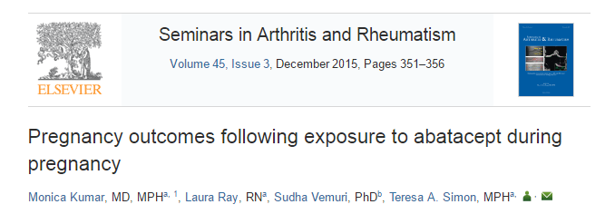
According to a review report including clinical trials, case reports and Organization of Teratology Information Specialists registry
Of 151 pregnancies following maternal exposure to abatacept
7 live births had congenital anomalies (cleft lip/cleft palate, congenital aortic anomaly, meningocele, pyloric stenosis, skull malformation, ventricular septal defect/congenital arterial malformation, and Down׳s syndrome).
59 cases with maternal exposure resulted in abortions (40 spontaneous and 19 elective)

Slide 45
According to EULAR 2014 guidelines for use of biologic drugs in clinical practice in pregnant and lactating patients
ABATACEPT
No statement can be made in regard to safety during pregnancy due to scarce documentation; treatment with abatacept is therefore avoided.
No data exist regarding abatacept in breast milk, therefore abatacept should be avoided in breast feeding.
Götestam Skorpen C, et al. Ann Rheum Dis 2016; 0:1-16

Slide 46
SUMMARY
ADA, INF, ETA and GOL are classified as FDA pregnancy category C.
They can be used in the first trimester if no therapeutic alternative is available. But use of these agents in late second and third trimester is not recommended because of the high placental transfer.
In case of exposure to these agents in the late second and third trimester, live vaccines should not be administered in the first six months of life because of increased risk for infections.
They are compatible with breast feeding.

Slide 47
CZB is different from other TNF inhibitors, it does not contain Fc region, thus it is not actively transported through the placenta.
It is in FDA category B.
It has only minimal transplacental transmission to newborn via passive diffusion during first, second and third trimesters.
It can be continued throughout pregnancy.
It is compatible with breastfeeding.

Slide 48
Abatacept and tocilizumab are classified as FDA pregnancy category C, and they should be discontinued three months before conception.
They should be avoided in breast feeding.

Slide 49
Anakinra is categorized in FDA category B. It can be used before and during pregnancy when there is no alternative treatment option.
It should be avoided in breast feeding.

Slide 50
RTX is categorized in FDA category C. In exceptional cases , İt can be used early in gestation.
With use at later stages of pregnancy, clinicians should be aware of the risk of B cell depletion and other cytopenias in the neonate.
It should be avoided in breast feeding.

Slide 51
The decision to use biologic agents during pregnancy is difficult. The benefits of biologic agents must outweigh the risks to the fetus/embryo or mother.
Larger and further studies are needed to demonstrate the safety of these agents during pregnancy.

Slide 52


