Slide 1


Adipose tissue dysfunction in PCOS
Yen Hao Chen, PhD
Depts. of Ob/Gyn, Medical College of Georgia, Georgia Regents University, Georgia

Slide 2
4 MAJOR DEFECTS WE FOUND IN ADIPOSE TISSUE FROM PCOS
1. Insulin resistance
2. Adipokines secretion
3. Genes expression
4. microRNAs expression

Slide 3
ADIPOSE TISSUE-RELATED LABORATORY PROCEDURES
Human Adipose tissue from Biopsy
Storage
Whole Tissue
Protein
mRNA
Enzyme digestion
Imaging
Protein
Adipocyte
Macrophage
Stromal-vascular fraction
mRNA
mRNA
DNA
Lipolysis
Protein
Cell sizing
Glucose uptake
Preadipocyte differentiation
cDNA microarray
miRNA microarray
Real-time RT-PCR
Methylation assay
Co-culture
Western blot
Immunofluorescence
Cellometer (Nexcelom)

Slide 4
4 MAJOR DEFECTS WE FOUND IN ADIPOSE TISSUE FROM PCOS
1. Insulin resistance
2. Adipokines secretion
3. Genes expression
4. microRNAs expression

Slide 5
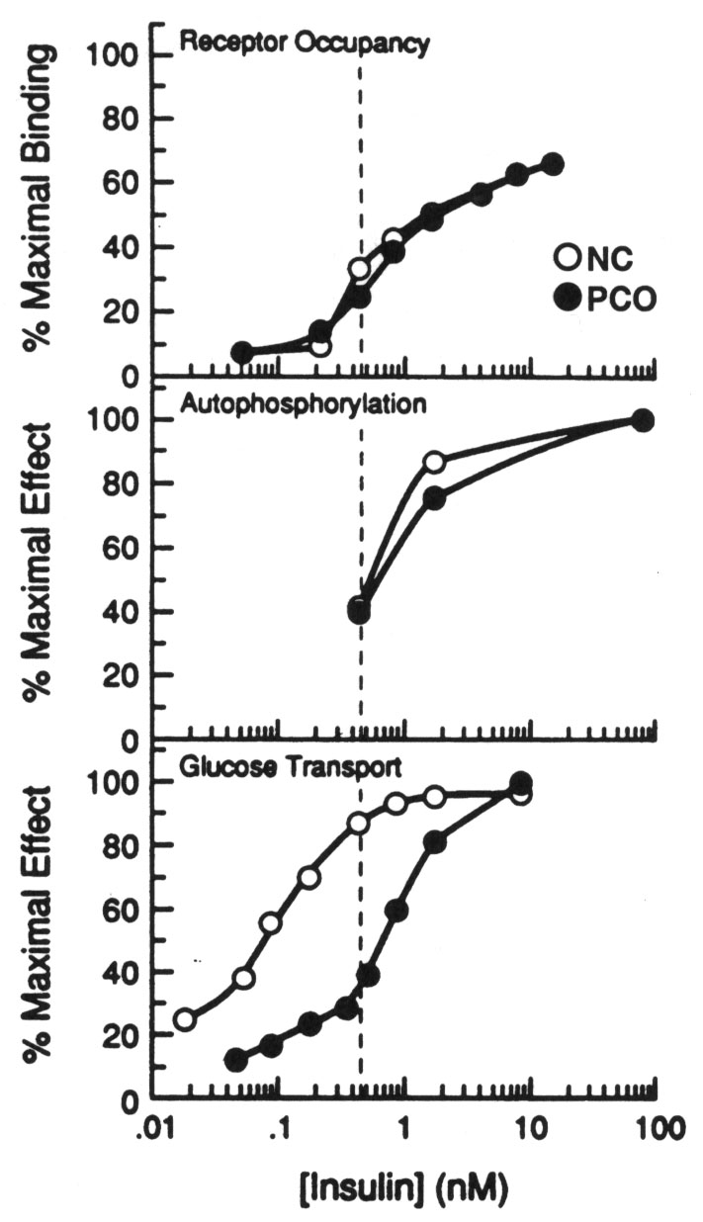
INSULIN ACTION IN ADIPOCYTES OF 8 PCOS AND 8 CONTROL WOMEN
Ciaraldi et al. J Clin Endocrinol Metab 75:577, 1992

Slide 6
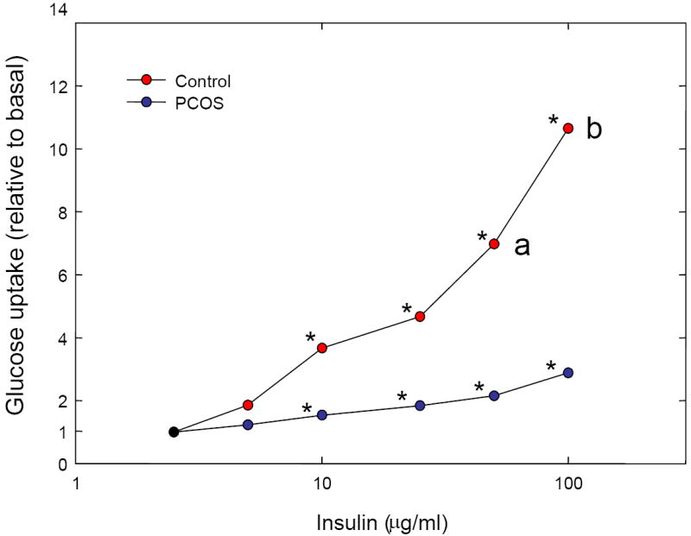
INSULIN STIMULATED GLUCOSE UPTAKE IS REDUCED IN ADIPOCYTES FROM PCOS
Chang et al. Fertil Steril 2008; 90:2291-7.

Slide 7
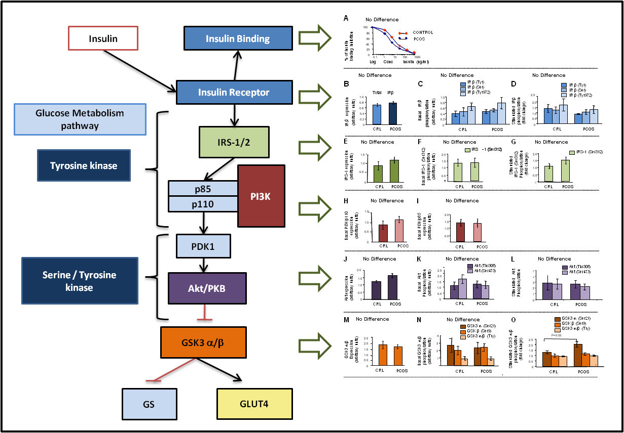
NO OBVIOUS DEFECT IN PI3-K/AKT INSULIN-SIGNALING PATHWAY IN ADIPOSE OF PCOS
Chen et al. Diabetes 62: 2278-86, 2013

Slide 8
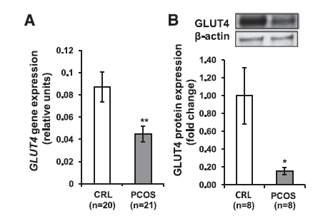
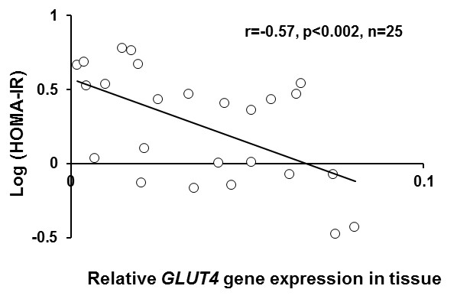
GLUT-4 EXPRESSION IS REDUCED IN ADIPOCYTES FROM PCOS AND NEGATIVELY CORRELATED TO HOMA-IR
Chen et al. Diabetes 62: 2278-86, 2013

Slide 9
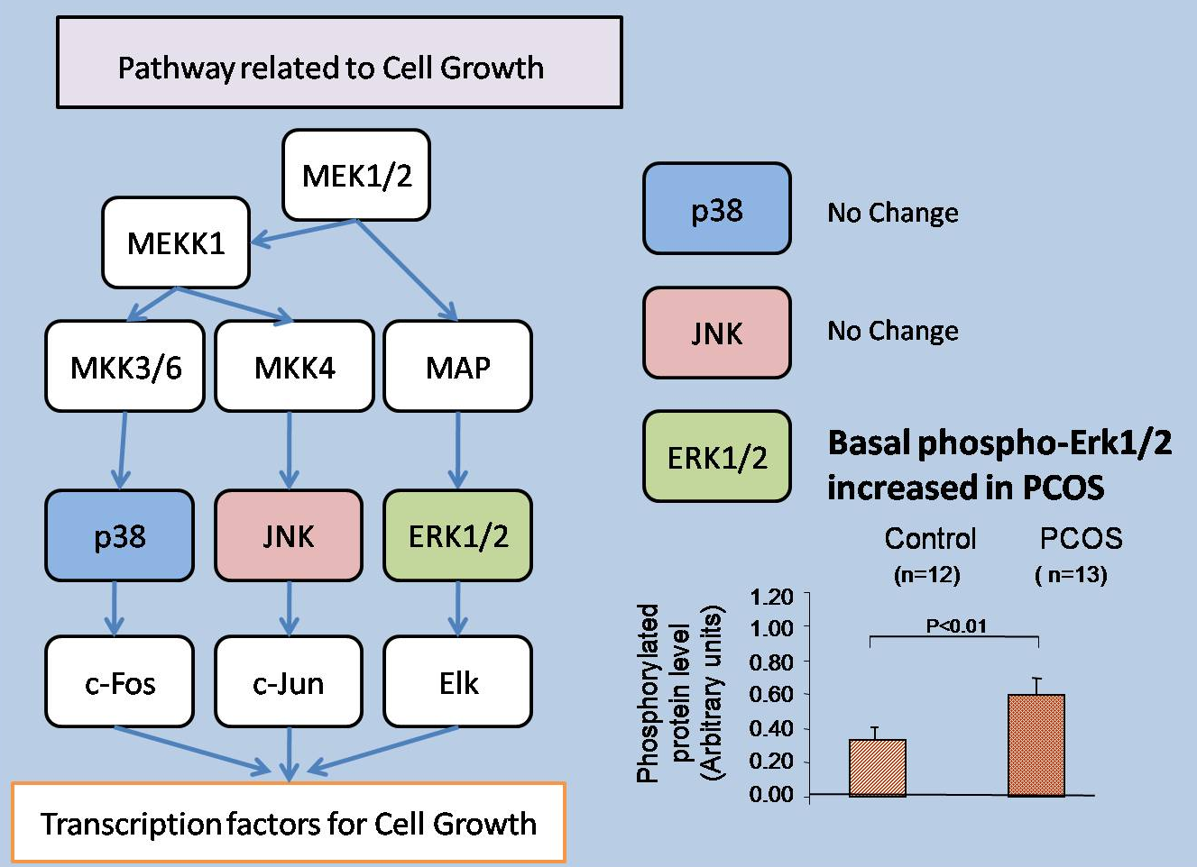
MAPK PATHWAY IN ADIPOCYTES OF PCOS
Simplified scheme of MAPK cascades. Total, basal and insulin stimulated phosphorylated proteins of selected components of the MAPK are represented by bars (medium ± SE): p38 (blue), SAPK/JNK (red) and ERK1/2 (green)
Chen et al, unpublished

Slide 10
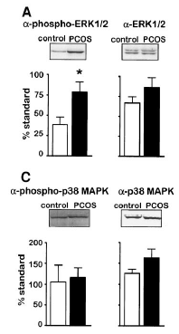
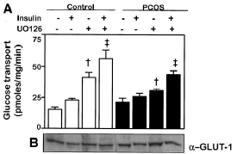
THE ERK1/2 SIGNALING PATHWAY IS CONSTITUTIVELY INCREASED IN THE SKELETAL MUSCLE OF WOMEN WITH PCOS
Corbould et al. Diabetes 2006; 55:751-9

Slide 11
Insulin resistance
1. Insulin stimulated glucose uptake is lower in PCOS adipocytes compared to control.
2. No defects detect in insulin-PI3K signaling pathway.
3. Basal ERK phosphorylation is increased in PCOS adipocytes.
4. GLUT4 protein expression is decreased in adipocytes from PCOS and negatively correlated with HOMA-IR, thus the loss of GLUT4 in the adipocytes may be a significant contributor to the IR in PCOS patients.

Slide 12
4 MAJOR DEFECTS WE FOUND IN ADIPOSE TISSUE FROM PCOS
1. Insulin resistance
2. Adipokines secretion
3. Genes expression
4. microRNAs expression

Slide 13
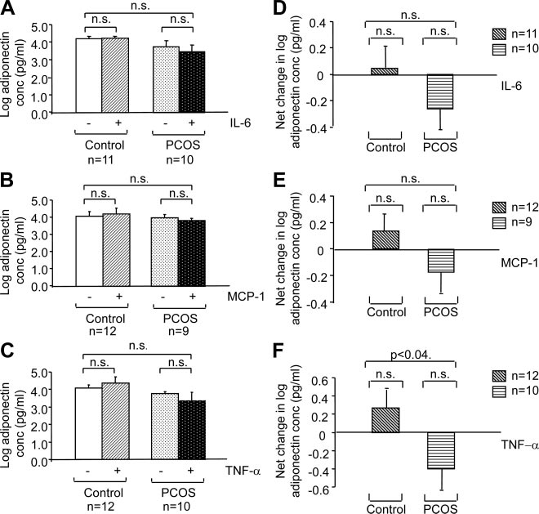
EFFECT OF IL-6, MCP-1 AND TNF-α ON ADIPONECTIN SECRETION IN PCOS
Chazenbalk et al. J Clin Endocrinol Metab 95: 935-942, 2010

Slide 14
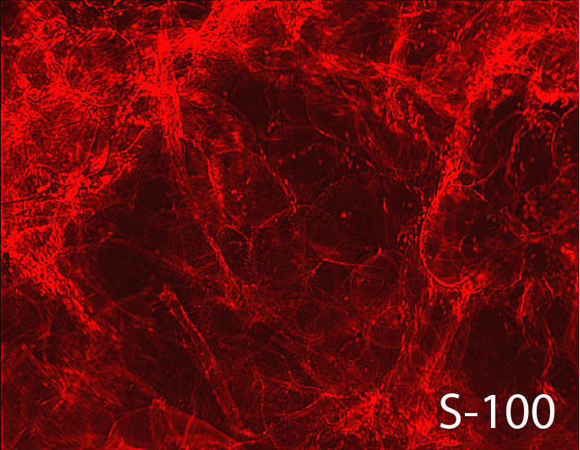
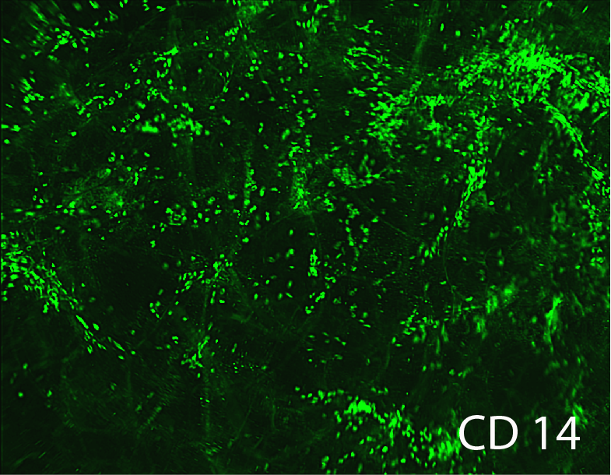
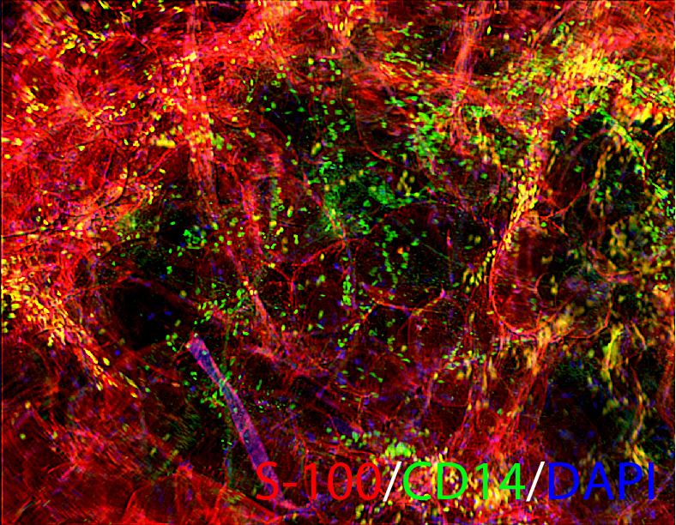
MACROPHAGES INFILTRATING HUMAN ADIPOSE TISSUE

Slide 15
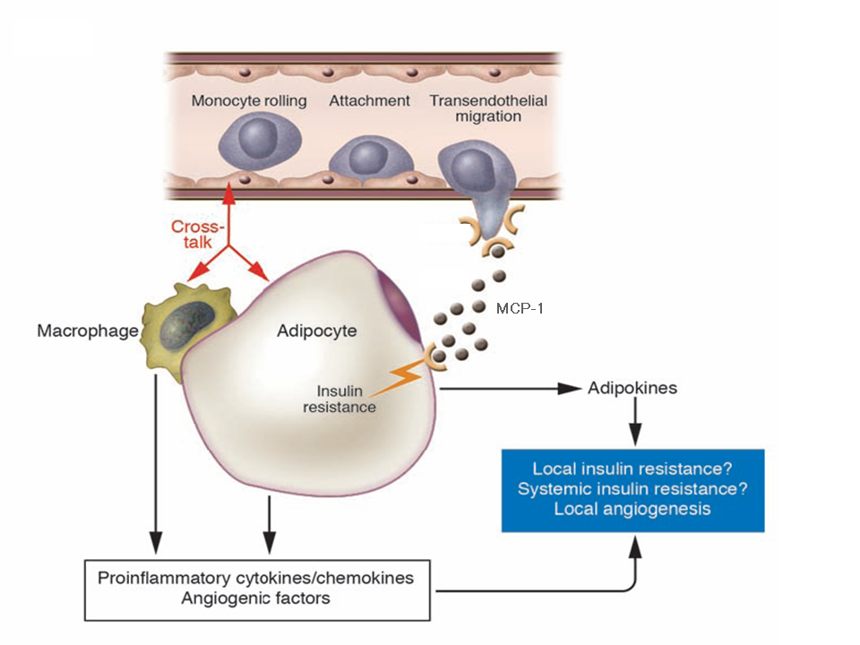
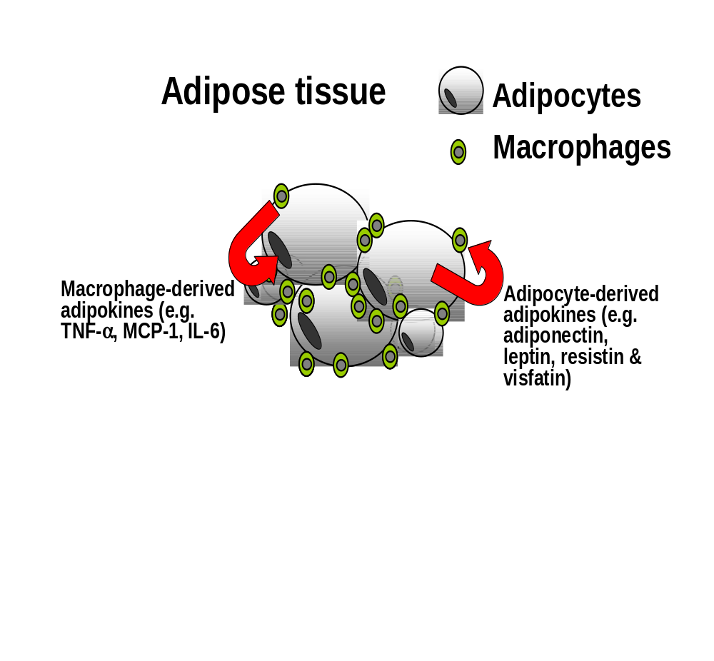
CROSS-TALK BETWEEN ADIPOCYTES AND ADIPOSE TISSUE MACROPHAGES
Neels & Olefsky. J Clin Invest 2006;116:33

Slide 16
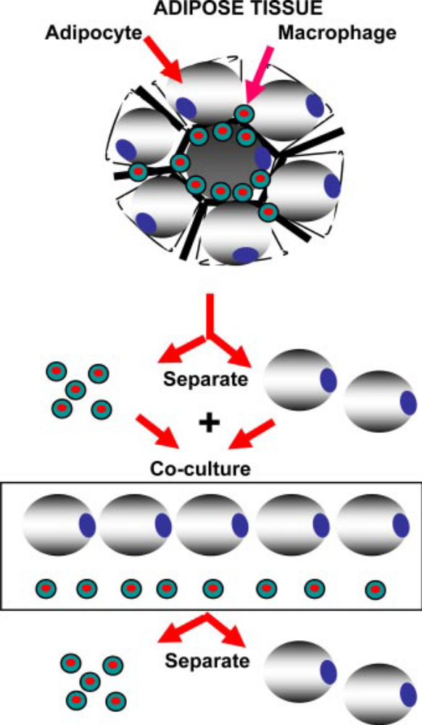
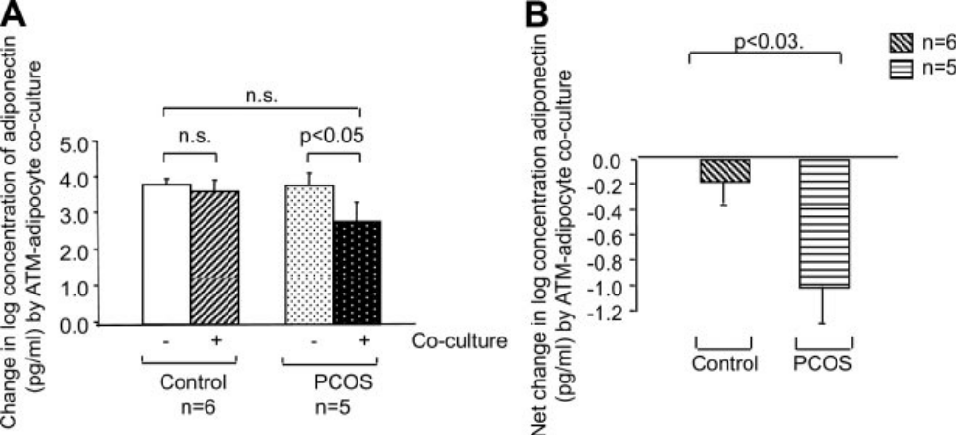
RESPONSE OF ADIPOKINE SECRETION TO ADIPOCYTE-RESIDENT MACROPHAGE CO-CULTURE IN PCOS
Chazenbalk et al. JCEM 2010; 95:935-42

Slide 17
Adiponectin secretion
Our results suggest that adiponectin secretion by adipocytes in response to cytokines/chemokines, and most notably in response to TNF-α and direct coculture with ATMs, differs between PCOS and control women, favoring greater suppression of adiponectin in PCOS

Slide 18
4 MAJOR DEFECTS WE FOUND IN ADIPOSE TISSUE FROM PCOS
1. Insulin resistance
2. Adipokines secretion
3. Genes expression- cDNA microarray
4. microRNAs expression

Slide 19
18 GENES INVOLVED IN INFLAMMATION IN ADIPOSE TISSUE OF LEAN PCOS
20.0
15.0
AOX1
PF4
BLNK
CCL8
CCL4
CCL3
IL8
CCL2
IL6
FOS
SPP1
CXCL14
CXCL2
TNFAIP6
B4GALT1
SELE
CXCL2
10.0
SAA1 /// SAA2
5.0
Fold changes
0.0
-5.0
-10.0
-15.0
Microarray
-20.0
-45.0
IL-6
SOCS3
CXCL2
B
p<0.04
C
p<0.02
D
p<0.02
n=4 n=4
n=4 n=4
n=4 n=4
14
12
16
12
10
14
10
ΔCt
8
ΔCt
12
ΔCt
8
10
6
8
6
4
6
4
2
4
2
2
0
PCOS Control
0
PCOS Control
0
PCOS Control
q-RTPCR
Chazenbalk et al. J Clin Endocrinol Metab 96: E765-E770, 2012

Slide 20
6 GENES INVOLVED IN Wnt SIGNALING IN ADIPOSE TISSUE OF LEAN PCOS
DKK2
SFRP4
MYC
SOX17
JUN
FOS
5
0
-5
Fold changes
-10
-45.0
Microarray
Dkk2
FOSB
JUN
p<0.001
p<0.001
p<0.05
14
n=4 n=4
12
n=5 n=4
7
n=5 n=4
13
10
6
ΔCt
12
ΔCt
8
ΔCt
5
11
6
4
10
3
9
4
2
8
2
1
0
PCOS Control
0
PCOS Control
0
PCOS Control
q-RTPCR
Chazenbalk et al. J Clin Endocrinol Metab 96: E765-E770, 2012

Slide 21
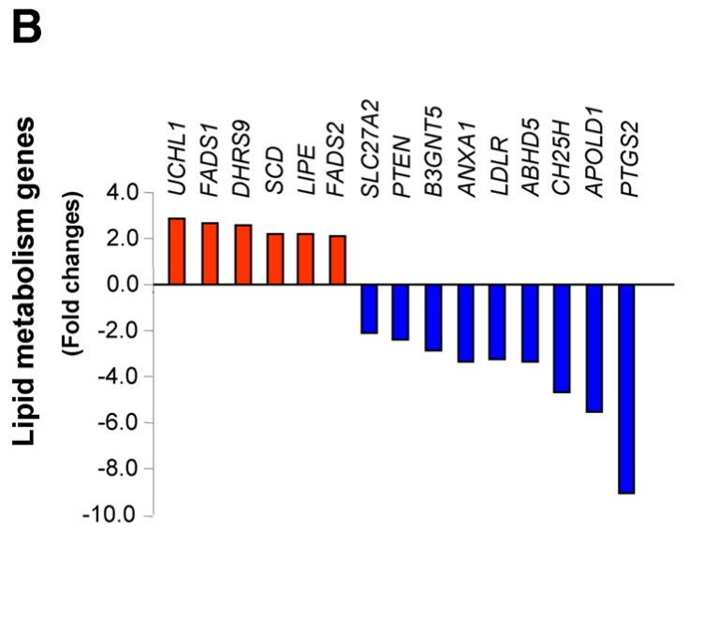
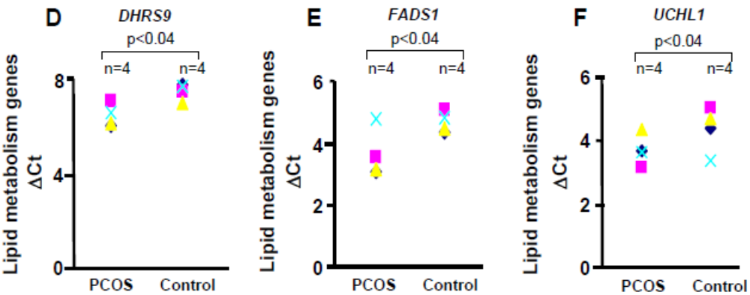
15 GENES INVOLVED IN LIPID METABOLISM IN ADIPOSE TISSUE OF LEAN PCOS
Chazenbalk et al. J Clin Endocrinol Metab 96: E765-E770, 2012

Slide 22
GENES EXPRESSION
Genes involved in inflammation, lipid metabolism, and Wnt signaling are differentially expressed in non-obese PCOS adipose tissue. Because these genes are known to affect adipogenesis and insulin resistance, their dysregulation may contribute to the metabolic abnormalities observed in women with PCOS.

Slide 23
4 MAJOR DEFECTS WE FOUND IN ADIPOSE TISSUE FROM PCOS
1. Insulin resistance
2. Adipokines secretion
3. Genes expression- cDNA microarray
4. microRNAs expression- microRNA (miRNA) microarray

Slide 24
miRNAs expression in adipocytes
miRNAs are short (20–24 nucleotides) noncoding RNAs involved in posttranscriptional regulation of gene expression
miRNAs are known to influence many cellular functions including glucose and lipid metabolism
We hypothesize that miRNA profile is different in adipocytes between control and PCOS.
miRNA microarray

Slide 25
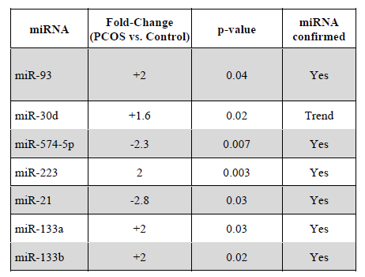
DIFFERENTIALLY EXPRESSED miRNAs IN ADIPOSE TISSUE OF PCOS
Chen et al. Diabetes 62: 2278-86, 2013

Slide 26
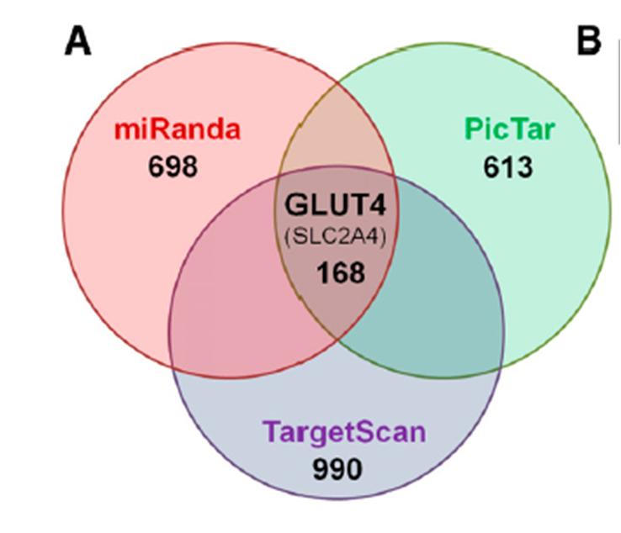
GLUT-4 IS A PREDICATED TARGET OF miR-93
Chen et al. Diabetes 62: 2278-86, 2013

Slide 27
GLUT-4 EXPRESSION IS REDUCED IN ADIPOCYTES FROM PCOS AND NEGATIVELY CORRELATED TO HOMA-IR
Chen et al. Diabetes 62: 2278-86, 2013

Slide 28
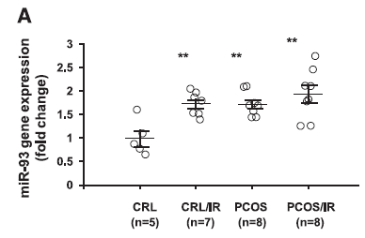
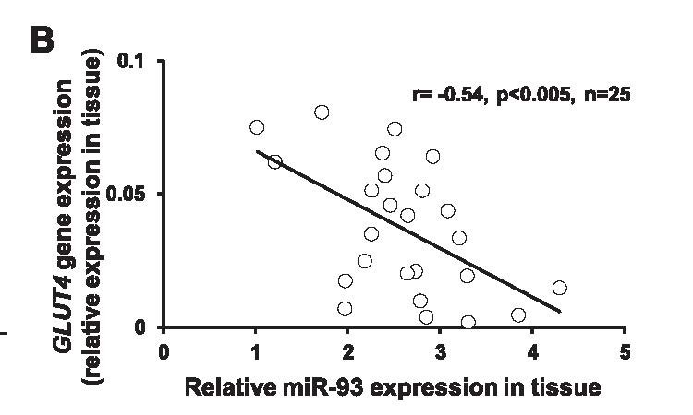
miR-93 IS OVEREXPRESSED AND IS NEGATIVELY ASSOCIATED WITH GLUT-4 EXPRESSION IN ADIPOSE TISSUE FROM PCOS
Chen et al. Diabetes 62: 2278-86, 2013

Slide 29
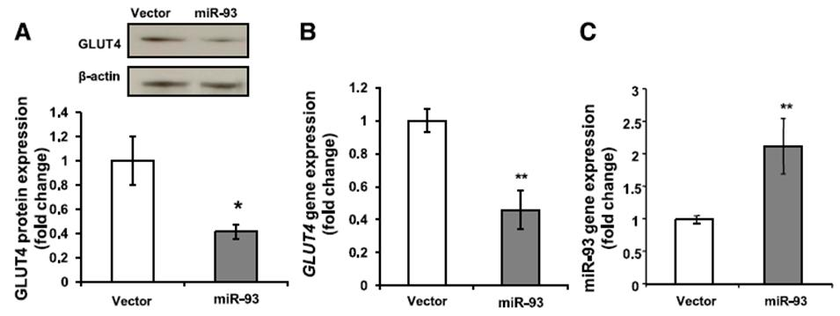
OVEREXPRESSION OF miR-93 IN ADIPOCYTES DECREASES GLUT-4 EXPRESSION IN VITRO
miR-93 vector
empty vector
D
E
GLUT4
GLUT4
Chen et al. Diabetes 62: 2278-86, 2013

Slide 30
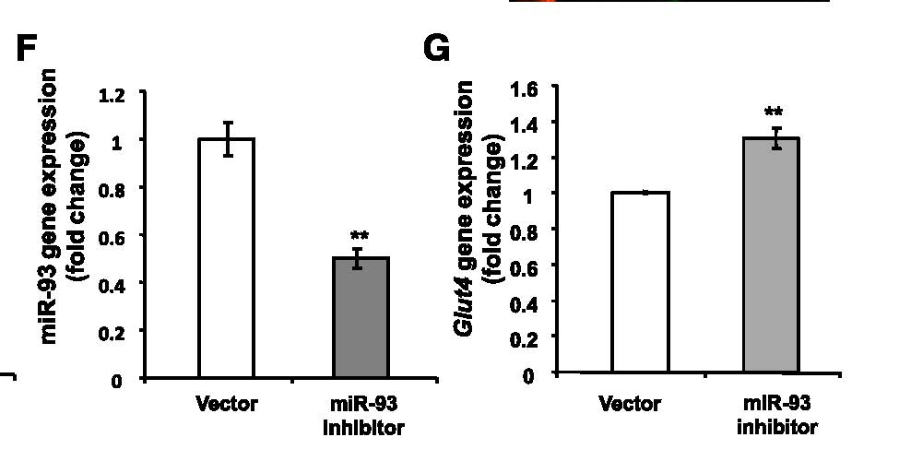
INHIBITION OF miR-93 IN 3T3-L1 ADIPOCYTES INCREASES GLUT-4 EXPRESSION IN VITRO
Chen et al. Diabetes 62: 2278-86, 2013

Slide 31
miRNAS EXPRESSION
Different miRNA profile in adipocytes from PCOS.
miR-93 is overexpressed in PCOS adipocytes.
Overexpression of miR-93 inhibits GLUT4 expression in adipocytes.
Our results suggest a novel mechanism for regulating insulin-stimulated glucose uptake via miR-93.

Slide 32
miRNAS EXPRESSION
However there are no direct evidence to show that overexpression of miR-93 in adipocytes will cause systemic insulin resistance.
To answer this question, we generated a miR-93 adipose tissue specific overexpressed mouse model by cross breeding miR-93 overexpression mouse with Cre adipose tissue specific overexpressed mouse.

Slide 33
CONCLUSIONS
Insulin-mediated glucose transport in AT in PCOS is dysfunctional, and associated with
  Decreased GLUT-4 content
  Increased sensitivity of adiponectin to suppressive effects of TNF-alpha, MCP-1 and IL-6
No major defects in PI3-K/Akt signaling observed in adipocytes of PCOS, although constitutively upregulated ERK 1/2 phosphorylation observed in MAPK pathway
Microarray of Adipose tissue demonstrates differences in the expressions of genes modulating inflammatory processes and adipogenesis

Slide 34
CONCLUSIONS
Epigenetic mechanisms may play a role in Adipose Tissue dysfunction in PCOS; notably, the miRNA profile differs in adipose tissue of PCOS
miR-93 regulates GLUT4 expression may be a novel mechanism which regulates insulin resistance in PCOS.
  miR-93, predicted to target GLUT-4, is higher in adipose tissue of PCOS
  miR-93 content is negatively associated with GLUT-4 content
  Overexpression and inhibition of miR-93 leads to suppression or increased GLUT-4 expression/content, resp.
Understanding the unique mechanisms of adipose tissue dysfunction in PCOS patients may point to potential new therapeutic avenues for this very common disorder.

Slide 35
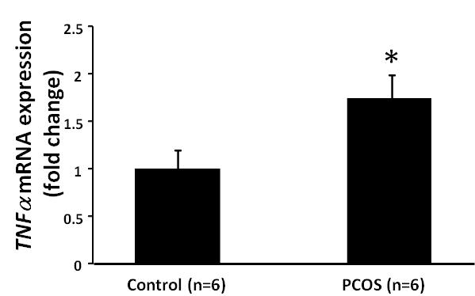
The adipose tissue of PCOS women had significant higher expression of TNFα (p<0.05) than matched controls

Slide 36
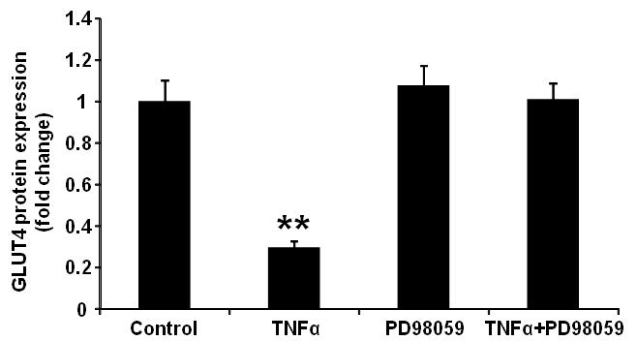
TNFα treatment for 24 hours reduces GLUT4 expression in differentiated adipocytes

Slide 37
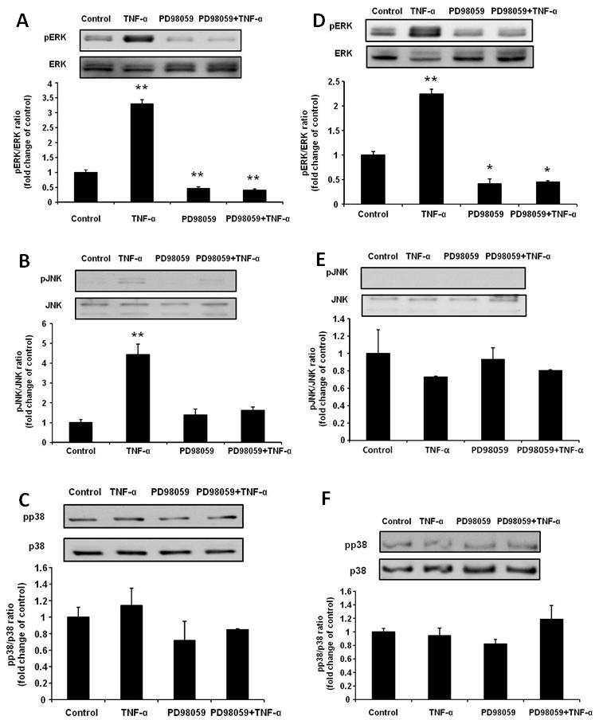
Protein expression of total and phosphorylated ERK1/2 (A), JNK (B), and p38 (C) after short term (24 hrs; A, B & C) and long term (72 hrs; D, E & F) treated with TNFα (10 ng/ml) in human cultured differentiated adipocytes.

Slide 38
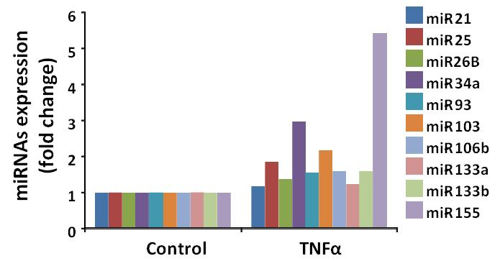
Expression of multiple miRNAs in primary cultured human adipocytes which treated with 10 ng/ml TNFα for 24 hours.

Slide 39
Our recently data in differentiated adipocytes suggest TNFα may play an important role in adipose tissue defects in PCOS
More works have to be done to confirm this hypothesis

Slide 40
COLLABORATORS, CO-INVESTIGATORS,
AND FELLOWS
GRU Lab:
  Ricardo Azziz, MD
Fellows/Postdocs:
  Tung Yueh Chuang, PhD
  Dara Lizneva, MD, PhD
  Soumia Brakta, MD
  Uche Ezeh, MD
  Hsiao-LI Wu, MS
Collaborators & co-investigators:
  Mark Goodarzi, MD, PhD
  Ida Chen, PhD
  Gregorio Chazenbalk, PhD

