Slide 1
ON SAMPLE STRUCTURE
FOR FABRICATING MICRO-MATERIAL
BY ELECTROMIGRATION
Graduate student
Yasuhiro KIMURA
|
Professor: Ph.D.
Masumi SAKA
|
Tohoku University
Department of Nanomechanics,
Aoba 6-6-01, Aramaki, Aoba-ku, Sendai 980-8579, Japan
TEL +81-22-795-6898 FAX +81-22-795-6893
kimura@ism.mech.tohoku.ac.jp
6th International Conference and Exhibition on
Materials Science and Engineering
September 12, 17:05-17:20
Young Research Forum
Notes:
The new approach is the
Sample structure is shape of micro-wire
ワイヤ創製のサンプルをSampleと言わない．Specimen or setup/device

Slide 2

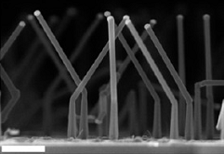
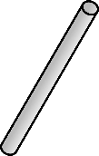
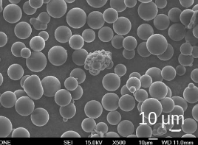

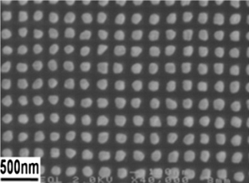
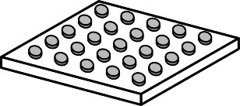
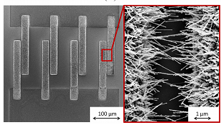
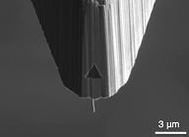
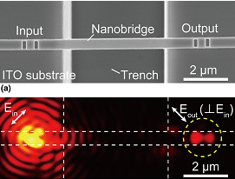
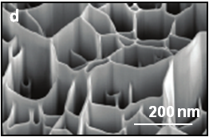
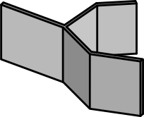
Introduction
|
What’re micro/nano-materials?
Micro/nano-materials
Morphology
Properties ^{5, 6}
Materials
Mechanical
Electrical
Thermal
Metal
Semiconductor
Polymer
1
wire
etc.
etc.
Applications for free-standing materials
particles
2
3D interconnection
Thermal application
Electrochemical sensor
Microscopy probe
Waveguide
High aspect-ratio
Stability
3
etc.
dots
4
wall
Fig. 1 Sensor using CuO nanowire⁷.
Fig. 2 Nanowire probe⁸.
Fig. 3 Nanowire waveguide⁹.
1. I.R. Musin and M.A. Filler, Nano Lett., 12 (2012) 3363.
2. Z. Li, M. Yoshino and a. Yamanaka, J. Micromech. Microeng., 24 (2014) 045011.
3. X. Dai, G.G. Wildgoose and R.G. Compton, Analyst, 131 (2006) 1241.
4. M.M. Brewster, et al., J. Phys. Chem. Lett., 2 (2011) 1940.
5. J. Sarkar, et al., Bull. Mater. Sci., 30 (2007) 271.
6. R. Dou and B. Derby, Scr. Mater. 59 (2008) 151.
7. S. Steinhauer, et al., Sens. Actuators, B, 186 (2013) 550.
8. M. Motoyama and F.B. Prinz, ACS nano, 8 (2014) 3556.
9. Y. Nagasaki, et al., MRS Commun., 5 (2015) 587.
Notes:
Synthesis
Bottom-up method is the directed growth and elevating ….
Because many applications utilize the surface area
Some reports indicats the characteristics depends on the shape
Typical synthesis technique are VLS as a bottom-up, and template as a top-down methods.

Slide 3
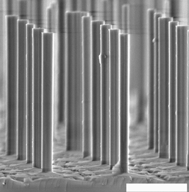
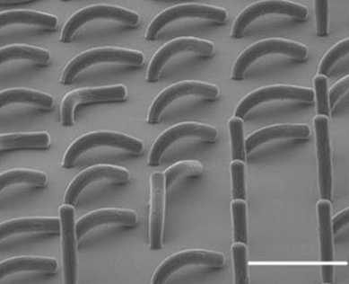
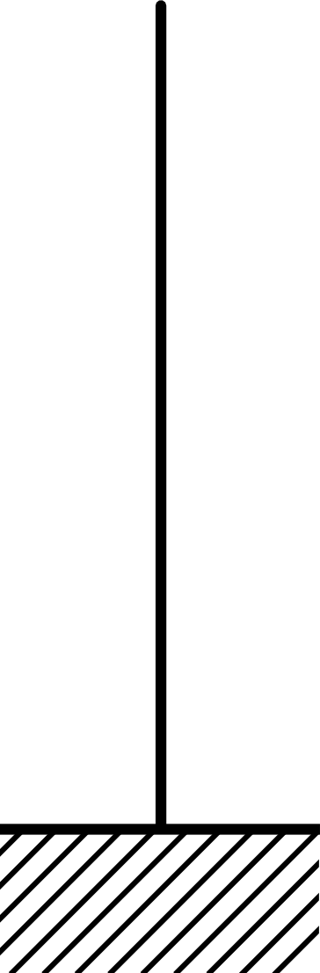
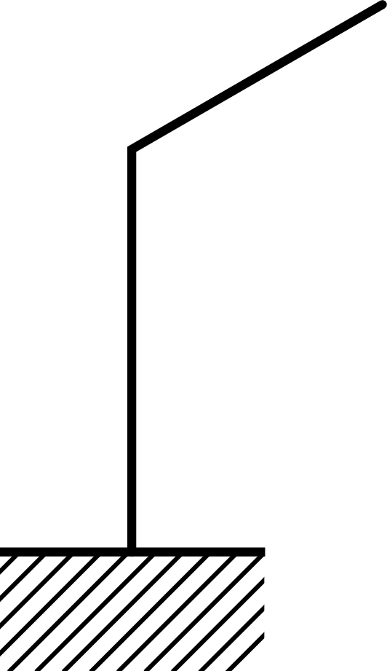
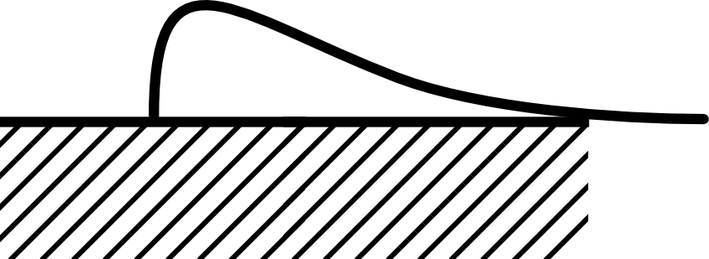
Motivation
|
Stability of free-standing micro-materials
Mechanism of the irregular structure for metal micro-material is not clear.
Mechanism for Nano-wire is clear¹¹.
Mechanism for micro-wire of polymer have been reported¹².
2 μm
400 nm
100 μm
Straight ¹⁰
Kink ¹¹
Collapse ¹²
10. Q. Li, et al., Opt. Express, 20 (2012) 17873.
11. I. Musin and M. Filler, Nano Lett., 12 (2012) 3363.
12. H. Liu, et al., RSC Advances, 6 (2016) 16640.

Slide 4
Motivation
|
Bending with time in electromigration technique
Bend of Al micro-wire still requires clarification.
Micro-wires bent, kinked and collapsed after growth.
One wire would bend during growth.
50 μm
50 μm
Fig. 8 Micro-wires grown immediately after.
Fig. 9 Micro-wires grown after a while.
Immediately after
After a while (< 5 h @High temp.)

Slide 5
Aim
|
The present work
Today’s topic
Investigation of a bending structure of micro-wires
Why?
Target:
Al micro-wires
Method:
Electromigration technique
Scale:
Micrometer
Number:
Specimen with 20 wires
1. Fabrication by electromigration technique
2. Observation
3. Discussion

Slide 6
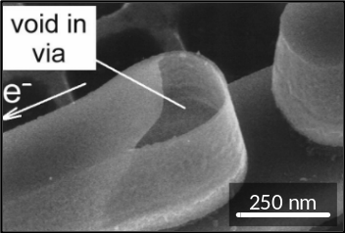
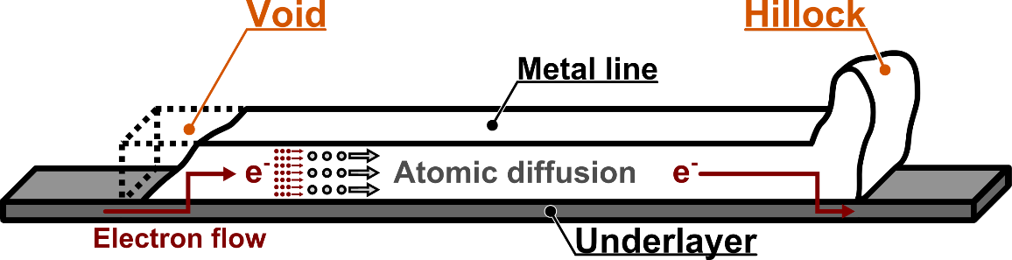
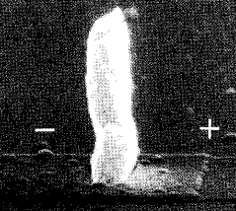

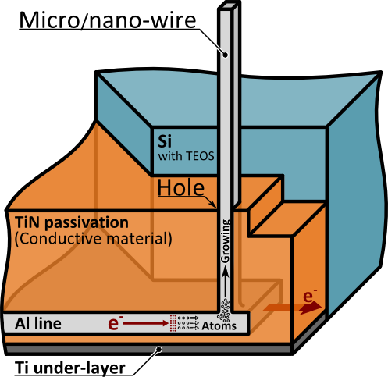
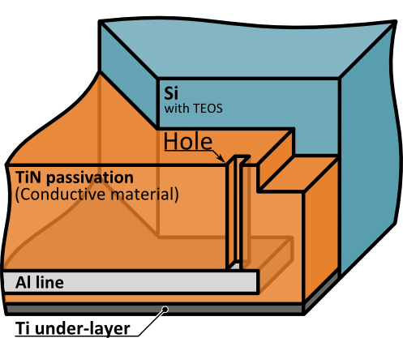
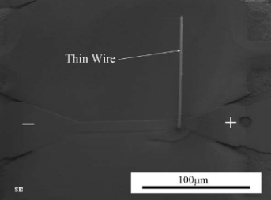
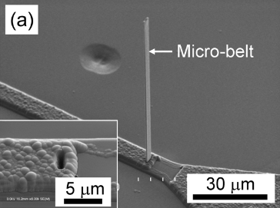
Principle
|
What’s Electromigration?
Electromigration
(EM)
Atomic diffusion with high-density electron flow
Voids
Hillocks
Vacancies ¹³
Fig. 4 The illustration of the EM principle.
Accumulations ¹⁴
Utilization
Application utilizing electromigration
EM technique is fabrication method
Micro/nano-wire¹⁵
Micro/nano-belt¹⁶
Before
After
Fig. 5 Fabrication of Al thin wire
by EM ¹⁵.
Fig. 6 Fabrication of a micro-belt
by EM ¹⁶.
13. A.H. Fischer, A. Abel, M. Lepper, et al., Microelectron. Reliab., 41 (2001) 445.
14. I.A. Blech, J. Appl. Phys., 47 (1976) 1203.
15. M. Saka and R. Nakanishi, Mater. Lett., 60 (2006) 2129.
16. Y. Lu, H. Tohmyoh and M. Saka, J. Phys. D: Appl. Phys., 44 (2011) 045501.

Slide 7
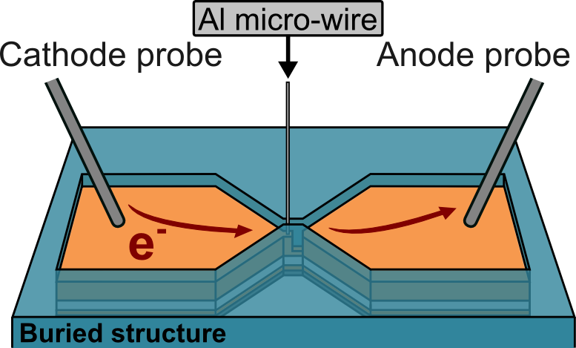
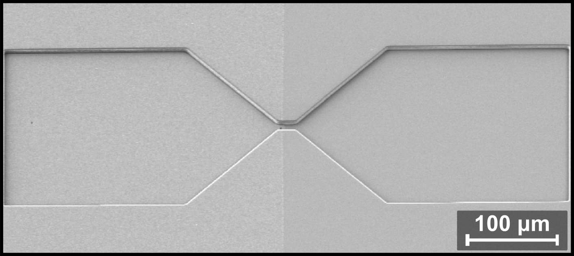
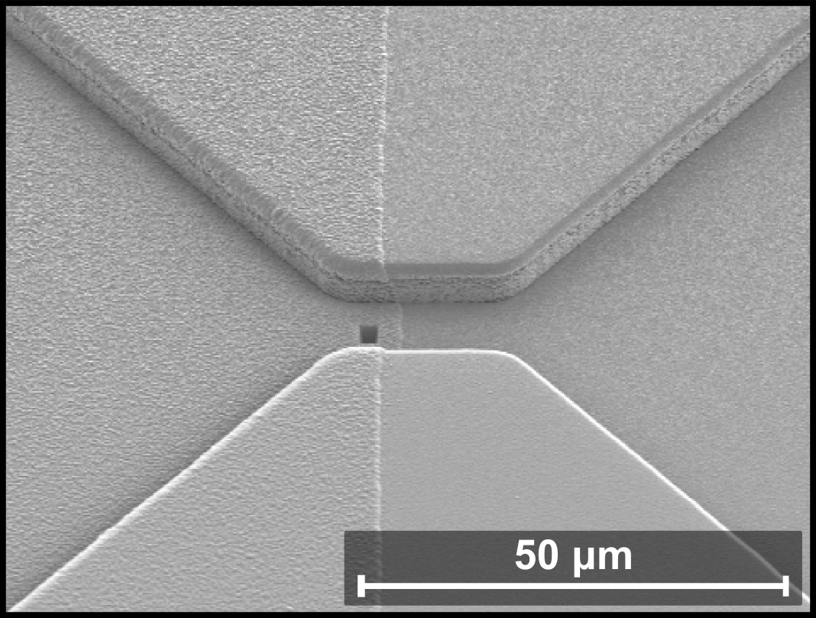
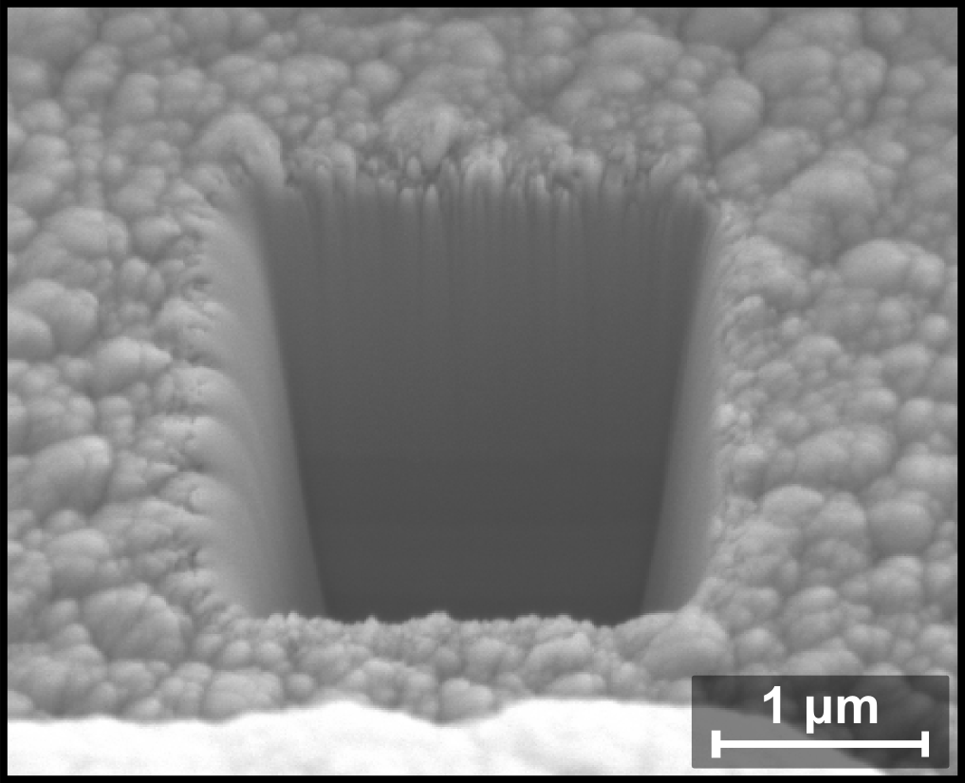
Fabrication method
|
Buried structure
Schematic illustration
Atoms are migrated by electron flows.
Atoms are discharged via a hole.
a.
b.
c.
b.
c.
Cathode
Anode
e⁻
e⁻
Fig. 7 FE-SEM image of sample: (a) whole image, (b) magnification of a fabrication area,
and (c) magnification of a hole.
Notes:
Widening planar direction. Simultaneously

Slide 8

Conclusions
Stability of a structure was investigated.
Time-dependence of varying a shape was observed.
Al micro-wires collapsed with time, due to buckling by gravity.
High temperature and shrinking root induce gravity effect.
Optimum conditions exist to control a shape.
Notes:
Demonstration of fabrication of micro-materials using multi-layer is important.
We hope that ….

Slide 9
Thank you very much
for your kind attention.
Acknowledgements
A part of this work was supported by JSPS KAKENHI Grant-in-Aid for Scientific Research (B) Number 26289001, and Grant-in-Aid for JSPS Fellows Number 15J02134. Also, a part was supported by Tohoku University Institute for International Advanced Research and Education. This work was performed via the Micro/Nano-Machining Research and Education Center of Tohoku University.

