Slide 1

ARDs: Connecting the Dots
6th World Congress on Biotechnology, New Delhi. October 05-07, 2015
Yasha hasija
ASSISTANT PROFESSOR
DEPARTMENT OF BIOTECHNOLOGY
Delhi technological University
*ARDs – Age Related Disorders

Slide 2
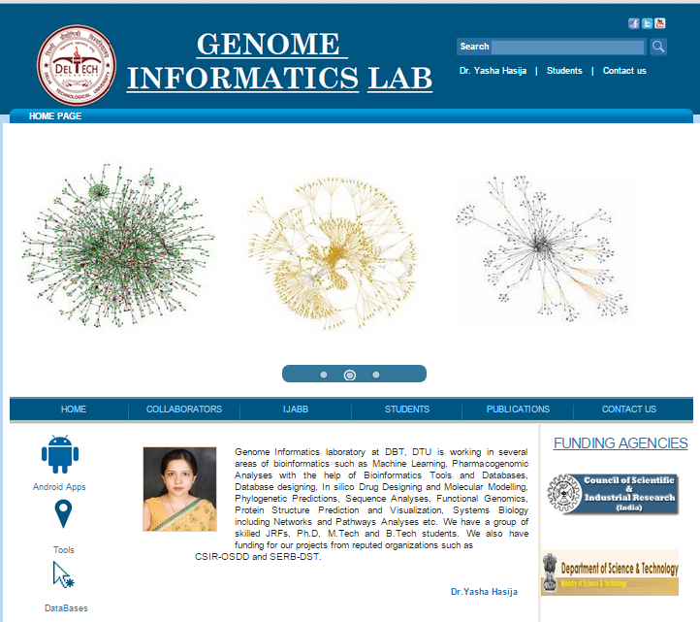
Genome Informatics Laboratory at Department of Biotechnology, DTU is working in several areas of bioinformatics such as genome annotation, microbial informatics, integration of genome-scale data for systems biology and personalized genomics. We have a skilled group comprising of Ph.D.s, JRFs, M.Tech and B.Tech students.
http://genomeinformatics.dtu.ac.in/

Slide 3
Contents
Overview
Plan Layout
Outcomes
dbAARD
ARD Gene Prediction Tool - AGP
NutriGene
dbPGx
ARDs - Connecting the dots
http://genomeinformatics.dtu.ac.in/
Notes:
My talk will be divided into three parts:
In my first part of the talk I will give an overview and background information regarding ageing and ARDs, and why there is a necessity to holistically understand ARD causation.,
the second part is essentially focussed on the various approaches by which we are trying to address ARD causation from various angles,
Third- Throwing light on outcomes – how we have constructed online, freely available resources
Dabaard
Agp
How personalized nutrition can help
Pharmacogenomics view of ARDs
Lastly – I would be talking on the Integration of all these approaches by taking a case eg. – what’s the way forward!

Slide 4
Contents
Overview
Plan Layout
Outcomes
dbAARD
ARD Gene Prediction Tool - AGP
NutriGene
dbPGx
ARDs - Connecting the dots
http://genomeinformatics.dtu.ac.in/
Notes:
My talk will be divided into three parts:
In my first part of the talk I will give an overview and background information regarding ageing and ARDs, and why there is a necessity to holistically understand ARD causation.,
the second part is essentially focussed on the various approaches by which we are trying to address ARD causation from various angles,
Third- Throwing light on outcomes – how we have constructed online, freely available resources
Dabaard
Agp
How personalized nutrition can help
Pharmacogenomics view of ARDs
Lastly – I would be talking on the Integration of all these approaches by taking a case eg. – what’s the way forward!

Slide 5

Overview
Ageing is a multilevel and multifaceted process of getting older characterized by physical, physiological, psychological and social changes.
It is an inevitable process and is usually marked by the increase in the rise of age-related disorders (ARDs).
Nearly 100,000 people die each day of ARDs such as CVD, cancer, arthritis, osteoporosis, diabetes, schizophrenia, Alzheimer’s disease to name a few (De Grey, 2007).
http://genomeinformatics.dtu.ac.in/
Notes:
What is ageing? Let me ask this audience..Who wants to age? Not many..why?? But we all know, ageing is inevitable..we are all perhaps apprehensive about the consequences of aging, which may be psychological or physical, and the concurrent diseases associated with ageing like high blood pressure, diabetes and depression. All these changes severely impact on a person's sense of well-being, as well as severely restrict his ability to contribute to his family and society in terms of productivity and general usefulness. If not addressed, a large reservoir of human talent in the age group (from 55 to 80 years old) may become unproductive. In the worst case, they become a burden not only to themselves but to their families and society.

Slide 6
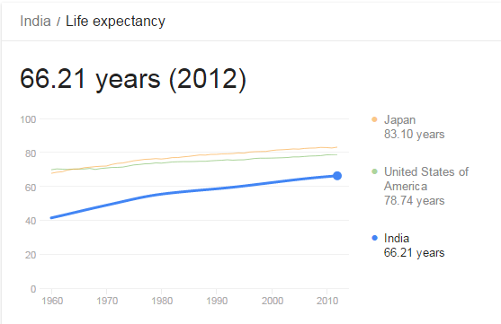
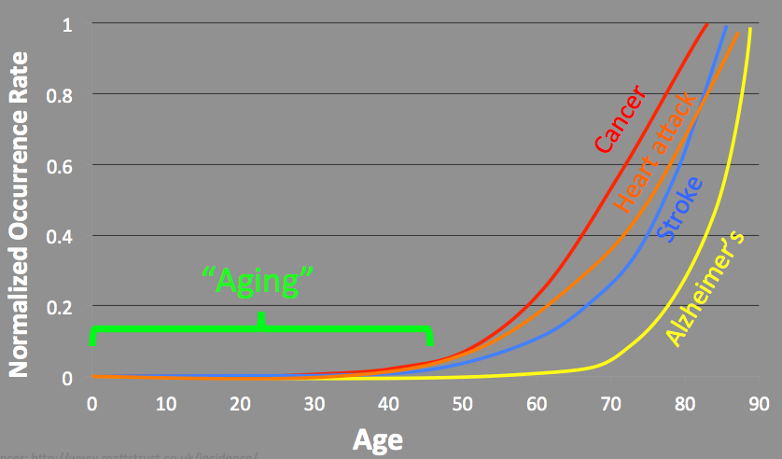
Overview
Multiple biochemical processes contribute to different pathologies as a result of ageing
Source: World Bank
http://genomeinformatics.dtu.ac.in/
Notes:
To add to it, Life expectancy is increasing, and at a faster pace than what the statisticians call "healthy life expectancy". That means we are living longer, but also that we are living longer in poor health.
The graph on the right illustrates how the occurrence rate of the diseases start increasing as we start to age with effects clearly visible after the age of 40.
Multiple biochemical processes contribute and as a result, these processes build up over time, and only late in life result into pathologies.

Slide 7

Overview
Both genetic (60%) and environmental factors (40%) interact with each other and influence ageing and lead to the development of “ARDs”
Need to holistically understand the various factors that interact and affect ageing, resulting in ARD causation.
Researchers so far focused on Longevity- Now need for a shift towards achieving “Healthy Ageing”
http://genomeinformatics.dtu.ac.in/
Notes:
What is the reason for the above?
Ageing is a multifactorial process that is determined by genetic and environmental factors that affect most physiological pathways.
The environmental conditions (stress, pesticides), individual genotype (genomic and mitochondrial DNA) and stochastic factors can induce genetic and epigenetic alterations that cause a decline in somatic stem cell function that can be the origin of metabolic, degenerative diseases, cancer and ageing in the individuals.
Healthy ageing --- That’s what we are trying to address through our holistic approach.

Slide 8
Contents
Overview
Plan Layout
Outcomes
dbAARD
ARD Gene Prediction Tool - AGP
NutriGene
dbPGx
ARDs - Connecting the dots
http://genomeinformatics.dtu.ac.in/

Slide 9
Plan Layout - Addressing ARDs in holistic manner
Age-Related Disorders
Environmental
Factors
(Nutrition/Lifestyle)
Genetic Factors
(Polymorphisms)
Drugs
dbAARD
NutriGene
dbPGx
http://genomeinformatics.dtu.ac.in/
Notes:
This greatest challenge faced by our ageing population arises due to the variations - in the disease incidence, prognosis, therapeutic response and toxicity -which have been attributed to the complex interplay of genetic variability and environmental factors. Thus, understanding the etiology of ageing, ARDs and hence the investigation of the genetic markers responsible for variation in the individuals response to disease incidence, therapeutic response and lifestyle have been of paramount importance.
With the advent in the field of genomics and computing, a lot of biological information on the genetic and environmental components of aging and ARDs have been generated, however, the studies integrating diverse information to better off in our ability to treat and prevent age-related diseases are lacking. In this regard, we have made an attempt to address certain aspects of aging and ARDs puzzle using an integrated computational approach. Using the manually curated information from our in-house databases on the genetic variants associated with ARDs (dbAARD), genetic variants modulating the drug response (dbPGX) and the polymorphisms interacting with diet (NutriGene) and using computational tools (such as AGP) and network analysis approach we have tried to connect the distinct spots in the space to form an informative pattern to solve the maze of human aging and ARDs.
[***
Data-driven approach.
A person’s genetic make-up plays a crucial role in the process of aging and determines how successfully an individual reaches old age.
Several public domain databases contain information on phenotype associated mutations. Also now with GWAS many studies are conducted around the globe how different dietary interventions interact with different genotypes. Lots of studies are revealing the importance of giving drugs based on indivdduals genotype (pharmacogenomics)
But there is no dedicated databases which houses these information in an organized way for all the diseases and specifically ARDs.
Thus we have made an effort to develop three databases that houses information on genetic polymorphisms associated with various ARDs (dbAARD)
***]

Slide 10
Addressing ARDs in holistic manner
Age-Related Disorders
Environmental
Factors
(Nutrition/Lifestyle)
Genetic Factors
(Polymorphisms)
Drugs
dbAARD
NutriGene
dbPGx
http://genomeinformatics.dtu.ac.in/

Slide 11
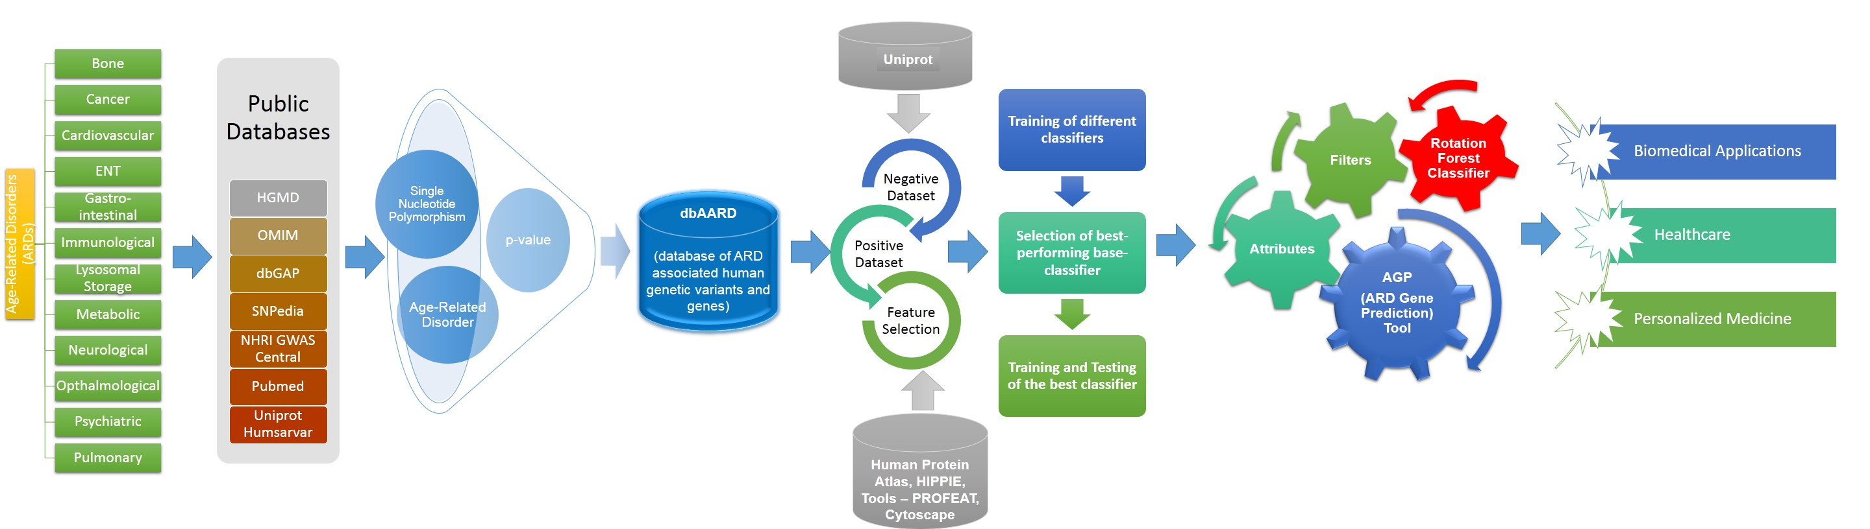
dbAARD (Database of Ageing and Age Related Disorders)
dbAARD is a freely accessible use-interactive database of the relationships of human single nucleotide polymorphisms (SNPs) and ARDs.
The database is available at http://genomeinformatics.dce.edu/dbAARD/
http://genomeinformatics.dtu.ac.in/
Notes:
It catalogues disease-SNP associations asserted in GWAS reports, from various publicly available databases like the NHGRI GWAS catalogue, GWAS Central, OMIM, HGMD and others, as well as literature searches
Mining the database for biologically meaningful information keeping these points in mind is likely to reveal hitherto unknown facts about the underlying causes of Age-Related Disorders.

Slide 12
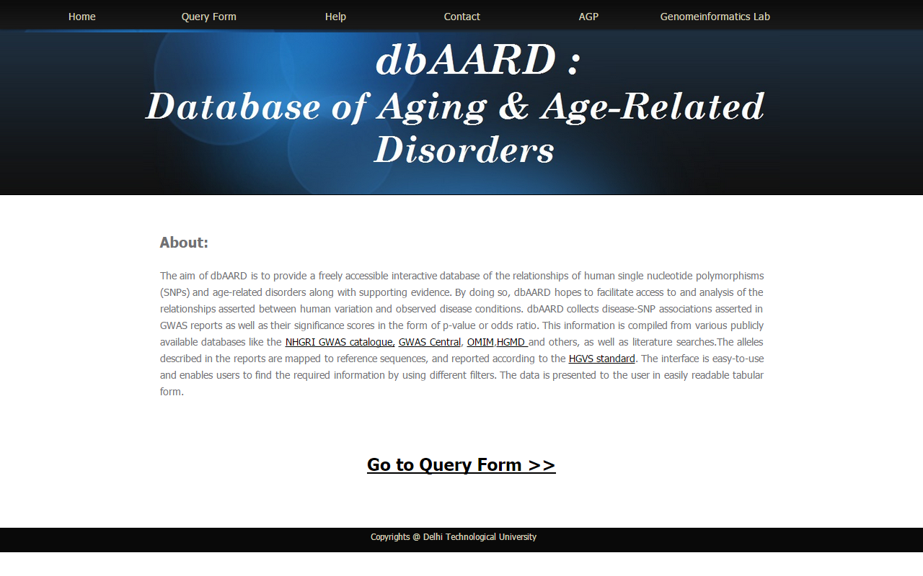
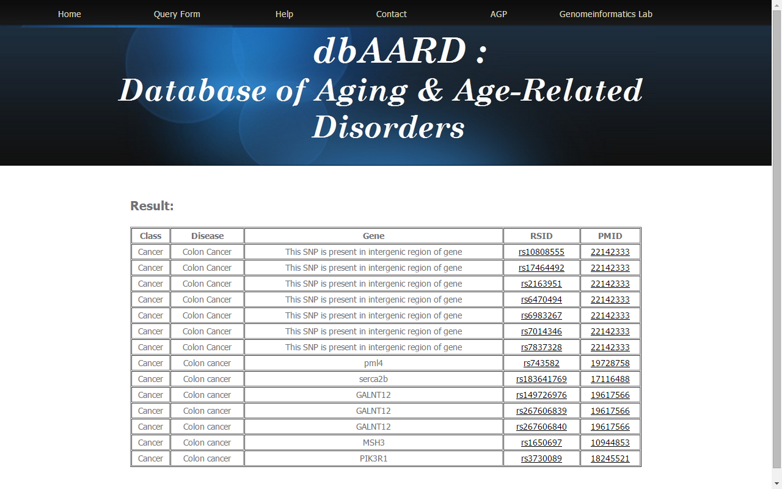
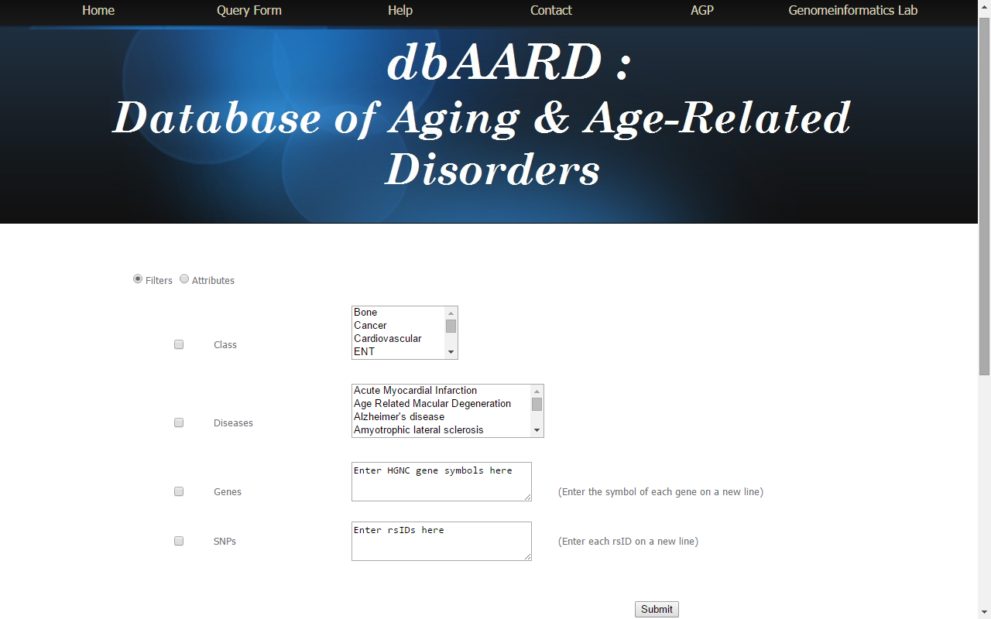
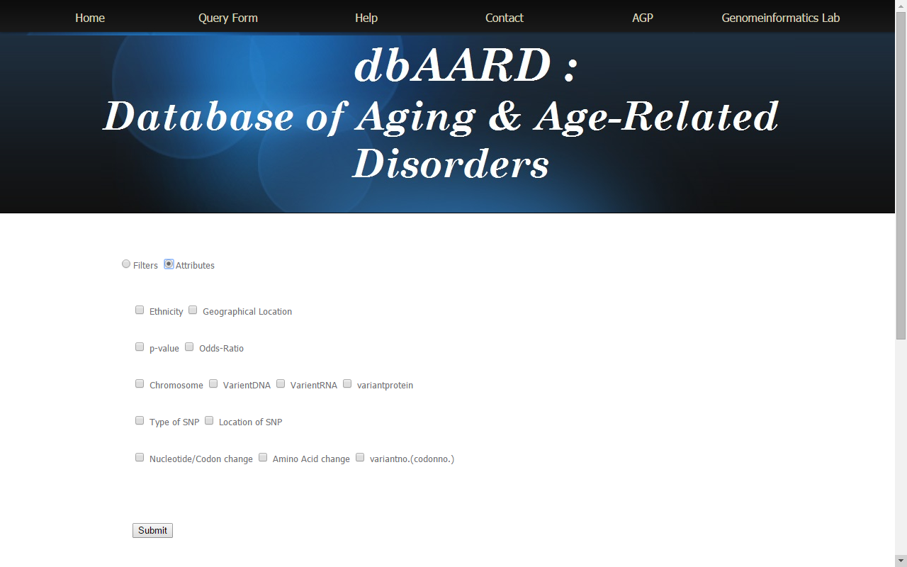
dbAARD (User Interface)
http://genomeinformatics.dtu.ac.in/
Notes:
The interface discussion. Homepage. Go to query form . Select the filter based on disease class or disease or gene or rsIDs. Then select the attributes based on what information is required in the result page.
Each entry in dbAARD contains the information on SNP, the associated disease, p-value assigned to the association, the odd ratio of the disease-SNP association and the literature reference. It also contains information on ethnicity which describes the ethnic group on which the study was carried out, geographical location in which the study was conducted and if large number of countries were involved in the study then the location has been considered as Mixed. Further, information about gene, chromosome, type of SNP, location of SNP on gene (such as exon, intron, intergenic and untranslated region), reference/mutant nucleotide and amino acid and protein change location has also been included.

Slide 13
dbAARD (Analysis)
Summary of information in disease-SNP in dbAARD
Diseases | 51
SNPs | 3197
Genes | 1297
Disease Classes | 12
Unique PMIDs | 1174
http://genomeinformatics.dtu.ac.in/
Notes:
These are some of the statistics of dbAARD data.

Slide 14
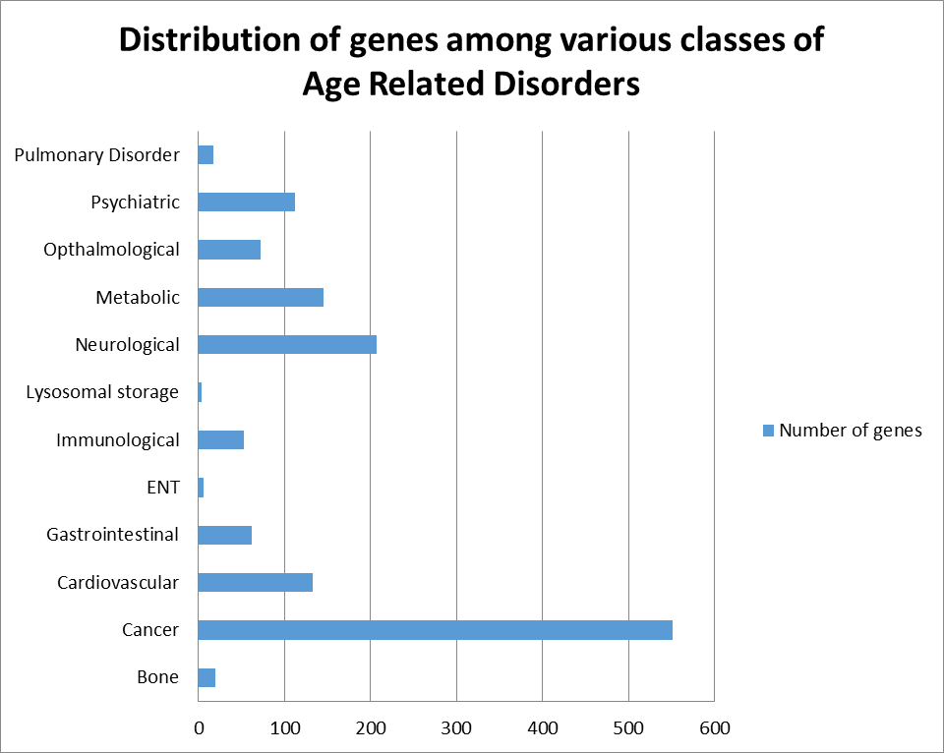
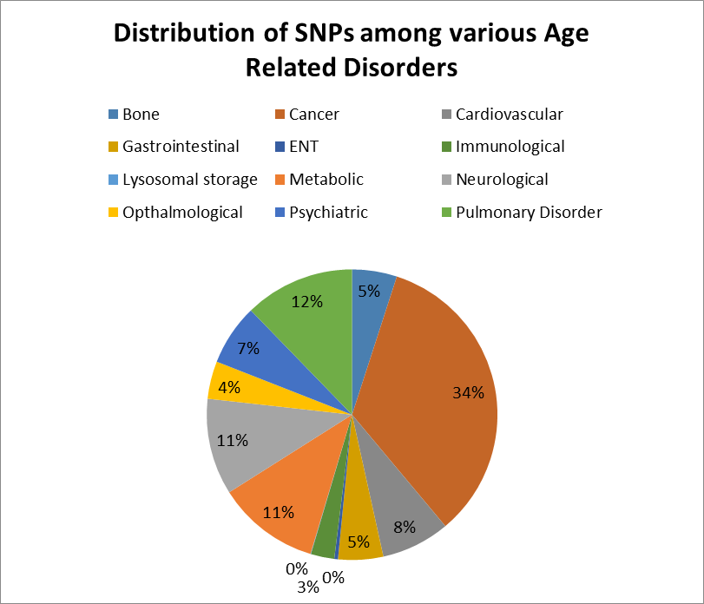
dbAARD (Analysis)
http://genomeinformatics.dtu.ac.in/
Notes:
Clearly shows the distribution of genes and SNPs among various ARDs. Most genes and SNPs lead to cancer.

Slide 15
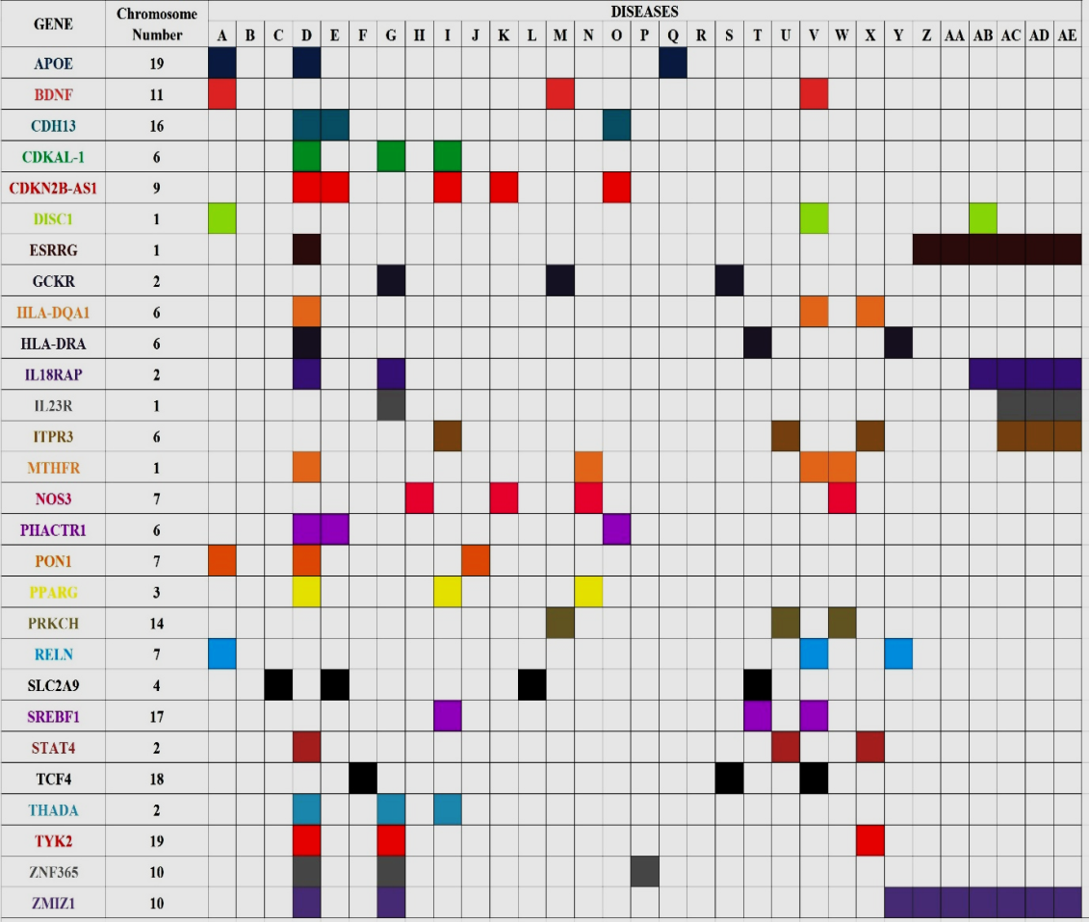
dbAARD (Analysis)
Mosaic chart: This chart represents the presence of common genes in the three or more ARDs.
http://genomeinformatics.dtu.ac.in/

Slide 16
AGP (Steps involved in development of the tool)
Step 1: Construction of dataset
Step 2: Attribute Selection (4 Groups)
Step 3: Test and Training Set formation
Step 4: Classifier Selection and Validation
http://genomeinformatics.dtu.ac.in/
Notes:
Step 1: Construction of Dataset
The data regarding genes involved in Age related disorders were retrieved from the developed database (dbAARD) and duplicate entries were removed. The genes thus obtained were mapped to UniProt IDs. The rest of the known human genes not present dbAARD were treated as non-ARD genes.
Step 2: Attribute Selection
For the model building, we included sequence based and physiochemical based features along with the subcellular localization and network topology information of proteins. Protein sequences of all the human proteins were retrieved from UniProt. The sequence based parameters such as amino acid composition and physiochemical properties like hydrophobicity, normalized van der Waals volume, polarity, charge, secondary structure, solvent accessibility, polarizability etc. were calculated using PROFEAT program. The information on the subcellular localization of proteins such as cell junction, centrosome, cytoskeleton, mitochondria, golgi body, endoplasmic reticulum, nucleus, lysosome, vesicle was obtained from The Human Protein Atlas. The proteins whose subcellular locations were not defined were categorized as unknown. The information about the various network features of protein – protein interaction network such as betweenness centrality, closeness centrality, degree and cluster coefficient were obtained by building PPI network in Cytoscape using data retrieved from HIPPIE.
Step 3: Test and Training set formation
2211 genes were ARD - associated and rest 25476 genes were considered as non ARD associated. With a help of Cygwin (Cygwin is a distribution of popular GNU and other Open Source tools running on Microsoft Windows) total 11 sets were created that contain 2211 ARD associated and 2211 randomly selected genes from non-ARD genes file.
All the training sets were evaluated in WEKA experimenter (The Weka Experiment Environment enables the user to create, run, modify, and analyze experiments in a more convenient manner than is possible when processing the schemes individually. The user can create an experiment that runs several schemes against a series of datasets and then analyze the results to determine if one of the schemes is (statistically) better than the other schemes.
Step 4: Classifier Selection and Validation
To choose the best classifier for disease-gene prediction, we tested 7 different classifiers – SVM, J48, Naïve Bayes, Random Forest, Rotation Forest, Multilayer Perceptron and Linear Regression using 10 fold cross-validation. The performance of each classifier was measured in terms of -Precision, Recall, Area under ROC curve and F-measure to find the best performing classifier which was further used to build final model for predictions by integrating base classifier and suitable filters. The Rotation Forest was found to perform best and hence was used as the base classifier and integrated with Principal Component Analysis filter to develop the ensemble classifier Rotation Forest which was then trained further with the training set (the gold standard) consisting of 2211 ARDs and 2211 non-ARDs in the explorer of WEKA.

Slide 17
AGP (ARD Gene Prediction Tool)
Group 1 | Group 2 | Group 3 | Group 4
Amino Acid composition | Hydrophobicity | Sub-Cellular Localization of Proteins | Network Properties
 | Normalized Vander Waal Volume
 | Polarity
 | Charge
 | Secondary Strcuture
 | Solvent Accessibility
 | Polarizability
Attributes considered in AGP tool
http://genomeinformatics.dtu.ac.in/
Notes:
To evaluate the efficiency of AGP, we carried out analysis of all the genes in the UniProt and determined the ability of AGP in predicting ARD associated genes which are not listed in dbAARD. Subsequently biological evaluation of the predicted ARD genes was carried out using DAVID Bioinformatics Resources 6.7 and DisGeNET.

Slide 18
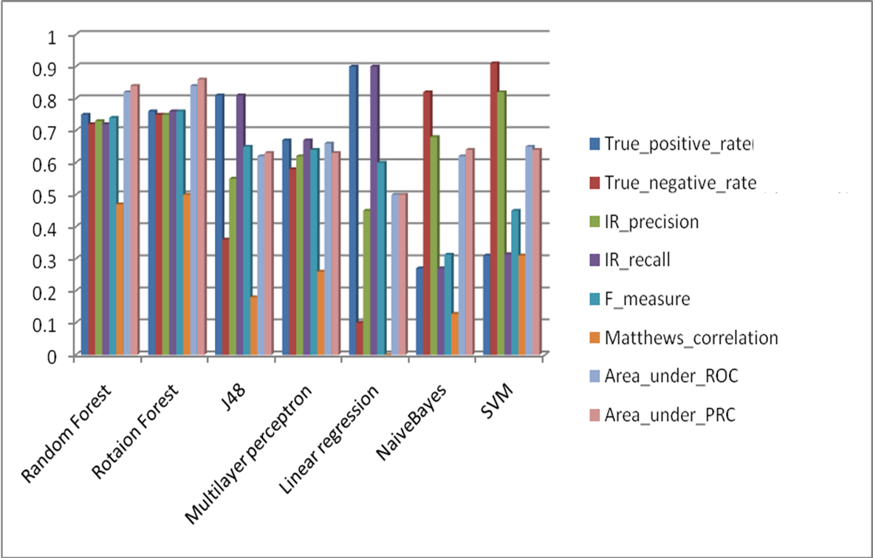
AGP (Classifiers Performance and Selection of Base Classifier)
S.No | Base_classifier | IR precision | IR recall | F measure | Area under ROC Curve
1 | Random Forest | 0.73 | 0.72 | 0.74 | 0.84
2 | Rotation Forest | 0.75 | 0.76 | 0.76 | 0.85
3 | J48 | 0.36 | 0.56 | 0.65 | 0.61
4 | Multilayer Perceptron | 0.62 | 0.67 | 0.64 | 0.65
5 | Linear Regression | 0.46 | 0.9 | 0.6 | 0.5
6 | Naive Bayes | 0.68 | 0.28 | 0.31 | 0.62
7 | SVM | 0.82 | 0.31 | 0.44 | 0.65
Performance of various classifiers
http://genomeinformatics.dtu.ac.in/
Notes:
To choose the best classifier for disease-gene prediction, we tested 7 different classifiers – SVM, J48, Naïve Bayes, Random Forest, Rotation Forest, Multilayer Perceptron and Linear Regression. For each classifier we used all the training sets created using Cygwin. In order to evaluate these classifying techniques and find the best performing classifier, we employed 10 fold cross validation and measured the performance in terms of Precision, Recall, Area under ROC curve and F-measure.
In order to determine the best performing classifier, we analyzed 7 different state-of-the art known classifiers and compared their performances in terms of precision, recall, F-measure and Area Underthe ROCcurve. Figure shows the performance comparison of all the seven supervised learning algorithms for disease gene prediction. SVM was found to have the highest precision (82%) but the recall was found to be only 31%. On the contrary, Linear Regression was found to have the highest recall (90%), however the precision was found to be only 46%. Since having either too small a precision or too small a recall is unacceptable in disease gene-prediction , F-measure is generally used to evaluate the performance of classifiers. F-measure is the average effect of both precision and recall, and will be large only if both of them are large. Also, it has been suggested that AUC is the better measure of accuracy when comparing the performance of different classifiers. Thus, considering both F-measure (76%) and AUC (0.85) Rotation Forest performs better than other classifiers. Hence, we trained Rotation Forest as our base classifier to build the final model for ARD gene prediction and tested it using all the genes in the UniProt.

Slide 19
AGP (ARD Gene Prediction Tool)
http://genomeinformatics.dtu.ac.in/
Notes:
* The data collected has been subjected to machine learning analysis. The classifier predicts putative genes involved in age related disorders from all the proteins present in UniProt

Slide 20
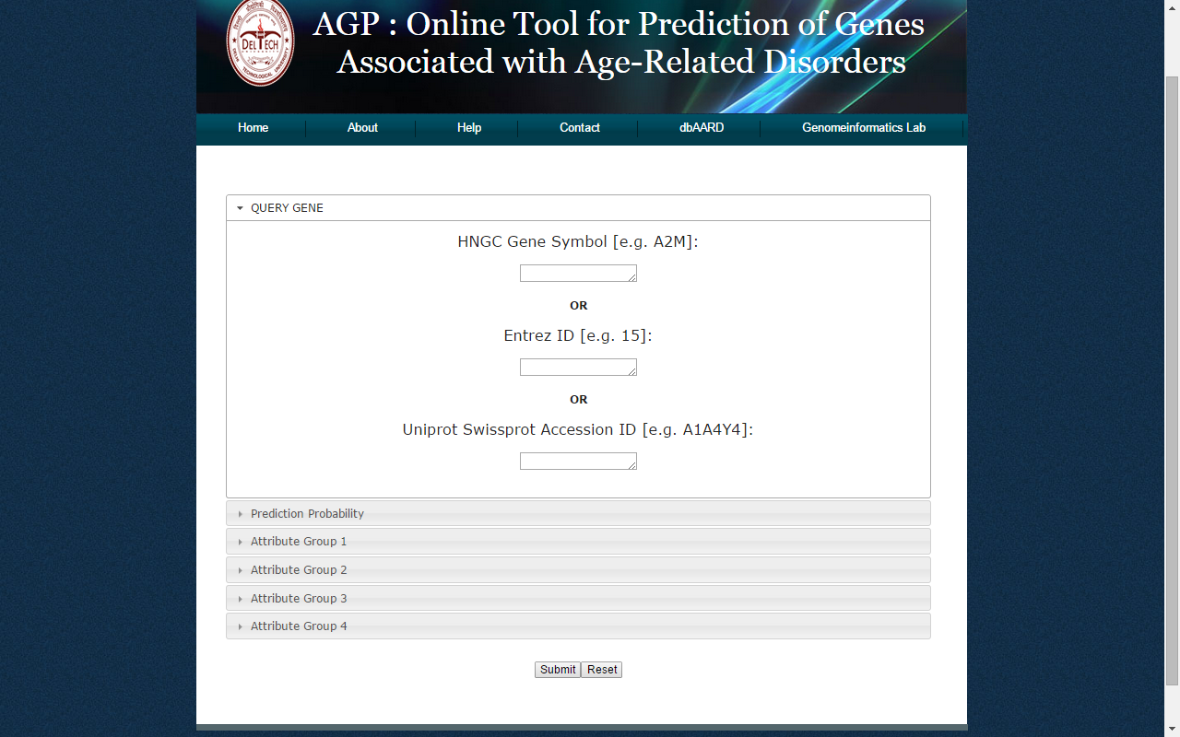
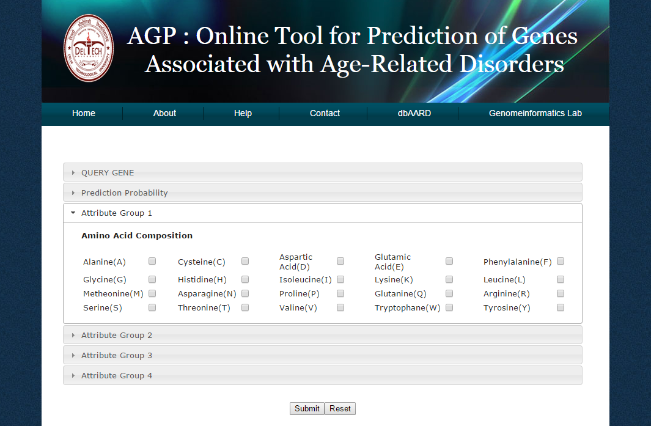
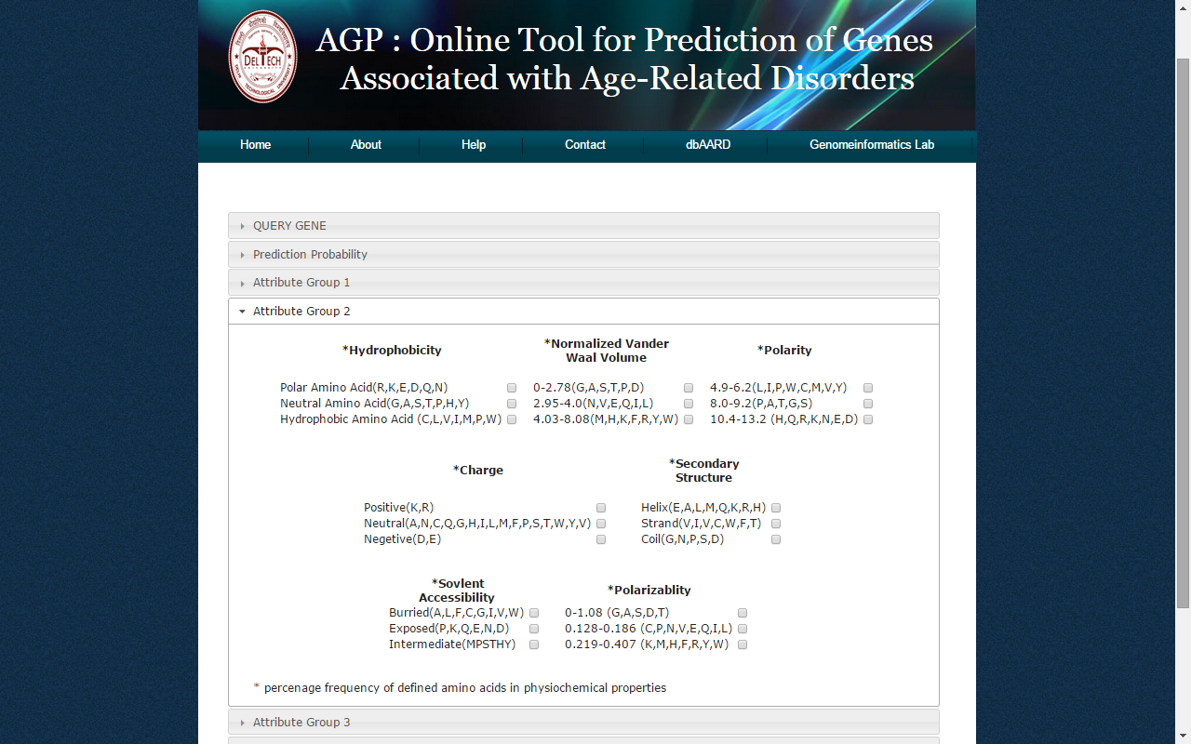
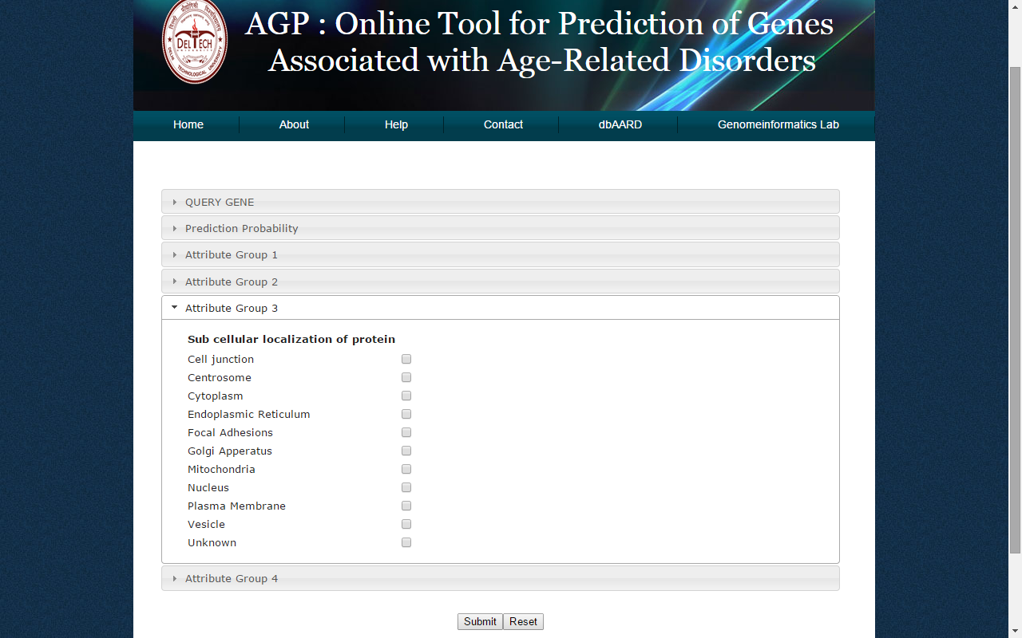
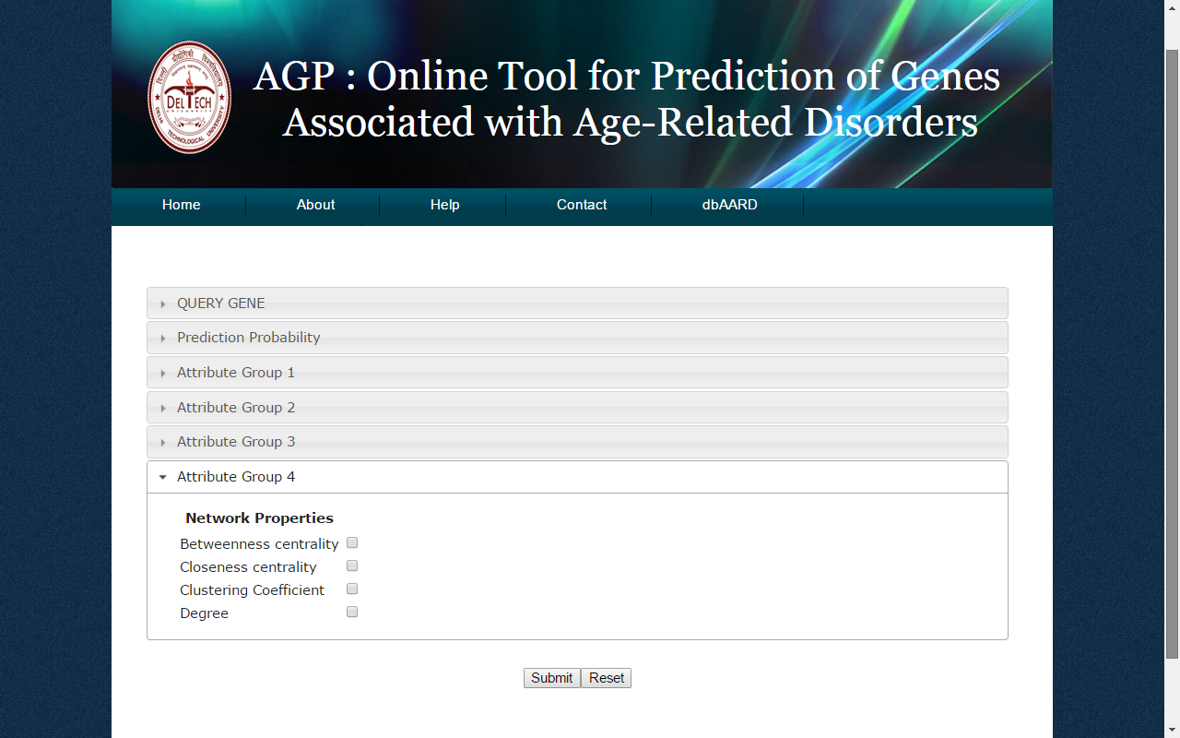
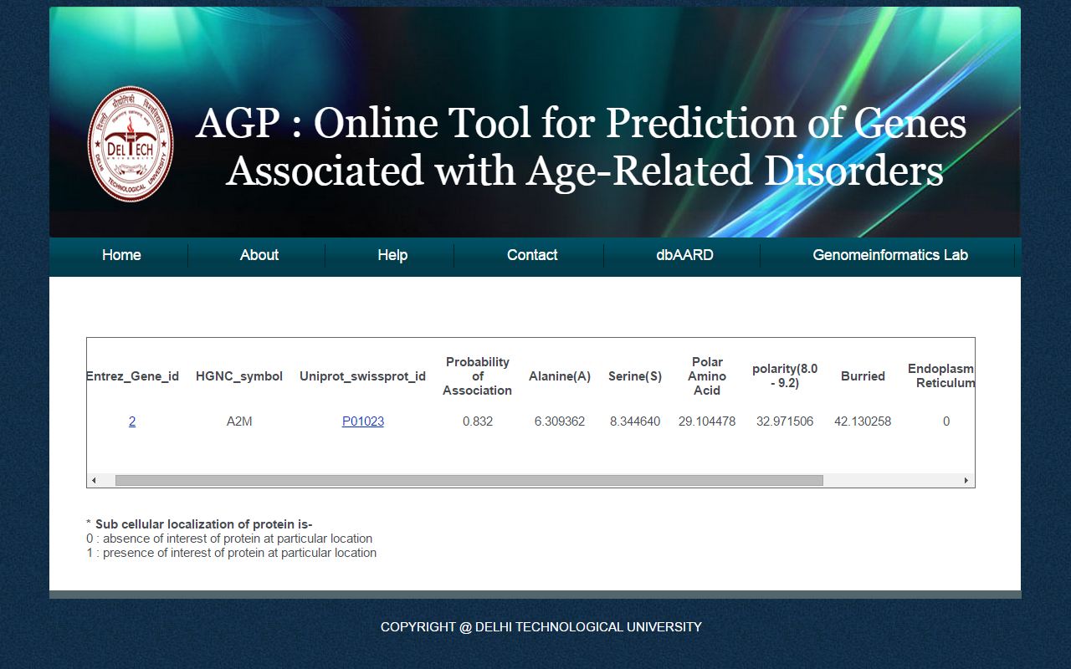
AGP (ARD Gene Prediction Tool - Interface)
http://genomeinformatics.dtu.ac.in/
Notes:
A user-friendly web interface of the tool has been developed using XHTML and CSS and PHP as programming language. AGP calculates the individual probability of association for each gene with Age Related Disorders (ARDs) in humans and allows the user to query the tool using Entrez ID, HGNC gene symbol, or the UniProt/SwissProt ID
One can select various attributes to be displayed in the result. The final result shows the predicted probability of association and values of the attributes selected by the user.

Slide 21

dbAARD and AGP
Network and Pathway based analysis may further provide insights into the complex process of ageing and ARDs
Understand the biology of ageing and ARDs
Identification of unknown ARD genes
http://genomeinformatics.dtu.ac.in/

Slide 22
Addressing ARDs in holistic manner
Age-Related Disorders
Environmental
Factors
(Nutrition/Lifestyle)
Genetic Factors
(Polymorphisms)
Drugs
NutriGene
http://genomeinformatics.dtu.ac.in/

Slide 23
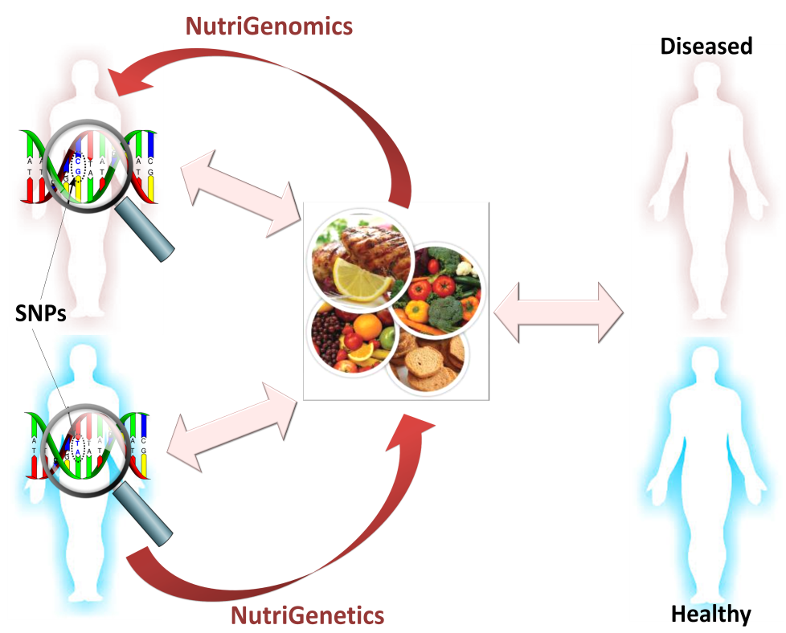
NutriGene- an online resource for Personalised Nutrition
It is now known that certain nutritional factors may increase or decrease the risk for certain disorders – also, this response is variable in individuals.
Understanding of the inter-relationship between nutrition and genotype, thereby modifying our metabolic pathways and homeostatic control, leading to varied susceptibility towards certain disorders has given rise to a new field of “Nutrigenomics”.
http://genomeinformatics.dtu.ac.in/
Notes:
Figure. Diet X Gene interaction has given rise to new fields of NutriGenomics and NutriGenetics. Although we are 99.9% identical, the 0.1% difference and the environmental factors (like diet, lifestyle) increases/decreases our predisposition to certain diseases thereby emphasizing the need for personalized nutrition. For the realization of this goal, both effect of nutrients on metabolism and effect of genotype on nutritionally related diseases must be considered.

Slide 24
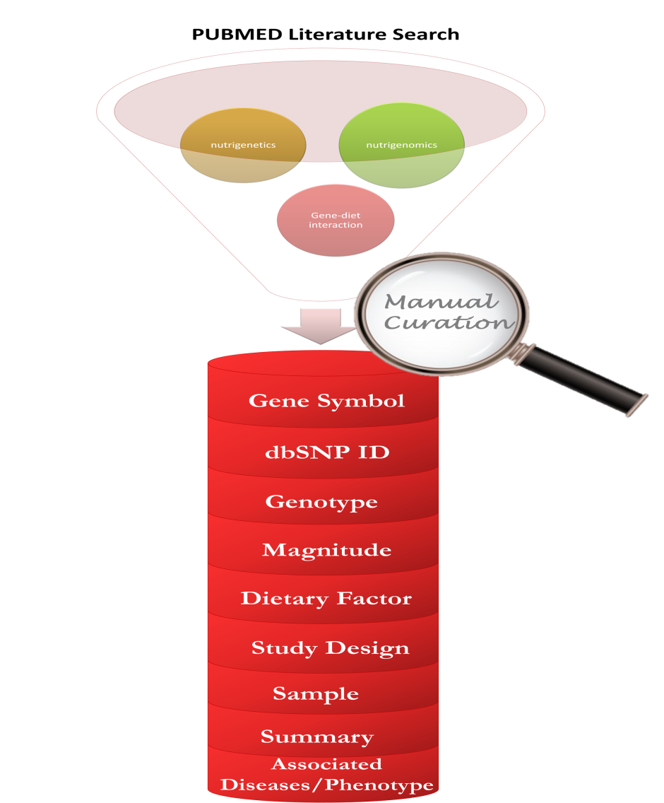
NutriGene (an online resource for Personalised Nutrition)
We have developed a manually curated, freely available, user-friendly interactive databank of the diet-gene interactions.
Incorporates studies on associations of specific foods/lifestyle with incidence and severity of obesity, diabetes, cardiovascular, cancer and/or other chronic diseases.
Disease prevention and health optimizing measures may be adopted.
Contains information related to the genes, such as gene symbol, rsID, type of SNP, reference and mutant nucleotide and amino acid change, ethnicity and geographical location in which the study was conducted
394 entries have been manually curated.
  A total of 152 unique genes and 199 unique variants were obtained as associated diet-gene interactions or nutritional polymorphisms.
Available at http://genomeinformatics.dtu.ac.in/nutrigene/
http://genomeinformatics.dtu.ac.in/

Slide 25
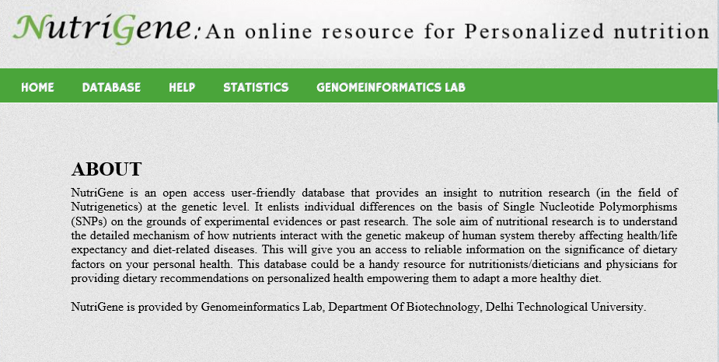
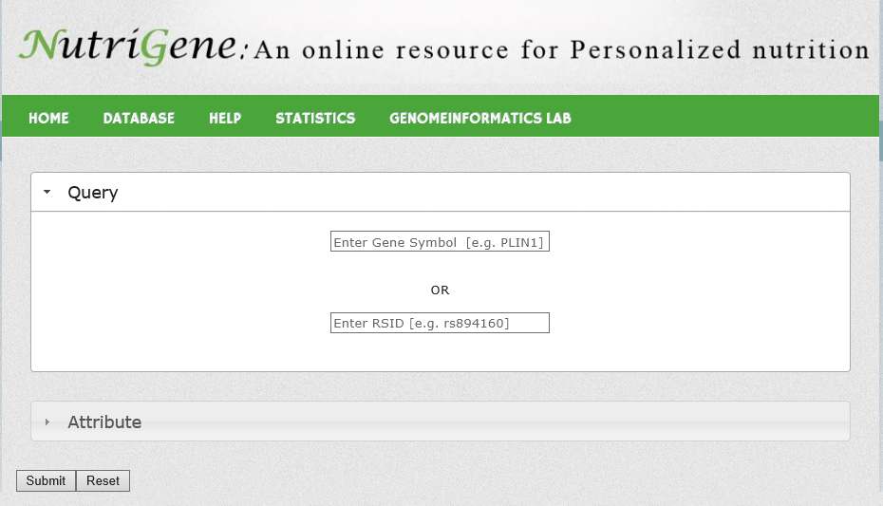
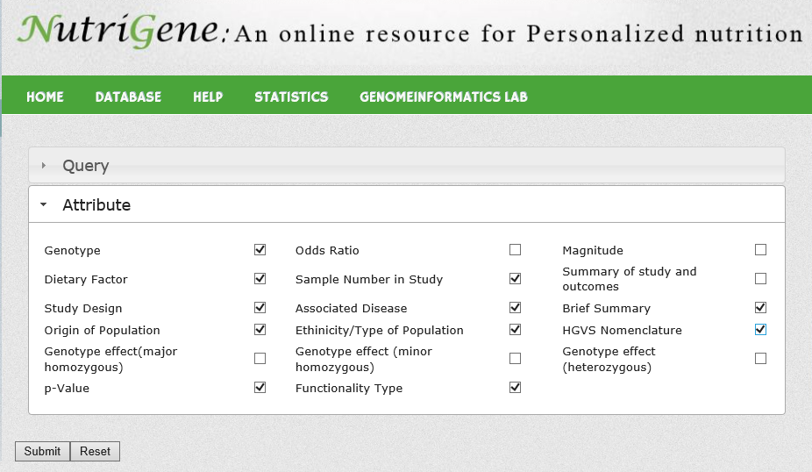
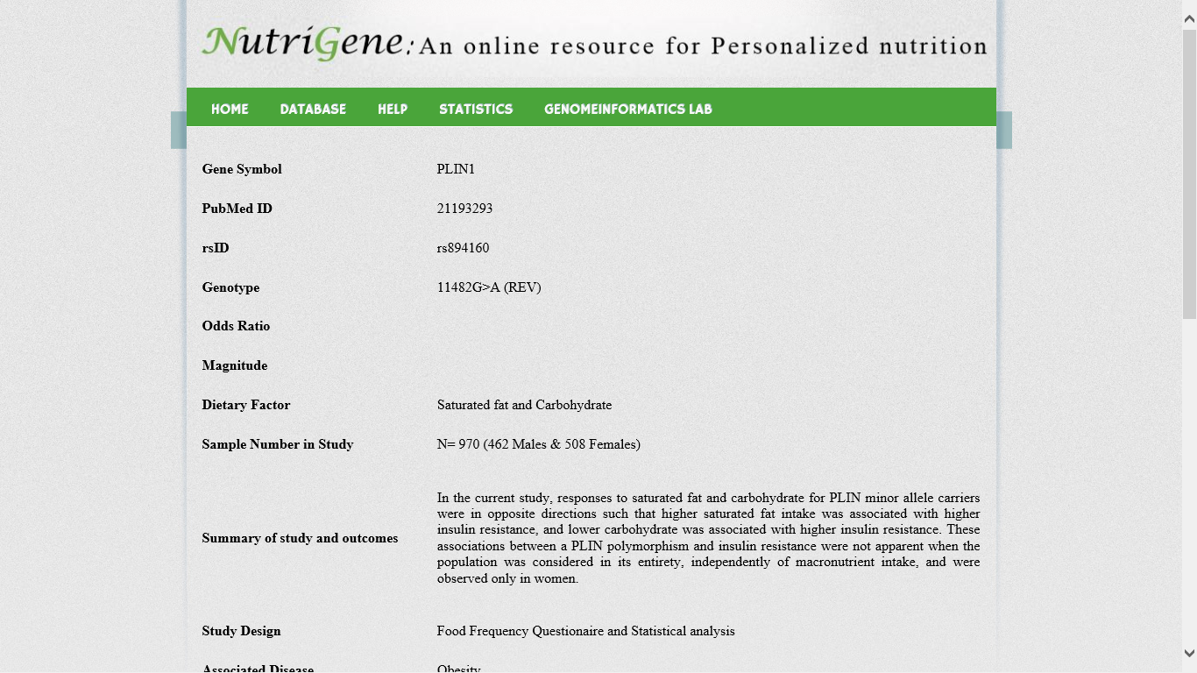

Slide 26
NutriGene (Analysis)
http://genomeinformatics.dtu.ac.in/
Notes:
After completing data collection from public resources and already published studies, it was concluded that there were such genotypic polymorphisms which were getting affected by more than one dietary factor thereby causing same or different diseases.
For example, APOA5 with polymorphism -1131T/C is influenced with various kinds of diets such as Polyunsaturated Fats, whole grains with legume meals or triglycerides.
Moreover, amongst such populations cardiological disorders was the most prevalent disorder followed by cancers and metabolic syndrome. Cancers such as prostate cancer, breast cancer were also observed to get influenced by dietary pattern followed by an individual.
]

Slide 27
NutriGene in ARDs
The main aim of such nutritional research is to understand the detailed mechanism of how nutrients interact with the genetic makeup of human system thereby affecting health/life expectancy and diet-related diseases.
While evaluating risk for acquiring nutrition-related ARDs, the personal-risk of a patient may be generated for advising “personalised diet”.
Although such contributions are the long-term efforts to be applied in this field but they could answer nutritional queries few years down the lane.
http://genomeinformatics.dtu.ac.in/

Slide 28
Addressing ARDs in holistic manner
Age-Related Disorders
Environmental
Factors
(Nutrition/Lifestyle)
Genetic Factors
(Polymorphisms)
Drugs
dbPGx
http://genomeinformatics.dtu.ac.in/
Notes:
Pharmacogenomics in ARDs

Slide 29



Slide 30
dbPGx (Open PGx database)
dbPGX (OpenPGx database) harbors data for human genetic variants modulating drug response.
The database hosts information for 4000 variants individually or in haplotypes across ~1000 genes reported to influence the efficacy of over 500 drugs.
Incorporating genomic data from drug-gene-environment studies into a single knowledgebase presents a handy resource to analyze drug therapy responses from different patients and paves ways to optimize therapies for future patients.
http://genomeinformatics.dtu.ac.in/

Slide 31
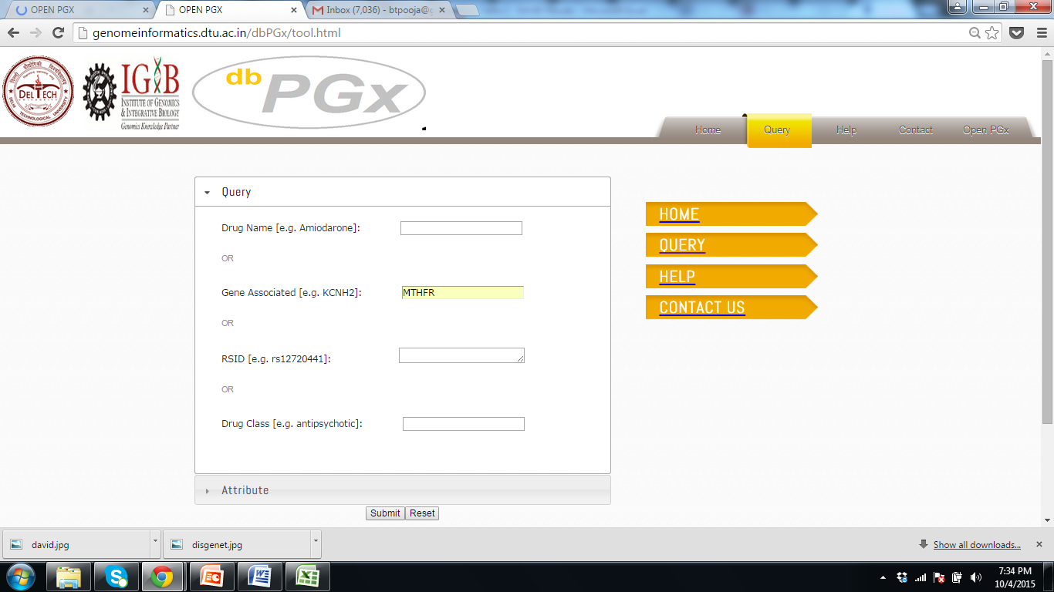


dbPGx (Interface)
http://genomeinformatics.dtu.ac.in/

Slide 32
Contents
Overview
Plan Layout
Outcomes
dbAARD
ARD Gene Prediction Tool - AGP
NutriGene
dbPGx
ARDs - Connecting the dots
http://genomeinformatics.dtu.ac.in/
Notes:
My talk will be divided into three parts:
In my first part of the talk I will give an overview and background information regarding ageing and ARDs, and why there is a necessity to holistically understand ARD causation.,
the second part is essentially focussed on the various approaches by which we are trying to address ARD causation from various angles,
Third- Throwing light on outcomes – how we have constructed online, freely available resources
Dabaard
Agp
How personalized nutrition can help
Pharmacogenomics view of ARDs
Lastly – I would be talking on the Integration of all these approaches by taking a case eg. – what’s the way forward!

Slide 33
ARDs: Connecting the Dots…
http://genomeinformatics.dtu.ac.in/

Slide 34
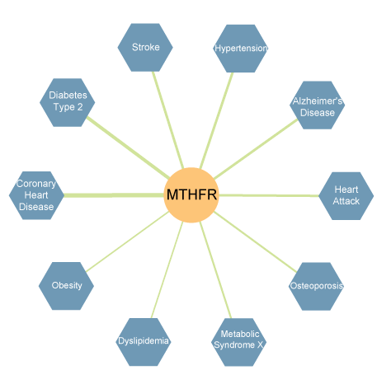
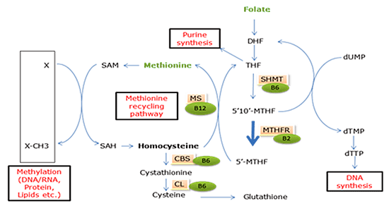
Case Study – MTHFR C677T Mutation
MTHFR gene and associated diseases
Simplified folate metabolism pathways involved in methionine recycling, DNA synthesis, purine synthesis and methylation reactions
http://genomeinformatics.dtu.ac.in/
Notes:
Background information on MTHFR Gene and the polymorphism. How the polymorphism leads to increase total homocysteine levels and low serum folate in TT homozygotes.
Figure on left - The gene-disease association network was created using information from the Genetic Association Database of NIH
(http://geneticassociationdb.nih.gov), which is an archive of human genetic association studies of complex diseases and disorders. The network is made visual using Cytoscape software (http://cytoscape.org). The blue hexagon represents disease, the orange circles represent genes, and the width of the edges represents the strength of association in the network. (Source : http://www.gbhealthwatch.com/GND-Cardiovascular-Diseases-MTHFR.php)
MTHFR enzyme is a key enzyme for folate homeostasis and catalyzes the conversion of 5,10-methylentetrahydrofolate to 5-methyltetrahydrofolate, the substrate for the conversion of homocysteine to methionine. The latter is involved in the methylation of DNA and proteins.
MTHFR includes 11 exons and several (>60) polymorphisms have been identified. Some of them are non-synonymous polymorphisms and alter the protein product. For example, C677T (rs1801133) is associated with decreased MTHFR activity and increased homocysteine levels.
MTHFR genetic variations cause MTHFR deficiency, neural tube defects and some evidence suggests an association with cancer. Severe deficiency in MTHFR causes elevated homocysteine concentrations, an atherothrombotic sulfur amino acid associated with increased risk of cardiovascular disease.

Slide 35
Case Study – MTHFR C677T Mutation and medication response
MTHFR 677C>T influence the side effects of the chemotherapeutic drugs fluoropyrimidines and antifolates due to their differential responses from that of the wild type genotypes.
5-fluorouracil (5-FU)- a member of the fluoropyrimidines that has been widely used to treat solid malignancies such as colorectal carcinoma.
    In one in vitro study in human colon cancer and breast cancer cells, the 667 T allele rendered carriers more sensitive to 5-FU. In addition, the 677T allele is also associated with a higher risk for developing severe treatment-related side effects such as vomiting and nausea (Lu et al, 2004).
Raltitrexed is a chemotherapy drug that mimics folic acid, thereby inhibiting dihydrofolate reductase, glycinamide ribonucleotide formyltransferase and thymidine synthase in folate metabolism pathways.
    Patients with the 677TT genotype that received the drug in combination with irinotecan (a DNA topoisomerase I inhibitor) showed significantly reduced toxicity when being treated for solid tumors (Toffoli & De Mattia, 2008).
Methotrexate (MTX) is an anti-neoplastic and anti-folate compound that has been used for the treatment of a number of solid tumors and hematologic malignancies. Due to its potential anti-inflammatory and autoimmune effects, this compound is one of the most commonly employed drugs in rheumatic and other inflammatory conditions. In many studies, not confirmed by some others, the 677T allele was associated with an increased toxicity after treatment with MTX (Toffoli & De Mattia, 2008).
http://genomeinformatics.dtu.ac.in/

Slide 36
Case Study – MTHFR C677T Mutation and dietary response
Folate, methionine, and alcohol intake are the three dietary factors that show the most interaction with MTHFR polymorphism.
Interaction between dietary folate intake and the MTHFR polymorphism with regard to cancer prevention.
  In a study, at sufficient folate intake, the MTHFR 677 genotype did not correlate with breast cancer. But when folate intake was low, the 677TT genotypes had a greatly increased risk for breast cancer (Alshatwi, 2010).
  In another study involving 257 gastric cancer cases, MTHFR 677TT carriers with low folate and vitamin B12 intake had the lowest survival rate in 3 years. Meanwhile, MTHFR 677TT carriers with high intake of folate and vitamin B12 before diagnosis dramatically decreased the risk for gastric cancer mortality (86% and 77% by folate and B12 respectively) (Galván-Portillo et al, 2009). Therefore, sufficient folate intake is the first line of defense against the associated diseases. Recommended daily values for other vitamin B family members (especially B2, B6 and B12) that are directly involved in folate metabolism are also very important to meet (Curtin et al, 2004).
In humans, vegan diets, which are typically low in methionine, is a useful nutritional strategy in cancer growth control. In terms of the interaction with the MTHFR polymorphism, the reduced enzymatic activity of the 677T respond to dietary methionine intake less efficiently.
  For example, post-methionine-load homocysteine concentrations in the 677TT carriers were significantly higher than that of the wild type carriers.Therefore, for the minor allele carriers, methionine restriction is the second line of defense against cancer and hyperhomocysteinemia associated diseases (Candito et al, 1999).
Alcohol is another strong factor interacting with folate metabolism. Moderate alcohol intake is beneficial for certain MTHFR genotypes. Men with the 677 TT genotype and alcohol intake of <20 g/day experienced a 70% reduced risk for colon cancer compared with 677 CC and individuals who drank no alcohol (Kim, 2007).
http://genomeinformatics.dtu.ac.in/
Notes:
Methionine is essential for protein synthesis, methylation of DNA and polyamine synthesis. Restriction of methionine is becoming appreciated as an important strategy in cancer growth control. Animal studies examining a methionine-restricted diet have reported inhibition of cancer growth and extension of a healthy lifespan
In a cross-sectional study conducted on men and women aged 40-60 years, Total Homocysteine seemed to decrease during follow-up in TT but not in CT. Analyses stratified by MTHFR C677T genotype showed that beer drinking had a protective effect among persons with the MTHFR TT genotype, but not among CC/CT individuals (Table 3). In other words, TT individuals drinking more beer had a decrease in tHcy, whereas TT individuals drinking less beer had an increase in tHcy when compared with TT individuals having unchanged beer consumption.

Slide 37
Case Study – MTHFR C677T Mutation
Age-Related Disorders
Alcohol
Dietary Folate
rs1801133 (C677T)
Raltitrexed
Nitrous oxide (Should not be used)
dbAARD
NutriGene
dbPGx
http://genomeinformatics.dtu.ac.in/
Notes:
About 85% of the general population carries a variant of the MTHFR gene associated with higher blood homocysteine, a risk factor for cardiovascular disease.
Green vegetables, folic acid fortified foods, vitamin B supplements and moderate alcohol intake can help reduce this risk.
Nitrous Oxide
Will cause B12 (methylcobalmin) deficiency in people with an MTHFR gene mutation that can possibly be severe. Prior to surgery and/or a dental visit it is important to let your doctor and anesthesiologist know that you cannot have nitrous oxide. Nitrous oxide can produce hyperhomocystenemia and high homocysteine which in turn can cause a life threatening clotting event.

Slide 38
Conclusion (Connecting the Dots)
We believe that by using holistic approach we can better understand the biology of aging and ARDs and can achieve our rationale of personalized nutrition and medicine, and eventually healthy aging.
http://genomeinformatics.dtu.ac.in/

Slide 39

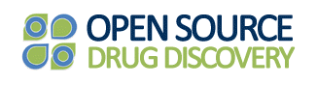
Acknowledgement
The study has been funded by SERB under OYS scheme
Financial support from Council of Scientific & Industrial Research (CSIR)-Open Source Drug Discovery (OSDD) is acknowledged.
http://genomeinformatics.dtu.ac.in/

Slide 40
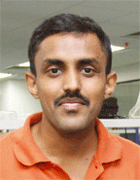

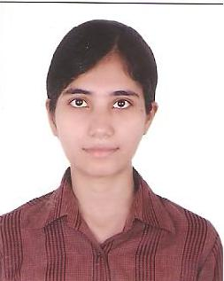
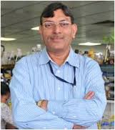

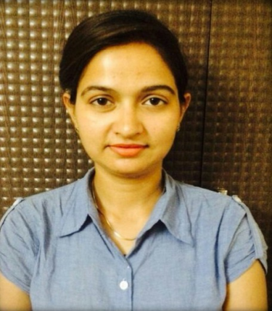
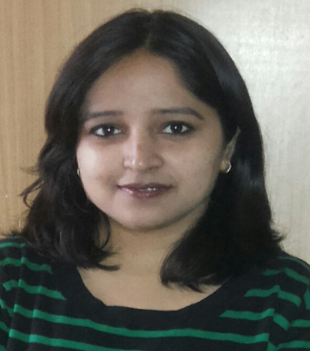

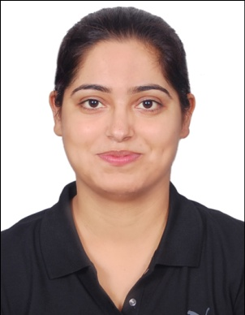
Team
Collaborators
Prof Y Singh
(CSIR-IGIB)
Dr Vinod Scaria
(CSIR-IGIB)
Ph.D. Students
Nitin Thukral
M. Tech. Students
Pooja Khurana
Isha Srivastava
Lalita Mehra
Richa Virmani
Lokesh Kumar Gahlot
Navneet Kaur Soni
http://genomeinformatics.dtu.ac.in/

Slide 41







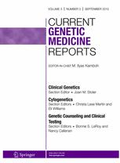


Publications in Peer Reviewed Journals

Slide 42
“Ageing is inevitable
but
suffering is optional”
THANK YOU !

