Slide 1



Transferring Dying Patients Home From Critical Care Units in China: Families’ Stories Of Making The Decision
Yanxia Lin, RN, PhD Candidate, University of Southampton, UK
Michelle Myall, PhD, University of Southampton, UK
Nikki Jarrett, RN, PhD University of Southampton, UK
Notes:
1

Slide 2

The study
Aims:
  to examine the extent of transfer in China
  to understand families’ experiences of transfer decision-making
The study comprised:
  a 12-month retrospective case note review
  family members’ narratives in situations around transfer
Ethics ID: 18845
Funder: China Scholarship Council (CSC)

Slide 3
Background
Evidence suggests many people prefer to die at home rather than in hospital (Gomes et al. 2013)
However, in many western countries only 16-57% eventually achieve home death, and most die in hospital or other institutions (Cohen et al. 2015).
Critical care units (CCUs) include intensive care units (ICUs), intensive therapy units (ITUs), and high dependency units (HDUs) (NICE 2009; NHS Choices 2015).
A number of patients die in CCUs. In the USA, approximately 20% of deaths occur in ICUs after admission (Angus et al. 2004), and in the UK 30% of patients die in ICUs following admission (Wunsch et al. 2005).

Slide 4
An integrative literature review
An intergrative review including 20 papers was carried out to understand the decision-making processes of transfer.
Main findings:
  The prevalence of transfer varied.
  Informed by limited literature, western contexts, HCPs’ perspective.
  No research into the prevalence of transfer in mainland China and the experiences of Chinese families.
  Table 1 The countries and number of papers included
Country | Number of paper included (n)
UK | 8
USA | 4
Australia | 2
New Zealand | 2
Tunisia | 2
The Netherlands | 1
China Taiwan | 1
Lin Y, Myall M and Jarrett N (in press) Uncovering the decision-making work of transferring dying patients home from critical care units: An integrative review. Journal of Advanced Nursing

Slide 5
Methodology and design
A mixed methods study design was used (Creswell and Clark 2007)
  Retrospective case note review (Hutchinson et al. 2010; Hutchinson et al. 2013)
  Narrative inquiry (Gilbert 2002; Clandinin 2007; Riessman 2008; Creswell 2011)
Patient and public involvement (PPI) was applied in designing the study (INVOLVE 2012)

Slide 6
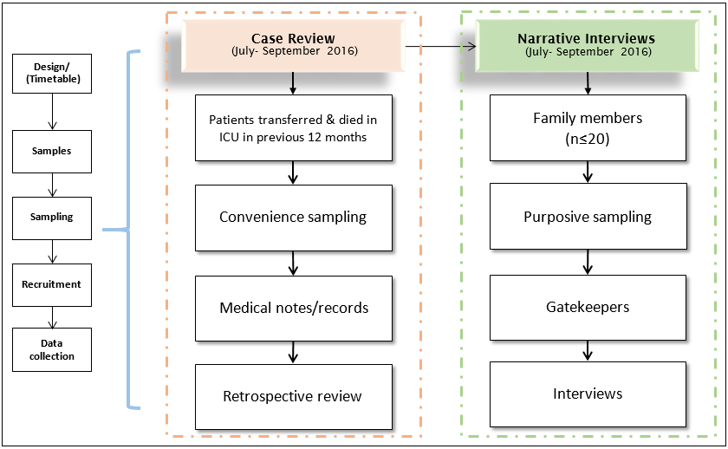
A summary of the design
Figure 1 A summary of the research design

Slide 7
Narrative Inquiry
A focus on stories (Creswell 2011).
Narrative is used to (Elliott 2005; Riessman 2008):
  connect events in sequence
  present meanings of individuals’ experiences
Narrative inquirers’ work (Clandinin and Connelly 2000) :
  being in the field
  from field to field texts
  composing field texts
  from field texts to research texts
  composing research texts

Slide 8
Setting
The ICU: a 22-bed general ICU, in a tertiary hospital located in the southeast of China.
The hospital: 2,500 beds, one of the biggest hospitals in the region.
ICU staff:
  15 doctors and 46 nurses
  six unqualified support workers

Slide 9
Participant recruitment
Inclusion and exclusion criteria
  Inclusion: family members (age≥18) who have a relative (age≥18) in the ICU transferred home to die
  Exclusion: families whose relative survived or was predicted to survive longer than six months post transfer.
Recruitment
  13 July - 13 September 2016
  With the assistance of clinicians working in the ICU

Slide 10
Data collection
Four-stage narrative interview (Jovchelovitch and Bauer 2000) :
Family joint interviews, and telephone interview, were conducted where this was a preference of participants.
All interviews were digitally recorded.
Field notes were written.
Initiation
Questioning phase
Concluding talk
Main narration

Slide 11
Data analysis
Table 2 The data type, methods and product of data analysis
Data | Methods/Tools |  | Product
Narrative | Structural analysis | Combining Gee’s stanza analysis (Gee 1991) and Labov’s framework concerning clause’ function (Labov and Waletzky 1997) | Storyline, structure, the way of making sense
 | Thematic analysis | Coding, case-centred comparison (Miles and Huberman 1994; Mishler 1996) | Category, theme, commonality, uniqueness

Slide 12
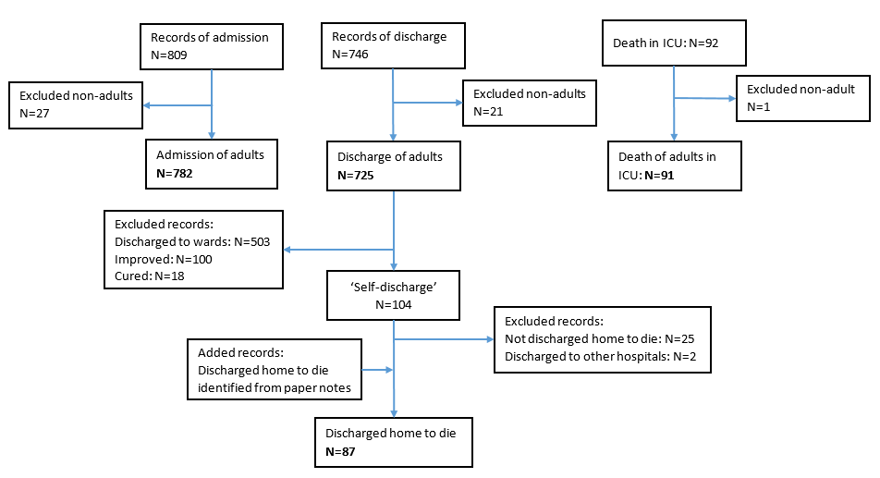
Overview of results: the transfer extent
Transfer: 48. 9%
Figure 2 Data extraction processes of the retrospective case review

Slide 13
Overview of results: participants
Ten interviews:
  seven face-to-face individual interviews
  two face-to-face family joint interviews
  one telephone interview
Thirteen participants contributed to in-depth narratives about ten patient transfers.
Table 3 Participants’ major characteristics
Participants’ age: 28-63 (M: 46) years old
Relationship to the patient | Number (n)
son | 6
daughter | 2
grandson | 2
spouse | 1
cousin | 1
daughter-in-law | 1

Slide 14
Structure of narrative
A master storyline or structure of narrative shared in families’ narratives:
  Families began their story with their views on the treatment and/or death of their relatives. Then they moved to the course of patient’s disease and decisions made regarding treatments and transitions of care that were unfolded in a chronological order, a start of their health history and getting ill, a middle of deterioration, transfer to ICU, ICU stay, transferring home to die, dying at home, and an end of home death. After telling the story, families reflected and made comments on their experiences.
Points of story
Main body: the patient’s trajectory
Comments and reflections
Figure 3 A master storyline shared across narratives

Slide 15
Preliminary categories
Five categories:
  Multiple decisions
  Family as primary decision-makers
  Custom as decisive factor
  Temporality
  Unmet decision-making needs
An overarching category
  Unsupported decision-making

Slide 16
Multiple decisions
There were multiple decisions that family had to make when transferring a relative home to die.
Case 01: Wei, 44, his father was transferred
“He (the ICU doctor) said ‘you think about your own custom and habits, and your family’s decisions.’…he was certainly inclined to mean basically there was no hope. … So later I discussed with my big brother, and also with my family. …around 8pm, we were looking for an ambulance, … So as for this, there was a problem. … so many tubes were inserted. If you pulled them out, …for example he could be able to open his mouth and he could be able to speak. We could hear what he said at the end. It became that we had no conversation.”

Slide 17
Family as primary decision-makers
A variety of individuals were involved in the transfer decision-making; transfer was decided by families predominantly
Case 06: Lili, 52, Jianguo, male, 53, the patient was Lili’s husband, Jianguo’s cousin, who was transferred and died on the journey home
“The ICU doctor asked the family to make the decision. We made the decision to continue the treatment or not. Then we refused (to continue) the treatment. We decided it on our own. The doctor would not stop us if we choose discharge.”

Slide 18
Custom as decisive factor
Tranfer was determinined by customs of home death and funeral rituals
Case 02: Qing, 48, his father was transferred
“In our custom, it’s better that the old people pass away from home. It is just a kind of custom. There is a funeral at home afterwards that relatives can come to. …”
Case 03: Jun, 63, his father was transferred
“Because we are from a villiage. It is the custom. My dad had so many children, sons and daughters. ‘You left him there (to die in the hospital).’ Relatives and friends would scold us.”

Slide 19
Temporality
Transfer decisions were made in an urgent situation that death was imminent but death during transit was not allowed by the customs
Case 04: Hui, 50, Ling, 48, their deceased mother was transferred
“(The ICU staff) kept urging us (to leave). …They kept urging (us to leave). If we were slow we could not leave (take the patient home).”
Case 06: Lili, 52, Jianguo, 53, Lili’s husband, Jianguo’s cousin, was transferred and died on the journey home
“He must be taken home. …You must use his car which was faster. … Others were slow. … His car went directly without stops on the way. Faster.”

Slide 20
Unmet decision-making needs
Families’ decision-making needs were unmet, including information about transport, resources and care needed post-transfer, knowledge and care around intubation and withdrawal, as well as how to judge death.
Case 02: Qing, 48, his father was transferred
“If my dad had exited the ICU ten or twenty days earlier and gone home as they recommended… the doctor at least should have said ‘what equipement you try to prepare in you home.’ If you did not even say this, I don’t know if it was because we did not agree (with the early discharge).”

Slide 21
Conclusion
The decision of transfer appeared to be easily made by Chinese families as it was strongly required by customs but there were a lot of other decisions that they had to make.
It seems that transfer was implemented quite later in China than it was in the west. Some pateints died during transit in China.
A number of decisions had to be made quickly by the families to transfer patients home to die but little support was provided by the HCPs in these processes.
Transfer decision-making required a range of healthcare knowledge but families (who were the primary decision-makers) were non-professionals.

Slide 22
Thank you!
Yanxia Lin
yl8g14@soton.ac.uk
Twitter: @Yeelin00
Faculty of Health Sciences
University of Southampton
UK

