Slide 1



Establishment and verification of
miRNAs expression molecules for
breast cancer and its distant metastasis
Yanhong Gao Associate Professor
Department of Clinical Biochemistry
Chinese PLA General Hospital

Slide 2


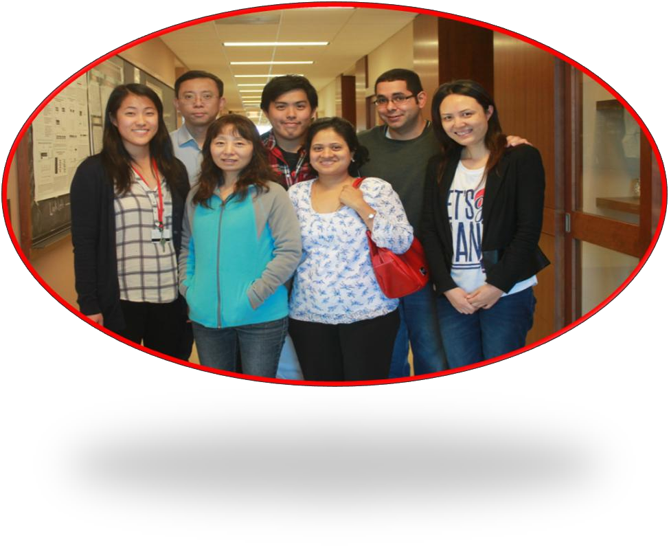
1999.08-2002.06 Academy of Medical Sciences, Master degree
❐ 2002.08-2005.06 Academy of Medical Sciences, Doctor degree
❐ 2005.08-now
Department of Clinical biochemistry,Chinese PLA General hospital,
Associate Chief physician and Associate Professor
❐ 2012.10-2013.10 The cancer institute of New Jersey , Rougters University, vistor scholar

Slide 3


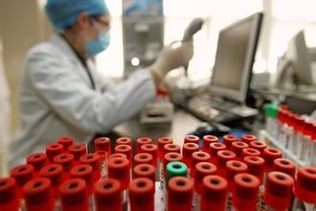
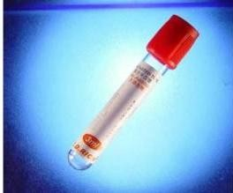
My Work
←Information and automation management of Clinical
Biochemistry ;
←Explorating new tumor biomarkers for diagnoses and
prognostic from blood by advanced technology methods

Slide 4


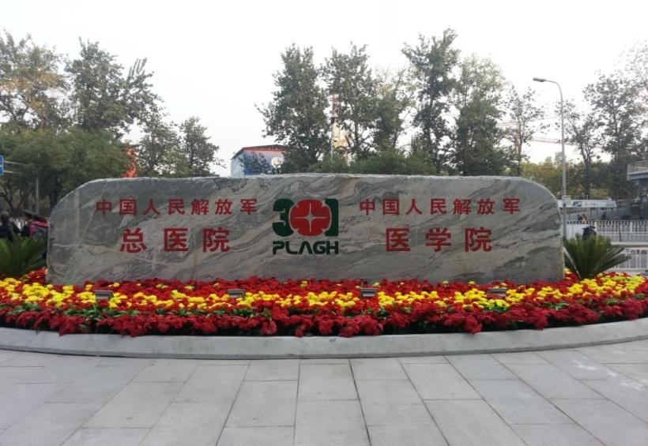
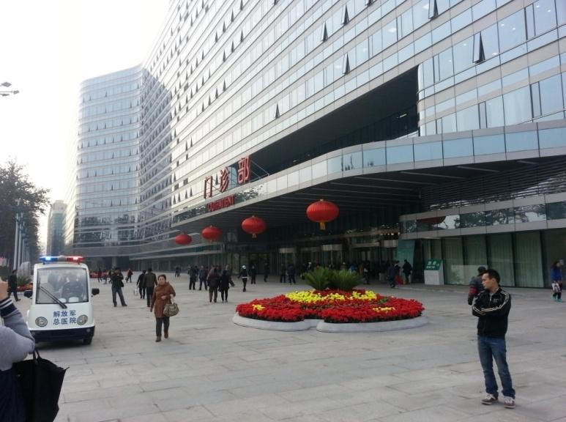


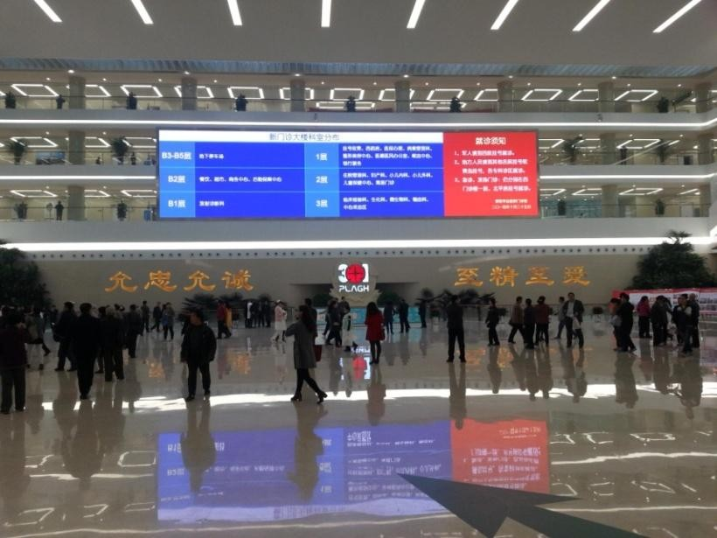
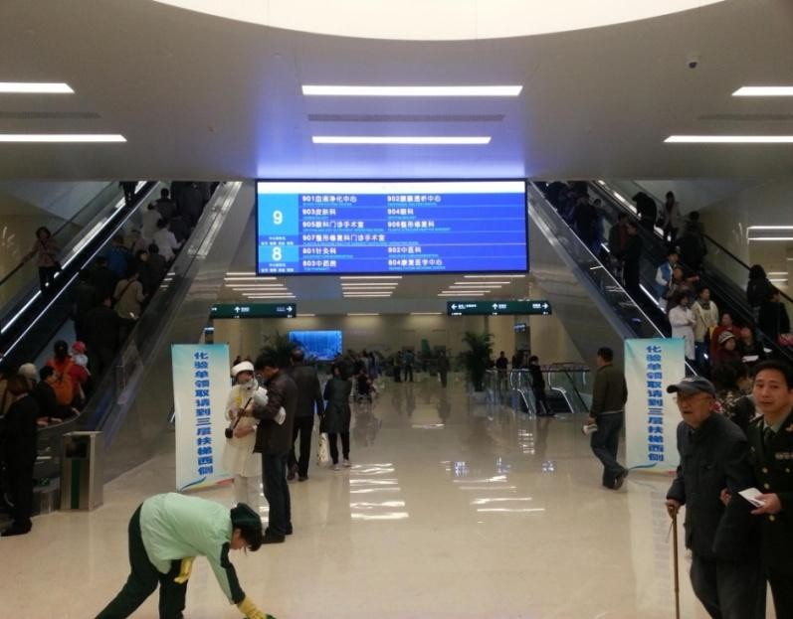
PLA
General
Hospital
2015/11/15

Slide 5
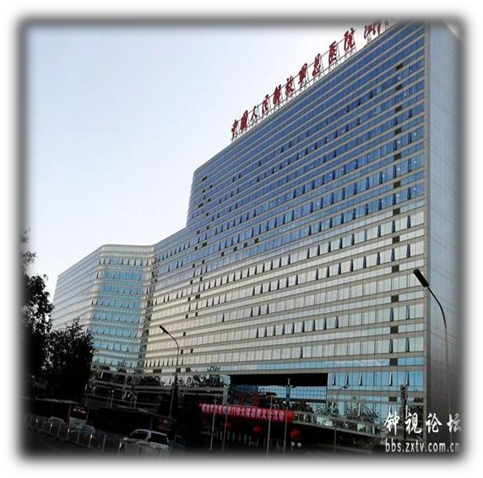

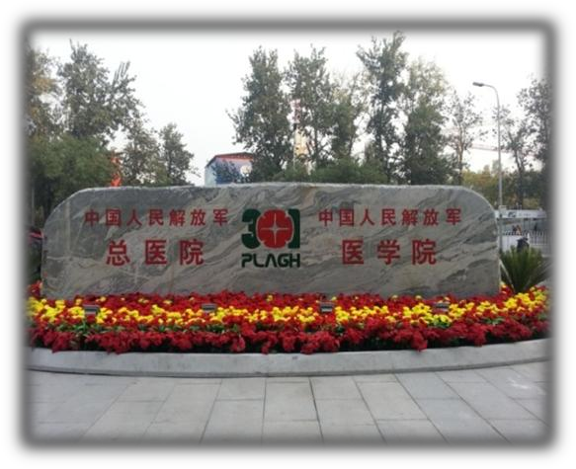
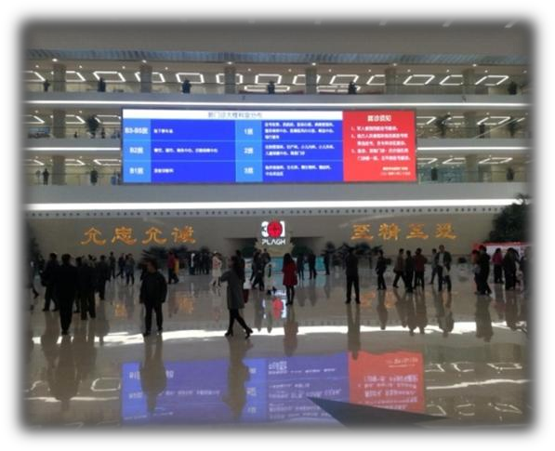
PLA
General
Hospital
✓450000 square
meters
✓15 floors in the ground
✓5 floors underground
✓50000 people

Slide 6


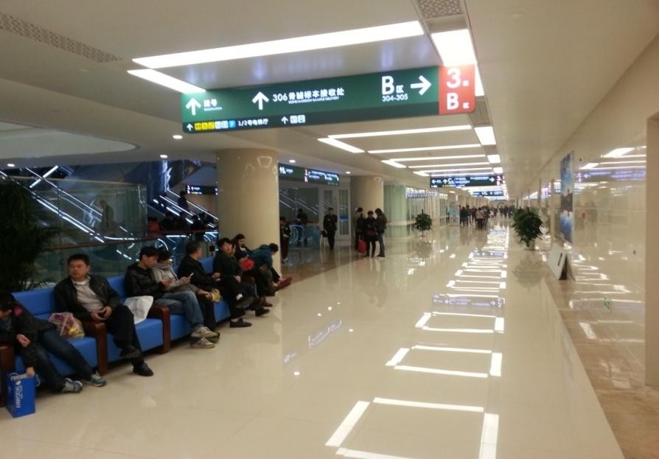
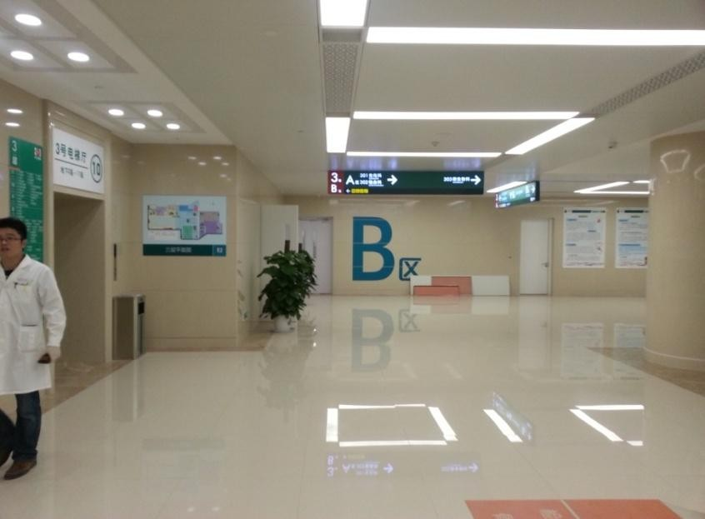


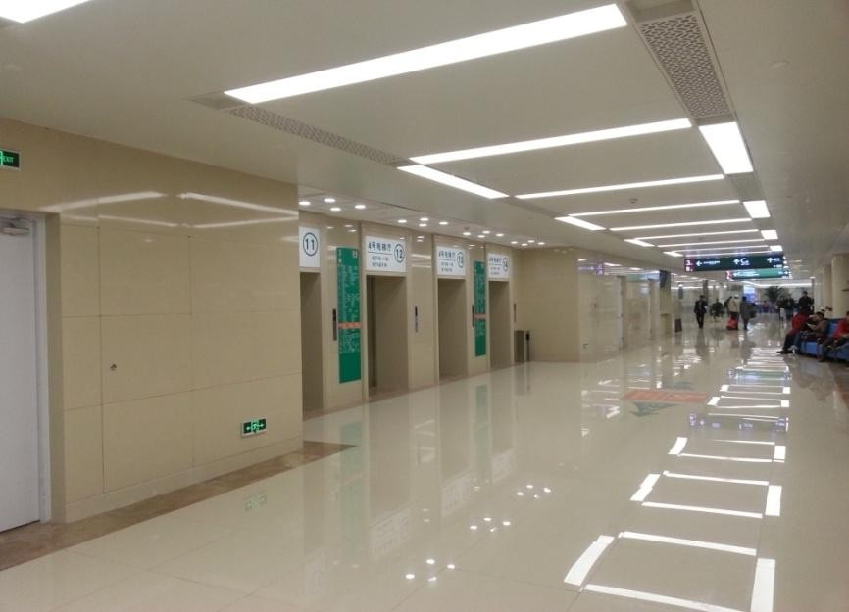
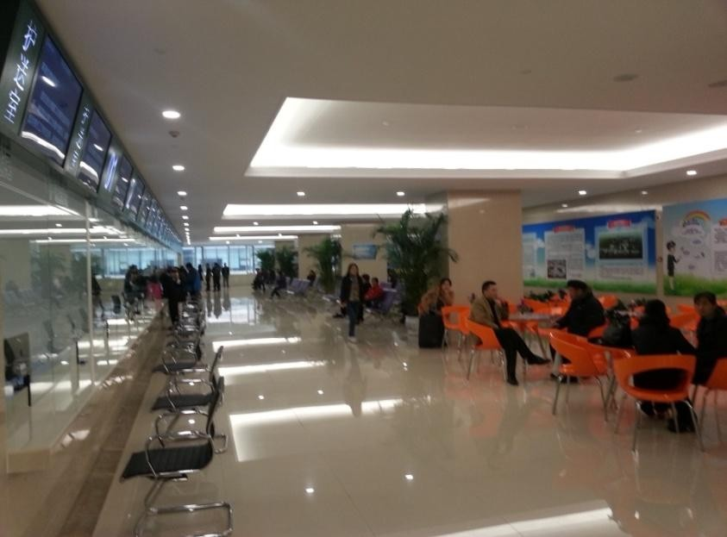
PLA
General
Hospital

Slide 7
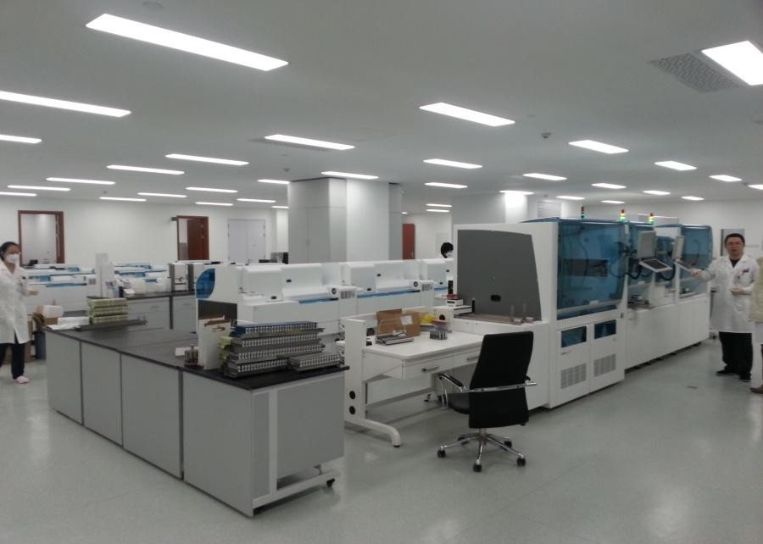
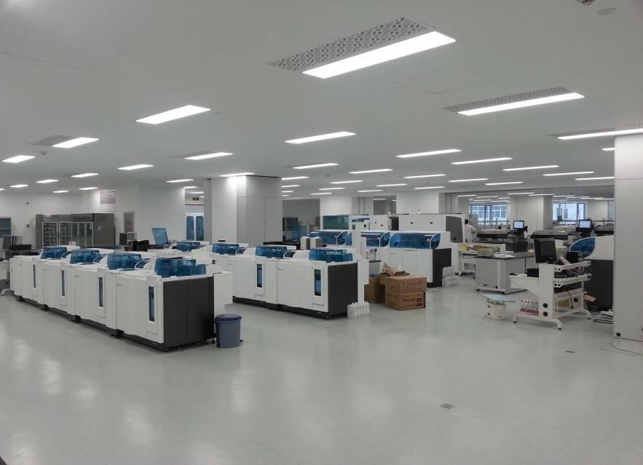
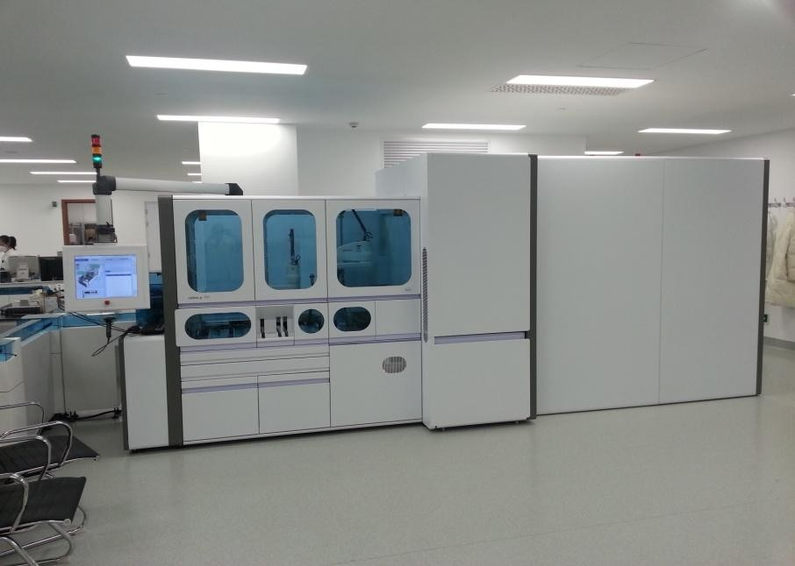
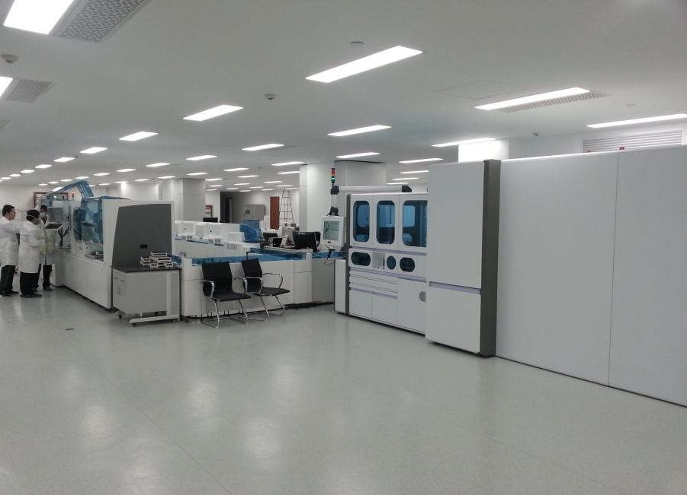
Department
of
Clinical
Biochemistry
2015/11/15

Slide 8
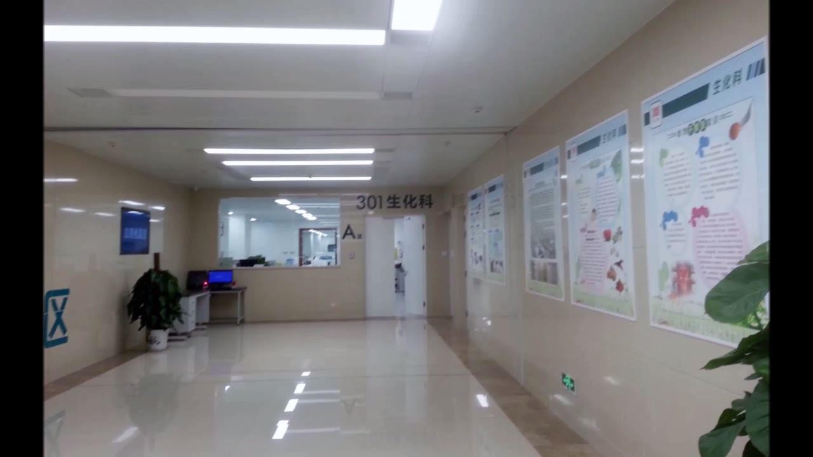

Slide 9





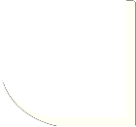






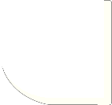













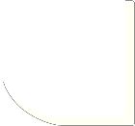

Department
of Clinical Biochemistry
1
Biochemistry Laboratory
2
Immunology Laboratory
3
PCR Laboratory
4
Emergency Laboratory
www.themegallery.com
Company Logo

Slide 10





Biochemical Test
Items
Disease
Items number
112 kinds of biochemical items
Liver Function 12
Renal Function
4
Myocardial function 8
Pancreatic function
2
Lipid examination 12
enough
Tumor marker
12
Diabetes mellitus 5
most
Bone metabolism test
4
Inorganic ion test 8
Nutritional index
8
wide
Blood gas analysis 15
Other items
6
Drug concentration test 3
Molecular biology
examination
2

Slide 11
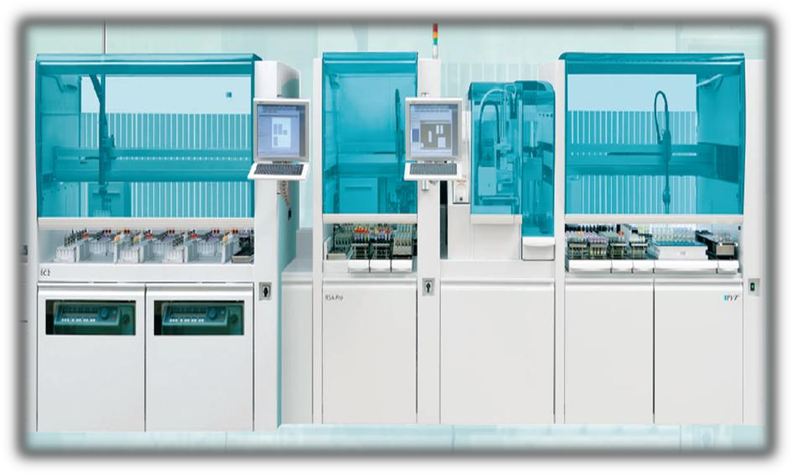
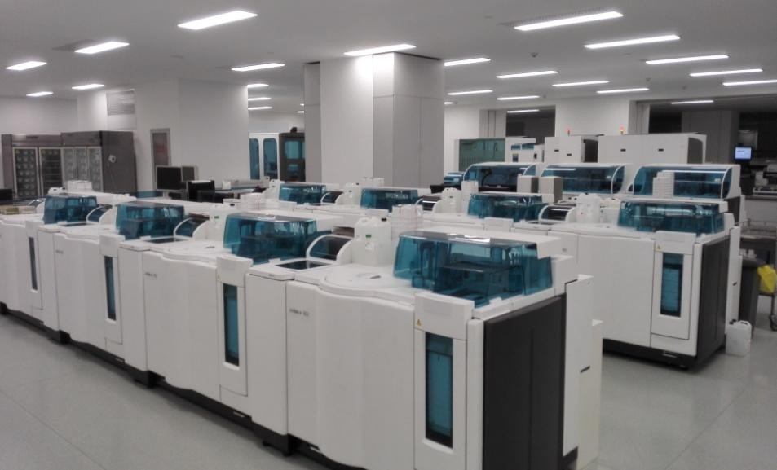
Technology platform
✓Fully automatic sample processing system
✓Biochemical and Immunology analysis system
RSA Pro
Cobas 8000 702/701、e602

Slide 12


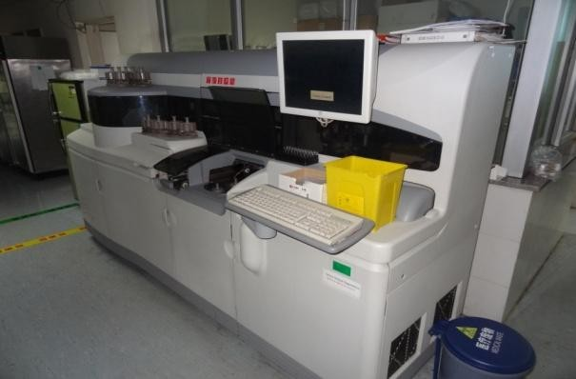
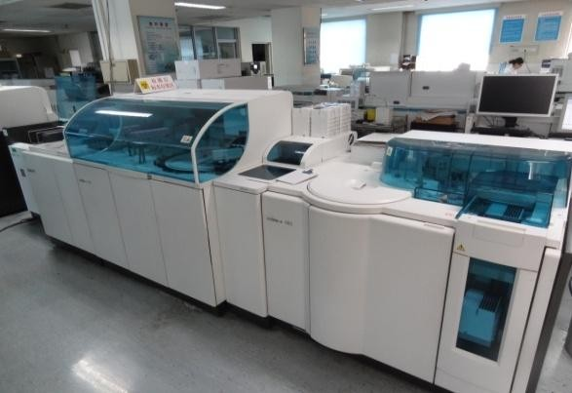
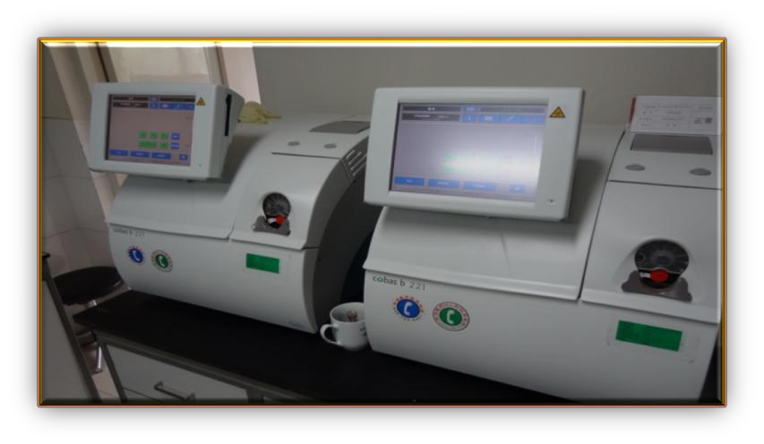

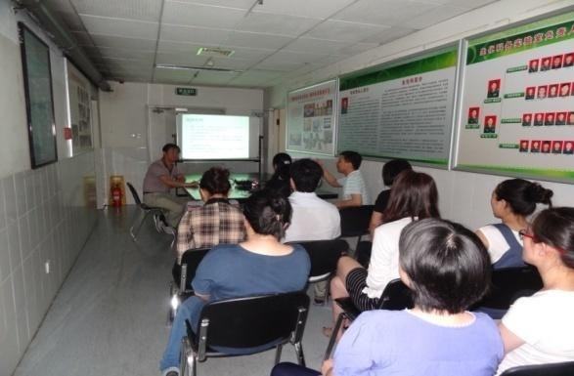
✓ Emergency automatic sample processing analysis system
FS5600
Combas 8000
Emergency Training
Combas 221

Slide 13
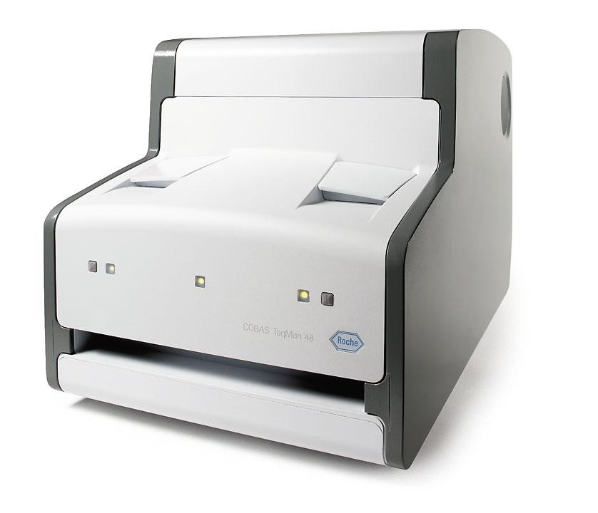
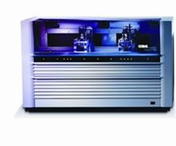
✓PCR analysis system
COBAS® AmpliPrep
COBAS® TaqMan 48 PCR

Slide 14

Biochemical
Test
Data
4000
x 10000
3500
Every
Every
Every
Day：10,0000
Month：300,0000
Year：3600,0000
3000
2500
2000
1500
1000
500
0
day
month
year

Slide 15

What is big data?
How many types of data in medicine ?
How to deal with big data?

Slide 16
Establishment and verification of miRNAs
expression molecules for breast cancer and
its distant metastasis

Slide 17
Breast cancer
➢Breast cancer is one of malignant tumors in women
➢ Distant metastasis is the main death cause for breast
cancer patients
➢The early detection of laboratory is the key for
prevention and therapy breast cancer

Slide 18
➢
MicroRNAs (miRNAs) are a major class of small endogenous
RNA molecules that post-transcriptionally regulate gene expression.
Recent researches demonstrated that miRNAs are closely associated with breast cancer the loss of several tumor suppressor
miRNAs and the overexpression of certain oncogenic miRNAs
have been observed in breast cancers
miRNA can be found in the plasma and serum, and it has some
advantages over other diseases, and has been shown to be
unique in the diagnosis and prognosis of breast cancer, liver
cancer, and other diseases.
➢
➢
➢

Slide 19
➢ When breast cancer and distant metastasis occur, it may be that
the
main (is)
the
release
of
endogenous
miRNAs
into
the
peripheral blood circulation.
➢ It is very important to explore
the breast cancer and its distant
metastasis
specific
miRNAs
for screening 、 diagnosis
cancer.
and
prognosis assessment of breast

Slide 20













Methods
group
control
mammary
gland
hyperplasia
breast cancer
(lymph node
metastasis)
breast cancer
metastasis)
（no lymph node
Agilent miRNA microarray hybridization
GX software calculation of gene expression differences and statistically significant P values

Slide 21
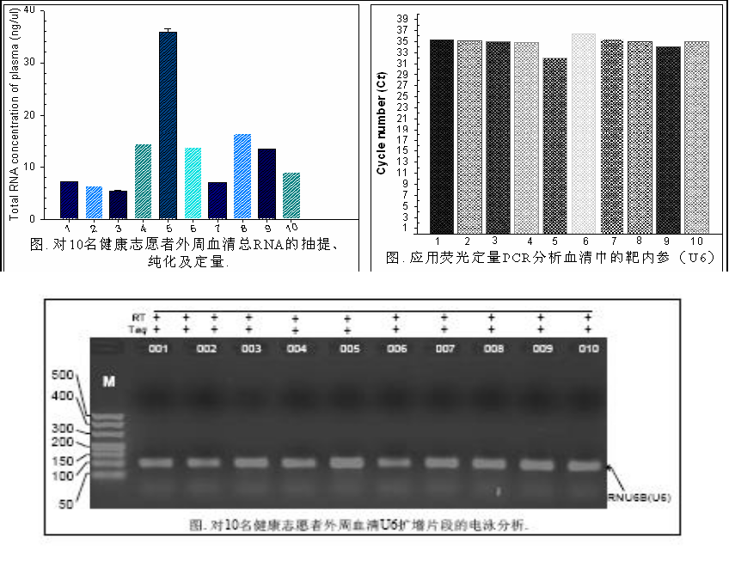
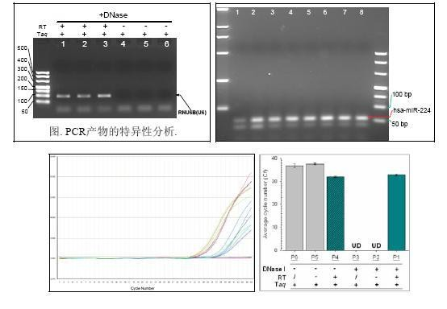
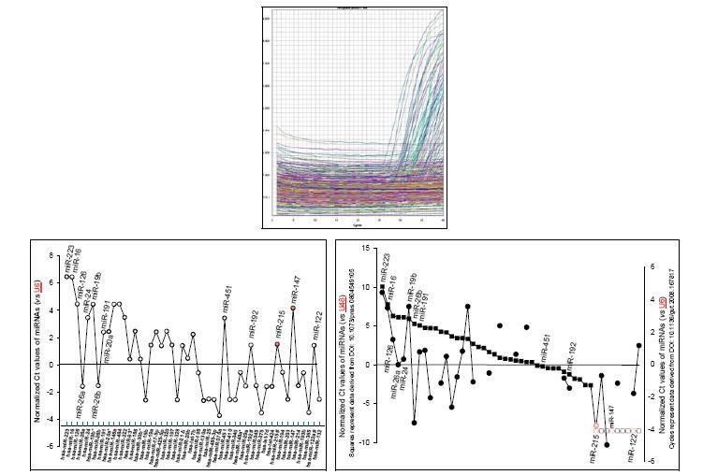
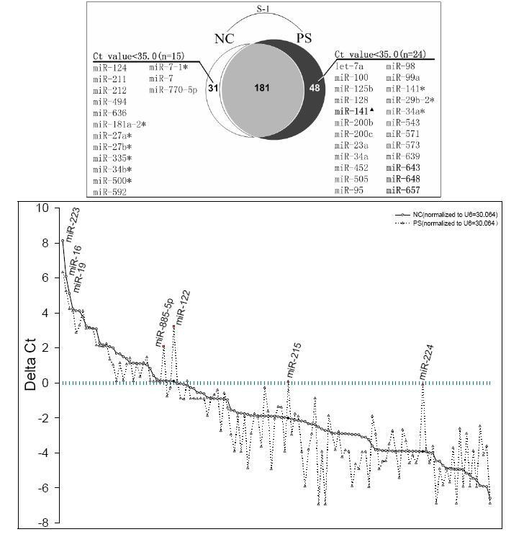
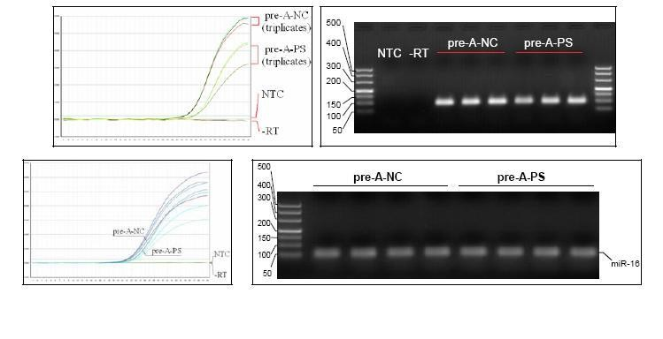
Research Work

Slide 22

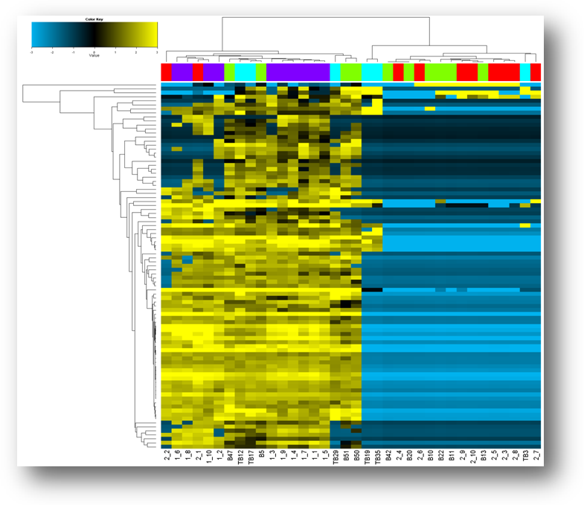
Results
the normal group was up-regulated,
MiRNAs molecules
of
while
miRNAs
for
group
B1,
B2
and B3 were down-regulated.
Normal control group (C group): purple;
mammary gland hyperplasia group(group B1): red;
breast lymph node metastasis (group B2): green;
breast lymph node metastasis group (group B3): blue. horizontal coordinates: different colors on behalf of different groups.
Vertical coordinates: representing the miRNA molecule.
Figure 1. MiRNA Agilent microarray in normal control group, breast hyperplasia group and breast cancer group
(yellow shows expressed up, blue shows down regulated).

Slide 23
B1 vs C Result
systemati
p (Corr)
p
FC (abs)
Regulatio
2_1:gTota
2_2:gTota
2_3:gTota
2_4:gTota
2_5:gTota
2_6:gTota
2_7:gTota
2_8:gTota
hsa-miR-4
0.005474
0.004368
26.14643
up
6.68754
0.1
9.90835
0.1
5.04728
13.904
0.1
6.70042
hsa-miR-1
6.39E-05
2.07E-05
8.640338
down
25.5646
9.7323
0.1
0.1
0.1
0.1
0.1
0.1
hsa-miR-1
6E-05
1.82E-05
11.63512
down
70.8152
18.6452
0.1
0.1
0.1
0.1
0.1
0.1
hsa-miR-1
0.002271
0.001675
4.565795
down
15.4405
0.1
0.1
0.1
0.1
0.1
0.1
0.1
hsa-miR-1
8.2E-05
3.83E-05
8.417439
down
28.7709
0.1
0.1
0.1
0.1
0.1
0.1
0.1
hsa-miR-1
0.001669
0.001146
5.292149
down
19.69378
4.18797
0.1
0.1
0.1
0.1
0.1
0.1
hsa-miR-1
7.56E-05
3.28E-05
18.68372
down
174.1619
45.7324
0.1
0.1
0.1
0.1
0.1
0.1
hsa-miR-1
0.041307
0.037151
2.501524
down
10.7378
0.1
0.1
0.1
0.1
0.1
0.1
0.1
hsa-miR-1
0.001687
0.001176
4.541967
down
11.47176
0.1
0.1
0.1
0.1
0.1
0.1
0.1
hsa-miR-1
6.22E-05
1.95E-05
13.74072
down
71.6221
29.94087
0.1
0.1
0.1
0.1
0.1
0.1
hsa-miR-1
5.87E-05
1.51E-05
4.974174
down
12.9534
0.1
0.1
0.1
0.1
0.1
0.1
0.1
hsa-miR-1
0.049804
0.045779
2.637006
down
0.1
4.30819
0.1
0.1
0.1
0.1
0.1
0.1
hsa-miR-1
0.004189
0.0033
4.221173
down
20.37246
0.1
0.1
0.1
0.1
0.1
0.1
0.1
hsa-miR-1
0.000479
0.000305
4.320887
down
13.1983
0.1
0.1
0.1
0.1
0.1
0.1
0.1
hsa-miR-1
6.44E-05
2.15E-05
14.14081
down
89.45689
32.8551
0.1
0.1
0.1
0.1
0.1
0.1
hsa-miR-1
7.43E-05
2.79E-05
8.54335
down
30.3739
11.5405
0.1
0.1
0.1
0.1
0.1
0.1
hsa-miR-2
0.001281
0.000854
4.102619
down
0.1
0.1
0.1
0.1
0.1
0.1
0.1
0.1
hsa-miR-2
5.87E-05
1.52E-05
27.61298
down
236.4534
67.1646
0.1
0.1
0.1
0.1
0.1
0.1
hsa-miR-3
1.46E-06
3.04E-08
9.911002
down
17.65581
0.1
0.1
0.1
0.1
0.1
0.1
0.1
hsa-miR-3
7.05E-05
2.42E-05
8.10563
down
25.2455
9.893749
0.1
0.1
0.1
0.1
0.1
0.1
hsa-miR-3
0.008162
0.006596
3.246993
down
9.90468
4.87377
0.1
0.1
0.1
0.1
0.1
0.1
hsa-miR-3
0.002556
0.001936
2.744788
down
0.1
0.1
0.1
0.1
0.1
0.1
0.1
0.1
hsa-miR-3
8.2E-05
3.88E-05
4.66605
down
3.90894
0.1
0.1
0.1
0.1
0.1
0.1
0.1
hsa-miR-3
1.46E-06
5.77E-08
8.196573
down
12.4654
0.1
0.1
0.1
0.1
0.1
0.1
0.1

Slide 24
B2 vs C Result
systemati
p (Corr)
p
FC (abs)
Regulatio
B10:gTota
B11:gTota
B13:gTota
B20:gTota
B22:gTota
B42:gTota
B47:gTota
B5:gTotal
hsa-miR-4
0.017252
0.010822
13.62833
up
7.7928
14.0879
7.41923
0.1
10.0489
0.1
14.9427
16.5205
hsa-miR-1
0.007408
0.003926
4.796492
down
0.1
0.1
0.1
0.1
0.1
0.1
79.0043
35.1783
hsa-miR-1
0.004002
0.001641
6.43993
down
0.1
0.1
0.1
0.1
0.1
0.1
144.6712
79.6578
hsa-miR-1
0.000956
0.000152
6.611596
down
0.1
0.1
0.1
0.1
0.1
0.1
24.0463
19.71815
hsa-miR-1
0.000956
0.000131
6.183637
down
0.1
0.1
0.1
0.1
0.1
0.1
47.4756
12.9018
hsa-miR-1
0.002333
0.000747
10.31755
down
0.1
0.1
0.1
0.1
0.1
0.1
469.758
101.3764
hsa-miR-1
0.011572
0.006596
6.294055
down
0.1
0.1
0.1
0.1
0.1
0.1
168.1858
144.7519
hsa-miR-1
0.000253
1.52E-05
4.746404
down
0.1
0.1
0.1
0.1
0.1
0.1
31.953
6.70616
hsa-miR-1
0.004025
0.001774
3.200518
down
0.1
0.1
0.1
0.1
0.1
0.1
17.8155
9.71535
hsa-miR-1
0.001711
0.000391
8.509321
down
0.1
0.1
0.1
0.1
0.1
0.1
83.0411
68.5585
hsa-miR-1
0.016072
0.009482
4.438121
down
0.1
0.1
0.1
0.1
0.1
0.1
244.442
33.1442
hsa-miR-2
0.001893
0.000454
14.1815
down
0.1
0.1
0.1
0.1
0.1
0.1
298.7388
205.5406
hsa-miR-3
0.013091
0.007593
4.05793
down
0.1
0.1
0.1
0.1
0.1
0.1
48.6381
42.6363
hsa-miR-3
0.004644
0.002183
4.819182
down
0.1
0.1
0.1
0.1
0.1
0.1
58.7436
30.2987
hsa-miR-3
0.000184
7.86E-06
4.540431
down
0.1
0.1
0.1
0.1
0.1
0.1
11.305
5.48684
hsa-miR-3
0.00346
0.001246
4.173489
down
0.1
0.1
0.1
0.1
0.1
0.1
49.9385
17.098
hsa-miR-3
0.001711
0.000394
12.25385
down
0.1
0.1
0.1
0.1
0.1
0.1
214.4448
156.743
hsa-miR-3
0.009025
0.004873
6.648063
down
0.1
0.1
0.1
0.1
0.1
0.1
231.504
103.9133
hsa-miR-3
0.003995
0.001581
14.23455
down
0.1
0.1
0.1
0.1
0.1
0.1
576.401
375.0161
hsa-miR-3
0.000138
4.15E-06
8.479019
down
0.1
0.1
0.1
0.1
0.1
0.1
31.1353
21.41802
hsa-miR-3
0.002059
0.000618
6.924864
down
0.1
0.1
0.1
0.1
0.1
0.1
79.4381
39.3588
hsa-miR-3
0.033138
0.022534
2.501641
down
0.1
0.1
0.1
0.1
0.1
0.1
11.9122
7.69866
hsa-miR-3
0.000548
5.48E-05
65.51481
down
0.1
0.1
0.1
0.1
0.1
0.1
1404.801
623.201
hsa-miR-4
0.005541
0.002881
4.019872
down
0.1
0.1
0.1
0.1
0.1
0.1
57.3831
15.79635
hsa-miR-4
0.033317
0.023322
13.43571
down
0.1
0.1
0.1
0.1
0.1
0.1
2347.79
987.655

Slide 25
B3 vs C Result
systemati
p (Corr)
p
FC (abs)
Regulatio
TB19:gTo
TB3:gTota
TB35:gTo
TB29:gTo
TB12:gTo
TB17:gTo
1_1:gTota
1_2:gTota
hsa-miR-1
0.019946
0.005843
12.14919
up
6.91169
4.33997
27.21457
4.26795
4.22739
20.18547
6.15812
0.1
hsa-miR-4
0.01595
0.0029
30.29061
up
42.7637
25.9244
137.0537
23.37182
39.2149
121.6528
27.79633
0.1
hsa-miR-1
0.025393
0.010773
4.736928
down
0.1
0.1
0.1
13.653
46.8799
99.6409
88.9333
21.44074
hsa-miR-1
0.009868
0.000884
6.69974
down
0.1
0.1
0.1
0.1
9.85215
15.78086
46.7113
0.1
hsa-miR-1
0.019946
0.005123
4.765573
down
0.1
0.1
0.1
0.1
15.16847
16.59695
25.9361
0.1
hsa-miR-1
0.076811
0.041897
4.243626
down
0.1
0.1
0.1
62.93712
88.0993
212.566
88.78286
62.97969
hsa-miR-1
0.003645
0.000117
4.35054
down
0.1
0.1
0.1
0.1
8.08551
9.81403
11.8505
4.76069
hsa-miR-1
0.027798
0.012355
3.230964
down
0.1
0.1
0.1
0.1
10.7816
13.5745
15.7049
4.64138
hsa-miR-1
0.01595
0.00277
6.430509
down
0.1
0.1
0.1
12.5822
45.2451
74.9702
146.8405
31.204
hsa-miR-1
0.039872
0.019503
3.674612
down
0.1
0.1
0.1
13.077
42.0341
35.0842
40.486
19.19611
hsa-miR-2
0.01595
0.002709
10.14579
down
0.1
0.1
0.1
33.93522
114.4881
191.7858
531.0196
91.3131
hsa-miR-3
0.024507
0.009902
3.659262
down
0.1
0.1
0.1
4.59719
16.97233
50.3216
30.8952
4.83868
hsa-miR-3
0.036868
0.017503
3.595808
down
0.1
0.1
0.1
13.02498
30.2922
30.552
38.8802
13.04262
hsa-miR-3
0.028949
0.013159
2.970878
down
0.1
0.1
0.1
4.31563
6.36581
5.41472
7.39285
4.74524
hsa-miR-3
0.039872
0.019735
3.069135
down
0.1
0.1
0.1
6.18031
20.91097
23.05389
30.07172
6.8092
hsa-miR-3
0.016021
0.003168
8.614912
down
0.1
0.1
0.1
38.3901
93.3226
140.9644
413.082
69.3615
hsa-miR-3
0.047009
0.024692
4.733173
down
0.1
0.1
0.1
44.0788
88.7561
136.6941
103.7526
64.1256
hsa-miR-3
0.025393
0.010729
9.154843
down
0.1
0.1
0.1
103.266
263.3799
474.61
620.577
174.44
hsa-miR-3
0.009868
0.00092
5.070235
down
0.1
0.1
0.1
4.88026
11.5674
13.20428
26.4383
13.4884
hsa-miR-3
0.016021
0.003244
5.447403
down
0.1
0.1
0.1
9.32947
28.6139
54.3122
96.9247
21.83537
hsa-miR-3
0.068375
0.036605
2.781604
down
0.1
0.1
0.1
0.1
5.49121
7.42877
17.5855
0.1
hsa-miR-3
0.0231
0.008867
7.534578
down
22.33667
0.1
14.47875
163.341
496.347
744.035
1622.385
329.048
hsa-miR-4
0.042174
0.0213
3.522117
down
0.1
0.1
0.1
0.1
14.60298
24.6221
20.8641
4.53669
hsa-miR-4
0.019946
0.005193
3.710709
down
0.1
0.1
0.1
0.1
14.14277
24.47792
13.87402
5.30308
hsa-miR-4
0.003645
0.000147
7.175142
down
0.1
0.1
0.1
6.00936
12.98
21.51
98.12653
22.1532

Slide 26
B2 vs B1 Result
systemati
p (Corr)
p
FC (abs)
Regulatio
2_1:gTota
2_2:gTota
2_3:gTota
2_4:gTota
2_5:gTota
2_6:gTota
2_7:gTota
2_8:gTota
hsa-miR-4
0.785551
0.421068
2.975647
down
170.9063
63.1946
3.70549
0.1
12.8041
0.1
11.63904
3.63003
hsa-miR-4
0.785551
0.698268
1.68006
up
4.88473
0.1
0.1
0.1
10.74289
0.1
16.41067
0.1
hsa-miR-4
0.785551
0.623846
1.918535
down
6.68754
0.1
9.90835
0.1
5.04728
13.904
0.1
6.70042
hsa-miR-6
0.785551
0.465765
3.430115
up
1722.185
627.527
0.1
0.1
0.1
0.1
7.03332
2.55856

Slide 27
B3 vs B1
systemati
p (Corr)
p
FC (abs)
Regulatio
2_1:gTota
2_2:gTota
2_3:gTota
2_4:gTota
2_5:gTota
2_6:gTota
2_7:gTota
2_8:gTota
hsa-miR-1
0.029593
0.007398
8.160369
up
25.5646
9.7323
0.1
0.1
0.1
0.1
0.1
0.1
hsa-miR-1
0.049617
0.03101
3.525788
up
15.4405
0.1
0.1
0.1
0.1
0.1
0.1
0.1
hsa-miR-1
0.034955
0.017909
9.375454
up
174.1619
45.7324
0.1
0.1
0.1
0.1
0.1
0.1
hsa-miR-1
0.001725
7.19E-05
26.85538
up
0.1
0.1
0.1
0.1
0.1
0.1
0.1
0.1
hsa-miR-3
0.069905
0.046603
16.03892
up
886.036
200.6418
0.1
0.1
0.1
0.1
0.1
0.1
hsa-miR-4
0.03054
0.008958
40.99584
up
386.233
198.8679
0.1
0.1
0.1
0.1
0.1
0.1
hsa-miR-4
0.017058
0.002132
44.34193
up
686.438
173.5183
0.1
0.1
0.1
0.1
0.1
0.1
hsa-miR-4
0.03054
0.01018
3.808936
up
0.1
0.1
0.1
0.1
0.1
0.1
0.1
0.1
hsa-miR-6
0.005291
0.000441
10.87901
up
8.62538
0.1
0.1
0.1
0.1
0.1
0.1
0.1
hsa-miR-6
0.034955
0.018521
12.65836
up
377.956
91.9273
0.1
0.1
0.1
0.1
0.1
0.1
hsa-miR-6
0.034955
0.018934
141.9156
up
3022.75
1347.944
0.1
0.1
0.1
0.1
4.22773
0.1
hsa-miR-6
0.034955
0.017904
56.43684
up
1722.185
627.527
0.1
0.1
0.1
0.1
7.03332
2.55856
hsa-miR-6
0.022721
0.004733
10.4385
up
30.2914
17.51701
0.1
0.1
0.1
0.1
0.1
0.1
hsa-miR-4
0.034955
0.01418
35.86911
down
6.68754
0.1
9.90835
0.1
5.04728
13.904
0.1
6.70042
hsa-miR-4
1
0.977396
1.040137
up
170.9063
63.1946
3.70549
0.1
12.8041
0.1
11.63904
3.63003
hsa-miR-4
0.074397
0.052698
17.36868
up
394.148
184.3179
0.1
0.1
0.1
0.1
12.53579
0.1
hsa-miR-4
0.150582
0.119211
11.59136
up
4.88473
0.1
0.1
0.1
10.74289
0.1
16.41067
0.1
hsa-miR-6
0.081947
0.06146
3.835599
up
18.13138
3.95915
0.1
0.1
0.1
0.1
0.1
0.1

Slide 28
B3 vs B2
systemati
p (Corr)
p
FC (abs)
Regulatio
B10:gTota
B11:gTota
B13:gTota
B20:gTota
B22:gTota
B42:gTota
B47:gTota
B5:gTotal
hsa-miR-1
0.142409
0.017089
10.46659
up
0.1
0.1
0.1
0.1
0.1
0.1
0.1
32.1095
hsa-miR-4
0.075617
0.006049
23.54545
up
0.1
0.1
0.1
0.1
0.1
0.1
1296.87
390.146
hsa-miR-6
0.142898
0.034074
5.043952
up
0.1
0.1
0.1
0.1
0.1
0.1
34.5324
17.25892
hsa-miR-4
0.142898
0.02505
18.69609
down
7.7928
14.0879
7.41923
0.1
10.0489
0.1
14.9427
16.5205
hsa-miR-1
0.23233
0.069544
4.530047
up
0.1
0.1
0.1
0.1
0.1
0.1
79.0043
35.1783
hsa-miR-1
0.474076
0.376139
1.810751
up
0.1
0.1
0.1
0.1
0.1
0.1
50.3633
15.5121
hsa-miR-1
0.23233
0.083242
5.177325
up
0.1
0.1
0.1
0.1
0.1
0.1
469.758
101.3764
hsa-miR-3
0.23233
0.091479
8.695217
up
0.1
0.1
0.1
0.1
0.1
0.1
1404.801
623.201
hsa-miR-4
0.290268
0.174161
9.46192
up
0.1
0.1
0.1
0.1
0.1
0.1
2347.79
987.655
hsa-miR-4
0.570031
0.478826
3.09508
up
0.1
0.1
3.01838
0.1
8.40435
0.1
650.215
985.928
hsa-miR-4
0.281614
0.155817
2.2946
up
0.1
0.1
0.1
0.1
0.1
0.1
4.51179
16.159
hsa-miR-4
0.4029
0.257856
5.630188
up
0.1
0.1
0.1
0.1
3.05451
0.1
2879.969
691.644
hsa-miR-4
0.281614
0.157704
6.899373
up
0.1
6.31799
2.32086
0.1
22.28651
0.1
8.44317
197.7143
hsa-miR-6
0.23233
0.100969
6.052623
up
0.1
0.1
0.1
0.1
0.1
0.1
549.115
332.047
hsa-miR-6
0.258928
0.124286
33.70969
up
0.1
0.1
0.1
0.1
5.48755
0.1
5845.16
4301.58
hsa-miR-6
0.23233
0.102225
16.45334
up
0.1
7.82411
5.11533
0.1
9.03554
0.1
4515.45
2483.53
hsa-miR-6
0.474076
0.346191
2.779317
up
8.347981
0.1
0.1
0.1
0.1
0.1
157.7886
60.2531
hsa-miR-6
0.404374
0.274974
2.301519
up
0.1
0.1
0.1
0.1
0.1
0.1
54.5557
28.5993

Slide 29
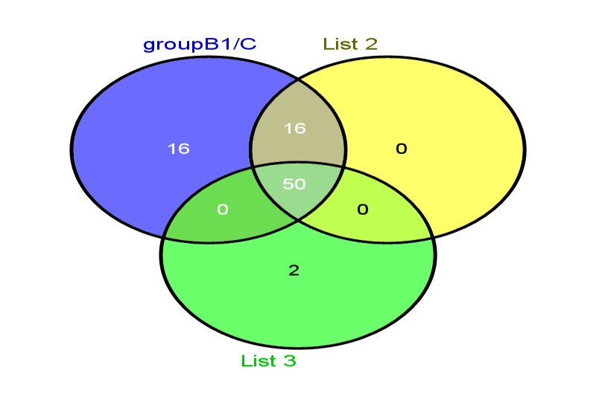
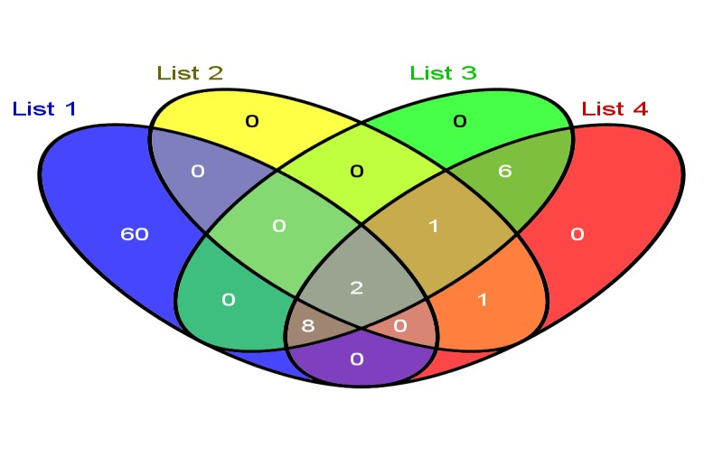
The common expression of difference
miRNA molecules among the B1/C,
B2/C, B3/C three groups were 50
Together with B3/B1, B3/B2, B2/B1, the
common expression of the difference miRNA
molecules is hsa-miR-6090, hsa-miR-451a

Slide 30
■ The common expression of miRNA molecules, which
was obtained by using the appropriate tool software, was
hsa-miR-6090, hsa-miR-451a.
http://bioinfogp.cnb.csic.es/tools/venny/

Slide 31


■ hsa-miR-6090, hsa-miR-451a molecules in the normal control
group,
group,
mammary gland hyperplasia, breast lymph node metastasis
breast
lymph
node
metastasis
group
were
expressed.
miRNA
B1/C
B2/C
B3/C
B2/B1
B3/B1
B3/B2
hsa-miR-
up
down
down
up
up
up
6090
hsa-miR-
up
up
up
up
up
up
451a

Slide 32
Results
The results indicated that the expression of hsa-miR-6090 was down regulated in the normal control group;
The expression of hsa-miR-6090 in mammary gland hyperplasia group was lower than that in breast cancer;
The expression of hsa-miR-6090 in breast cancer lymph node metastasis was lower than that in breast cancer.
For hsa-miR-451a, the expression of hsa-miR-415a molecules in the other groups increased significantly compared with the normal control group.
The expression of hsa-miR-451a in breast cancer tissues was up-regulated, and the expression of hsa-miR-451a in breast cancer lymph node metastasis was higher than that in breast cancer.
❐
❐
❐
❐
❐

Slide 33
Conclusion
❐ Therefore, we speculate that hsa-miR-451a
play an important role in the development breast cancer
and hsa-miR-6090
and metastasis of
❐ The
Further validation work will continue

Slide 34


THANK YOU!

