Slide 1


Fabrication and characterization of Magnesium/Hydroxyapatite (HA) nanocomposites for biomedical applications
Yan Huang
Institute of Materials and Manufacturing
Brunel University London, UK
Thanks to:
EPSRC and The Royal Society for financial support
Dr Mehdi Razavi, Mr Junyi Li, Dr Li Zhou and Dr Mingxu Xia for collecting experimental results

Slide 2
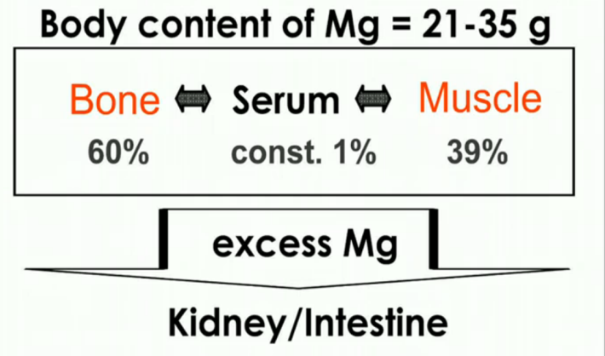
Mg for implantation
  Biocompatible
  Bioresorbable
  Mechanically compatible
  Promising candidate for degradable orthopaedic and cardiovascular implants
  – less complications and no revisit surgeries.
Mg = Mg²⁺ + 2e (Anodic reaction)
2H₂O + 2e²⁻ = H₂ + 2OH⁻ (Cathodic reaction)
Mg²⁺+ 2H₂O = Mg(OH)₂ + H₂↑
(Total reaction)
↓
MgCl₂ → dissolve
In body fluid:

Slide 3
Problems
    In vivo corrosion too fast:
      Loss of integrity before healing completion
      Harmful hydrogen accumulation
    Over dosage of potentially toxic alloying elements
    Inadequate toughness in pure state.

Slide 4
Degradation control - why HA?
  Hydroxyapatite (HA) Ca₁₀(PO4)6(OH)₂ is a natural bone constituent.
  In physiological environment, excessive OH⁻ due to Mg(OH)₂ dissolution can result in reaction:
  10Ca²⁺+ 6PO4³⁻ + 2OH⁻= Ca₁₀(PO4)6(OH)₂
    HA becomes more stable with increasing pH value (>>7.4)
  HA- non-resorbable
  →forming a protection barrier on Mg surface

Slide 5
Degradation control - why HA?
    Natural HA flakes are coarse and porous; yet pH ~7.4 should be maintained in surgeries and HA formation is practically limited – insufficient and ineffective in degradation control
    Adding nano-HA has several benefits:
      Promote uniform HA nucleation and the formation of an evenly distributed HA layer in the Mg surface
      Intensify the protection layer by the gradual deposition of the HA particles upon corrosion
      Strengthening the material
    Alloying and coating are not sufficient.

Slide 6
Technical challenge
A key problem for particulate MMC fabrication is particle agglomeration, resulting in poor bonding, heterogeneous microstructures and inadequate properties.
Powder metallurgy cannot overcome the problem.

Slide 7
Present work
Fabrication - a novel approach for fabricating biodegradable Mg/HA nanocomposites:
  High shear solidification + ECAE/extrusion
Characterization – microstructure, mechanical and electrochemical properties, in vitro performance.

Slide 8
Experiments -material
Matrix alloy:
  Commercial pure Mg-3Zn-0.5Zr
  High purity Mg-2Zn-0.1Mn-0.5Ca
  High purity Mg-2Zn-0.2Mn-0.5Ca
  High purity Mg-4Zn-0.2Mn-0.5Ca
  High purity Mg-0.5Ca
Reinforcing HA particles:
  Spherical, 20-50nm in diameter
  Needle, φ20×100nm

Slide 9
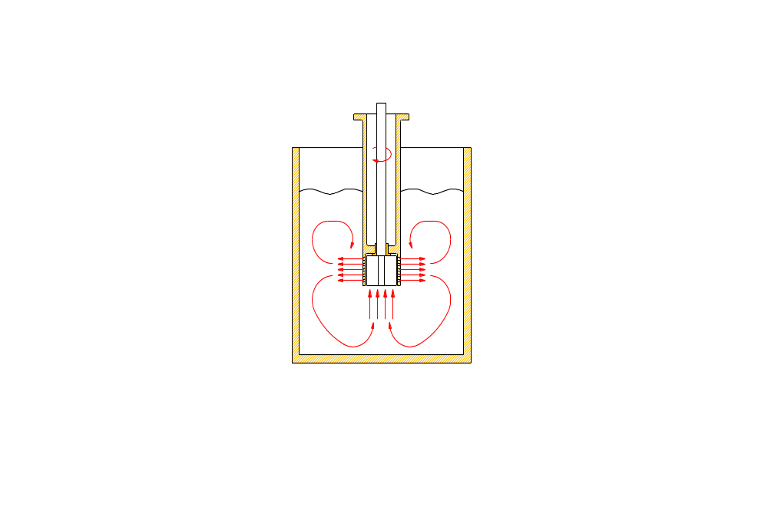
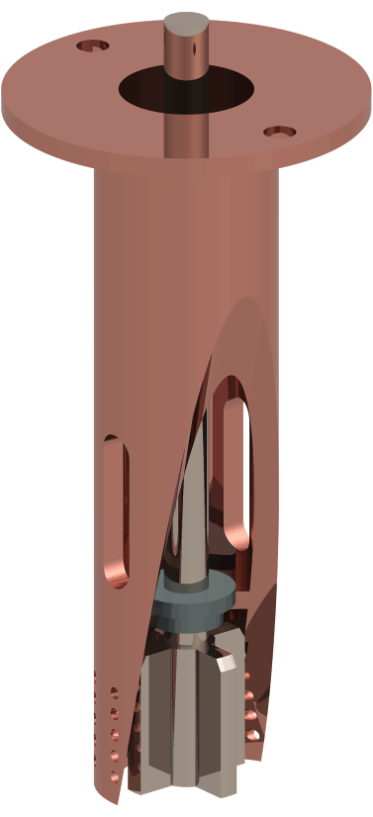
Experiments -fabrication
Fabrication tech 1: high shear melt treatment
Rotor-stator mechanism
Rotor
Conditions:
~10k rpm, 660-680ºC, 5-10min
Stator
Melt
Steel
crucible

Slide 10
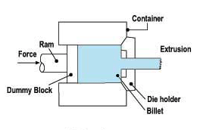
Experiments -fabrication
Fabrication tech 2: extrusion
Conditions:
350ºC, 60mm/min
φ60 ingot → 15×15mm bar
φ60 ingot → 3×30mm sheet

Slide 11
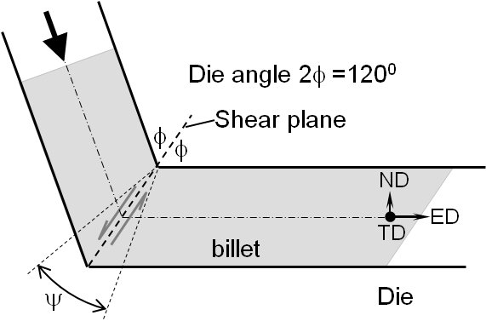
Experiments -fabrication
Fabrication tech 3: ECAE
ECAE conditions:
Route A, 350ºC, 50mm/min graphite lubricated, ~6 passes
P
Billet
ED
True strain per pass: 0.67
ECAE-equal channel angular extrusion

Slide 12
Experiments -fabrication
Fabrication routes 1: HSS + Extrusion
Fabrication routes 2: HSS + ECAE
Fabrication routes 3: HSS + Extrusion + ECAE
Heat treatment
Isochronic annealing: 1h @ 300, 350 and 400°C

Slide 13
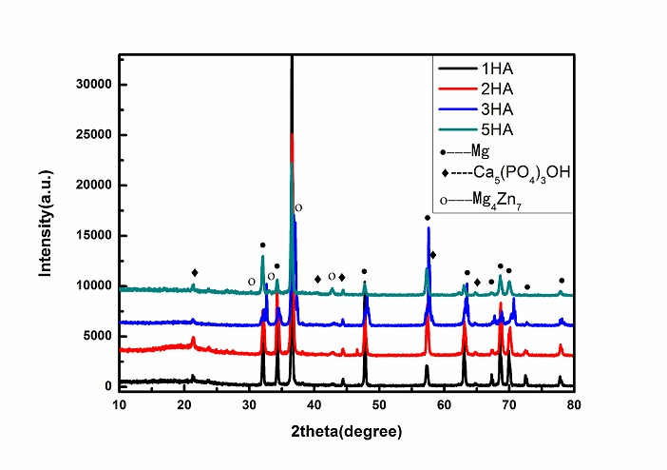
Experiments -characterization
Spherical HA
XRD results
Needle HA

Slide 14
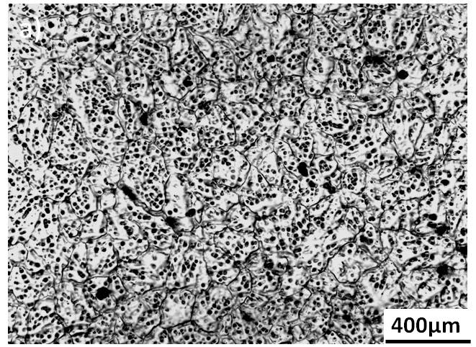
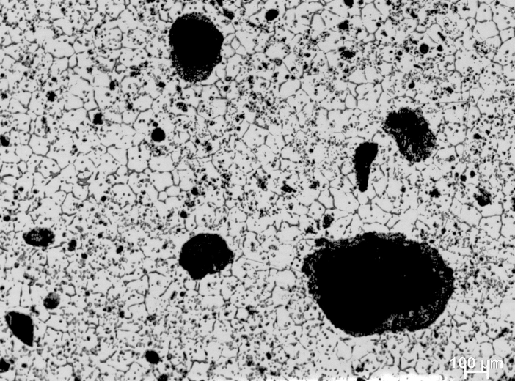
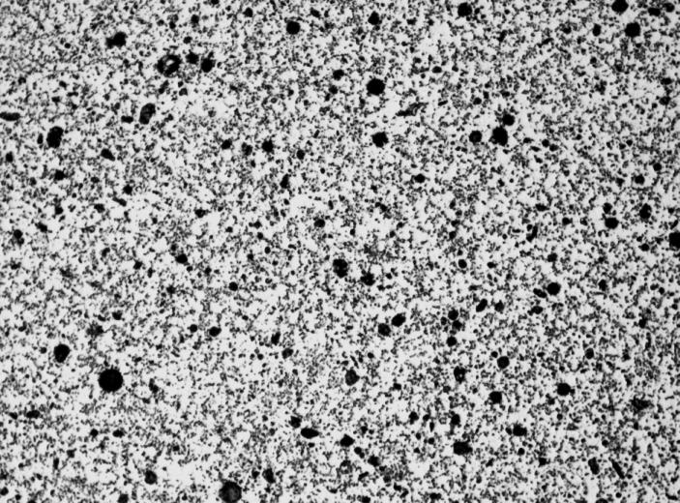
Experiments -characterization
Effect of HA particles and high shear
b)
Matrix alloy –no shear
Mg/5HA
Mechanically mixed but No shear
Mg/5HA
With shear

Slide 15
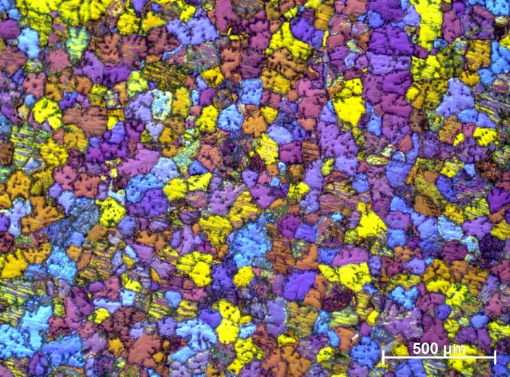
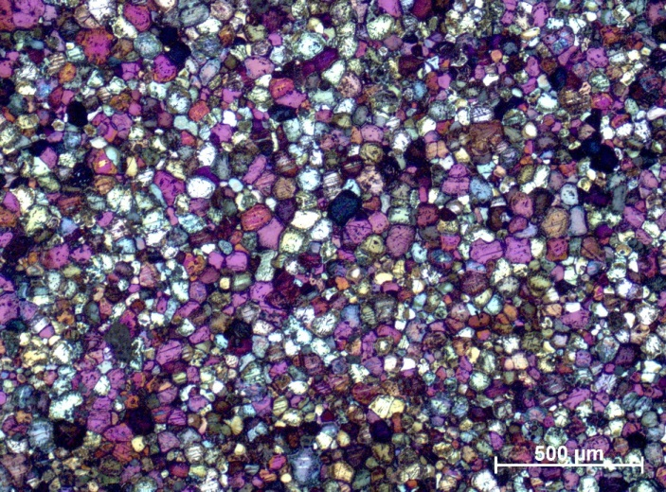
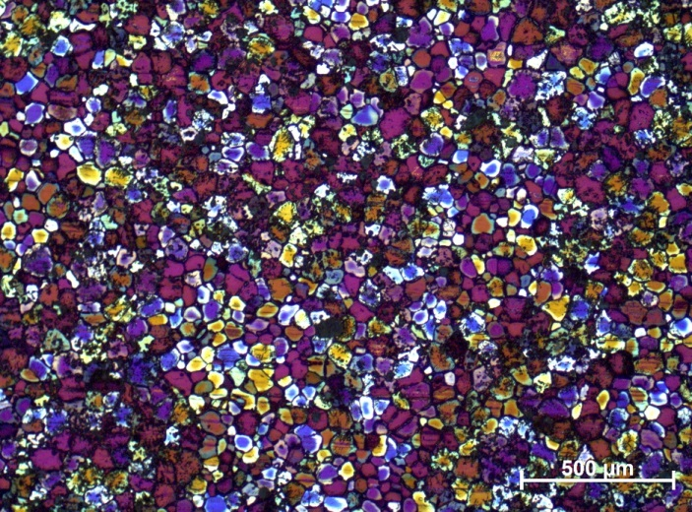
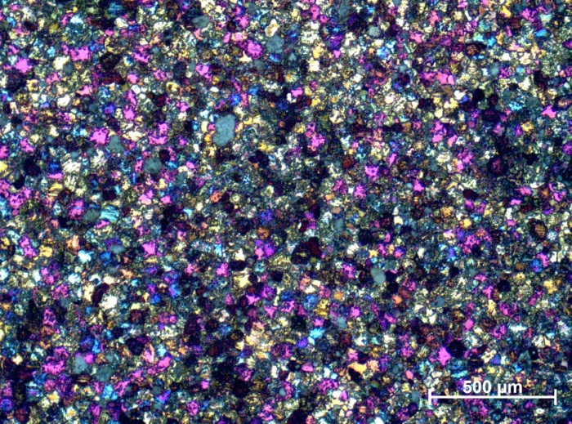
Experiments -characterization
As-cast microstructures
Matrix alloy
Mg/1HA
Mg/2HA
Mg/3HA

Slide 16
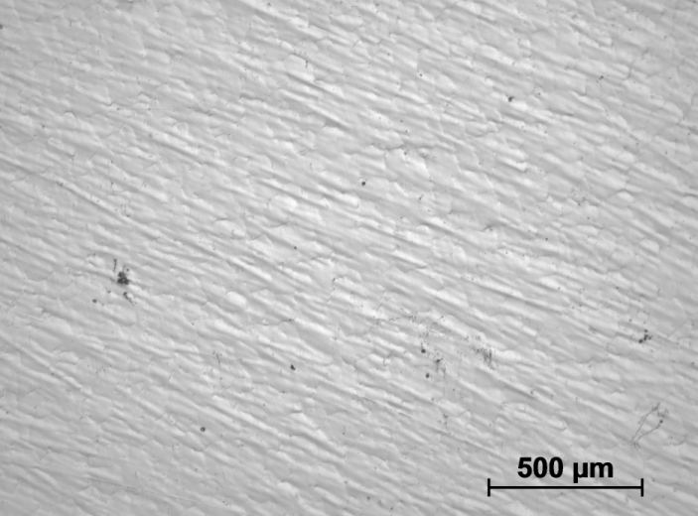
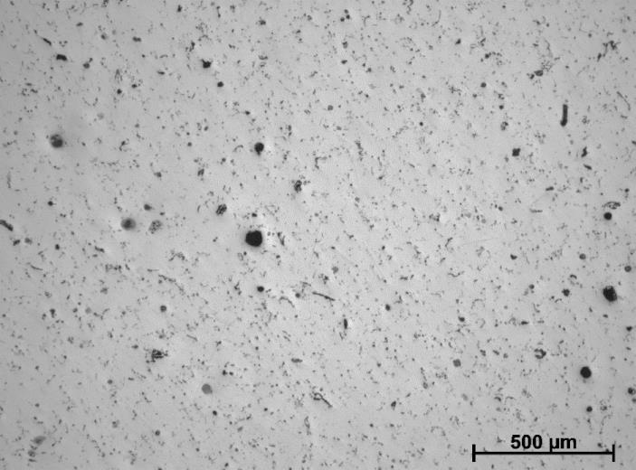
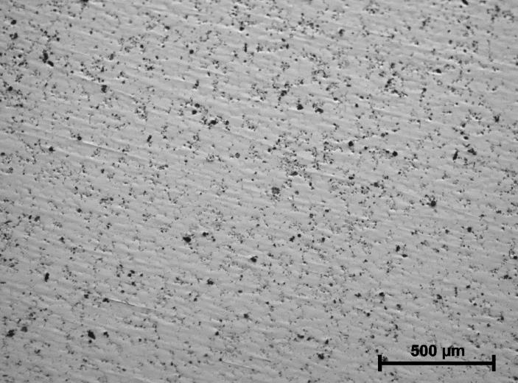
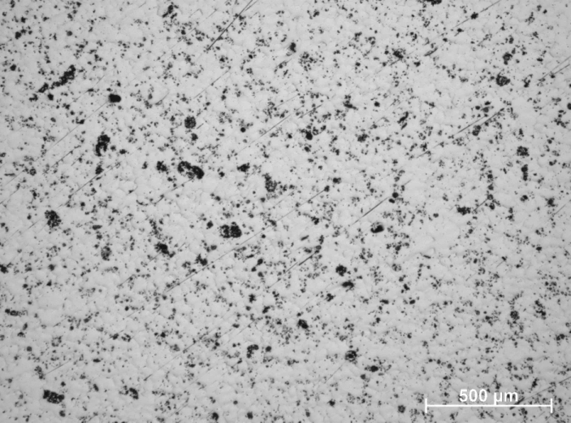
Experiments -characterization
As-cast microstructures
Matrix alloy
Mg/1HA
Mg/2HA
Mg/3HA

Slide 17

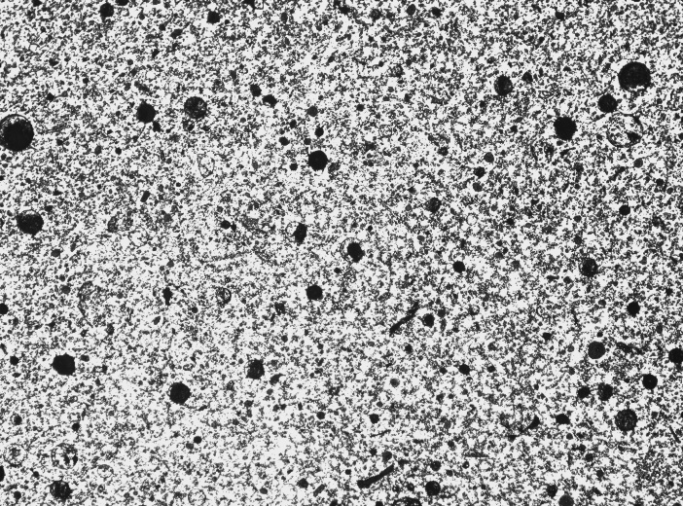
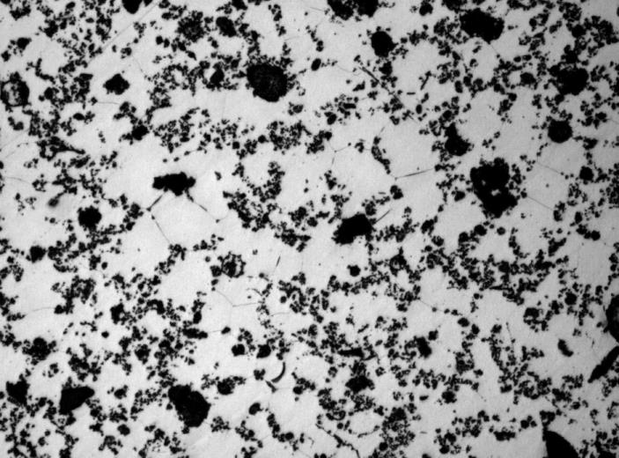
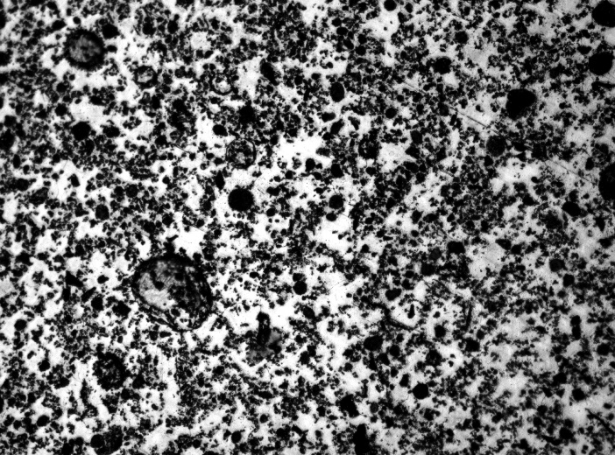
Experiments -characterization
As-cast microstructures
500µm
100µm
Mg/5HA
Mg/10HA

Slide 18
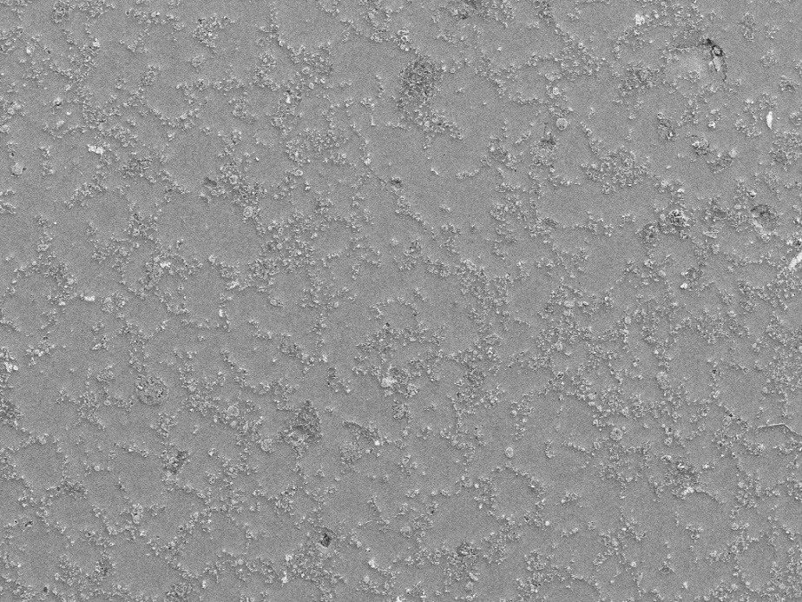
Experiments -characterization
As-cast HA particles
200µm
100µm
50µm
25µm
Mg/5HA

Slide 19
Experiments -characterization
As-cast HA particles
5µm
5µm
1µm
100nm
Mg/5HA

Slide 20
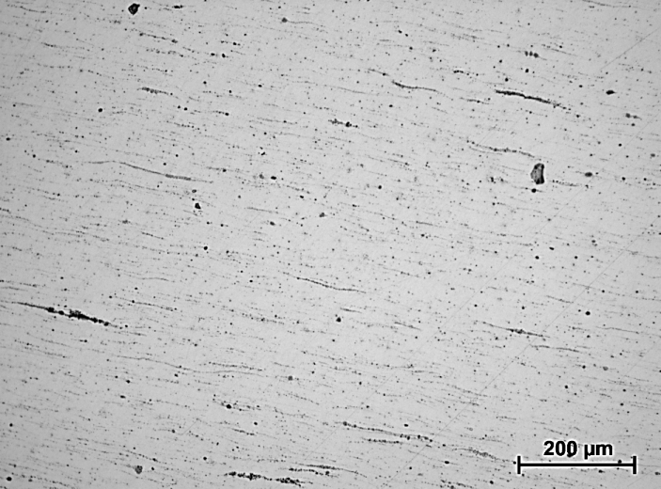
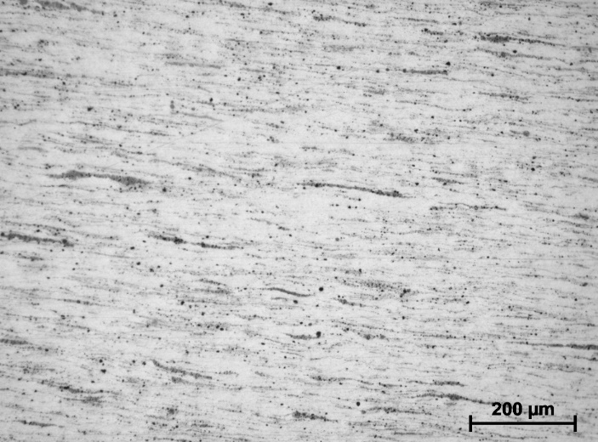
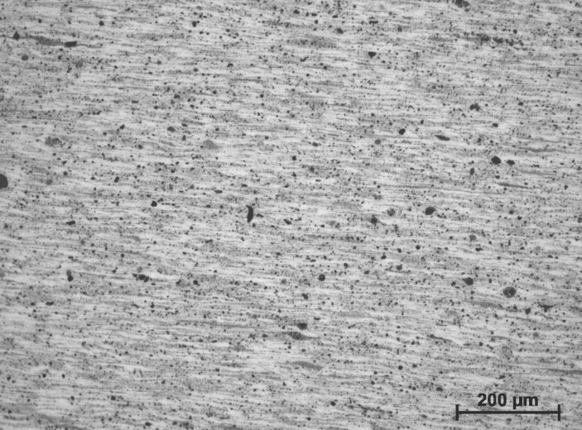
Experiments -characterization
6 pass ECAE microstructures
Mg/1HA
Mg/3HA
Mg/10HA

Slide 21
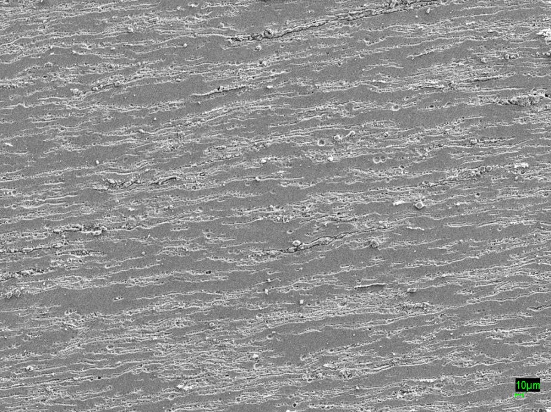
Experiments -characterization
HA particles after 4 pass ECAE
100µm
1µm
Mg/5HA

Slide 22
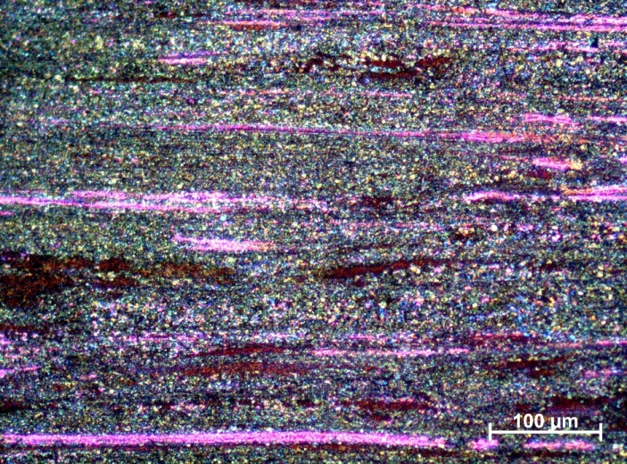
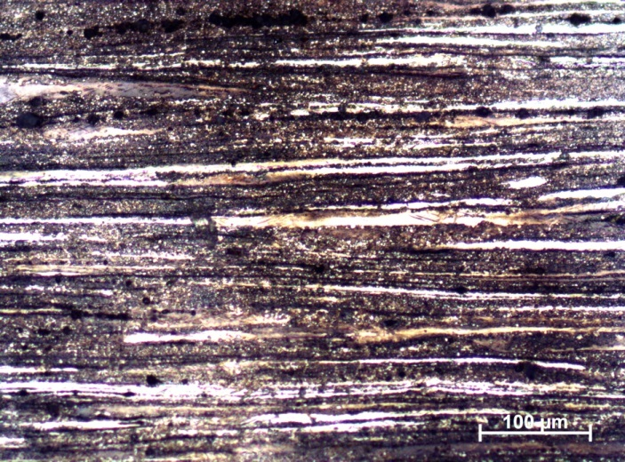
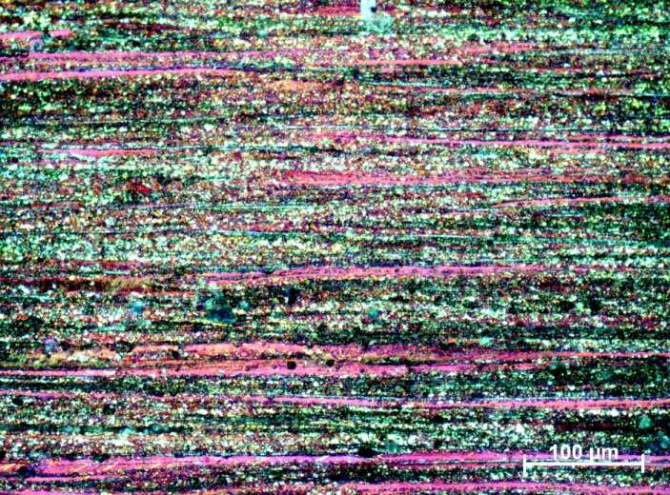
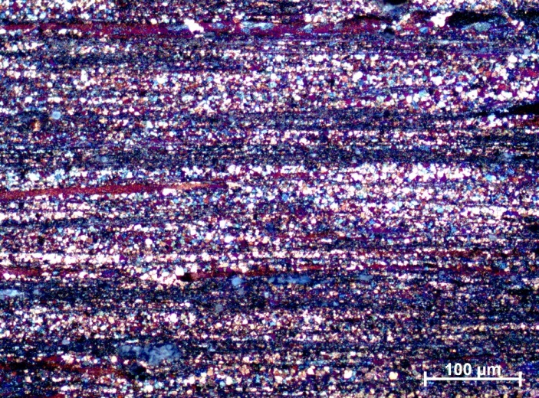
Experiments -characterization
As extrusion microstructures for bars
Matrix alloy
Mg/1HA
Mg/2HA
Mg/3HA

Slide 23
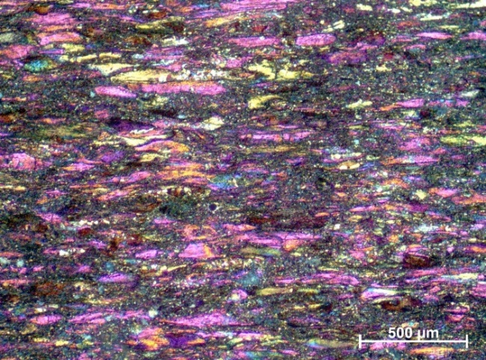
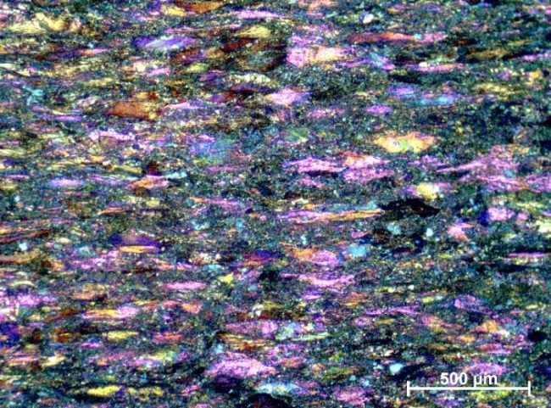
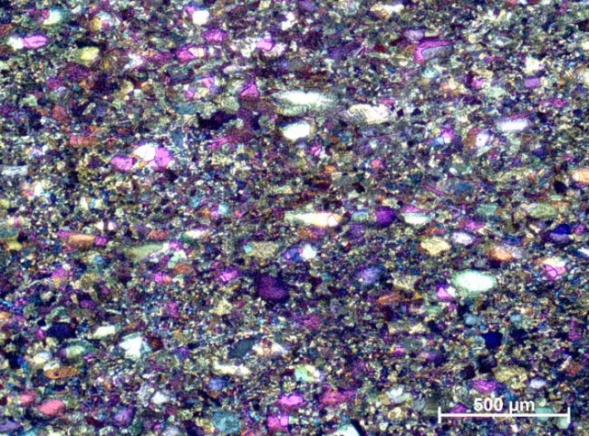
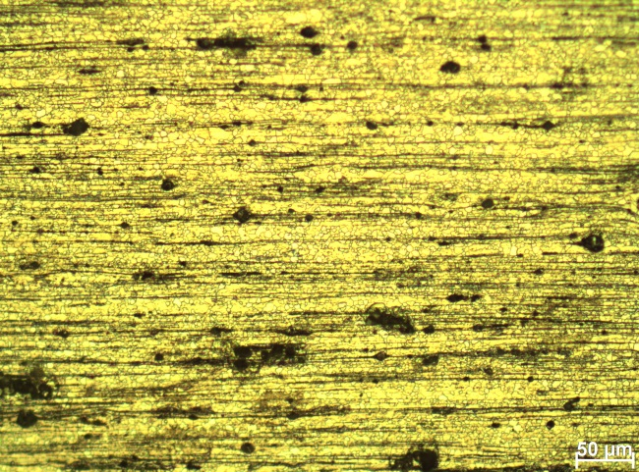
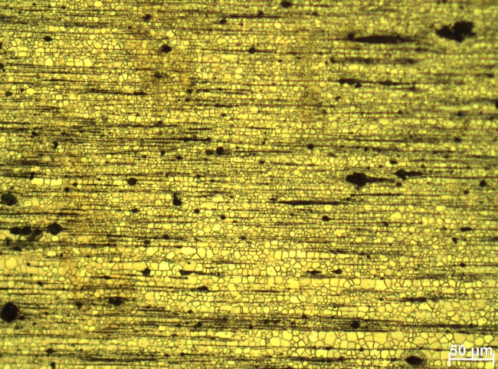
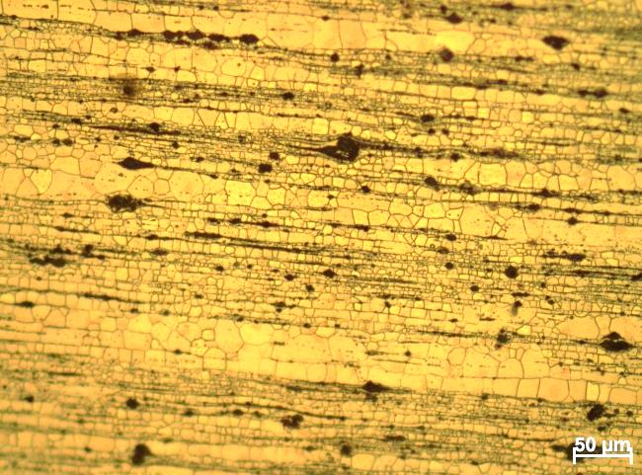
Experiments -characterization
Microstructures after heat treatment for bars (Mg/3HA)
Bar, 1h@300°C
Bar, 1h@350°C
Bar, 1h@400°C
sheet, as-deformed
Sheet, 1h@350°C
Sheet, 1h@400°C

Slide 24
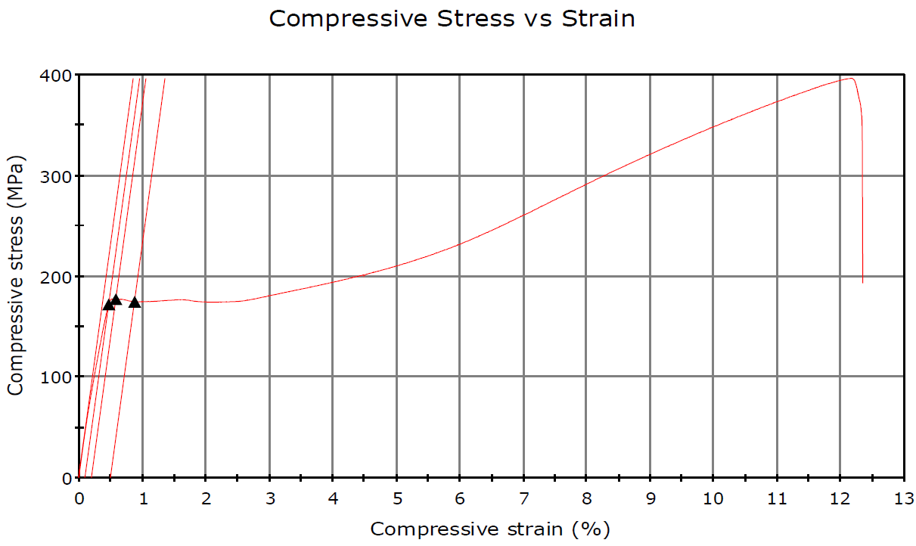
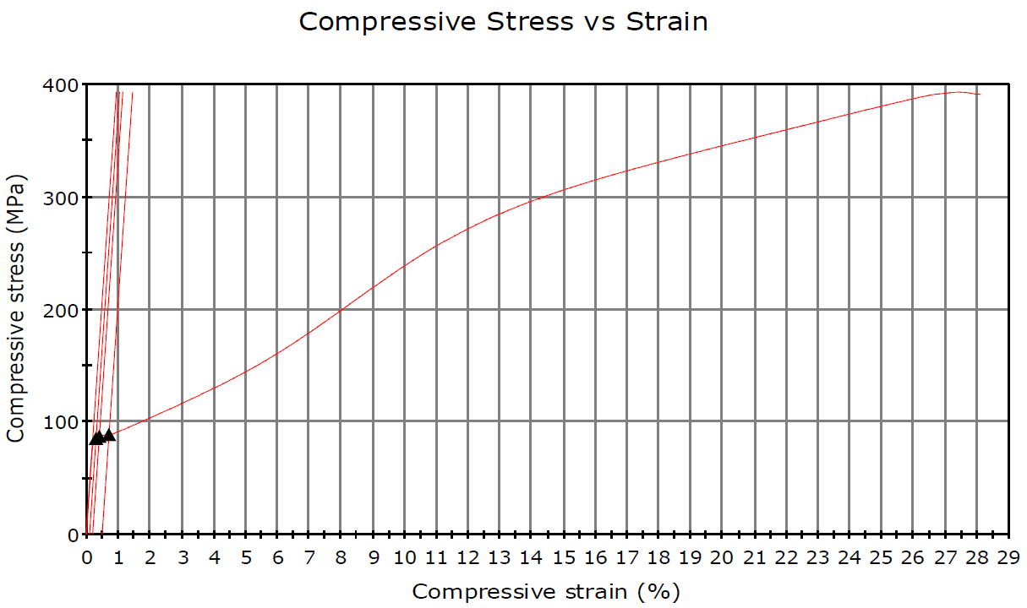
Experiments -characterization
Compression tests(STAM standard
Mg/0HA
Extruded
Modulus = 44GPa
σ0.2 = 179MPa
Elongation = ~11.5%
Mg/0HA
Extrusion+annealing
1h@350°C
Modulus = 42GPa
σ0.2 = 88MPa
Elongation = ~27%

Slide 25
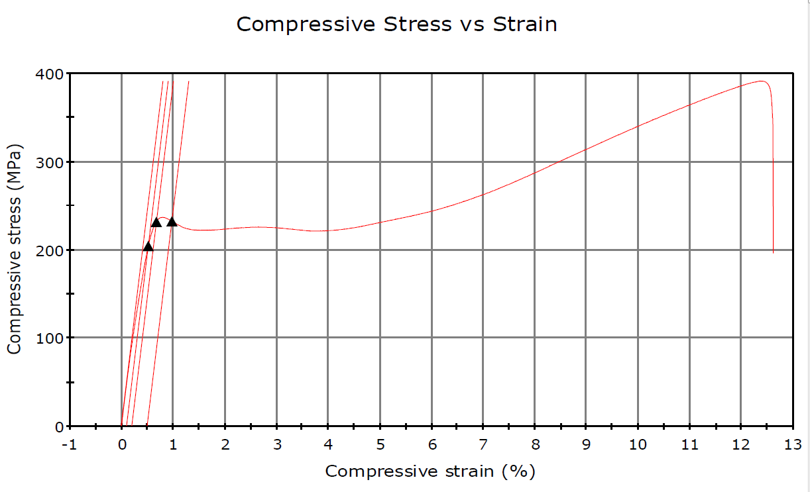
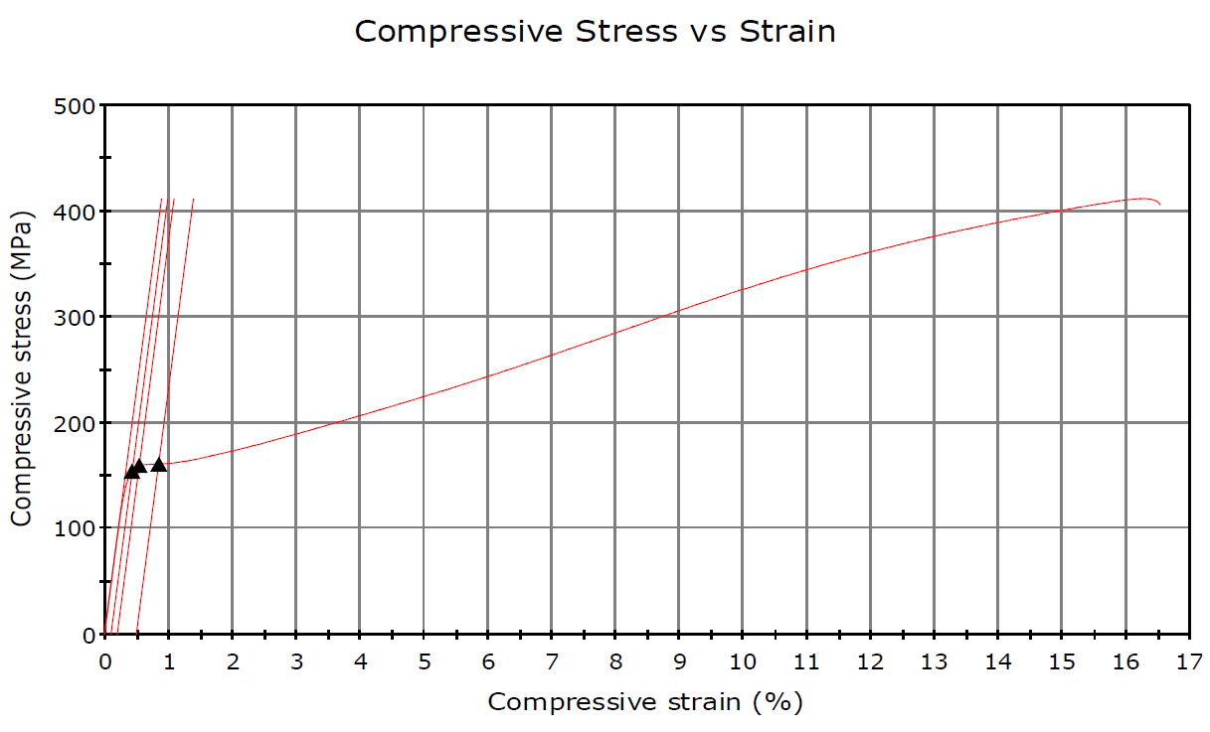
Experiments -characterization
Compression tests(ASTM E9)
Mg/3HA
Extruded
Modulus = 47GPa
σ0.2 = 234MPa
Elongation = ~12%
Mg/3HA
Extrusion+annealing
1h@350°C
Modulus = 46GPa
σ0.2 = 160MPa
Elongation = ~16%

Slide 26
Experiments -characterization
Polarization tests: SBF (Hank’s solution) @37°C, constant pH 7.4
1wt% HA (spherical)
Extruded bar
1wt% HA (spherical)
Bar -annealed at 400C

Slide 27
Experiments -characterization
Polarization tests: SBF (Hank’s solution) @37°C, constant pH 7.4
Processing state | HA content, wt% | Ecorr (V) | Icorr (nA/cm²)
As-cast | 0 | -1.70 ± 0.05 | 17560 ± 7560
Extruded | 0 | -1.54 ± 0.01 | 13900 ± 2600
Annealed 1h@350 °C | 0 | -1.43 ± 0.03 | 7540 ± 1640
As-cast | 1 | -1.51 ± 0.05 | 17852 ± 4844
Extruded | 1 | -1.45 ± 0.01 | 11726 ± 1150
Annealed 1h@400 °C | 1 | -1.45 ± 0.02 | 5101 ± 806
As-cast | 2 | -1.48 ± 0.04 | 15344 ± 1626
Extruded | 2 | -1.45 ± 0.01 | 13000 ± 3188
Annealed 1h@350 °C | 2 | -1.41 ± 0.02 | 29330 ± 1528
As-cast | 3 | -1.48 ± 0.02 | 30741 ± 3748
Extruded | 3 | -1.40 ± 0.02 | 23297 ± 1213
Annealed 1h@350 °C | 3 | -1.39 ± 0.02 | 31274 ± 5924

Slide 28
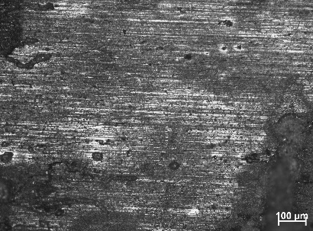
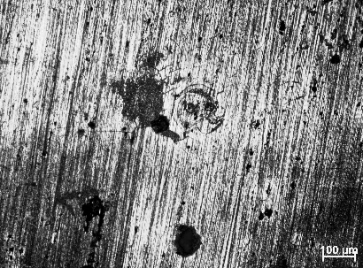
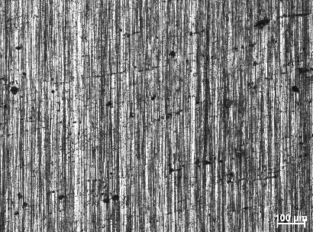
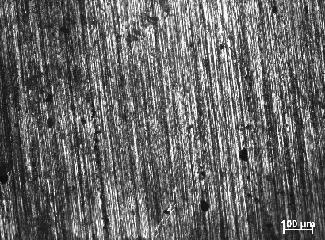
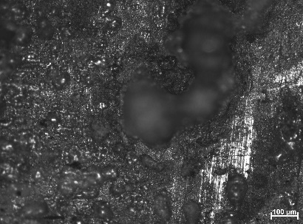
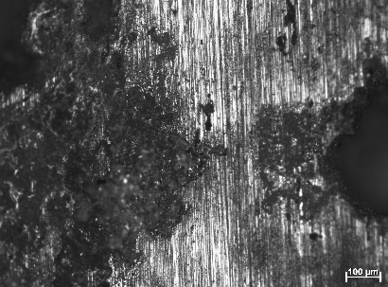
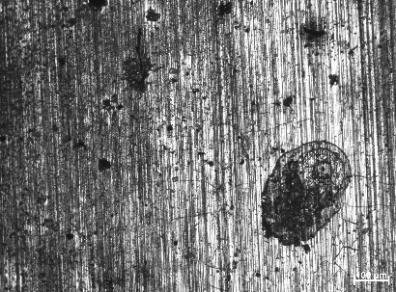
Experiments -characterization
Immersion tests: SBF (Hank’s solution) @37°C, constant pH 7.4
7d
3d
1d
4h
30d
21d
11d
Mg/2HA Annealed 1h@350 °C

Slide 29
Experiments -characterization
Immersion tests: SBF (Hank’s solution) @37°C, constant pH 7.4
Mg/2HA Annealed 1h@350 °C

Slide 30
Experiments -characterization
Immersion tests: 7 days in SBF (Hank’s solution) @37°C constant pH 7.4
7d
Processing state | HA content, wt% | Corrosion rate (mg/cm²/day)
Extruded | 0 | 0.43 ± 0.04
Extruded | 1 | 0.28 ± 0.02
Annealed 1h@400 °C | 1 | 0.26 ± 0.05
Extruded | 2 | 0.18 ± 0.07
Annealed 1h@350 °C | 2 | 0.15 ± 0.05
Extruded | 3 | 0.23 ± 0.07
Annealed 1h@350 °C | 3 | 0.21 ± 0.04

Slide 31
Conclusions
The combined HSS and ECAE is feasible for fabricating Mg-HA nanocomposites with a range of HA weight percentage of up to 10.
HSS results in grain refinement and uniform distribution of HA particles. ECAE further refines microstructure, breaks down HA aggregates and generates an HA dispersion in the Mg matrix.
The fabricated Mg/HA nanocomposites displayed excellent and adjustable mechanical properties.
The nanocomposites displayed also enhanced corrosion resistance.

Slide 32
Thanks for your attention!

