Slide 1


4th International Conference on Nanotek and Expo
(Nanotek-2014) San Francisco, USA
December 1st, 2014
Nanostructured self-assembled
P3HT thin films
and their application
to enhance organic solar cell efficiency
Varun Vohra¹,Hideyuki Murata²
¹University of Electro-Communications (UEC), Japan
²Japan Advanced Institute of Science and Technology (JAIST), Japan

Slide 2
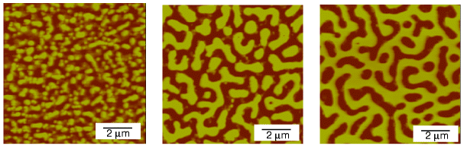
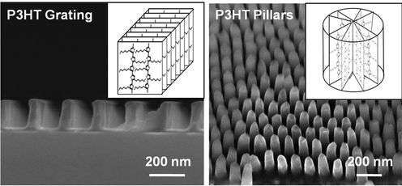
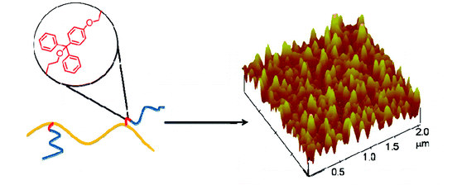
Introduction: Nanostructured films of P3HT
Phase separated polymer blends studied since over a decade
Mostly electronically inactive blends (e.g. PS-PMMA)
S. Zhu et al. in Nature 400, 49-51(1999)
Methods to obtain nanostructured thin films of P3HT:
Nanolithography
M. Aryal et al. in ACS Nano 3, 3085-3090 (2009)
Elaborated chemistry
K. Sivanandan et al. in Macromolec. 43, 233-241 (2010)
Can we obtain similar structures using commercially available polymer blends?

Slide 3
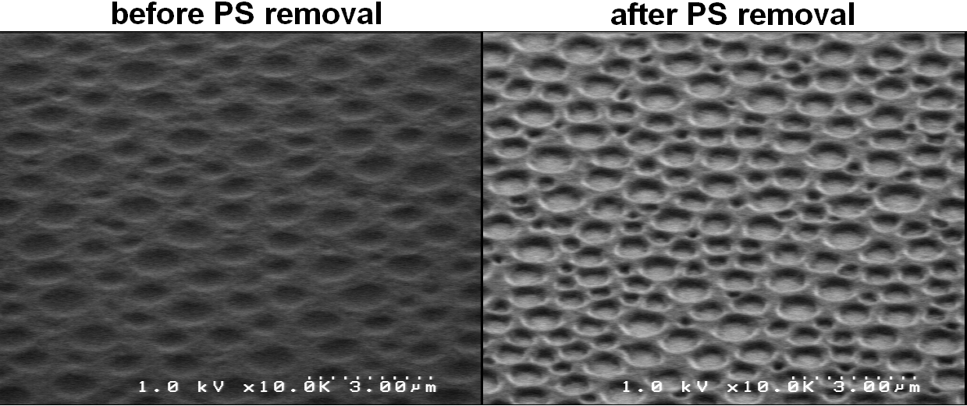
Simple idea to form nanostructured P3HT
Phase separation between P3HT and commercially available polymer materials
Example of nanoporous structures obtained from P3HT:PS blends
before and after selective removal of PS
(structure already formed prior to PS removal)

Slide 4
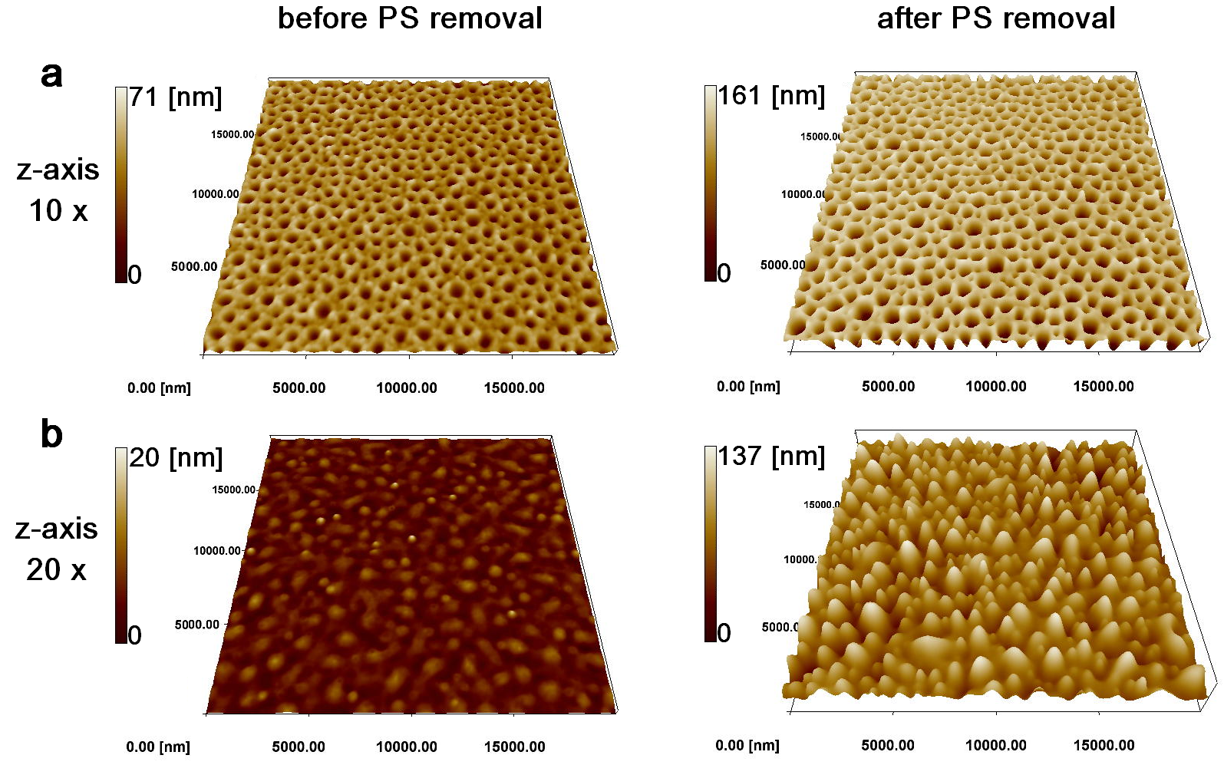
P3HT nanoporous and nanoisland films
Two types of structure can be fabricated with PS
Focus on nanoporous films

Slide 5
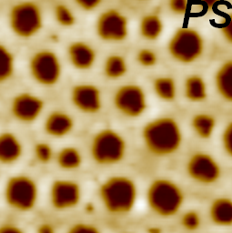
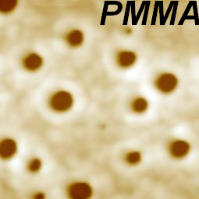
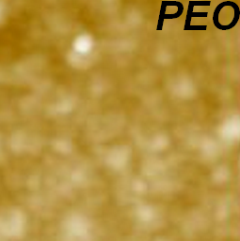
Effect of polymer-polymer miscibility
solubility parameter (MPa^{1/2}) | δ_{T} | δ_{d} | δ_{p} | δ_{H}
P3HT | 20.0 | 18.5 | 5.3 | 5.3
PS | 22.5 | 21.3 | 5.8 | 4.3
PMMA | 22.6 | 18.6 | 10.5 | 7.5
PEO | 22.1 | 17.0 | 11.0 | 8.9
Miscibility with P3HT:
PS > PMMA
> PEO
5μm x 5μm
AFM
Adequate polymer miscibility necessary
Relatively ordered
lateral phase separation
Disordered (low density) lateral phase separation
Vertical phase separation

Slide 6
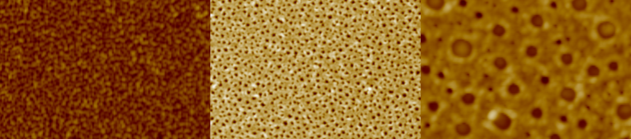
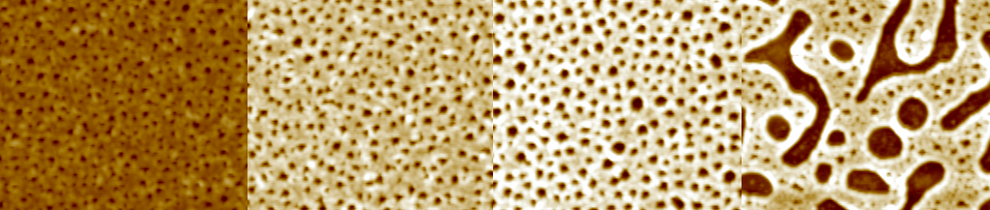
Tuning the pore dimensions / morphology
Method 1: Changing the molecular weight of the polymers
Increasing polystyrene molecular weight
Method 2: Changing the P3HT:PS ratio
Increasing polystyrene wt % (15 to 50 wt%)
Combination of the two methods:
Pore diameters can be tuned from 100 to 650 nm

Slide 7
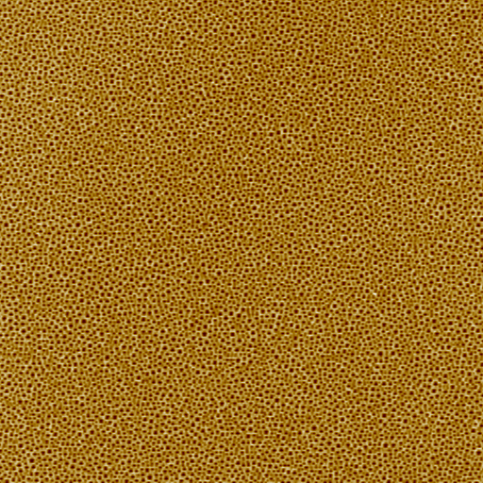
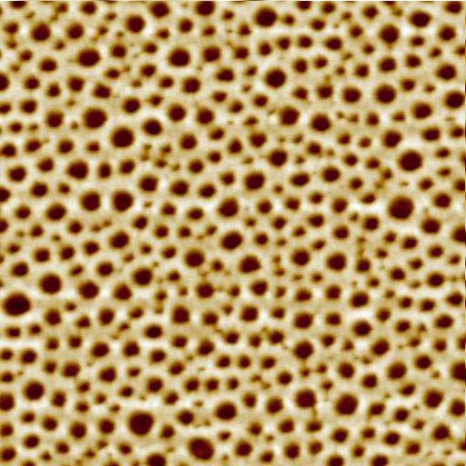
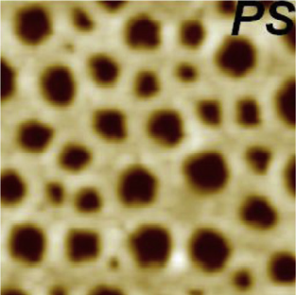
Large scale nanostructured film formation?
Uniform samples (small exception at the edges)
Sample size: 2.5 cm x 2.5 cm
5 μm x 5 μm
100 μm x 100 μm
20 μm x 20 μm
What can we use these porous films for?

Slide 8
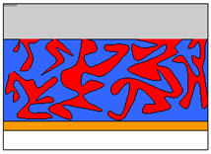
Potential applications
Organic solvent extraction
Increased sensitivity of P3HT based OFET sensors
Solvent +
water + impurities
Solvent
Sensing surface
Au
Au
SiO₂
Si wafer
vacuum
Increased donor-acceptor interface in organic solar cells
Increased sensing surface
Au
Au
SiO₂
Si wafer

Slide 9
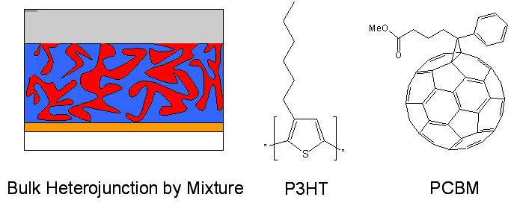
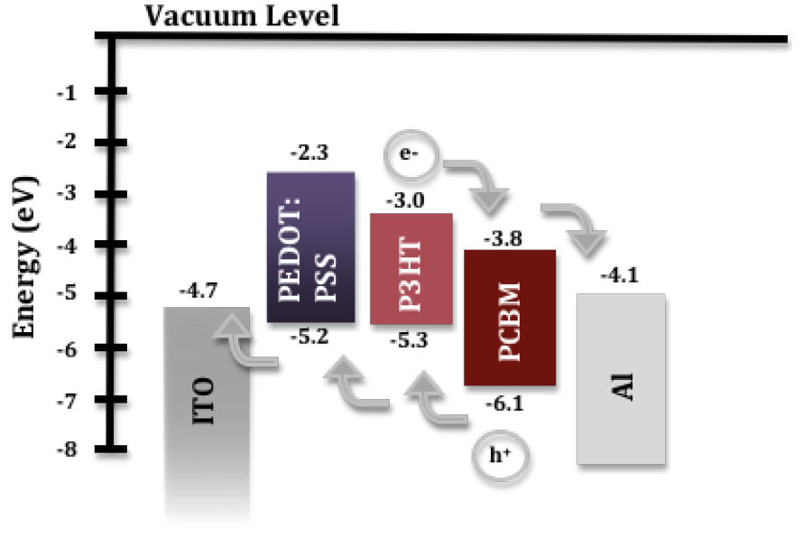
Ideal morphology for polymer solar cells
Interdigitated Diffusive Bilayer by Sequential deposition
Efficient charge transport
to their respective electrodes
Less charge generation in planar bilayers
Efficient charge generation
Unefficient charge collection
Can we increase the charge generation through nanostructured donor-acceptor interfaces?

Slide 10
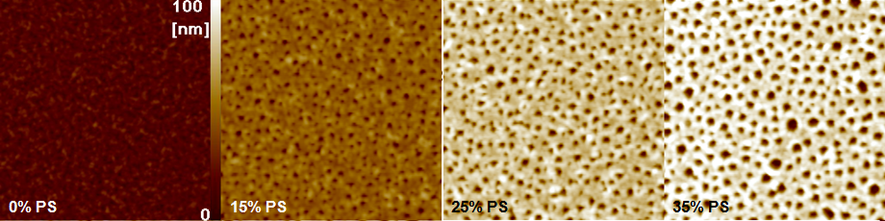
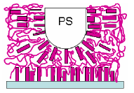
Morphology of the nanoporous films
AFM measurements: underlying non structured P3HT buffer layer
Angle dependent FTIR: organization of the P3HT chains at the P3HT-PS interface
PEDOT:PSS
In addition to increased Jsc, we should observe increased FF

Slide 11
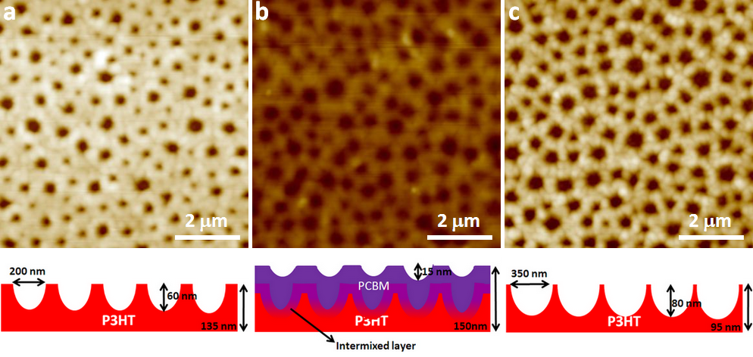
Different orientations in the bulk and the surface
1/ Deposition of PCBM
from dichloromethane
2/Removal of PCBM
with cyclohexanone
1/ filling the pores with PCBM and allowing diffusion of PCBM into P3HT
pore depth decreases from 60 to 15 nm (PS 25wt% after PS removal)
2/ removing the PCBM and the parts of P3HT containing a high concentration of (diffused) PCBM
➔ widening : +75 nm on each sides deepening: +60 nm
Lateral diffusion > Vertical diffusion: Confirms the different orientations!

Slide 12
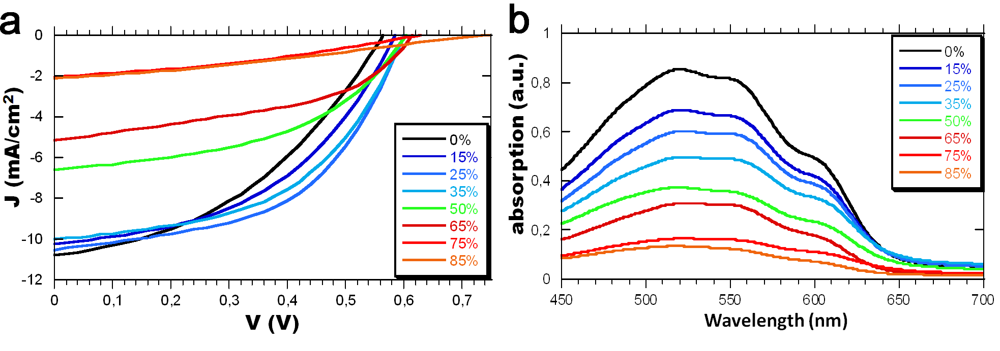
Photovoltaic parameters
PS (wt%) | Jsc* (mA/cm²) | Voc (V) | FF (%) | η (%) | Rs (Ω/cm²) | Wetting layer | Absorption ratio (A/A₀)
0 | 10.8 10.8 | 0.57 | 41 | 2.51 | 7.04 | 130 nm | 1
15 | 10.2 12.3 | 0.60 | 46 | 2.77 | 8.27 | 104 nm | 0.832
25 | 10.5 14.1 | 0.61 | 51 | 3.25 | 4.61 | 76 nm | 0.745
35 | 10.0 15.6 | 0.61 | 49 | 3.02 | 4.18 | 63 nm | 0.640
*Jsc corresponds to the measured Jsc divided by the absorption ratio
Increase in corrected Jsc, Voc, FF and consequently PCE

Slide 13
Origins of the increase in device performances
PS (wt%) | Jsc* (mA/cm²) | Voc (V) | FF (%) | η (%) | Rs (Ω/cm²) | Wetting layer | Absorption ratio (A/A₀)
0 | 10.8 10.8 | 0.57 | 41 | 2.51 | 7.04 | 130 nm | 1
25 | 10.5 14.1 | 0.61 | 51 | 3.25 | 4.61 | 76 nm | 0.745
1
PEDOT:PSS
2
1
Planar bilayer ➔ nanostructured bilayer: increase in donor-acceptor interface
P3HT crystallite reorientation : better hole transport properties
reduced Rs → increased Voc and FF
2
Thin P3HT buffer layer (no PCBM): nanostructured p-i-n junction
➔ further increases FF

Slide 14
Summary
Easy and cost effective method to prepare spin-coated nanostructured P3HT films from blends of commercially available polymers (P3HT + PS)
Tuning of pore dimensions can be controlled by wt% and Mw
Nanoscale phase separation induces reorientation of the polymer crystallites at the P3HT/PS interface
Nanostructured diffusive bilayer solar cells have an average PCE of upto 3.25% (30% increase with respect to the planar equivalent)
A deeper analysis of the active layer morphology is necessary to understand the increase in PV performances
The nanostructured thin films have potential for various applications
Feel free to come and exchange ideas

Slide 15







An international collaboration
On-going and future collaborations:
Mariano Campoy-Quiles
Miguel Garriga
Hideyuki Murata
Masayuki Yamaguchi
Osamu Notoya
Tong Huang
Varun Vohra
Xiaojun Guo
(future projects)
Very open to new collaboration and projects
Organic solar cells based on nanoporous P3HT obtained from self-assembled P3HT:PS templates
V. Vohra, M. Campoy-Quiles, M. Garriga, H. Murata, J. Mater. Chem., 2012,22, 20017-20025
Nanostructured P3HT films with tunable dimensions through self-assembly with PS
V. Vohra, O. Notoya, T. Huang, M. Yamaguchi, H. Murata, Polymer, 2014, 55, 2213-2219

Slide 16

Thank you for your attention!!!
Email: varun.vohra@uec.ac.jp
Energy related research!!
Energy related re...zzearch
Ener...zzzzzy

