Slide 1
Dynamic Modeling of RAS-MAPK Signaling Pathway.
Sensitivity, Bistability and Oscillations
Mohammadreza Yasemi and Yaman Arkun*
Department of Chemical and Biological Engineering, Koc University, Rumeli Feneri Yolu, 34450 Sariyer, Istanbul, TURKEY. yarkun@ku.edu.tr

Slide 2
MOTIVATION
The MAPK (mitogen activated protein kinase) pathway, activated by a wide range of stimuli, controls cellular growth, proliferation, differentiation and apoptosis.
Mutationally activated Ras occurs in approximately 15% of cancers.
MAPK is hyperactivated in approximately 30% of cancers.
Dynamics (duration, amplitude, frequency, stability) of MAPK pathway determines biological responses. Feedback regulation of this pathway is crucial to control biological outcomes.
Modeling can help to predict the complex dynamics and provide insight into understanding biological processes as integrated systems.

Slide 3
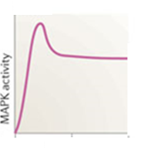
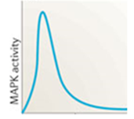
Motivating example
MAPK pathway generates different dynamics and biological outcomes depending on the stimulus:
EGF
PC-12 Cells
NGF
time
time
Cell Proliferation Cell Differentiation
How can we adjust the dynamics to affect these cellular functions?

Slide 4
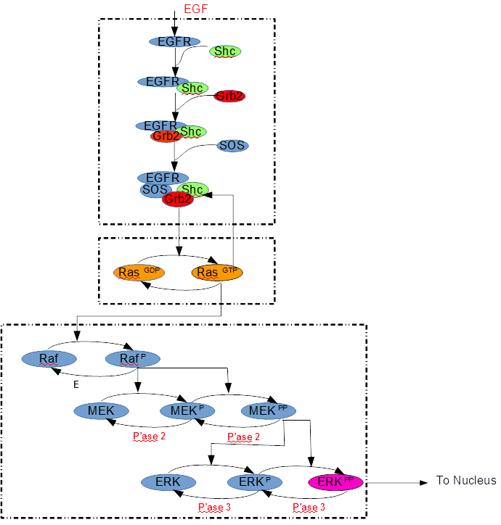
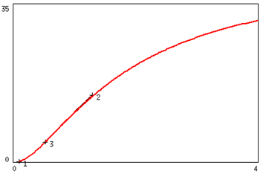
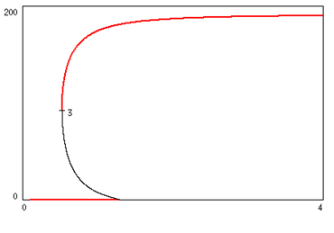
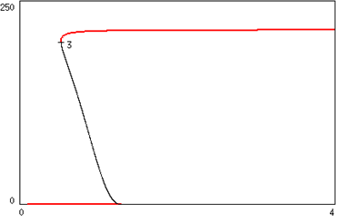
Shc-Grb2-SOS
EGF/SOS Subsystem
RAS Subsystem
MAPK
Subsystem
EGF
RasGTP
EGF
ERK
EGF

Slide 5
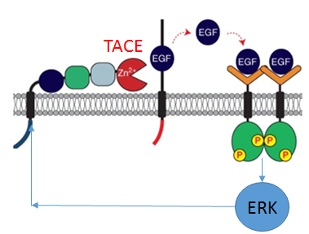
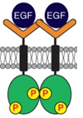
Regulatory Feedback Loops
Autocrine positive feedback Cytoplasmic Negative Feedback Transcriptional Negative Feeedback
argos
ERK
argos
Grb2-SOS
nucleus
Ras
Raf
ERK
MEK
nucleus
ERK
DUSP

Slide 6




CONTROLLER PROCESS
EGF
TACE
Argos
Grb2-SOS
Ras
Cytoplasm
Raf
ERK
MEK
ERK
DUSP
ERK
Cellular
response
Nucleus
Cellular response
Transcription

Slide 7
Model
Our model comprises 46 ordinary differential equations, 17 algebraic equations, 143 parameters.
In developing the model, parameter and kinetic reactions were borrowed from the literature.
Modifications were done at connecting parts and negative/positive feedback loops were added.
Mathematical techniques, i.e. bifurcation analysis were done using XPPAUTO* software.
Section of the Model | Source
EGFR - SOS | (Kholodenko, Demin, Moehren, & Hoek, 1999)
SOS - RasGTP | (Das et al., 2009)
RasGTP - Erk | (Qiao, Nachbar, Kevrekidis, & Shvartsman, 2007)⁠
___________________________
*http://www.math.pitt.edu/~bard/xpp/xpp.html

Slide 8
1. Analysis without Feedbacks
EGF
Plasma
membrane
Grb2-SOS
Ras
Raf
mins
Cytoplasm
MEK
ERK
ERK
Nucleus
Transcription
Cyclins

Slide 9
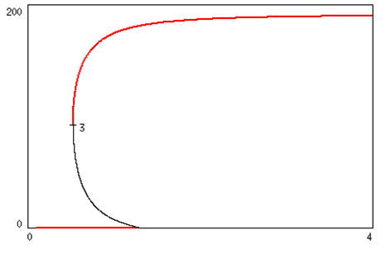
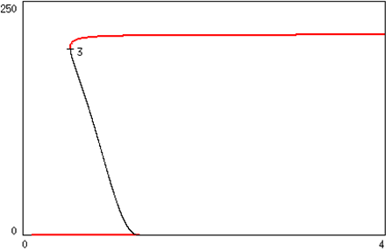

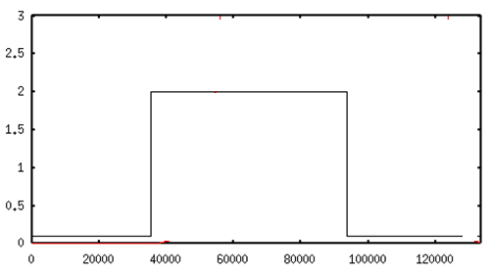
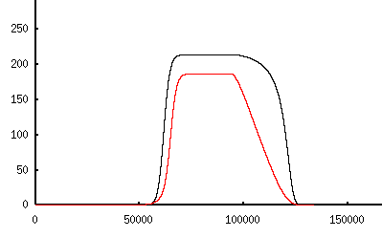

A Hallmark of Cellular Dynamics:
Robust Bistability and Switching Dynamics
RasGTP
ERK
ERK
EGF
RasGTP

Slide 10
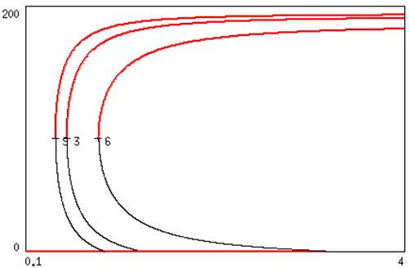
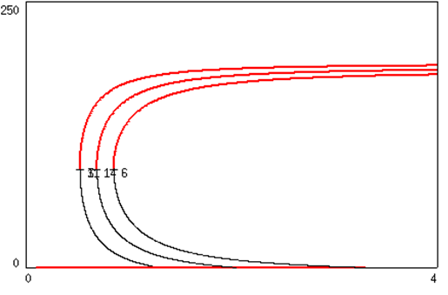



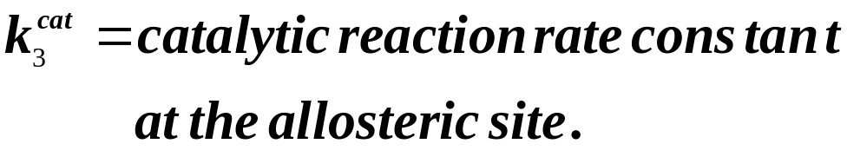
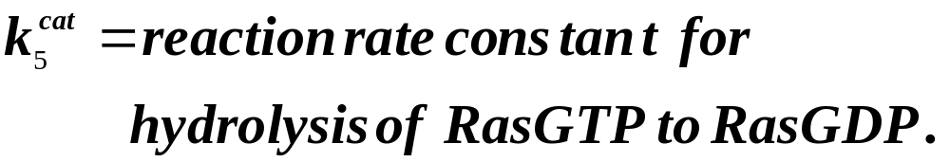
RasGTP is Robustly Bistable

Slide 11
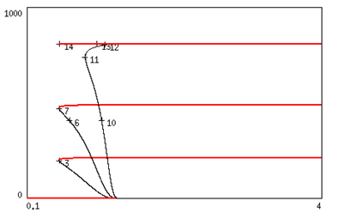
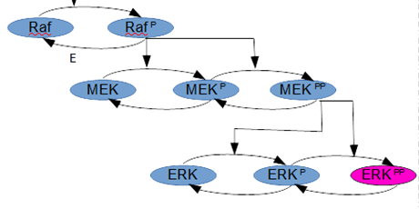


ERK is Robustly Bistable

Slide 12


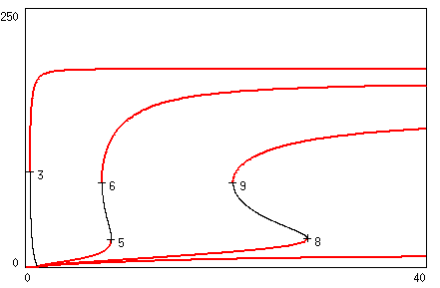
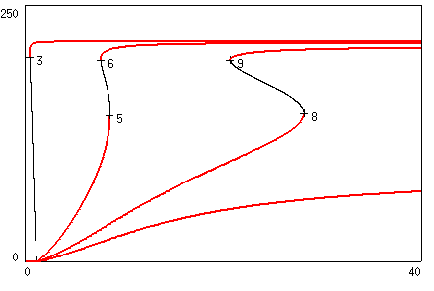
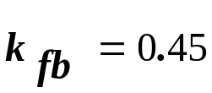
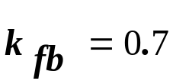
2. Effect of Negative Feedback FB(ERK,Shc-GrB2-SOS)
Regime 1: High Phosphatase MAPKKP’
Grb2-SOS
ERK
RasGTP
Ras
Raf
MEK
Negative feedback can modify MAPK pathway dynamics from switch-like
to graded monotonic response. No periodic orbits/oscillations.
ERK

Slide 13
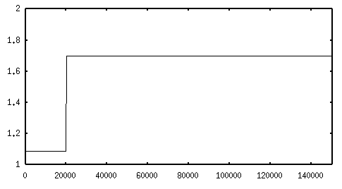
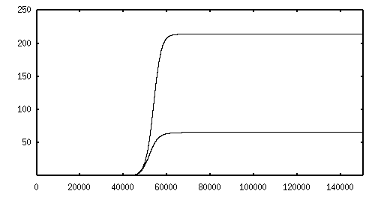




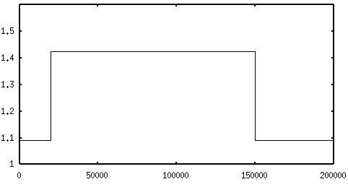
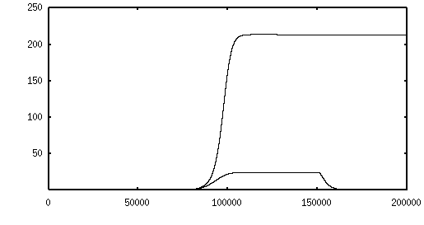
Steady-state and Dynamic Sensitivities

Slide 14
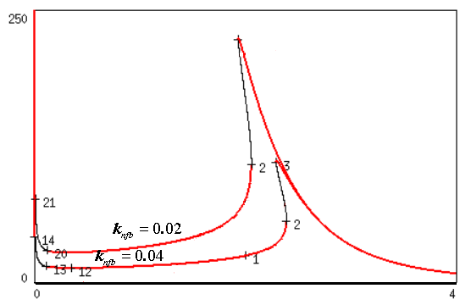

Negative Feedback Reduces Sensitivity to Disturbances

Slide 15

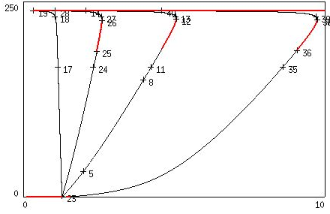

Regime 2: Low Phosphatase MAPKKP’
HB
HB
Negative fb introduces 2 Hopf Bifurcations and oscillations.

Slide 16
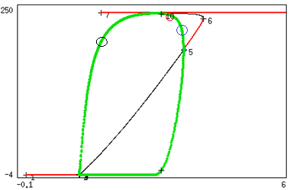
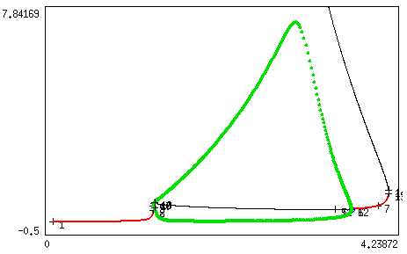

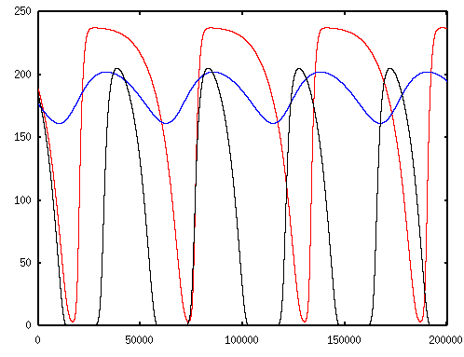
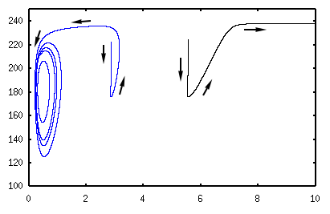
Limit Cycles

Slide 17
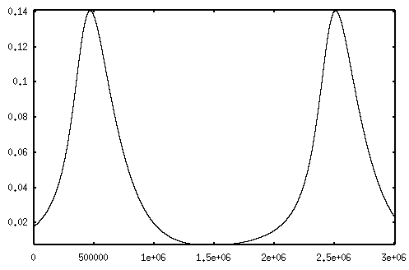
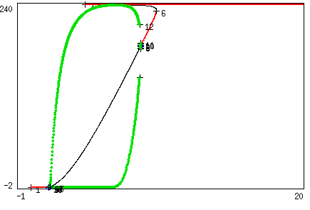
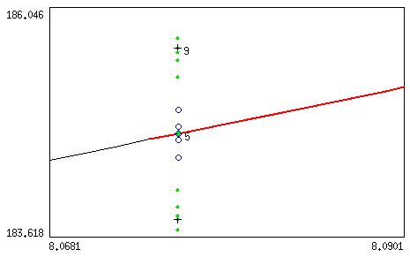
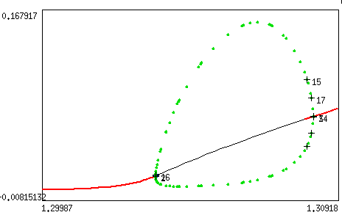
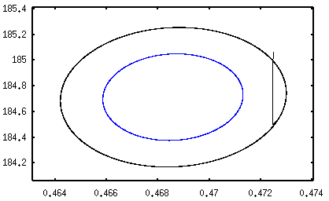
3. The effect of ARGOS Negative Feedback FB(ARGOS,EGFR)
HB
Stable limit cycles emanate from
the lower Hopf Bifurcation points.
Stable and unstable limit cycles emanate
from the upper Hopf Bifurcation points.
HB
HB
HB

Slide 18
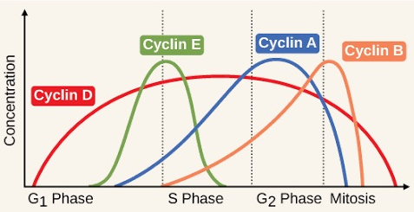
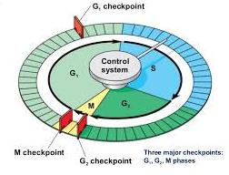

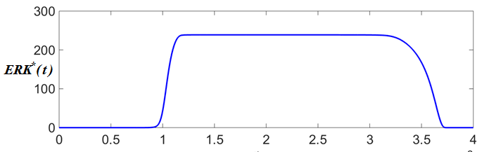
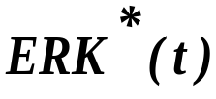

ERK Signaling and Cell Cycle Control
FB Regulation
CERKell
ERK

Slide 19
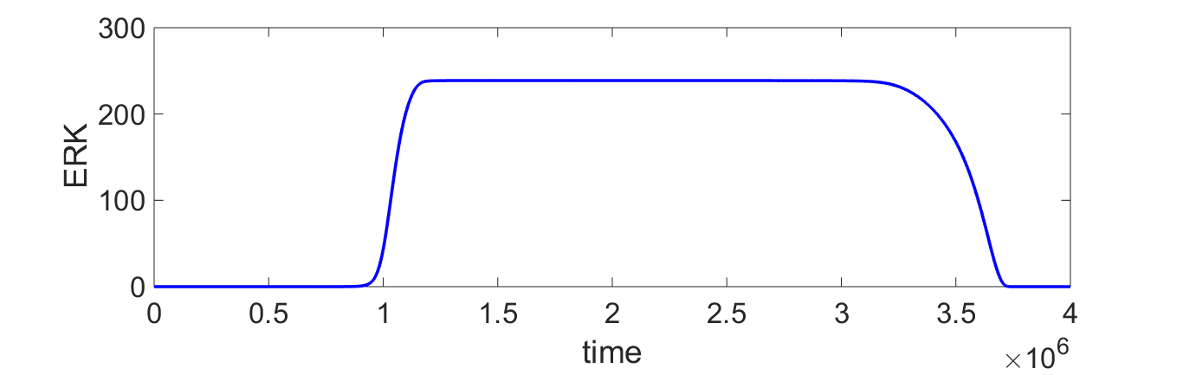
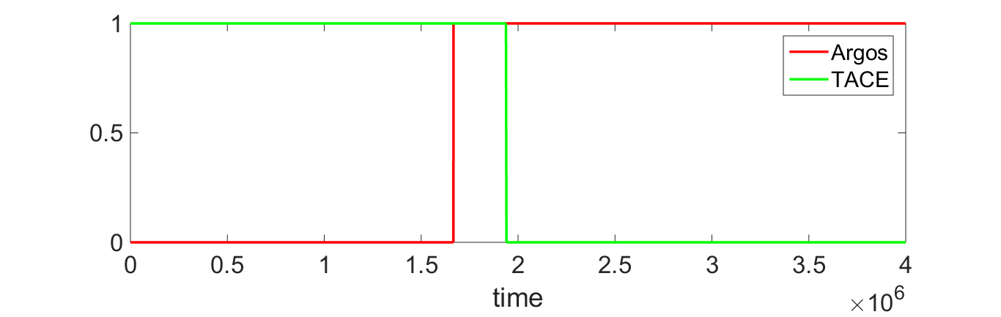
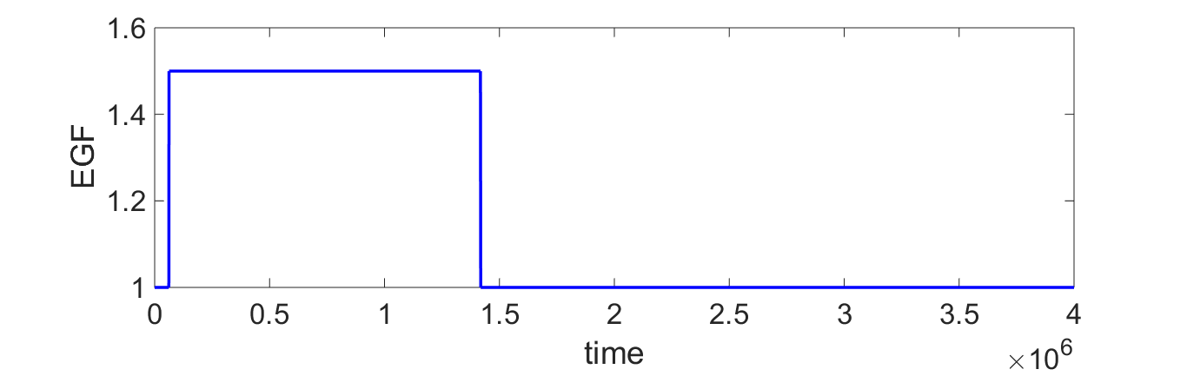

Slide 20
CONCLUSIONS
A dynamic model for EGF-RAS-MAPK pathway was developed.
The key negative and positive feedback loops were included.
The model can be used to explain the observations made in the literature.
It can be used to test/design different control mechanisms.
The model can be used to propose new hypothesis for further validation.
Models can help in the design of synthetic feedback networks (in vivo or in silico) for signal transduction pathways.

