Slide 1



Effect of the printing remedies and lamination techniques on barrier properties “ WVTR and OTR value” for polypropylene film
Yahya Ibrahiem Mohamed Khalifa
Printing, Publishing and Packaging Dept.
Faculty of Applied Arts, Helwan Univeristy,
Cairo, Egypt

Slide 2
Research outline
Introduction
Research Problem
Research objective
The important of Research
Methodology
Materials and methods
Results and Discussions
Recommendations
Conclusions

Slide 3
Research outline
Introduction
Research Problem
Research objective
The important of Research
Methodology
Materials and methods
Results and Discussions
Recommendations
Conclusions

Slide 4
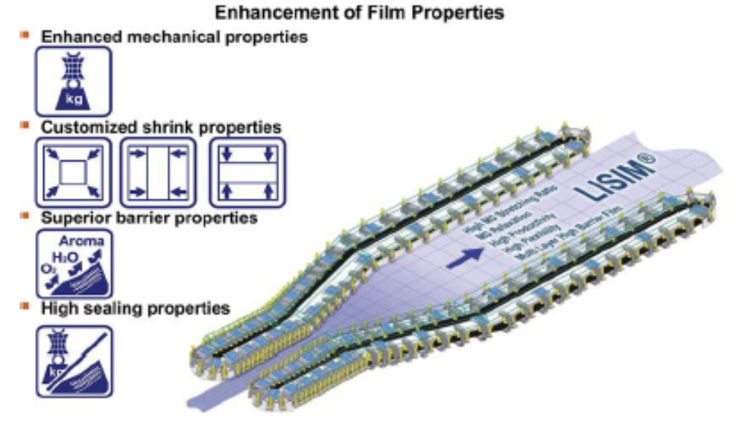
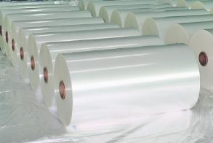
Introduction
Biaxially oriented polypropylene film (BOPP) is recognized as an appropriate barrier ‎film for most dry food after lamination with metalized film whether OPP or PET, ‎moreover that film is considered an excellent for moisture and moderate for oxygen ‎permeability.

Slide 5
OTR Permeability properties of Polypropylene
OTRs of Bulk materials
Film type OTR 73°f (23 0C), o %. RH CC/100 in 2/day CC/m 2/day
EVOH (ethylene vinyl alcohol) Good barrier | 0.005-0.12 | 008-1.9
Biax nyIon-6 | 1.2-2.5 | 18.6-39
OPET (oriented polyester) | 2-6 | 31-93
BOPP | 100-160 | 1,550-2,500
Cast pp | 150-200 | 2,300-3,100
HDPE (high-density polyethylene) | 150-200 | 2,300-3,100
OPS (oriented poly5tyrene) | 280-400 | 4.350-6.200
lDPE (Iow-density polyethylene) Poor barrier | 450-550 | 7.000-8,500
Source: Jonthan Flowe, Barrier films for packaging, Pira International Ltd, 2005

Slide 6
WVTR Permeability properties of Polypropylene
Typical WVTR barrier values
Film type WYTR. 100°' (300C) , ), 90 %. RH g/100 in 2/day g/m 2/day
biaxial - Oriented PP Good WYTR | 0.25-0.40 | 3.9-6.2
HDPE | 0.3-0.5 | 4.7-7.8
Cast pp | 0.6-0.7 | 9.3-11.0
Biax PET | 1.0-1.3 | 16-20
LDPE | 1.0-1.5 | 16-23
EVOH | 1.4-8.0 | 22-124
OPS | 7-10 | 109-155
Biax nyIon-6 Poor WYTR | 10-13 | 155-202
Source: Jonthan Flowe, Barrier films for packaging, Pira International Ltd, 2005

Slide 7
Why barrier plastic films ?
The Definition of Barrier
Something blocks or intended to block passage
Natural formation or structure that prevents or hinders movement or action
Using Barrier in Food Packaging
One of the core functions of plastic films is make a protection against environmental impact, so There are three basic reasons for using barrier material for food packaging products :
Keep desirable elements in (such as flavor, aroma or a controlled atmosphere).
Keep undesirable elements out (such as moisture, oxygen or other corrosive gases).
Avoiding migration from within the film into the packaged goods

Slide 8
Oxygen
Odors
Outer Layer
Tie
Barrier Layer
Tie
Inner Layer
Freshness
Flavor
CO2

Slide 9
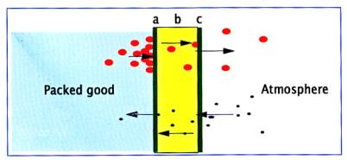
Moreover, permeability rates depend on three factors: -
Nature of the polymer film
Nature of the gas
Interaction between the gas and the film

Slide 10
Barrier plastic Films Classification
Barrier Levels Classifications
Low barrier
Medium barrier
High barrier
Used for frozen Foods, Fruits, Vegetables and sugar
Used for Chilled foods
Used for dry-roasted peanuts, coffee
Source: Jonthan Flowe, Barrier films for pakaging, Pira International Ltd, 2005

Slide 11
Barrier plastic Films Classification
Barrier Classification | Oxygen ASTM D3985 | Moisture ASTM F 1249
LOW | < 100Cm3/m2/24hr | < 100g/m2/24hr
Medium | 6- 100Cm3/m2/24hr | 6-100g/m2/24hr
High | 1-5Cm3/m2/24hr | 1-5 g/m2/24hr
Very High | > 1Cm3/m2/24hr | > 1g/m2/24hr
Source: PCI Films Consulting Ltd

Slide 12
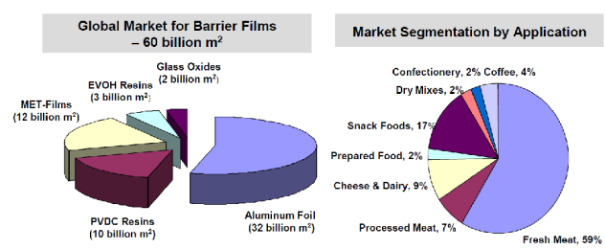
Global Market for Barrier Films

Slide 13
Research outline
Introduction
Research Problem
Research objective
The important of Research
Methodology
Materials and methods
Results and Discussions
Recommendations
Conclusions

Slide 14
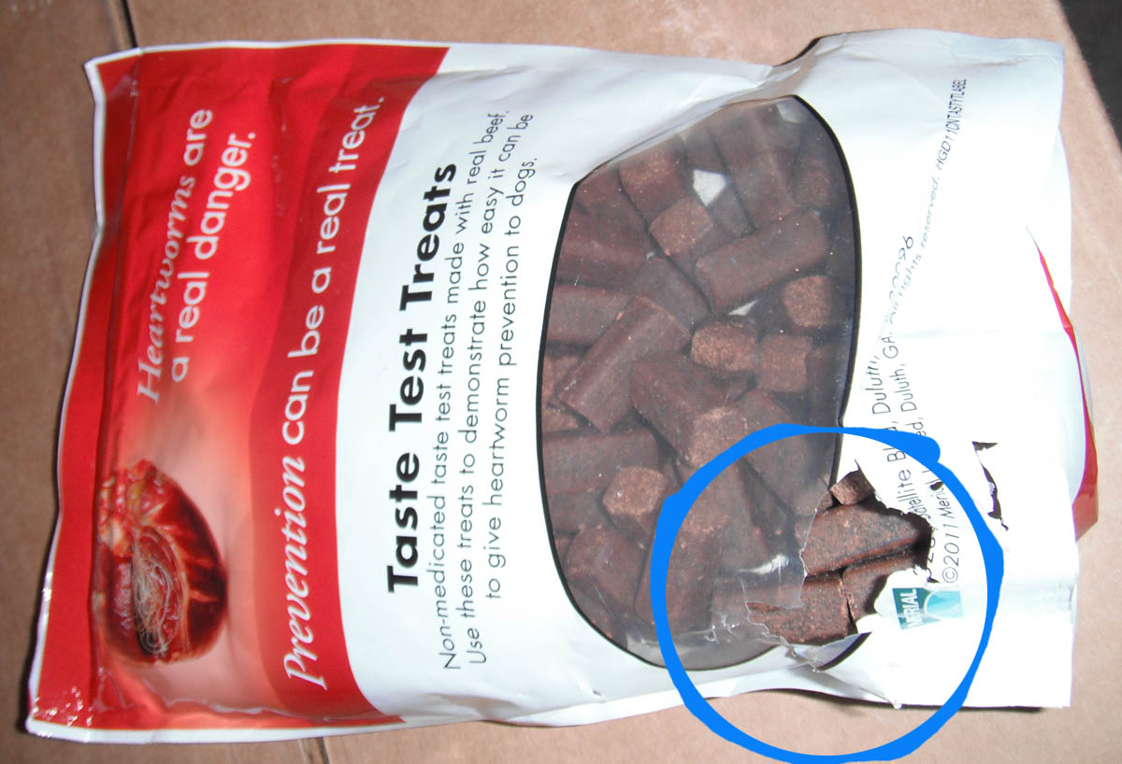
Research Problem
Plastic Films appears a shortage convenient for suitable the optimal protection and preservation of food products which will causes damages and corruption before it use.

Slide 15
Research outline
Introduction
Research Problem
Research objective
The important of Research
Methodology
Materials and methods
Results and Discussions
Recommendations
Conclusions

Slide 16
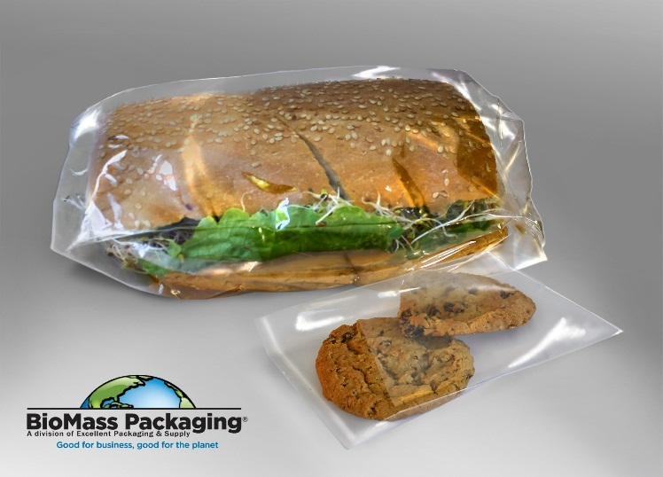
Research objective
Evaluate the main factors especially printing remedies “coating and ‎lamination” which affecting the strength of barrier properties of the plastic film against ‎gasses and water vapor
Tracking the first stages changing the barrier properties of Polypropylene film form the beginning of production ending to the packing stage.
Gain and analysis reliable data to measure the
invisible set-off migration from solvents remaining
at the package to the food product.

Slide 17
Research outline
Introduction
Research Problem
Research objective
The important of Research
Methodology
Materials and methods
Results and Discussions
Recommendations
Conclusions

Slide 18
The importance of research : " Loss rates in the food in the world is very high ."
Food and Agriculture Organization FAO give the proportion of corruption and waste of food as more than 1.3 billion tons per year, as part of the packaging industry, this data was recorded on international conference Interpack 2011 in Dusseldorf, Germany and it’s results was :
Both industrialized and developing countries is almost dissipated the same amounts of food, which increased by 670 and 630 million tons respectively.
Every year, consumers have wasted food rich countries increased by 222 million tons, equivalent to the total net food production in Africa and sub-Saharan Africa about 230 million tons.

Slide 19
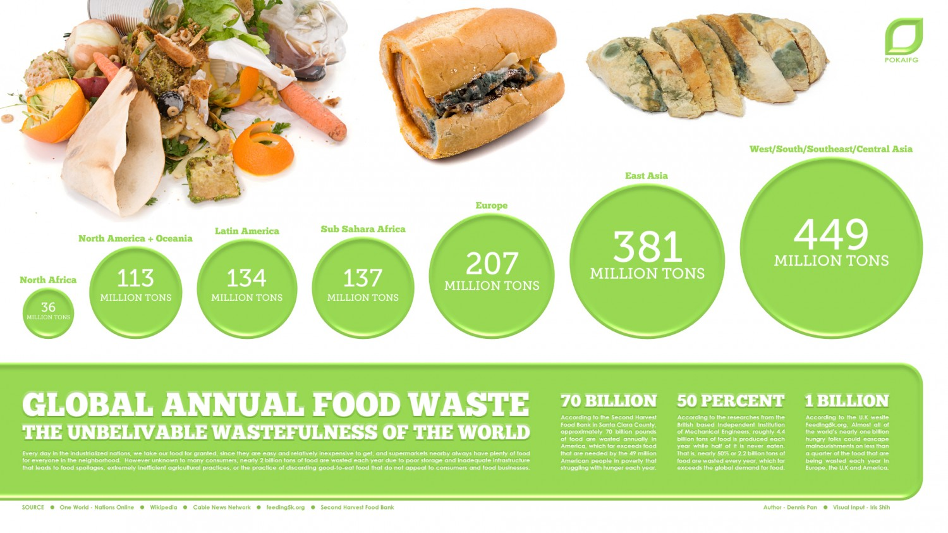

Slide 20
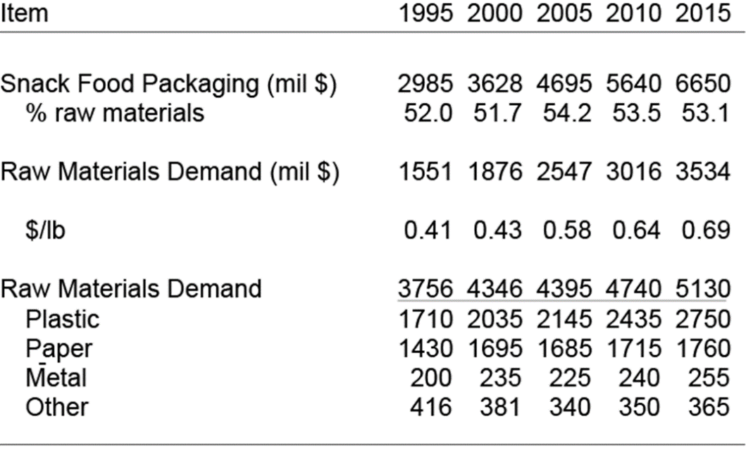
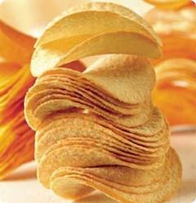
According to the foodstuff : Snack foods "snacks" Considered of processed food products and they are intended to does not substitute for the main meal of the day, such as potatoes and candy chips, baked goods, characterized as give the body the necessary energy between meals.
World consumption of Snack foods and as much as about 107 million tons in 2003, also estimated growth have increased by 3 - 4% per year that sales reached $ 20 billion in 2010 and then by the Organization of simther Pira, and considers these products it is very sensitive to oxygen gas products so it requires a high level of reservation.

Slide 21
Research outline
Introduction
Research Problem
Research objective
The important of Research
Methodology
Materials and methods
Results and Discussions
Recommendations
Conclusions

Slide 22
Methodology
Practical program consists of three main parts , namely:
The First part:
Identify the factors that affect the Barrier Properties , including those related ( oxygen permeability OTR properties - water permeability WVTR vapor ) prior to printing on polypropylene films directed in two axes, both Metalized BOPP & Transparent BOPP in order to determine the effect of the change permeability of the raw material due to the lamination techniques the impact of printing variables on the permeability either positively or negatively .
The second part:
Measuring the impact of change the concentration ratios of O2 on the biological effect on potato chips on exact time periods “ 30 days” on different places of storage
The third part:
Measurement of migration potential from rotogravure printing inks compounds “"Residual Solvent" Solvent retention” into snacks food samples contacted by GC

Slide 23
part I:
The first experiment : measuring the oxygen permeability OTR before lamination after lamination “solvent base technique” .
The second experiment : measuring water vapor permeability WVTR before lamination after lamination “solvent base technique” .
Where the measurement of polypropylene film in three cases :
- The first sample is transparent film only 20 microns thickness.
- The second sample printed film only thickness of 20 microns.
- The third film sample printed and laminated with polypropylene mineralized film thickness of 20 microns.

Slide 24
Part II : measuring the impact of changing oxygen ratios O2 on the biological effect on Potato Chips and on time periods and from different places to store
Measuring the impact of change the concentration ratios of O2 on the biological effect on potato chips on the same production line on exact time periods “ 30 days” on different places of storage " wet - dry - medium " :-
Oxygen ratio is greater than 5 % < (O2) inside the plastic bag (printed and laminated with polypropylene mineralized film thickness of 20 microns).
Oxygen ratio is smaller than 5 % > (O2) packaged inside the plastic bag.
Normal air without the injection of nitrogen (O2 = 21%) packaged inside the plastic bag.

Slide 25
To estimate the rates of chemical changes through the most important factors that affect the quality and taste , namely:
1- Flavor Percent
2- Oil Content
3-Moisture Percent
4- Oxygen percent
5- Peroxide Value
6- Free Fatly acid
7- Air Level

Slide 26
Part III : Measurement of migration potential from rotogravure printing inks compounds into foodstuff contacted by GC
Seven packaged samples on printed polypropylene film and laminated with metalized polypropylene both with 20 micros from different inks companies to the same product.
Four packaged samples with different kinds of snacks food from Egyptian market “ Before and after Lamination ( solvent base & solvent less)
Regarding the volatile measured, all sample were analyzed by Gas Chromatography.

Slide 27
Research outline
Introduction
Research Problem
Research objective
The important of Research
Methodology
Materials and methods
Results and Discussions
Recommendations
Conclusions

Slide 28
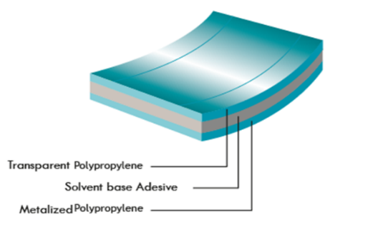
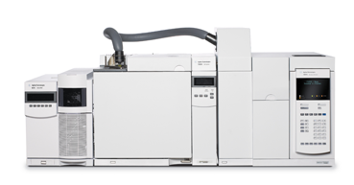
Materials and methods
Samples “ Six Samples”
Plain Transparent BOPP 20 Micron from EGYWRAP Company
Printed BOPP film 20 Micron from Rorographia Company
Laminated BOPP Printed film 20 with 20 micron metalized BOPP film
Devices
Oxygen Transmission permeation analyzer
Water Vapour Transmission permeation analyzer
GC “ Gas Chemotrophic” from Agilent Technologies
OXYBABY O₂ from WITT-GASETECHNIK

Slide 29
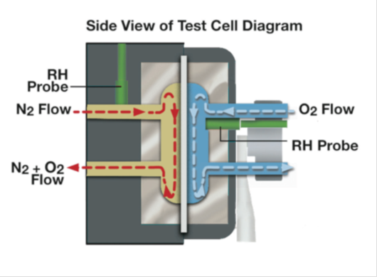
Oxygen Transmission Test
Test conditions
Temperature 23 degrees.
Humidity zero % "and is to be inside the machine ."
Standard used ASTM D 3985

Slide 30
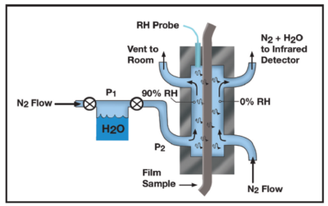
Water Vapour Transmission Test
Test conditions
Temperature 23 degrees Celsius.
Humidity 80-90% "and it is to be inside the machine ."
Standard used ASTM F-1249

Slide 31
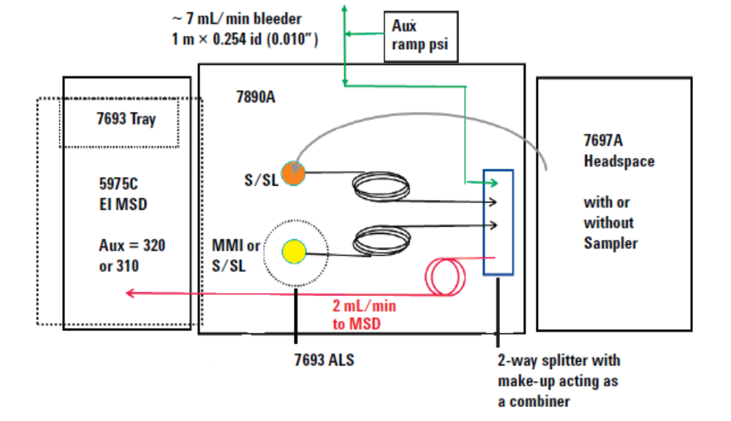
GC “Gas Chemotrophic”
Test conditions
Temperature 23 +/- 2 ^{O} .
Humidity 50-60%% “ .
Standard used ASTM F1884-04

Slide 32
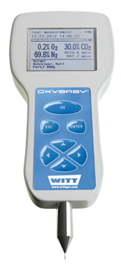
Oxygen Concentration tester
Test conditions
Temperature 23 +/- 2 ^{O} .
Humidity 50-60%.

Slide 33
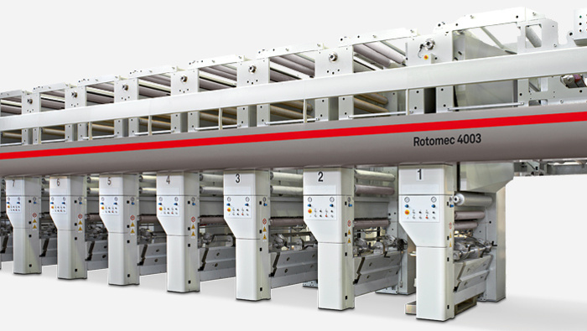
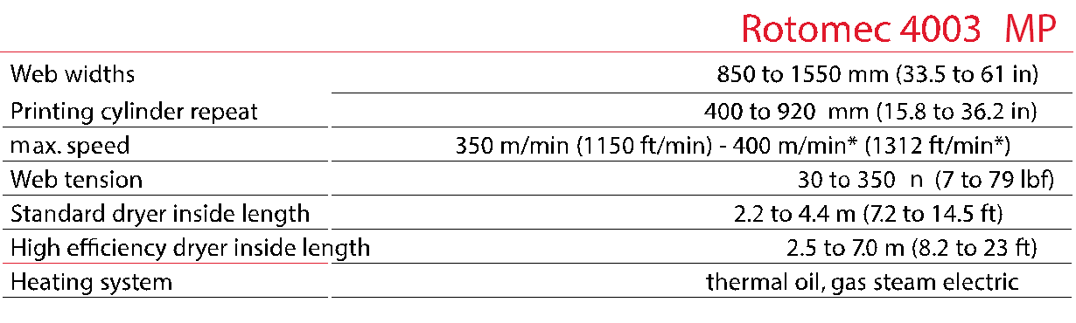
Printing machine
Plastic films is printed on Rotomec Rotogeravuor model machine 4003 composed of 10 units of printing , production of Bobst company.
Technical specifications of the machine Rotomec 4003,
which has been printing them

Slide 34
Research outline
Introduction
Research Problem
Research objective
The important of Research
Methodology
Materials and methods
Results and Discussions
Recommendations
Conclusions

Slide 35
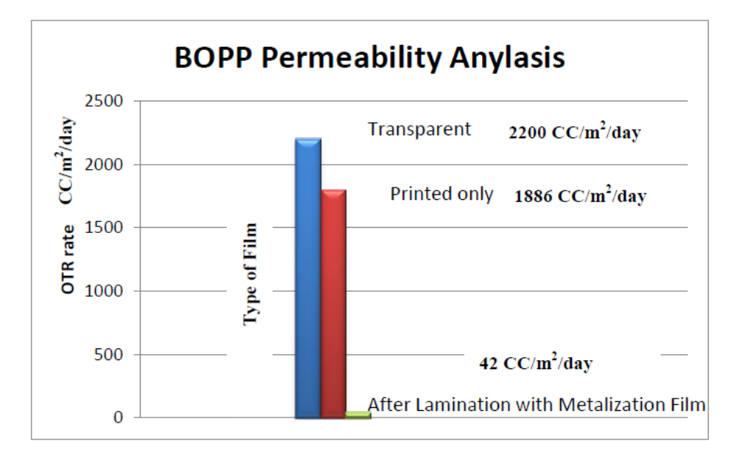
Results “First Part”
Permeability OTR of polypropylene film after and pre-printed and lamination

Slide 36
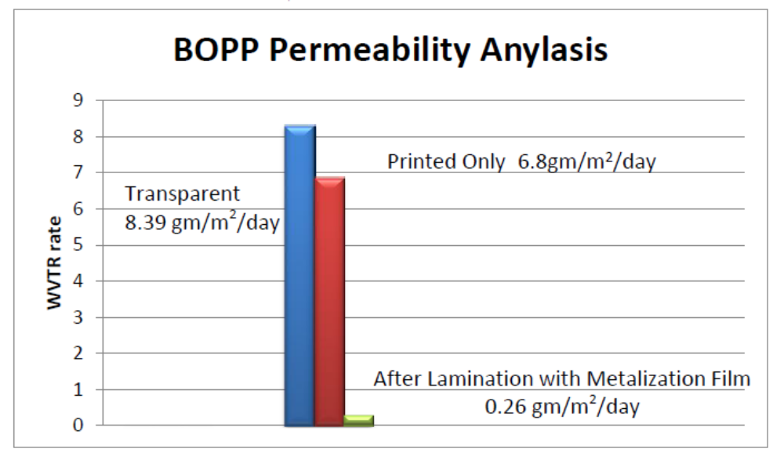
Results “First Part Cont.”
Permeability WVTR of polypropylene film after and pre-printed and lamination

Slide 37
Results “Second Part”
Date | Location | Test Name | O2- | O2+ | Air
First day | inside lab | flavor percent | 1.40% | 1.42% | 1.38%
 |  | oil content | 31.40% | 32.30% | 31.20%
 |  | moisture percent | 1.30% | 1.10% | 1.10%
 |  | oxygen percent | 3.00% | 12.40% | 21.40%
 |  | peroxide value | 0.4 gm/km | 0.38 gm/km | 0.38 gm/km
 |  | free fatty acid (FFA) | 0.18% | 0.18% | 0.18%
 |  | air level hight in product | 5.5 cm | 5.7 cm | 5.4 cm
After 30 days | outside lab | flavor percent | 1.28% | 1.30% | 1.35%
 |  | oil content | 31.80% | 33.40% | 31.50%
 |  | moisture percent | 1.20% | 1% | 1.40%
 |  | oxygen percent | 2.80% | 12.20% | 21.50%
 |  | peroxide value | 0.17% | 0.12% | 0.18%
 |  | Free fatty acid (FFA) | 0.18% | 0.18% | 0.18%
 |  | Air level hight in product | 5.8 cm | 5.8 cm | 5.5 cm
The impact of an increase or decrease of oxygen on potato chips after 30 days

Slide 38
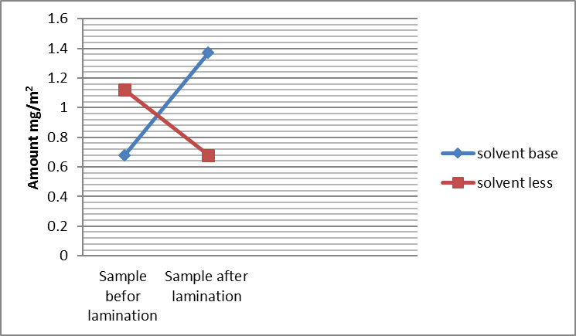
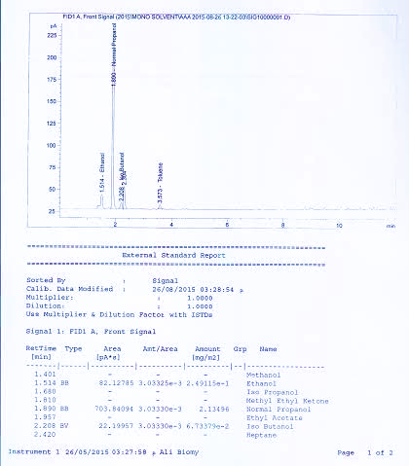
Results “Third Part”
RS mg/m² | Type of Sample
2.5 | A
9.47 | B
5.86 | C
5.38 | D
1.60 | E
4.8 | F
9.53 | G

Slide 39
Discussions
Part I:
Through the results of OTR became clear to us that printing materials had a positive impact where the ratio converted from 2200 to 1886 CC / m2 / 24 H, while in comparison with the film after lamination has reached to 42 , therefore we find that the film Aluminum and laminating adhesives have increased the final barrier capability very large margin .
Through the results of WVTR became that printing materials had a positive impact of ratio of 8.3 to 6.8 g / m2 / 24 H, while in comparison with the film after lamination has reached to 0.26 , and therefore, they also worked to reduce the number to a premium rate recommended by the World Organization Pira , which should be in the range of 0.3-0.5 .

Slide 40

Part II:
It is clear from the results of the experiment influenced Free Fatly acid, as well as the presence of oxygen Peroxide Value inside the product, but was up slightly, but there are changes in these properties, but these changes still did not exceed the standard specification of the plant which is more than the one mark .

Slide 41
Part III:
GC-MS analysis showed that the solvents volatile were readily found in all samples after finishing printing and lamination process with different values of residual solvents. According to the first test which contacted on seven samples, It can see that there are hazards and contaminated compounds such as “ methanol, iso – butyl, methyl Kenyon”.
The value of seven samples was recorded with 2.5, 9.47, 5.38, 5.38, 1.60, 4.8, 9.53 g/m² respectively. otherwise, the second test contacted on four snacks packaged samples. It provided a data on the decline of the RS value after one month past recorded with 5.55 to 2.75 g/m² . In brief, this result leads us to recognize the was a migration potential and there are considerable transmissions to inside the package, and it may effect on the consumer’s healthy cause of the chemical reaction.

Slide 42
Research outline
Introduction
Research Problem
Research objective
The important of Research
Methodology
Materials and methods
Results and Discussions
Recommendations
Conclusions

Slide 43
Recommendations
The use of Coating technology on a thin plastic film layers as a thin layer of aluminum oxides, silicates and oxides lead to increase the barrier properties of the film
EVOH is consider a high barrier polymers of the which has the same properties reserved for 10 times from LDPE and the same high performance, also for it can be used as a layer in the packaging of food products in multi-layered structure with different thicknesses up to 12 -25 microns
The use of nanotechnology as Nano particle size “ Nano clay” will be better if it mixed together with polymers to increase barrier properties

Slide 44
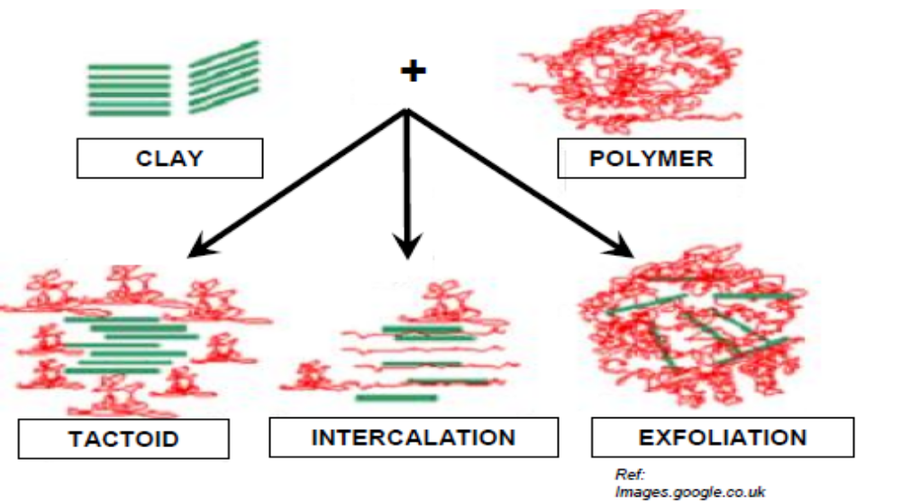
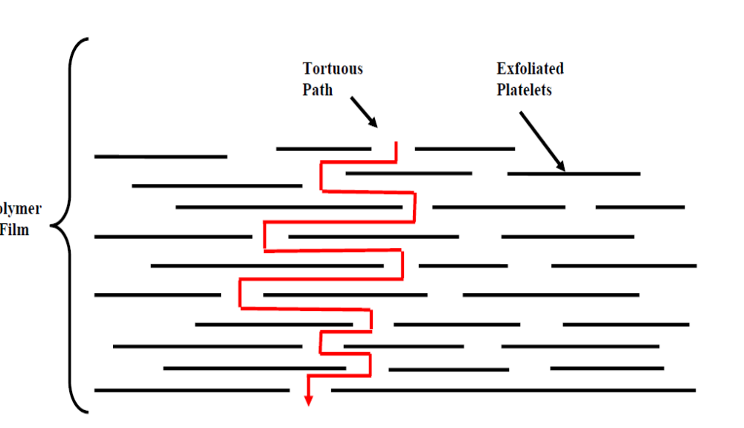
Recommendations

Slide 45
Research outline
Introduction
Research Problem
Research objective
The important of Research
Methodology
Materials and methods
Results and Discussions
Recommendations
Conclusions

Slide 46
Conclusions
Although the film Aluminum work to enhance the barrier to 42 in oxygen permeability of the film but the ratio recommended by the World Organization Pira when record potato chips should be from 5 to 10 CC / m2 / day, so it is necessary access to this medium to ensure the high quality of the product by adjusting the factors that increase the quality of the film.
Oxygen ratio must not increases more than 5% inside the plastic bag packed with slices of potatoes in order to be affected both Peroxide Value, Free fatty acid (FFA)

Slide 47


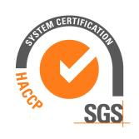
Advised to follow up on these measurements over spaced days for a period of six months , a period of validity of this the product to make sure to ensure the stability of these properties.
Commitment to implement the system BRC British Retail Consortium and HACCP System the application of nitrogen injection technology Nitrogen Injection (Flashing) and use the tracking system Traceability to the quality of the product through the various stages of his technique Modified atmosphere packaging

Slide 48

Tank you for Kind Attention
Yahya Ibrahiem Mohamed Khalifa
Yahya.appliedarts@gmail.com

