Slide 1

THE EFFECT OF ANTICOAGULANT TYPE ON LEVOFLOXACIN ANALYSIS IN PLASMA USING HIGH PERFORMANCE LIQUID CHROMATOGRAPHY – PHOTODIODE ARRAY
Yahdiana Harahap, Agus Imam Bahaudin, Harmita
Bioavailability/Bioequivalence Laboratory
Faculty of Pharmacy, Universitas Indonesia
  Analytical & Bioanalytical Techniques
Valencia, Spain 2015

Slide 2
INTRODUCTION
Levofloxacin is a broad spectrum antibiotic and is one of the compulsory drugs for bioequivalence testing, so that determination of its level in plasma is needed to be done for monitoring and ensuring its quality
Plasma is the most used biological matrix in bioanalysis and when it is used in an analysis, one of the important factors to be noticed is the types of anticoagulant being used.
Anticoagulant is used to avoid coagulation in handling the blood sample.
Ethylene Diamine Tetraacetate (EDTA), heparin, and citrate are anticoagulants often used in drug analysis in human blood

Slide 3


BACKGROUND
Analyte Molecule
Metabolism Profile
Clinical Parameter
Type of Anticoagulant
EDTA (Ethylene Diamine Tetra Acetate)
Chelating agent Ca²⁺
Heparin
Anti-Trombin III
Citrate / Citric Phosphate Dextrose (CPD)
Chelating agent Ca²⁺

Slide 4
THE OBJECTIVE OF RESEARCH
To develop and validate levofloxacin method analysis in human plasma by HPLC-Photodiode array and observing the effect of anticoagulant types to parameters stability, recovery, and the chromatogram profile .
The validated method will be applied to pilot bioequivalence study with six healthy subjects which were administered two 500 mg levofloxacin formulations.

Slide 5
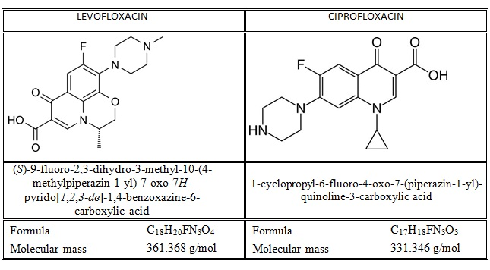

Slide 6
Methodology
Instruments and Chromatography condition
Preparation of Standard Calibrators
Sample Preparation
Method Validation
Comparison of levofloxacin analysis using 3 types of anticoagulant
Application to pilot bioequicalence study

Slide 7
Instruments
The HPLC (Waters Alliance 2695) consisted of degasser, HPLC pump, data processor, oven column, and photo diode array detector (Waters 2996).

Slide 8
Chromatographic Condition
Column : C₁₈ SunfireTM (5µm, 250 x 4,6 mm)
Column temperature : 45°C
Mobile Phase : 0.5% triethylamine pH 3.0 - acetonitrile (88:12)
Flow rate : 1.25 mL/minute
Detection : 293nm

Slide 9
Preparation of Standard
The standard curve in the concentration range of 50-10000 ng/mL was used in this study. The calibration samples were prepared at nine different concentration levels with blank and zero.

Slide 10


Blood Collection and Plasma Isolation
centrifugation
Heparin Plasma
Vacutainer Li-Heparin
Six Healthy Subjects
centrifugation
EDTA Plasma
Vacutainer K₃EDTA
Citrate Plasma

Slide 11
Sample Preparation
300 µL Plasma with Levofloxacin
(+) 50 µL Ciprofloxacin HCl 100.0 µg/mL
Add 450 µL Methanol
Shake with Vortex
for 3 mins
Centrifugation 10,000 g
for 10 mins
20 µL aliquot injected into HPLC
vortex

Slide 12
Method Validation of Levofloxacin in Plasma
Heparin Plasma
EDTA Plasma
Citrate Plasma
Full Validation:
LLOQ
Calibration Curve/Linearity
Selectivity
Carry-over
Accuracy & Precision
Recovery
Dilution integrity
Stability Test
Partial Validation:
Accuracy
Precision
-Stability Test

Slide 13
LLOQ
Conc. ng/mL | Area |  | PAR | Measured Concentration
 | Analyte | IS |  | ng/mL | Average | SD | % CV | % diff
50.00 | 2018 | 221269 | 0.0091 | 55.18 | 50.63 | 5.35 | 10.57 | 10.37
 | 1797 | 222022 | 0.0081 | 48.34 |  |  |  | -3.32
 | 1795 | 202890 | 0.0088 | 53.36 |  |  |  | 6,73
 | 1446 | 201289 | 0.0072 | 42.28 |  |  |  | -15.45
 | 1811 | 202550 | 0.0089 | 53.99 |  |  |  | 7.98
25.00 | 626 | 213044 | 0.0029 | 13.98 | 15.53 | 3.41 | 21.94 | -44.09
 | 857 | 230882 | 0.0037 | 19.13 |  |  |  | -23.46
 | 877 | 234988 | 0.0037 | 19.27 |  |  |  | -22,92
 | 578 | 206921 | 0.0028 | 13.01 |  |  |  | -47.95
 | 556 | 207467 | 0.0027 | 12.26 |  |  |  | -50.98

Slide 14
Calibration Curve
Concentration (ng/mL) | Area |  | PAR | Measured Concentration (ng/mL) | % diff
 | Analyte | IS
0.00 |  | 207181 | 0.0000 | 0.00
50.00 | 1525 | 207732 | 0.0073 | 43.33 | -13.35
100.00 | 3704 | 219318 | 0.0169 | 106.97 | 6.97
200.00 | 6474 | 225071 | 0.0288 | 186.12 | -6.94
500.00 | 15311 | 199824 | 0.0766 | 505.13 | 1.03
1000.00 | 31286 | 199670 | 0.1567 | 1038.81 | 3.88
5000.00 | 156726 | 210453 | 0.7447 | 4958.30 | -0.83
10000.00 | 315374 | 209742 | 1.5036 | 10016.95 | 0.17
Slope (b) | Intercept (a) | R | R²
0.0002 | 0.0008 | 1.0000 | 1.0000

Slide 15
Calibration Curve Inter-day
Conc. (ng/mL) | 0 | 50 | 100 | 200 | 500 | 1000 |  | 5000 |  |  | 10000 | R | Slope (b) | Intercept (a)
No. | Measured Concentration (ng/ml)
1 | 0.00 | 59.63 | 106.30 | 225.66 | 440.48 |  | 1025.36 |  | 4998.80 | 10000.42 |  | 1.0000 | 0.0001 | 0.0007
2 | 0.00 | 54.73 | 113.21 | 199.70 | 512.97 |  | 1042.01 |  | 4907.66 | 10041.17 |  | 0.9999 | 0.0001 | 0.0032
3 | 0.00 | 55.09 | 112.16 | 182.05 | 474.47 |  | 1008.02 |  | 4998.77 | 10001.30 |  | 1.0000 | 0.0002 | -0.0027
4 | 0.00 | 53.32 | 104.59 | 211.51 | 449.55 |  | 1040.93 |  | 5033.07 | 9981.60 |  | 1.0000 | 0.0001 | 0.0027
5 | 0.00 | 42.89 | 90.47 | 170.60 | 468.31 |  | 911.97 |  | 5294.21 | 9864.00 |  | 0.9994 | 0.0002 | -0.0011
Average | 0.00 | 56.48 | 110.56 | 202.47 | 475.98 |  | 1025.13 |  | 4968.41 | 10014.30 |  | 0.9998 | 0.0001 | 0.0006
SD | 0.00 | 2.73 | 3.72 | 21.94 | 36.27 |  | 16.99 |  | 52.61 | 23.28
CV (%) | 0.00 | 4.84 | 3.37 | 10.83 | 7.62 |  | 1.66 |  | 1.06 | 0.23

Slide 16
Selectivity
Conc. (ng/mL) |  | Area |  | PAR | Measured Concentration |  |  |  | % diff
 |  | Analyte | IS |  | ng/mL | Average | SD | % CV
50.00 | A | 2018 | 221269 | 0.0091 | 58.41 | 53.05 | 5.07 | 9.56 | 16.81
 |  | 1675 | 200094 | 0.0084 | 51.59 |  |  |  | 3.18
 | B | 1797 | 222022 | 0.0081 | 49.07 |  |  |  | -1.86
 |  | 1814 | 197173 | 0.0092 | 59.13 |  |  |  | 18.27
 | C | 1795 | 202890 | 0.0088 | 55.92 |  |  |  | 11.85
 |  | 1716 | 196319 | 0.0087 | 54.96 |  |  |  | 9.91
 | D | 1446 | 201289 | 0.0072 | 40.79 |  |  |  | -18.42
 |  | 1542 | 188658 | 0.0082 | 49.79 |  |  |  | -0.41
 | E | 1811 | 202550 | 0.0089 | 56.78 |  |  |  | 13.55
 |  | 1684 | 201939 | 0.0083 | 51.30 |  |  |  | 2.60
 | F | 1893 | 213495 | 0.0089 | 56.10 |  |  |  | 12.20
 |  | 1996 | 234873 | 0.0085 | 52.75 |  |  |  | 5.50

Slide 17
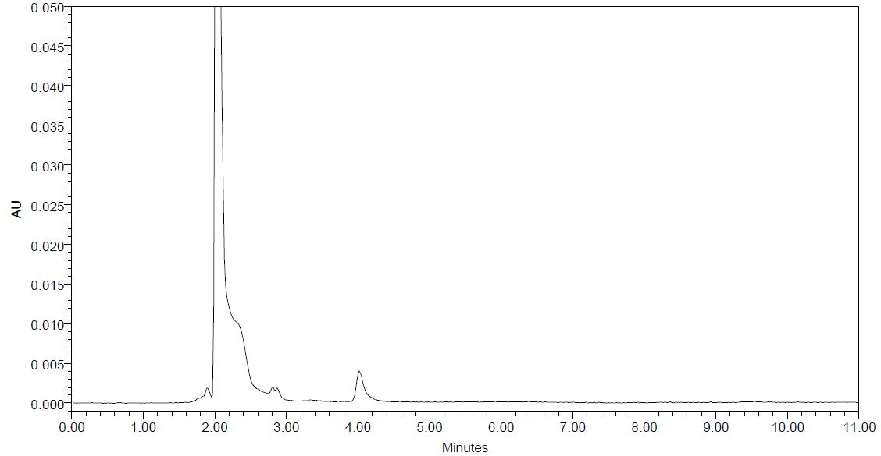
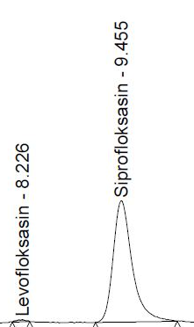
Overlay Plasma LLOQ-Blank
Plasma LLOQ
Blank Plasma

Slide 18

Accuracy, Precision, and Recovery
LLOQ
QCL = 3 x LLOQ
QCM = ± 50% Calibration Curve
QCH = 75% ULOQ
Citrate Plasma
Heparin
Plasma
EDTA
Plasma
Sample
5 repl
Min. 2 different days
Within-run (intra-day)
Between-run (intra-day)
Parameter:
Accuracy → % diff
Precision → % CV
Rec → Absolute Recovery and Modification

Slide 19
Result of Accuracy and Precision of Citrate Plasma
Conc. ng/mL | Day | Measured Conc. | % CV | % diff | % CV
50.00 | 1 | 53.29 | 10.85 | 6.59 | 8.94
 |  | 46.02 |  | -7.96
 |  | 44.65 |  | -10.71
 |  | 40.59 |  | -18.83
 |  | 51.17 |  | 2.35
 | 2 | 52.18 | 17.16 | 4.35
 |  | 40.20 |  | -19.61
 |  | 40.92 |  | -18.16
 |  | 56.48 |  | 12.96
 |  | 58.06 |  | 16.12
 | 3 | 56.10 | 4.67 | 12.21
 |  | 55.23 |  | 10.47
 |  | 59.36 |  | 18.72
 |  | 52.17 |  | 4.34
 |  | 56.87 |  | 13.75
Conc. ng/mL | Day | Measured Conc. | % CV | % diff | % CV
150.00 | 1 | 166.70 | 3.23 | 11.14 | 7.16
 |  | 155.73 |  | 3.82
 |  | 162.54 |  | 8.36
 |  | 169.85 |  | 13.23
 |  | 164.19 |  | 9.46
 | 2 | 128.23 | 8.81 | -14.52
 |  | 150.25 |  | 0.16
 |  | 132.66 |  | -11.56
 |  | 156.56 |  | 4.37
 |  | 152.30 |  | 1.53
 | 3 | 141.86 | 4.61 | -5.43
 |  | 147.53 |  | -1.64
 |  | 139.79 |  | -6.81
 |  | 145.03 |  | -3.31
 |  | 157.11 |  | 4.74

Slide 20
Result of Accuracy and Precision of Citrate Plasma
Conc. ng/mL | Day | Measured Conc. | % CV | % diff | % CV
5000 | 1 | 4294.73 | 7.69 | -14.11 | 3.72
 |  | 4949.63 |  | -1.01
 |  | 5174.05 |  | 3.48
 |  | 4500.77 |  | -9.98
 |  | 4529.02 |  | -9.42
 | 2 | 4336.18 | 3.09 | -13.28
 |  | 4408.63 |  | -11.83
 |  | 4504.54 |  | -9.91
 |  | 4635.21 |  | -7.30
 |  | 4294.67 |  | -14.11
 | 3 | 4475.16 | 3.30 | -10.50
 |  | 4254.95 |  | -14.90
 |  | 4265.83 |  | -14.68
 |  | 4294.45 |  | -14.11
 |  | 4576.37 |  | -8.47
Conc. ng/mL | Day | Measured Conc. | % CV | % diff | % CV
7500 | 1 | 8579.07 | 0.39 | 14.39 | 12.11
 |  | 8563.39 |  | 14.18
 |  | 8551.07 |  | 14.01
 |  | 8521.93 |  | 13.63
 |  | 8496.01 |  | 13.28
 | 2 | 6847.25 | 2.23 | -8.70
 |  | 6833.94 |  | -8.88
 |  | 7011.39 |  | -6.51
 |  | 6591.29 |  | -12.12
 |  | 6766.47 |  | -9.78
 | 3 | 6922.07 | 3.53 | -7.71
 |  | 7061.70 |  | -5.84
 |  | 7570.93 |  | 0.95
 |  | 7309.02 |  | -2.55
 |  | 7091.72 |  | -5.44

Slide 21
Result of Accuracy and Precision of Heparin Plasma
Conc. ng/mL | Day | Measured Conc. | % CV | % diff | % CV
50.00 | 1 | 47.51 | 5.99 | -4.97 | 2.27
 |  | 47.71 |  | -4.58
 |  | 53.57 |  | 7.14
 |  | 52.57 |  | 5.14
 |  | 53.28 |  | 6.55
 | 2 | 50.48 | 5.01 | 0.97
 |  | 50.50 |  | 1.00
 |  | 53.96 |  | 7.93
 |  | 56.02 |  | 12.03
 |  | 55.51 |  | 11.03
 | 3 | 52.83 | 7.28 | 5.66
 |  | 52.99 |  | 5.98
 |  | 55.15 |  | 10.29
 |  | 54.35 |  | 8.70
 |  | 45.61 |  | -8.77
Conc. ng/mL | Day | Measured Conc. | % CV | % diff | % CV
150.00 | 1 | 132.01 | 10.91 | -11.99 | 6.13
 |  | 129.84 |  | -13.44
 |  | 137.67 |  | -8.22
 |  | 150.61 |  | 0.41
 |  | 167.52 |  | 11.68
 | 2 | 152.31 | 2.70 | 1.54
 |  | 146.10 |  | -2.60
 |  | 156.36 |  | 4.24
 |  | 155.99 |  | 3.99
 |  | 153.38 |  | 2.26
 | 3 | 133.35 | 3.31 | -11.10
 |  | 139.08 |  | -7.28
 |  | 140.86 |  | -6.09
 |  | 131.06 |  | -12.63
 |  | 131.70 |  | -12.20

Slide 22
Result of Accuracy and Precision of Heparin Plasma
Conc. ng/mL | Day | Measured Conc. | % CV | % diff | % CV
7500 | 1 | 7619.34 | 5.40 | 1.59 | 5.32
 |  | 7936.15 |  | 5.82
 |  | 7544.60 |  | 0.59
 |  | 6833.72 |  | -8.88
 |  | 7573.50 |  | 0.98
 | 2 | 8357.92 | 3.98 | 11.44
 |  | 8509.14 |  | 13.46
 |  | 7667.75 |  | 2.24
 |  | 8349.55 |  | 11.33
 |  | 8309.99 |  | 10.80
 | 3 | 8293.64 | 3.49 | 10.58
 |  | 8373.96 |  | 11.65
 |  | 7739.40 |  | 3.19
 |  | 8301.36 |  | 10.68
 |  | 8473.62 |  | 12.98
Conc. ng/mL | Day | Measured Conc. | % CV | % diff | % CV
5000 | 1 | 4348.19 | 0.88 | -13.04 | 9.19
 |  | 4333.78 |  | -13.32
 |  | 4362.10 |  | -12.76
 |  | 4434.01 |  | -11.32
 |  | 4363.40 |  | -12.73
 | 2 | 4464.63 | 1.91 | -10.71
 |  | 4276.02 |  | -14.48
 |  | 4264.94 |  | -14.70
 |  | 4282.25 |  | -14.35
 |  | 4318.77 |  | -13.62
 | 3 | 4916.75 | 2.98 | -1.67
 |  | 5042.10 |  | 0.84
 |  | 4954.71 |  | -0.91
 |  | 5181.81 |  | 3.64
 |  | 5273.00 |  | 5.46

Slide 23
Result of Accuracy and Precision of EDTA Plasma
Conc. ng/mL | Day | Measured Conc. | % CV | % diff | % CV
150.00 | 1 | 132.82 | 7.43 | -11.45 | 0.97
 |  | 145.76 |  | -2.82
 |  | 160.28 |  | 6.85
 |  | 158.73 |  | 5.82
 |  | 149.74 |  | -0.17
 | 2 | 138.60 | 7.95 | -7.60
 |  | 156.38 |  | 4.25
 |  | 160.91 |  | 7.27
 |  | 133.13 |  | -11.25
 |  | 145.65 |  | -2.90
 | 3 | 141.55 | 6.83 | -5.63
 |  | 133.80 |  | -10.80
 |  | 148.83 |  | -0.78
 |  | 160.56 |  | 7.04
 |  | 150.44 |  | 0.29
Conc. ng/mL | Day | Measured Conc. | % CV | % diff | % CV
50.00 | 1 | 53.06 | 4.11 | 6.12 | 2.70
 |  | 51.63 |  | 3.25
 |  | 55.71 |  | 11.42
 |  | 56.73 |  | 13.47
 |  | 56.40 |  | 12.79
 | 2 | 53.04 | 5.20 | 6.07
 |  | 53.44 |  | 6.87
 |  | 49.49 |  | -1.02
 |  | 51.71 |  | 3.43
 |  | 57.02 |  | 14.04
 | 3 | 48.73 | 5.74 | -2.54
 |  | 52.92 |  | 5.83
 |  | 49.91 |  | -0.18
 |  | 56.39 |  | 12.79
 |  | 51.37 |  | 2.74

Slide 24
Result of Accuracy and Precision of EDTA Plasma
Conc. ng/mL | Day | Measured Conc. | % CV | % diff | % CV
7500 | 1 | 8250.49 | 1.35 | 10.01 | 6.54
 |  | 8380.35 |  | 11.74
 |  | 8414.35 |  | 12.19
 |  | 8546.61 |  | 13.95
 |  | 8494.73 |  | 13.26
 | 2 | 7246.72 | 7.50 | -3.38
 |  | 7010.43 |  | -6.53
 |  | 8446.75 |  | 12.62
 |  | 7322.54 |  | -2.37
 |  | 7770.12 |  | 3.60
 | 3 | 7414.01 | 4.71 | -1.15
 |  | 7074.69 |  | -5.67
 |  | 7601.88 |  | 1.36
 |  | 8039.14 |  | 7.19
 |  | 7392.79 |  | -1.43
Conc. ng/mL | Day | Measured Conc. | % CV | % diff | % CV
5000 | 1 | 4934.47 | 5.78 | -1.31 | 6.47
 |  | 5145.11 |  | 2.90
 |  | 4439.22 |  | -11.22
 |  | 4823.51 |  | -3.53
 |  | 5100.48 |  | 2.01
 | 2 | 4757.35 | 4.72 | -4.85
 |  | 4401.42 |  | -11.97
 |  | 4287.12 |  | -14.26
 |  | 4261.61 |  | -14.77
 |  | 4285.99 |  | -14.28
 | 3 | 4901.06 | 1.75 | -1.98
 |  | 4941.48 |  | -1.17
 |  | 4870.09 |  | -2.60
 |  | 5062.68 |  | 1.25
 |  | 5049.33 |  | 0.99

Slide 25
Recovery
Concentration | Citrate |  | Heparin |  | EDTA
 | % Rec | %CV | % Rec | %CV | % Rec | %CV
QCL | 80.35 | 6.29 | 84.20 | 2.09 | 75.57 | 9.34
 | 90.86 |  | 82.37 |  | 86.22
 | 83.85 |  | 80.75 |  | 90.94
QCM | 88.22 | 3.66 | 77.87 | 6.39 | 69.44 | 8.09
 | 83.20 |  | 86.77 |  | 80.32
 | 89.09 |  | 87.55 |  | 80.03
QCH | 103.75 | 3.82 | 100.07 | 7.10 | 90.26 | 8.39
 | 100.55 |  | 101.10 |  | 103.13
 | 108.47 |  | 113.45 |  | 105.98
IS | 43.40 | 2.01 | 46.10 | 9.56 | 50.49 | 5.80
 | 42.86 |  | 48.52 |  | 47.66
 | 41.72 |  | 55.32 |  | 44.96

Slide 26
Dilution Integrity
Sample
Concentration above ULOQ
Objective:
To check whether the dilution during in-study analysis is reliable or not especially when samples are over ULOQ.
Half Dilution
Quarter Dilution

Slide 27
Dilution Integrity
Half Dilution
Conc. | Day | Meas Conc | % CV | % diff | % CV
7500 | 1 | 7405.31 | 2.73 | -1.26 | 6.51
 |  | 7868.28 |  | 4.91
 |  | 7789.45 |  | 3.86
 |  | 7874.63 |  | 5.00
 |  | 7932.50 |  | 5.77
 | 2 | 7255.18 | 3.06 | -3.26
 |  | 7072.10 |  | -5.71
 |  | 7178.69 |  | -4.28
 |  | 6954.84 |  | -7.27
 |  | 6705.20 |  | -10,60
 | 3 | 6885.55 | 1.61 | -8.19
 |  | 7055.88 |  | -5.92
 |  | 6882,88 |  | -8.23
 |  | 6745.84 |  | -10.06
 |  | 6923.86 |  | -7.68
Quarter Dilution
Conc. | Day | Meas Conc | % CV | % diff | % CV
3750 | 1 | 3486.88 | 3.11 | -7.02 | 4.36
 |  | 3611.49 |  | -3.69
 |  | 3647.82 |  | -2.72
 |  | 3405.76 |  | -9.18
 |  | 3424.06 |  | -8.69
 | 2 | 3222.80 | 1.01 | -14.06
 |  | 3245.27 |  | -13.46
 |  | 3299.70 |  | -12.01
 |  | 3218.47 |  | -14.17
 |  | 3258.33 |  | -13.11
 | 3 | 3220.26 | 2.78 | -14.13
 |  | 3426.82 |  | -8.62
 |  | 3194.40 |  | -14.82
 |  | 3254.09 |  | -13.22
 |  | 3295.14 |  | -12.13
  Analytical & Bioanalytical Techniques

Slide 28
Carry-Over
No. | Area on blank plasma |  | Area on LLOQ Plasma Sample |  | % Carry-over
 | Analyte | IS | Analyte | IS | Analyte | IS
1 | 43 | 92 | 2018 | 221269 | 2.13% | 0.04%
2 | 40 | 108 | 1797 | 222022 | 2.23% | 0.05%
3 | 35 | 79 | 1795 | 202890 | 1.95% | 0.04%
4 | 71 | 111 | 1446 | 201289 | 4.91% | 0.06%
5 | 41 | 90 | 1811 | 202550 | 2.26% | 0.04%
Average |  |  |  |  | 2.70% | 0.05%
Requirement % carry-over |  |  |  |  | < 20% | < 5 %

Slide 29
Stability Test
Freeze-Thaw Stability
Long Term Stability
Stock Solution Stability
Short Term Stability
Autosampler Stability
Citrate
Plasma
Heparin
Plasma
EDTA
Plasma

Slide 30
Freeze and Thaw Stability
Citrate Plasma
Conc. | Cycle | % diff
QCL | 0 Cycle | 11.98
 |  | -3.88
 |  | -7.82
 | 3 Cycle | 14.68
 |  | 12.42
 |  | -2.64
QCH | 0 Cycle | 9.93
 |  | 13.98
 |  | 12.81
 | 3 Cycle | 13.79
 |  | 14.16
 |  | 11.07
Heparin Plasma
Conc. | Cycle | % diff
QCL | 0 Cycle | -6.20
 |  | -2.93
 |  | -3.66
 | 3 Cycle | 8.45
 |  | 11.61
 |  | 5.57
QCH | 0 Cycle | 14.74
 |  | 14.39
 |  | 14.53
 | 3 Cycle | 14.88
 |  | 14.71
 |  | 13.93
EDTA Plasma
Conc. | Cycle | % diff
QCL | 0 Cycle | 3.90
 |  | 3.82
 |  | -2.14
 | 3 Cycle | -8.49
 |  | -5.11
 |  | -10.68
QCH | 0 Cycle | -14.92
 |  | 14.57
 |  | 13.39
 | 3 Cycle | 14.03
 |  | 14.57
 |  | 14.25

Slide 31
Short Term Stability
Time | % diff Citrate |  | % diff Heparin |  | % diff EDTA
 | QCL | QCH | QCL | QCH | QCL | QCH
Hour -0 | 11.98 | 9.93 | -6.20 | 14.74 | 3.90 | -14.92
 | -3.88 | 13.98 | -2.93 | 14.39 | 3.82 | 14.57
 | -7.82 | 12.81 | -3.66 | 14.53 | -2.14 | 13.39
Hour-7 | 2.01 | 5.22 | 6.06 | 12.64 | -4.41 | 5.44
 | 13.60 | 9.00 | -1.80 | 14.83 | -13.56 | 9.83
 | -11.70 | -2.81 | -12.63 | 14.00 | 11.88 | 14.21
Hour-24 | -12.80 | -11.03 | 11.74 | 11.22 | 2.06 | 14.65
 | -13.99 | 8.66 | 6.82 | 5.11 | 0.83 | 14.69
 | -1.54 | 7.40 | 8.16 | -1.43 | -5.39 | 14.32

Slide 32
Long Term Stability
Time | % diff Citrate |  | % diff Heparin |  | % diff EDTA
 | QCL | QCH | QCL | QCH | QCL | QCH
Day-1 | 11.98 | 9.93 | -6.20 | 14.74 | 3.90 | -14.92
 | -3.88 | 13.98 | -2.93 | 14.39 | 3.82 | 14.57
 | -7.82 | 12.81 | -3.66 | 14.53 | -2.14 | 13.39
Day-7 | -0.11 | -10.37 | 13.24 | -3.91 | 0.37 | -14.74
 | 9.45 | -12.25 | 14.15 | -1.78 | -3.22 | -7.14
 | 4.47 | -13.64 | 14.11 | -7.59 | -1.75 | -10.40
Day-14 | -6.07 | -14.18 | -5.09 | -12.40 | -12.72 | -9.80
 | 1.53 | -13.41 | -3.08 | -11.63 | -14.18 | -7.65
 | -1.31 | -14.68 | -7.95 | -5.95 | -14.09 | -12.14
Day-23 | 4.89 | -13.38 | 8.84 | -7.17 | -11.80 | -3.67
 | 5.06 | -11.94 | -0.67 | -8.38 | 1.62 | -14.35
 | 10.64 | -14.88 | -4.74 | -8.21 | -6.31 | -6.00
Day-31 | 13.04 | -0.53 | -9.14 | -10.96 | -12.04 | -5.84
 | -1.48 | -2.25 | 2.66 | 3.03 | -13.11 | 5.42
 | 10.39 | 0.85 | -7.11 | 11.55 | -13.85 | -3.43

Slide 33
Autosampler Stability
Time (hour) | % diff Citrate |  | % diff Heparin |  | % diff EDTA
 | QCL | QCH | QCL | QCH | QCL | QCH
0 | 11.98 | 9.93 | -6.20 | 14.74 | 3.90 | -14.92
 | -3.88 | 13.98 | -2.93 | 14.39 | 3.82 | 14.57
 | -7.82 | 12.81 | -3.66 | 14.53 | -2.14 | 13.39
24 | 10.16 | 6.06 | 5.44 | 14.41 | -1.78 | -13.19
 | 4.42 | 10.70 | -3.85 | 14.83 | -12.98 | 12.74
 | 9.07 | 12.64 | -10.96 | 10.99 | 14.22 | 12.25

Slide 34
Comparison of Levofloxacin Analysis Using 3 Types of Anticoagulant

Slide 35
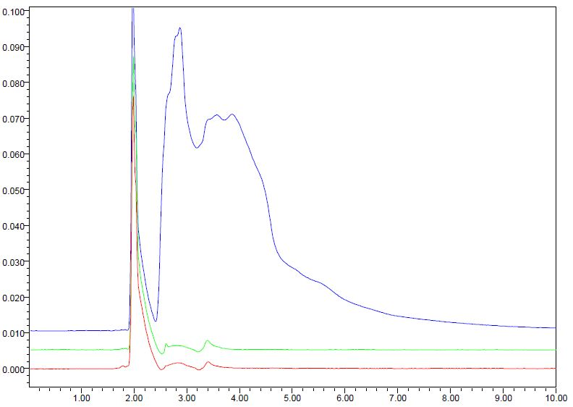
EDTA Plasma Blank
Heparin Plasma Blank
Citrate Plasma Blank

Slide 36
Parameter Analysis |  | Plasma Type |  |  |  |  |  | Difference | PValue
 |  | Citrate |  | Heparin |  | EDTA
Recovery (% ± SD)
1.QCL | 85.02 ± 5.35 |  | 82.44 ± 1.72 |  | 84.24 ± 7.87 |  | There is no significant difference |  | 0.849
2.QCH | 104.25 ± 3.99 |  | 104.87 ± 74.88 |  | 99.79 ± 8.38
 |  |  |  |  |  |  |  |  | 0.635
Peak Area Ratio (± SD)
1.QCL | 0.0211 ± 0.0030 |  | 0.0221 ± 0.0024 |  | 0.0177 ± 0.0020 |  | Citrate-EDTA; Heparin-EDTA |  | 0.000*
2.QCM | 0.6174 ± 0.0714 |  | 0.6896 ± 0.0550 |  | 0.6896 ± 0.0564 |  | Sitrat-Heparin; Sitrat-EDTA |  | 0.020*
3.QCH | 1.0218 ± 0.0569 |  | 1.2012 ± 0.0723 |  | 1.1396 ± 0.1092 |  | Sitrat-Heparin; Sitrat-EDTA |  | 0.000*
P > 0,05 ; no significant difference
P < 0,05 ; significant different
* Kruskal Wallis and Mann-Whitney Test

Slide 37
Parameter Analysis | Type of Plasma
 | Citrate | Heparin | EDTA
Stability at temperature of ±25°C (short term)
QCL | 24 h | 24 h | 24 h
QCH | 24 h | 24 h | 24 h
Stability post preparation (in autosampler)
QCL | 24 h | 24 h | 24 h
QCH | 24 h | 24 h | 24 h
Stability freeze-thaw cycle
QCL | 3 cycle | 3 cycle | 3 cycle
QCH | 3 cycle | 3 cycle | 3 cycle
Stability at temperature of -20°C (Long Term)
QCL | 31 days | 31 days | 31 days
QCH | 31 days | 31 days | 31 days

Slide 38
Application to Pilot Bioequivalence Study

Slide 39
Pilot Bioequivalence study
The validated method was applied to the pilot bioequivalence study of levofloxacin after a single oral administration of 500 mg levofloxacin film-coated tablet to 6 healthy Indonesian subjects.

Slide 40
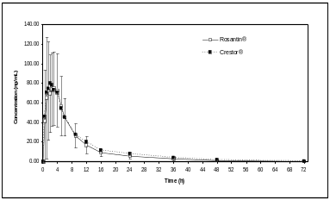
Study
Protocol
passed
Subject screening
6 healthy subjects
Signed
informed
consent
single-dose, open-label,
randomized,
two-way crossover
fasting
Blood pressure, heart
rate, body temperature and adverse events were monitored during blood sampling.
Blood sampling pre dose, 0.25, 0.5, 1, 1.5, 2, 2.5, 3, 4, 6, 8, 12, 24 hours (one week wash-out period)
Committee of The Medical Research Ethics of the Faculty of Medicine, Universitas Indonesia
9 mL of Blood
Plasma isolation using CPD-A
Validated method
Linear 50-10000 ng/mL
Plasma was frozen at -20°C
Notes:
40

Slide 41
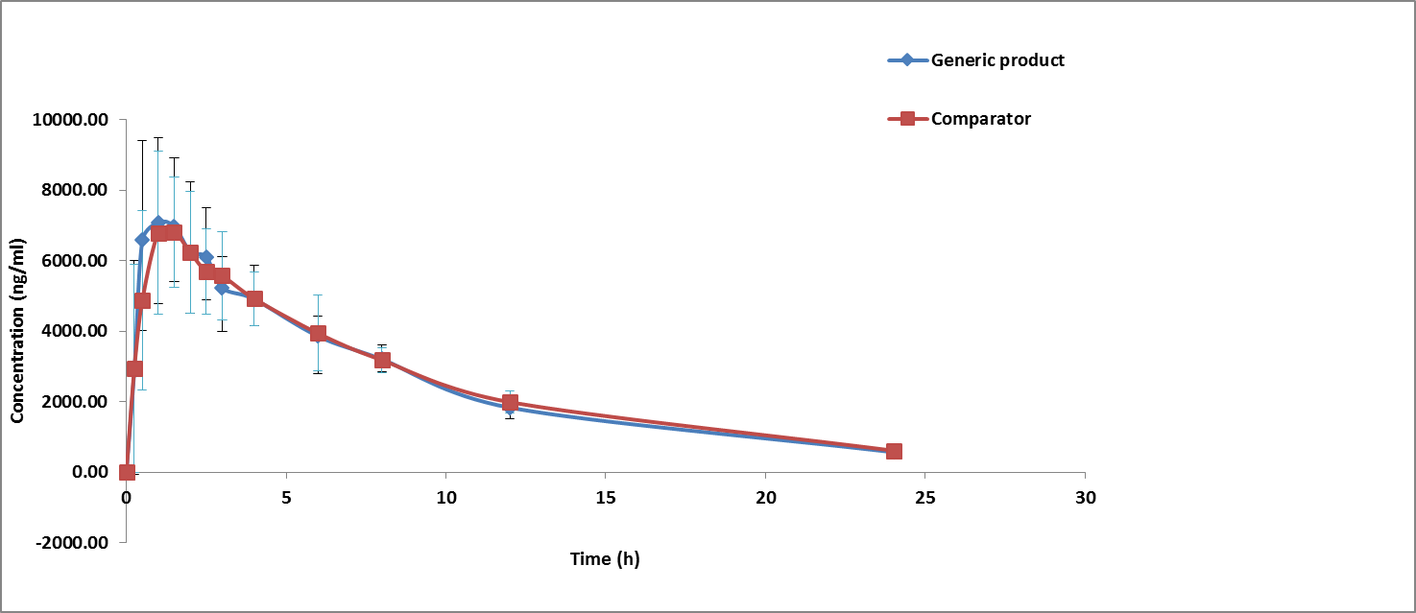
Pharmacokinetic evaluation
Mean plasma concentration-time profiles of levofloxacin after a single dose of two 500 mg levofloxacin film-coated tablets of two different formulations

Slide 42
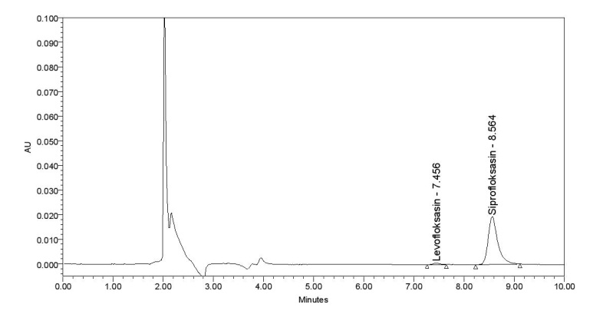
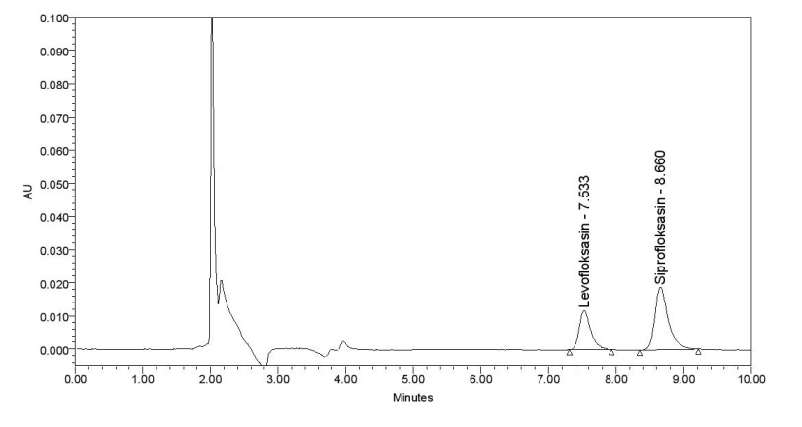
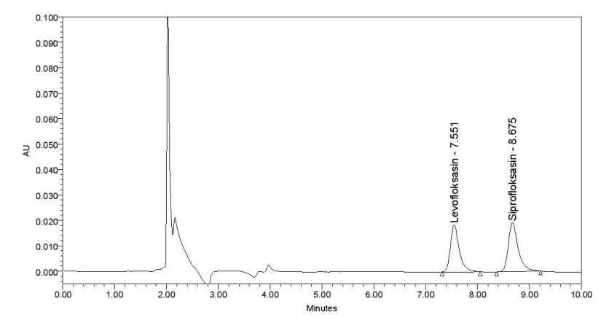
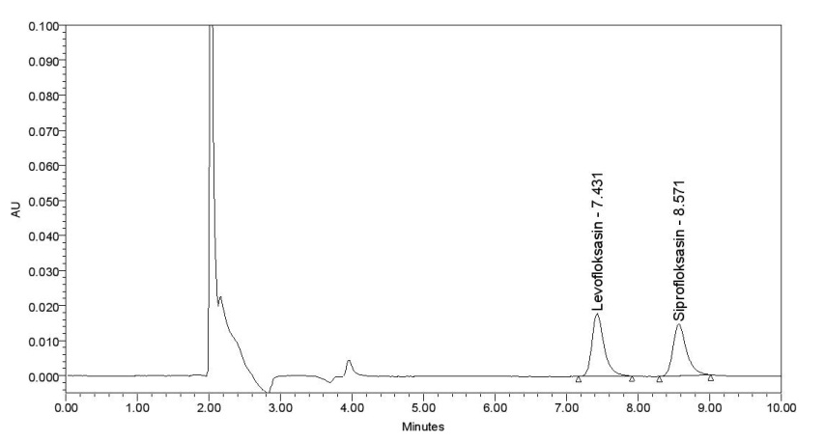
Chromatogram of QCL
Chromatogram of QCM
Chromatogram of QCH
Chromatogram of Sample

Slide 43
CONCLUSION
  Bioanalysis method has fulfilled the validation criteria, which was linear at 50 – 10000 ng/ml
  There was no significant difference in stability and recovery of levofloxacin in plasma (p > 0.05), however there was significant difference (p < 0.05) in PAR value.
  The method has been successfully applied for pilot bioequivalence study with six Indonesian healthy subjects using CPD-A as anticoagulant after administration of 500mg levofloxacin.

Slide 44
ACKNOWLEDGEMENTS
This study was supported by the Directory of Research and Public Service Universitas Indonesia.

Slide 45

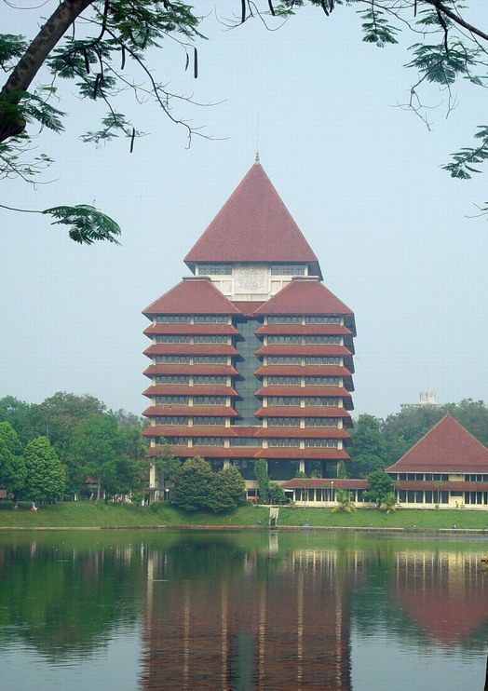
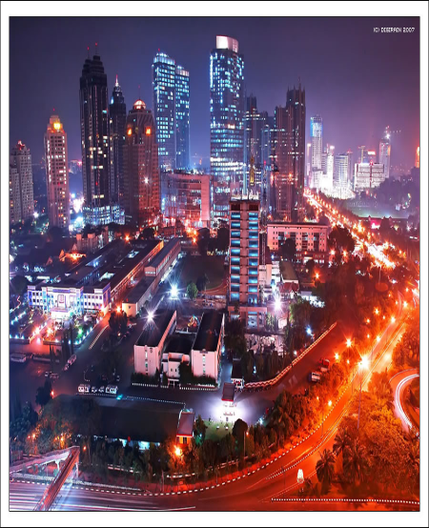
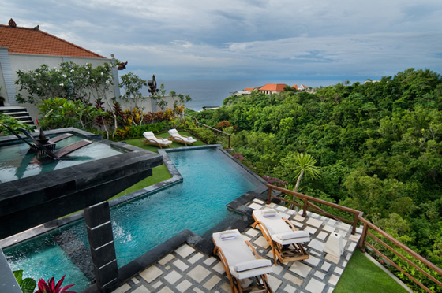
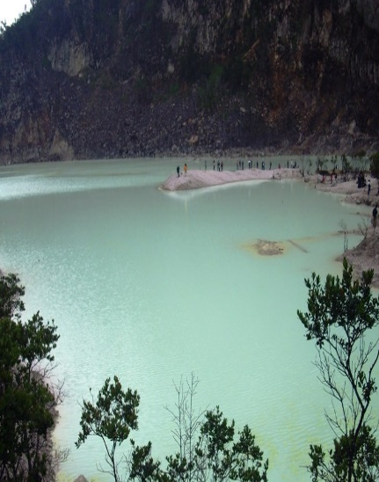
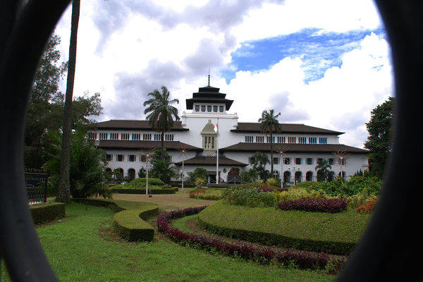
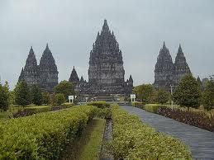
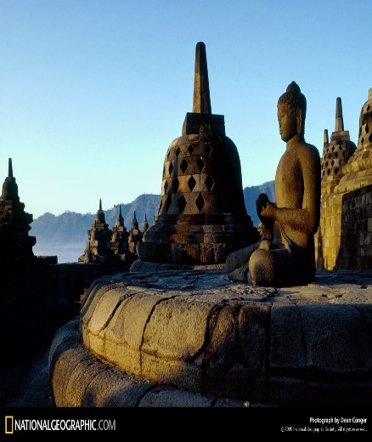
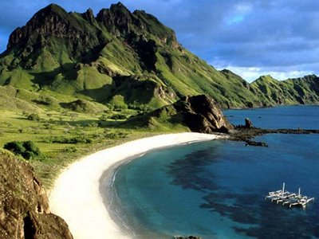
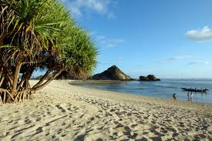
Universitas Indonesia
Thank You

