Slide 1


PITAVASTATIN CONTAINING NANOEMULSIONS:
PREPARATION, CHARACTERIZATION AND IN-VITRO CYTOTOXICITY
EGE UNIVERSITY
FACULTY OF PHARMACY
DEPARTMENT OF PHARMACEUTICAL BIOTECHNOLOGY

Slide 2
NANOEMULSIONS
GENERAL INFORMATION
disadvantages of new chemical entities
poor solubility
high partition coefficient
high molecular weight
→low bioavailability
→nanoemulsion
advantages of nanoemulsions
enhanced drug solubility
enhanced dissolution
enhanced drug stability
low biotoxicity
avoiding organic solvants
scale-up

Slide 3
NANOEMULSIONS
routes of application
dermal/transdermal
parenteral
ocular
oral
  enhanced bioavailability
    primaquine
    cefpodoxime
    desmopressin
    paclitaxel
    saquinavir

Slide 4
PITAVASTATIN CONTAINING NANOEMULSIONS:
PREPARATION, CHARACTERIZATION AND IN-VITRO CYTOTOXICITY
AIM
increase intestinal absorption of pitavastatin by nanoemulsion
effects of the positive charge of the nanoemulsion
PREPARATION
Microfluidization
CHARACTERIZATION
droplet size
size distribution
zeta potential and
permeability
IN-VITRO CYTOTOXICITY
Caco-2 cells.
Notes:
Pitavastatin properties
low solubility
poor absorption
solution
nanonisation
enhanced absorption and higher bioavailability

Slide 5
PITAVASTATIN CONTAINING NANOEMULSIONS:
PREPARATION
important parameters
formulation parameters
  type and concentration of the constituents
    oil
    emulsifiers
    PS
production parameters
  temperature (15 °C and 25 °C)
  pressure (300 bar and 500 bar)
  time (1, 2, 3, 4 and 5 minutes)
Notes:
Production parameters are more effective than the formulation parameters.
The oil phase, the emulsifiers and PS are the crucial formulation constituents.
The stabilizing effects of polysorbate 80 and egg lecithin Lipoid E 80 are well known, no alternative to PS, only the oil phase was investigated.
Two substances, oleic acid and Eutanol G, were investigated as oil constituents with respect to their capacity to dissolve PT.

Slide 6
PITAVASTATIN CONTAINING NANOEMULSIONS:
PREPARATION
 |  | F1 | F2
oil phase |  | % | %
drug
oil
positive charge
emulsifier
antioxidant
water phase
emulsifier
preservative
water |  | ad 100 | ad 100

Slide 7
PITAVASTATIN CONTAINING NANOEMULSIONS:
PREPARATION
 |  | F1 | F2
oil phase |  | % | %
drug | pitavastatin
oil | oleic acid
positive charge | phytosphingosine
emulsifier | Lipoid E 80
antioxidant | alpha-tocopherol
water phase
emulsifier | Tween 80
preservative | potassium sorbate
water |  | ad 100 | ad 100

Slide 8
PITAVASTATIN CONTAINING NANOEMULSIONS:
PREPARATION
 |  | F1 | F2
oil phase |  | % | %
drug | pitavastatin | 0.1 | 0.1
oil | oleic acid | 20 | 20
positive charge | phytosphingosine | - | 0.6
emulsifier | Lipoid E 80 | 1 | 1
antioxidant | alpha-tocopherol | 0.03 | 0.03
water phase
emulsifier | Tween 80 | 2 | 2
preservative | potassium sorbate | 0.1 | 0.1
water |  | ad 100 | ad 100

Slide 9
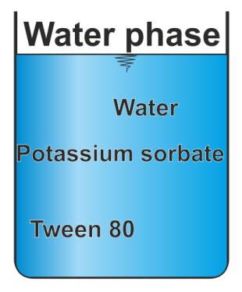
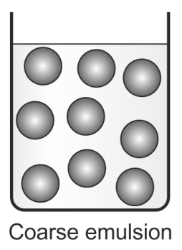
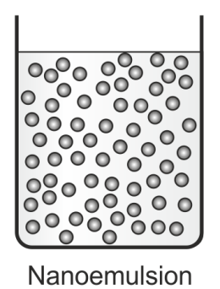
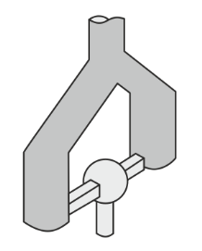
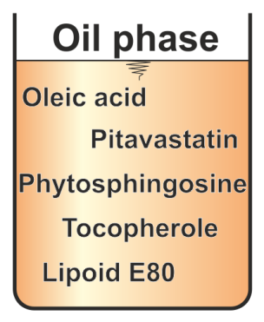
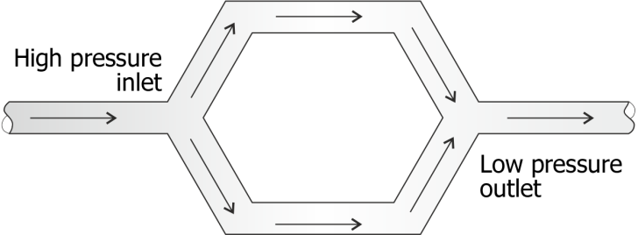
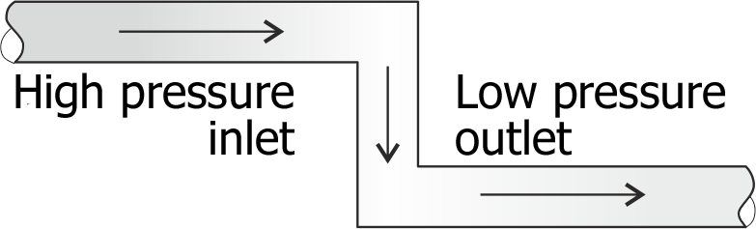
PITAVASTATIN CONTAINING NANOEMULSIONS:
PREPARATION
high shear mixer
microfluidization
8000 rpm, 3 min
Notes:
The nanoemulsions were produced using the Microfluidizer M-110Y.
The water phase was prepared separately and added to the oil phase.
Then, the pre-emulsion was obtained by using a high speed stirrer with 8000 rpm for 3 min.
These coarse emulsion was subjected afterwards to the M-110Y.
These emulsion was homogenized under the predetermined conditions.

Slide 10
PITAVASTATIN CONTAINING NANOEMULSIONS:
CHARACTERIZATION
physicochemical stability
  physical stability
    droplet size
    size distribution
    zeta potential
  chemical stability
    drug content
permeability and
cytotoxicity
Notes:
300 bar was not stable
chemical stability
the drug concentration was investigated per HPLC at the day of production
there is a high of degradation of PT for the NEs homogenized at 25 °C
the chemical degradation of PT may be caused by an evolved temperature inside the Microfluidizer during the production process.
the NEs produced at 15 C resulted in chemical stable formulations with a drug content of approximately 100%

Slide 11
PITAVASTATIN CONTAINING NANOEMULSIONS: CHARACTERIZATION
Notes:
500 bar, 15 °C and 4 min for F1 (droplet size: 179 nm, PDI: 0.15, ZP: -45 mV)
500 bar, 15 °C and 3 min for F2 (droplet size: 306 nm, PDI: 0.36; ZP: 35 mV)

Slide 12
PITAVASTATIN CONTAINING NANOEMULSIONS: CHARACTERIZATION
Permeability studies with Caco-2 cells by measuring TEER
Formulations | P_{ab} (cm/s) | P_{ba}(cm/s) | Efflux ratio
F1 | 1.49×10⁻⁶ ± 0.0048 | 0.81×10⁻⁷ ± 0.0040 | 0.054 ± 0.011
F2 | 9.53×10⁻⁶ ± 0.0021 | 0.904×10⁻⁷ ± 0.0025 | 0.0095 ± 0.002
PT-solution | 8.16×10⁻⁶ ± 0.007 | 1.893×10⁻⁷ ± 0.0036 | 0.023 ± 0.003
% reduction of TEER values
Formulations | A → B direction | B → A direction
F1 | 13.83 ± 0.75 | 2.86 ± 0.09
F2 | 27.82 ± 1.12 | 6.08 ± 0.23
PT solution | 24.96 ± 0.99 | 4.58 ± 0.15
Notes:
The positively charged nanoemulsions showed the highest permeation through Caco-2 cell lines, compared to the negatively charged nanoemulsions and a drug solution.
The increased permeation of the positively charged nanoemulsion can serve as a sign for a possible increased bioavailability and can probably enhance the absorption of the drug.

Slide 13
PITAVASTATIN CONTAINING NANOEMULSIONS:
IN-VITRO CYTOTOXICITY
Caco-2
Notes:
both types of nanoemulsions, positively and negatively charged, were not cytotoxic for Caco-2 cells.

Slide 14
PITAVASTATIN CONTAINING NANOEMULSIONS:
PREPARATION, CHARACTERIZATION AND IN-VITRO CYTOTOXICITY
nanoemulsions containing the poorly soluble drug pitavastatin were prepared by microfluidization
the formulation F2 with PS showed the highest permeation using Caco-2 cells
both nanoemulsions, with and without PS, were not cytotoxic
an oral application of pitavastatin and PS containing nanoemulsions
with an enhanced intestinal permeation
Notes:
the formulation F2 with PS showed the highest permeation using Caco-2 cell lines, which can serve as a sign for a possible increased bioavailability and could probably enhance the absorption of pitavastatin
F1, produced with 500 bar, 15 ° C and 4 min had compared to F2 a decreased droplet size with a narrow size distribution and, disregarding the prefix, a higher ZP.
F2 was produced with 500 bar, at 15 ° C and 3 min
by proving that F2 with PS was not cytotoxic for the Caco-2 cells, and an enhanced permeation, it could be shown that it is possible to use PS for the oral administration

Slide 15
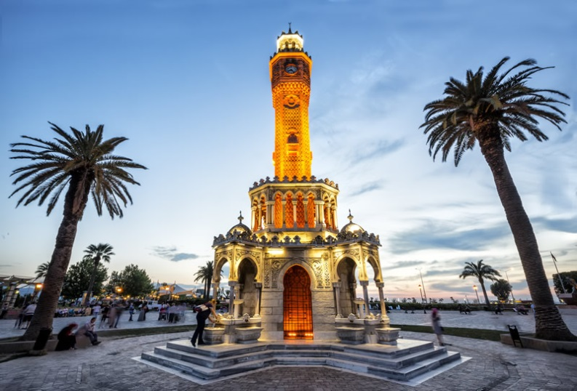
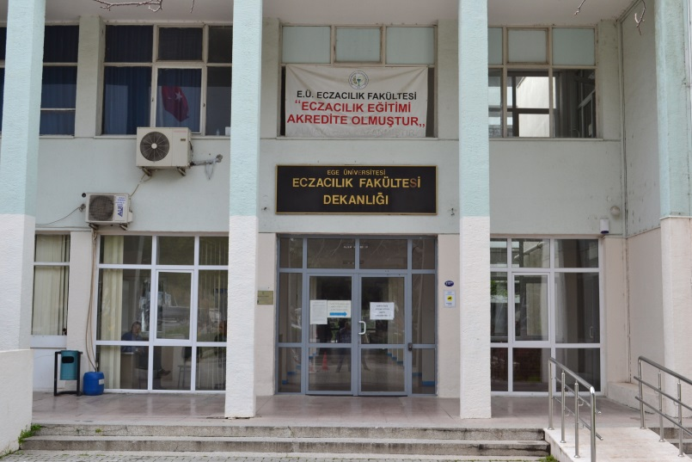
THANK YOU FOR YOUR ATTENTION
THANKS TO
Dr. Çinel KÖKSAL
Assis. Prof. Dr. Evren GÜNDOĞDU

