Slide 1
The effects of initial and subsequent adiposity status on diabetes mellitus
Speaker: Qingtao Meng. MD
West China hospital, Chendu, China

Slide 2
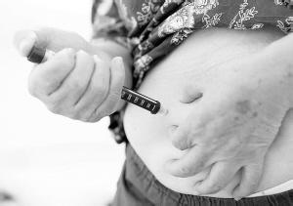
Background
Diabetes Mellitus is a major global public health challenge

Slide 3
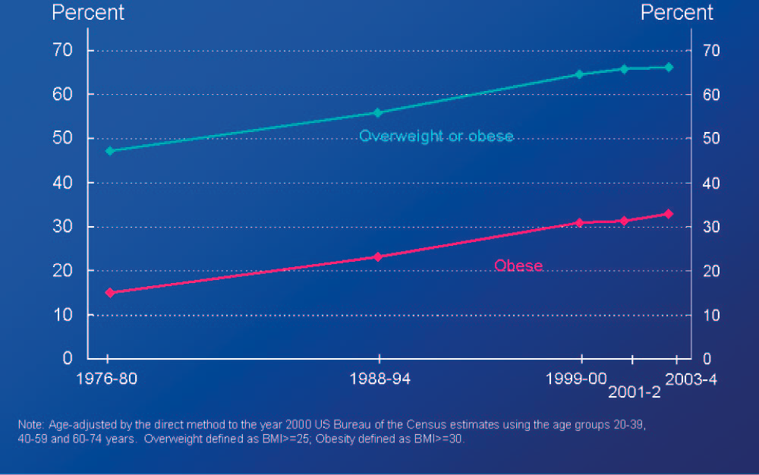
Background
As an important risk factor for DM, Obesity is rising throughout the world
Therefore, obesity-related DM is a large public health burden

Slide 4
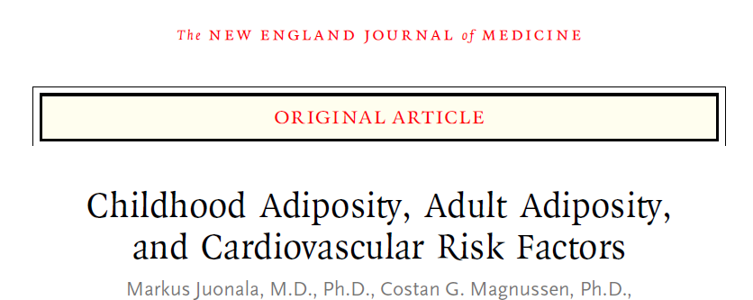
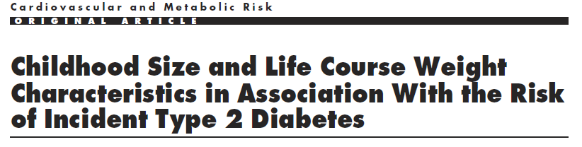
Background
There is recent evidence showing that becoming a non-obese adult could reverse the adverse effects of childhood obesity on DM

Slide 5
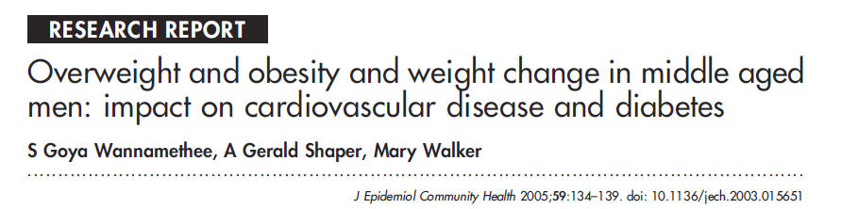
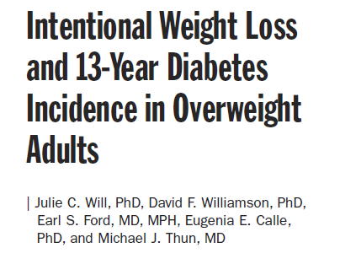
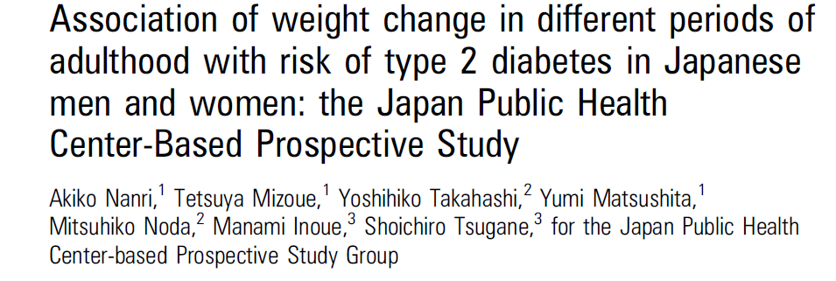
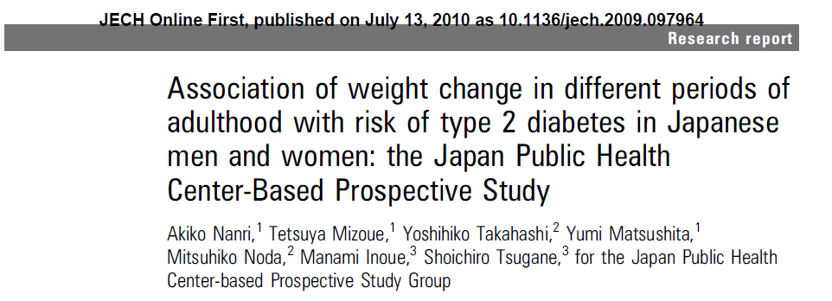
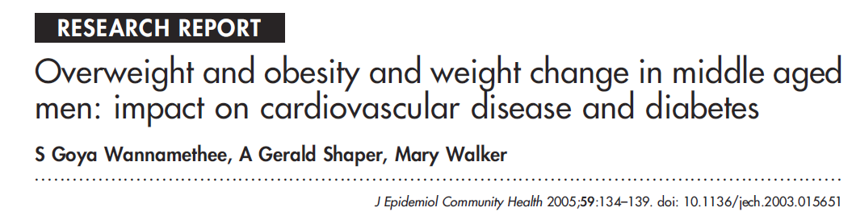
Background
There is also evidence demonstrating that weight loss could reduce the subsequent risk of developing DM in adulthood.

Slide 6
Objective
Therefore, the main purpose of the study was to determine whether a change from initial overweight or obesity to subsequently non obese body mass index(BMI), as compared with the subjects who persist with overweight or obesity, would be associated with a reduced risk of DM in adulthood.

Slide 7

Method
1. Study population
A group of 711 participants in an urban community , located in Chengdu, Sichuan province, China.

Slide 8
Method
2. Data collection
The data were collected in 1992 and then again in 2007 from this group.
In both of the years, the medical professionals did a survey of cardiovascular disease (CVD) risk factors including the standardized questionnaire, physical examination and laboratory tests.

Slide 9
Method
2. Data collection
The questionnaire included sex, age, and CVD risk factors, such as smoking status, alcohol consumption levels and physical activity.
The physical examination included measurement of blood pressure, height, weight, and so on.
Laboratory tests included measurement of fasting plasma glucose (FPG), fasting serum total cholesterol (TC), low-density lipoprotein cholesterol (LDL-C), high-density lipoprotein cholesterol (HDL-C), and triglyceride (TG).

Slide 10
Method
3. Related definitions
1). Hypertension: SBP ≥140 mmHg, or DBP ≥90 mmHg, and/or those receiving antihypertensive medications;
2). Diabetes mellitus: self-reported history or a fasting plasma glucose ≥7.0 mmol/L;
3). Smoking: average cigarette consumption ≥ 1 /day;
4). Alcohol intake: average intake of alcohol ≥ 50g/ day；
5). Physically active: excise one or more times per week, and more than 20 min each time;
6). Overweight or obese: BMI≥ 25 kg/m²

Slide 11
Method
4. Classification of adiposity status
24 subjects were excluded because they were diagnosed of DM in 1992; only 687 participants have complete data.
According to both the 1992 and 2007 BMI status, the participants were categorized into 4 groups:
Group I: constantly normal BMI
Group II: turning to be overweight or obese
Group III: turning to have normal BMI
Group IV: constantly overweight or obese

Slide 12
Method
4. Classification of adiposity status
Group I (constant normal BMI) 412 persons 1992: BMI < 25 2007: BMI < 25 | Group II (turning overweight or obese) 88 persons 1992: BMI < 25 2007: BMI ≥ 25
Group III (turning normal BMI) 58 persons 1992: BMI ≥ 25 2007: BMI < 25 | Group IV (constant overweight or obese) 129 persons 1992: BMI ≥ 25 2007: BMI ≥ 25
Total:687
male: 58.1%
48.1±6.2 in 1992

Slide 13
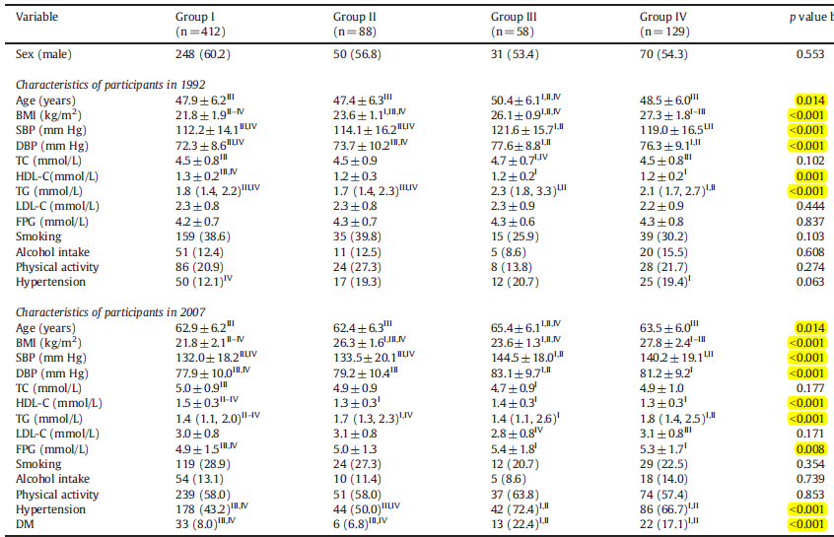
Results
Characteristics of participants in 1992 and 2007 according to the adiposity status

Slide 14
Results
Cumulative incidence of DM during the follow-up according to the adiposity status groups
The cumulative incidence of DM was 8.0% for group I, 6.8% for group II, 22.4% for group III and 17.1% for group IV, respectively. The cumulative incidence of DM was significantly higher in groups III and IV than in groups I and II (all p values < 0.05). There are no significant difference between group I and group II, and also, the cumulative incidence of DM were not significantly different between group III and IV.

Slide 15
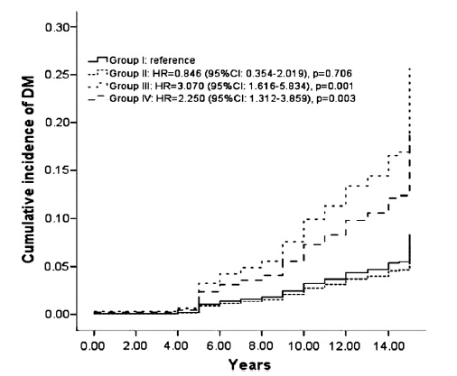
Results
Using COX’s proportional hazards regression model, with group I as reference, groups III and IV had a significant two to three-fold increased DM risk;

Slide 16
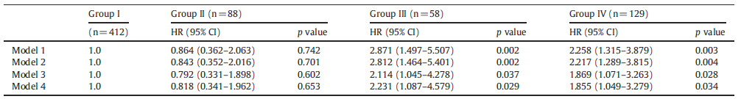
Results
Cox model were adjusted by covariates, the hazards ratio of DM:
Model 1: adjusted for age and sex.
Model 2: adjusted for age, sex and the history of hypertension.
Model 3: adjusted for age, sex, the history of hypertension and lipids (including TC,
HDL-C, TG and LDL-C).
Model 4: adjusted for age, sex, SBP, DBP, TC, HDL-C, TG, LDL-C, FPG and the history of hypertension.
After adjustment of all the covariates, the risk was only slightly reduced

Slide 17
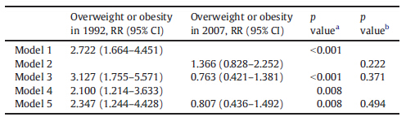
Results
Multivariate logistic regression model, relative risks of overweight or obesity in 1992 and 2007 in predicting DM.
Model 1 included the status of overweight or obesity in 1992.
Model 2 included the status of overweight or obesity in 2007.
Model 3 included the status of overweight or obesity in 1992 and 2007.
Model 4 included age, sex, SBP, DBP, TC, HDL-C, TG, FPG, LDL-C, and
the history of hypertension, as well as the status of overweight or obesity
in 1992.
Model 5 included age, sex, SBP, DBP, TC, HDL-C, TG, FPG, LDL-C, and
the history of hypertension, as well as the status of overweight or obesity
in 1992 and 2007.

Slide 18
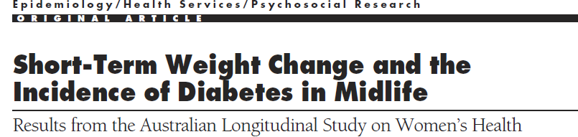
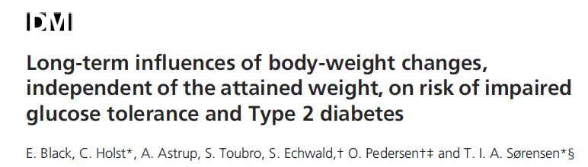
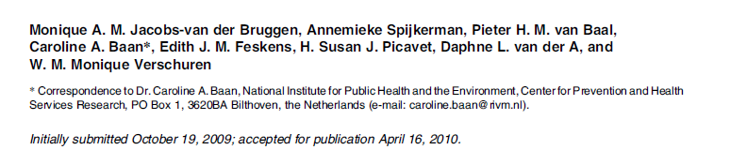
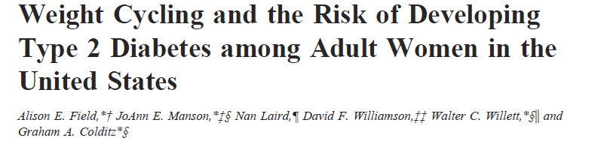
Evidence from other studies
Some previous studies have shown that initial weight change might have a larger impact on DM incidence than recent weight change. And our results complement their finding, because we confirm that initial overweight or obesity in adulthood could predict the development of DM independently of subsequent overweight or obesity.
obesity.

Slide 19
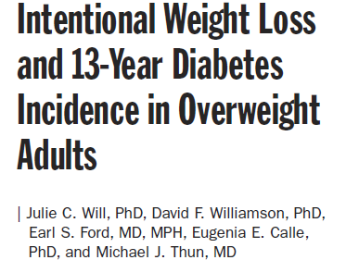
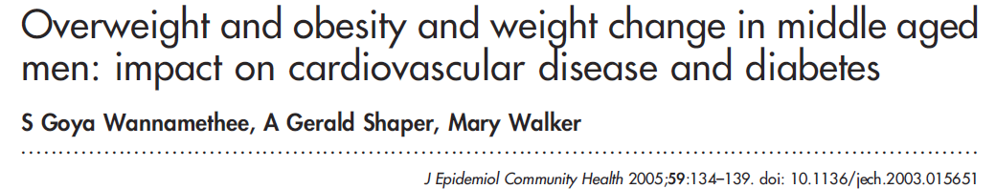
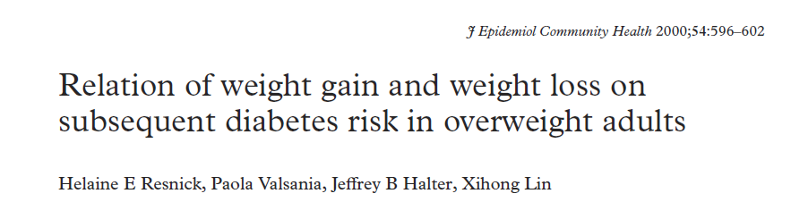
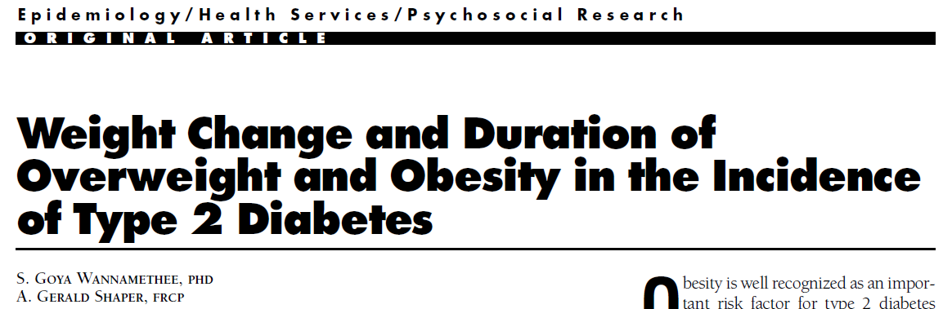
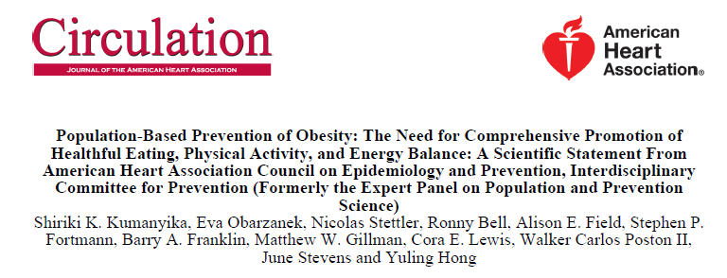
Evidence from other studies
Weight loss is still important, because many studies have shown that weight reduction in the adulthood is associated with significantly reduced DM risk, however, these current studies also suggest that weight status plays a larger role in diabetes risk than do changes in weight.

Slide 20
Conclusion
Our findings showed that a change from initial overweight or obesity to a normal BMI, as compared with the subjects who persist with overweight or obesity, would not be associated with a reduced risk of DM in adulthood.
On the other hand, the risks of DM among the subjects with initially normal BMI who became overweight or obese subsequently were similar to those who were never overweight or obese.
Therefore, initial BMI status might play a larger role in DM risk than do changes in BMI in adulthood.
Once the subjects are overweight or obese in adulthood, they are at high risk for DM to a certain extent, as compared with the subjects who are never overweight or obese, even succeeding in weight loss.
Keeping weight in the normal BMI range should be emphasized in the public for preventing DM.

Slide 21


