Slide 1
Ocean subsurface studies from space-based lidar measurements
Xiaomei Lu,¹ Yongxiang Hu,²
¹ Science Systems and Applications, Inc. (SSAI), Hampton, Virginia 23666, USA
(xiaomei.lu@nasa.gov)
² Atmospheric Composition Branch, NASA Langley research Center, Hampton, VA, 23681, USA
(yongxiang.hu-1@nasa.gov)

Slide 2
Outline
Space-based and Ground-based Lidar
Overview of CALIPSO mission
Ocean Subsurface results from space-based lidar
Particulate Organic Carbon (POC) Results

Slide 3
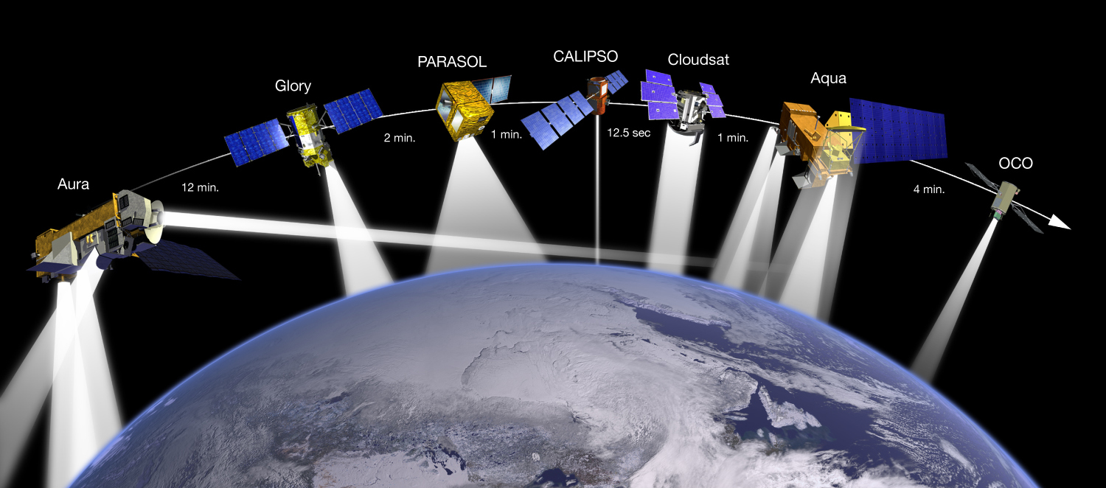
Afternoon Constellation Evolution
A-train
Notes:
3

Slide 4
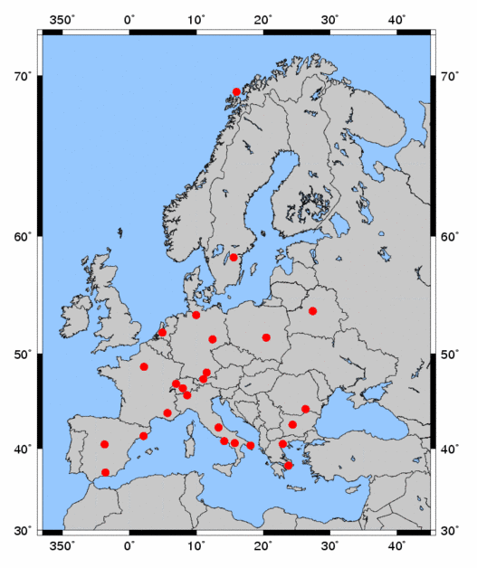
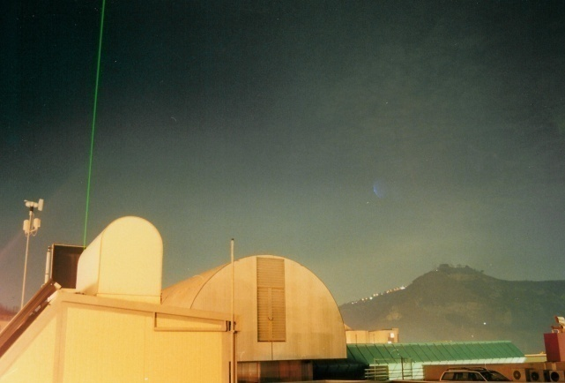
Ground-based lidar-EARLINET
25 stations
European
Aerosol
Research
LIdar
NETwork
Earlinet Network
Naples station (40.833°N, 14.183°E, 118 m. asl)

Slide 5
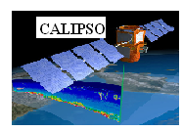

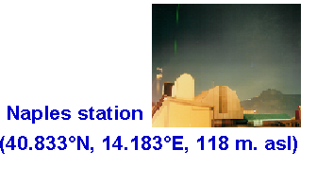
Combing the ground-based and space-based lidar measurements
Reference：
Xiaomei. Lu, Yuesong. Jiang, Xueguo. Zhang "An Algorithm to retrieve aerosol properties from analysis of multiple scattering influences on both Ground-Based and Space-Borne Lidar Returns," Opt. Express 17, 8719-8728 (2009)

Slide 6
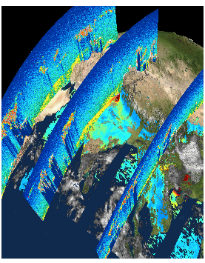
CALIPSO Mission Overview
CALIPSO: lidar measurements of aerosol and clouds
Launched: April 28, 2006
Operational Achievements:
• Long term measurements: CALIPSO collected more than 9 years of measurements so far;
• Observations during day/night and for all seasons
• Data publicly available
• CALIPSO Adds the Vertical Dimension

Slide 7
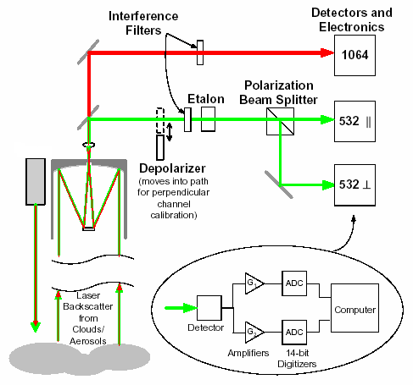

Lidar station of CALIPSO

Slide 8
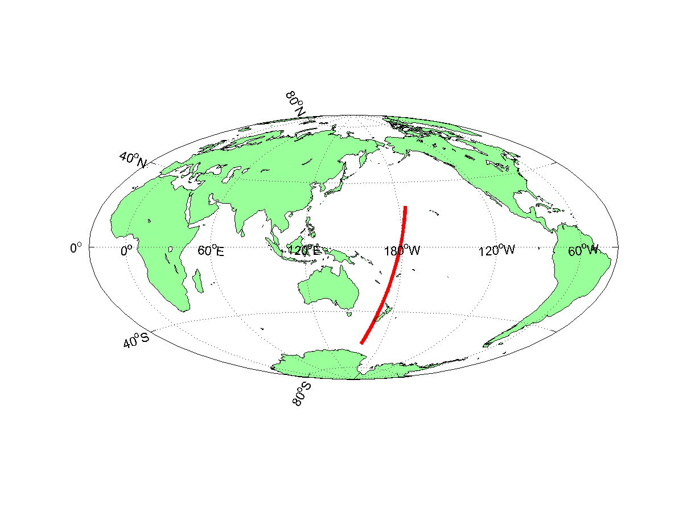
30 degree off-nadir measurement for ocean subsurface studies- 2014 July 17 Night
Why pointing CALIPSO 30 degree off-nadir: avoid ocean surface backscatter
Direct demonstration of CALIPSO ocean subsurface signals in both co-polarization and cross-polarization to convince the community that CALIOP can measure phytoplankton backscatter
Direct measurements of depolarization ratios of phytoplankton backscatter to improve CALIOP estimate of phytoplankton backscatter and biomass estimate
Behrenfeld, Hu, Hostetler, Dall'Olmo, Rodier, Hair, Trepte(2013), Space-based lidar measurements of global ocean carbon stocks, Geophys. Res. Lett., 40, 4355–4360, doi:10.1002/grl.50816.
Lu., Hu, Trepte, Zeng, and Churnside (2014), Ocean subsurface studies with the CALIPSO spaceborne lidar, J. Geophys. Res. Oceans, 119, 4305–4317, doi:10.1002/2014JC009970.

Slide 9
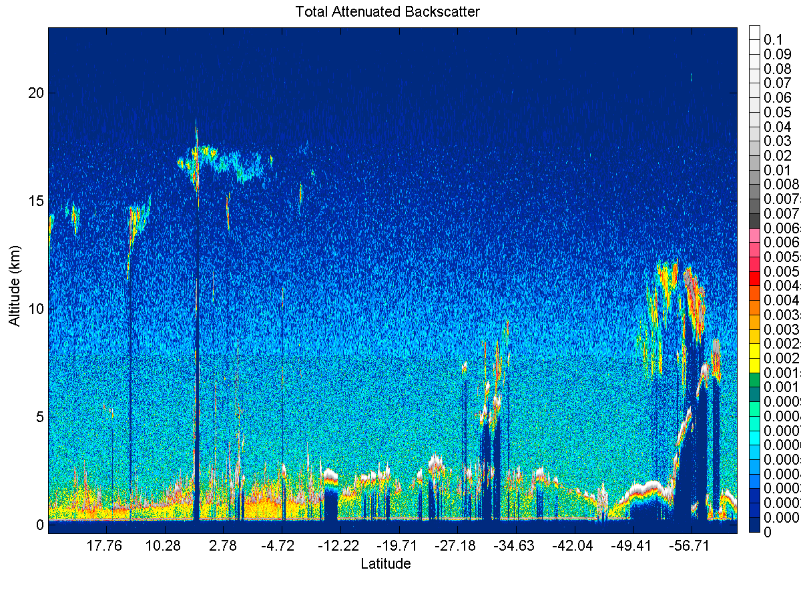
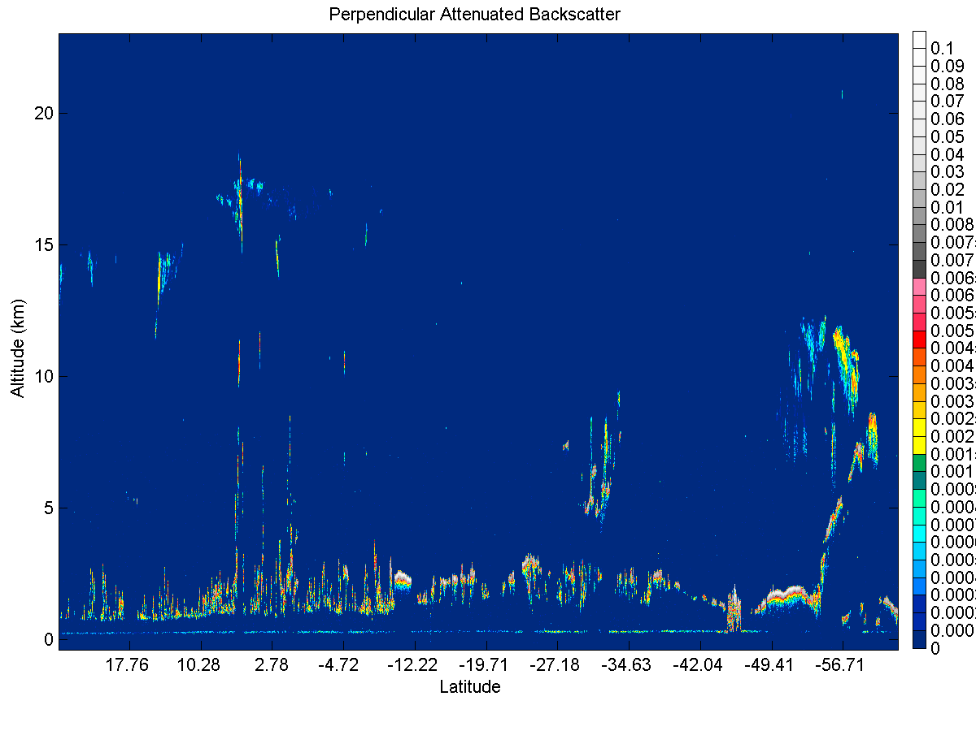

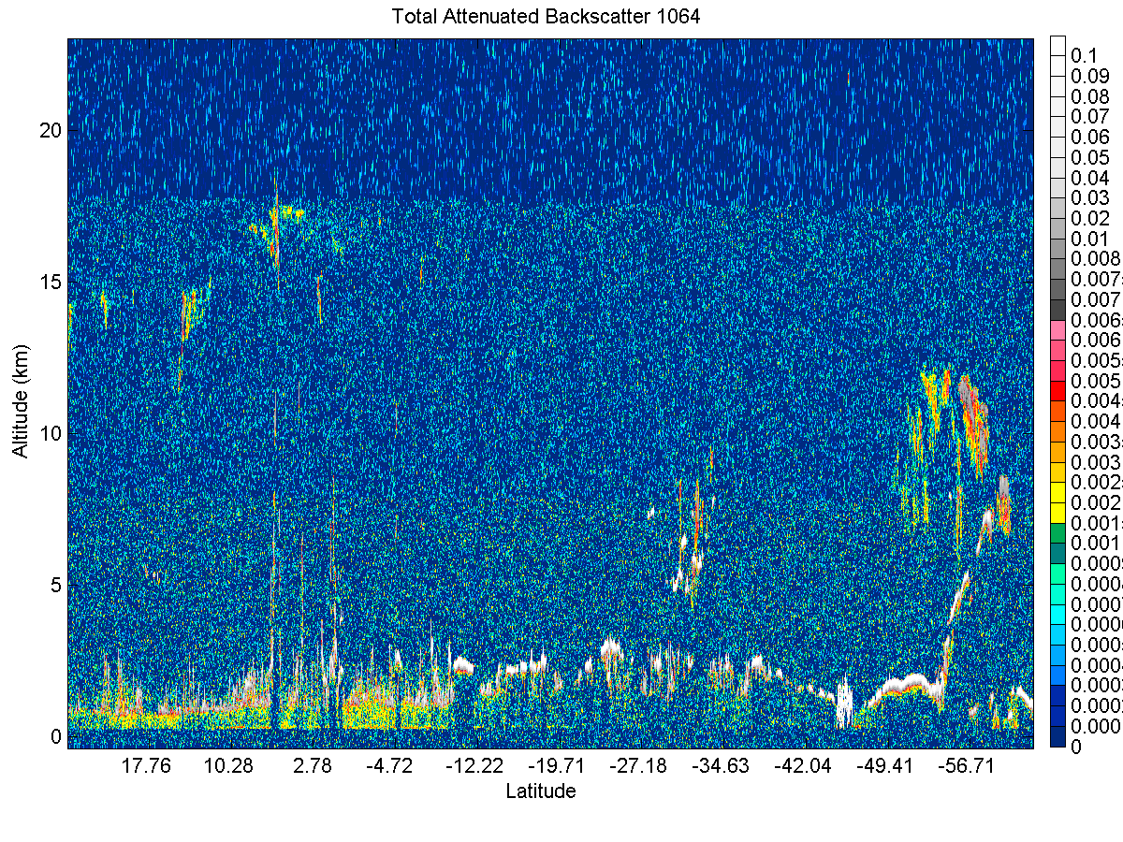
subsurface
532nm Total
532nm Cross Polarization
Subsurface signal
1064nm Total

Slide 10
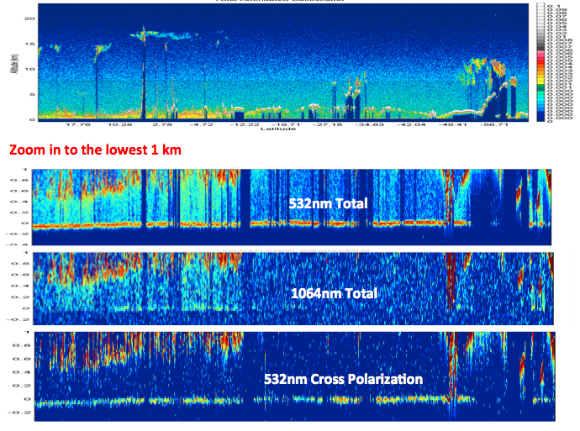
subsurface
532nm Toal
1064nm Total
532nm Cross Polarization

Slide 11
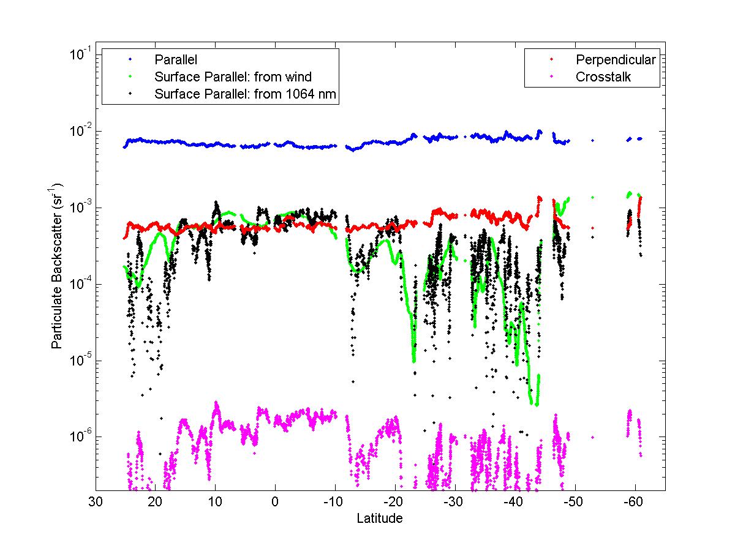
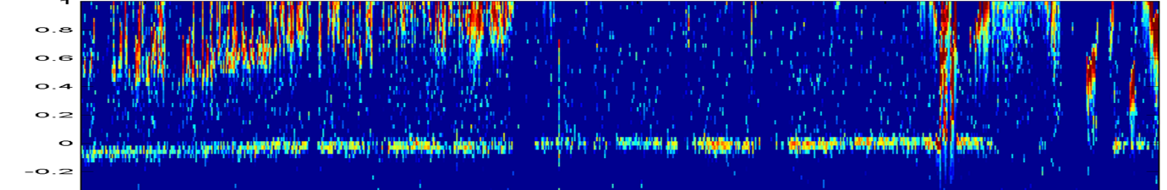
Surface signals are much weaker than subsurface signals and can be corrected using 1064nm measurements
Blue: surface and subsurface in 532nm co-polarization
Red: subsurface signal in cross polarization
Black and Green:
surface signal
in co-polarization
Magenta: surface signal in cross polarization

Slide 12
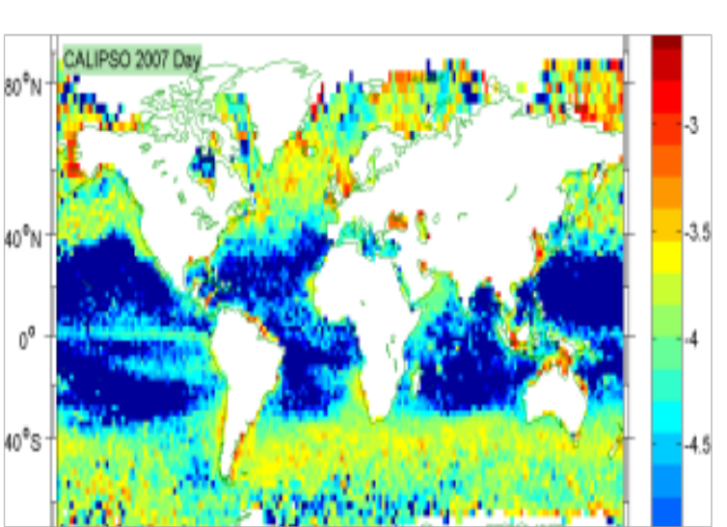
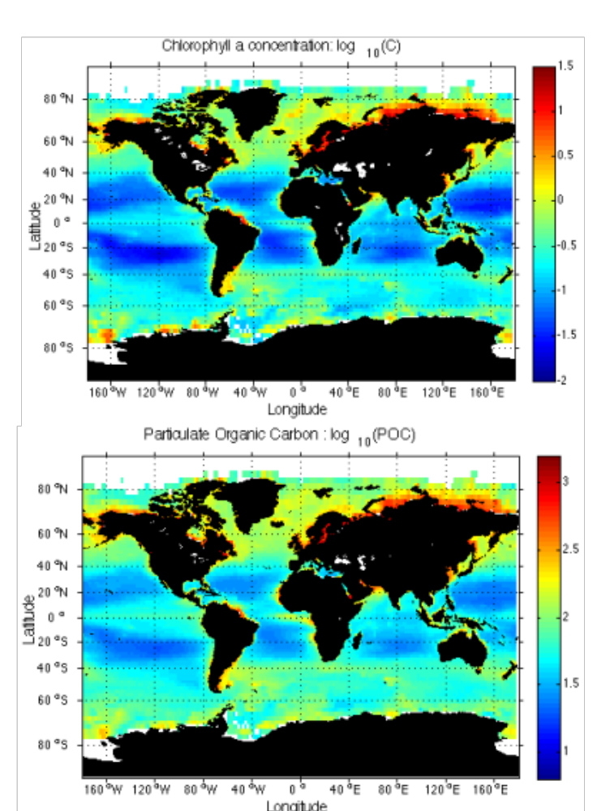
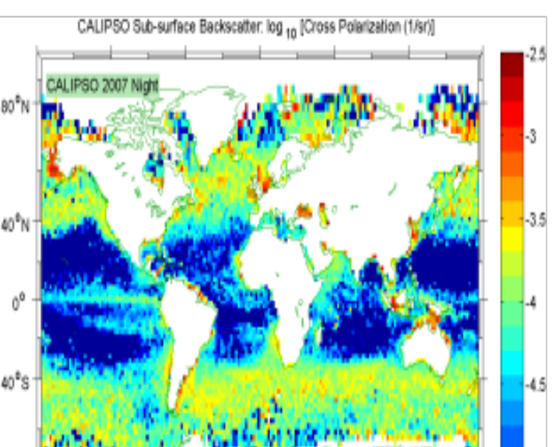
Ocean Subsurface results
Results from CALIPSO
Results from MODIS

Slide 13
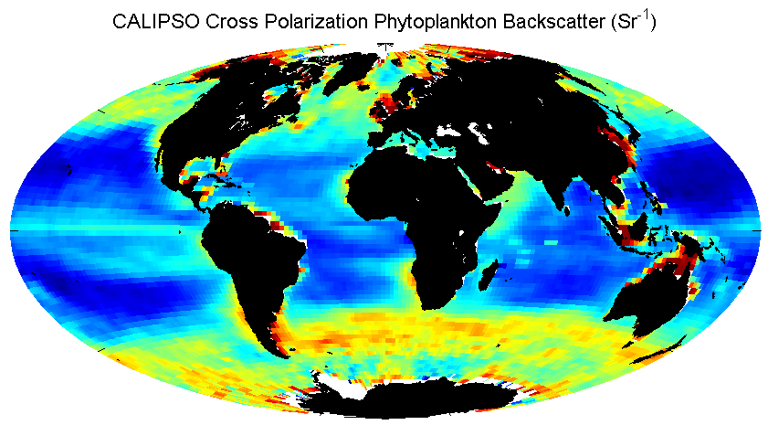
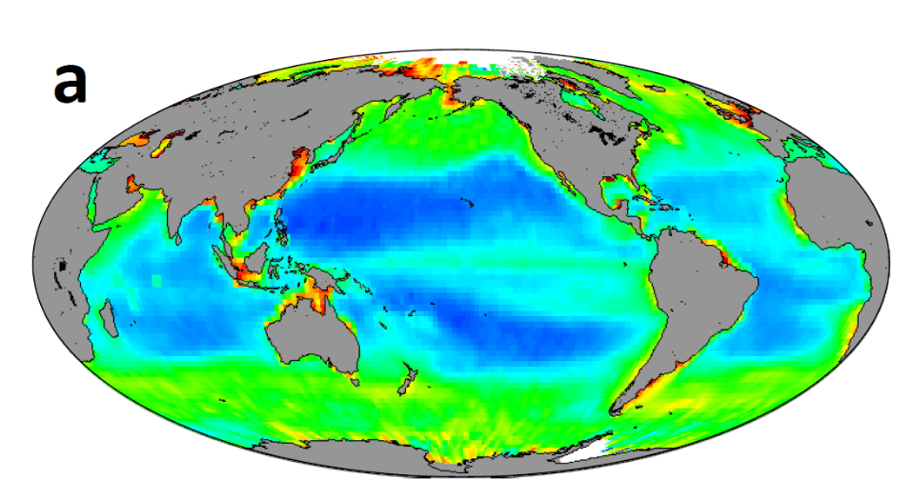
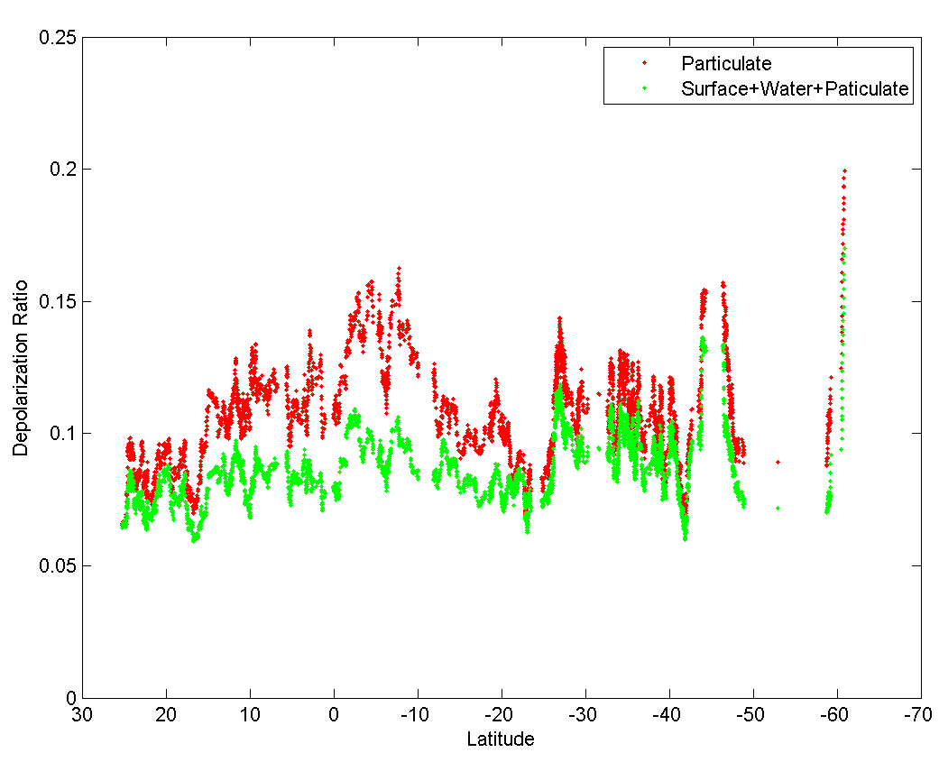
Applications: Improving Phytoplankton Particulate Organic Carbon (POC) Estimate from CALIPSO
Particulate Organic Carbon (mg m⁻³) from CALIPSO
The 30 degree off-nadir measurement verifies the assumption about depolarization ratio
Behrenfeld, Hu, Hostetler, Dall'Olmo, Rodier, Hair, Trepte, GRL, 2013

Slide 14
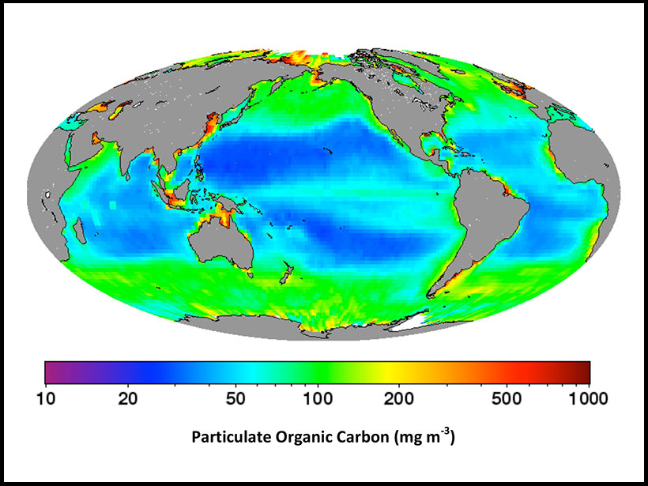

AGU’s EOS Research Spotlight on CALIPSO Ocean subsurface measurements
Earth & Space Science News
27 May 2015
Hacking a Climate Satellite to See Beneath the Ocean's Surface
When NASA launched its CALIPSO spacecraft, the space agency did not intend to estimate phytoplankton populations.
References
Behrenfeld, M. J., Y. Hu, C. A. Hostetler, G. Dall'Olmo, S. D. Rodier, J. W. Hair, and C. R. Trepte (2013), Space-based lidar measurements of global ocean carbon stocks, Geophys. Res. Lett., 40, 4355–4360, doi:10.1002/grl.50816.
Xiaomei Lu, Yongxiang Hu, Charles Trepte, Shan Zeng, James H. Churnside, Ocean subsurface studies with the CALIPSO spaceborne lidar, Journal of Geophysical Research: Oceans, 2014, 119, 7, 4305.

Slide 15
Conclusion
CALIPSO satellite is tilted for one night-time orbit in July in order to measure phytoplankton backscatter at 30-degree off-nadir accurately
Subsurface signals are clearly seen in both polarization channels of 532 nm (green) CALIOP measurements, where surface signals are one (co-polarization) and two (cross-polarization) orders of magnitudes weaker than subsurface signals.
Depolarization ratios of phytoplankton backscatter are measured from space for the first time.
The operation helps reduce uncertainty in global carbon biomass assessment using CALIPSO ocean subsurface optical measurements.

