Slide 1

Gynura divaricata rich in 3, 5-/4, 5-dicaffeoylquinic acid and chlorogenic acid reduces islet cell apoptosis and improves pancreatic function in type 2 diabetic mice
Xiao-Lu Yin, Bing-Qing Xu and Yu-Qing Zhang*
[* Corresponding author: 086-0512-65880181(Tel/Fax); E-mail: sericult@suda.edu.cn
Yin Xiaolu, Email: yinxiaolu1881992@163.com,
Xu Bingqing, Email: 209858603@qq.com. ]
Silk Biotechnology Laboratory, School of Biology and Basic Medical Sciences, Soochow University.

Slide 2

Content
Introduction
Research contents
Results

Slide 3



Introduction
hyperglycemia
hyperlipidemia
sulfonylurea drugs
biguanide drugs
α-glucosidase inhibitor
drugs and so on.
Diabetes
hypertension
drug resistance
and side effects
arteriosclerosis

Slide 4
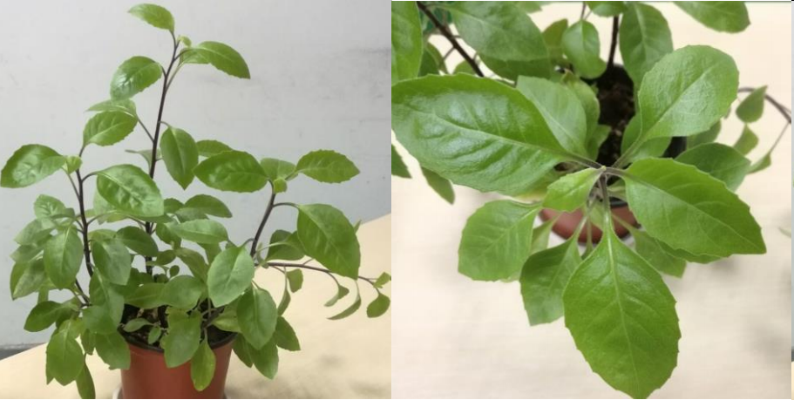
Gynura divaricata (L.) DC (GD), a kind of TCMH, called“Bai Bei San Qi”in China.
A new cerebroside from Gynura divaricata, is a new source of food approved by the
Ministry of Health of the People’s Republic of China in 2010.
It is a medicinal and edible plant that is usually used for the treatment of diabetes.

Slide 5
contents
Identification of main
bioactive components
of GDP (Fresh GD
aerial parts were lyophilised
into powders)
Study on the therapeutic
effects and mechanism of
GD lyophilised powder
on type 2 diabetic mice

Slide 6
Results
Identification of main bioactive components of GD
Part 1

Slide 7
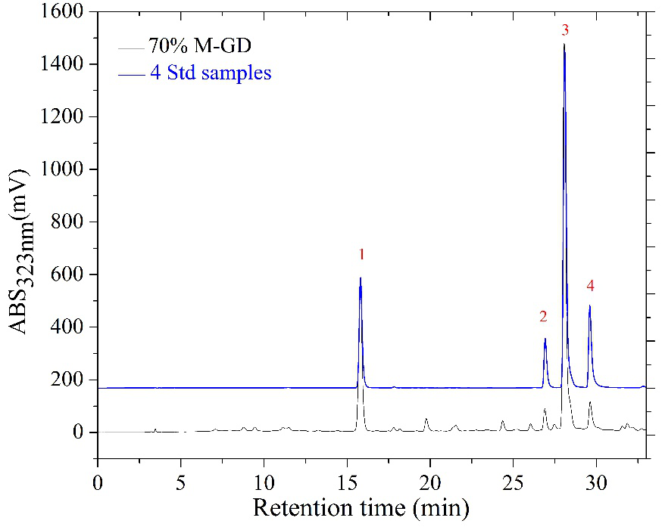
3,5-dicaffeoylquinic acid
chlorogenic acid
4,5-dicaffeoylquinic acid
3,4-dicaffeoylquinic acid
HPLC chromatogram of 70% methanol extract of GD and four standards at 323 nm.
70% M-GD(70% methanol extract of GD lyophilised powder);

Slide 8
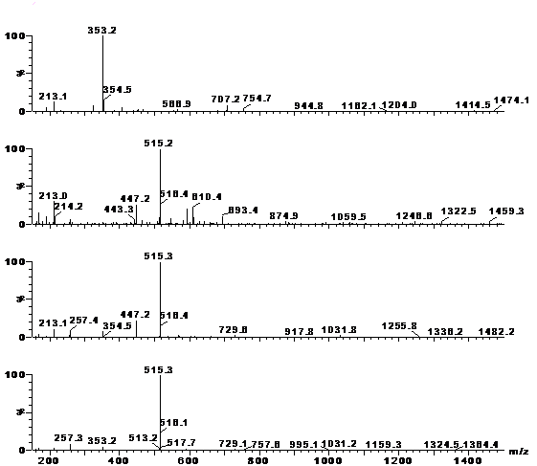
Peak | Retention time (min) | [M-H]⁻ | MolecularWeight | Name of Compound
1 | 15.790 | 353.2 | 354 | chlorogenic acid
2 | 26.893 | 515.2 | 516 | 3, 4-dicaffeoylquinic acid
3 | 28.060 | 515.3 | 516 | 3, 5-dicaffeoylquinic acid
4 | 29.615 | 515.3 | 516 | 4, 5-dicaffeoylquinic acid
Negative ion mass spectra of four main chemical constituents in 70% methanol extract of GD.

Slide 9
Quantification of four bioactive components in methanol extract of GD
Bioactive components | Linear regression equations | Correlation coefficients (R2) | Contents (mg/g GD powder)
Chlorogenic acid | y=381854.86597+57440112.13043x | 0.99884 | 5.57±0.35
3, 4-dicaffeoylquinic acid | y=-27745.44883+68618107.60542x | 0.99988 | 0.67±0.08
3, 5-dicaffeoylquinic acid | y=250500.51458+78350260.14366x | 0.99905
4, 5-dicaffeoylquinic acid | y=26676.51400+9837283.14720x | 0.99975 | 6.84±0.14
10.29±0.74

Slide 10
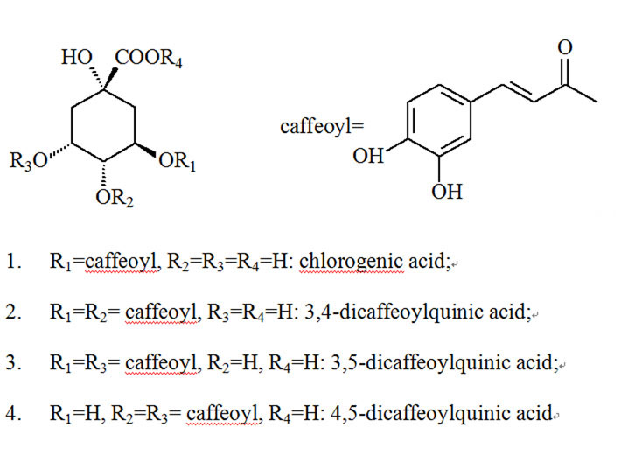
Chlorogenic acid, a phenolic compound
found widespread in plants, is widely recognised as an antioxidant function and had hypoglycemia effects.
Structures of chlorogenic acid and its 3 derivatives

Slide 11
Part 2
Study on the therapeutic effects and mechanism of GD lyophilised powder on type 2 diabetic mice

Slide 12
Effects of GD on FBG(Fasting Blood Glucose)
Groups | FBG (mmol/L) |  |  |  |  | Hypoglycae-mic rate
 | 0 Week | 1 Week | 2 Week | 3 Week | 4 week
Normal | 5.36±1.22 | 6.80±0.35 | 5.34±0.96 | 5.76±0.81 | 5.47±0.89 | －
Model | 21.94±4.63** | 20.88±3.53** | 21.20±4.55** | 19.85±2.76** | 22.78±0.87** | －
1% GD | 22.07±0.70 | 19.52±5.33 | 16.38±4.54# | 17.40±3.85 | 17.42±5.76# | 21.07%
5% GD | 22.06±0.55 | 18.39±2.98 | 13.97±3.75## | 14.99±4.69# | 13.39±5.78## | 39.30%
10% GD | 21.23±1.58 | 17.49±4.92 | 12.47±5.32## | 13.24±5.38## | 12.44±4.60## | 41.40%
The hypoglycaemic rate= (FBG before treatment－FBG after 4 weeks of GD treatment)/FBG before treatment×100%.
The groups included normal,model, 1%,5%,10%GD group.normal and model mice were fed normal diet,
and the other groups were fed GD diet.After 4 weeks, the FBG in normal mice was unchanged, and the FBG in
model mice was been very high. The FBG in other 3 GD-treated groups was always going down.the
hypoglycaemia rate had reduced 41.4% in 10%GD group. the results proved that GD could lower FBG level,

Slide 13
Effects of GD on OGTT and ITT
Figure 1 The effects of different dose of GDP on OGTT (left) and ITT (right) in mice

Slide 14
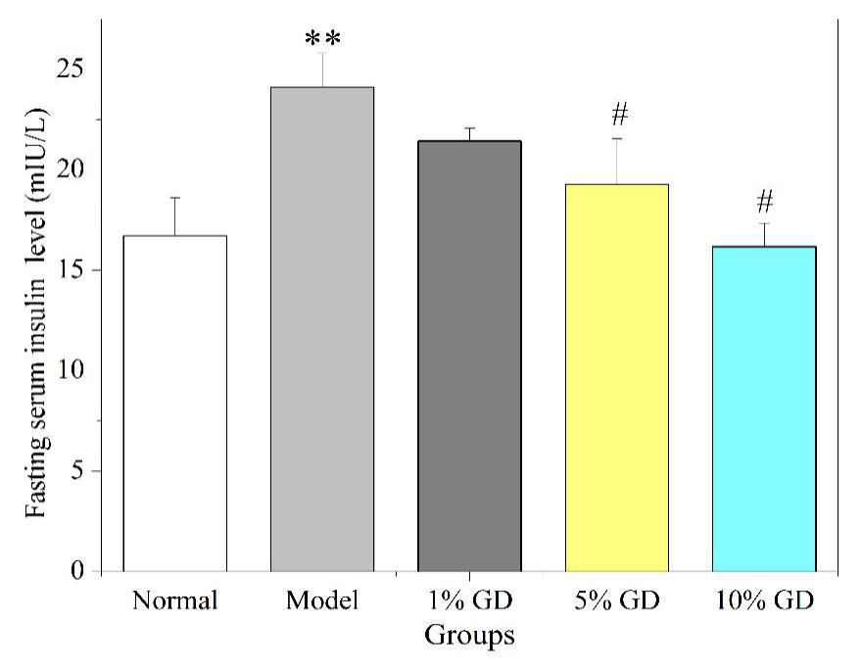
insulin resistance
the fasting serum insulin of the
model mice was markedly increased
compared with those normal mice.
following the GD treatment,the inceasd
fasting serum insulin was reduced
gradually. the insulin of highest group
had approached to the normal group.
Figure 2 Effect of oral GD on the fasting serum insulin levels. The fasting serum insulin levels were determined in mice in the fasting state after 4 weeks of GD treatment.

Slide 15
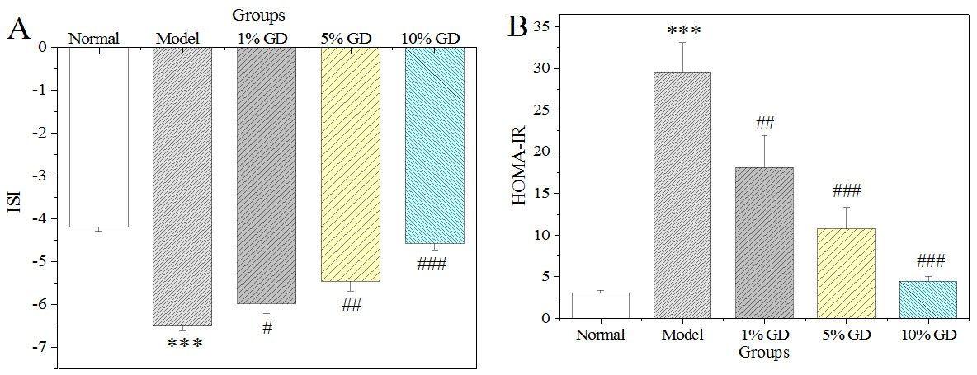
The two index were related to the insulin metabolism. the obvious decrease in ISI and a significant increase in HOMA-IR.
Figure 3 Effects of GD on ISI (Ln[1/(FBG × fasting plasma insulin)])
and HOMA-IR (FBG (mmol/L) × fasting plasma insulin (mIU/L)]/22.5).
.

Slide 16
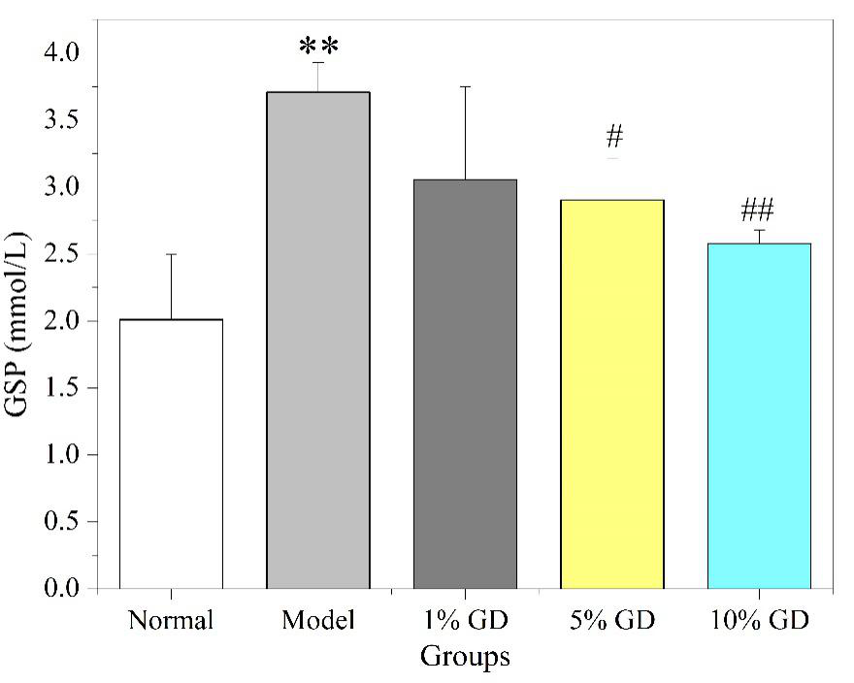
GSP(glycated serum protein), which is related to the blood glucose concentration, can effectively reflect the average blood glucose level of diabetic patients 1 to 2 weeks in the past .
The GSP level in model group was obviously increased relative to that of normal mice. Oral GDP decresed the GSPand the 10% GD-treated group had reduced to 2.5mmol/L.
Figure 4 Effect of GD on GSP.

Slide 17
Effects of GD on GSH-PX, T-SOD and MDA
Groups | GSH-PX(U/mgprot) | T-SOD(U/mgprot) | MDA(nmol/mgprot)
Normal | 81.57±5.48 | 210.50±2.37 | 0.68±0.10
Model | 49.68±6.89** | 131.99±10.19** | 1.57±0.31**
1% GD | 61.10±6.34 | 138.79±3.78# | 1.24±0.19
5% GD | 68.43±7.49# | 184.35±10.02## | 0.97±0.09#
10% GD |  |  | 0.79±0.10#
76.05±5.31##
197.18±7.74##
the level of GSH-PX and T-SOD in 10% GD group had reached 76.05 and 197.18, respectively.
after oral GDP,GD prevent the increase of MDA in a dose-dependent manner. the results showed
that GD enhance antioxidant capacity effectively and reduce oxidative damage.

Slide 18
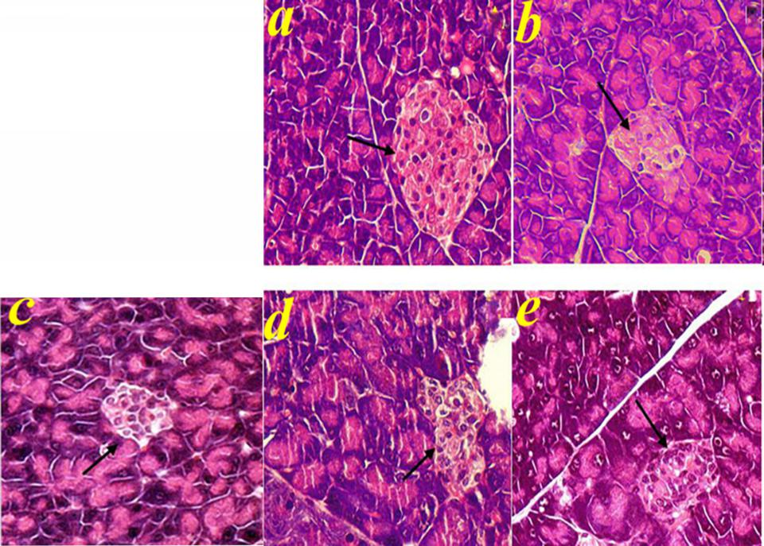
In normal mice,the complete pcreatic islet structure and abundant β-cells
the islets were
atrophic and
severely damaged,the β-cells were reduced in diabetic mice.
had no obvious
pathological changes or hollowing in highest dose group.
Figure 5 Histopathologic examination of pancreas in diabetic mice (HE stain, ×400).
Arrows represent the pancreatic islet with pancreatic β-cells.

Slide 19
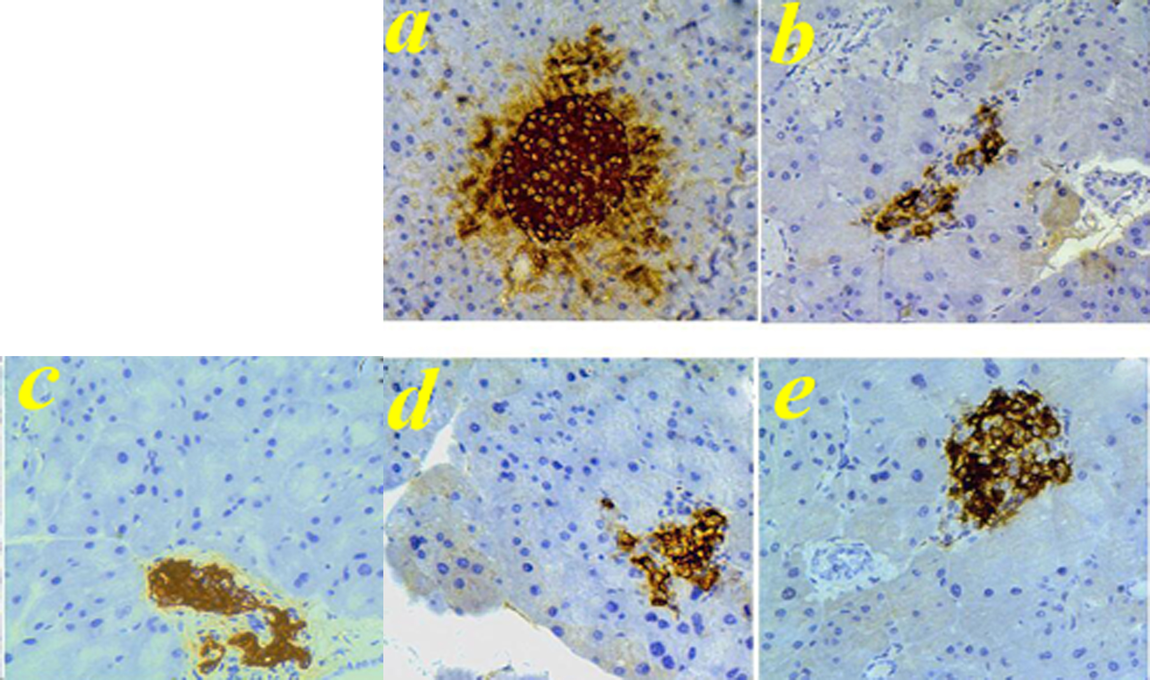
A large number of insulin-positive β-cells were found in normal mice.
the number of insulin-positive
β-cells was lesseded.
the distribution area of the brown
granules was larger and formed on oval shape.
Figure 6 Insulin immunohistochemistry of pancreas in diabetic mice (×400).

Slide 20
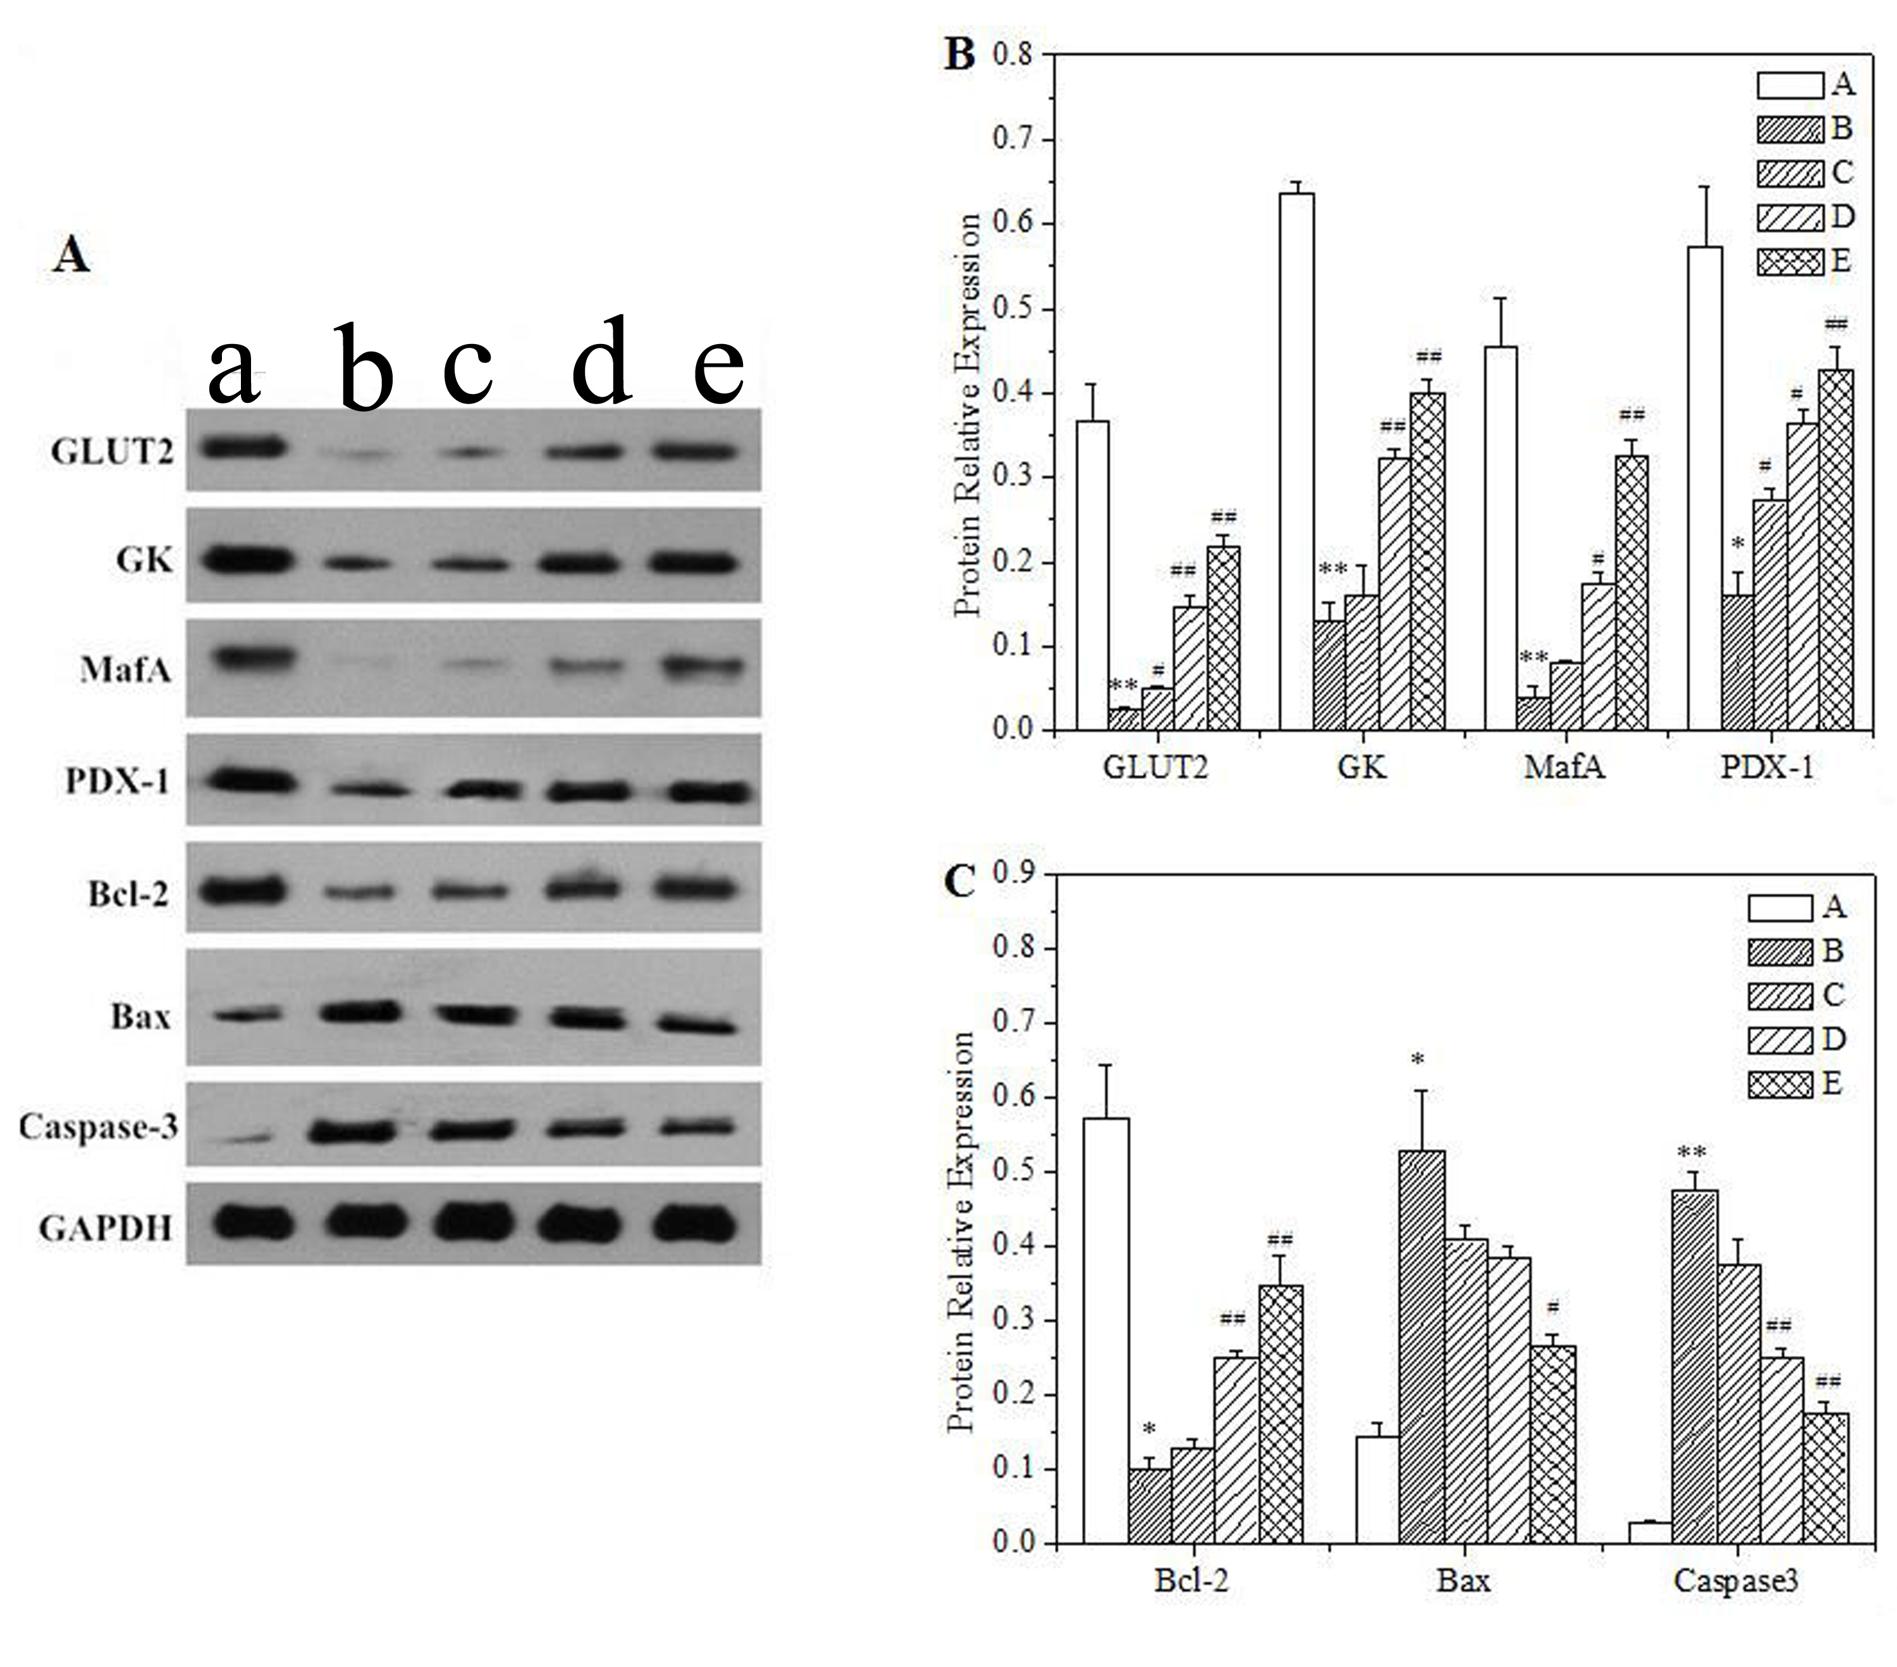
a novel target for the treatment of T2D
involved in glucose metabolism
an important transcription factor for insulin gene expression.
were ralated to cell apoptosis.
Figure 7
Effect of GD on GLUT2, GK, MafA, PDX-1, Bcl-2, Bax, and caspase-3 protein expressions in pancreas.

Slide 21
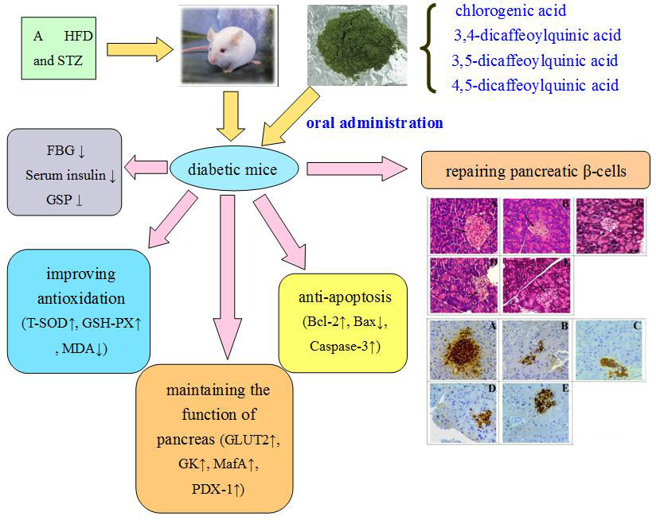
Figure 8 Schematic representation of the protective effect of GD diet in pancreatic tissue of
type 2 diabetic mice.

Slide 22
Summary
the treatment of GD rich in chlorogenic acid and its derivatives can successfully ameliorate hyperglycaemia and hyperinsulinemia, and improve the function of the pancreas.
1. GD can be regarded as vegetables, and the tender stems are edible.
2. GD can be made into medicine to treat diabetes.

Slide 23


