Slide 1


Dual Inhibition of Cdc7 and Cdk9 by PHA-767491 Suppresses Hepatocarcinoma Synergistically with 5-FU
5th Pacific-Asia Cancer Summit on Cancer Therapy
July 20-22, 2015, Brisbane, Australia
Xi Chen, MD, PhD
Associate Professor, Zhejiang University School of Medicine
Deputy Director, Zhejiang Key Laboratory for Neonatal Diseases
Hangzhou, China

Slide 2
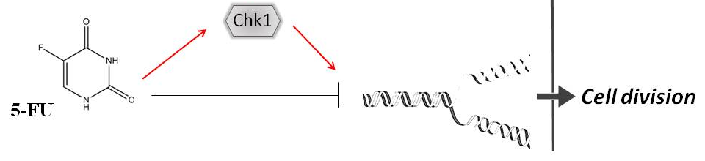
Background
Hepatocarcinoma (HCC) chemoresistance:
5-Fluorouracil (5-FU): antimetabolite, S phase block
Checkpoint kinase 1 (Chk1) activation: DNA repair and cell division

Slide 3
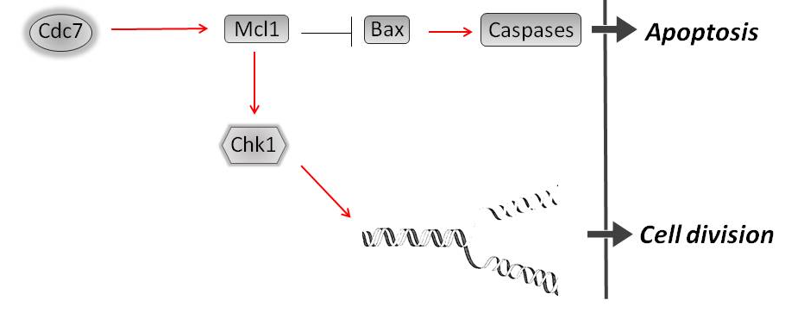
Background
Cell division cycle kinase 7 (Cdc7): target for re-sensitize chemoresistance through Chk1 inhibition and promotion of apoptosis

Slide 4
Background
PHA-767491: dual inhibitor of Cdc7 and Cdk9
Cdk9: cyclin-dependent kinase, binds to cyclins to regulate transcription

Slide 5
Data
Co-administration of PHA-767491 with 5-FU exhibited enhanced cytotoxicity on HCC cells.

Slide 6
Data
Inhibition of 5-FU-associated Chk1 phosphorylation by PHA-767491.

Slide 7
Data
Downregulation of Mcl1 by PHA-767491.

Slide 8
Co-administration of PHA-767491 with 5-FU further increased apoptosis in HCC cells.

Slide 9
Data
Synergistic antitumor activity of PHA-767491 with 5-FU in HCC xenografts.

Slide 10
Conclusion
● Combination of 5-FU with PHA-767491, a dual inhibitor of Cdc7 and Cdk9, exhibited a synergistic antitumor effect on human HCC cells through inhibition of Chk1 and Mcl1 and promotion of apoptosis.

Slide 11
Perspectives
Further mechanistic studies on the combinational regimen.
Prodrug PHA-767491: systematic in vivo studies for its antitumor efficacy and systematic toxicology.

Slide 12

Acknowledgements
National Science Foundation of China
National Science & Technology Pillar Program
Drs. Wei Li, Lin-Jie Li, Hong-Qiang Shen, Shi-Qiang Shang
from the Central Laboratory, Children’s Hospital,
Zhejiang University School of Medicine
Thank you!

