Slide 1




Feasibility of biofuels production: combining H₂-CH₄ and lipid production from food wastes using mixed anaerobic microflora
X. Gómez, C. Fernández, EJ. Martínez, J. Fierro, F. González-Ándres

Slide 2
Table of content
IRENA
Food waste valorisation
Digestion and fermentation
Coupling H₂-CH₄ production
Feasibility of lipid production from the process

Slide 3


Slide 4
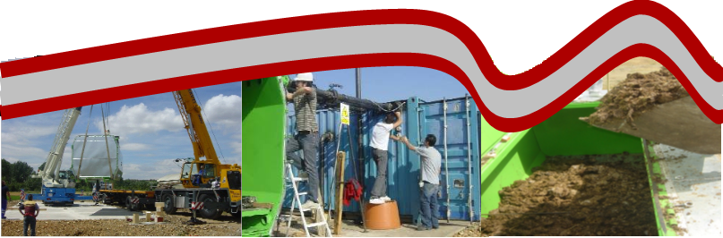
The research Group of Chemical Engineering, Environmental and Bioprocess (located at IRENA) has dedicated its activity to the valorisation of waste
In the last ten years our research work has focus on:
Energy recovery from organic waste: anaerobic digestion and pyrolysis.
Wastewater treatment by MEC and MFC.
Production of bio-fertilizers.
Hydrogen production from biological fermentation of organic waste
Development of prototypes for energy recovery

Slide 5
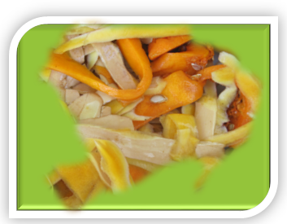
Food wastes valorisation
Food wastes: food losses – food processing wastes
Edible food
Discarded in different stages of the food supply chain
Production
Postharvest
Handling
Processing
Distribution
Consumption
utilization and disposal of food waste should yield benefits to the industry, society, and environment

Slide 6
Food wastes valorisation
Phenols and carotenoids
Pectin
Insoluble fibres
Proteins
Extracting high added-value products
Pre-treatments
Molecule separation
Extraction
Isolation and Purification
Product formation
Biofuels-production
H₂ – CH₄ – lipid production

Slide 7
Cheese whey valorisation
Cheese whey (CW) is a by-product from cheese factories that represents between 85 and 90% of the total volume of processed milk.
Lactose is the main component (4.5–5%), but other substances are also present:
proteins (0.6–0.8%),
lipids (0.4–0.5%)
and salts (0.7%)
Proteins concentrates
Saccharide mixtures

Slide 8
Whey treatment
Skimming for casein fines and whey cream removal
Protein concentration by membrane filtration
separation of glycoproteins in liquid form (heat coagulation, cooling, precipitation and centrifugation)
Lactose recovery: time-temperature depended crystallisation by adding seed crystals
Animal feeding
Biofuels-production
H₂ – CH₄ – lipid production

Slide 9




Food wastes fermentation
Referencia proyecto: IPT-2012-0144-120000
Anaerobic digestion
Fermentative H₂ production
Single stage process
Two-stage: Evaluating hydrolysis and H₂ production
Stream Recycling

Slide 10
Cheese whey fermentation
Anaerobic digestion
Fermentative H₂ production
Single stage process
Two-stage: Evaluating hydrolysis and H₂ production
VFA accumulation
Membrane separation for effluent clarification

Slide 11
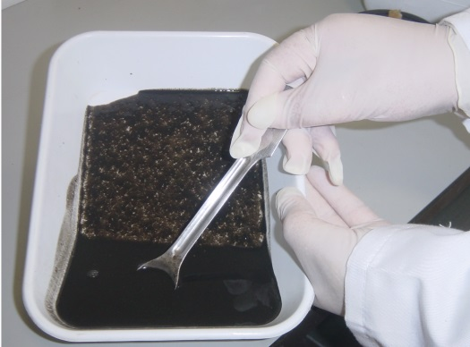
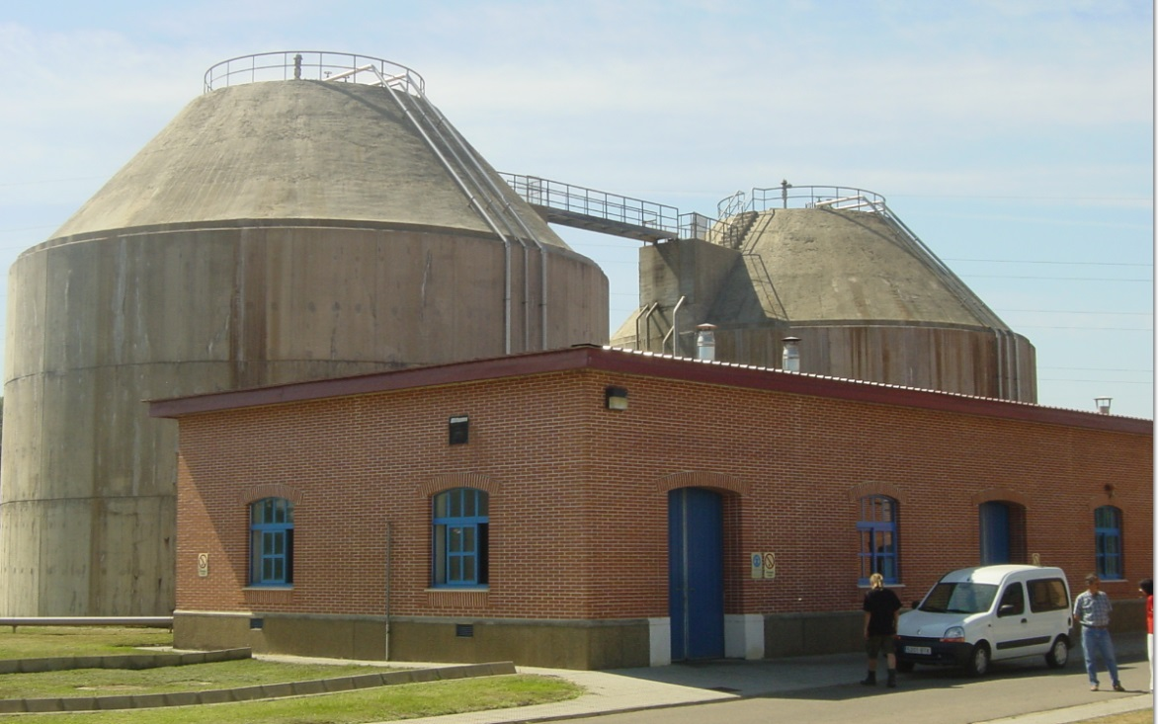
Material & methods
Inoculum: WWTP of city of León
Digesters: WAS and primary sludge
Parameters | Units | Inoculum
TS | (g L⁻¹) | 18.3 ± 0.1
VS | (g L⁻¹) | 9.1 ± 0.1
COD | (g L⁻¹) | 25.6 ± 4.6
Alkalinity | (g L⁻¹) | 1.8 ± 0.2
KN | (g L⁻¹) | 1.3 ± 0.1
TP | (g L⁻¹) | 0.5 ± 0.1
NH₄⁺ | (mg L⁻¹) | 578 ± 21
K⁺ | (mg L⁻¹) | 19.1 ± 5.2
Na⁺ | (mg L⁻¹) | 49.8 ± 9.1
K⁺ | (mg L⁻¹) | 19.1 ± 5.2
Chemical characteristics of inoculum

Slide 12
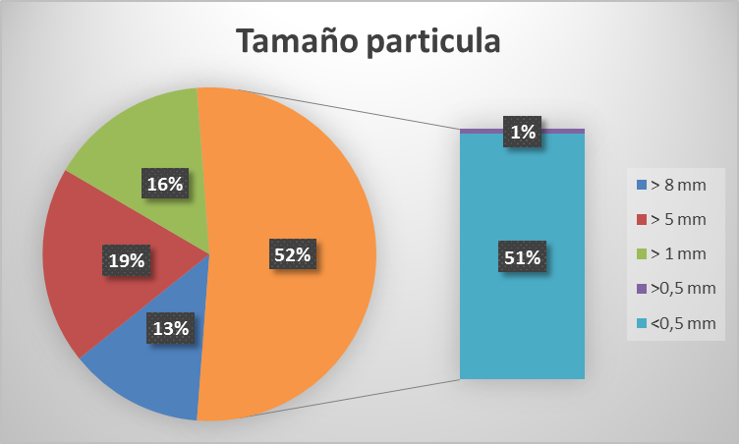

Material & methods
Substrate
Food wastes: Obtained from food processing industry elaborating salads and fresh packed fruits.
Parameters | Units | Food wastes
TS | (g kg⁻¹) | 123.7 ± 2.2
VS | (g kg⁻¹) | 115.1 ± 2.7
COD | (g Kg⁻¹) | 163.8 ± 7.6
Organic matter | (%) | 86.4 ± 4.0
N | (%) | 1.5 ± 0.1
Carbohydrates | (%) | 44.5 ± 2.2
Cellulose | (%) | 16.7 ± 0.8
Hemicellulose | (%) | 19.2 ± 1.2
Ash | (%) | 7.1 ± 0.4
K⁺ | (mg L⁻¹) | 19.1 ± 5.2
Particle size distribution
JWCE Muffin Monster
Chemical characteristics of Food Wastes

Slide 13
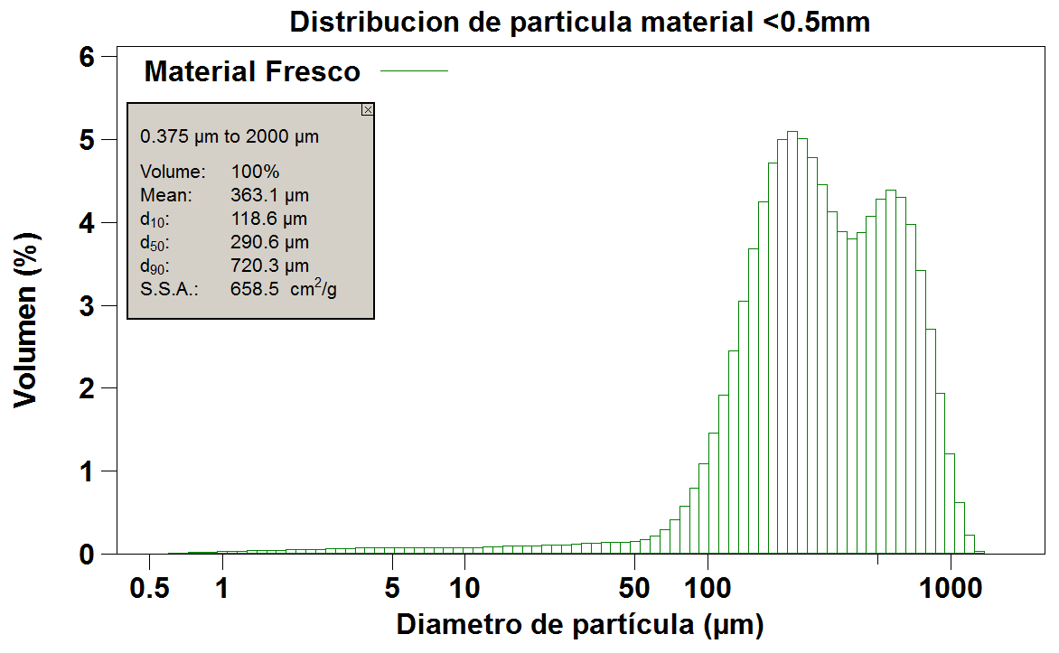
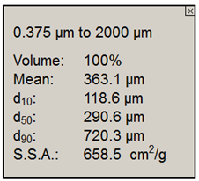
Material & methods
Particle size distribution < 0.5 mm
Food waste
Volume (%)
Mean particle diameter (µm)
Particle size analysis was carried out using a Laser Diffraction particle Size Analyser LS 13 320 Beckmann Coulter. Samples were previously diluted in tap water for analysis. 10 measurements were performed for each sample

Slide 14
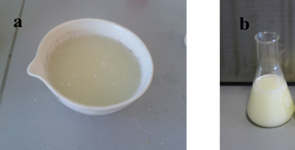
Material & methods
Substrate
Cheese whey: Obtained from Cheese processing factory (Zamora (Spain))
The CW liquid effluent was obtained after treatment with a membrane separation unit designed to recover proteins, thereby resulting in a liquid waste stream with poor nitrogen content
Parameters | Units | CW
TS | (g L⁻¹) | 33.1 ± 0.1
VS | (g kg⁻¹) | 30.1 ± 0.1
COD | (g Kg⁻¹) | 38.4 ± 1.4
Alkalinity | (mg L⁻¹) | 370 ± 10
KN | (g L⁻¹) | 0.4 ± 0.1
NH₄⁺ | (mg L⁻¹) | 26 ± 2.2
K⁺ | (mg L⁻¹) | 639 ± 30
Na⁺ | (mg L⁻¹) | 167 ± 10
Cl⁻ | (mg L⁻¹) | 487 ± 20
K⁺ | (mg L⁻¹) | 19.1 ± 5.2
Chemical characteristics of CW

Slide 15
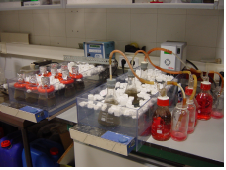
Material & methods
Digestion and fermentation: Batch
Experiments were carried out in Erlenmeyer flasks of 250 mL
Substrate – Inoculum ratio: Controlled based on desired process performance.
Tap water was added when needed to complete a 250 mL volume
Replicates: measuring gas production and composition.
Control: Batch reactor containing only inoculum was used as blank.
Temperature: 34°C, this being controlled by a water bath. Agitation was provided by means of magnetic stirrers.

Slide 16
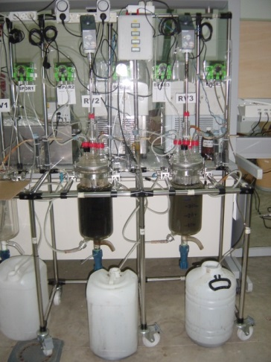
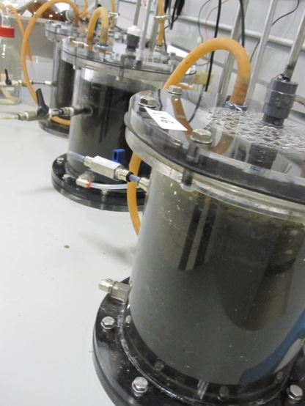
Material & methods
Digestion under mesophilic conditions
3 L volume reactor
Analytical techniques
Kjeldahl nitrogen, TS, VS, COD, alkalinity, ammonium, and pH
Biogas composition and VFA (Varian CP 3800 GC)
Thermal analysis
FTIR spectroscopy
NMR
Soxhlet method
Digestion under thermophilic conditions
5 L volume reactor

Slide 17
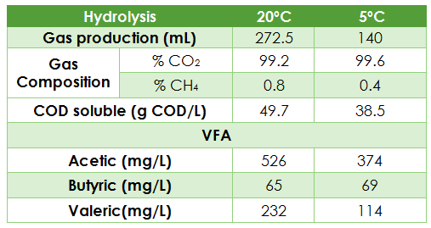
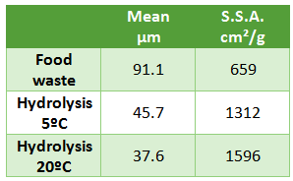
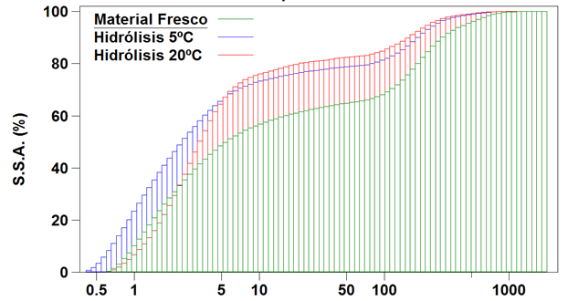
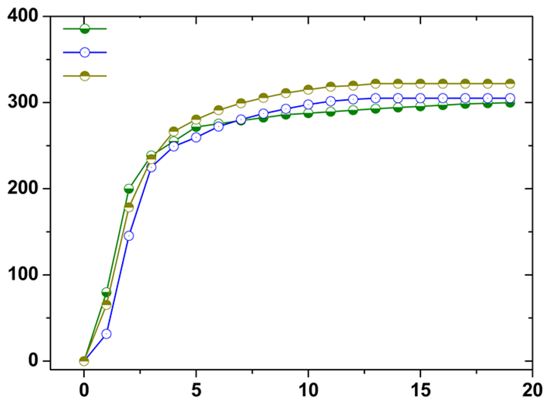


Results
Hydrolysis of vegetable wastes (3 d period) at 20 and 5 ºC.
Particle size distribution < 0.5 mm
Batch digestion
SMP (L CH₄/kg VS)
Food waste
Food waste
Hyd 5 ºC
Hyd 5 ºC
Hyd 20 ºC
Hyd 20 ºC
Time (days)
Mean particle diameter (µm)

Slide 18

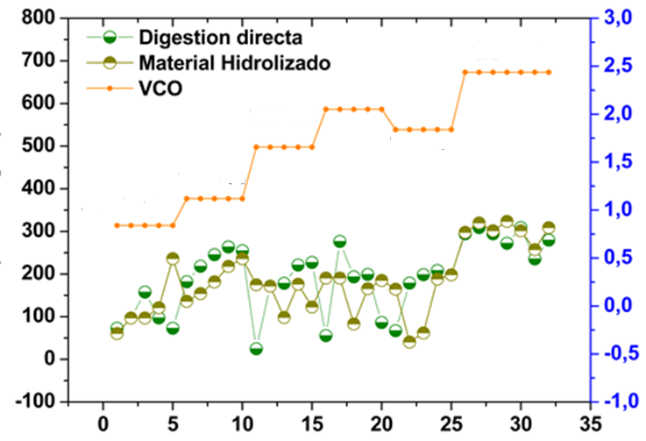
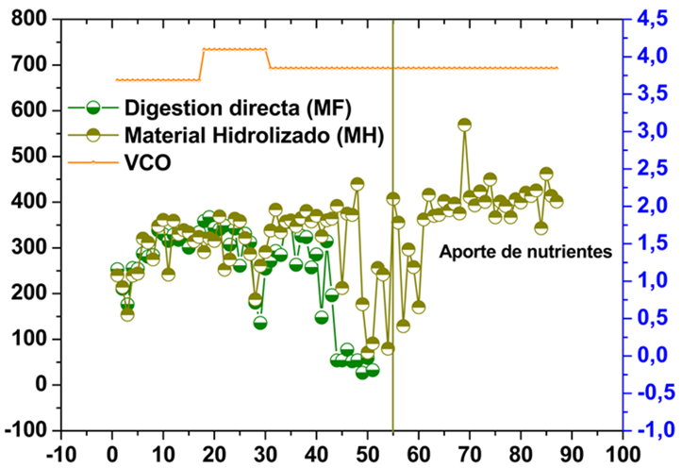
Results
Digestion of vegetable wastes
Food waste
Hydrolysed material
OLR
OLR (g VS/L d)
SMP (L CH₄/kg VS)
Food waste
Time (days)
Hydrolysed material
OLR
Parameters | Food Waste |  |  | Hydrolysed material
HRT (d) | 30 |  |  | 30
OLR (g VS/L d) | 3.68 | 4.09 | 3.84 | 3.68 | 4.09 | 3.84
Biogas (L) | 5.4 | 5.9 | 3.8 | 5.3 | 6.1 | 6.5
CH₄ (%) | 58 | 61 | 58 | 59 | 60 | 60
SMP (LCH₄/kg VS) | 290 | 299 | 195 | 291 | 300 | 350
pH | 7.4 | 7.2 | 7.1 | 7.4 | 7.3 | 7.1
OLR (g VS/L d)
SMP (L CH₄/kg VS)
Nutrient addition
Time (days)

Slide 19
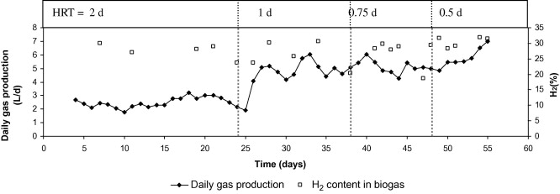
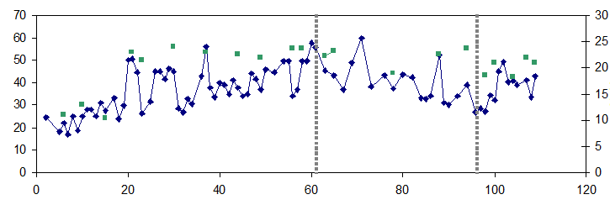
Results
Coupling H₂ – CH₄ Production
3 L reactor
V. Redondas , X. Gómez , S. García , C. Pevida , F. Rubiera , A. Morán , J.J. Pis. Hydrogen production from food wastes and gas post-treatment by CO2 adsorption. Waste Management, Volume 32, Issue 1, 2012, 60 - 66
Daily gas production (L/d)
 | H2 producing reactor
HRT (d) | 2 | 1 | 0.75 | 0.5
Daily gas production (L/d) | 2.5 | 4.7 | 5.1 | 5.8
H2 production (L/ Lr d) | 0.23 | 0.42 | 0.44 | 0.6
SH₂P (L/g VS) | 20.6 | 18.5 | 14.5 | 13.1
Supernatant recirculation (20% v/v)
7500 mg CaCO₃/L)
25 L reactor
HRT: 3 d
Daily gas production (L/d)
Time (days)

Slide 20
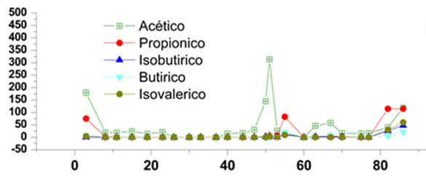
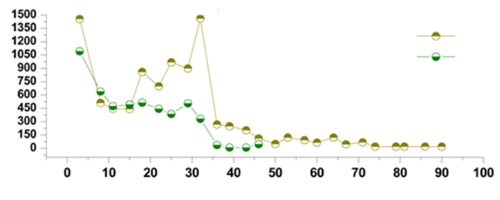
Results
CH₄ Production
Acetic
Propionic
Isobutyric
Butyric
VFA (mg/L)
Isovaleric
Time (days)
Hydrolised
Food Waste
NH₄⁺ (mg/L)
Time (days)

Slide 21
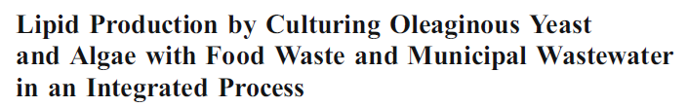


Feasibility of lipid production
Single cell oil production from low cost substrate
Cryptococcus curvatus,
Yarrowia lipolytica,
and Rhodotorula glutinis
Food wastes
Municipal wastewater
Biomass concentration: 0.58 – 1.5 g/L
Lipid content: 18,7 – 28.6%

Slide 22
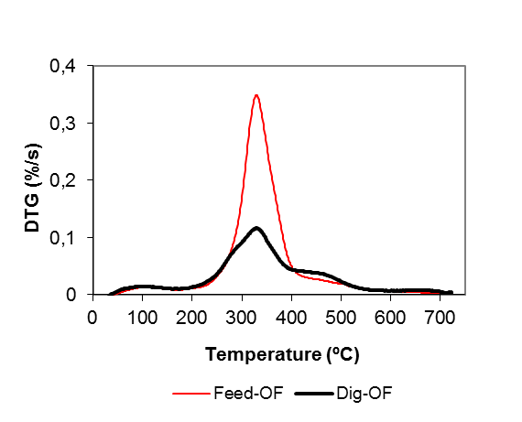
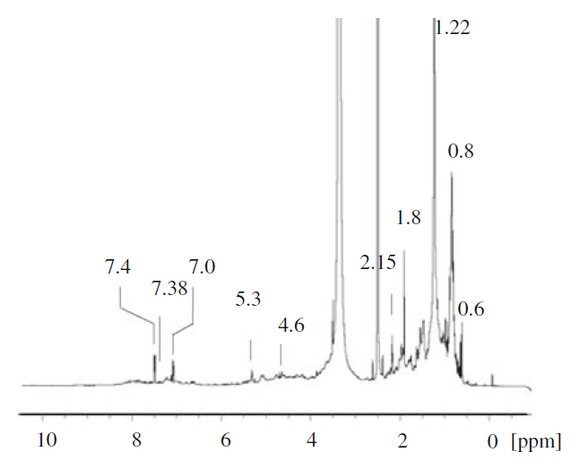


Results
Lipid extraction
2.15%
Inoculum: 0.8%
(Solid content: 23 g/L)

Slide 23
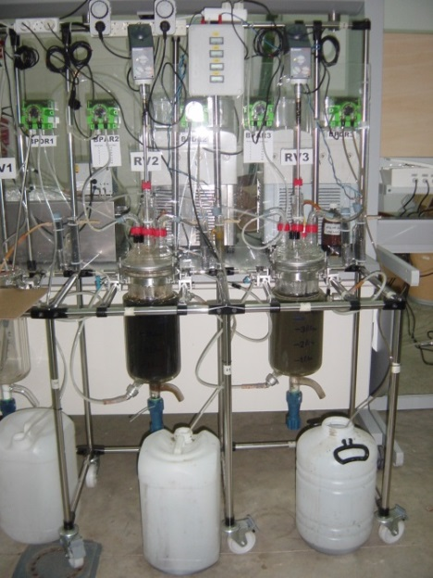
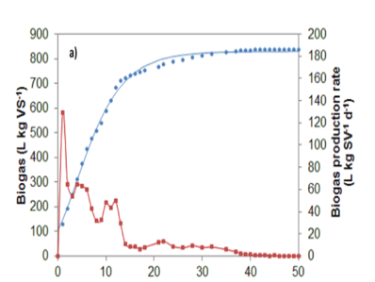
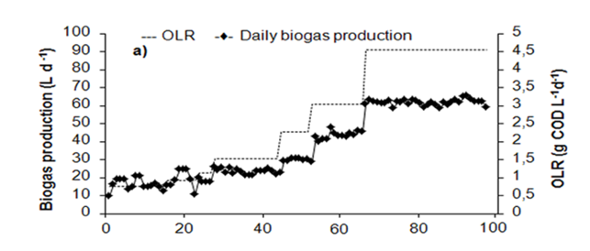
Results: Thermophlic
CH₄ Production: Cheese whey
Batch digestion
Biogas (L/kg VS)
Biogas production rate (L/kg VS d)
5 L semi-continuous digestion
Time (days)
Time (days)

Slide 24
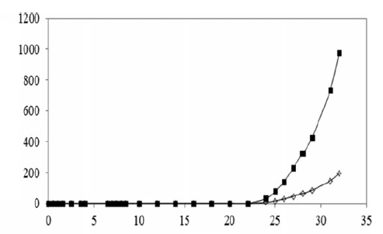
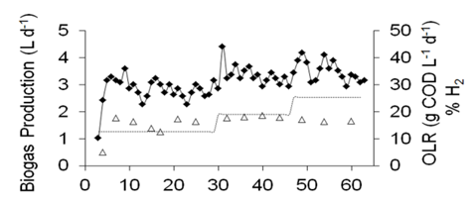
Results: H₂ - mesophilic
Batch fermentation
DGGE analysis: revealed that the
genus Clostridium was dominant,
Clostridium acetobutyricum (at 24 h)
Clostridium butyricum (at 32 h)
H₂
Biogas
Cumulative Biogas (mL)
3 L reactor
Mesophilic conditions
Time (days)
Time (days)

Slide 25
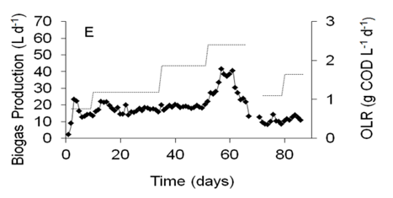
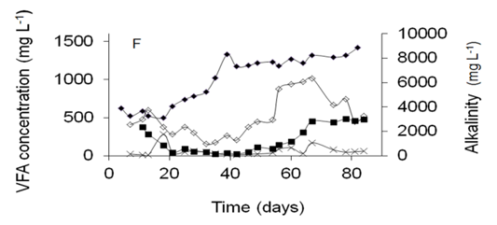
Results
Coupling H₂ – CH₄ Production
Second Stage (25 L reactor)
Thermophilic conditions
Biomass accumulation
Lipid extraction
Single digestion
HRT 8.3 d: 1.61%
Second phase
HRT 16.7: 0.81%

Slide 26
Conclusions
Food waste (Fruit and vegetables) and cheese whey valorisation by means of fermentative processes was evaluated. Results indicated high methane potential from these wastes. The need of nutrient addition to keep steady operation becomes an economical burden to the process.
Exploring the alternative of increasing the amount of lipid extracted from digestates may be a novel option for producing polar lipids.
Further studies are needed to explore the characteristics of polar lipids obtained from anaerobic microflora and its industrial application

Slide 27
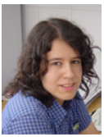
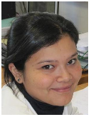

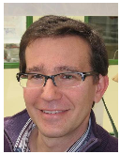
Thanks for your attention
Acknowledgements: Proyect Flexiner financialy supported by Ministerio de Economía y competitividad. Ref: IPT-2012-0144-120000

