Slide 1
About OMICS Group
OMICS Group International is an amalgamation of Open Access publications and worldwide international science conferences and events. Established in the year 2007 with the sole aim of making the information on Sciences and technology ‘Open Access’, OMICS Group publishes 400 online open access scholarly journals in all aspects of Science, Engineering, Management and Technology journals. OMICS Group has been instrumental in taking the knowledge on Science & technology to the doorsteps of ordinary men and women. Research Scholars, Students, Libraries, Educational Institutions, Research centers and the industry are main stakeholders that benefitted greatly from this knowledge dissemination. OMICS Group also organizes 300 International conferences annually across the globe, where knowledge transfer takes place through debates, round table discussions, poster presentations, workshops, symposia and exhibitions.

Slide 2
About OMICS Group Conferences
OMICS Group International is a pioneer and leading science event organizer, which publishes around 400 open access journals and conducts over 300 Medical, Clinical, Engineering, Life Sciences, Pharma scientific conferences all over the globe annually with the support of more than 1000 scientific associations and 30,000 editorial board members and 3.5 million followers to its credit.
OMICS Group has organized 500 conferences, workshops and national symposiums across the major cities including San Francisco, Las Vegas, San Antonio, Omaha, Orlando, Raleigh, Santa Clara, Chicago, Philadelphia, Baltimore, United Kingdom, Valencia, Dubai, Beijing, Hyderabad, Bengaluru and Mumbai.

Slide 3
Multilevel modelling approach to identify factors affecting HIV testing and counselling among women who were attending antenatal care services in Ethiopia
21/10/2014
Wondwossen Lerebo, Debra Jackson, Christina Zarowsky, Marleen Temmerman, Steven Callens

Slide 4
HIV counseling and testing
vitally important in order to access treatment
knowledge of one’s status can lead to behaviors to protect other people from infection
Less than one in five people who are infected with HIV in Ethiopia know their status
Too many people are presenting for treatment at a late stage in HIV disease

Slide 5
Factors affecting
The use of single-level analytical techniques in prior research ignores possible clustering.
  it discards hierarchical structuring of data on individuals living in different households, neighbourhoods, cities, and provinces.
Multilevel modelling that can simultaneously account for factors at individual and neighbourhood levels is likely to provide a more robust and sophisticated understanding of factors associated with HCT uptake.
  A woman HCT accessing behavior is nested at the health facility, health facility is nested in district

Slide 6
Multilevel modelling
This study aimed to elucidate individual and community level factors associated with the uptake of
  HIV Counselling and Testing (HCT) by implementing a hierarchical (multilevel) methodological approach.

Slide 7
Cont…
Multilevel modelling was developed in response to the challenge of appropriately analysing clustered data.
This technique preserves the original data structure (i.e., individual level variables need not be aggregated to group means) while explicitly modelling the within-group homogeneity of errors by allowing the estimation of error terms for both the individual and the group.

Slide 8
Methodology
cross-sectional study design
multistage sampling technique
  in which health facilities first selected (stage 1)
  followed by recruitment of post-partum women who come for child immunization from each health facility (stage 2) in Tigray region
Study population
  population of this study constitute the post-partum women who were attending the health facility for the child immunization

Slide 9
Sampling procedures
From 46 districts 50 health facilities (one bigger and well functioning facility) from each selected
From each health facility systematically sampled 30-36 post-partum women interviewed
  If the selected facility is medium the sampling was purposive until we get the needed size
  If it is not possible to attain 30 in the facility the nearest one in the same district to attain the desired size

Slide 10
Data management & data analysis
Data captured and analyzed using STATA v11
Analyses included descriptive and analytic statistics
Multilevel regression modeling used to examine different levels of factors in hierarchical models
Ethical consideration
  Permission to conduct the source studies granted from the Ethics Committee of the University of the Western Cape and from Tigray Region Bureau of Health

Slide 11
Results
Variables | HCT Utilized N(%) | Single level full model | Multilevel full model
Mother educ None Primary Secondary/H | 353(68.5) 387(78.8) 372(84.6) | 1 1.28 (0.803-2.049) 1.06 (0.585-1.936) | 1 1.23 (0.749-2.015) 1.06 (0.564-2.000)
Father educ None Primary Secondary/H | 261(66.6) 378(78.3) 465(82.9) | 1 1.26 (0.805-1.976) 1.12 (0.644-1.968) | 1 1.44 (0.890-2.339) 1.35 (0.738-2.484)
Ever utilized ANC Yes No | 959(82.9) 152(53.0) | 4.16 (2.705-6.407) 1 | 4.54 (2.815-7.328) 1
Get enc. From hus Yes No Know HCT sites Yes No | 911(83.6) 194(56.2) 983(80.0) 127(59.3) | 1.94 (1.272-2.963) 1 1.64 (0.988-2.710) 1 | 1.97 (1.252-3.104) 1 1.95 (1.114-3.398) 1
Knowledge level Poor Good SES quintile 1st quintile 2nd quintile 3rd quintile 4th quintile 5th quintile | 561(71.6) 548(83.2) 220(65.9) 252(78.5) 253(74.4) 179(83.3) 210(88.2) | 1 1.81 (1.236-2.646) 1 1.18 (0.691-2.009) 0.66 (0.368-1.193) 1.60 (0.729-3.523) 1.76 (0.779-3.981) | 1 1.44 (0.904-2.284) 1 1.17 (0.658-2.071) 0.65 (0.341-1.241) 1.71 (0.735-3.960) 1.59 (0.652-3.881)

Slide 12
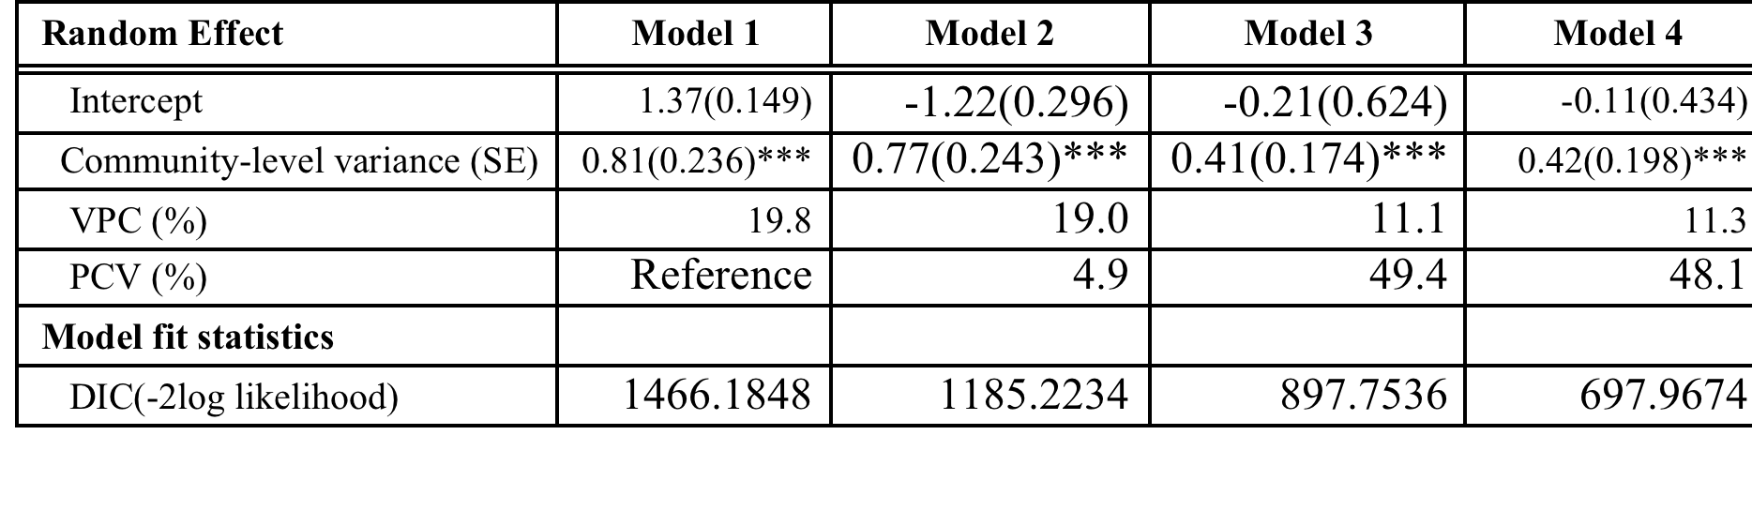
Results
Variables | Single level full model | Single level full model | Multilevel full model
Place of residence Urban Rural | 724(83.0) 380(67.4) | 0.79 (0.486-1.281) 1 | 0.84 (0.484-1.450) 1
Proximity <1km 1-5kms >5kms | 390(83.9) 208(80.0) 170(70.2) | 1 0.74 (0.470-1.170) 0.61 (0.380-0.963) | 1 0.76 (0.461-1.260) 0.59 (0.346-1.019)
Population per HCT site ≤24000 >24000 | 544(81.2) 570(73.3) | 1 0.53 (0.329-0.868) | 1 0.54 (0.267-1.079)
Proportion of women with no education <30% 30-50% >50% Population per health workers ≤1500 >1500 | 476(77.9) 461(79.1) 177(69.7) 704(80.0) 410(72.2) | 1 0.74 (0.487-1.121) 0.35 (0.209-0.599) 1 0.61 (0.383-0.978) | 1 0.75 (0.449-1.261) 0.44 (0.217-0.892) 1 0.61 (0.307-1.206)

Slide 13
Discussion
In single-level logistic regression and multilevel modelling:
  attending ANC was associated with the uptake of HCT.
  It is consistent with studies conducted previously in Ethiopia
    attributable to the women’s exposure to information regarding HIV and PMTCT during the ANC follow-up.
Getting their husband’s approval to access HCT.
  Other studies; supportive husband significantly increased the likelihood of women’s utilizing HCT.
    This may be related to culture, traditional beliefs, and women’s economic dependence on their husbands which includes their not having the freedom to make decisions regarding their own health.

Slide 14
Cont…
‘knowing an HCT site’ and uptake of HCT is an interesting finding, whereas ‘knowledge level of HIV’ seems to make no significant difference for the uptake of HCT in multilevel modelling.
community-level characteristics
  woman who is living in a given community with higher proportion of educated women has a higher chance of utilizing HCT
Random effects of the districts of HCT utilization are significant.
  unmeasured factors operating at the community/ or district level play a significant role in determining women’s getting HCT beyond the influence of individual-level factors. (20% in null and 11% in full model)

Slide 15
Conclusion
At the individual level
  utilizing ANC and
  getting approval from a spouse are consistently strong predictors of utilization of HCT in both single-level and multilevel logistic regression,
  while other factors generally vary in magnitude and significance.
At the community-level
  a significant predictor in utilizing HCT was where a district had more than 50% of the women without education,
    suggesting that group illiteracy is an impediment to utilizing HCT in Tigray region, Ethiopia.

Slide 16
Limitation
Facility level factors were not addresses
mothers who did not patronize the immunization facilities were excluded
there may have been recall bias
social desirability bias may have been present
unmeasured individual factors may partly account for variations in the community-level factors
the administratively defined boundaries of districts might non-differentially misclassify individuals into inappropriate administrative boundaries

Slide 17
Thank you!!

