Slide 1
THE FUTURE OF MICROBIAL ECOLOGY AND TECHNOLOGY
The Manufacturing & Trading Microbiome
WILLY VERSTRAETE
LabMET july 2015

Slide 2
OVERVIEW
1.The microbiome as an operational (read engineering) concept
2.The microbiome and the methodology
3.The physical interfaces as sites for ‘ ICT’
4.The manufacturing microbes
5.The microbiome and the society at large
6.The platforms of progress for MET (and possibly for LabMET)
7.The conclusions

Slide 3
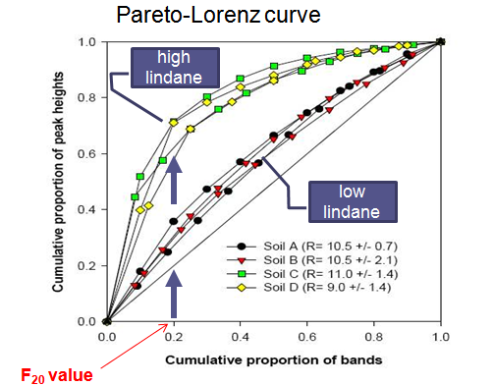
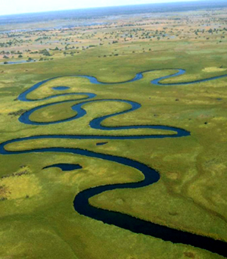
1.The microbiome as an operational concept
1.1. A real ‘team’ and not a haphazard mix
-Examine the Pareto structure : note the 80% have-nots are essential to keep the other 20% active ( Marzorati et al. 2008)
-Observe for ‘added value ‘ cross feeding patterns (more exergy per delta G ) for example by meandering slow metabolism
-Observe for diversity : the more the better the stability (Ho et al. 2014)

Slide 4
1.The microbiome as an operational concept
1.2.The generator of ‘new life’
Due to selection pressures in communities of higher plants heritable phenotypes resulting from distinct genotypes, have recently and for the first time been reported( Zuppinger-Dingley et al. 2014)
This certainly happens also in microbiomes (although only fragmentary evidence so far, Wilmes et al 2009 ) and this will generate :
NEW NOVEL GENES AND THEIR PRODUCTS

Slide 5
1.The microbiome as an operational concept
1.2. The generators of new life are ….
Apparently ‘generalists’ have too large genomes to allow mutations / they must keep tight control (Mc Ilroy et al2013 ; Wilmes et al 2014). Hence ‘specialists’ have high levels of within population variation for diversification and fine-scale niche participation ( Carbonero et al. 2014)
Take Home : Microbiomes are generators of new value! Specialists are drivers for fitting new niches

Slide 6
1.The microbiome as an operational concept
1.3. The proctector of established ‘law and order’
Now for the first time it is scientifically established : Biodiversity is inversely related to disease (Johnson et al. 2013).
The established microbiome has a ‘barrier’ function
Take Home: There is an urgent need to better learn how microbiomes deal with invasion (De Roy et al. 2013) and how to use them instead of ‘stamping out disinfection’

Slide 7
2.The microbiome and the methodology
2.1.Genomics and microbiomes
-The genomics of today are far too bulky
-The genomics now give mainly lists and ratios
-We should not be gene-centric but system genome-centric ( Prosser 2015)
Compare : machine - factory - multinational

Slide 8
2.The microbiome and the methodology
2.2. Genomics as predictors of change
They must deal with changes which are going to occur in capacity and traits -We need early warning indicators – We must give more attention to Proteomics (Wilmes and Bond 2009)
Take Home: Monitor changes in Anabolic Genes. It can signal that the microbiome is developing the ‘intelligence’ to desporulate at lower trigger values,to produce a new cutting edge enzyme, etc.

Slide 9
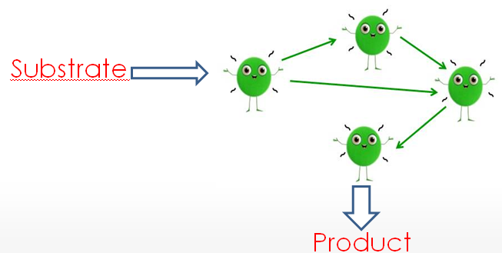
2.The microbiome and the methodology
2.3. Engineering the ‘team’
From scratch (DeRoy et al. 2014)
Start with generalists, they are essential for Ecosystem Functioning , particularly if you have low redundancy, which is normally the case at on-start (Gravel et al. 2011)
In the near future of use : genomic editing tools (RNAi, DNAi, guide nucleases ), robotic DNA alterations (Trent et al. 1995) with a priori in silicio validation of the outcome

Slide 10
2.The microbiome and the methodology
2.3. Engineering the team
B. By conventional MRM ( Verstraete et al. 2007; 2012) : take an existing team and force it to evolve to new tasks and better cooperation
Examples:
Microbial team resilient to changes in NH3 levels in biofilters ( Cabrol et al. 2013)
-Microbial team ‘vaccinated’ against invaders( viruses ?)
Take Home : Verify if you have a team/Implement microbial management to create ‘new knowledge’

Slide 11
3.The physical interfaces as sites for microbial ICT
3.1.Microbial ICT :
A microbiome depends on information exchange - It must deal with
-its 3D structure
-its work flow
Examples:
-the methanogenic consortia organized at the 2um level
-pheromones,AHLs, nanowires, e-shuttles
-gradients of metabolites (Bachmann et al. 2013) / advective flow patterns in flocs

Slide 12
3.The physical interfaces as sites for microbial ICT
3.2.The sites of interactive microbial behavior are the interfaces
Type A : the external co-habitation
Rhizosphere / Phylosphere / Gut / Skin / Abiotic materials (electrodes ) :
-they achieve densities of 40 gCDW/L
-in case of higher host : the interface is ‘ privileged ’ e.g. in the mucosa by immuno responses ( Jacob et al. 2014); in the roots by exudates (Guttman et al. 2014)
Remark: It has been shown for roots that the interface maintains its microbiome when transplanted (Tumbull et al. 2014). This is a very important tool for MRM

Slide 13
3.The physical interfaces at sites for ICT
3.2.Types of interfaces :
B. Mutalism / Symbiosis : The microbial partner is often integrated into the higher cell structure
The nodule / The Amoeba-Legionella vacuole / the Wolbachia –insect system / The mitochondria
Take Home : We should learn to ‘evolve’ new types of integrated microbiomes e.g.
-root nodules which hold bacteria that produce metal chelators, plant defence chemicals,vitamins,PHA, special bio-acitve proteines
- mitochondria from rumen cells empowered by special methanotrophs, resp butyrate producing bacteria

Slide 14
4.The manufacturing microbiomes (Verstraete 2015)
Key Question: What can microbes / microbiomes do that industrial technology can not (yet) readily bring forward ?
1.Total dissipation of substances at minimal costs. Yet this is diminishing in demand –The focuss is now on degradation to operational units ready to be recovered.
2.Upgrading to high(er) molecular order : proteins, PHAs, vitamins, exo PS
3.Providing a ‘healthy entourage’ (De Schrijver et al; 2014) ; counteracting the ‘resistome ‘ (Neyra etal.2014)
Consideration : The urban society is in need of cycling at site
( see further ) and also of better protection against pandemics and Antibiotic Resistance Genes (Frosberg et al.2014)

Slide 15
OVERVIEW
1.The microbiome as an operational (read engineering ) concept
2.The microbiome and the methodology
3.The interfaces at sites for ‘organic ICT’
4.The manufacturing microbes
5.The microbiome and the society at large
-Lessons in general / Planetary challenges /Market economy
6.The platforms of progress for MET (and possibly for LabMET )
7.The conclusions

Slide 16
5.The microbiome and the society at large
A.Lessons to be learned from special microbiomes
Minimal life: eg in deep soils and sediments : minimal entropy, max homeostasis, slow metabolism : the driving force of life is H2 from minerals (Parkes et al. 2011)
The viral parasitism : Oceans are full of virusses (10 for 1 bacterium ) (Wertz and Williams 2013). The viruses drive the re-cycling!
Ageing and caring : older cells get damaged, but they then transfer all the good traits in ONE daughter line. Eternal life thus exists ! (Ackermann 2008)
Take Home : There are boundaries conditions from which we can learn eg in terms of basic needs, optimal cycling and methods to activate the next generation

Slide 17
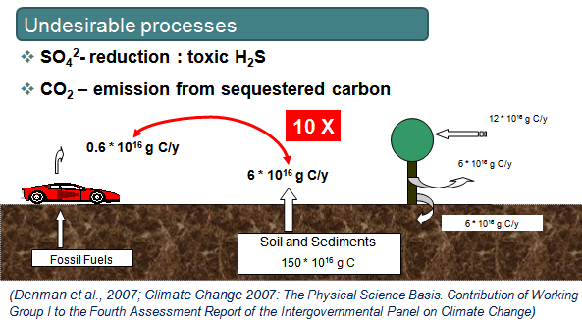
5.The microbiome and the society at large
B. The planetary challenges and Ecosystem Functioning (EF)
-The soil microbiomes
produce massive amounts
of CO2!!
-The soil microbiomes
are THE bio-actuators in
Climate Change but we have
no clue as yet on how to deal with
them
Take Home : The microbial services in the soil and sediment ecosystems will get recognition and become the hype , next to the one of the gut

Slide 18
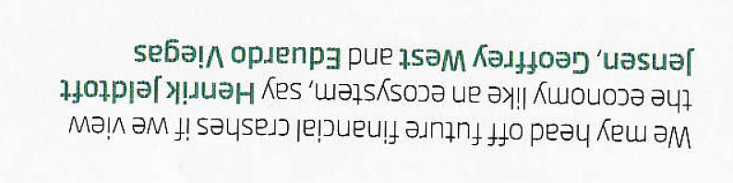
5.The microbiome and the society at large
C.The market economy within the microbial world
-We humans need large scale experiments about new societal approaches
Such as
- the concept of minimal garanteed income for each
- the Morris (2012) theorem about world dominance of the western culture. Is it really a matter of constant ‘exposure / challenge / change’ ?
Take home: We can use microbial ecology, operating at the level of millions of actuators, and learn in a short time a lot of lessons applicable in macro-economics.

Slide 19
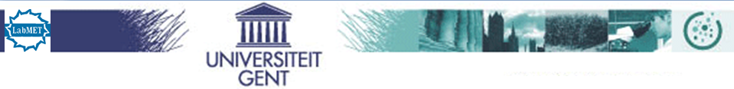
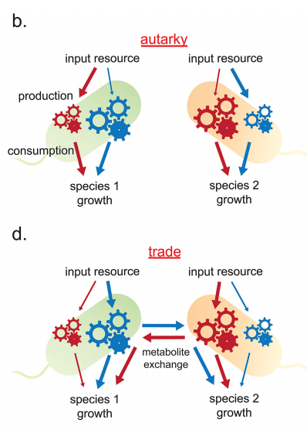
C.The market economy within the microbial world
*Economists start to
deal with microbial
metabolism
(Tasoff et al. 2015 PLOS ONE )
The “trading “ between bacteria
Take home : By trading with one another , microbes clearly grow better !

Slide 20
5.The microbiome and the society at large
D.Some key microbial ecology elements to better explore :
-r and K strategies : the progressive and the conservative investors
-team players versus ‘profiteurs’ : changing environments with real gradients disfavor microbial cheators (Allisson et al. 2014)
-sexual promiscous resp ‘puritan’ behavior (HGT) : in ‘hot’ spots, the former thrive (Van Meirvenne et al. 2014)
-the Hubbell (2005) neutral niche theorem : each species constantly creates its own niche ,thereby trying to improve its fate ( each tries to be happy)
Take Home :There is plenty of room for transferable macro ecological wisdom

Slide 21
6.The platforms of progress-3 examples
1.Socalled ‘gene drive systems ‘ for advanced medical and zootechnical microbiomes (Trent et al. 1997)
We will have systems which redesign the entire DNA
-by means of tools for improved guidance of DNA functioning
-by mapping in advance the outcome of the functionality in the open microbial world
Take Home : We will create the platform for accelerated evolvement towards
NEW UNEXPECTED MICROBIAL OUTCOMES AND OPPORTUNITIES

Slide 22
6.The platforms of progress
2. The interaction higher-lower organisms under transient conditions (plants (algae), insects, animals –humans)
The vast domains of having lower levels of Antibiotic Resistance Genes (ARGs), less immuno deficiency, better microbial entourage, competitive exclusion for biocontrol, suppressive microbiomes (ex- and internal ), microbiomes vaccinated against X, Y, Z

Slide 23
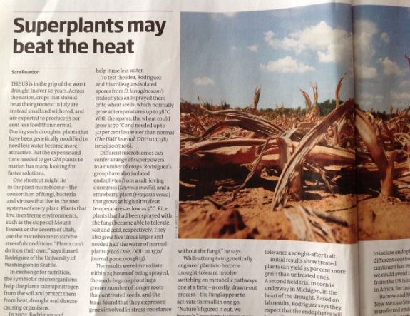
6.The platforms of progress
2.The interaction …
Root symbionts for drought conditions : Do not transfer genes but a whole endophyte microbiome (the set of evolved species ) and wheat can use 50% less water and can endure 70 C (Rodriguez et al 2008, Bell et al 2005)
Take Home: The interfase procaryotic/eucaryotic interaction is booming business for decades to come

Slide 24
6.The platforms of progress
3.The cyclic economy
-Stop the massive transport from the agro environemnt to mega cities , but cycle at site by involving empowered microbiomes !!!
Feed and food production needs to be set beyong the current agro-system as it stands today .The latter have reached their limits of efficiency (!!)
Example : The N cycle

Slide 25
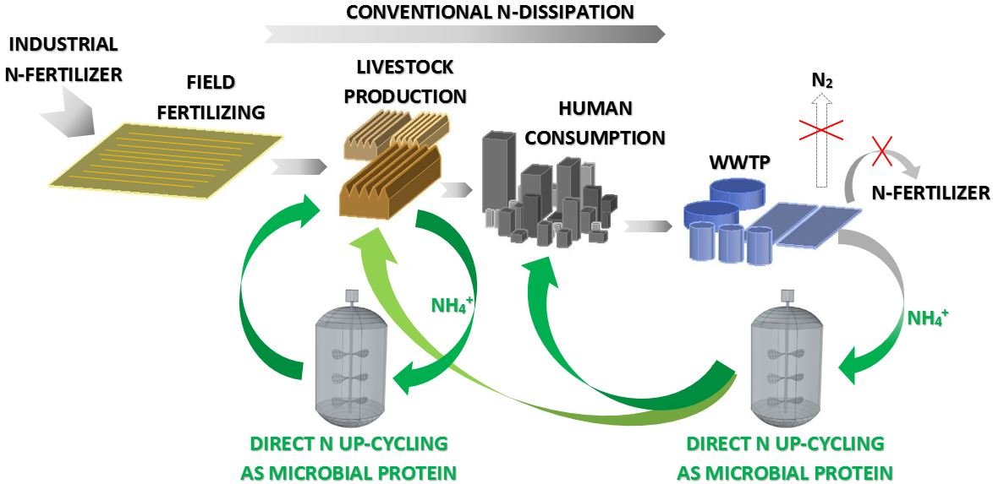
6.The platforms of progress
Short cycling at site

Slide 26
7. Conclusions (1/5)
The future of Microbial Ecology and Technology :
a)The microbiome as such
-it strives for max exergy and thus max complexity
-its operational structure (Pareto) is its hallmark
-it is a constant creator of new life, new added value
-its generalists are the ‘conservators’, its specialists are the ‘renewers and inventors’
-its anabolism is its predictor

Slide 27
Conclusions (2/5)
b)Interfaces / abiotic and biotic / are the sites of microbial organisation by means of organic ICT:
-the abiotic interface guides, but the biotic interface even creates ‘privileges ’ for its microbiome
-the interface is the tool to ‘engineer’ and transplant the microbiome

Slide 28
Conclusions (3/5)
c) The long term ecosystem services
-the microbial component of Ecosystem Services is bound to become a central theme of Climate Change

Slide 29
Conclusions (4/5)
d)The manufacturing microbiomes
-develop microbiomes which are our protectors against ‘resistomes’
-establish the effective operational connection between lower and higher biology (nodule, mitochondrium, …) This will require the development of integrative ‘gene drive systems’
-engineer a biobased cyclic economy for the mega urbanized society and its urgently needed local sustainability

Slide 30
Conclusions (5/5)
e) The manufacturing microbiome also trades
-microbiomes evolve and constantly generate NEW processes and products and trade/ exchange them

Slide 31

Outlook forward
Happy are those who now start…
(Beijerinck 1930)

Slide 32
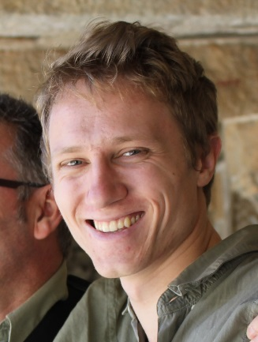

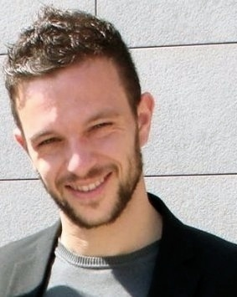



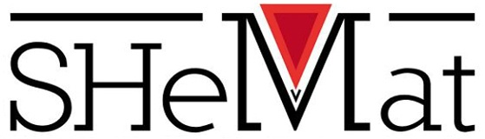
Thanks to…
Silvio Matassa ; Filipe Silva, Stef Vervaet

