Slide 1

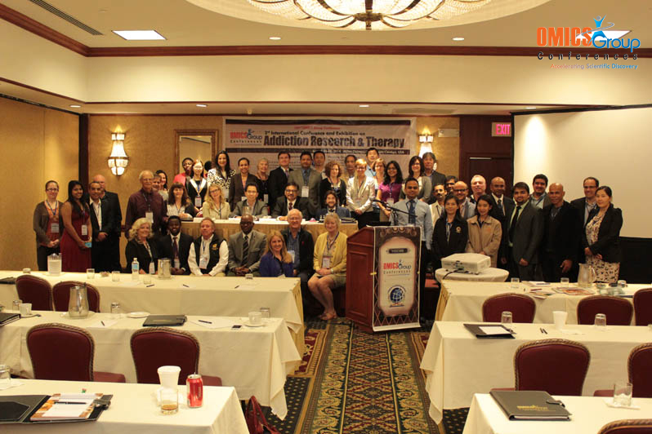
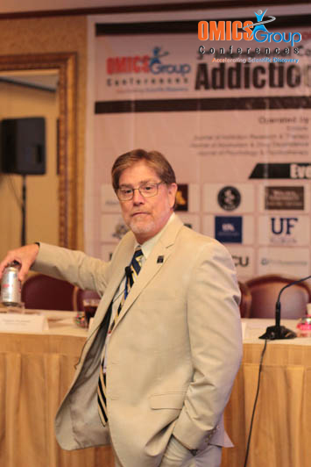
Addiction Therapy-2014
Chicago, USA
August 4 - 6, 2014
William S. Jacobs

Slide 2
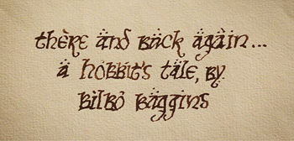
Pain & Addiction
William S. Jacobs, MD
Chief of Addiction Medicine/Associate Professor
Medical College of Georgia
Medical Director
The Bluff Plantation
Chief Medical Officer
Georgia Detox & Recovery

Slide 3


Prior to the 1990s, “chronic pain” was not a broadly recognized concept in medicine.

Slide 4
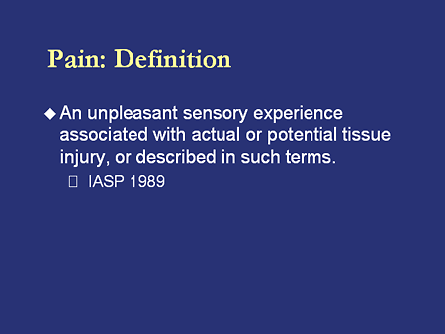

Slide 5
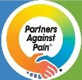
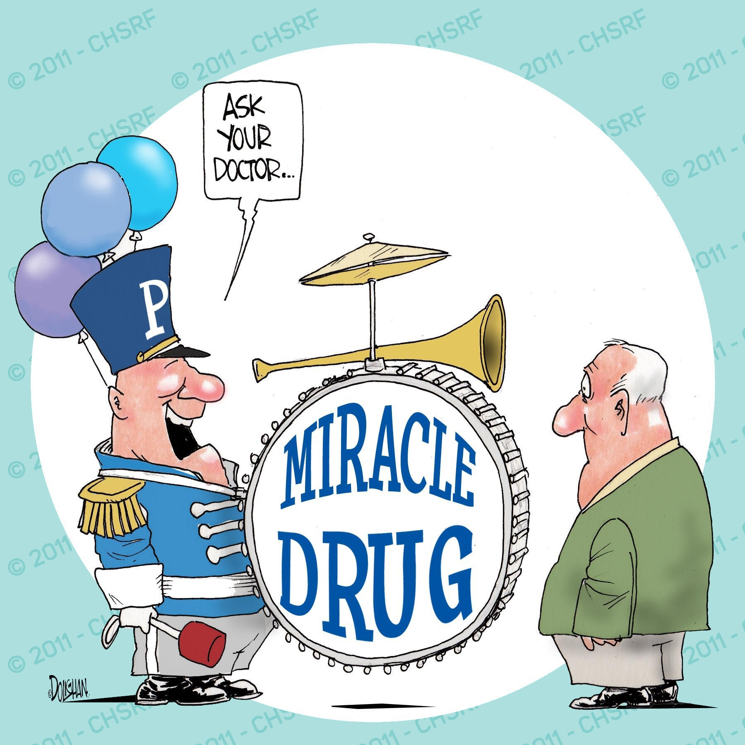
By the mid 1990s I was told that I was doing an inadequate job of treating pain. I was being needlessly stingy with opioids.
Esteemed speakers at medical conferences preached for more “appropriate” (liberal) use of opioids in pain management.

Slide 6
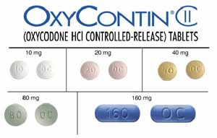
in 1996, Purdue Pharmaceuticals introduced Oxycontin as a “safe, long-acting opioid that would avoid the euphoric rush of short-acting opioids, and thus could be used chronically without fear of addiction or misuse”.
A new wonder drug had been developed “just in time” to meet our new needs and with new pressures to aggressively treat all forms of pain.
Oxycontin became
the best selling
opioid in the
world by 2001.
______________________

Slide 7


At UF, several factors led to the creation of the Department of Psychiatry Chronic Pain Clinic.
We were early adopters of this newly recommended practice.
We treated patients whom others refused to treat.
Though I knew the dangers of Oxycontin, which by this time had proven to be easily crushed and injected by those seeking to abuse it, I championed the concept that a long-acting opioid ought to be safe for chronic use.

Slide 8
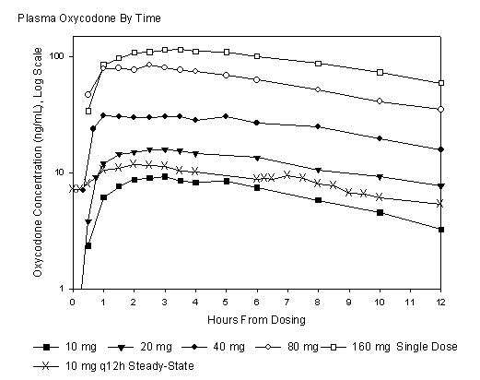

Slide 9
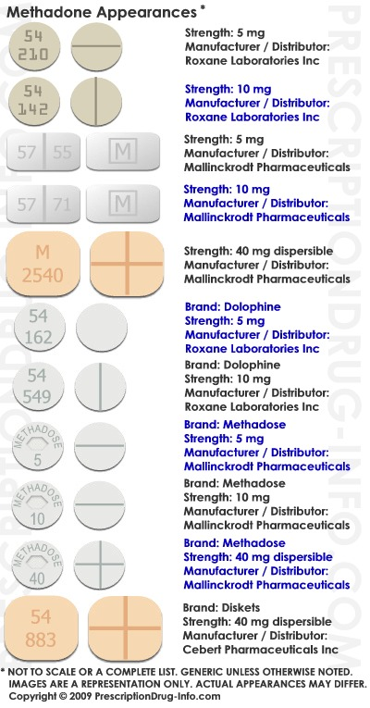
We were also early adopters of methadone in the management of chronic non-malignant pain. It was generic, cheap, had been around forever,
and was used to treat opioid addiction
And I was also an addictionologist who had worked in a not-for-profit Methadone Maintenance Program

Slide 10
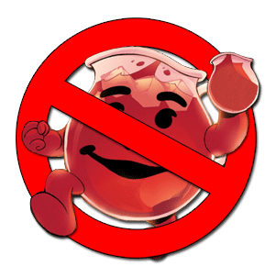
I believed that patients with chronic pain deserved to have a background dose of a long acting opioid like methadone, and then some short-acting opioids on hand for breakthrough pain.
A “controller” medication and a “rescue” medication is a pharmaceutical model widely used in the treatment of asthma, rheumatoid arthritis, and diabetes, so I embraced that concept for treating chronic pain.

Slide 11
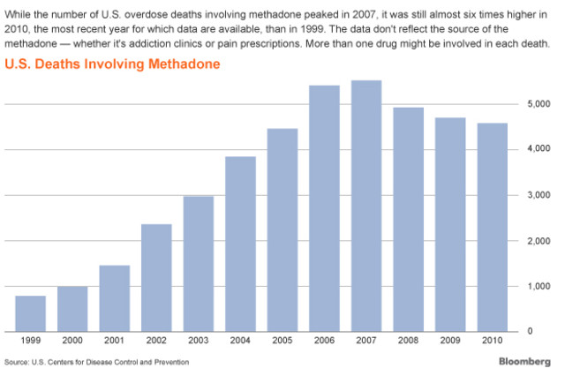

Slide 12

This movement toward more aggressive pain management was so strong that the Joint Commission (the accrediting body for quality medical practice) created a standard:

Slide 13
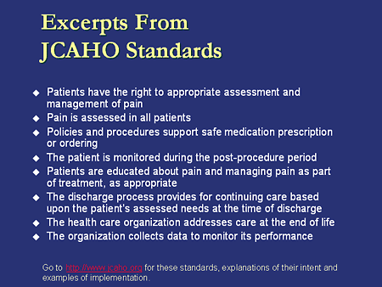
From Medscape

Slide 14
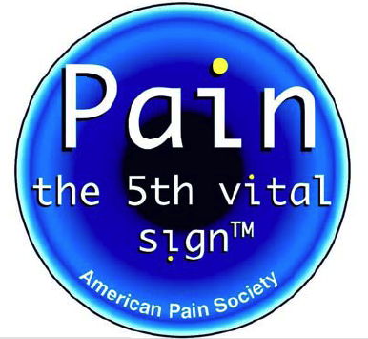
every patient must be asked about their pain at every visit so that it could be appropriately addressed.
We put visual analog pain scales on the paperwork for every visit, so the “pain scales” became a vital sign just like heart rate, blood pressure, respiratory rate and temperature.

Slide 15
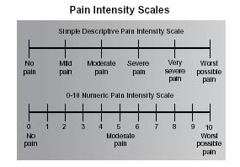

Slide 16
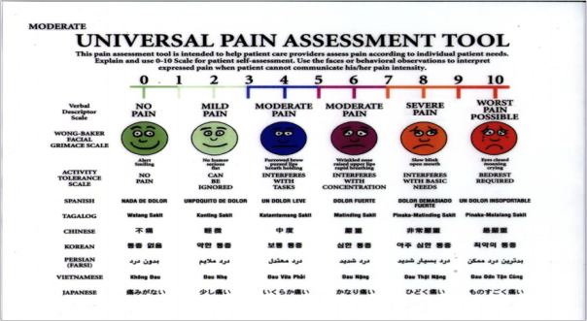

Slide 17
Our clinic became very busy. We had patients seeking out our compassionate, forward thinking care, coming from hundreds of miles. These turned out to be some tough and very needy patients - lots of worksman’s comp cases, lots of patients with multiple prior back surgeries, lots of permanently disabled low functioning depressed unemployable patients.
To the point where it became overwhelming.

Slide 18
I noticed that no matter how much I listened and empathized and cared, and no matter how many opioids I prescribed, most never got better.
Many cheated and lied to me and got more opioids & other drugs from different doctors. They sold their drugs on the street. They lost them and demanded more.

Slide 19
Around 2003 “chronic pain syndrome” was recognized with its own ICD-9 diagnostic code.
ICD-9 338.4
Disease Synonyms
Chronic pain associated w psychosocial dysfunction
Chronic pain associated with psychosocial dysfunction
Psychosocial dysfunction due to chronic pain
Applies To
Chronic pain associated with significant psychosocial dysfunction

Slide 20
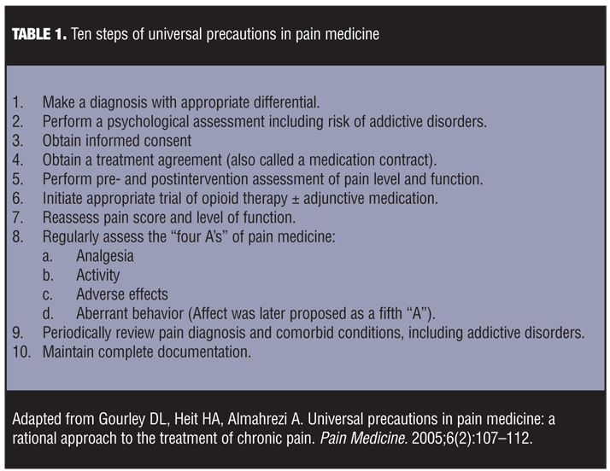

Slide 21
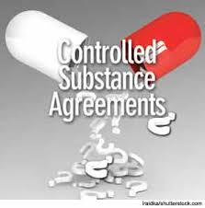
We did recognize these aberrant behaviors so we created a structured, standardized program for our patients who we thought needed opioids to manage their pain.
Every patient prescribed opioids signed a consent/treatment agreement which explained the dangers of opioids and the “rules” of our program. We required them to participate in educational group visits. We had them see psychiatrists and psychologists for the psychiatric symptoms.

Slide 22
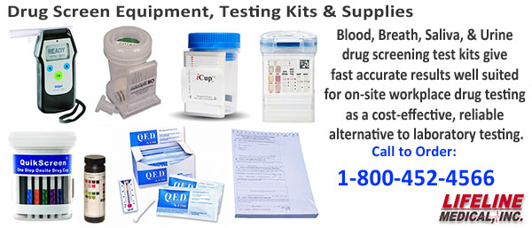
We required Urine Drug Screens to ensure they were not using other drugs, and even more importantly, to ensure they were actually taking the drugs we were prescribing.

Slide 23

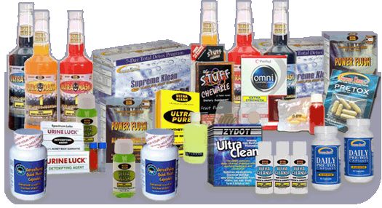
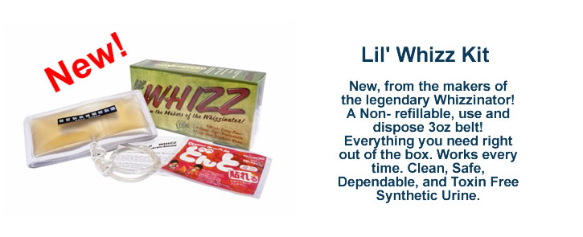

Slide 24
We prescribed opioids only in a 28-day supply, to ensure that refills never came due on a weekend.
We never refilled opioids by phone or on the weekend.
We did a substance abuse evaluation for all the patients we were considering starting on chronic opioids.

Slide 25

We tightened the boundaries whenever aberrant behavior was identified.
If a patient ran out early when would bring them back in 2 weeks instead of 4.
If a patient tested positive for unprescribed or illicit substances (or negative for prescribed ones), we counseled them and told most they could have one and only one more chance.
we re-evaluated their substance use disorder diagnoses and used ASAM criteria to recommend appropriate levels of treatment.

Slide 26
Yet even with our carefully structured pain program,
even with a program which exceeded published recommendations for cautious opioid prescribing,
our patients were not getting better.
I still found these pain patients to be the the most challenging patients I had ever treated.

Slide 27
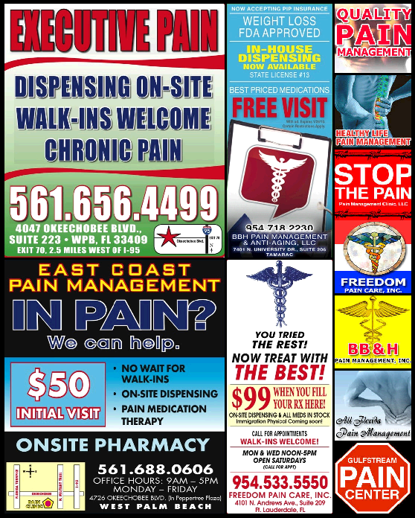
I saw physicians across the state build up huge numbers of pain patients on massive doses of opioids, and then close their clinics and disappear, releasing hundreds of opioid-dependent patients onto the streets in search of a compassionate provider.

Slide 28
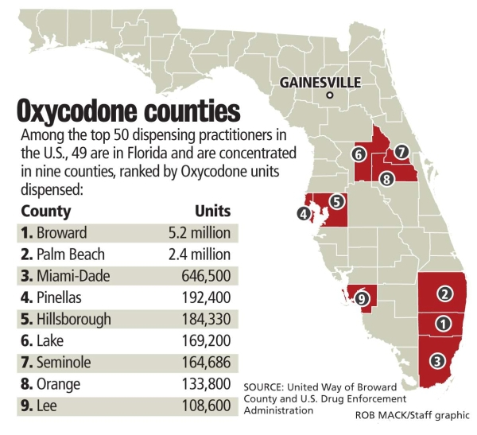
December 11, 2010 www.Gainesville.com

Slide 29
Some patients were admitted to the hospital for unrelated problem (out of control diabetes or HTN…) and were placed on the dose which they had been prescribed and were supposed to have been taking.
Many became somnolent and stopped breathing, because in fact they had not been taking anything close to that dose, but rather had been selling most of their opioids.
Now I became “the bad guy”, explaining that although I was willing to try to help, I could prescribe only a fraction of the dose their prior physician was prescribing, especially with the benzodiazepines and sedatives.

Slide 30
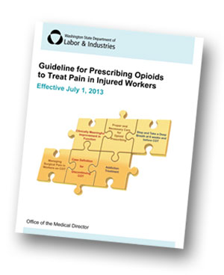
In 2007 after I returned to private practice, the State of Washington published guidelines for the use of opioids in the management of chronic pain.
The pain and addiction practice I created in Jacksonville already met or exceeded all of these standards.

Slide 31
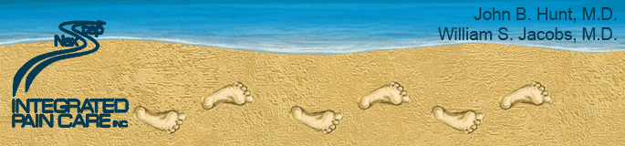
I thought I had one of the most advanced pain programs in the state.
When Florida passed legislation requiring licenses for pain clinics, I trained their first set of inspectors.

Slide 32
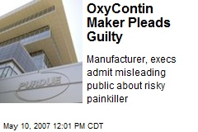
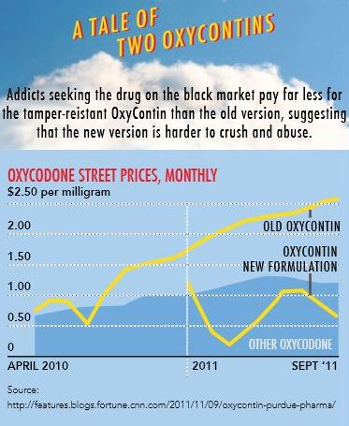

Slide 33

The Florida Prescription Drug Monitoring Program, known as E-FORCSE® (Electronic-Florida Online Reporting of Controlled Substance Evaluation Program), was created by the 2009 Florida Legislature in an initiative to encourage safer prescribing of controlled substances and to reduce drug abuse and diversion within the state of Florida.

Slide 34
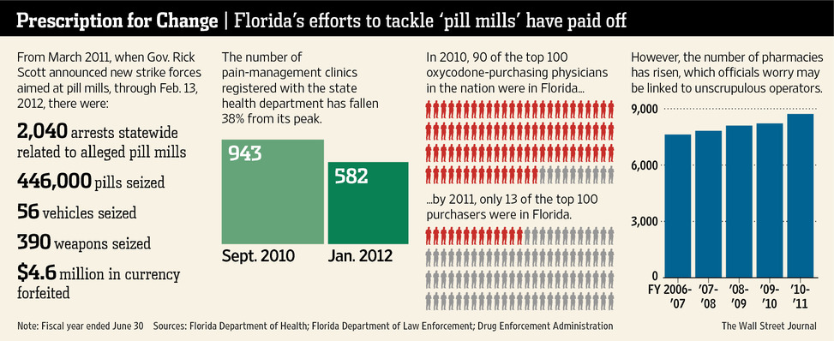

Slide 35
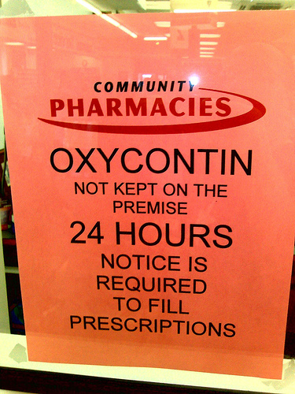
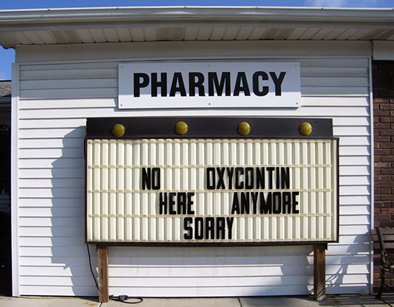

Slide 36
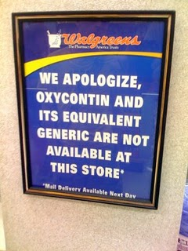
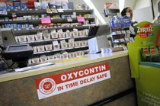

Slide 37
I was continuing to do Forensic work as an Expert Witness and was being bombarded with cases of overdose deaths from around the state.
I reviewed patient mortality in our practice. I had not had any deaths but my partner had a couple.
They were all listed by the Medical Examiners as
“Accidental death related to the combined effects of . . .”
and listed all of the drugs discovered on a post mortem toxicology screen, at least one of which was an opioid.

Slide 38
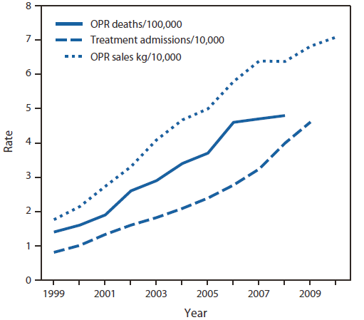

Slide 39
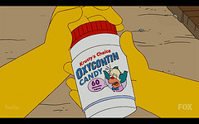
The US has 5% of the world’s population, yet consumes 85% of the world’s prescription opioids.
Accidental opioid overdoses are now the leading cause of death in adults between the ages of 35 and 55 (above cancer, suicide, car accidents, heart attacks, smoking, HIV).
Emergency Departments see more cases related to prescription drug abuse than to illegal drug abuse.
One quarter of high school students have used prescription opioids to get high.
High school students now look forward to having their wisdom teeth taken out because they know they will get a prescription for opioids.

Slide 40
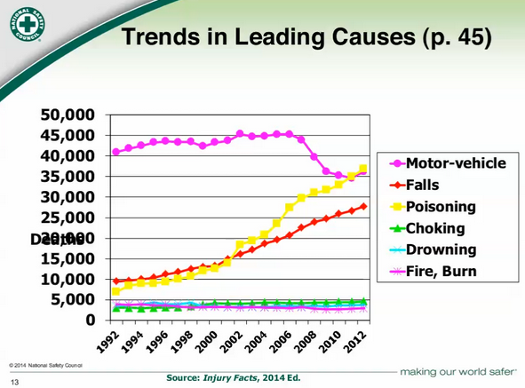

Slide 41
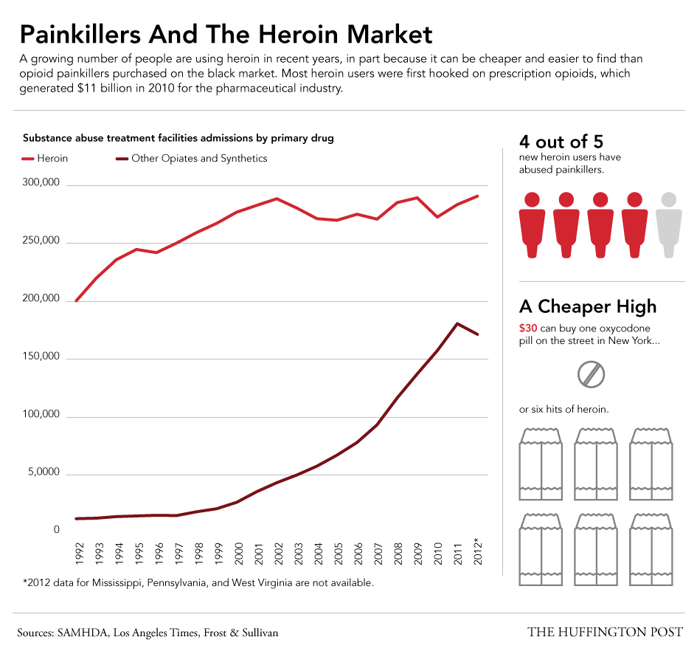

Slide 42
This is a public health issue. It is about keeping patients safe. It is NOT about which providers are the nicest or most compassionate. In fact, in this instance, the best practice is the hardest practice – the one that sets limits and tells patients what they don’t want to hear.
There are no published guidelines around the recommended amount of opioids for acute pain.
There is no easy method to dispose of opioids that are no longer needed.
  It is illegal to return them to your doctor or your pharmacist.
  It is unsafe to flush them down the toilet.
  The Drop Boxes that do exist are few and far between.

Slide 43

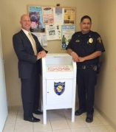
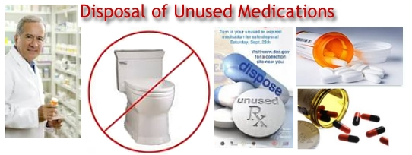

Slide 44
I was only doing what I was told to do. The paradigm shift in the standard of practice required me and my colleagues to ask every patient about their pain and then to treat it.
With no real accurate way to measure benefit except the patient’s report.
Just as Galen had been taught by Hippocrates that bloodletting was safe and effective medicine,
I had been taught that lots of chronic daily opioids in both immediate & extended release formulations should be used safely in the management of chronic pain.

Slide 45
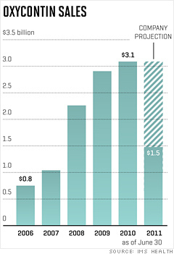

Slide 46
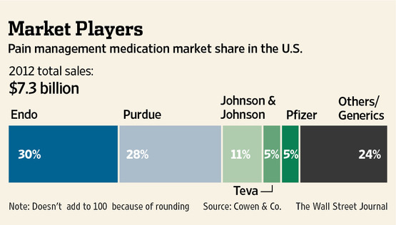

Slide 47
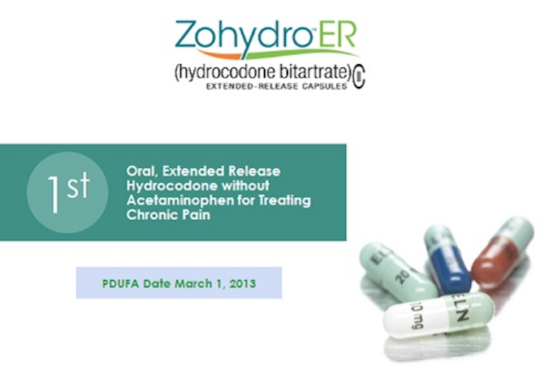
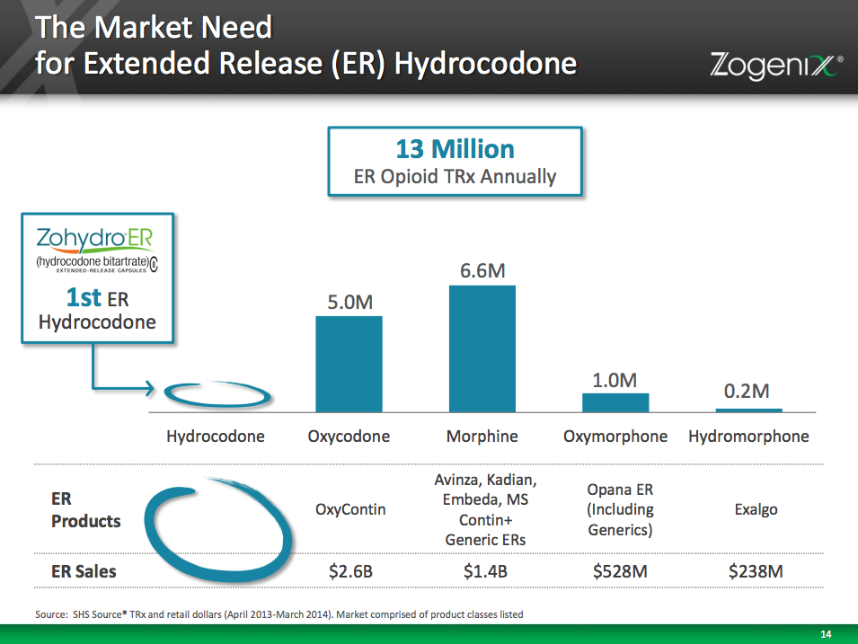

Slide 48
After 30 plus years of trying to follow unsubstantiated standards
of pain management-
  There is NO convincing evidence that opioids improve outcomes in chronic pain.
  There is good evidence that opioids impair social function, contribute to behavioral comorbidities, decrease function,
  and kill people.
  Opioids are excellent for acute pain but are usually the wrong tool for chronic pain.

Slide 49
By asking every patient about pain at every visit, we had “medicalized” pain.
  Pain is a normal component of everyday life – it is not always an anomaly requiring treatment.
  Pain is a protective reflex. It galvanizes us to improve and change. Removing it does the opposite, allowing us to become victims and to stagnate.

Slide 50
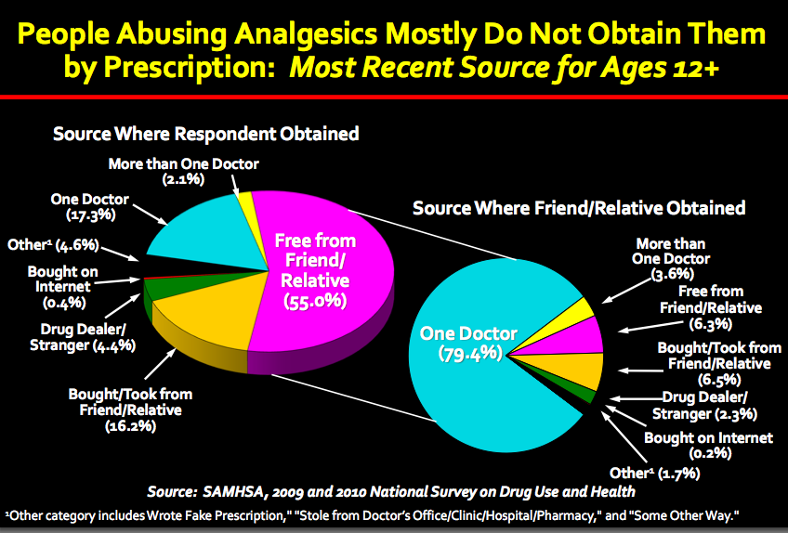

Slide 51
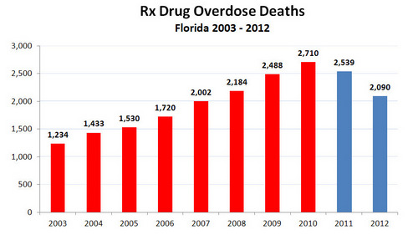

Slide 52
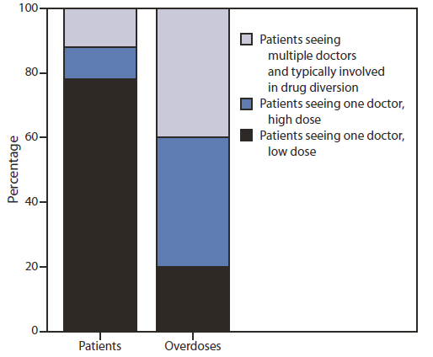

Slide 53
As I have weaned patients down on their opioids – their function and ADLs didn’t seem to change.
The patients who were working while taking 400mg a day are still working when taking 100mg a day.
Those who were lying on the couch while taking 400mg a day are still lying on the couch while taking 100mg a day.
  There appears to be a dose above which more opioids don’t improve function in chronic pain – and it must be pretty low, as I still haven’t found it.

Slide 54
Chronic pain is a witches’ brew of
nociceptive & neuropathic pain,
emotional, spritual and psychic pain,
boredom, and anhedonia
– all of which initially feel better on opioids, and all are usually made worse by high dose chronic opioids.
  Acute pain is almost entirely nociceptive pain, and is well managed with opioids.
  Chronic pain is usually amplified and prolonged by the use of opioids.

Slide 55
I have found that if we do the difficult interventions with patients as well as
their other health care providers,
opioid related morbidity and mortality drops.
We are getting evidence that we have improved the safety of our patients.

Slide 56
…by changing the paradigm back…

Slide 57
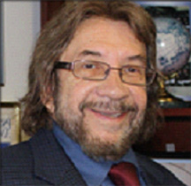

Slide 58
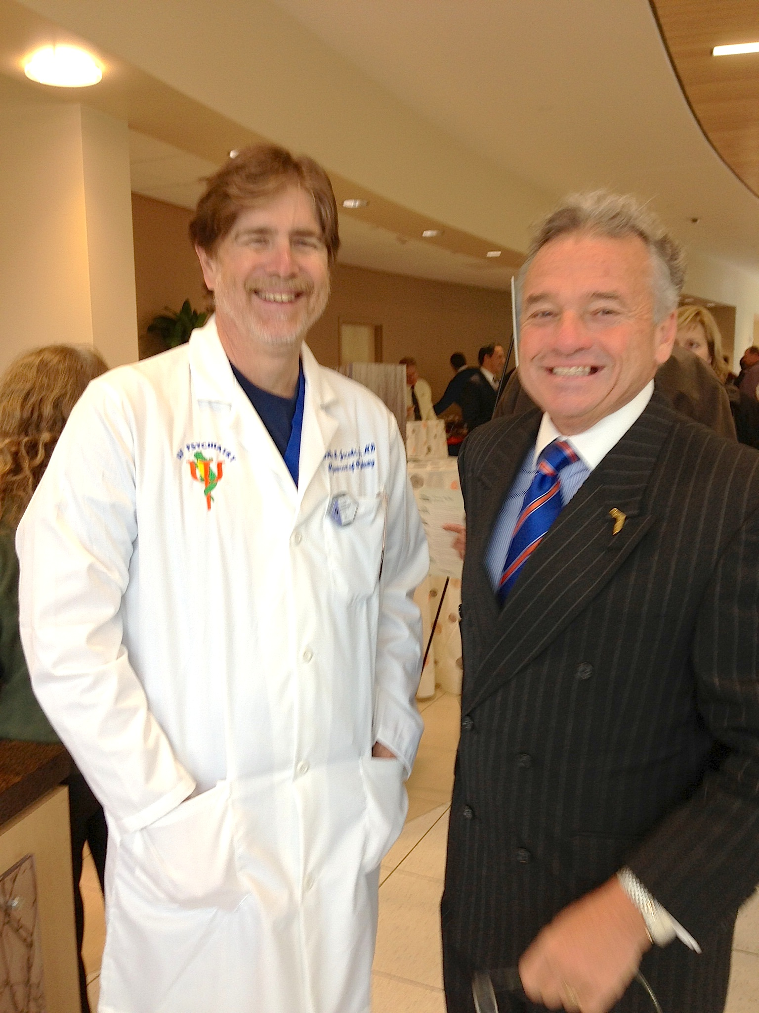

Slide 59
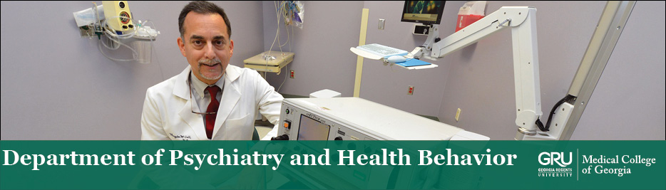

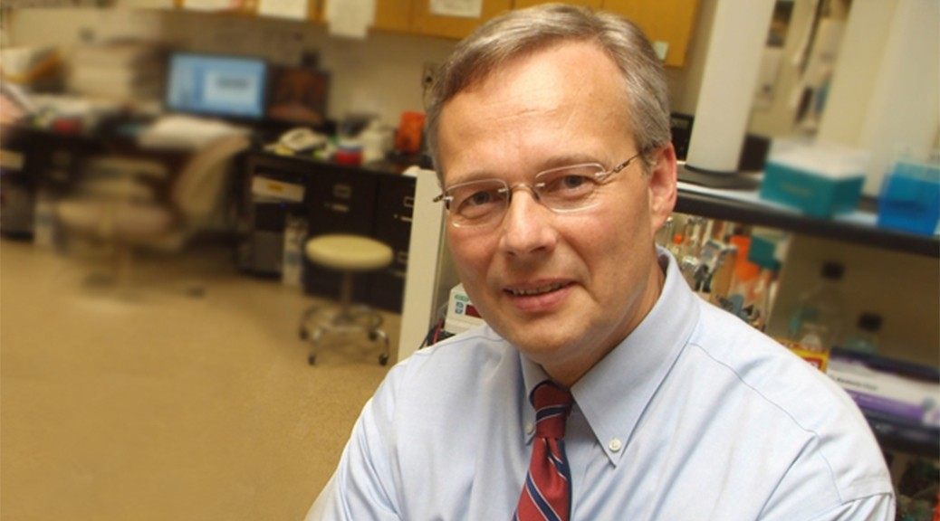

Slide 60


Slide 61

Meet the eminent gathering once again at
Addiction Therapy-2015
Florida, USA
August 3 - 5, 2015
Addiction Therapy – 2015 Website:
addictiontherapy.conferenceseries.com

