Slide 1


Intensified manufacturing culture media development considerations
William Whitford Cell Culture
GE Healthcare
Imagination at work

Slide 2
Agenda
Continuous Manufacturing
Drivers for Continuous Manufacturing
Case Study 1
Case Study 2
Conclusion
2

Slide 3
Continuous manufacturing

Slide 4
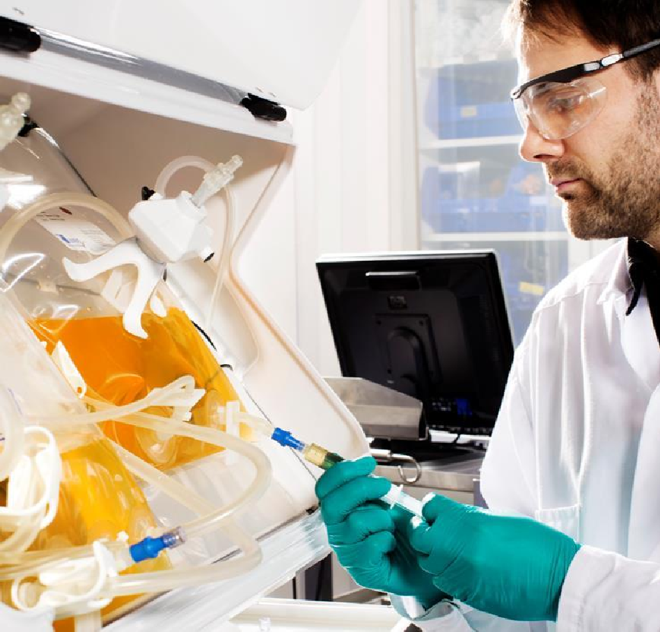
The future of pharmaceutical manufacturing: what to expect in the next 25 years?
Intensified manufacturing approaches are being accepted
Growing interest in leveraging the benefits of continuous manufacturing into the biopharmaceutical industry
Industrial and academic researchers involved in development of continuous manufacturing
Cleaner, flexible, more efficient CM is encouraged by the EMA and FDA
CM= Continuous Manufacturing EMA = Europien Medical Agency
FDA = US Food and Drug Administration
4

Slide 5
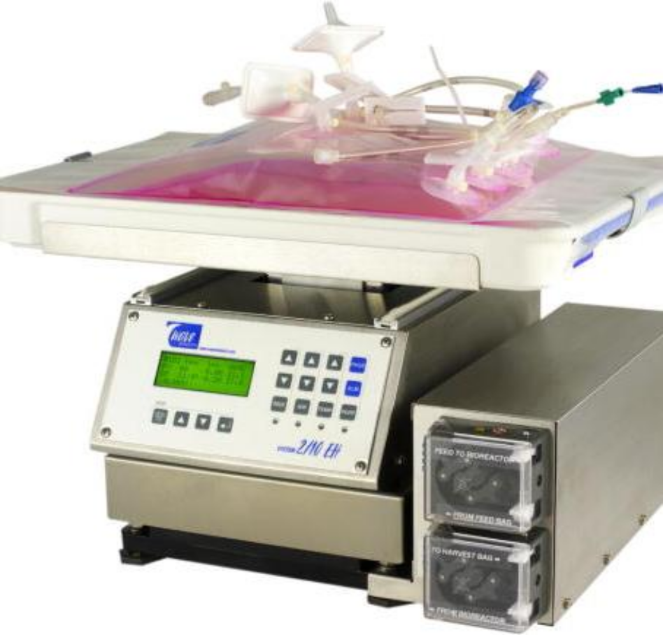
Intensified biomanufacturing
High density perfusion
In distinct modes
  Intensified batch
  Continuous biomanufactruing
Many approaches and instruments
  Culture parameter changes
  Altered media circuits
  Altered performance demands
Optimized materials is an economic imperative
5

Slide 6

Why consider continuous manufacturing?
General considerations:
continuous vs batch
General
Quality
Cost
Speed
Flexibility
General
Flexibility
Quality
Why consider continuous manufacturing?
Speed
Cost
6

Slide 7
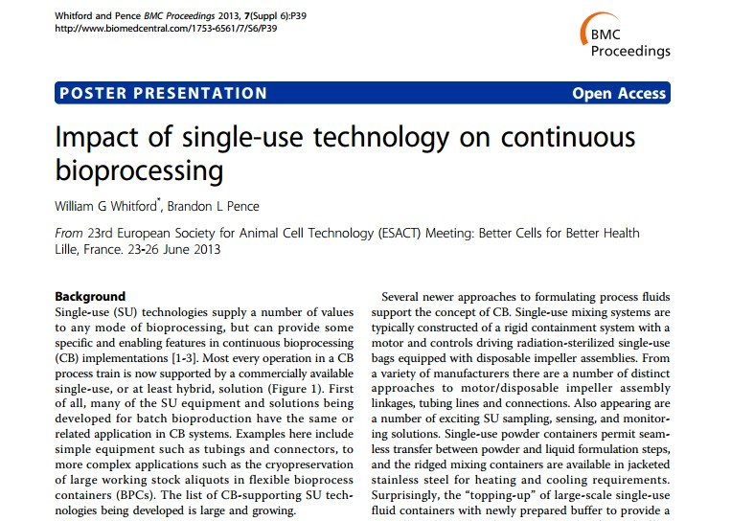
Advantages to continuous biomanufacturing
Supported by standards / regulatory agencies
An established PAT / QbD friendly technology
Faster and more robust process development
Heightens processing parameter consistency
Less failure from stressed mulitplex PID control
Increases operational efficiency and capability
Accepts materials / activity unavailable in batch
Runs at higher molecular / metabolic efficiency
Lowers process / reaction volume and times
Provides increased process and flow flexibility
Reduces equipment footprint and facility extent
Reduces operator activities and intervention
Increases overall facility utilization efficiency
Reducing CPA and COG increases profitability
Reduces initial build and equipment expenses
Supports many sustainability / green initiatives
Many limitations and concerns being alleviated
Simplifies process / reduces wastage and loss
Reduced material usage in process development
Heightens operating material utilization efficiency
Reduces intermediate and final product inventory7
29-1442-41 AA | March 2015

Slide 8
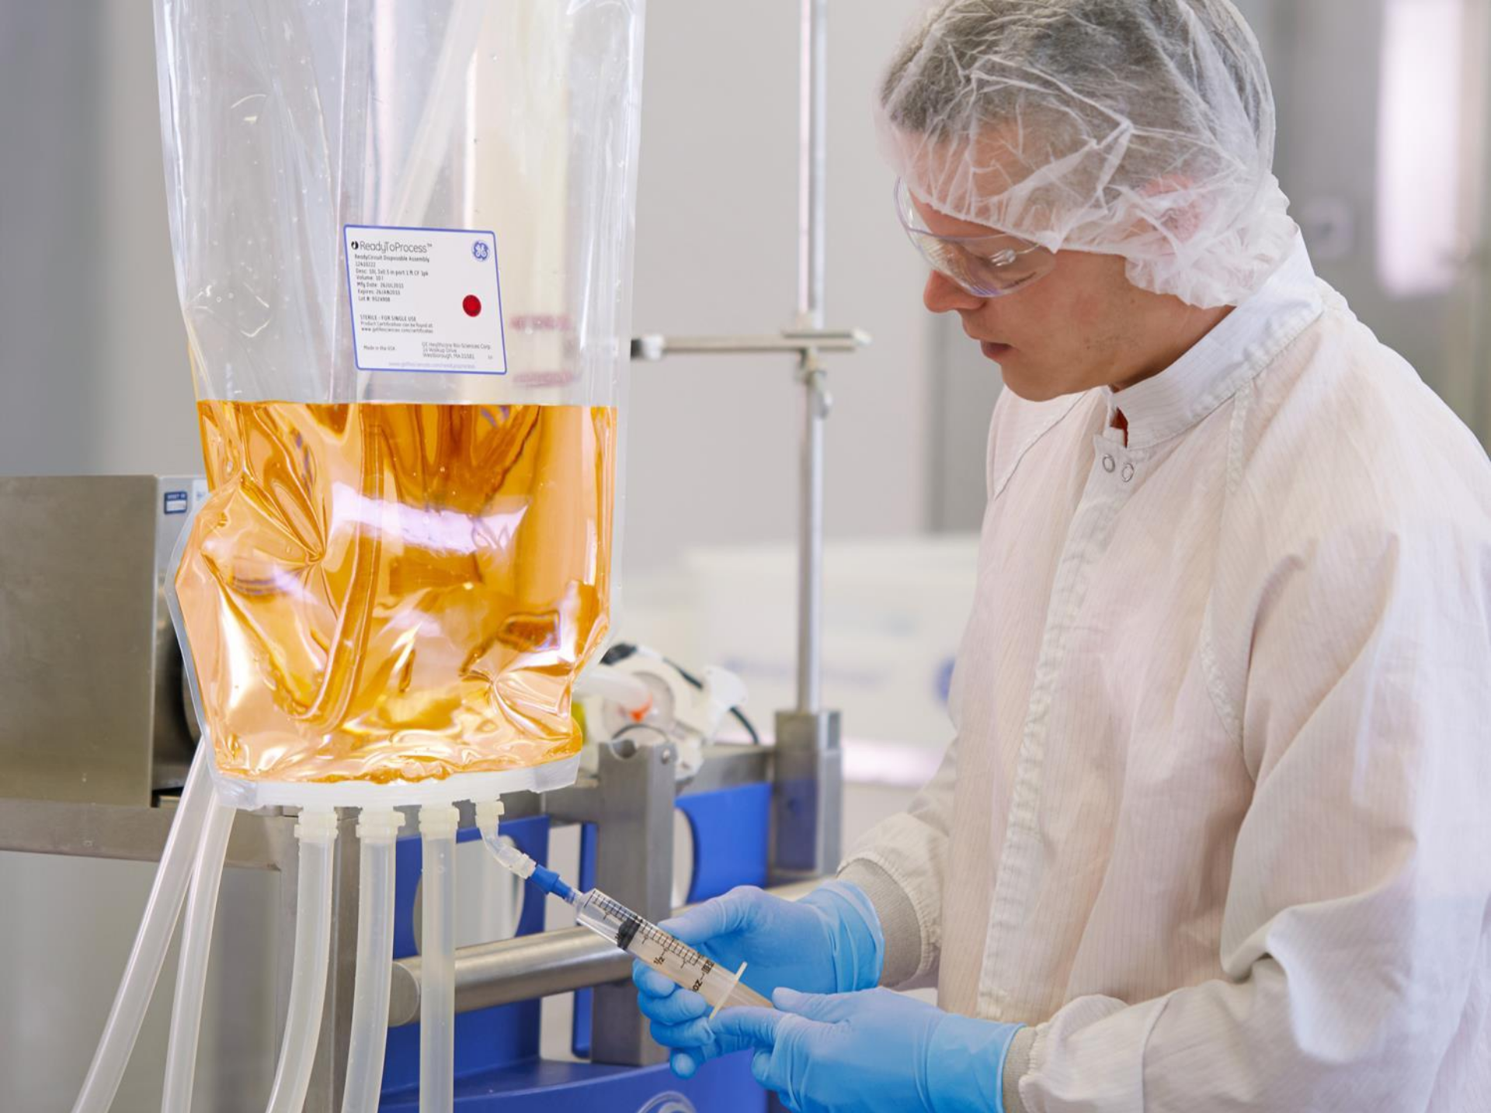

Enabling technologies for continuous manufacturing
Single-use technology Process control Facility design
Perfusion culture systems Cell culture medium design

Slide 9
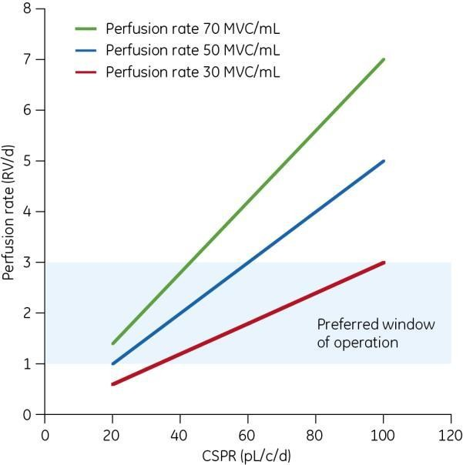
Perfusion culture medium design
Importance of cell culture medium performance on manufacturability
Many perfusion processes are based on maintaining a constant cell- specific perfusion rate (CSPR)
High CSPR:
  medium not adapted to the cell
metabolism
  requires high volumetric perfusion
  many medium components leave the bioreactor unmetabolized
  operation not cost-efficient
Low CSPR:
  the cell culture medium is meeting the cell lines nutritional needs
MVC = million viable cells
9

Slide 10
Case study 1: perfusion
media development

Slide 11
Perfusion medium development based on an existing fed-batch medium platform
Scope
To study combinations in an existing medium platform, consisting of medium and feeds, to develop a high performing perfusion medium
Materials and methods
ActiCHO™ platform (ActiCHO P medium, ActiCHO Feed A and ActiCHO Feed B)
ReadyToProcess WAVE™ 25 system
2 L perfusion Cellbag™ bioreactor with floating filter
MAb-producing cell line (licensed from Cellca GmbH)
11

Slide 12
Experimental strategy
Perfusion medium development
Batch approach
Steady-state approach
Screening DoE study
Perfusion with steady-state conditions
Optimization DoE study
Spent media analysis and new medium design
Medium verification
in perfusion
Medium verification
in perfusion
DoE = design of experiments
12

Slide 13
Batch approach

Slide 14
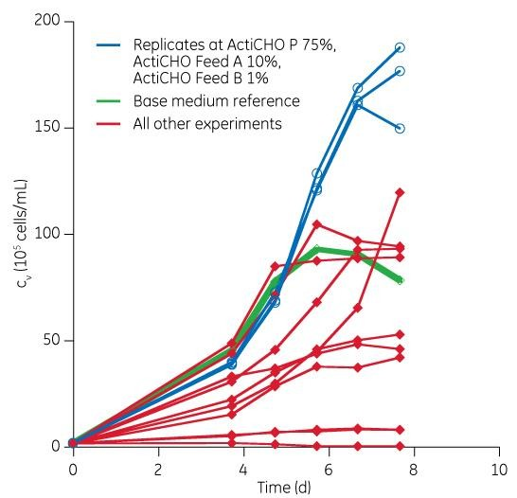
Screening DoE study: design
BATCH APPROACH
Three factors:
– ActiCHO™ P medium (50%, 75%, 100%)
– ActiCHO Feed A (0%, 5%, 10%, 15%)
– ActiCHO Feed B (0%, 0.5%, 1%, 1.5%)
Ten experiments, three replicates at ActiCHO P 75%, ActiCHO Feed A 10%, and ActiCHO Feed B 1%
D-optimal design, interaction model
Clear potential that medium performance can be enhanced by the addition of feed solutions
Viable cell (c_{v}) concentrations

Slide 15
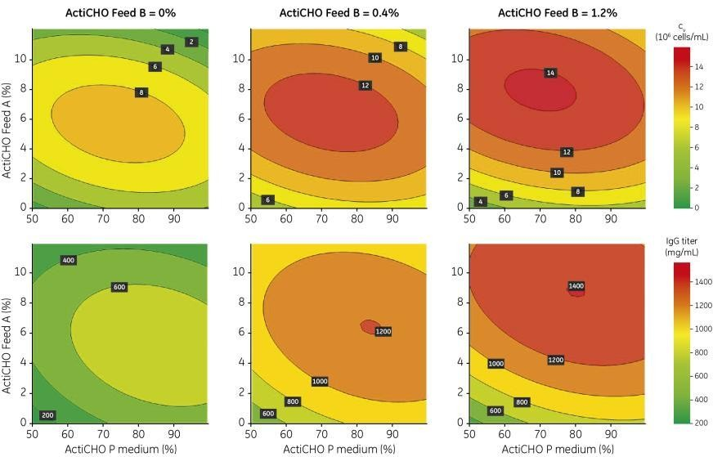
Optimization DoE study: results
BATCH APPROACH
Good models obtained for viable cell density (VCD) and titer
Contour plots for VCD and titer vs ActiCHO P
medium, Feed A, and Feed B concentrations
Model statistics | _{R}2 adj | _{Q}2 | RSD
VCD | 0.84 | 0.67 | 1.88
Titer | 0.89 | 0.78 | 146
VCD
VCD
VCD
Sweet spot identified at
  71% ActiCHO™ P medium
  7.5% ActiCHO Feed A
  0.9% ActiCHO Feed B
Titer
Titer
Titer
RSD = residual standard deviation

Slide 16
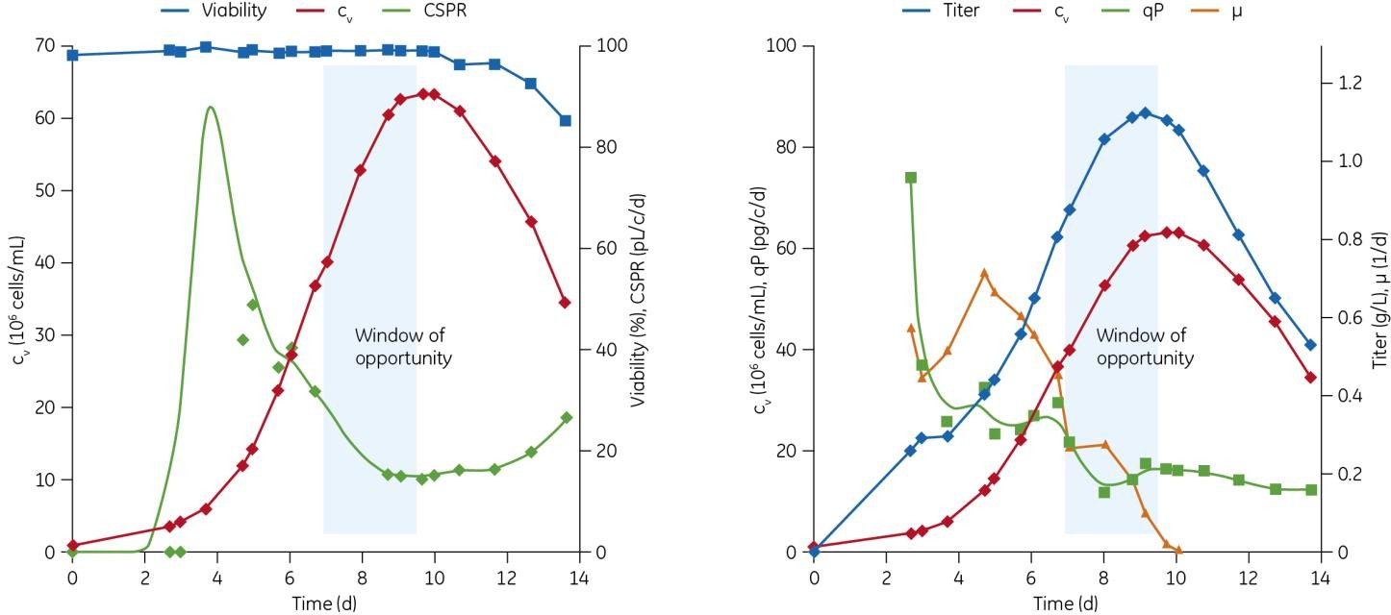
Medium verification in perfusion
BATCH APPROACH
Perfusion run at 1 RV/d to determine the medium’s maximum performance
qP = cell-specific productivity MVC = million viable cells RV = reactor volume
Window of opportunity identified: c_{v} > 50 MVC/mL, CSPR ≈ 20 pL/c/d, qP maintained at ≈ 20 pcd, NH₄ < 4 mM, lactate < 0.5 g/L, μ < 0.2 d⁻¹

Slide 17
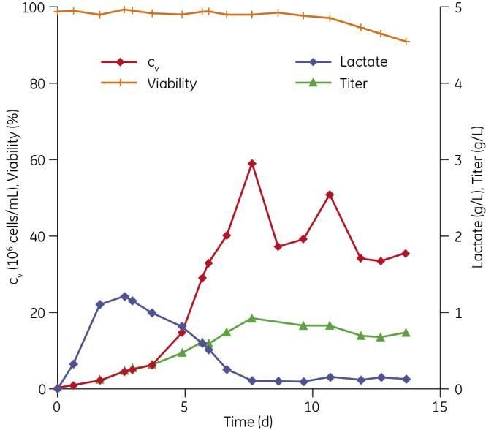
Medium verification in perfusion
BATCH APPROACH
Step 2: confirmation under steady-state conditions at ≈ 40 MVC/mL and 1 RV/d ( = CSPR 25)
MVC = million viable cells RV = reactor volume

Slide 18
Steady-state approach

Slide 19
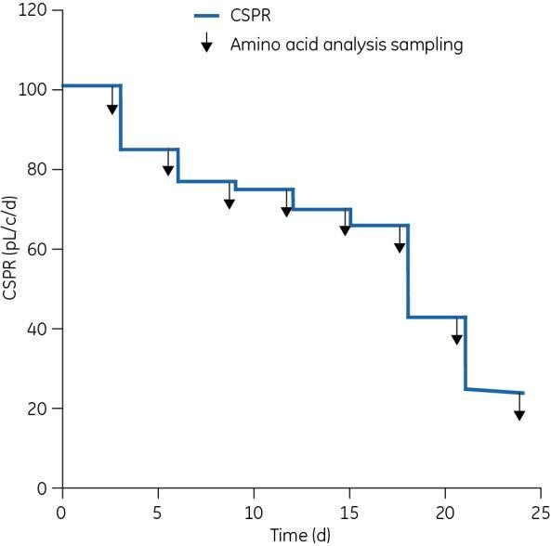
Perfusion with steady-state conditions
STEADY-STATE APPROACH
Objective
Measure cell specific productivity and amino acid consumption rates as the perfusion rate is decreased stepwise from 100 to 25 pL/c/d.
Use information to design perfusion
medium
Illustration of experimental
strategy in steady-state approach
19

Slide 20
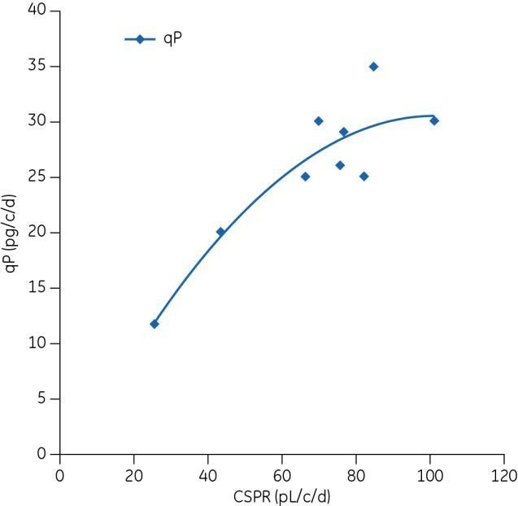
Spent media analysis and new medium design
STEADY-STATE APPROACH
Impact of the cell-specific perfusion rate (CSPR) on the cell- specific productivity (qP)
20

Slide 21
Spent media analysis and new medium design
STEADY-STATE APPROACH
Impact on CSPR on amino acid consumption:
heat map for seven limiting amino acids at different CSPR
Amino acid | ActiCHO™ supplement | CSPR (pL/c/d)
 |  | 101.1 | 84.9 | 82.3 | 76.8 | 75.8 | 70 | 66.3 | 43.4 | 25.4
ASN | Feed A
SER | Feed A
GLY | -
ARG | Feed A
PRO | Feed A
TYR | Feed B
LYS | Feed A
Between 20% and 30% of initial ActiCHO P medium Below 20% of initial ActiCHO P medium

Slide 22
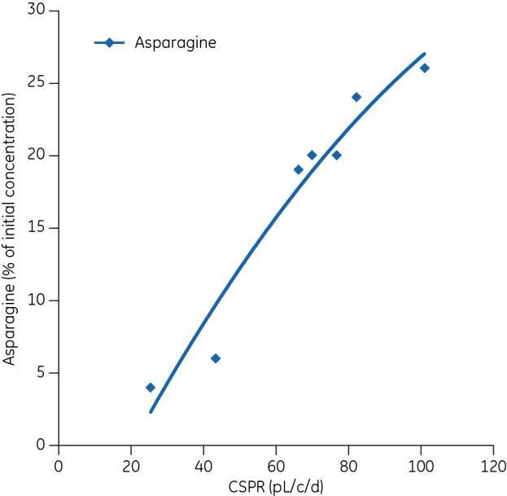
Spent media analysis and new medium design
STEADY-STATE APPROACH
Example of amino acid concentrations (asparagine) as function of the cell-specific perfusion rate (CSPR)

Slide 23
Spent media analysis and new medium design
STEADY-STATE APPROACH
Conclusion
Enhance ActiCHO™ P medium with
ActiCHO Feed A: 7%
ActiCHO Feed B: 1%

Slide 24
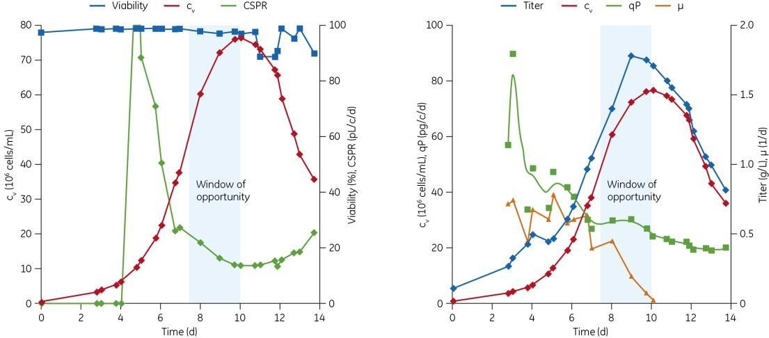
Medium verification in perfusion
STEADY-STATE APPROACH
Step 1: Perfusion run at 1 RV/d to determine the maximum performance
RV = reactor volume
Window of opportunity identified: c_{v} > 50 MVC/mL, CSPR ≈ 20 pL/c/d, qP maintained at ≈ 30 pcd, NH₄ < 4 mM, lactate < 0.5 g/L, μ < 0.2 d⁻¹

Slide 25
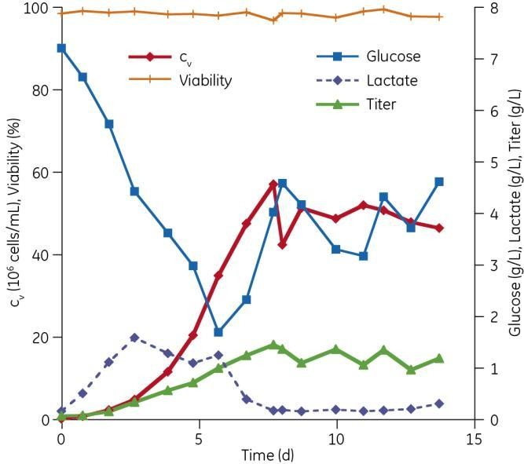
Medium verification in perfusion
STEADY-STATE APPROACH
Step 2: confirmation under steady-state conditions at 50 MVC/mL and 1 RV/d ( = CSPR 20)
MVC = million viable cells RV = reactor volume

Slide 26
Case Study 2: T-Cells in
perfusion

Slide 27
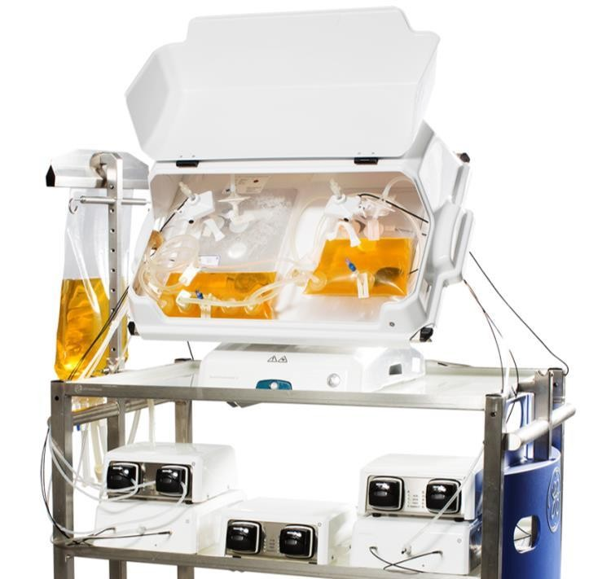
Perfusion with steady-state set-up
T-CELLS
Objective
Employ a XuriTM Cell Expansion System W25 rocking bioreactor
Compare batch and perfusion culture
Study relative impact of perfusion

Slide 28
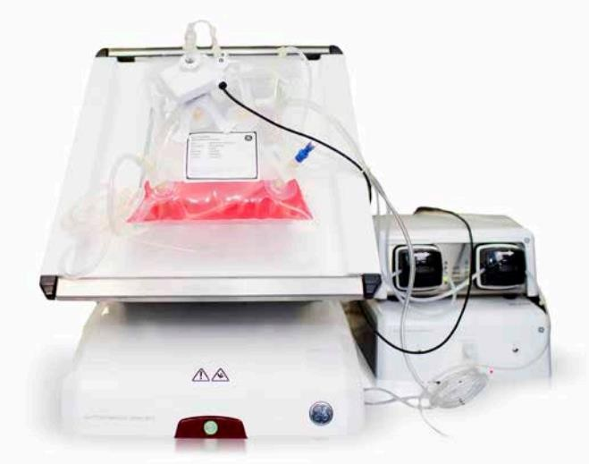
Perfusion with steady-state set-up
T-CELLS
Methods
Expansion of T-Cells
  T225 flasks
  CD3/CD28 beads
  >day 3: cells kept @ 0.5x10⁶
Day 5 post expansion
  Xuri 2L CellbagTM perfusion reactor
  Count kept at 0.5x10⁶ until 1L volume
Perfusion initiated at 2.0x10⁶
  Perfusion rate per cell concentration
  Through 2.0x10¹⁰ as in Results
Xuri™ Cellbag™ bioreactor

Slide 29
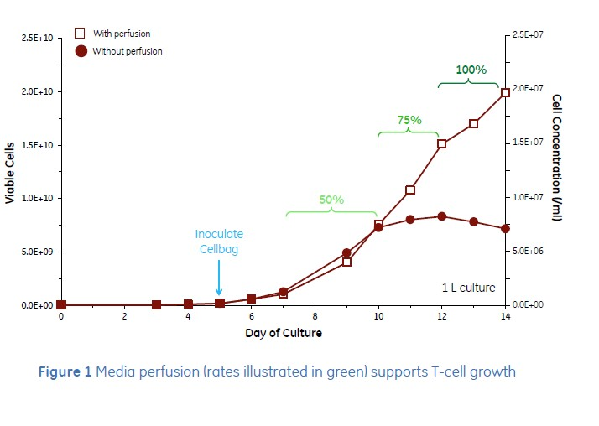
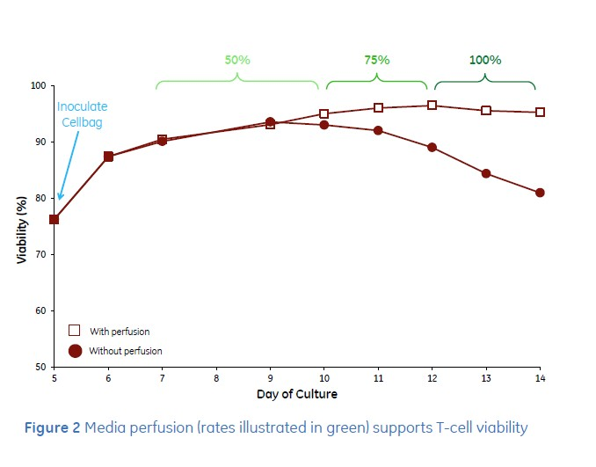
Perfusion with steady-state results
T-CELLS
Perfusion culture effects
Delays T-cell culture arrest
Extends T-cell culture viability
Supports much higher culture densities

Slide 30
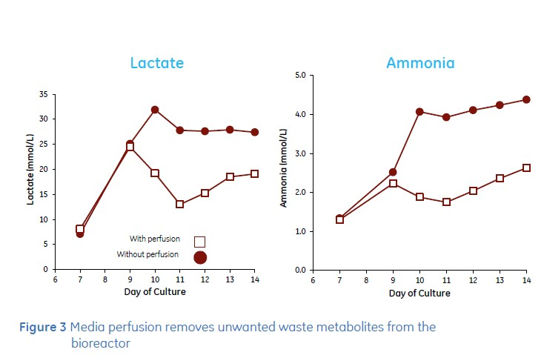
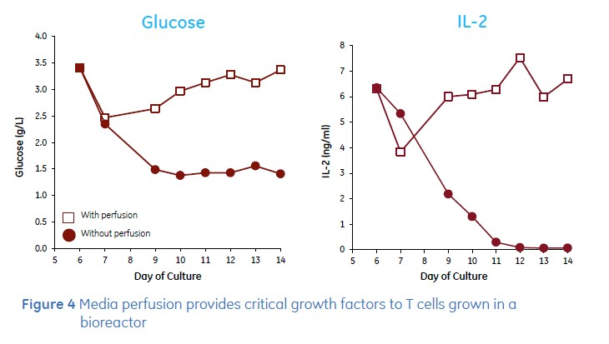
Perfusion with steady-state results
T-CELLS
Metabolite effects
Effectively restores primary metabolites
Efficiently removes undesired secondary metabolites
Equally effective for growth factors,
hormones and co-factors.

Slide 31
Perfusion at different rates as a tuning fork for MAb product quality
STEADY-STATE APPROACH
Analytical technology | Analyte | Fed-batch | 20 pL/c/d | 43 pL/c/d | 77 pL/c/d | 90 pL/c/d
CIEX | Acidic variants | > 60% | 25% | 23% | 19% | 12%
 | Alkaline variants | 3% | 2% | 4% | 4% | 4%
SEC | Aggregate | 1% | 0.4% | 0.3% | 0.2% | 0.5%
Glycan map | G0F | 35% | n.a. | n.a. | n.a. | 36%
 | G1F | 41% | n.a. | n.a. | n.a. | 45%
 | G2F | 15% | n.a. | n.a. | n.a. | 14%
 | Man5 | 3% | n.a. | n.a. | n.a. | 1%
TNF-α binding kinetics* | On rate, k_{a} | 5.2 10⁵ Ms⁻¹ | 3.82 ⁺ 0.07 10⁵ Ms⁻¹ | n.a. | n.a. | n.a.
 | Off rate, k_{d} | 14.9 10⁻⁵ s⁻¹ | 8.64 ⁺ 0.72 10⁻⁵ s⁻¹ | n.a. | n.a. | n.a.
 | Affinity, K_{D} | 287 pM | 226 pM | n.a. | n.a. | n.a.
* Results obtained using Biacore™ T200 processing unit and Sensor Chip Protein A
SEC = size exclusion chromatography, n.a. = not analyzed CIEX = cation exchange chromatography

Slide 32
Perfusion study conclusions

Slide 33
Conclusions
Batch and steady-state approaches
Presented to develop high performing perfusion media from an existing
medium platform
Easily applicable for other cell culture media
Serves as a fast route to an efficient upstream perfusion process
Has great potential to meet many of tomorrow’s demands within biopharmaceutical manufacturing, when combined with a continuous downstream operation

Slide 34
Conclusions
The steady-state approach
Showed highly improved performance, using twice the development time,
compared with the batch approach
Resulted in a final process with more than a 75% decrease in cell-specific perfusion rate (CSPR), compared with the starting process conditions (20 compared to 90 pL/cell/d)

Slide 35

Thank You
GE Healthcare Bio-Sciences AB, a General Electric company. Björkgatan 30
751 84 Uppsala Sweden
GE, imagination at work and GE monogram are trademarks of General Electric Company. HyClone, Cell Boost, ActiCHO, Xuri, and Cellbag are a trademark of General Electric Company or one of its subsidiaries.
© 2014 General Electric Company – All rights reserved.
All goods and services are sold subject to the terms and conditions of sale of the company within GE Healthcare which supplies them. A copy of these terms and conditions is available on request. Contact your local GE Healthcare representative for the most current information.

Slide 36


