Slide 1


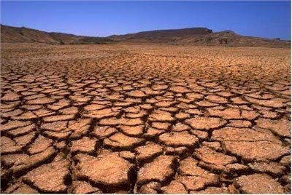
Using MUSLE model and GIS to predict and estimate soil erosion
Wided Batita
Ing, Ph.D Geomatics
Laval University
Québec, Canada
28th April 2017

Slide 2
Outline
Statement of the Problem
Methodology & Theoretical Orientation
Findings
Conclusion & Significance
1

Slide 3
Statement of the Problem
Soil erosion by water is:
recognized as a major problem arising from agricultural intensification, land degradation and global climatic change
a major threat to sustainable land and crop production and causes degradation of water resources
leading to significant decrease of soil fertility in the Mediterranean region as well as in Europe
2

Slide 4
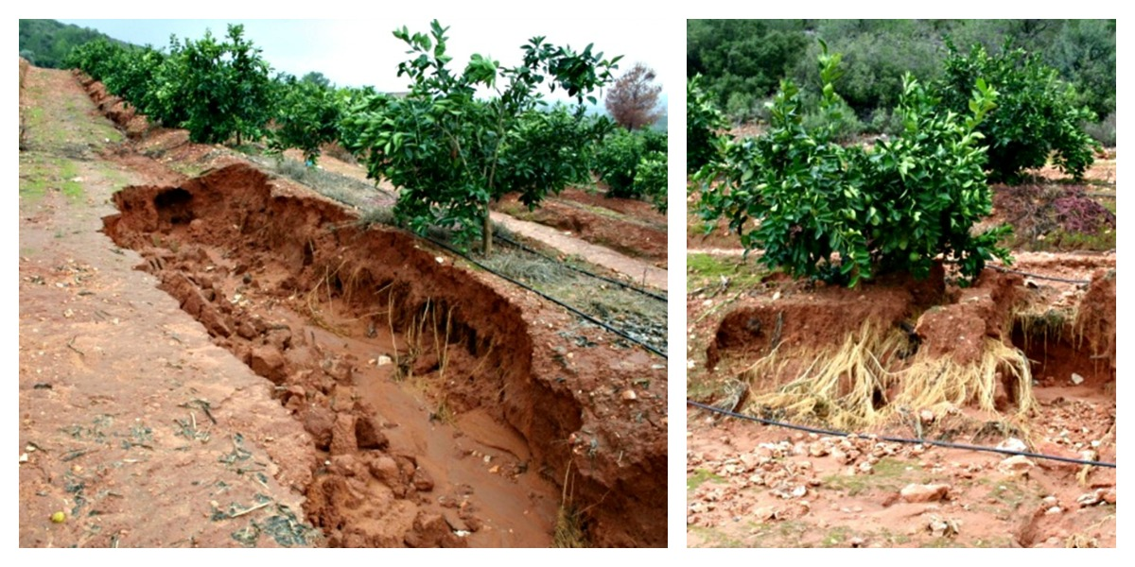
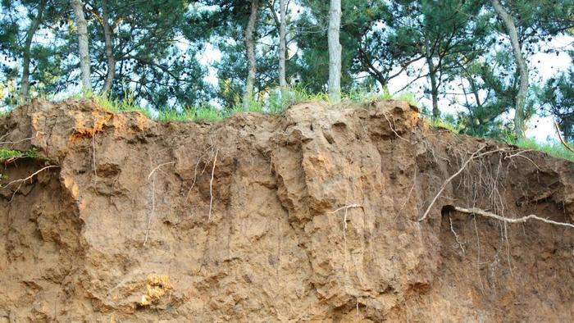
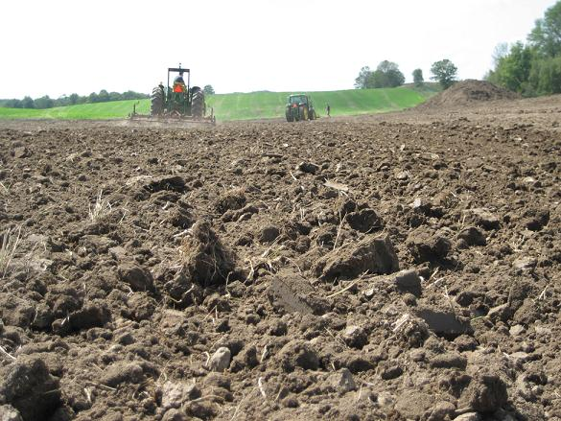
Statement of the Problem
3
https://www.google.ca/search?q=soil+erosion&source=lnms&tbm=isch&sa=X&sqi=2&ved=0ahUKEwjyur7818HTAhUIbxQKHbi6BNgQ_AUIBigB&biw=1280&bih=615#imgrc=8rDm20tfqFn2bM:

Slide 5

Statement of the Problem
Use of GIS and RS tools to assess risk
4

Slide 6
Methodology & Theoretical Orientation
Monitor potential land degradation in the Kolymvari municipality, which will be achieved through Modified Universal Soil Loss Equation Model (MUSLE) that could be utilized for predicting the scale and extent of land degradation in the study area
5

Slide 7
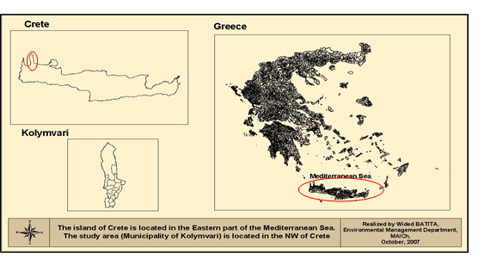
Methodology & Theoretical Orientation
Study area
The centre of geographic location of the Municipality of Kolymvari is approximately, E 23:46:18.00 longitude and N 35:28:54.00 latitude
6

Slide 8
Methodology & Theoretical Orientation
The characteristics of the study area:
The area of Kolymvari, Crete, Greece is a typical Mediterranean landscape dominated by olive cultivation
The island of Crete enjoys a typical Mediterranean climate, with dry hot summers and mild rainy winters
Snow and frost are rare near the coast
It is characterised by Karstic limestone of the White Mountains range
Groundwater is discharged through the limestone mainly to the North and South of the island
Two soil types that are predominant in the area: Rendzina soils & Terra Rosa soil
Ecologically, the predominant flora in the area consists mainly of maquies, garrigues and phrygana with few varieties of coniferous, chestnut and plane forest
7

Slide 9
Methodology & Theoretical Orientation
The Dataset used:
The Quickbird imagery (2.5m)
A digital elevation model (DEM) is a digital representation of ground surface topography
Corine Land Cover (CLC) is a map of the European environmental landscape
Soil data
Rainfall data by field work
8

Slide 10
Methodology & Theoretical Orientation
  The MUSLE: Modified version of the well known USLE
  The main difference compared to the USLE is the replacement of the rainfall factor with a direct estimate of surface runoff and peak runoff rate
  The equation : S = 11.8 (Q* q _{p}) ^{0.56} K* LS * C *P
where:
S is the single storm sediment yield,
Q is the runoff volume,
qpi is the peak discharge: q _{p}= 0.278*A*d / T_{p}
where:
A is area (km²)
d is runoff depth (mm)
Tp is the rise time of the hydrograph (h) (time from the beginning of runoff to the time of peak runoff)
9

Slide 11
Methodology & Theoretical Orientation
Slope length factor (LS)
Soil loss increases more rapidly with slope steepness than it does with slope length
Equation:
LS = L^{0.5} (0.0138 + 0.00974 * Y + 0.001138 * Y²)
where
Y is the gradient (Slope %) over the runoff length,
L is the length (m) of slope from the point of origin of the overland flow to the point where the slope decreases to the extent that sedimentation begins
10

Slide 12
Methodology & Theoretical Orientation
Soil erodibility factor (K)
The K factor is the soil erodibility factor expressed in ton hectare hour/hectare megajoule millimetre (t ha h/ ha MJ mm) which represents both susceptibility of soil to erosion and the rate of runoff
The K values are estimated by the soil erodibility nomograph tool
It consists of interpolation among plotted curves
The calculated 45-point K-factors were used to create a soil erodibility grid surface for the whole area, using Arc Map geostatistical analyst, radial basis functions interpolation
11

Slide 13
Methodology & Theoretical Orientation
Cover management factor (C)
The C factor represents the effect of plants, soil cover, below-ground biomass, and soil-disturbing activities on soil erosion
Soil erosion potential is increased if the soil has no or very little vegetative cover of plants and/or crop residues
The C factor was derived from NDVI after reclassification using the fuzzy logic membership, monotonically increasing function (This method doesn’t need a lot of field surveys and it can cover large areas without data)
12

Slide 14
Methodology & Theoretical Orientation
Support practice factor (P)
P-factor reflects the impact of support practices on the average annual erosion rate
For the Kolymvari municipality, the only support practice existing is terracing
Terracing affects sheet and rill erosion by breaking the slope length into shorter distances and hence, decreasing runoff and the associated erosion
After extraction of linear features, they were buffered by 30m and a value of 0.6 for the P factor was assigned
13

Slide 15
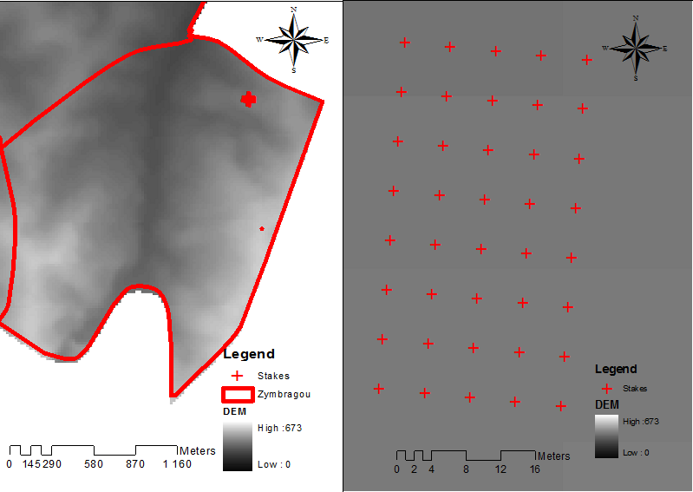
Methodology & Theoretical Orientation
Field work
30 pins were installed in Zympragou
10 more pins were added; they are statistically needed because erosion pins are frequently disturbed or lost due to farmers or animal traffic
14

Slide 16
Findings
The total precipitation for the winter period that corresponds to the study period was 750 mm.
The estimation of the peak discharge and the runoff volume were estimated for the Zympragou area to 3.9 km²
They were extended for the whole olive cultivation area of Kolymvari
The runoff volume (Q) was estimated to 525 m³
The average peak discharge (qp) was estimated to 0.085 m³ s⁻¹
The surface runoff was equal to 98.86.
MUSLE equation becomes: S = 98.86* K* LS * C *P
15

Slide 17
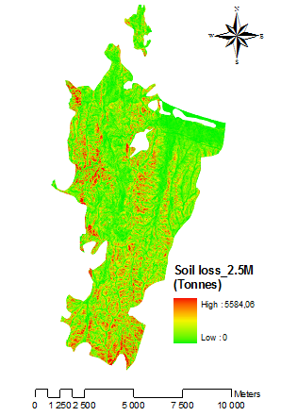
Findings
The final thematic map of soil erosion risk over the olive cultivation area:
16

Slide 18
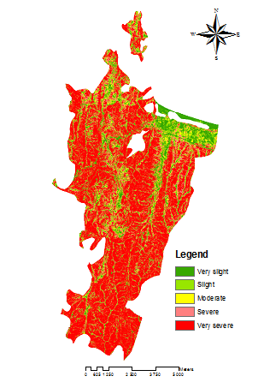
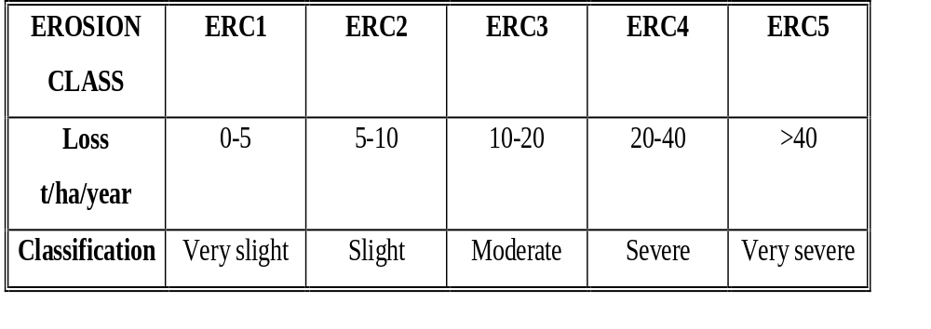
Findings
The final thematic map of the soil erosion risk reclassified into the five ERC over the olive cultivation area
17

Slide 19
Findings
The strength of MUSLE model includes its ability to directly estimate sediment delivery potential from soil erosion
This is a valuable tool for environmental management and much needed for source-sink characterization of terrestrial source and aquatic sinks of particulate matters
18

Slide 20
Conclusion & Significance
The areas located in the northern part of the peninsula belong to ERC5, because soil erosion potential coincided with the steeper slope length (L) and steepness (S) factors
The areas in the southern part of the area belong to ERC5, because soil erosion potential coincides with relatively intense olive cultivation
There is no big difference between the thematic maps generated by the two models MUSLE and RUSLE, almost the same values were found for the 5 ERCs
The assessment of soil erosion risk potential comprises a valuable tool for planning successful and sustainable management practices, especially for those areas with moderate to severe erosion potential
19

Slide 21
Conclusion & Significance
X The annual soil loss values generated by the MUSLE model was subject to errors included in different data and different GIS layers that are created by ArcMap software
X Some of these included errors in digitizing the roads, soil layer land cover as well as the support practices (terracing) from the Quickbird satellite imagery
X The processing of these different layers, by multiplication, into the Arc Map, will result in the magnification of the total error term
20

Slide 22
References
1.Tegegne M and B Sisheber (2017) Estimating soil erosion risk and evaluating erosion control measures for soil conservation planning at Koga watershed in the highlands of Ethiopia. Solid Earth, Vol 8, 13–25, doi:10.5194/se-8-13-2017.
2.Fidele K, C Zhang, A Kayiranga, H Shao, X Fang, F Ndayisaba, L Nahayo, C Mupenzi and G Tian (2016) USLE-Based Assessment of Soil Erosion by Water in the Nyabarongo River Catchment, Rwanda. International Journal of Environmental Research and Public Health — Open Access Journal, 13, 835; doi:10.3390/ijerph13080835.
3.Bosco CD, de Rigo O, Dewitte J, Poesen J, Panagos P (2015) Modelling soil erosion at European scale: towards harmonization and reproducibility. Nat. Hazards Earth Syst. Sci., 15: 225-245. Doi: 10.5194/nhess-15-225-2015.
4.Biola K B, Sampson K A, Grace B V and Samuel N O (2015) An Approach for Simulating Soil Loss from an Agro-Ecosystem Using Multi-Agent Simulation: A Case Study for Semi-Arid Ghana, Land, Vol 4: 607-626; doi:10.3390/land4030607.
5.Parveen R, Kumar U (2012) Integrated Approach of Universal Soil Loss Equation (USLE) and Geographical Information System (GIS) for Soil Loss Risk Assessment in Upper South Koel Basin, Jharkhand. Journal of Geographic Information System, 4, 588-596. Doi: 10.4236/jgis.2012.46061.
21

Slide 23

End
Thank you for your attention
22

Slide 24
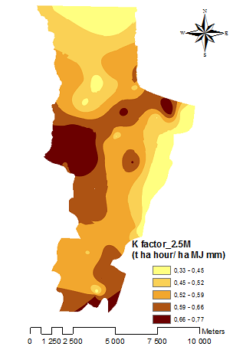
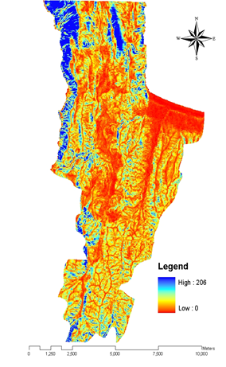
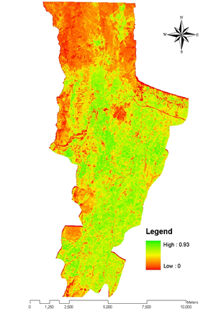
Factors generation
23

Slide 25
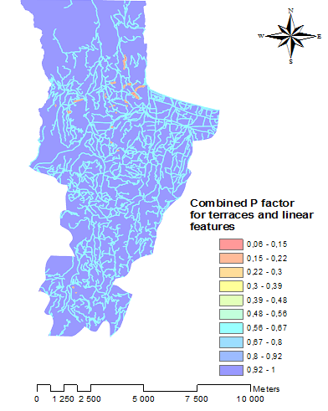
Factors generation
24

