Slide 1

Patient Centered Transitional Care for Patients Transferred from Intensive Care Unit (ICU) to Step-down Care Unit: A Mixed Method Study
PHD Candidate:
Zhou Wentao

Slide 2


Slide 3
Outline
Introduction
Literature review
Study aim
Theoretical framework
Method
Results (analysis in progress)

Slide 4
Introduction
Critical ill patients
  experience multiple transition
  survived with complex health problem
healthcare providers (HCPs) face great challenges to provide continuity of care
  shortage of ICU beds
  immature ICU discharge
  silo clinical practices
  under equipped general ward care
To ensure the continuity of care
  understand ICU patients’ transitional needs
  identify gaps exist in the current transitional care
  explore ways to improve patients’ transition

Slide 5
Define Terms
Transition
  is not only a process but also refers to the outcome of the complex person interaction with environment
  (Chick, 1986)
Transitional care
  is defined as critical component of healthcare system to ensure patients’ care coordination and continuity
  (Chaboyer et al., 2005; Coleman & Boult, 2003)
ICU transitional care
  refers to care provided before, during and after transferring patients from ICU to other care units
  is to ensure continuity of care
  (Chaboyer et al., 2005)

Slide 6
Literatures Review - Patients
Critical ill patients’ perception on transition
  reorientation and readapting to the new environment
  dependent due to certain irreversible pathophysiology, physical deficit and psycho-social difficulties
  sense of abandon, vulnerable, anxiety and depression, helpless, unimportant, high care demand from wards nurse
  Lack of care continuity
    (Chaboyer et al. 2002; Russel, 1999;Mckinney & Deeny, 2002; Ramsay et al., 2014; Kralik et al., 2006)
Therefore, understand the patients’ transitional needs will equip HCPs to assist their transition
(Chaboyer et al., 2005; Kralik et al., 2006 )

Slide 7
Literatures Review-Factors
Factors affecting patients’ transition
  Patients’ factors
    physical instability, functional decline, not ready for self-care, poor coping skills
    unrealistic expectation, unavailability of social support, and inadequacy of education and information (Weiss et al., 2007)
  HCPs’ factors
    lack of ICU discharge planning, last minutes decision due to bed shortage
    lack of team collaboration for discharge plan
    lack of common goals for patient’s transfer
    lack of efficiency and effectiveness of handover information and accountability /responsibility
    lack of following up care and insuffiently equipped step-down wards
    lack of wards manpower
    (Field,2008; Chaboyer et al 2003, Haggstorm et al., 2009, 2012; Wu & Coyer, 2007; Abraham et al., 2012; Arora et al., 2009; Chaboyer et al 2003)
Hence, build supporting structure and system between intra-professionals, inter-professionals and inter-departments will ensure patients’ continuity of care (Lin et al., 2012)

Slide 8
Literature Review- Interventions
Interventions to improve
  Information booklets to prepare patients and relatives prior to transfer
  ICU liaison nurse to ensure continuity of care
  Critical care outreach services (CCOS) and extent ICU services
  (Chaboyer et al., 2005; Wendy Chaboyer, Thalib, Alcorn, & Foster, 2007; Endacott & Chaboyer, 2006; Endacott et al., 2009; Green & Edmonds, 2004; Harrison, Gao, Welch, & Rowan, 2010)
However, the limitations
  Lack of common goals, objectives, and activities
  lack of theoretical fundamental support
  lack of exploring transitional needs related to their clinical context
  lack of multi-disciplinary collaboration
  (Kibler & Lee, 2011; Burke et al., 2009)
Therefore, effective intervention need to explore
  patients’ needs
  healthcare providers’ needs and restrictions
  clinical context
  theoretical support
(Bruner et al., 2011, Dacies, 2005)

Slide 9
This Study
Aims:
  To explore, develop and evaluate the Patient Centered Transitional Care to support patient who transferred from ICU to step-down care unit
Objectives are:
  explore what is patient centered ICU transitional care
  develop a Patient Centered Transitional Care (PCTC) pathway
  pilot test the effectiveness of the PCTC pathway

Slide 10
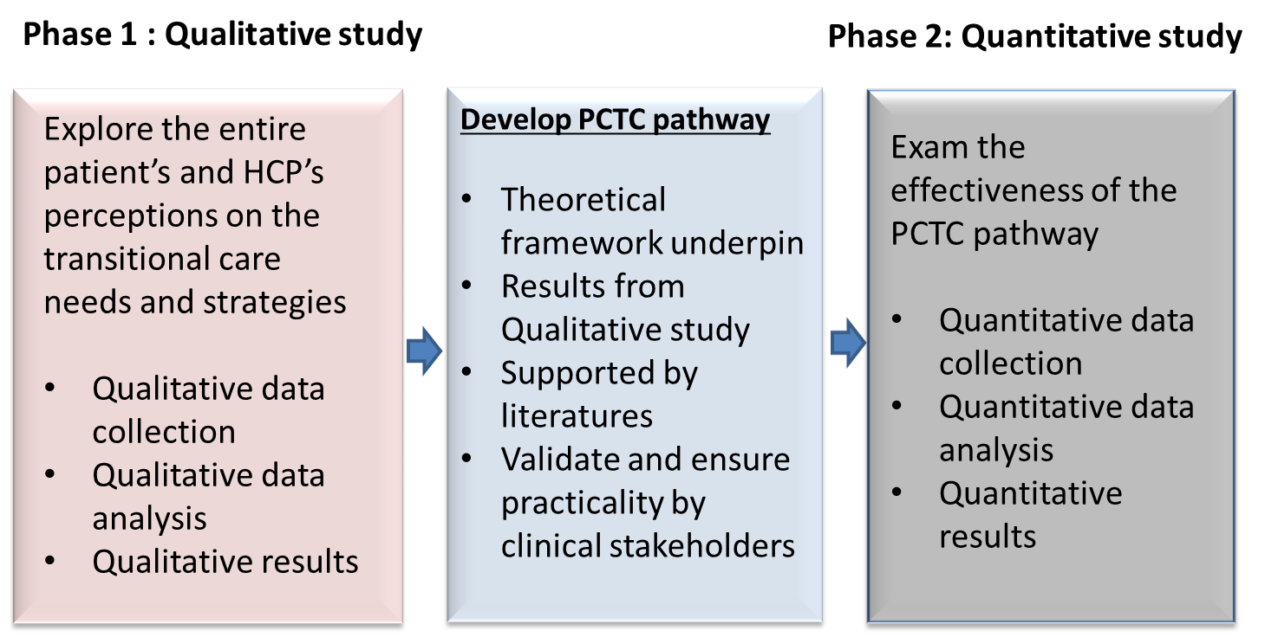
Study Design
A exploratory sequential (Qual-Quan) mixed method design

Slide 11
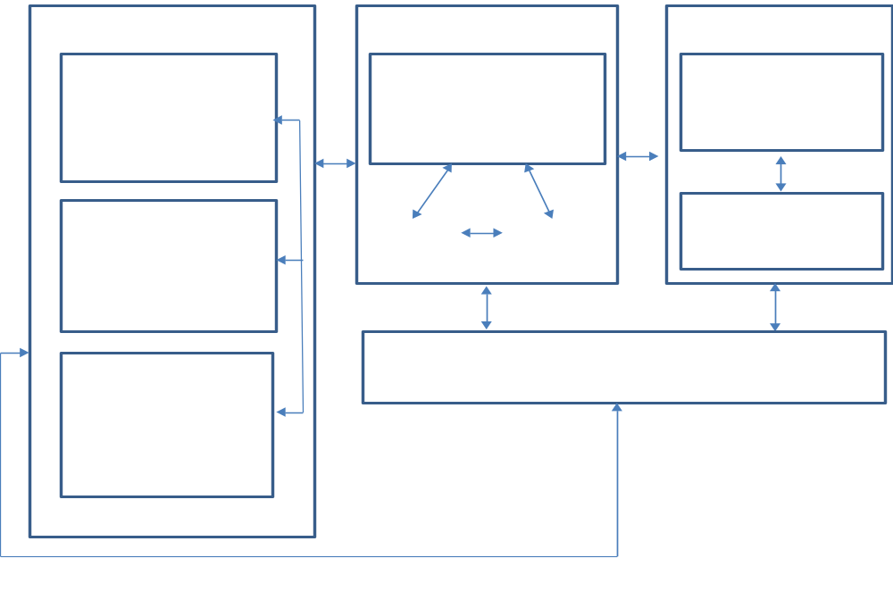
Theoretical Framework
Nature of Transition
Transition Conditions:
Facilitators and Inhibitors
Patterns of response
Process indicators
Feelings connected
Interactions
being situated
Developing confidence/coping
Types:
Development
Situational
Health/illness
Organizational
Personal
Meanings
Culture beliefs & attitudes
Socioeconomic status
Preparation & knowledge
Patterns
Single
Multiple
Sequential
Simultaneous
Related/unrelated
Outcome indicators
Mastery
Fluids integrative
identities
Community
Society
Properties
Awareness
Engagement
Change and different
Transition timespan
Critical points and
events
Nursing therapeutics
Mid-range Transitional Theory
(Meleis et al. 2000)

Slide 12
Theoretical Framework
The transitional theory will help to
  develop interview guideline for qualitative study
  underpin the PCTC pathway development
  identify the outcome measures for quantitative study

Slide 13
Qualitative Exploration
PCTC Pathway
Quantitative study outcome
Outcomes
Process Indicator
Patient satisfaction on continuity of care
Healthcare provider satisfaction on collaboration
ICU Readmission
Patient’s transitional experience
Transition Conditions
Facilitators
Inhibitors
Types:
Situational
Health/illness
Outcome Indicators
Functional status
Nurses clinical decision making ability
Properties
Awareness
Engagement
Change and different
Transition timespan
Critical points and
events
Health providers therapeutics
Before Transfer
Assess the need
Discharge
decision
Plan for discharge
During Transfer
After Transfer
Assessment
Review information
Complete tasks
Required knowledge
Evaluate outcome
Hand-over
Modified ICU Transitional Care Model

Slide 14
Qualitative study
Explore and Develop the Patient Centered Transitional Care (PCTC) Pathway for Patients Transferred from Intensive Care Unit (ICU) to Step-down Care Unit

Slide 15
Study Aim
To explore the patients’ transition experiences and the healthcare providers’ perspectives towards patients’ transition experiences and transitional care provided
To develop a Patient Cantered Transitional Care (PCTC) pathway for patients who are transferred from ICU to step-down care units

Slide 16
Research Questions
What are the patients’ transition experiences and needs when transferred from ICU to step-down care unit?
What are the factors affecting their transitional experiences?
What are the healthcare providers’ perspectives towards patients’ transition experience and needs?
What are the barriers that affect the transitional care provided?
What are the strategies that will help patients’ transition care?

Slide 17
Study Method
Study design
  Descriptive qualitative research design
Study setting
  A restructured public hospital in Singapore, has total 33 wards, 4 ICUs and 1500 beds
  2 ICUs (NICU, SICU), Surgical HD and 10 wards will be the study sites

Slide 18
Study Sample
Purposive sampling method
  Helps to maximize the variation of samples
  Patients
    Based on length of stays
    Age
    Surgical and medical cases
    Destination location
  Healthcare providers
    Multi-professional groups
    Seniorities
    Locations

Slide 19
Sample Size
No. of participants are based on evidence of data saturation
20 patients were proposed, 3 patients have been interviewed
30 healthcare providers were interviewed
  Nurses, Doctors, Allied health providers (includes: PT, OT, ST, Dieticians and Medical Social Workers)

Slide 20
Inclusion Criteria | Exclusion criteria
patients | patients
>21 years old Stay in NICU/ SICU for >48 hours Able to communicate in English Neurological GCS 15 Transferred from NICU/SICU to step-down care units (Surgical HD or general wards) Stays in step-down care units >24hours and < 72hours | Terminal ill and DNR patients Transferred to step-down care units from other hospitals’ ICUs Have ICU transitional experience in the past 2 months
healthcare providers | healthcare providers
Have experience in transferring patient out from NICU/SICU and receiving patient from NICU/SICU Work experience at the relative settings for >6 months | Healthcare providers who are interns or fellows from other institutions

Slide 21
Ethical Consideration
This study has been approved by Domain Specific Review Board (DSRB)
Study participation is voluntary

Slide 22
Recruitment process
Obtain Permission from Department head and Nursing Manager
Department head and nursing manager shared the study to their patients and staffs
Participants call me if they fulfill the criteria and will be invited to the study
Patient: Face-to-face interview (45mins)
All interviews are audiotaped
Consent taken before interview
HCPs: Focus group interview (60mins)

Slide 23
Data Collection Tools
Semi structured interview guide
Pilot test
  to ensure understandability and changes were done after
Face to face interview guide
  What your experiences are during the transfer from ICU to step down care wards?
  What can be improved for this transfer process?
  What will be the idea care before, during and after transfer?

Slide 24
Data collection
  Focus group interview guide
    What are the patients’ transfer needs when they transferred from ICU to step-down care wards?
    What are the current structure or process to transfer patient from ICU to step-down wards?
    What are the barriers and strategies to ensure the continuity of care?
  Probing technique was used for interviews
  Observation diaries were recorded

Slide 25
Data Analysis
Interviews were transcribed immediately
  to ensure consistency
Checked with audiotape again after transcription
  to ensure accuracy
Nvivo10 were used
  analysis in progress
Themes derived from qualitative study
  used to develop PCTC protocol

Slide 26
Study Rigor
Credibility
  Developed interview guide based on transitional theory and literatures
  Pilot tests were done to ensure understandabilities
Dependability
  Purposive sampling to ensure representative
  Interview is conducted by researcher herself
  Immediate transcription to ensure accuracy
  code by using an inter-rater agreement between the researcher and experienced supervisors
Confirmability
  All data will safe kept for audit purpose
Transferability
  Purposive sampling method helps to ensure well represent the study context

Slide 27
Develop PCTC Pathway
Drafted transitional care protocol has been developed
  Transitional theory and available literatures
The study findings will help to
  identify the common goals among patients and healthcare providers to direct the transitional care
  integrate patient centeredness into the transition process
  include and expand some of the drafted interventions
  interlink the three phases
  ascertain the appropriate implementation method
Clinical stakeholders were and will be consulted on the feasibility and usability

Slide 28
Pre-transfer-discharge phase: Coordination of care and decision making for ICU transfer
Domains | Activities and action plan | who
developing multidiscipline discharge planning | Multi-disciplinary team create discharge planning medication reconcile functional ability nutritional needs psychosocial needs advanced care planning (Palliative care) Level of follow up care required Setting Multidisciplinary goals of care for patient under transition Coordination care among team members | Multi-disciplinary Physician, ICU Nurses, pharmacist, ST, PT, OT as per patients’ need
providing patient education to ensure transition aware, engage, prepare for the changes and differences | Educate on recovery process new wards’ environment resource person outside plan of care | ICU Nurses
During transfer- handover phase: Information transfer and assess the care providers’ needs for the complex care
communicating information by using structure format | Communicating information Situation: Patient identity , primary diagnosis, patients’ vital data and precautions and status, patient’s need (physical, function, psychological) Background: Past medical history, past related investigations Assessment: Problem list, pharmacy issues Recommendation: Plan of care and activities, Pardon me for not clear ( equipment , invasive lines and special devices, properties) | ICU and GW nurses
Post-transfer phase – admission phase: follow up care activities
providing continuum support | providing continuum support for patient as well as for healthcare providers in general wards Support step-down wards to reprioritize the nursing care Act as resource person to support step-down nurses to assess and monitor patients’ clinical condition Educate step-down nurses to skilled up to care for critical ill patients’ need | Liaison nurse/Advanced practice nurse/Clinical Nurse specialist

Slide 29
PCTC pathway
Aims to
  improve patients’ continuity of care
  improve the collaboration between the intra-professional, inter-professional, and inter-departmental
  improve patients’ cognitive and functional status
  improve nurses’ clinical decision making ability

Slide 30

☺

