Slide 1
Brief comparison of LC-esi-MS and
LC-APCI-MS
Wenjie Cao
SABIC Technology Center
Riyadh, Saudi Arabia

Slide 2
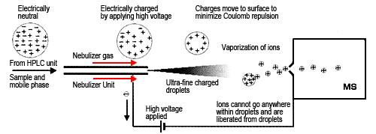
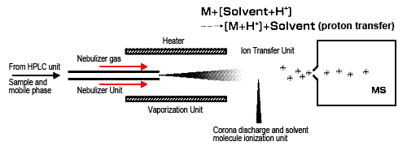
Less background in APCI
Heater in APCI
Proton Exchange and Ion “Evaporation”
1st difference
2nd
3rd
Courtesy of Shimazu.com

Slide 3
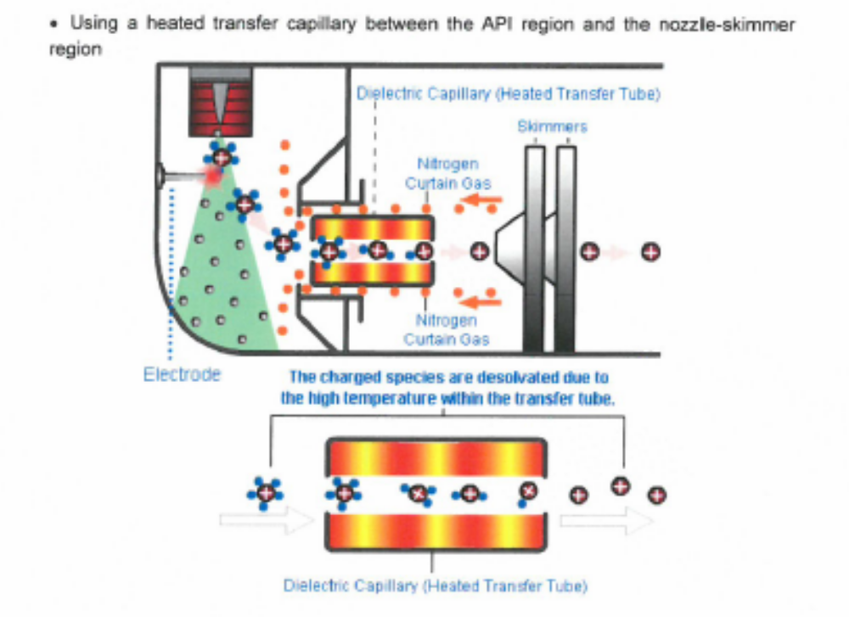
A closer look of apci Ionization
Courtesy of LGC.com

Slide 4
Brief Comparison of ESI and APCI
Pros and Cons of ESI and APCI
ESI |  |  | APCI
ESI Ionization | Pros | Cons | APCI Ionization | Pros | Cons
"Evaporate" ions out of droplets | Multiple charged ions for high MW chemicals | Could be difficult in MS interpretation | Gas Phase Proton Exchange | Easier to get M+1 for identification | Less sensitive or can't handle ionic chemicals
 | Metal ion for confirmation of M? | Metal adducts |  | No multiple-charged ions, easier for identification
 |  | May mess up with MRM |  | No metal ions, easier for identification
 |  | More background ions |  | Easier for MRM
 |  | Ion suppression |  | Neater background
Lower Temperature | Good for thermally unstable chemicals | More adducts and clusters | Higher Temperature | Less cluster/adduct ions | Thermally unstable chemicals?
 |  | Can't handle higher flow rate |  | Can ionize less polar chemicals
 |  |  |  | Can handle higher LC-flow rate

Slide 5
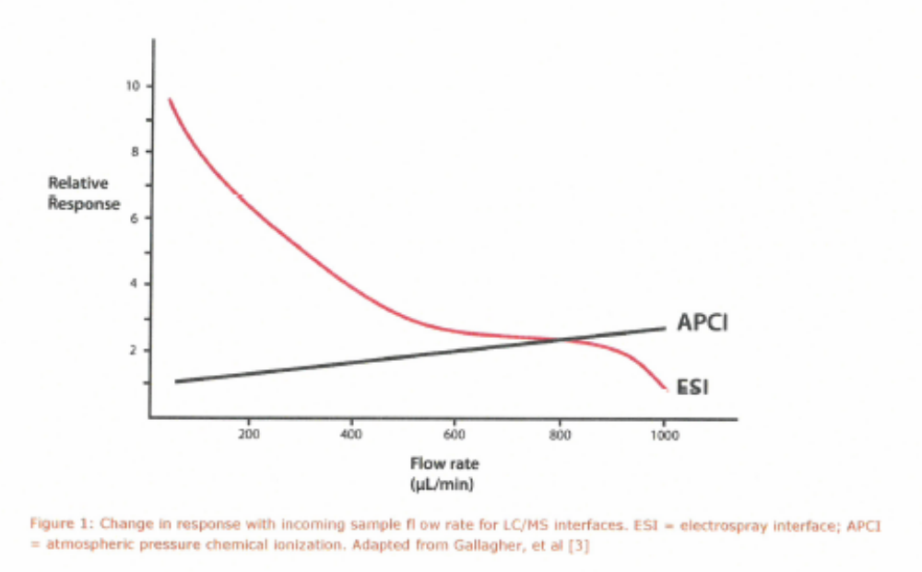
LC FLOW RATE FOR ESI AND APCI
Courtesy of F. Klink

Slide 6
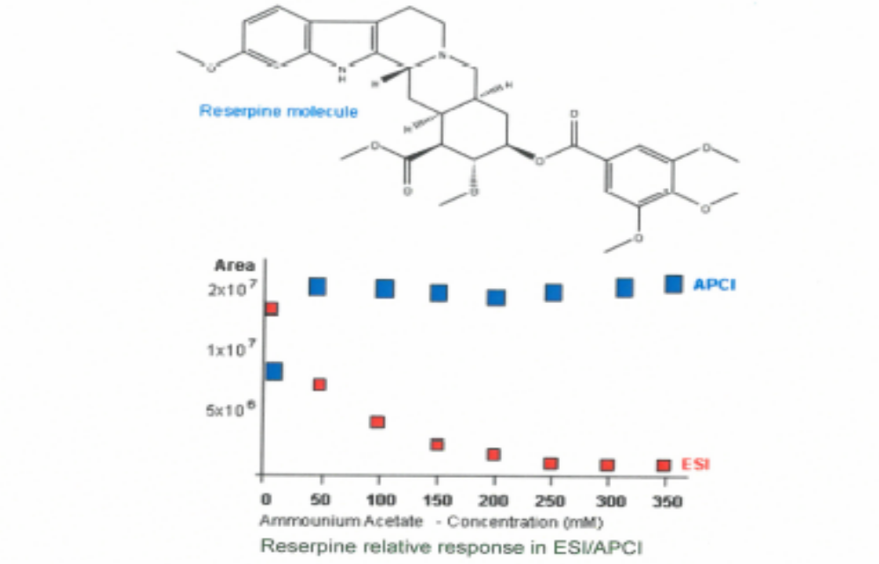
ION SUPPRESSON IN ESI AND APCI
Courtesy of LGC.com

Slide 7
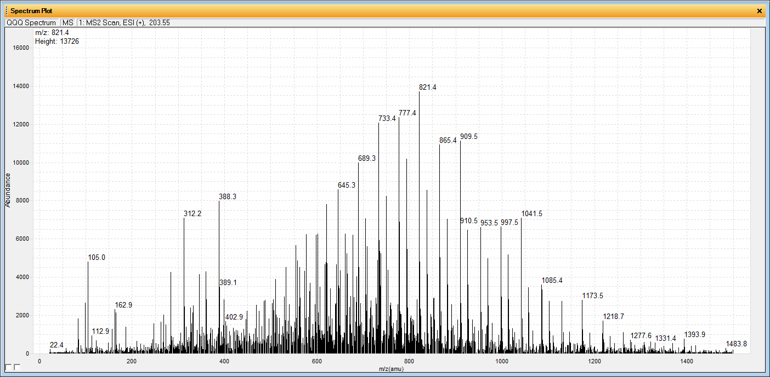
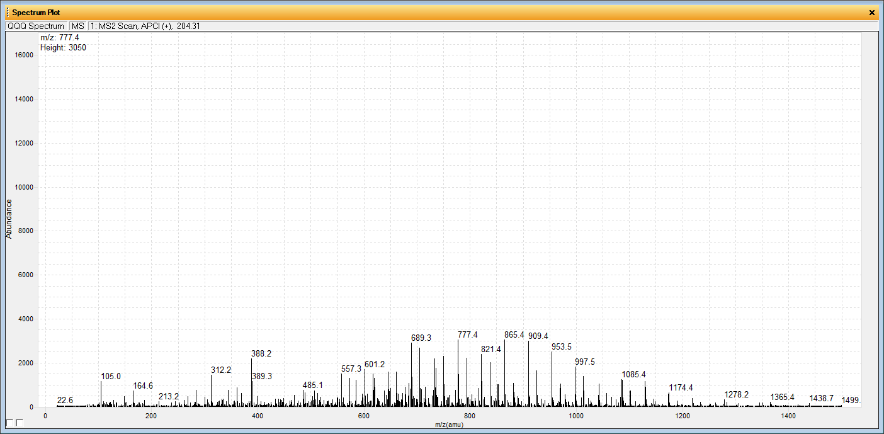
Background adduct ions of Esi over APCI at “the same LC-MS conditions”
ESi
apci

Slide 8
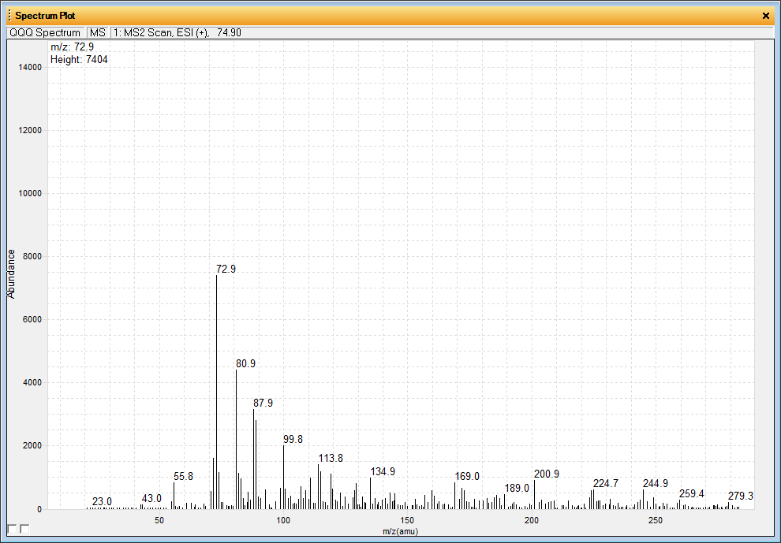
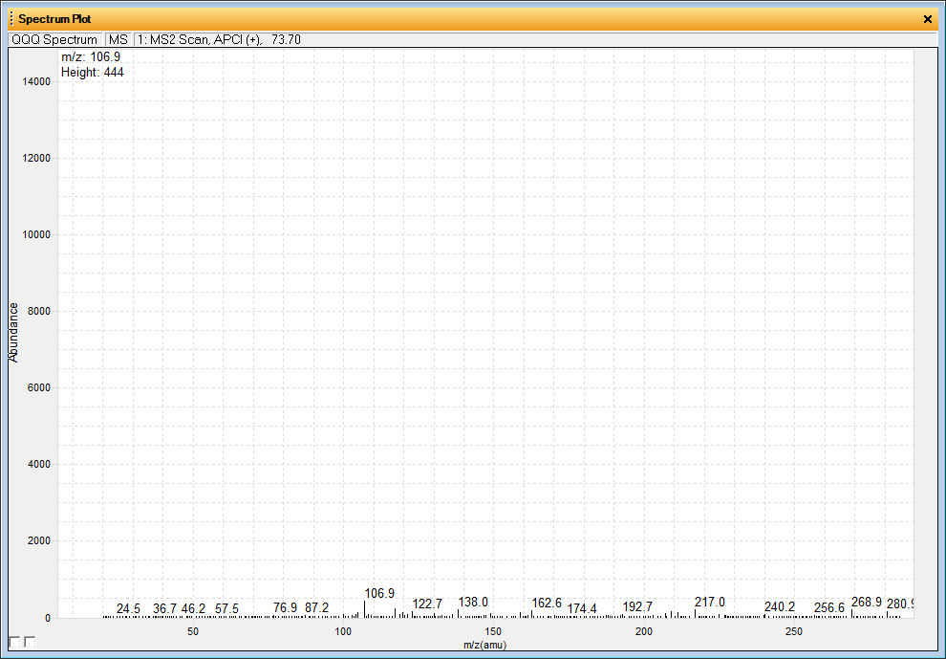
Background adduct ions of Esi over APCI at “the same condition”
ESi
apci

Slide 9
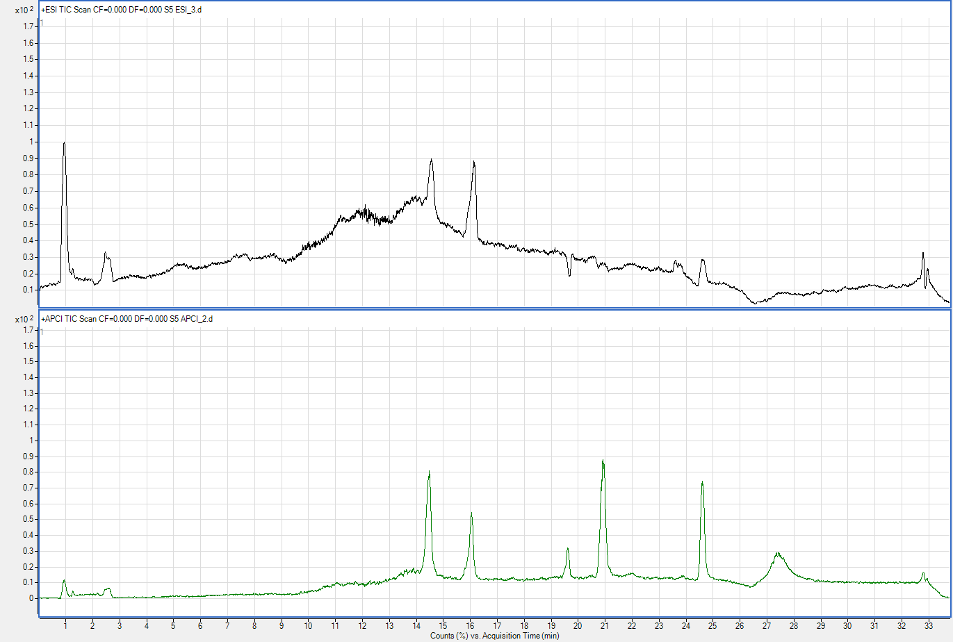
Chromatograms of Esi and APCI at “the same LC-MS conditions”
ESi
apci

Slide 10
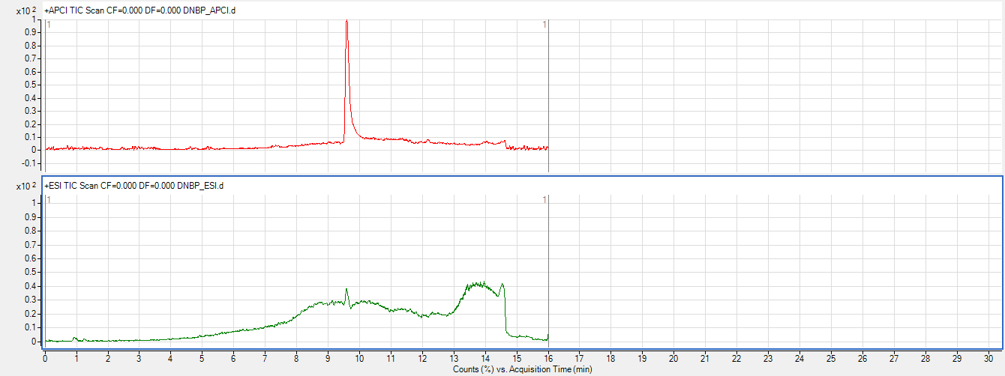
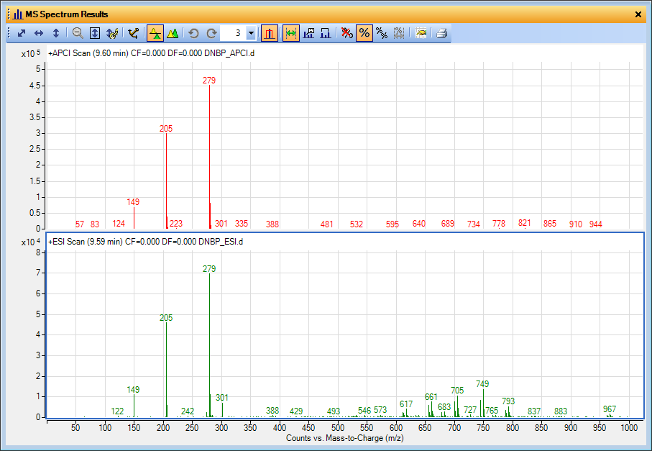
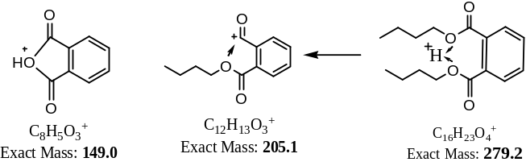
LC-MS chromatograms and MS spectra of Esi and APCI at “the same LC-MS conditions”
W.J. Cao, 2014
apci
ESi
W.J. Cao, 2014
apci
ESi

Slide 11
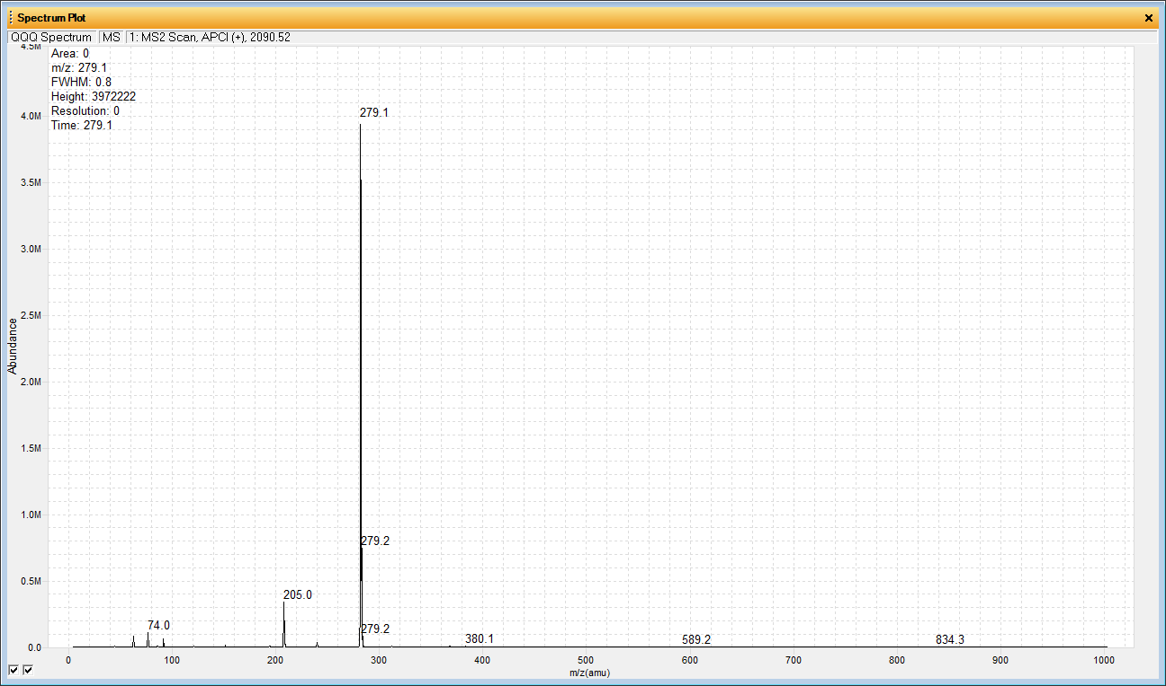
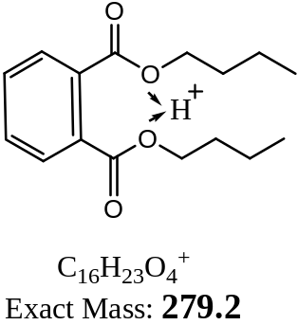
APCI-MS scan spectrum of DNBP
W.J. Cao, 2014
W.J. Cao, 2014

Slide 12
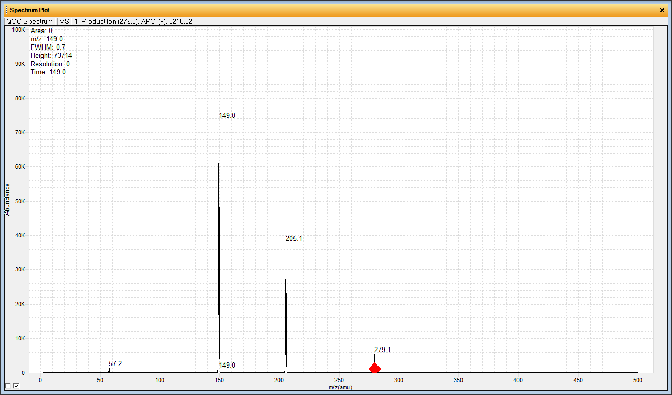
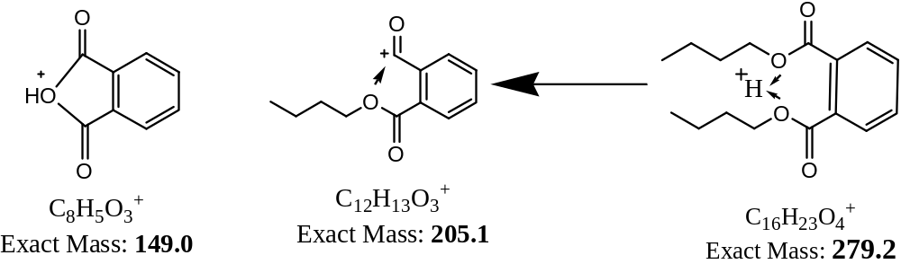
APCI Product ions of M+H⁺
W.J. Cao, 2014
W.J. Cao, 2014
Ready for MRM

Slide 13
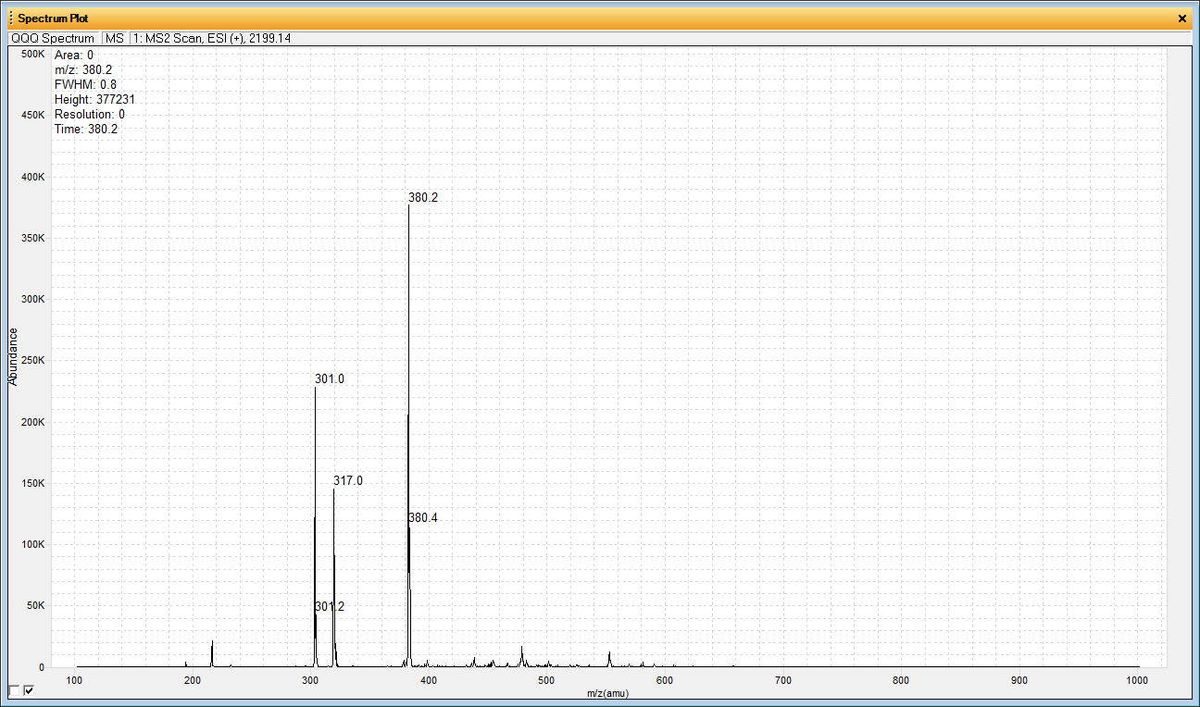
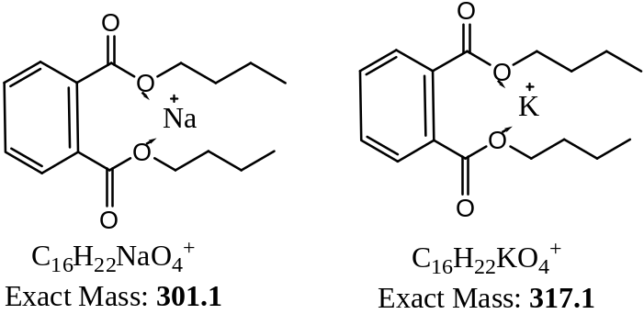
ESI-MS Scan spectrum of DNBP at the “same condition”
W.J. Cao, 2014
May not be able to do fast FIA or Infusion optimization

Slide 14
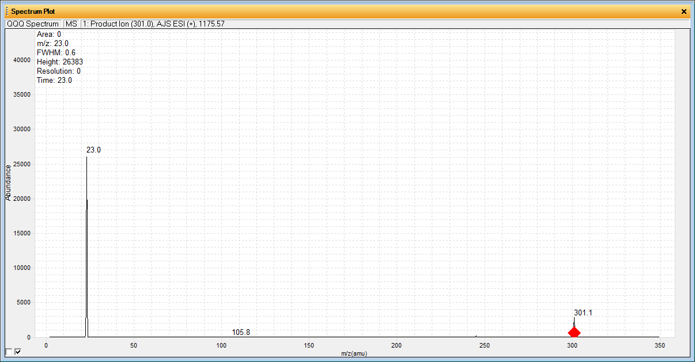
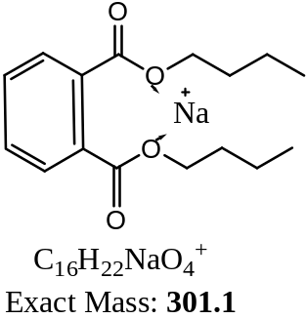
ESI PRODUCT ION SPECTRUM OF M+Na⁺
W.J. Cao, 2014

Slide 15
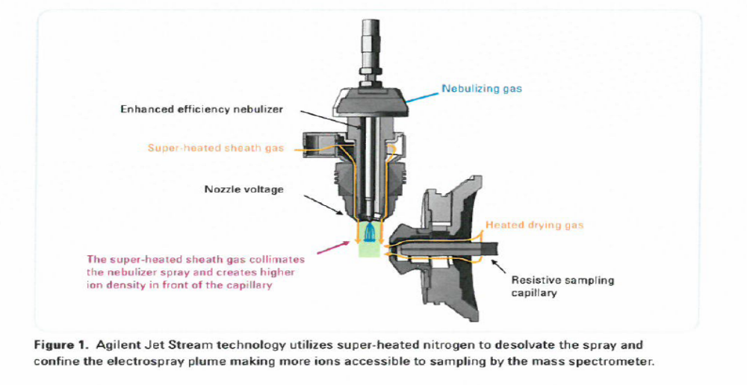
AGILENT JET-STREAM ESI
Courtesy of Agilent.com

Slide 16
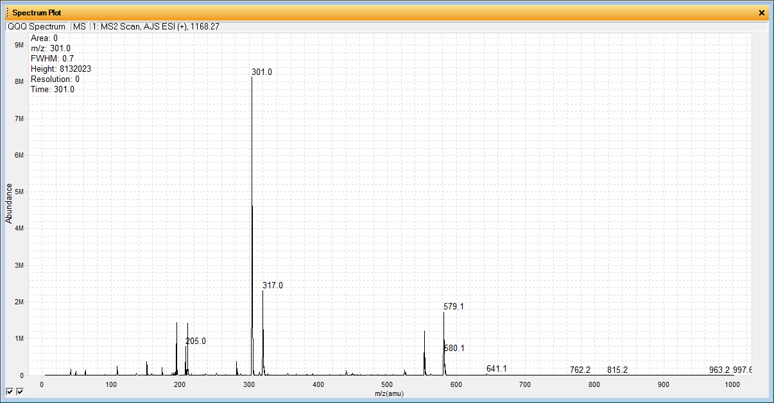
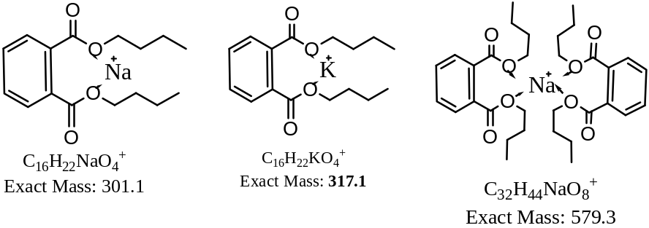
AJS-ESI SPECTRUM OF DNBP
W.J. Cao, 2014
W.J. Cao, 2014
Figure I. ESI produce many metal adduct ions which can’t be used for MRM analysis.

Slide 17
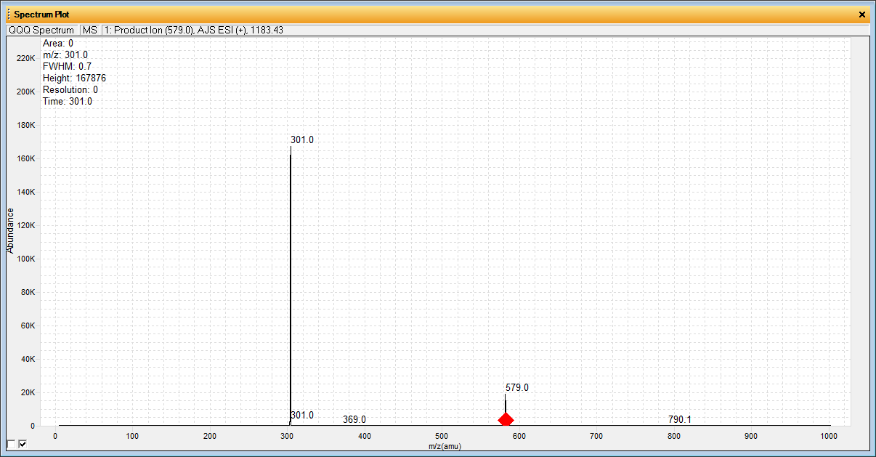
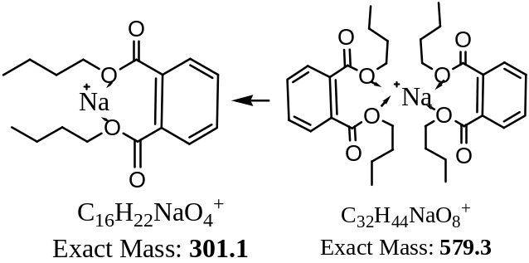
AJS-ESI PRODUCT IONs OF 2M+Na⁺ At LOW CE
W.J. Cao, 2014

Slide 18
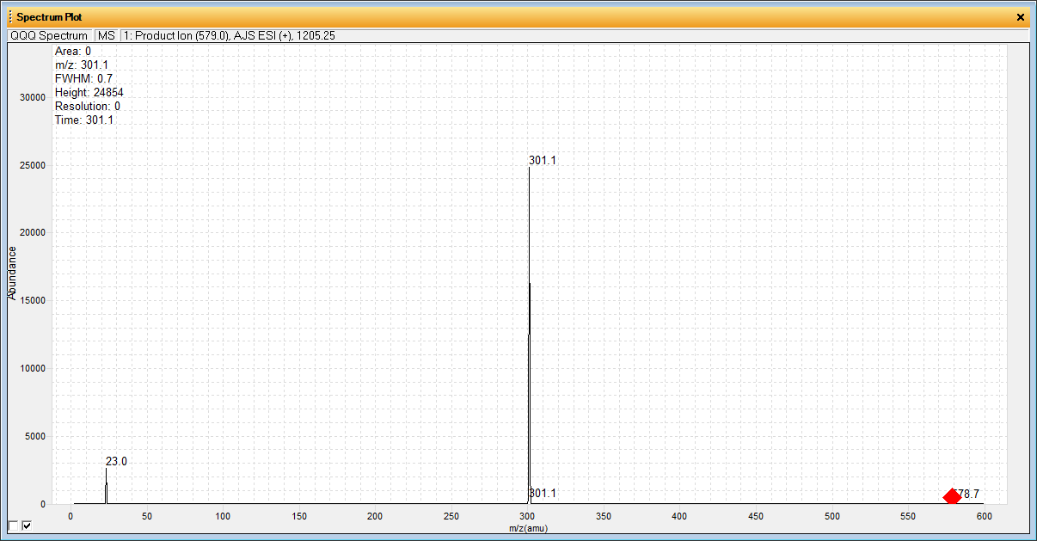
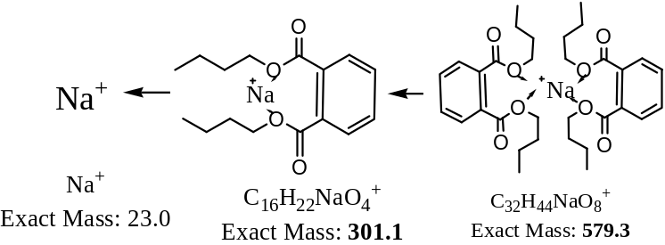
AJS-ESI PRODUCT IONS OF 2M+Na⁺ At HIGHER CE
W.J. Cao, 2014
W.J. Cao, 2014

Slide 19
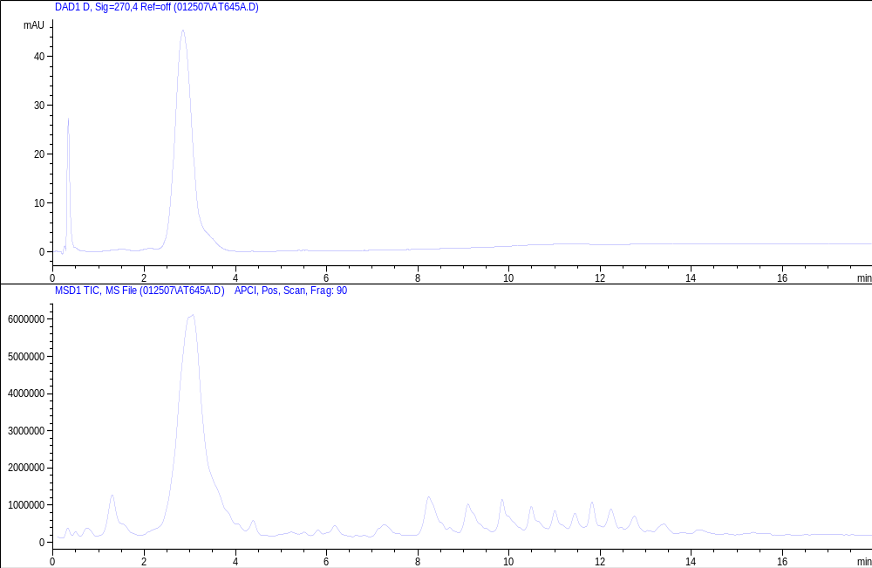
Characterization of Polymer Additives by LC-APCI-MSD
Chromatogram of LC-UV @ 270 nm
Strong UV adsorption indicates aromatic groups
Chromatogram of LC-MSD (APCI +)
No UV peaks, nice series

Slide 20
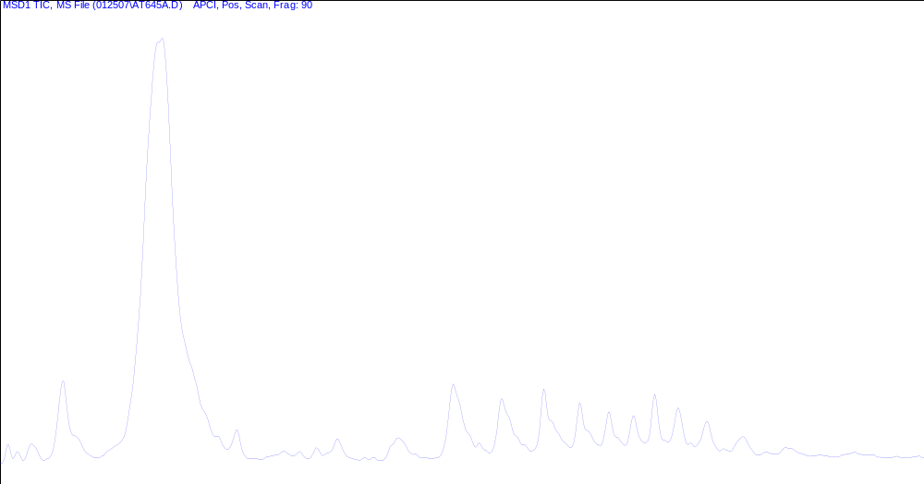
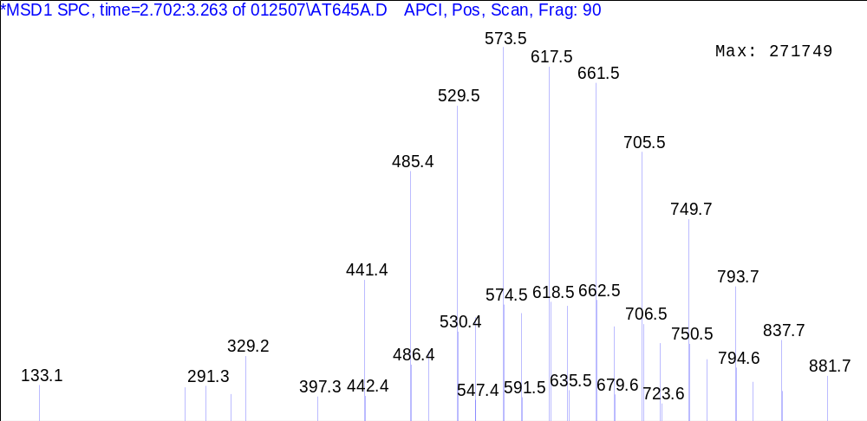
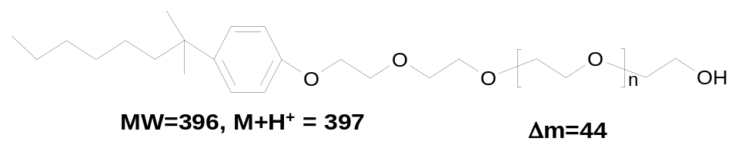
Characterization of Polymer Additives by LC-APCI-MS
Δm=44
Nonylphenol Ethoxylates (NPE)
Alkylphenol Ethoxylates (APE)

Slide 21
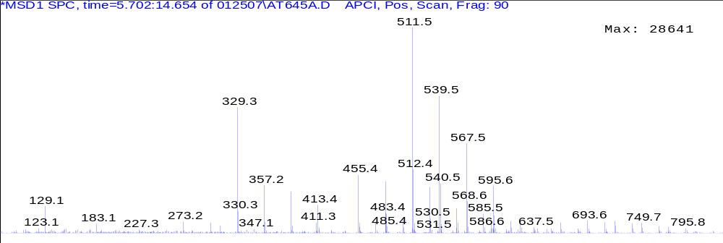

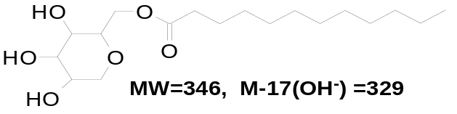
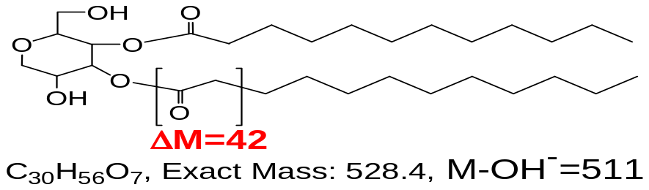
Characterization of Polymer Additives by LC-APCI-MSD
Sorbitan Mono-Laurate
Δm=28
Δm=28
Δm=28
Δm=42
Δm=42
Sorbitan Di-Laurate
Wenjie Cao, 2007

Slide 22
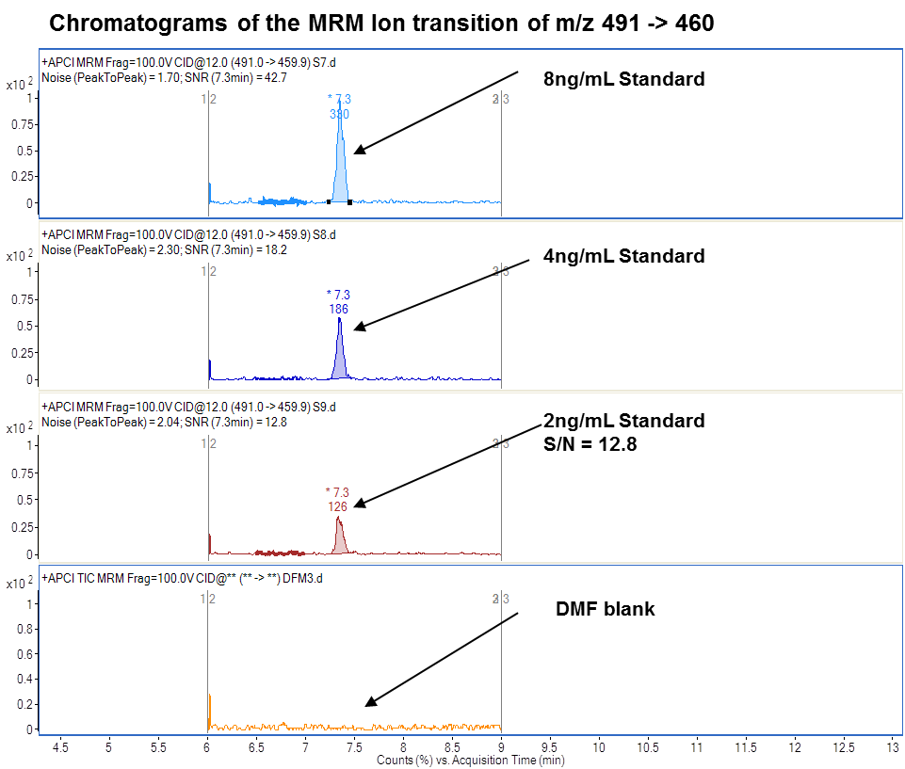
Quantitation by UHPLC-APCI-MS/ms
Wenjie Cao, November 2011

Slide 23
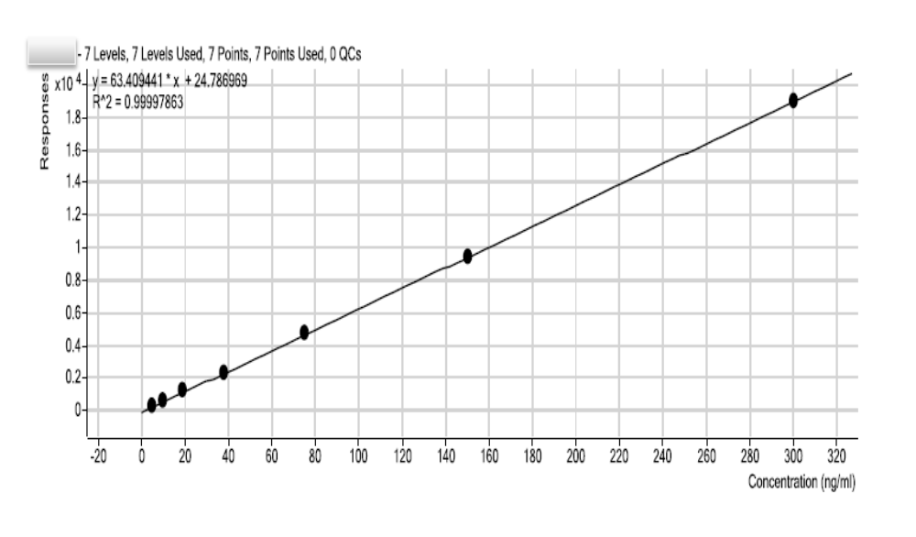
Quantitation by UHPLC-APCI-MS/MS
Wenjie Cao, November 2011

Slide 24
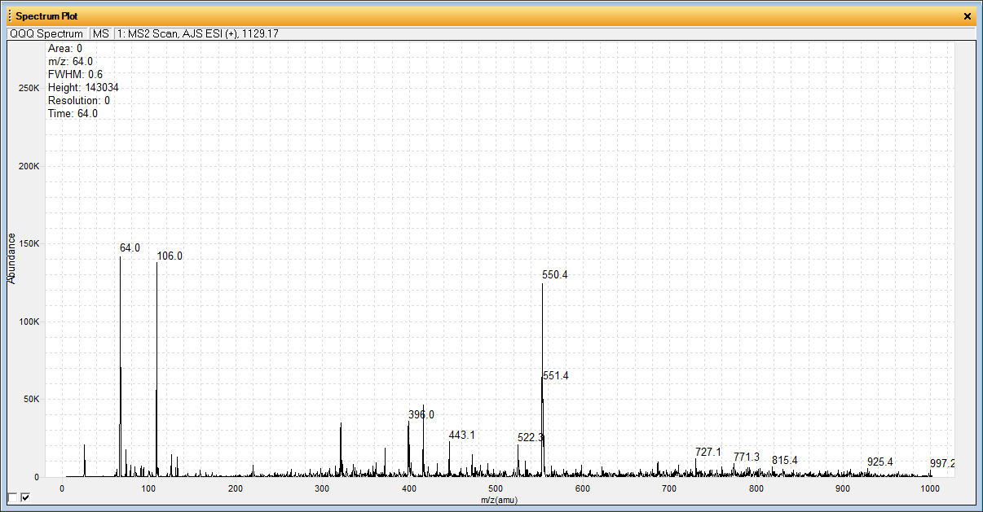
EI, ESI, CI, APCI, A trouble shooting story
“Perfect” reasoning with publication backup
What is that 106 ion?

Slide 25
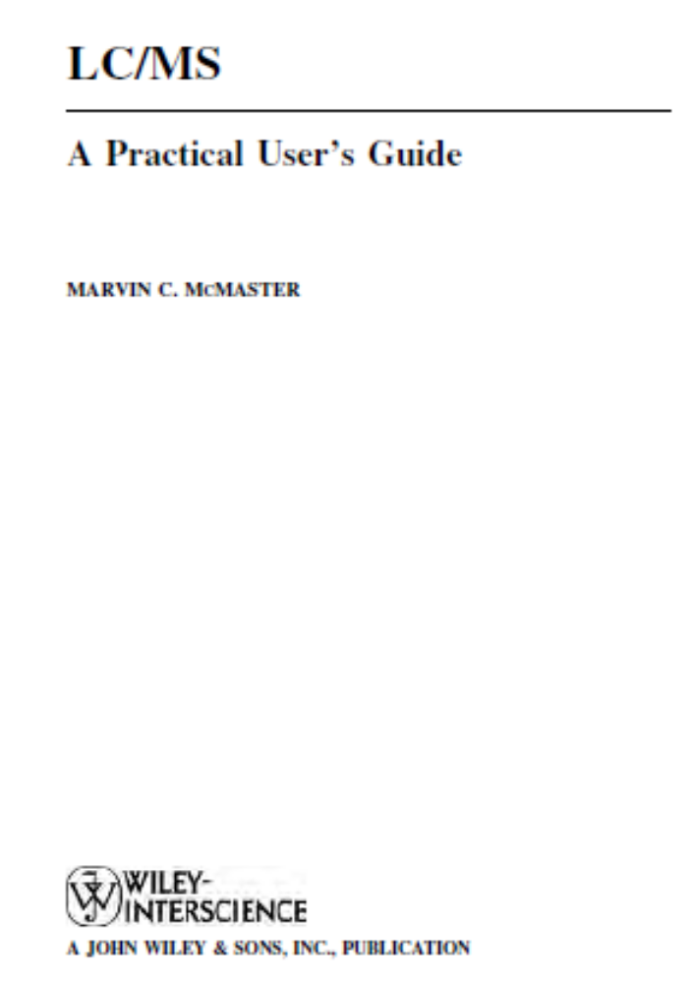
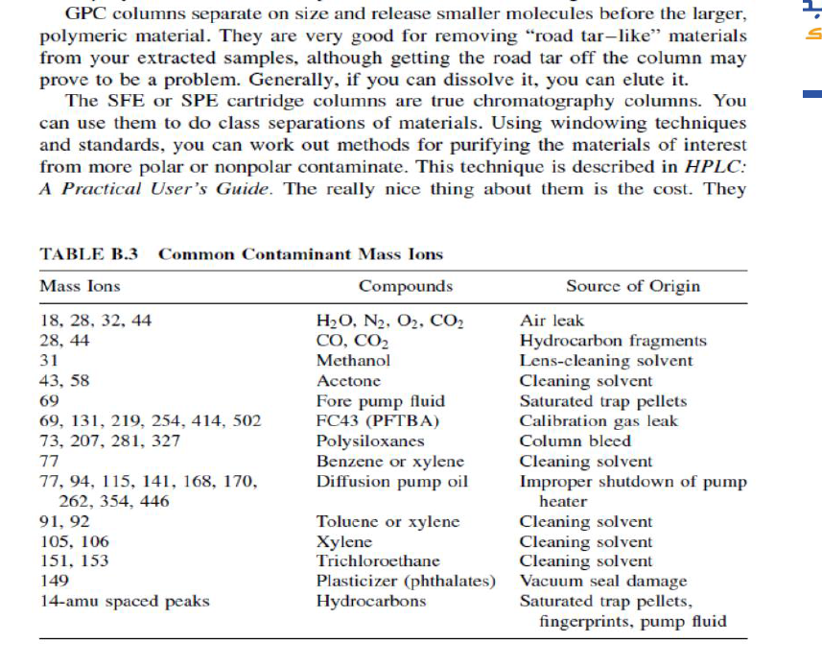
Perfect reasoning, but fundamentally wrong A trouble shooting story Mislead by publications

Slide 26
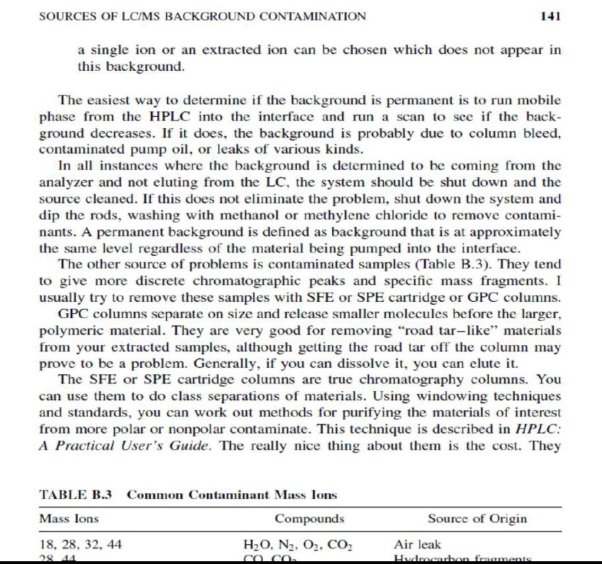
Perfect reasoning, but fundamentally wrong A trouble shooting story Mislead by publications

Slide 27
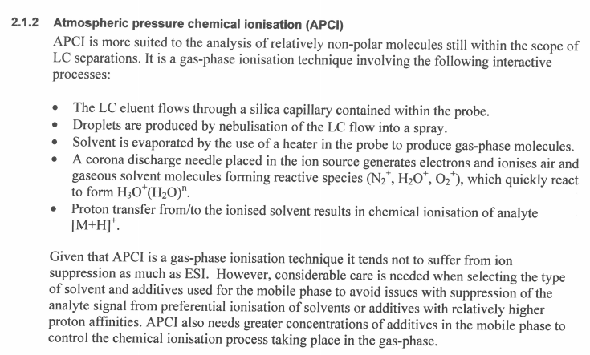
EI, ESI, CI, APCI, One more publication on APCI
Use air in APCI?
APCI needs “greater C of additives in mobile phase?

Slide 28
Summary of ESI and APCI for lc-ms
Summary of Pros and Cons of ESI and APCI
ESI |  | APCI
Pros | Cons | Pros | Cons *
Multiple charged ions for high MW chemicals | Could be difficult in MS interpretation | Proton exchange, easier to get M+1, M-1 | Can't handle chemicals which can’t do proton-exchange.
Metal ions for confirmation of M? | Metal adducts | No multiple-charged ions, easier for identification | MW range is usually less than 1500
 | May mess up with MRM | No metal ions, easier for identification
 | Ion suppression could be more serious | Less ion suppression
 | More background ions, noisy baseline | No metal ions to mess up MRM
Ionic chemicals | More matrix dependent | Neater background
Popular, more publications and references |  |  | Less good publications and references.
Low T, good for thermally unstable chemicals | More adducts and clusters | High T, Less cluster/adduct ions | Thermally unstable chemicals
 | Can't handle high flow rate | Can ionize less polar chemicals
 | Ion suppression could be more serious | High T, can handle higher LC-flow rate
 |  | * may not be APCI issues

Slide 29
Thank you!
Questions?

