Slide 1
A Non-Replicating Ad5 Vaccine for the Treatment of HSV-2 Infection
Wendy Peters, PhD | Associate Director of Immunology
August 2015
Notes:
I’d like to thank the organizers for inviting me

Slide 2


ORAL Prophylactic and Therapeutic VACCINES
PLATFORM
First-in-Class: Oral
Recombinant Vaccines
STAGE
Clinical Stage Company
PIPELINE
Advanced Preclinical
Pipeline
Administered by tablet
We believe the platform is suitable for delivery of many recombinant protein antigen: Flu, HPV, Hep B, industry pipeline
H1N1 seasonal Flu tablet vaccine
Safety/immunogenicity profile competitive with commercial vaccines after single administration
Seasonal Influenza (Flu B)
Norovirus
RSV
First Therapeutic Candidate–HSV2
Notes:
Today I’d like to talk to you about the platform technology that Vaxart is developing for oral delivery of prophylactic and Therapeutic vaccines. The vaccine is administered by tablet and we believe the platform is suitable for delivery of any viral antigen. We are a clinical stage company that has completed 2 phase 1 clinical trials for H1N1 seasonal flu. And the safety and Immunogenicity profile is competitive with commercial vaccines after 1 dose. We also have an advanced preclinical pipeline for Norovirus, RSV and our first Therapeutic vaccine HSV-2.

Slide 3
Outline
Background on Vaxart’s oral vaccine technology
  Non-replicating Ad5-TLR3 agonist platform
Clinical data from phase I trials using delivery H1N1 vaccine in a tablet
Characterization of potential T cell antigens for inclusion in our therapeutic HSV-2 vaccine
Notes:
I’ll be breaking mt talk into 3 parts

Slide 4
Outline
Background on Vaxart’s oral vaccine technology
  Non-replicating Ad5-TLR3 agonist platform
Clinical data from phase I trials using delivery H1N1 vaccine in a tablet
Characterization of potential T cell antigens for inclusion in our therapeutic HSV-2 vaccine

Slide 5
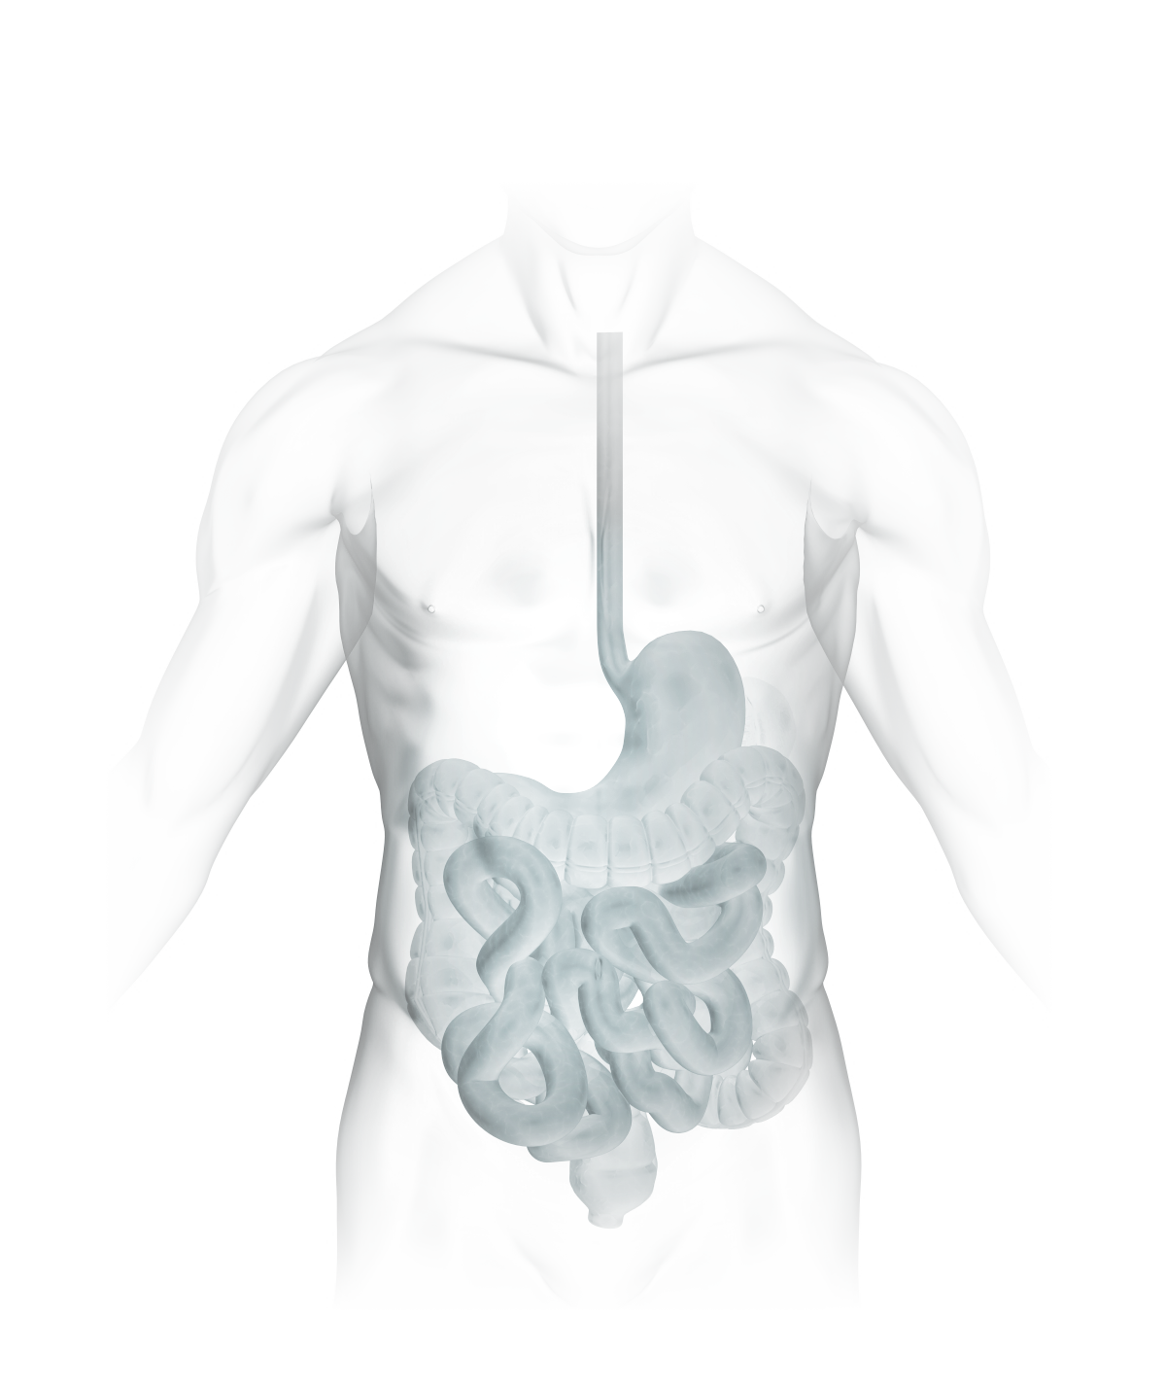
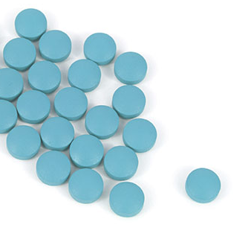

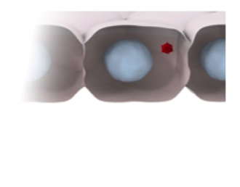
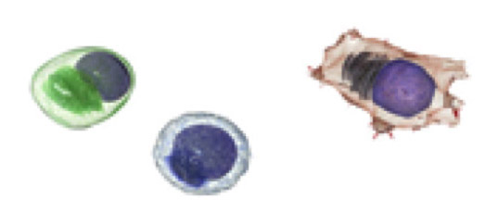
Tablet Delivers Vectored Vaccine to Small Intestine
– Antigen and Adjuvant Are Co-Expressed
1
Enteric-coated tablet protects against stomach acid and delivers vaccine to small intestine
2
Non-replicating adenovirus 5 (Ad5) vector delivers antigen genes to mucosal epithelium for expression
Mucosal Epithelium
T Cell
B Cell
Activated Dendritic Cell
3
dsRNA adjuvant expressed in the same cell as the antigen activates the immune cascade
Notes:
The vaccine is delivered by enteric coated tablet to protect the virus from the acidic environment of the stomach. Once in the SI the tablets dissolve allowing the virus to deliver the payload antigen and the dsRNA adjuvant to the mucosal epithelium. There the TLR3 adjuvant activates the immune system to induce a strong T and B cell response to the vaccine specific antigen.
Transition
Clearly, administering the vaccine by tablet has advantages over regular injectable vaccines since it is needle free

Slide 6
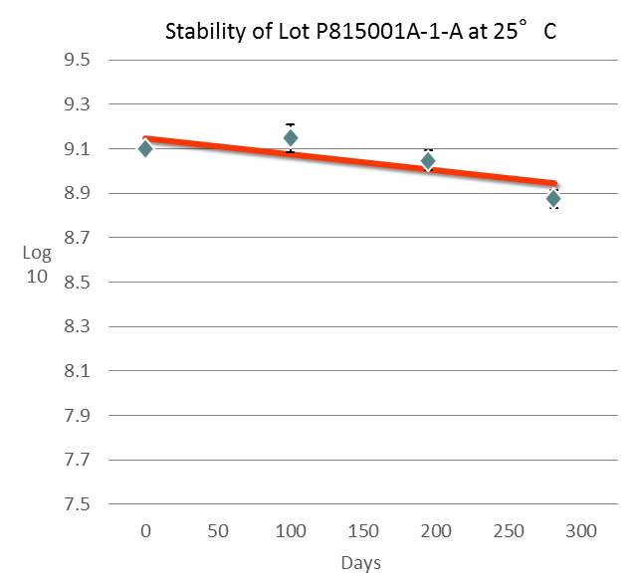
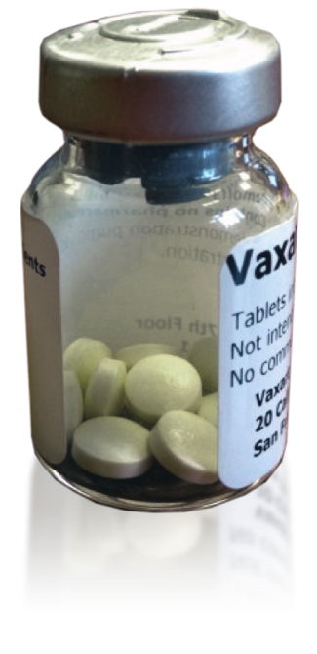
Tablet Vaccine: Easy to Distribute and Administer
Vaxart Vaccine Advantages
Stability of Vaxart’s Tablet Vaccine
Needle Free
  Patient acceptance
  Ease of administration
  No needle stick, biohazard
No Cold Chain
  Ease of distribution
  Logistics are simpler
  Costs are reduced
Stable at 25⁰C > 1 year
Stable at 4⁰C >> 1 year
Notes:
Which leads to patient acceptance and better compliance. No needles means no medical personel required to administer the vaccine. And no needles also means no needle stick biohazard and no difficult disposal. Vaxarts tablets are also extremely stable. At RT they are stable for greater than 1 year. Which means no cold chain is required which makes distribution easy and reduces costs.

Slide 7
Outline
Background on Vaxart’s oral vaccine technology
  Non-replicating Ad5-TLR3 platform
Clinical data from phase I trials using delivery H1N1 vaccine in a tablet
Characterization of potential T cell antigens for inclusion in our therapeutic HSV-2 vaccine
Notes:
So now I would like to share with you the data from our phase I trials where we have delivered H1N1 vaccine as a tablet

Slide 8
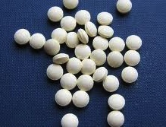
H1N1 Influenza: Phase I Placebo-Controlled Studies
DELIVERY SYSTEM
STUDY DESIGN
Coated Tablets
Randomized, Double Blind, Placebo Controlled
THREE DOSE LEVELS | # SUBJECTS
Placebo, 1e9, 1e10 IU | 36 (3 x 12)
Placebo, 1e11 IU | 24 (2 x 12)
TOTAL | 60
  Purpose:
  Safety and immunogenicity
  Dose ranging
Notes:
We have completedv2 phase 1 trials that were randomized, double blind and placebo controlled the first trial had groups of 1e9 and 1e10 iu plus placebo and the second trial had a group of 1e11 IU plus placebo. The purpose of the trials were to determine safety and immunogenicity as well as determining the optimal dose.

Slide 9
Safety Summary: Primarily Mild Adverse Events,
Evenly Distributed Between Active and Placebo
SOLICITED ADVERSE EVENTS
ADVERSE EVENT* | TOTAL AEs | 1E9 | 1E10 | 1E11 | PLACEBO
# Subjects |  | 12 | 13 | 12 | 24
Diarrhea | 3 | 1¹ | 1¹ | 1¹ | 0
Nausea | 3 | 1¹ | 0 | 0 | 2¹
Vomiting | 0 | – | – | – | –
Abdominal Pain | 2 | 1² | 0 | 1¹ | 0
Hematochezia | 0 | – | – | – | –
Malaise | 2 | 1¹ | 0 | 0 | 1¹
Anorexia | 0 | – | – | – | –
Headache | 9 | 3¹ | 1² | 1¹ | 3¹
Fever (Pyrexia) | 1 | 0 | 0 | 1¹ | 0
All AEs Mild Except One Moderate
Headache and Abdominal Pain
No Notable Differences in Either Solicited and Unsolicited Adverse Events in Comparison to Placebo Recipients
No Vaccine-Related SAEs
Solicited local and systemic adverse events (AEs) collected for 7 days post vaccination.
Unsolicited AEs and AEs of special interest (AESIs) collected for 1 year post vaccination.
Adverse Event Severity: ¹Mild, ²Moderate, ³Severe
Notes:
The take home message for the safety profile is that all the AE’S were mild except for one moderate headache and abdominal pain and there were no notable differences between AE’s in placebo and vaccine treated groups.

Slide 10
Robust and Dose-Dependent Neutralizing Antibody Responses in 92% of Subjects
75% of Subjects Seroconverted by HAI after Single Dosing
%
Responders
Placebo Tablet
H1 Tablet
1e9
H1 Tablet
1e10
H1 Tablet
1e11
Hemagglutinin Inhibition (HAI) and Microneutralization (MN) assays conducted by Focus Diagnostics
Notes:
Turning to the immunogenicity data. The correlate of protection for Flu is a 4 fold rise in neutralizing antibody titer. And you can see here that 75% of subjects seroconverted by HAI, 92% by microneut assay. Thus we have comparable efficacy to commercial im vaccines.

Slide 11
Advantage-Strong and Dose Dependent Mucosal IgA Immune Response
No Mucosal Response when Vaccinated with Commercial Vaccine
ASC per 1e6 Cells
N=8
N=8
N=10
N=12
N=4
Placebo
1e9
1e10
1e11
Injectable
Vaxart Tablets
IgA Antibody Secreting Cells (ASC) present in peripheral blood at Day 7
Notes:
But Vaxarts vaccine has a bigger advantage as it can also elicit a strong and dose dependent Mucosal IgA response as seen here by ASC assay. In contrast 4 volunteers that took the injectable vaccine did not elicit an IgA response.
Transition
So the vaccine can induce both systemic neutralizing antibodies as well as mucosal IgA responses, but what about the CELL MEDIATED response.

Slide 12
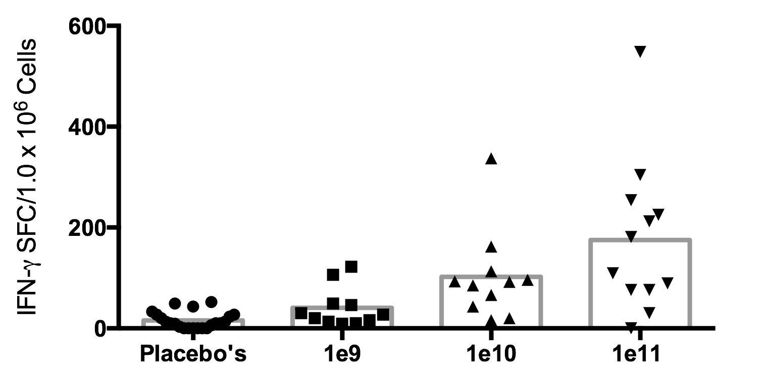
Dose Dependent Cell Mediated T Cell Responses
**
**
*
* P ≤ 0.05
Mean | 9 | 41 | 102 | 175
**P ≤ 0.01
Notes:
When we looked at IFN-g production by PB T cells we saw a clear dose dependent response.

Slide 13
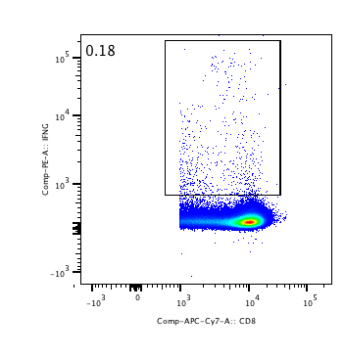
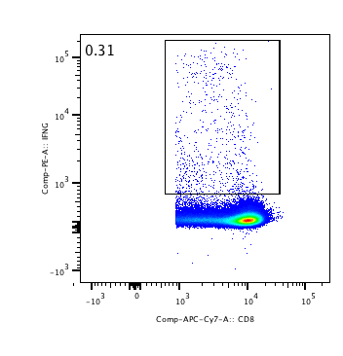
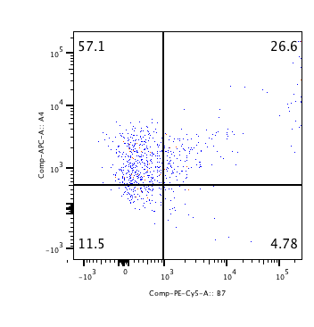
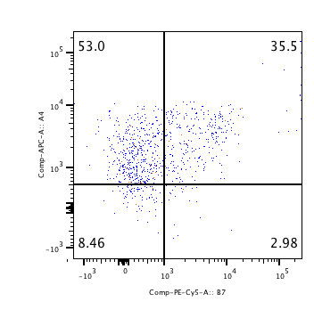
Mucosal Homing T Cells Expressing α4β7
Day0
Day7
HA specific
IFN-γ
CD8 (T cell)
α4+β7+
α4+β7+
α4
β7
Notes:
But even more compelling it that the mucosal homing receptor A4B7 was upregulated on these IFN-producing CD8 T cells.
So this got us thinking about diseases that might benefit from mucosal homing T cells.
We know from work by Connie Trimble and others that A4B7 is used by T cells to enter the genital tract.

Slide 14
α4β7 Directs Genital Tract T Cell Homing
Trimble et al 2010. Human Papillomavirus 16-Associated Cervical Intraepithelial Neoplasia in Humans Excludes CD8 T Cells from Dysplastic Epithelium. Journal of Immunology
Shannon B et al 2014. Impact of Asymptomatic Herpes Simplex Virus Type 2 Infection on Mucosal Homing and Immune Cell Subsets in the Blood and Female Genital Tract. Journal of Immunology
Notes:
And we know from work by Connie trimble and others that A4B7 is used by T cells to enter the genital tract and more recent work by Shannon et al found the expression of this homing receptor on PB T cells of HSV-2 + subjects So by putting all this information together the Therapeutic program for HSV-2 was born

Slide 15
α4β7 Directs Genital Tract T Cell Homing
Trimble et al 2010. Human Papillomavirus 16-Associated Cervical Intraepithelial Neoplasia in Humans Excludes CD8 T Cells from Dysplastic Epithelium. Journal of Immunology
Shannon B et al 2014. Impact of Asymptomatic Herpes Simplex Virus Type 2 Infection on Mucosal Homing and Immune Cell Subsets in the Blood and Female Genital Tract. Journal of Immunology
Vaxart’s Therapeutic HSV-2 Vaccine Program
Notes:
And we know from work by Connie trimble and others that A4B7 is used by T cells to enter the genital tract and more recent work by Shannon et al found the expression of this homing receptor on PB T cells of HSV-2 + subjects So by putting all this information together the Therapeutic program for HSV-2 was born

Slide 16
Outline
Background on Vaxart’s oral vaccine technology
  Non-replicating Ad5-TLR3 platform
Clinical data from phase I trials using delivery H1N1 vaccine in a tablet
Characterization of potential T cell antigens for inclusion in our therapeutic HSV-2 vaccine
Notes:
So now I would like to move on and tell you about the characterization of potential T cell antigens for inclusion in the HSV-2 vaccine

Slide 17
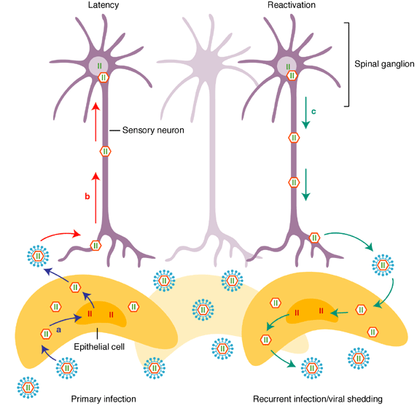
HSV-2 Life Cycle
LP
Epithelium
Adapted from Expert Reviews in Molecular Medicine 2003
Vaginal
Vault
Notes:
But before I do that that would like to review with you the pathogenesis of HSV and how a therapeutic vaccine can help.

Slide 18
HSV-2 Life Cycle-Therapeutic Vaccination
CD8
CD8
CD8
Non Cytocidal
Mechanisms
CD8
LP
CD8
CD8
Epithelium
Cytocidal
Mechanisms
Vaginal
Vault
Adapted from Expert Reviews in Molecular Medicine 2003
Notes:
After therapeutic vaccination we hope to elicit cytotoxic CD8 T cells to keep the virus in latency and to be able to kill infected cells if the virus does reactivate we would also like to elicit neutralizing antibody incase the virus does reactivate.
But we don’t just want these cells to be cytotoxic we also want them to polyfunctional since numerous reports have now been published correlating the existence of polyfunctional T cells with efficacious vaccines such as yellow fever and with HIV non-progressors.

Slide 19
HSV-2 Life Cycle-Therapeutic Vaccination
CD8
CD8
CD8
Non Cytocidal
Mechanisms
POLYFUNCTIONAL
CD8
LP
CD8
CD8
Epithelium
Cytocidal
Mechanisms
Vaginal
Vault
Adapted from Expert Reviews in Molecular Medicine 2003
Notes:
After therapeutic vaccination we hope to elicit cytotoxic CD8 T cells to keep the virus in latency and to be able to kill infected cells if the virus does reactivate we would also like to elicit neutralizing antibody incase the virus does reactivate.
But we don’t just want these cells to be cytotoxic we also want them to polyfunctional since numerous reports have now been published correlating the existence of polyfunctional T cells with efficacious vaccines such as yellow fever and with HIV non-progressors.

Slide 20
Why Polyfunctional CD8 T Cells?
Efficacious vaccines
  Yellow Fever (Akondy et al, Miller et al)
  Small Pox (Miller et. al)
HIV Non-progressors (Betts et. Al)
“Asymptomatic” HSV seropositive (Srivastava R et. al)
TNF-α
IL-2
CD4/CD8
IFN-γ
CD107a

Slide 21
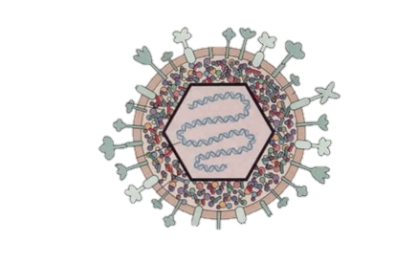
Vaxarts HSV Vaccine-gD Plus T Cell Antigen ICP0^{mut}
gD-Late Gene
Envelope glycoprotein
Good neutralizing Ab target
Used to enter host cell
Documented T cell epitopes
ICP0-Immediate Early Gene
First gene expressed as HSV reactivates
Rapid Immune response -Ag is presented early after infection
Documented CD8 T cell epitopes
gD
ICP0
ICP0
Notes:
Vaxarts HSV vaccine contains
So we went on to test the efficacy of the vaccine

Slide 22

Therapeutic Guinea Pig Model of HSV-2
HSV-2
Primary Disease
Monitor Lesion Scores/Shedding
D0
D63
D14
D21
D28
Ad5-gD-ICP0-dsRNA
R. Cardin,
D.Bernstein
Notes:
In collaboration with R. Cardin and D. Bernstein using their Therapeutic GP model of HSV-2
GPS are infected at DO disease generally peaks around 7 days

Slide 23
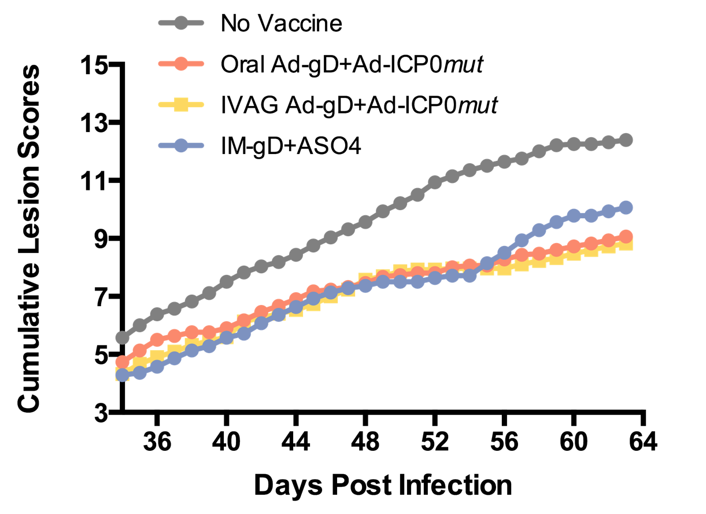
Cummulative Lesion Scores Reduced After gD+ICP0^{mut} Vaccination
35%
Decrease
Notes:
Here we are looking at the cummulative lesion scores. You can see after either oral of Ivag delivery of the vaccine we see around a 35% decrease in lesion scores. So this was a little disappointing. So we decided to go back and characterize the quality of the T cell.response

Slide 24
Mouse Genital Tract T Cell Characterization
D28
D0
D7
D14
Ad5-gD-ICP0-dsRNA
Genital Tract T Cell Isolation
Multicolor Flow Cytometry
CD4 and CD8
IFN TNF IL-2 and CD107A
Notes:
To do this we vaccinated mice 3x, a week apart and then 2 weeks after the last vaccination we

Slide 25
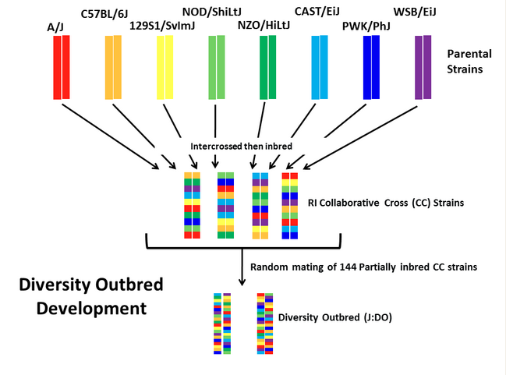
Jax Diversity Outbred Mice J:DO-To Mimic Outbred Human Population Immune Response
Notes:
Decided to use the diversity out bred mice to mimic more closely the human immune response. These mice were developed from crossing these 8 inbred strains and then inbreeding the R1 to produce a collaborative cross strains. These collaborative cross mice were then randomly mated to produce the diversity outbred mice.

Slide 26
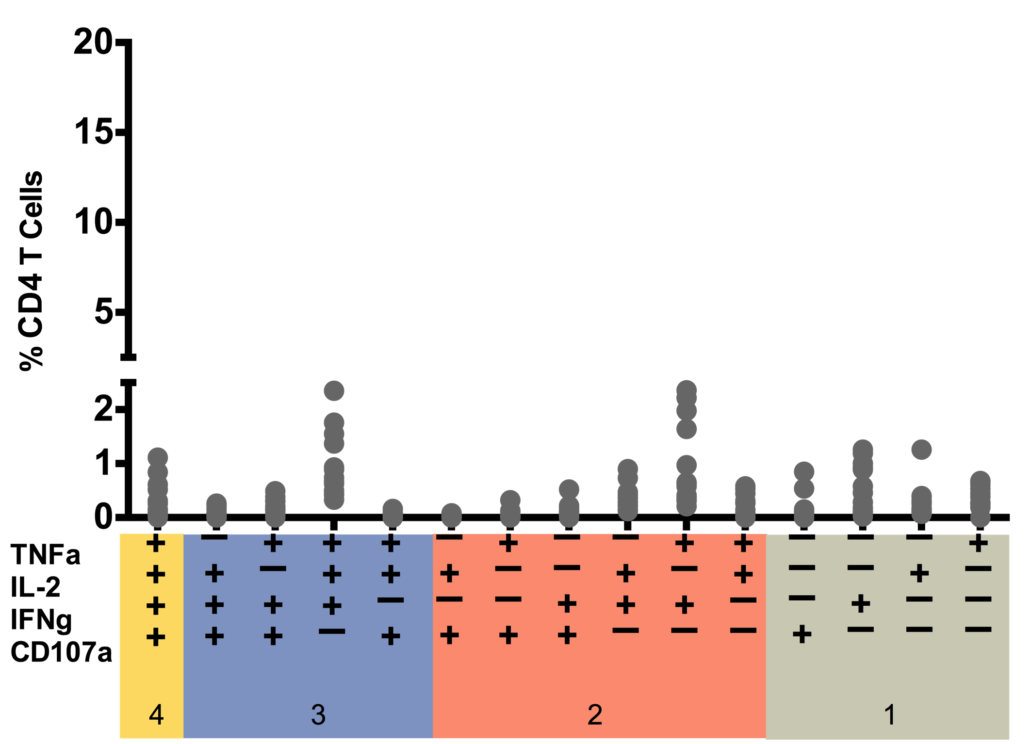
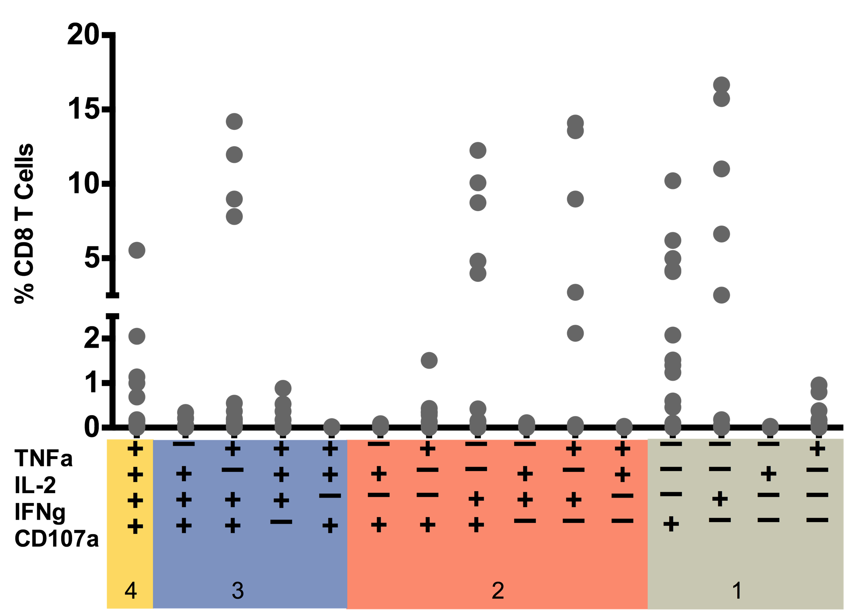
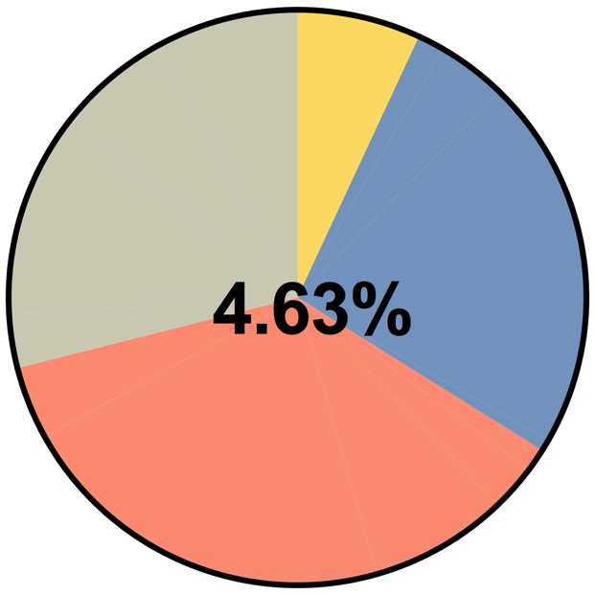
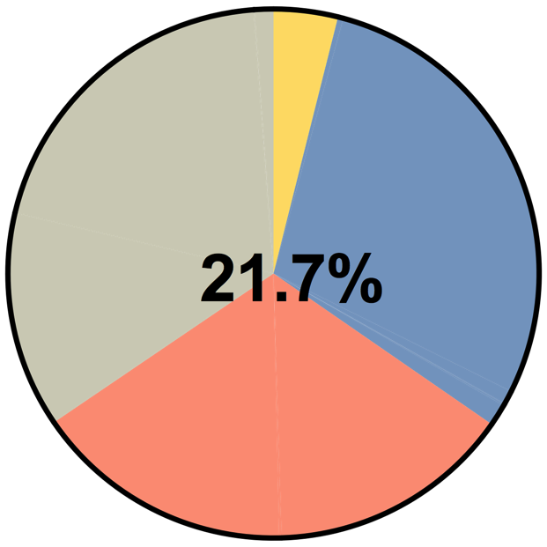
Analysis of T cell Subsets in the Genital Tract Induced After Vaccination with Ad-gD-dsRNA
CD4
CD8
Notes:
T cell subsets produced after vaccination with gD alone.
The graph is showing the % CD4/CD8 T cells that are producing the different cytokines or function.
The subsets in yellow and blue are those that are poly functional while orange are bifunctional and tan monofunction
Each circle is an individual mouse.
I think it is clear to see that more CD8 cells are producing cytokines infact on average 21.7% of CD8 T cells are producing cytokines compared to 4.6% CD4’s. And we are also seeing some nice polyfunctional responses.
The overall proportion of polyfunctionals is the same between CD4 and CD8.

Slide 27
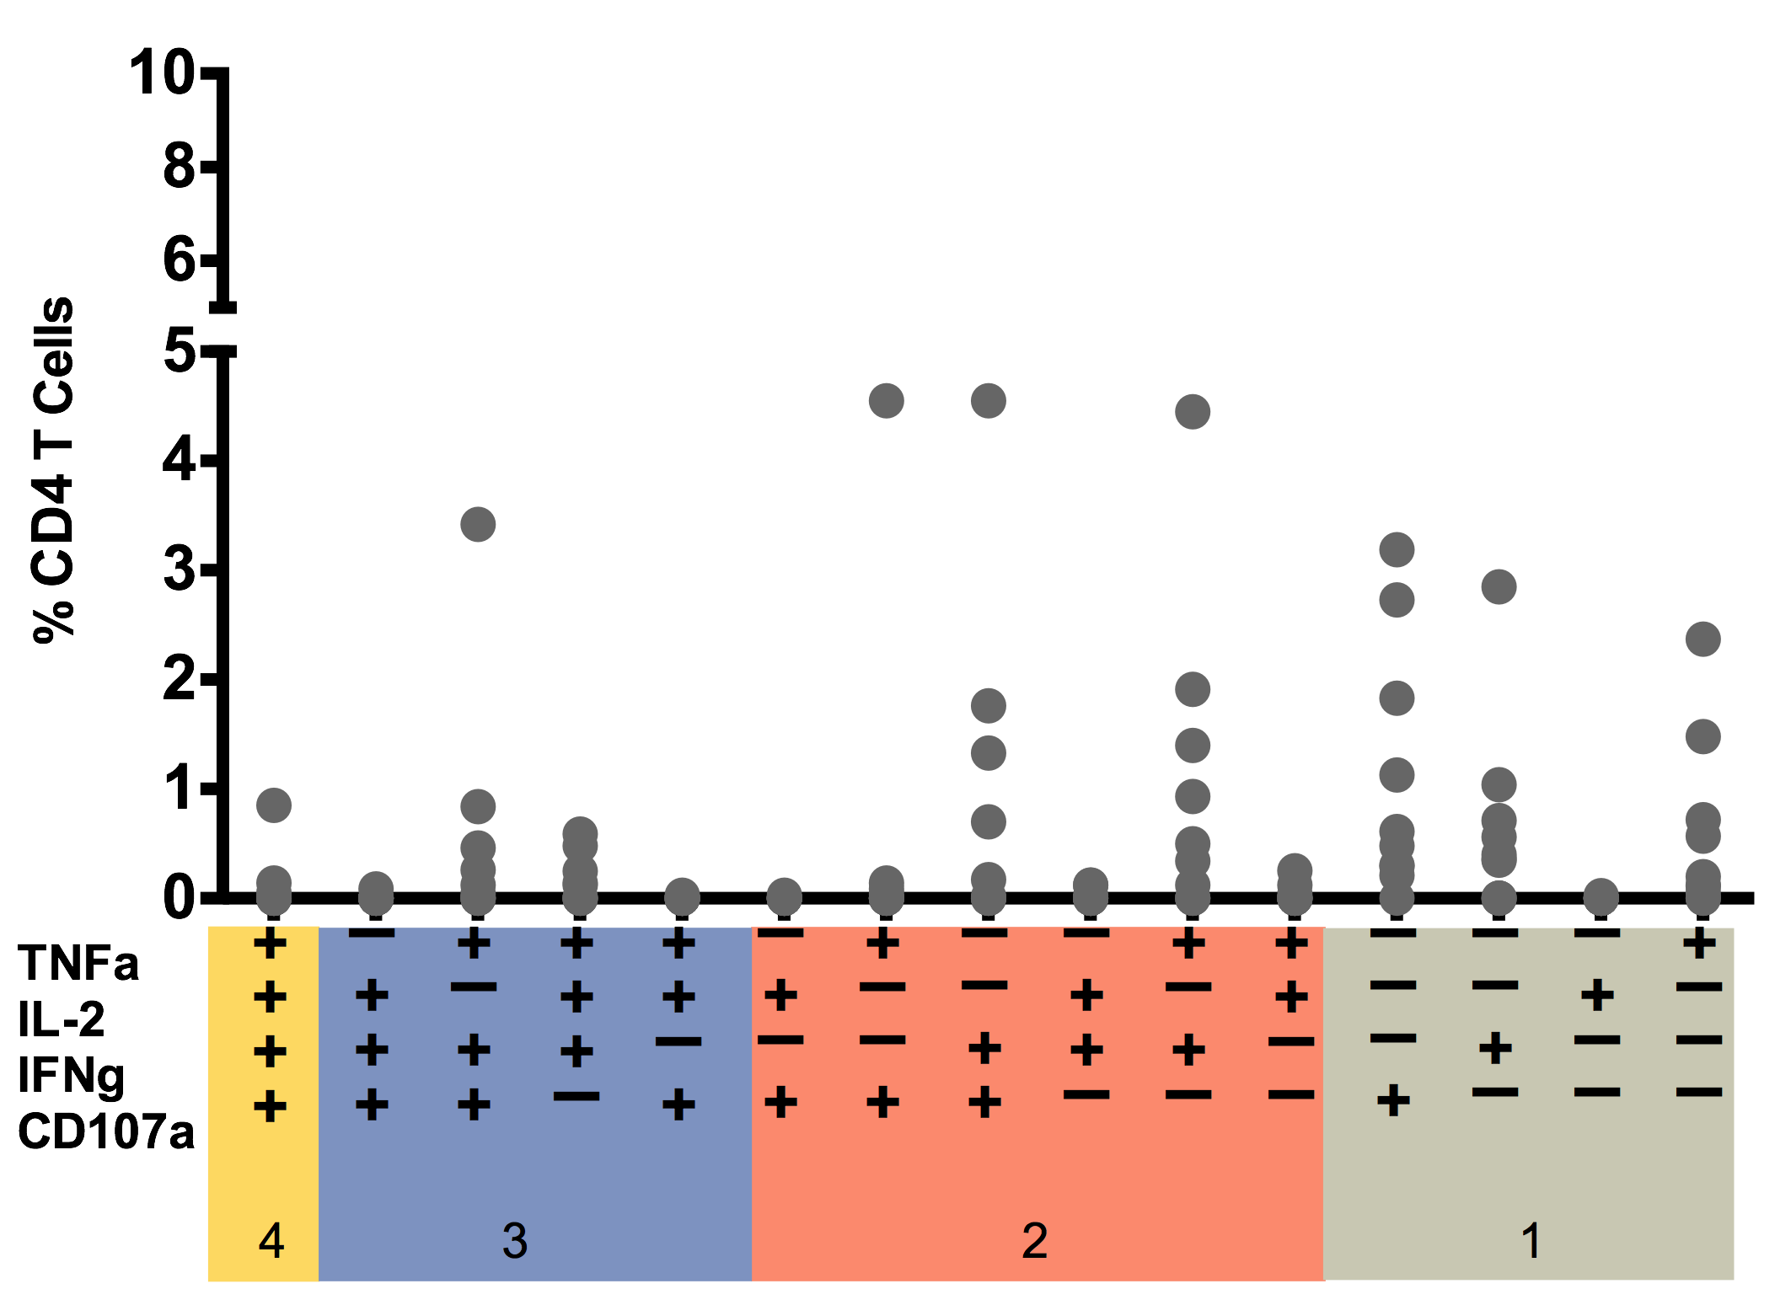
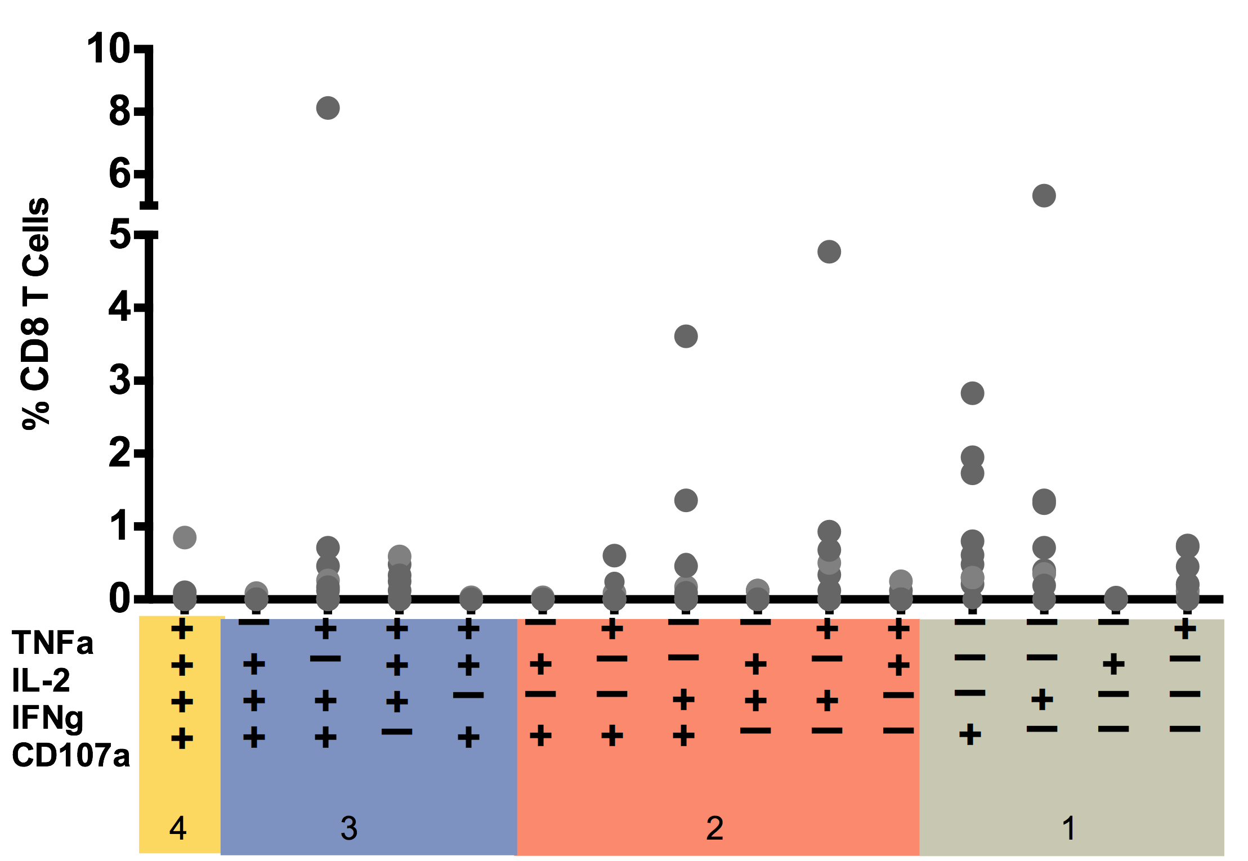
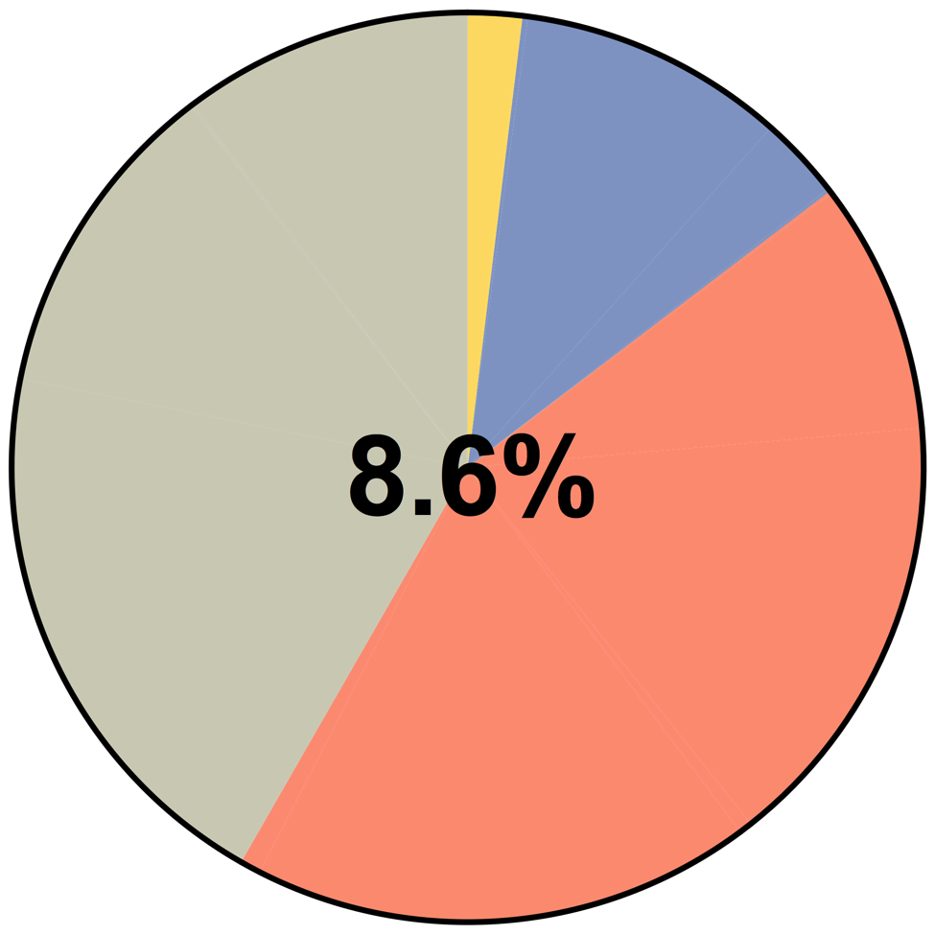
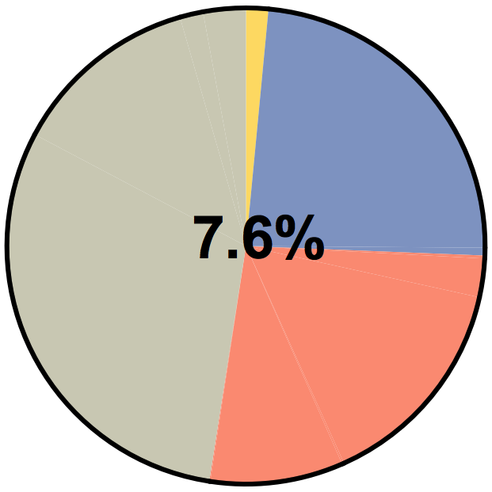
Analysis of T cell Subsets in the Genital Tract Induced After Vaccination with Ad-ICP0^{mut}-dsRNA
CD4
CD8
Notes:
When we do the same analysis after ICP0 vaccination. It appears that similar % of CD4 and CD8 are producing cytokines.And the subsets are more bi and monofunctional rather than polyfunctional. Levels of CD8 T cells producing cytokines are less than half of the those that gD induced and there seem to be more bifunctional and monofunctional cells

Slide 28
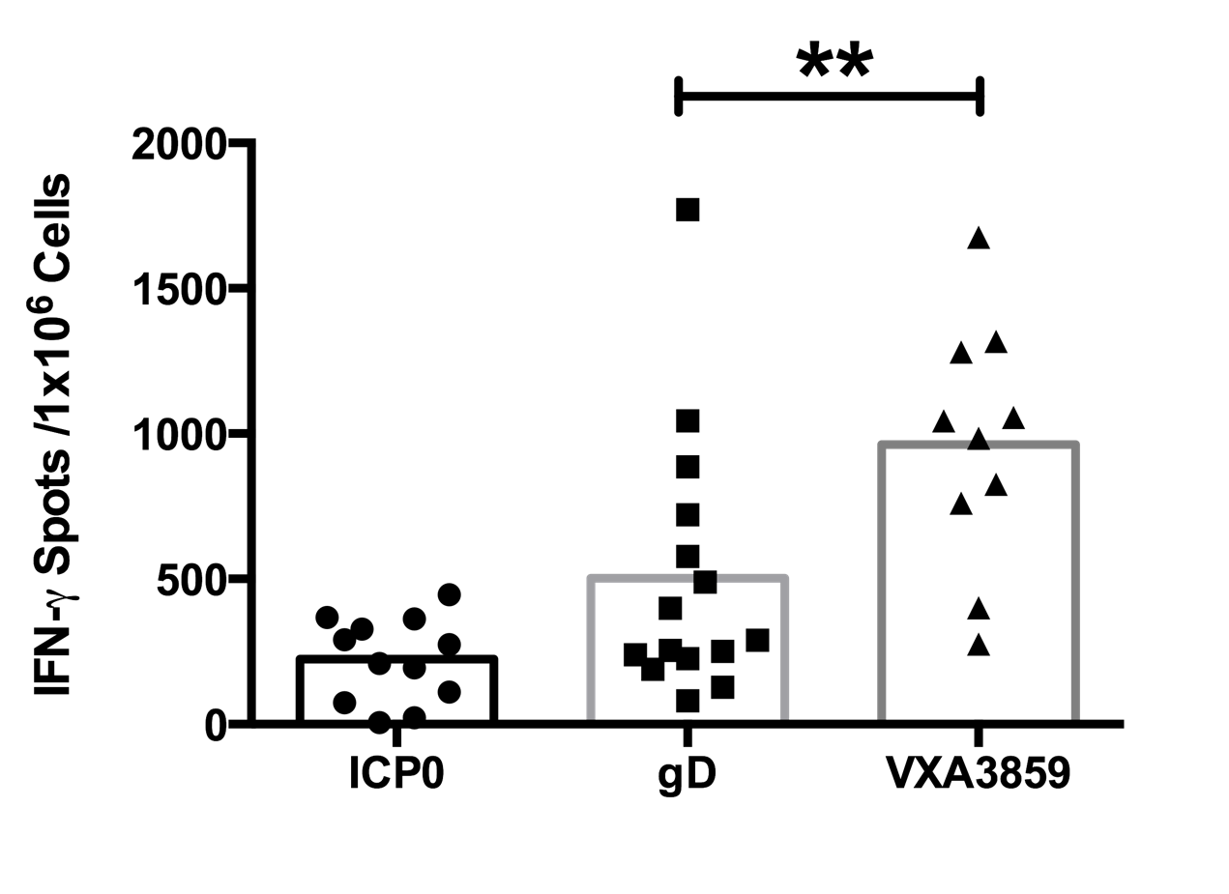
Splenocyte IFN-γ Response to HSV-2 Antigens
Notes:
When we look at the total amounts of Ifn being produced by the spenocytes of vaccinated mice it is clear that gD is superior to ICPO when it comes to eliciting IFN-g. So this may all explain the disappointing efficacy results. So we went back to our screen and found another antigen VXA3859 and at lest at the total IFN level the

Slide 29
Splenocyte IFN-γ Response to HSV-2 Antigens
Notes:
This antigen looks more superior than eith er ICP0 or gD. So encouraged by this we went on and examined the quality of the repsonse.

Slide 30
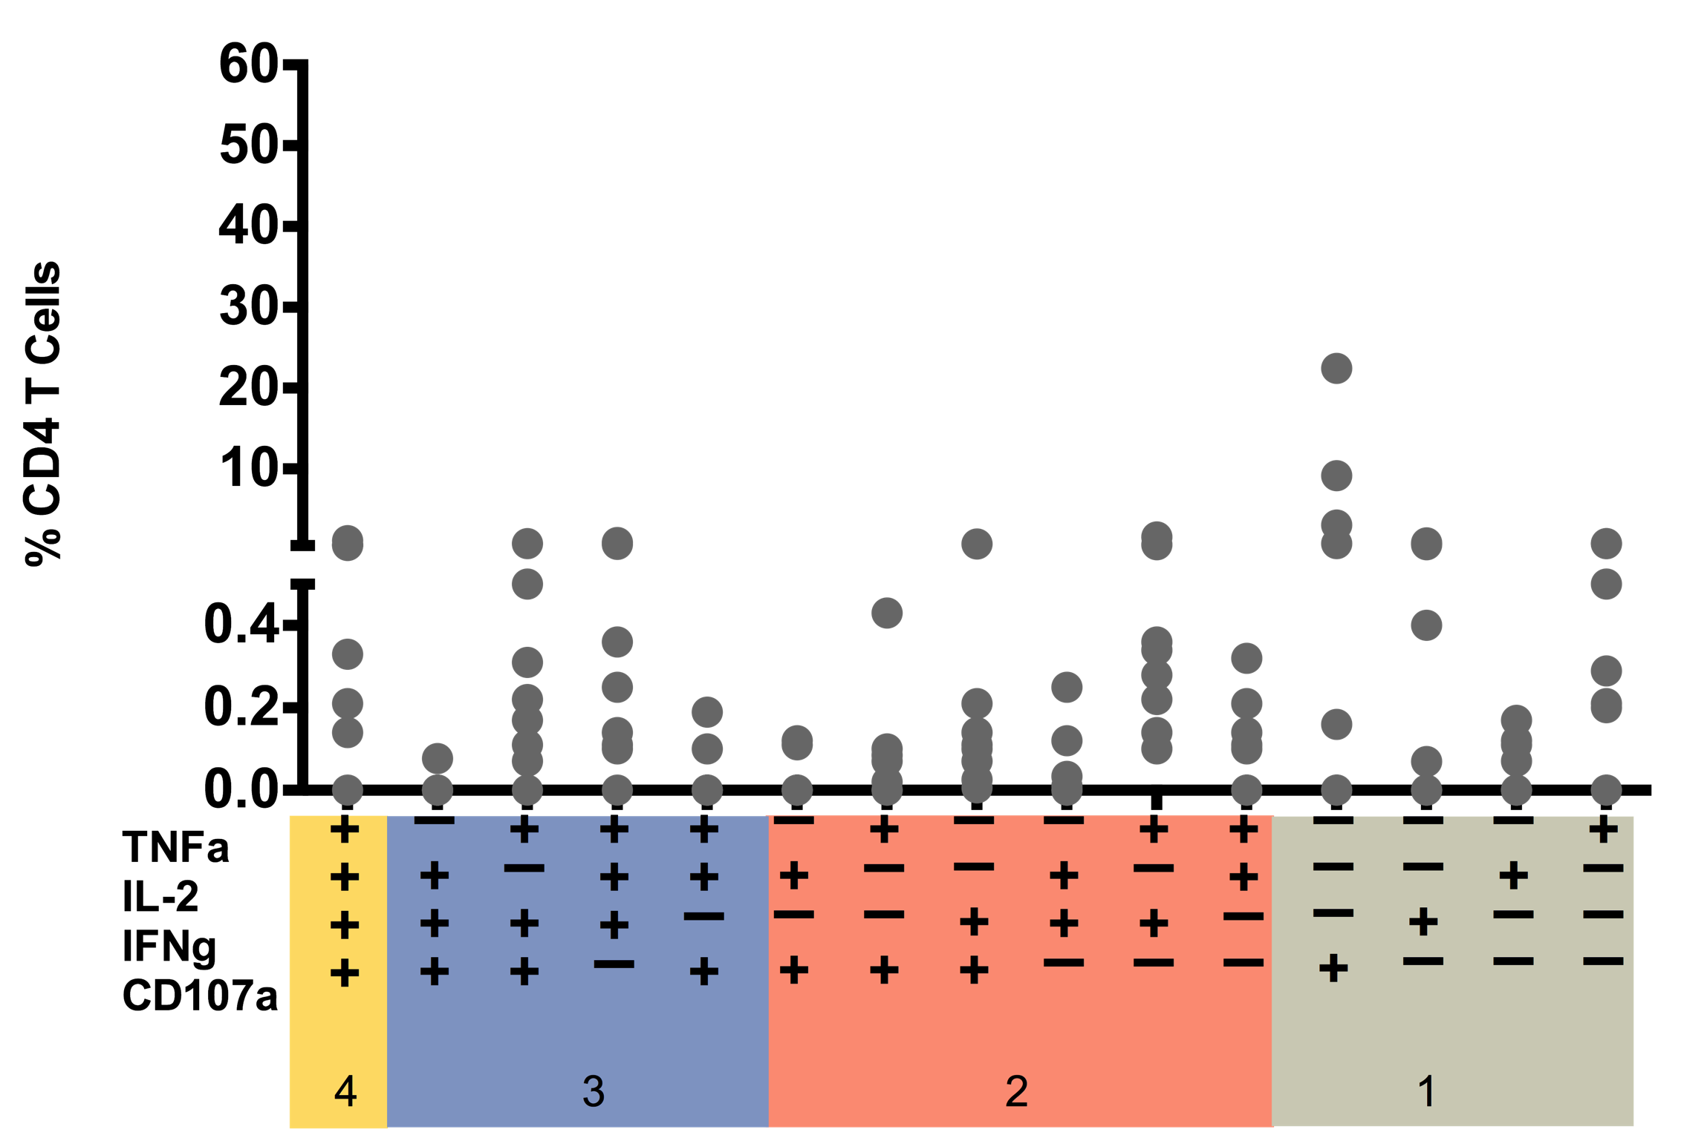
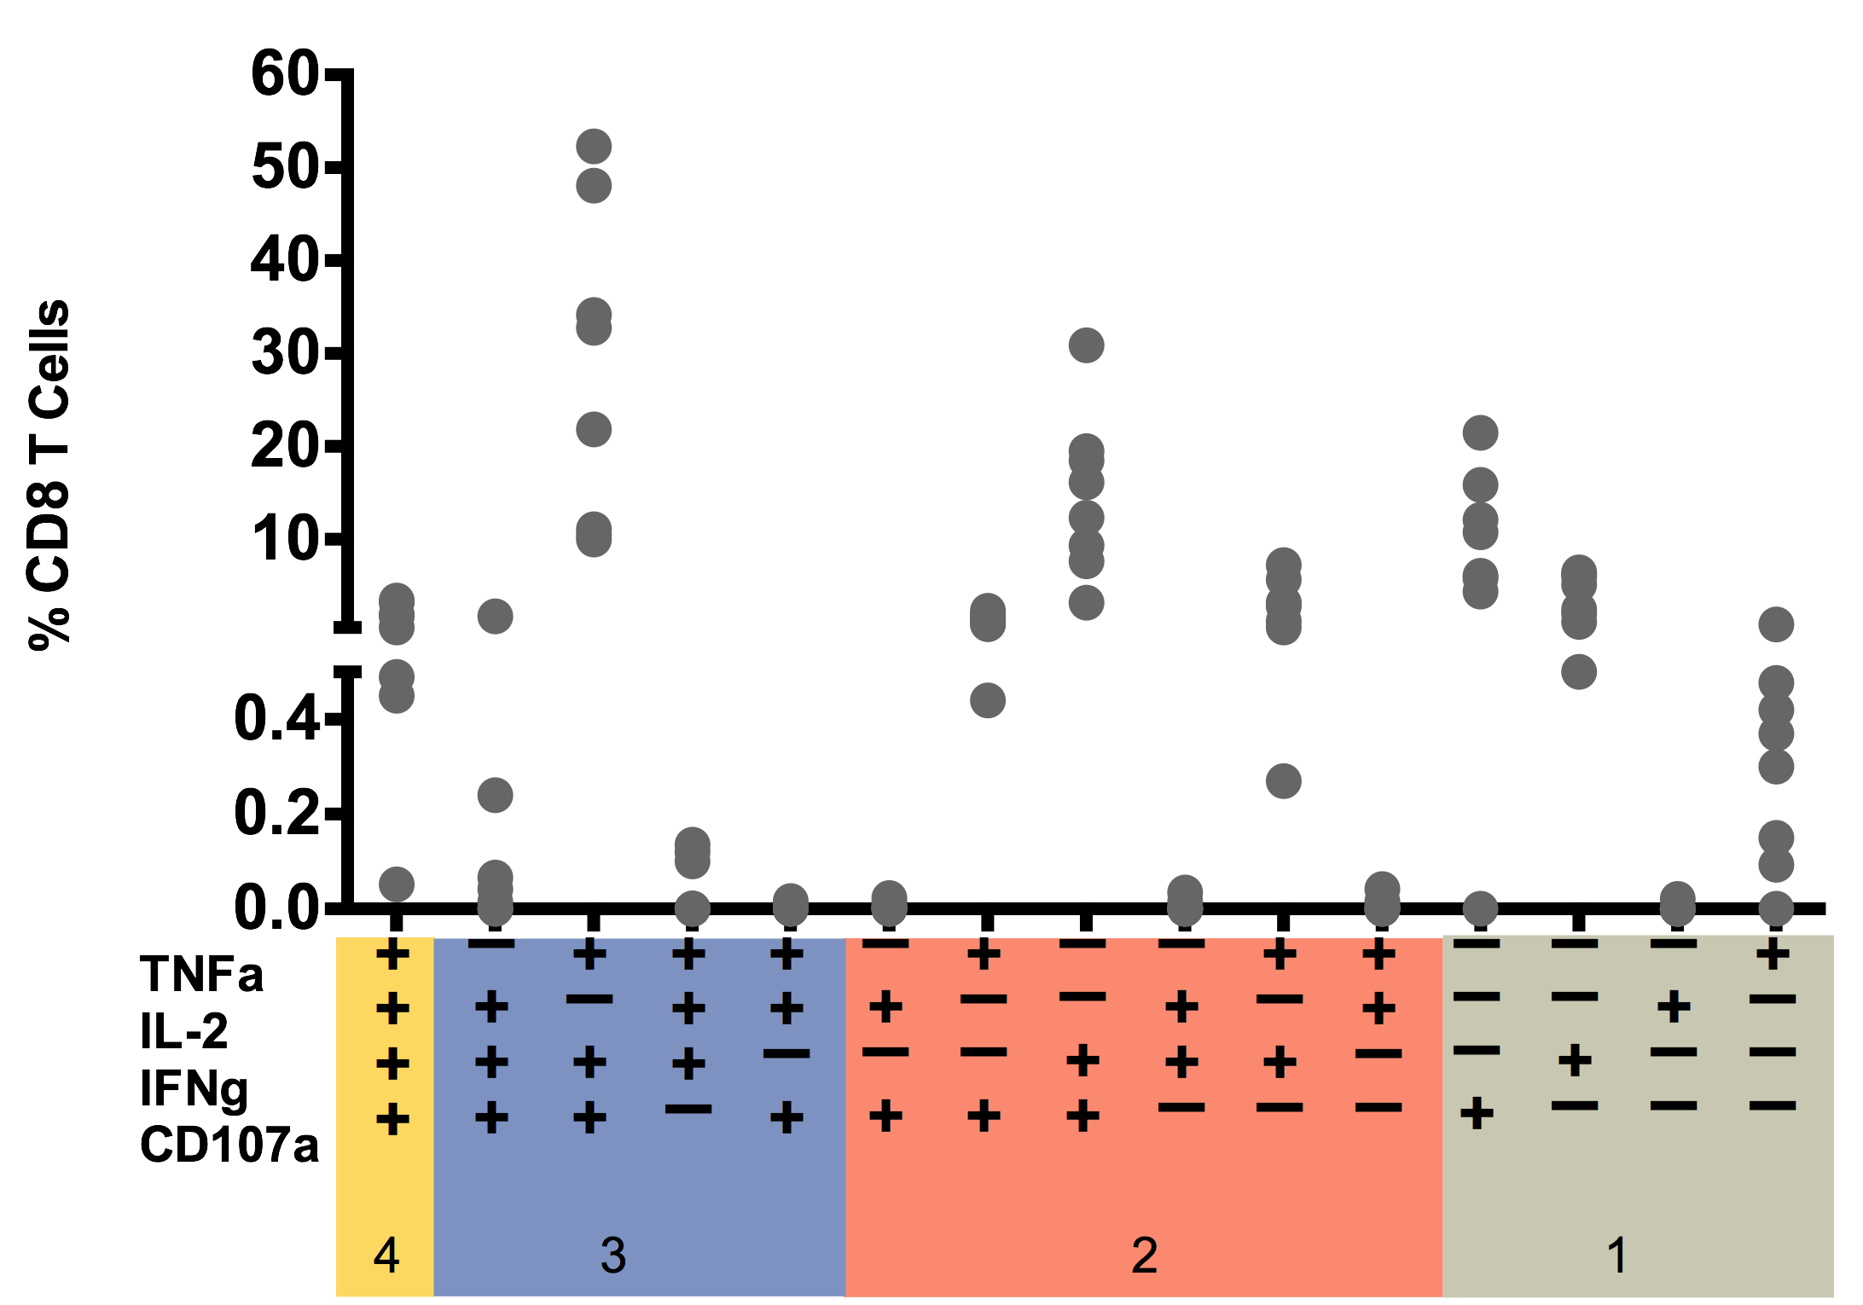
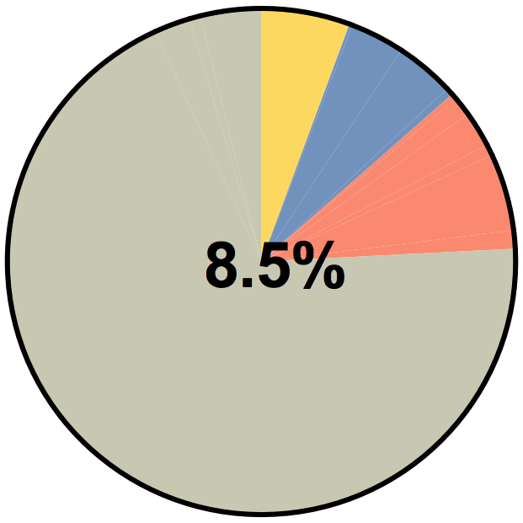
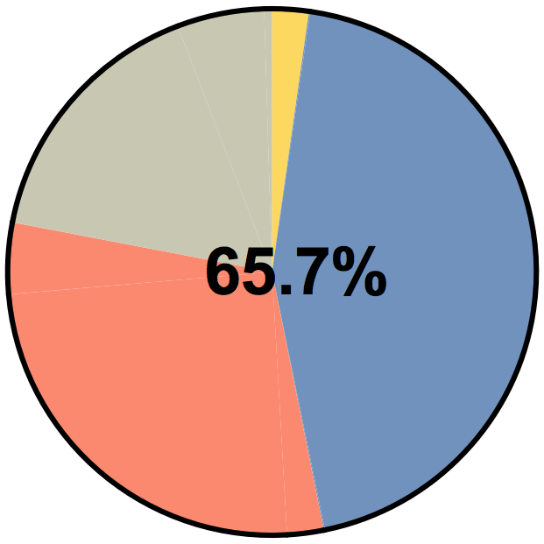
Analysis of T cell Subsets in the Genital Tract Induced After Vaccination with Ad-VXA3859-dsRNA
CD4
CD8
Notes:
We were excited to see that around 65% of the CD8 T cells were producing cytokines and and furthermore a large percentage are polyfunctional

Slide 31
Proportions of T cell Subsets Induced by HSV-2 Antigens
CD4
CD8
gD
ICP0
VXA3859
Notes:
So to summarise gD induces cytokine production by 21% of CD8 cells and

Slide 32
Proportions of T cell Subsets Induced by HSV-2 Antigens After Vaccination
CD4
CD8
gD
33%
ICP0
VXA3859
Notes:
33% of those are polyfunctional
In contrast vaccination with ICP0 leads to 7% of its CD8’s producing cytokines and of those

Slide 33
Proportions of T cell Subsets Induced by HSV-2 Antigens After Vaccination
CD4
CD8
gD
33%
ICP0
26%
VXA3859
Notes:
Only 26% are polyfunctional
However vaccination with 3859 results in 65% of its CD8’ s producing cytokines and around 50% of those are polyfunctional.

Slide 34
Proportions of T cell Subsets Induced by HSV-2 Antigens After Vaccination
CD4
CD8
gD
33%
ICP0
26%
VXA3859
47%
Notes:
So an efficacy study vaxinating with gD and 3859 is onging.

Slide 35
Summary
Clinical Trials-Tablet Influenza Vaccine
Neutralizing antibody responses induced comparable to seasonal IM vaccines
Mucosal IgA responses elicited
Mucosal homing, IFN-γ producing, CD8 T cells induced
Preclinical HSV-2 Therapeutic Vaccine
Identified a potential T cell antigen with immunodominant epitope/s
Elicits a high % of polyfunctional CD8 cytotoxic T cells
Efficacy study vaccinating with gD plus VXA3859 is on going

Slide 36

Acknowledgements
Sean Tucker
Katie Hodgson
Josefina Martinez
Leesun Kim
Jennifer Brandl
Ciaran Scallan
Jon Lindbloom
Emery Dora
David Bernstein
Rhonda Cardin

Slide 37
Appendix

Slide 38
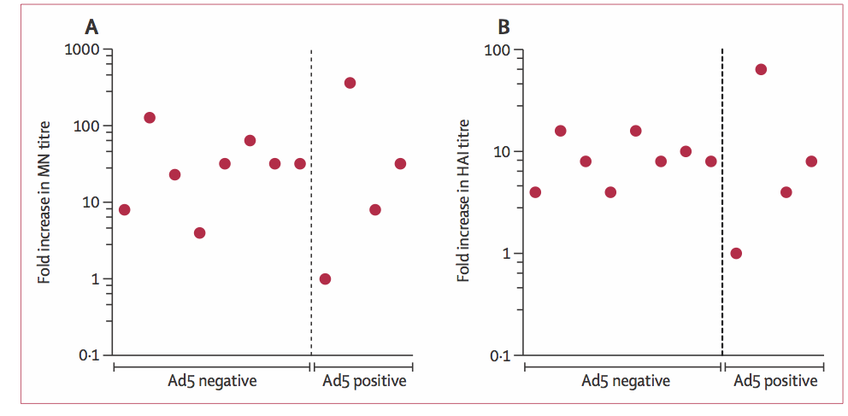
Neutralizing Titers to Transgene Not Affected by Pre-Existing Immunity to Ad5
Microneutralization Titer
HAI Titer

Slide 39
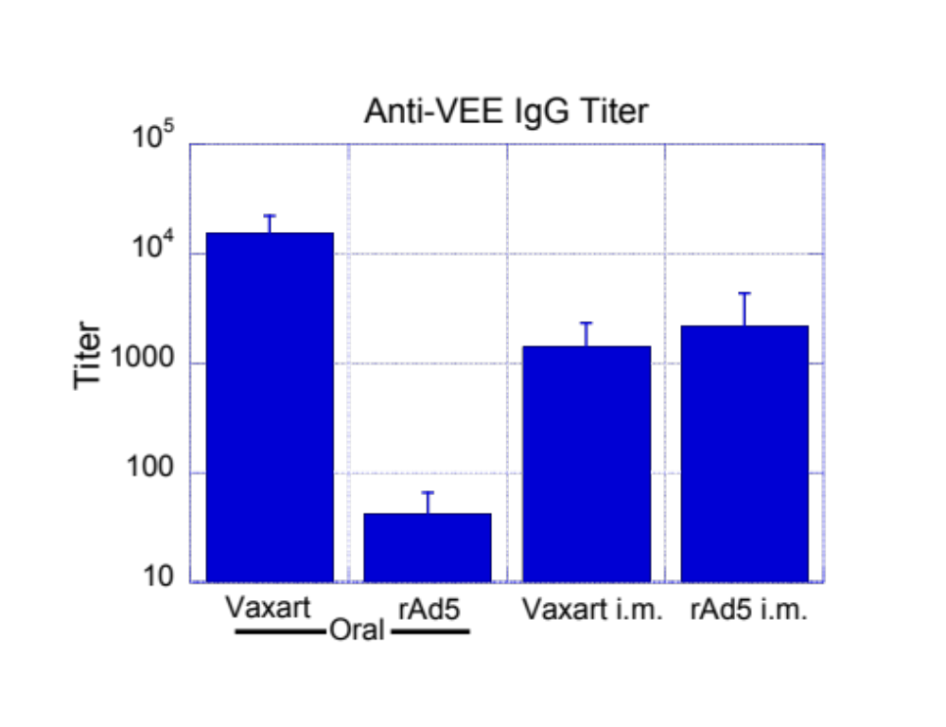
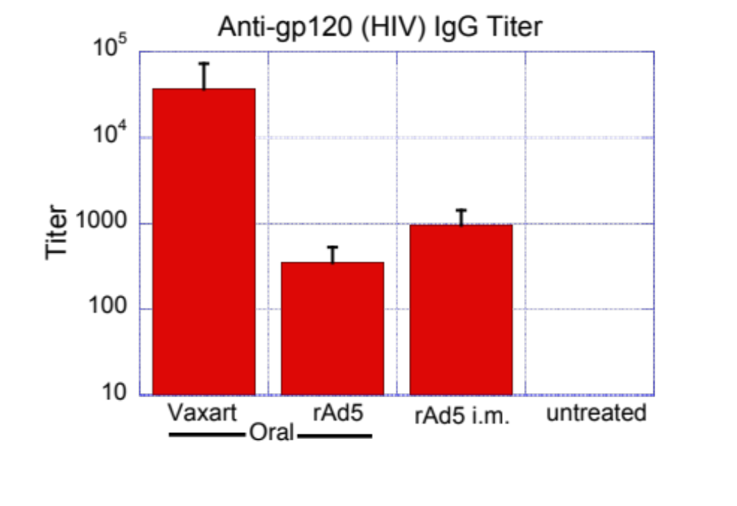
TLR3 Adjuvant Improves Immune Response with Oral Delivery
“Vaxart” = recombinant Ad5 with dsRNA
“rAd5” = recombinant Ad5, no adjuvant
Balb/c mice, 6 animals per group

