Slide 1


Facilitating EP4 export and synthesis is a novel mechanism underlying PGE2-induced nociceptor sensitization
Weiya Ma, PhD
Douglas Mental Health University Institute
and Dept. of Psychiatry
McGill University
Montreal, Quebec, Canada

Slide 2
Acute and chronic pain
Pain
Physiological pain
(Warning and protective)
Pathological pain
(A disease)
Inflammatory pain
(Injury or inflammation
in tissues)
Neuropathic pain
(Injury or diseases
of nervous systems)
Acute pain
(<1 month)
Chronic pain
(Months, years or
a lifetime)

Slide 3
Facts of chronic pain
Chronic pain affects >20% of the world population and incurs the worst quality of life.
Its total cost to Canadian society is $37 billion per year, more than cancer, heart disease and HIV combined.
Persistent inflammatory pain and neuropathic pain are common chronic pain conditions.
Treatment of chronic pain is frequently unsatisfactory due to unclear key mechanisms.

Slide 4
Possible mechanisms of chronic pain
Injured tissue
Maladaptive Neuron plasticity
DRG
Dorsal Horn
Brain
Inflammatory
mediators
Neurons
Glial cells
Peripheral
sensitization
Central
sensitization
Cytokines
chemokines
neurotrophins
Peptides
lipid mediators
etc.
Hyperalgesia
allodynia

Slide 5

Role of PGE2-induced plasticity in
nociceptor sensitization and chronic pain
PGE2-induced plasticity occurs at functional, transcriptional and translational levels.
Enhanced
pain signal
Enhanced
pain signal
Glu, SP,
CGRP,BDNF
C and Aδ axons
Sensitized Dorsal
Horn Neurons
PGE2
Injured tissue

Slide 6
Four PGE2 EP receptors are expressed in DRG neurons
PGE2
EP1
EP2
EP3
EP4
Gq
Gs
Gi
Gs
PLC
AC
AC
AC
PI3K
DAG
IP3
cAMP
cAMP
cAMP
AKT
PKC
Ca++
PKA
Epac

Slide 7
Acute and chronic nociceptor sensitizing effects of PGE2
Increases Na⁺, Ca⁺⁺ currents
and TRPV1 currents
Acute
effects
Increases the release of
glutamate, SP and CGRP
Potentiates the sensitizing effects of other pain mediators
PGE2
(well documented)
Up-regulates EP4 receptor
Injured tissue
Chronic
effects
Up-regulates TRPV1, Nav1.8, SP, CGRP, NGF, BDNF, IL-6, etc.
(Villarreal et al., 2009; Ma, 2010; Ma et al, 2010; St-Jacques and Ma, 2011)
DRG neurons

Slide 8

EP4 is up-regulated in DRG neurons
during inflammatory and neuropathic pain
and EP4 antagonists relieve these pain conditions
Naive
?
Inflammation
(Lin et al., 2006)
Nerve injury
(Ma et al., 2010;
St-Jacques and Ma, 2011)

Slide 9
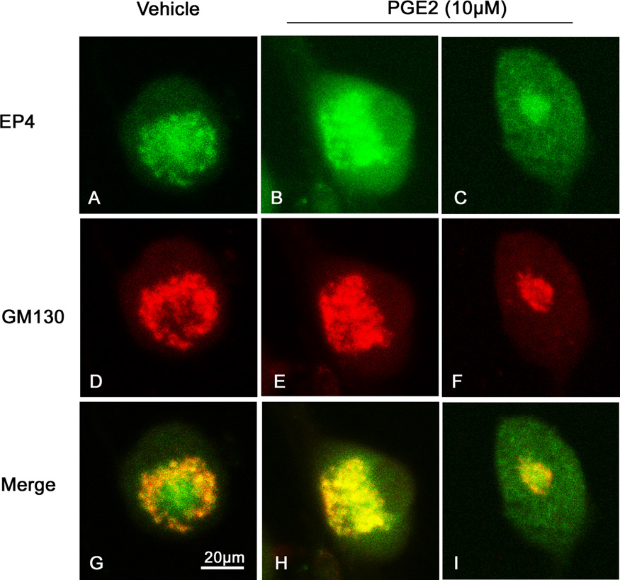
EP4 was localized in Golgi apparatus of naive DRG neurons
And PGE2 increased EP4 distribution into peripheral region
St-Jacques and Ma, Pain, 2013

Slide 10
Questions of Part I
1. Whether PGE2 stimulates EP4 externalization in a positive forward manner?
2. Whether this event contributes to PGE2-induced nociceptor sensitization?

Slide 11
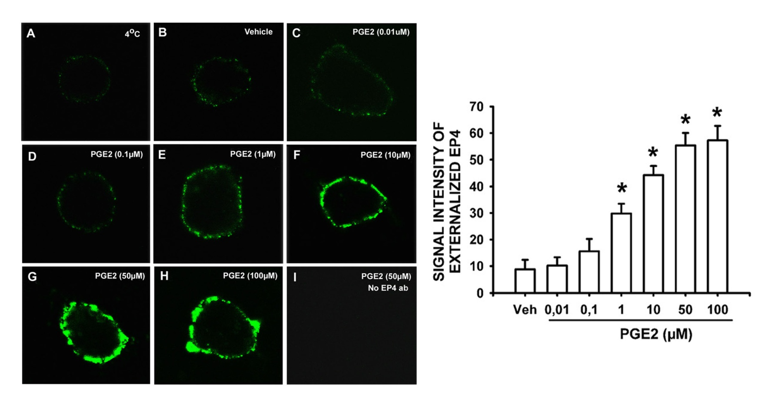
PGE2 concentration-dependently increased EP4
cell surface density in cultured DRG neurons
St-Jacques and Ma, Pain, 2013

Slide 12
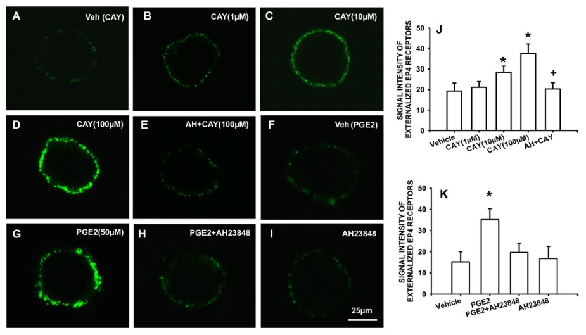
EP4 agonist CAY10580 also increased EP4 surface density while EP4 antagonist suppressed PGE2-induced effect
St-Jacques and Ma, Pain, 2013

Slide 13
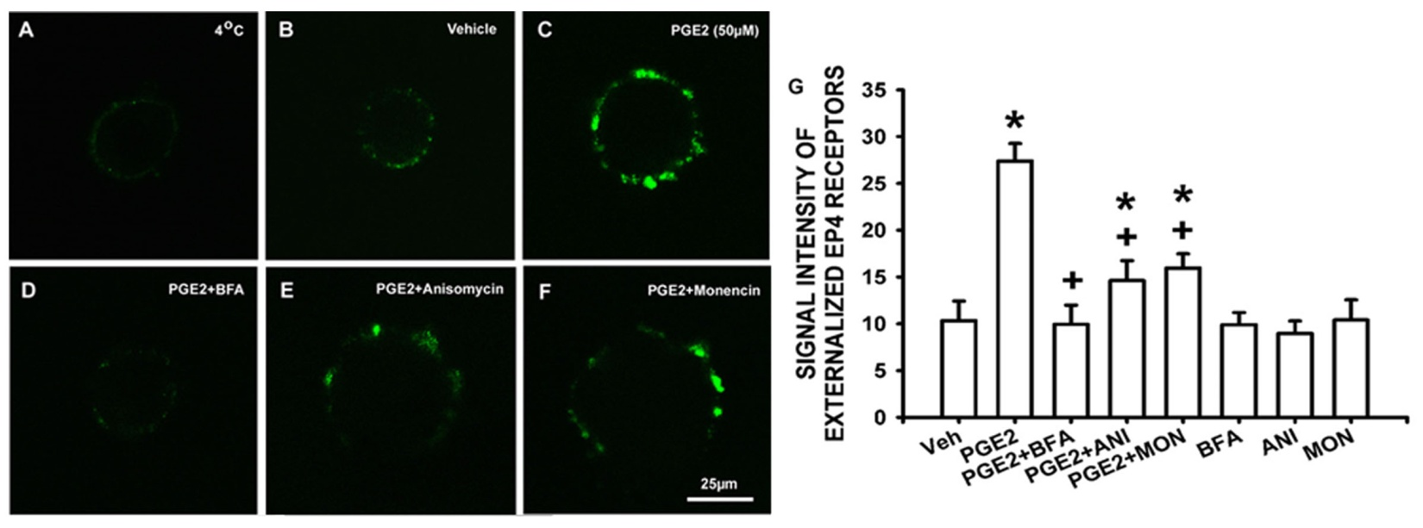
Inhibitors of anterograde transport and protein synthesis suppressed PGE2-induced EP4 cell surface trafficking
St-Jacques and Ma, Pain, 2013

Slide 14
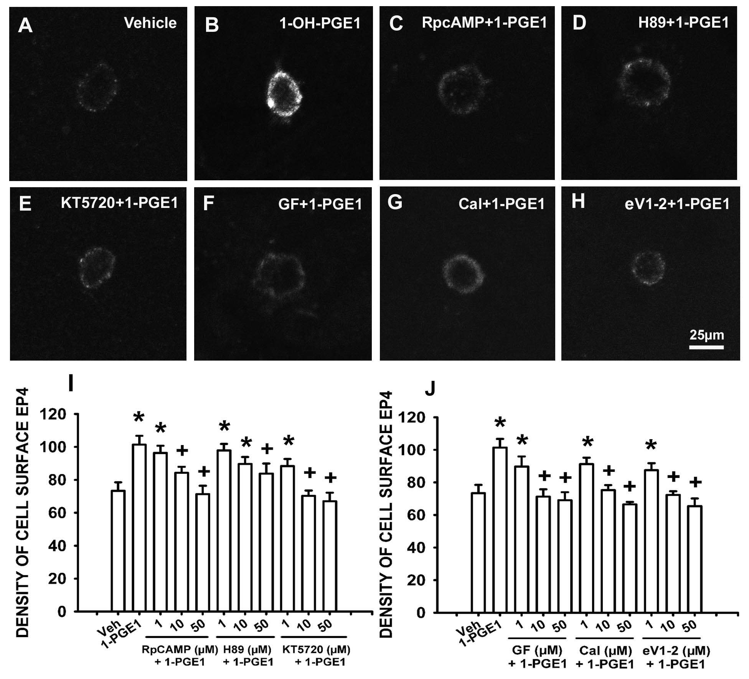
Inhibitors of cAMP, PKA, PKC and PKCε attenuated
EP4 agonist-induced EP4 externalization
St-Jacques and Ma, 2015, in preparation

Slide 15
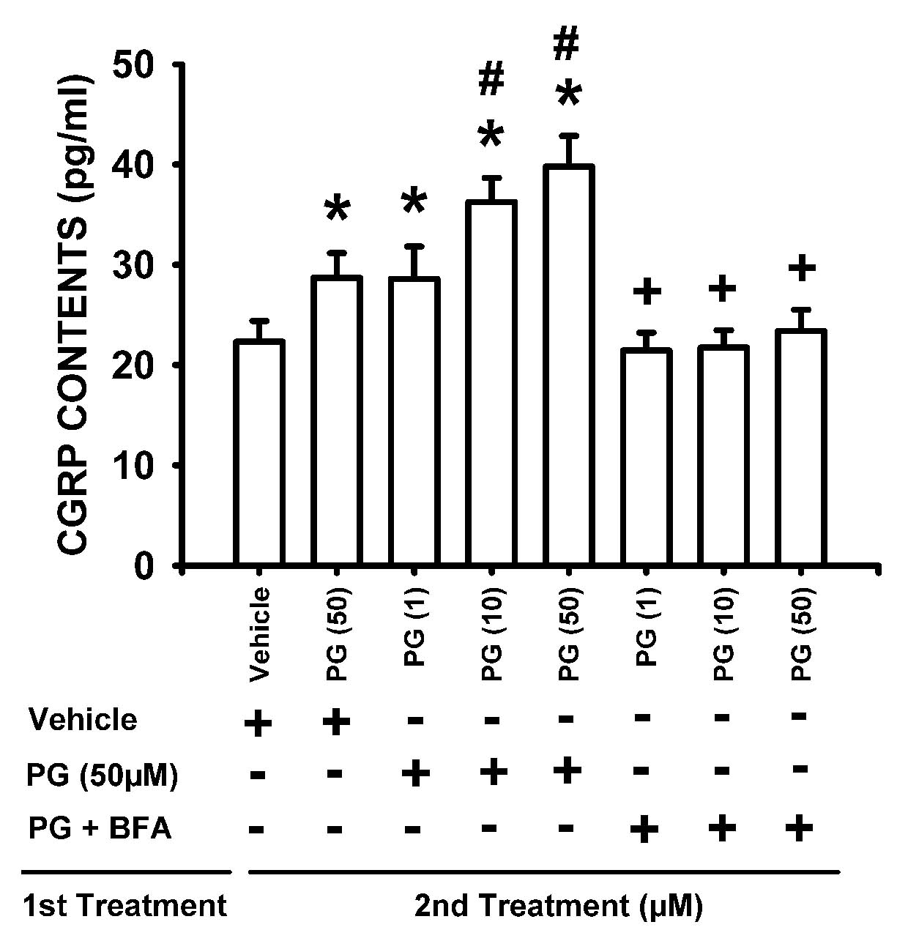
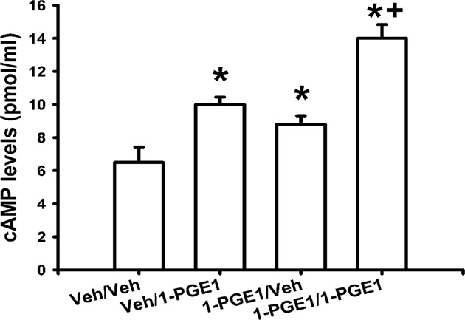
Double exposures to EP4 agonist induce a greater increase in intracellular cAMP levels and CGRP release than a single exposure, events blocked by anterograde transport inhibitor
Intracellular cAMP levels
CGRP release
St-Jacques and Ma, Pain, 2013
St-Jacques and Ma, 2015, in preparation

Slide 16
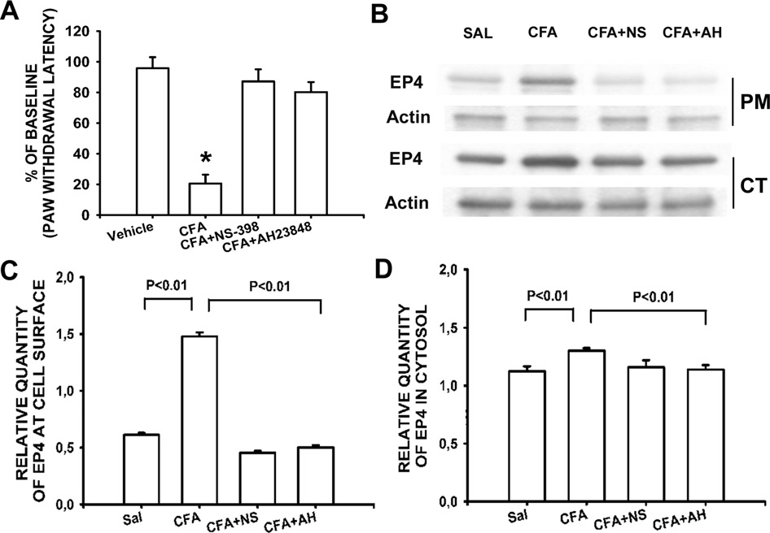
Intraplantar injection of CFA increased EP4 levels
at cell surface and in cytoplasm of DRG neurons, events blocked by COX2 inhibitor or EP4 antagonist
St-Jacques and Ma, Pain, 2013

Slide 17
Summary of Part I
PGE2/EP4 signaling facilitates EP4 cell surface trafficking in cultured DRG neurons.
cAMP/PKA and PKC/PKCε signaling pathways contribute to PGE2-induced EP4 externalization.
PGE2-induced EP4 export is coupled to enhanced EP4 sensitivity, thus sensitizing nociceptors.
PGE2/EP4 signaling in inflamed tissue increases EP4 cell surface trafficking in DRG neurons.
Taken together, facilitating EP4 cell surface trafficking is a novel mechanism underlying PGE2-induced nociceptor sensitization.

Slide 18
Questions of Part II
1. Whether PGE2 stimulates EP4 synthesis and axonal trafficking in DRG neurons in a positive-forward manner?
2. Whether this event contributes to transition from acute to chronic pain?

Slide 19


Hyperalgesic priming or prolonged sensitization pain, a pre-clinical model for transition from acute to chronic pain
Single i.pl. PGE2
Pain
<4h
Week 1
Week 2
i.pl. carr, IL-6 or stressors
Primary Pain
i.pl. PGE2
Pain
>24h
Reichling and Levine, TINS, 2009

Slide 20
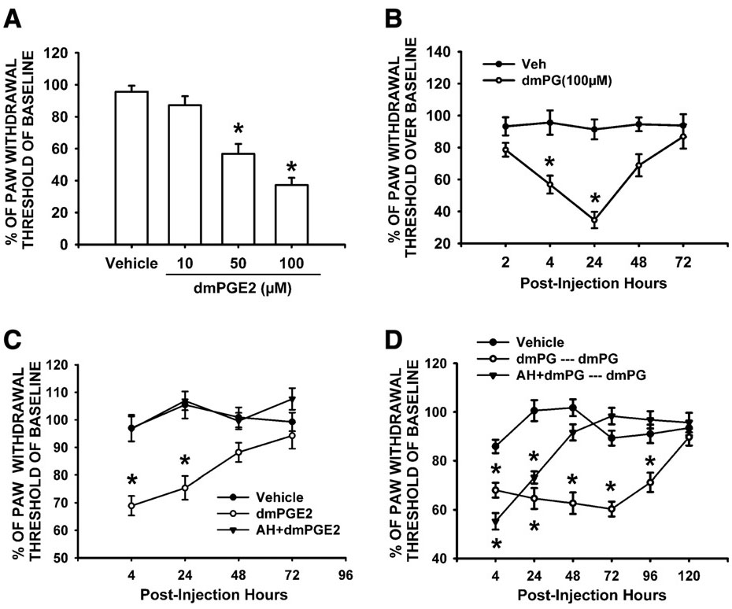
Pre-exposure to a stabilized PGE2 analog dmPGE2 induced the prolongation of pain evoked by subsequent dmPGE2 challenge, an event prevented by EP4 antagonist
1d
4d
St-Jacques and Ma, Exp.Neurol., 2014

Slide 21
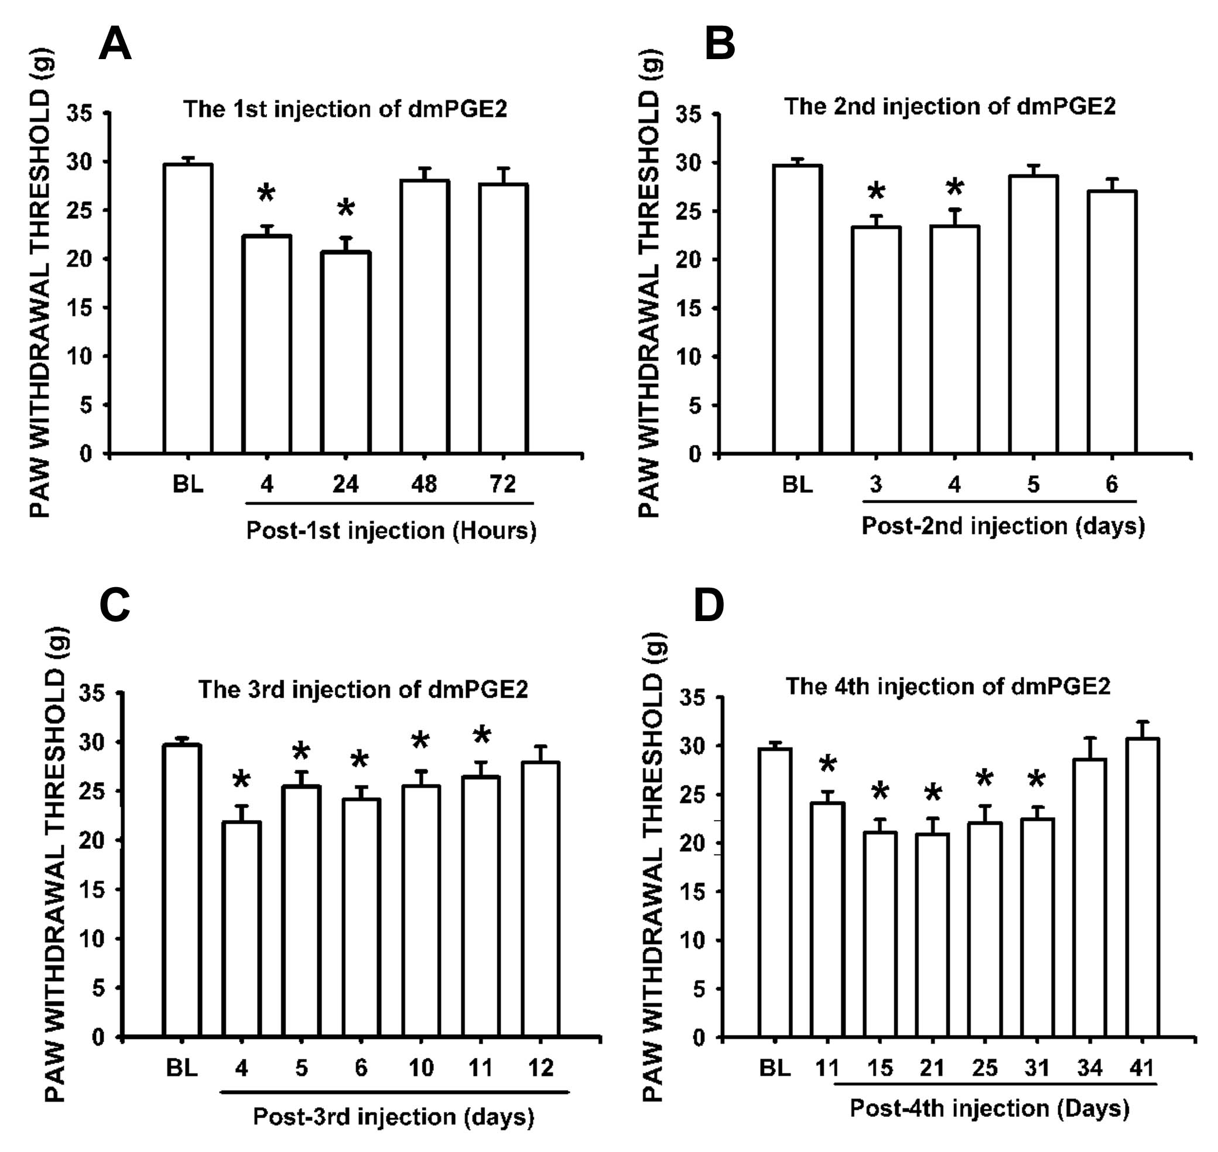
Multiple sequential i.pl. injection of dmPGE2
Progressively prolonged tactile allodynia
1d
4d
11d
31d
St-Jacques and Ma, Exp.Neurol., 2014

Slide 22
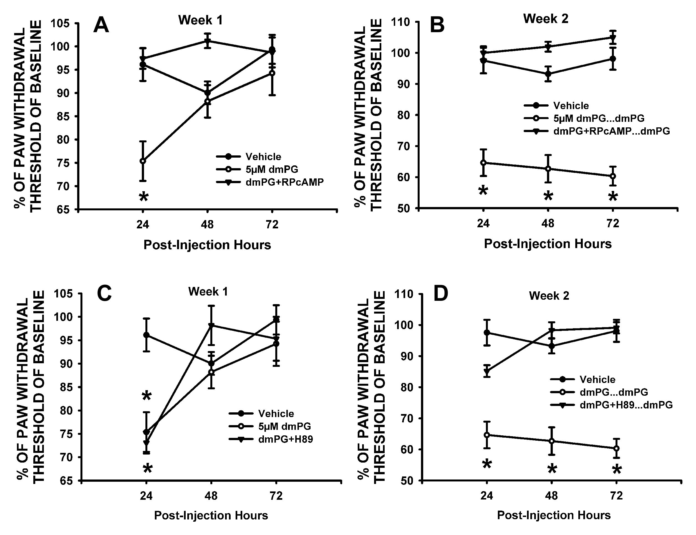
Pre-injection of the inhibitors of cAMP and PKA with the 1st dmPGE2 blocked the prolongation of allodynia evoked by the 2nd dmPGE2
St-Jacques and Ma, Exp.Neurol., 2014

Slide 23
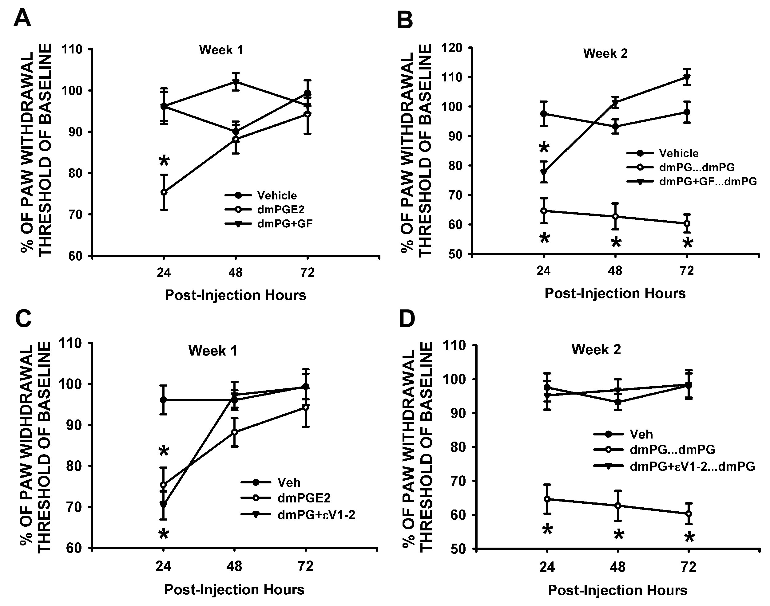
Pre-injection of the inhibitors of PKC and PKCε with the 1st dmPGE2 blocked the prolongation of allodynia evoked by the 2nd dmPGE2
St-Jacques and Ma, Exp.Neurol., 2014

Slide 24
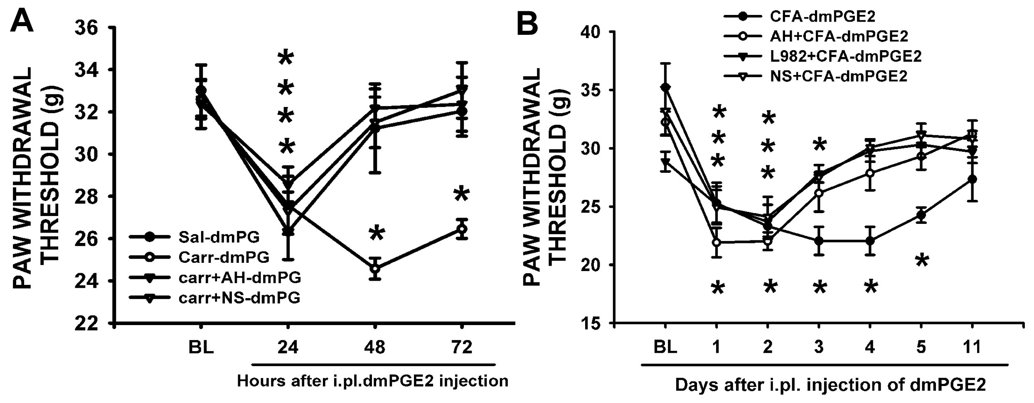
Pre-injection of COX2 inhibitor or EP4 antagonist with carr or CFA blocked or shortened prolongation of tactile allodynia evoked
by subsequent dmPGE2 challenge
St-Jacques and Ma, Exp.Neurol., 2014

Slide 25
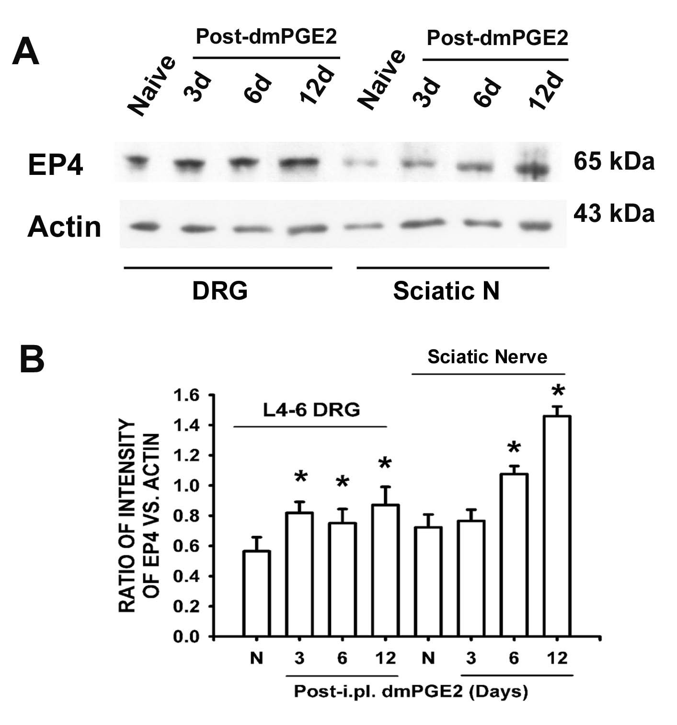
A single i.pl. dmPGE2 injection induced a delayed and prolonged EP4 up-regulation in DRG and sciatic nerve
St-Jacques and Ma, Exp.Neurol., 2014

Slide 26
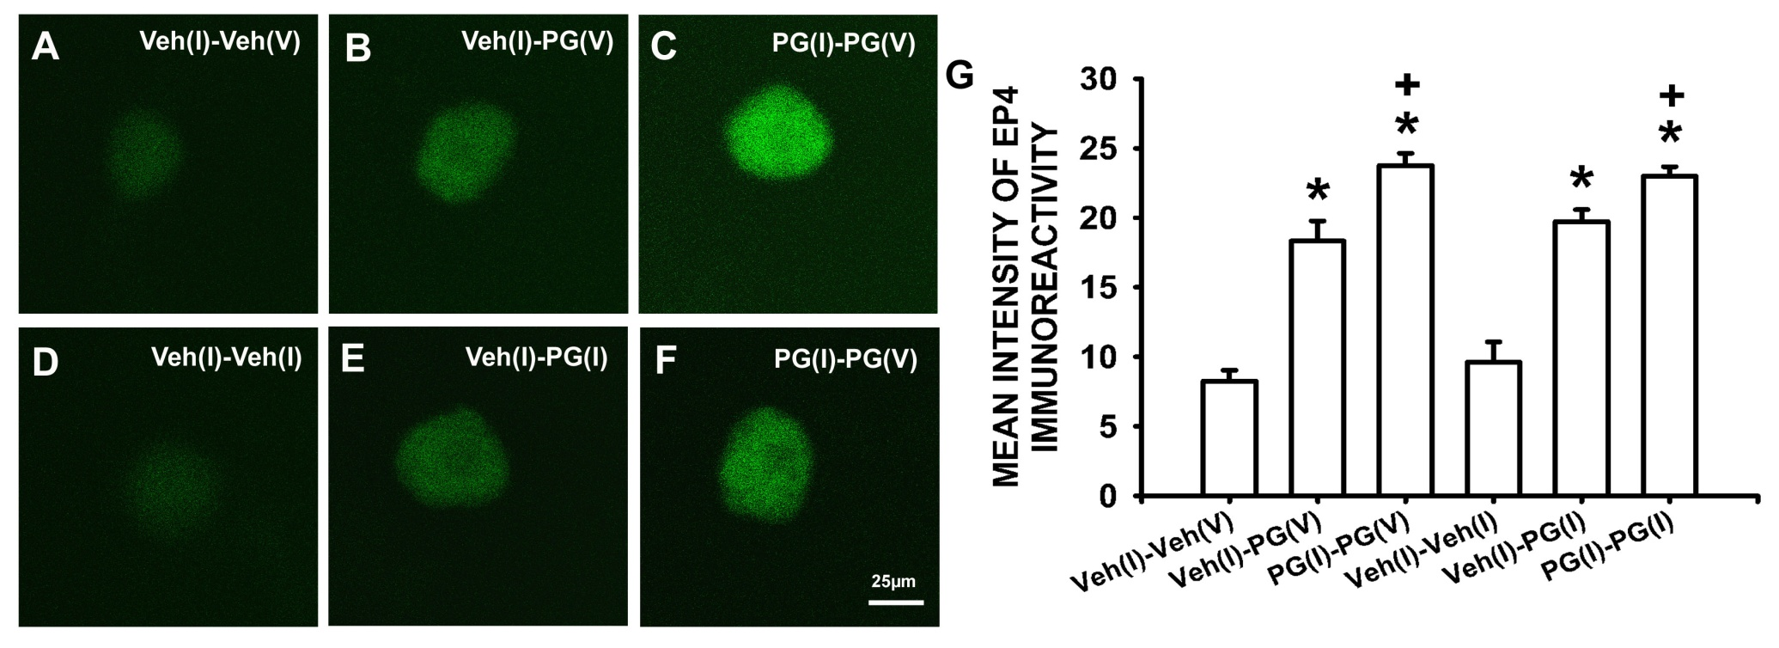
Double sequential exposures to dmPGE2 induced a greater
increase of EP4 levels in DRG neurons than a single exposure
St-Jacques and Ma, Exp.Neurol., 2014

Slide 27
Summary of Part II
Repeated sequential exposures of PGE2 progressively prolonged sensitization pain.
Activation of EP4, cAMP/PKA and PKC/PKCε signaling pathways is involved in this event.
PGE2/EP4 signaling in inflamed tissue sensitizes nociceptors to subsequent challenge of pain mediators.
EP4 up-regulation in DRG neurons is possibly a key event in prolonged sensitization pain and transition from acute to chronic pain.

Slide 28
Conclusions
PGE2/EP4 signaling in inflamed tissue stimulates the synthesis and cell surface trafficking of EP4 in DRG neurons in a positive-forward manner.
PGE2/EP4 signaling-induced EP4 synthesis and cell surface trafficking is coupled to enhanced EP4 activity and nociceptor sensitization.
Facilitating EP4 synthesis and cell surface trafficking is a novel mechanism underlying PGE2-prolonged nociceptor sensitization and transition from acute to chronic pain.

Slide 29
Future direction
Does prolonged sensitization pain occur in mice with EP4 conditional deletion in DRG neurons?
Can EP4 receptor antagonists reverse the established prolonged sensitization pain?
Is stress hormone cortisol able to stimulate EP4 up-regulation in DRG neurons?
Is PGE2-induced EP4 synthesis under epigenetic modulation?

Slide 30




Acknowledgements
Bruno St-Jacques, Research assistant
Pedro Cruz Duarte, MSc student
Manish Shukla, PhD student
Ya Na Kim, project student
Uladzislau Rudakou, project student
Supported by
Canadian Institutes of Health Research.
National Science and Engineering Research Council of Canada
Alan-Edwards Pain Research Foundation at McGill University

