Slide 1
About Omics Group
OMICS Group International through its Open Access Initiative is committed to make genuine and reliable contributions to the scientific community. OMICS Group hosts over 400 leading-edge peer reviewed Open Access Journals and organize over 300 International Conferences annually all over the world. OMICS Publishing Group journals have over 3 million readers and the fame and success of the same can be attributed to the strong editorial board which contains over 30000 eminent personalities that ensure a rapid, quality and quick review process.

Slide 2
About Omics Group conferences
OMICS Group signed an agreement with more than 1000 International Societies to make healthcare information Open Access. OMICS Group Conferences make the perfect platform for global networking as it brings together renowned speakers and scientists across the globe to a most exciting and memorable scientific event filled with much enlightening interactive sessions, world class exhibitions and poster presentations
Omics group has organised 500 conferences, workshops and national symposium across the major cities including SanFrancisco,Omaha,Orlado,Rayleigh,SantaClara,Chicago,Philadelphia,Unitedkingdom,Baltimore,SanAntanio,Dubai,Hyderabad,Bangaluru and Mumbai.

Slide 3
Networks for Large Data Flows - Revolution or Evolutions?
Weiqiang Sun and Weisheng Hu
Shanghai Jiao Tong University
{sunwq, wshu}@sjtu.edu.cn
sunwq@mit.edu

Slide 4
Outline
The Increasing Challenges of Big Data on the network infrastructure
The Characteristics of Data Flows
Existing Efforts in Delivering Big Data
Our Proposal - Integrated Data Flow Delivery with Built-in Mass Storage
Some Results

Slide 5
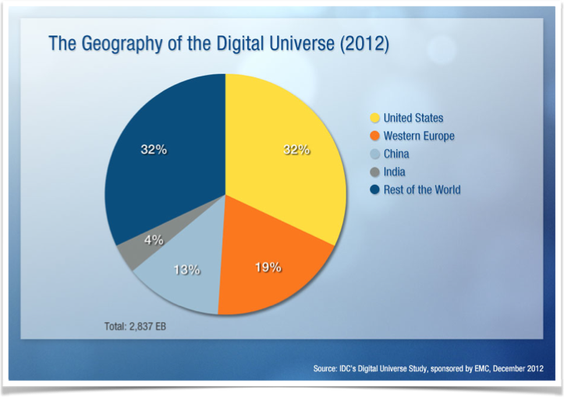
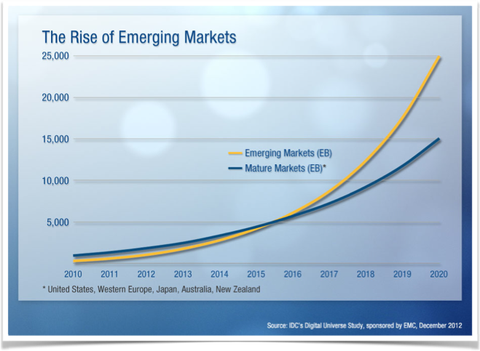
The Ever-increasing Demand
In 2013, data generated everyday exceeds 1EB (10¹⁸ bytes)
In the coming 10 years, the data generated will increase by 50-folds
The traffic between Data Centers will increase 34% every year

Slide 6
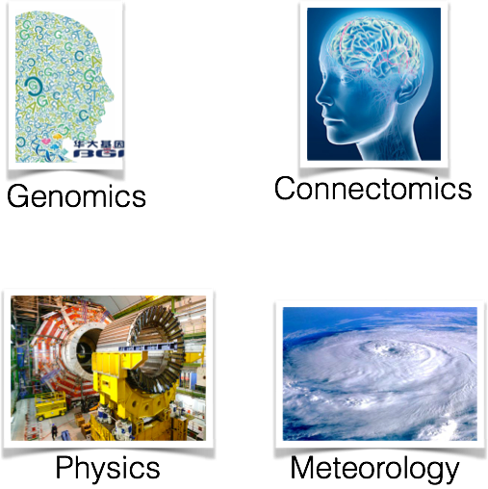


Big Data From the Science Domain
The demand of moving large data set among research institutions has been immense
Genomics
  Data volume generated by HGP 10-folds every 12-18 Months
  Still rely on courier mail of HDs or tapes (BGI) *
High Energy Physics (LHC at CERN)
  10s - 100s TB, distributed on a daily basis
Connectomics
  1 mm³ of brain image could produce 1PB (10¹⁵ bytes)

Slide 7
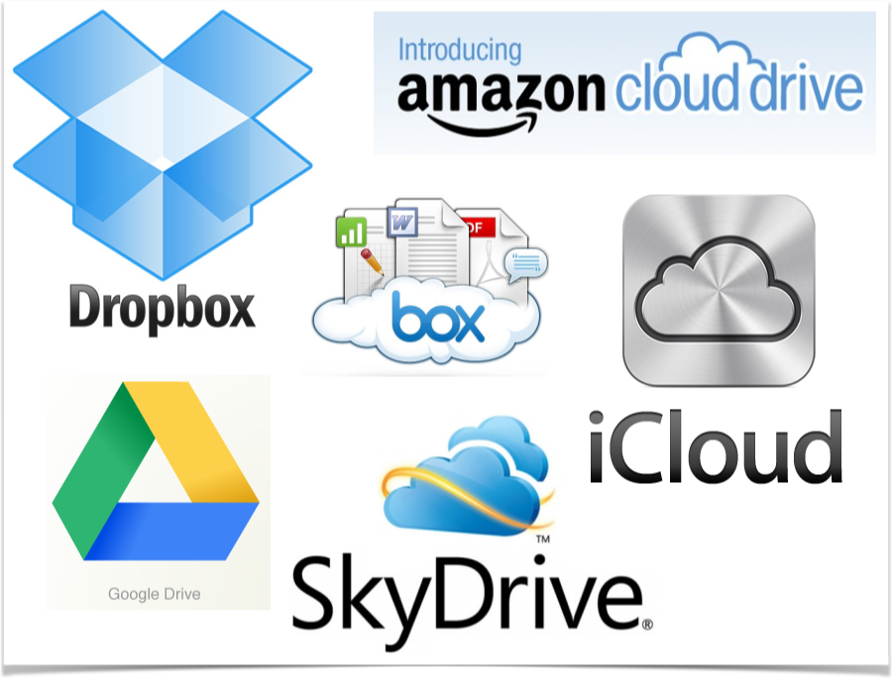
Big Data From the End Users
Huge Email attachments
    Gmail allows attachments up to 10GB from Nov. 2012. Before that, it was 25MB
    outlook.com and hotmail allows 300GB (in OneDrive)
    Yahoo mail allows unlimited attachments, if file is attached via dropbox
This makes distributing and sharing of huge files a lot more easier than before
Cloud storage plays an important role

Slide 8
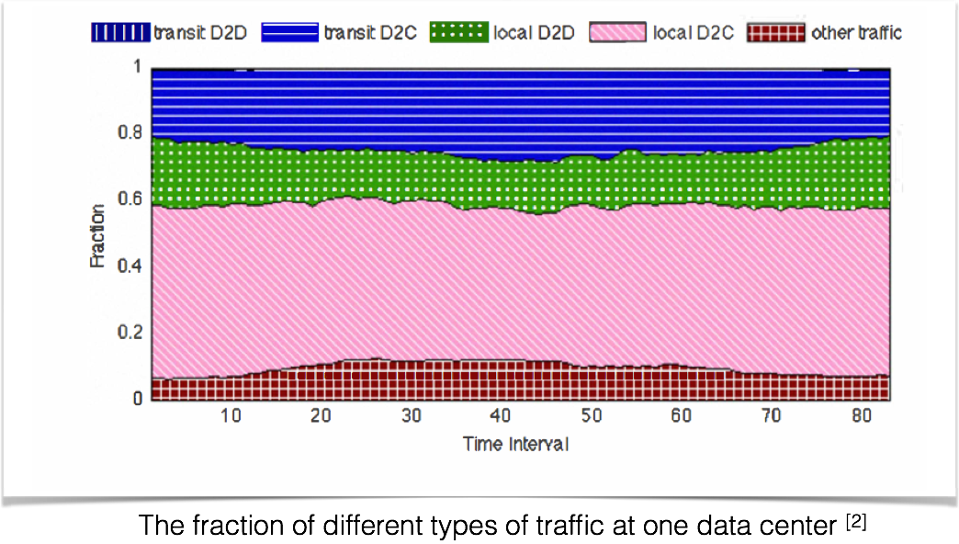
Data Movement between DCs
By 2015, the traffic betw. DCs will reach 1 ZB (10²¹ bytes)
The cost of network infrastructure is dominated by the Inter-DC Net. [1]
  Peering - where traffic are handled to ISP and then to users
  The inter-DC links
  Backhaul, metro-connectivity and others to reach the WAN sites
A. Greenberg et al. "The cost of a cloud: research problems in data center networks." ACM SIGCOMM Computer Communication Review 39.1 (2008): 68-73.
Y. Chen, S. Jain, V. K. Adhikari, Z.-L. Zhang, and K. Xu. A First Look at Inter-Data Center Traffic Characteristics via Yahoo! Datasets. In IEEE INFOCOM’11.

Slide 9
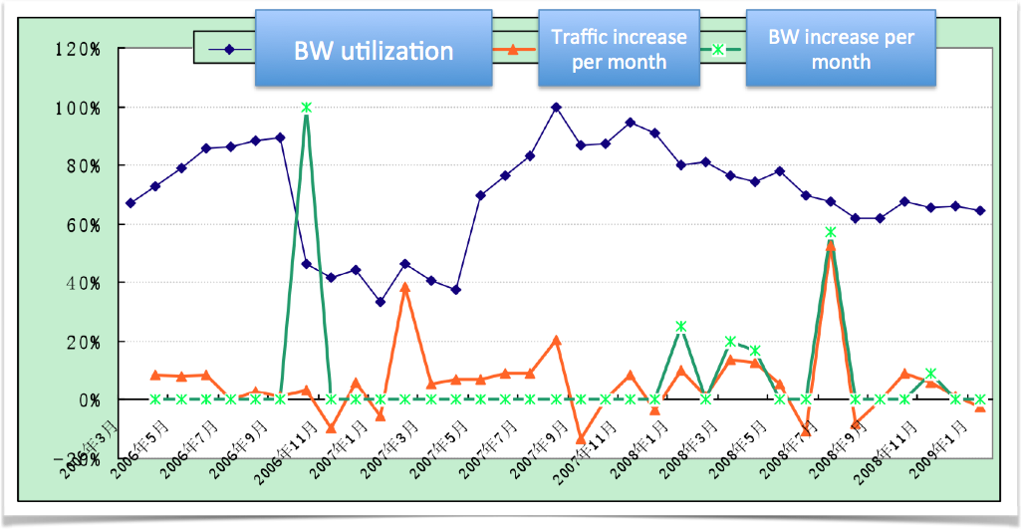
What Are the Problems?
Bandwidth increase can barely keep up with the pace of demand increase
Bandwidth increased by 6-fold, but revenue and number of customers increase only by a single digit each year

Slide 10
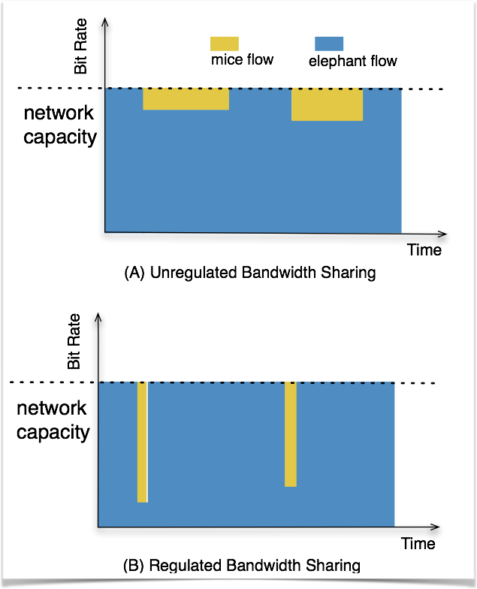
What Are the Problems? - cont.
Elephant flows compete bandwidth with interactive but small flows
Degrading the QoE of mice flows without bringing significant benefit to elephant flows
Make resource sharing among large/small flow very difficult

Slide 11
Outline
The Increasing Challenges of Big Data on the network infrastructure
The Characteristics of Data Flows
Existing Efforts in Delivering Big Data
Our Proposal - Integrated Data Flow Delivery with Built-in Mass Storage
Some Results

Slide 12

Characteristics of Big Data Flows
(From a transport network point of view)

Slide 13
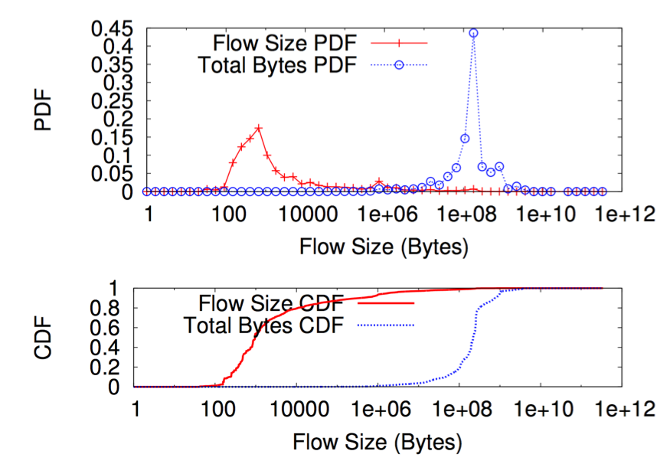
Data Flows are Bulky
The total traffic is dominated by bulk flows that is:
  Very few in number: <1%
  Big in size: between 100 - 1000MB
  and most 100MB flows comes from larger flows
Bulk flows occupy more than 90% of total bandwidth
* A. Greenberg et al. "VL2: a scalable and flexible data center network." ACM SIGCOMM Computer Communication Review. Vol. 39. No. 4. ACM, 2009.

Slide 14

Data Flows are Delay Tolerant
Data flows in E-Science is often delay tolerant
  Genomic data
  HEP data
Data flows between DCs are dominated by background traffic *
  Backups
  Content distributions and so on
* Y. Chen, S. Jain, V. K. Adhikari, Z.-L. Zhang, and K. Xu. A First Look at Inter-Data Center Traffic Characteristics via Yahoo! Datasets. In IEEE INFOCOM’11.

Slide 15
Outline
The Increasing Challenges of Big Data on the network infrastructure
The Characteristics of Data Flows
Existing Efforts in Delivering Big Data
Our Proposal - Integrated Data Flow Delivery with Built-in Mass Storage
Some Results

Slide 16
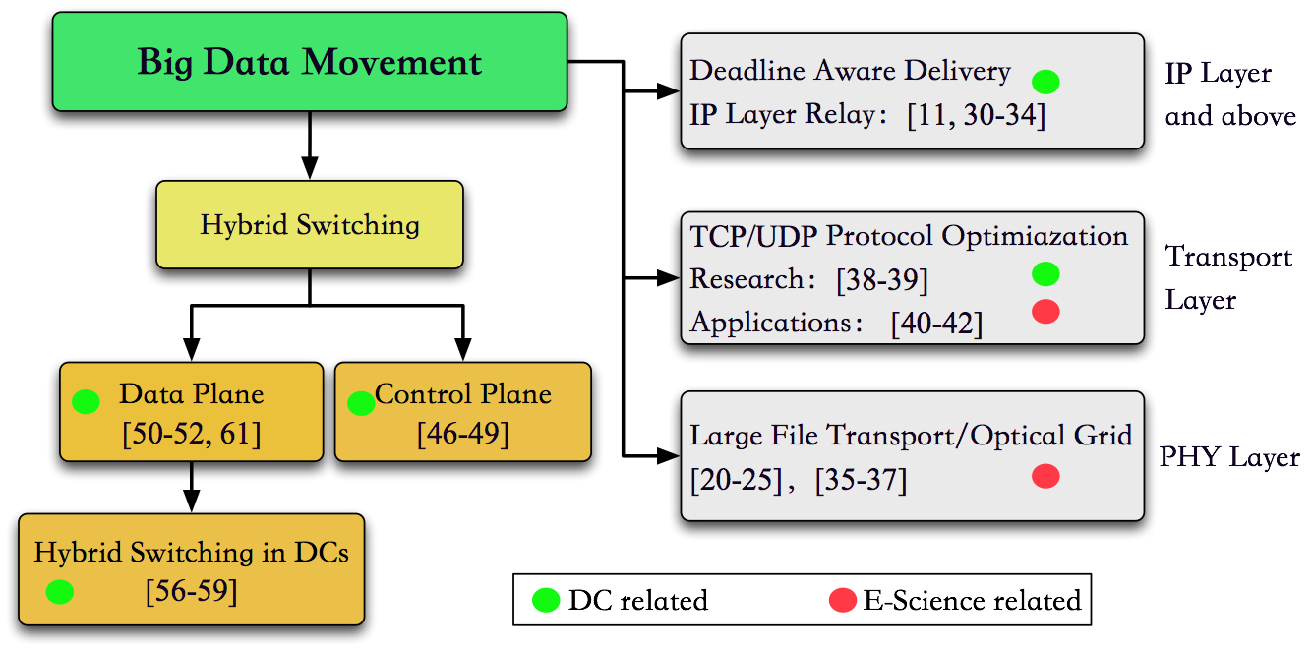
Big Data Movement - Existing Work

Slide 17
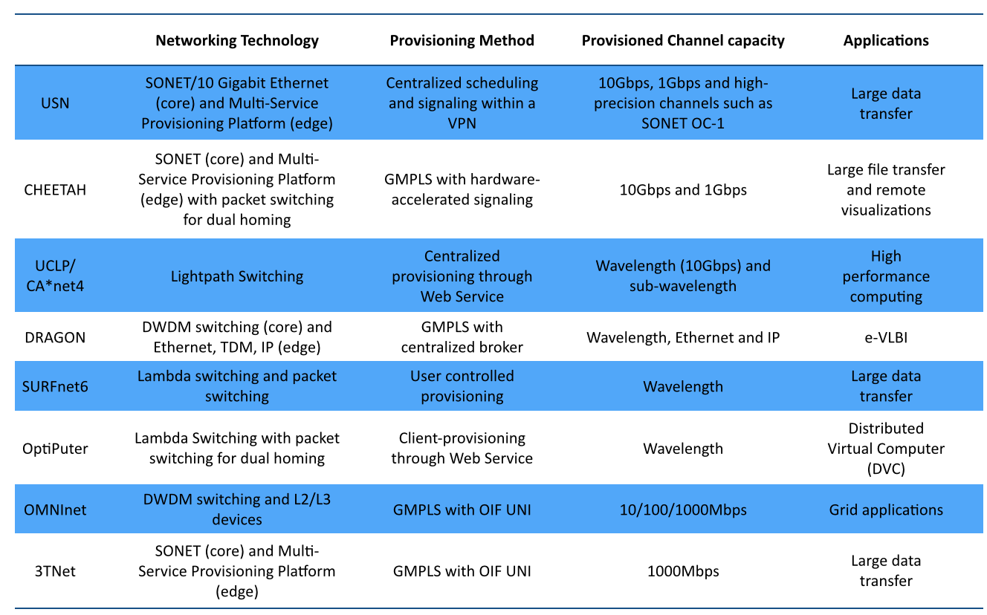
Moving bulk data with dedicated Optical Networks
Can be dated back to early 2000s
Use circuit switched optical networks
A lot of interesting research and testbeds
Resulted in good experience in building dedicated and small scale networks. But not intended for large scale deployment because of scalability issues.

Slide 18
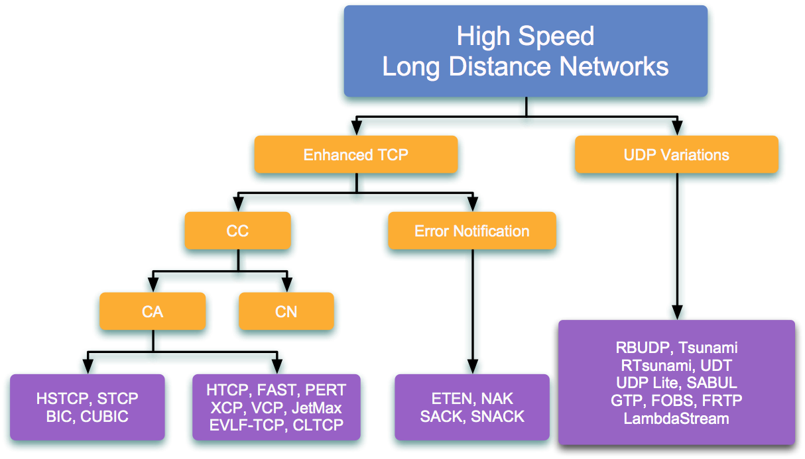
Transport Protocol Optimizations
Over High speed long distances networks
Within Data Centers
Over the public Internet
Over dedicated high speed networks
Necessary and important enhancements to existing protocols, but will not be able to address the scalability issues (capacity, power consumption and management).

Slide 19
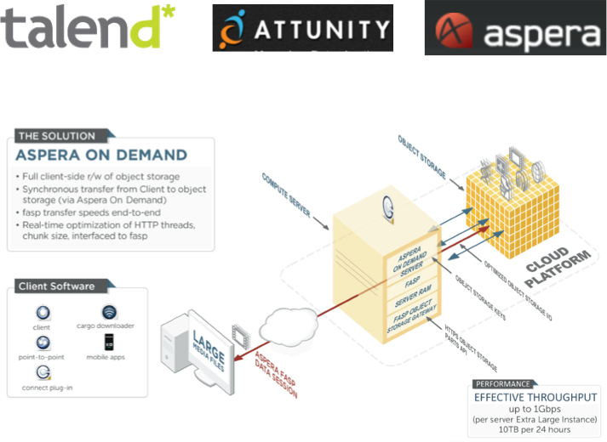
Moving Bulk Data with the public Internet
By optimizing the transport layer and application layer protocols
By utilizing unused bandwidth
Make the best use of the current infrastructure and not considered to be a long term solution.

Slide 20
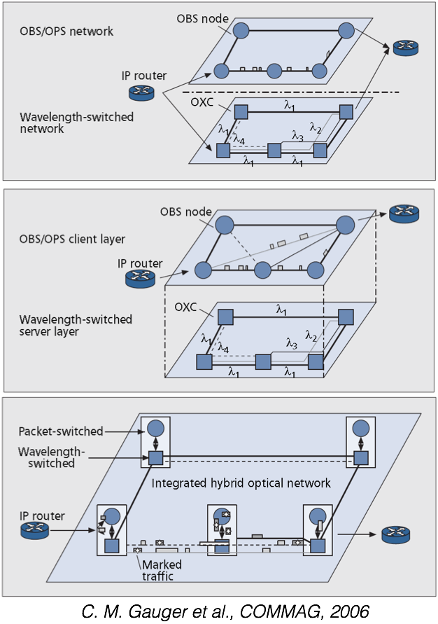
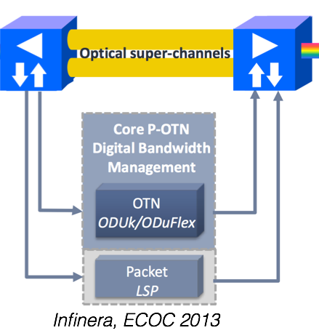
Hybrid Switching
Try to leverage the advantages of both
  Fine granular packet switching
  Coarse granular, large capacity optical circuit switching
Different modes
  Parallel Mode
  Client/Server Mode
  Integrated Mode

Slide 21
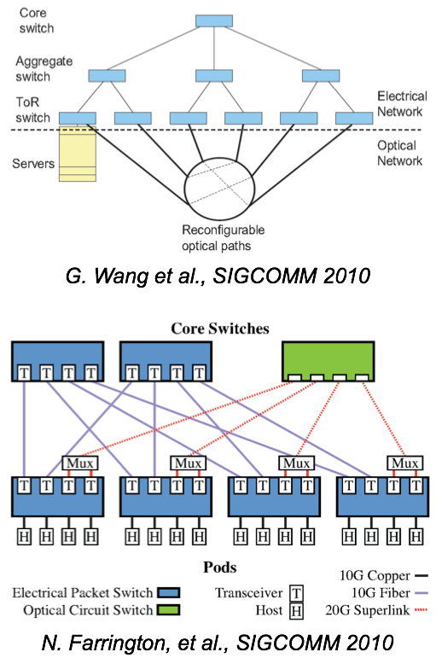
Hybrid Switching in DCNs
The packet-switched portion
  all-to-all bandwidth for the bursty traffic
The circuit-switched portion
  baseline, slowly changing traffic
Significant benefits
  Up to a factor of 3 reduction in cost
  A factor of 6 reduction in complexity
  And a factor of 9 reduction in power consumption

Slide 22
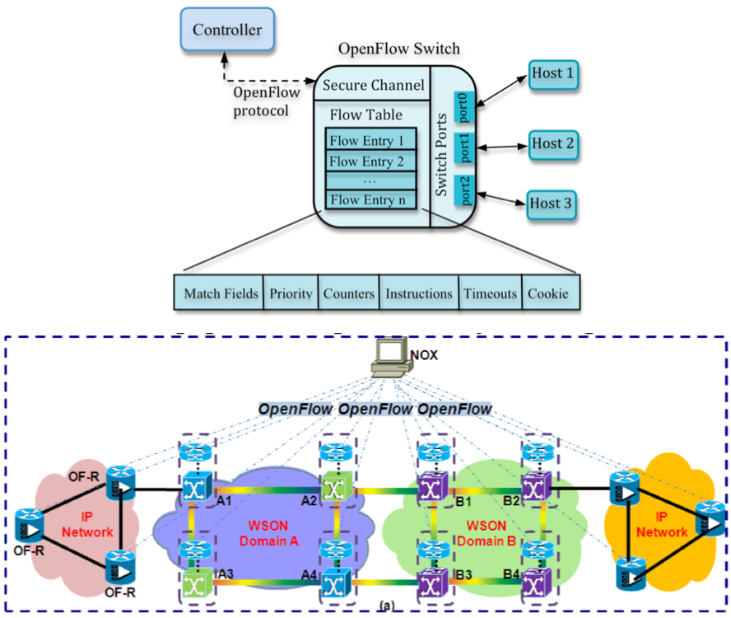
SDN - the Control Plane-ng?
A centralized way of controlling the network elements
Separation of Data Plane and Control Plane
Flow based management and control

Slide 23





Big Data Movement - the Evolutions!
High Speed Transmission
for E-Science
Hybrid Switching
Hybrid Switching in DCN
Converging with Flow Switching
High Speed Transmission
in LDN
Early 2000~
2005~
2010~
2012-

Slide 24
Outline
The Increasing Challenges of Big Data on the network infrastructure
The Characteristics of Data Flows
Existing Efforts in Delivering Big Data
Our Proposal - Integrated Data Flow Delivery with Built-in Mass Storage
Some Results

Slide 25
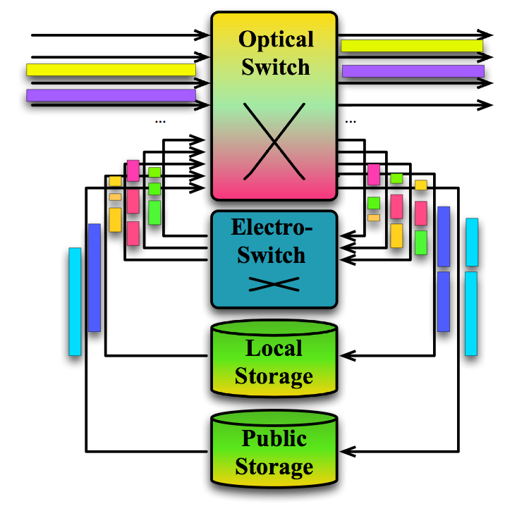
SSS- Integrated Data Flow Delivery with Built-in Mass Storage
High capacity optical switch for big data transfer and VT provisioning
Low capacity Electronic Switch for fine granular packet switching
In-network mess storage (for big data)

Slide 26
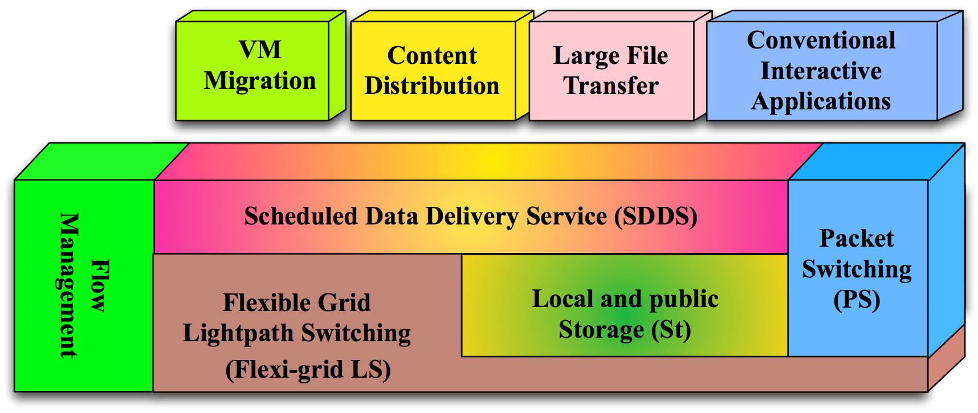
SSS - Integrated Data Flow Delivery with Built-in Mass Storage

Slide 27
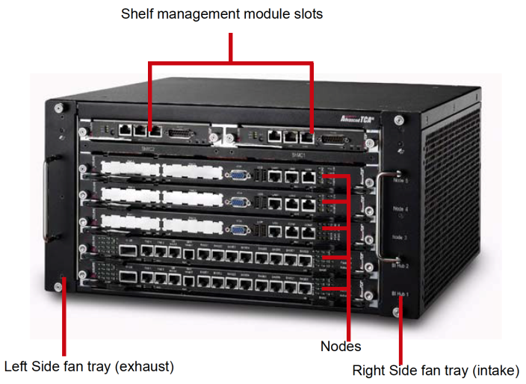
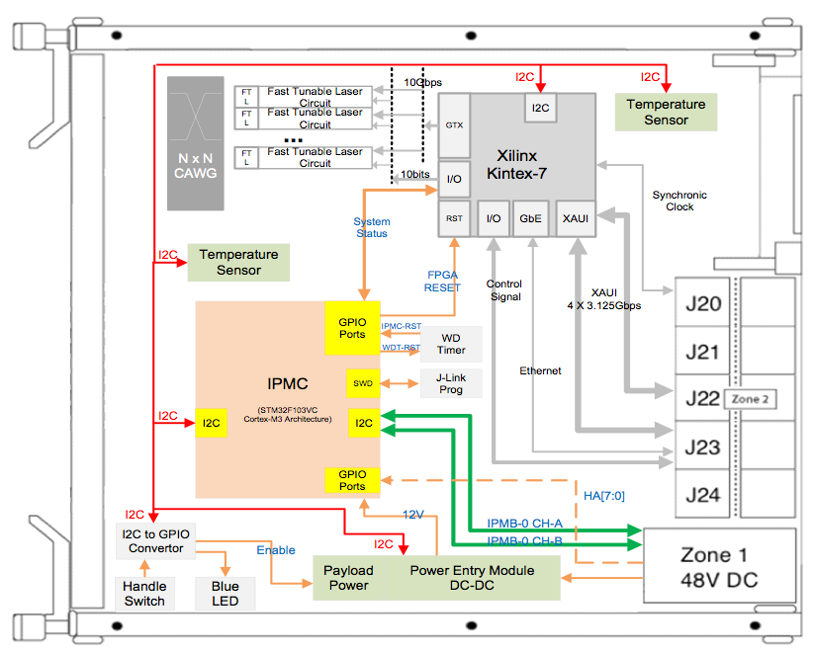
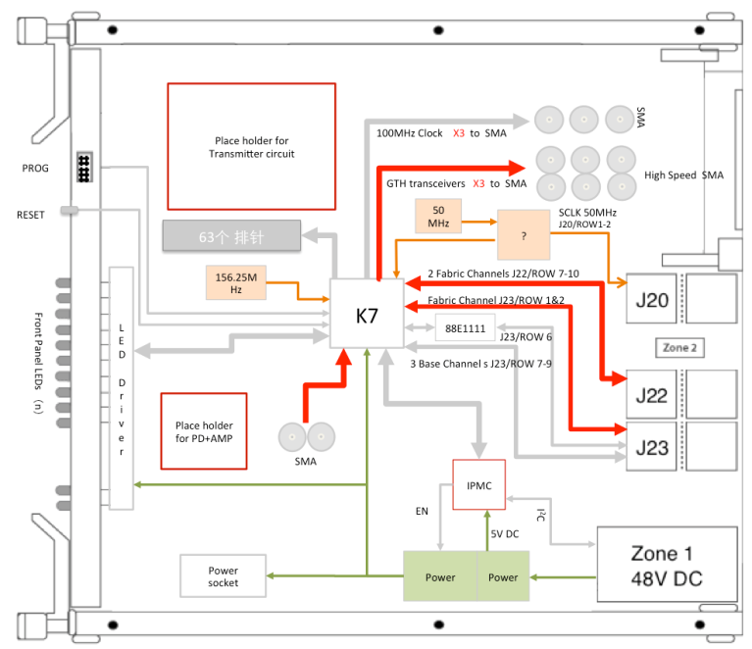
Prototype Implementation
Built on an ATCA chassis
  AWGR+TWC for Optical Switching
  E-Switching
  Local Storage
Network controller with OpenFlow

Slide 28
Outline
The Increasing Challenges of Big Data on the network infrastructure
The Characteristics of Data Flows
Existing Efforts in Delivering Big Data
Our Proposal - Integrated Data Flow Delivery with Built-in Mass Storage
Some Results

Slide 29
Some Results
Single queue with traffic aggregation
Requests/clients has a deadline
Use Earliest Deadline First (EDF) policy

Slide 30
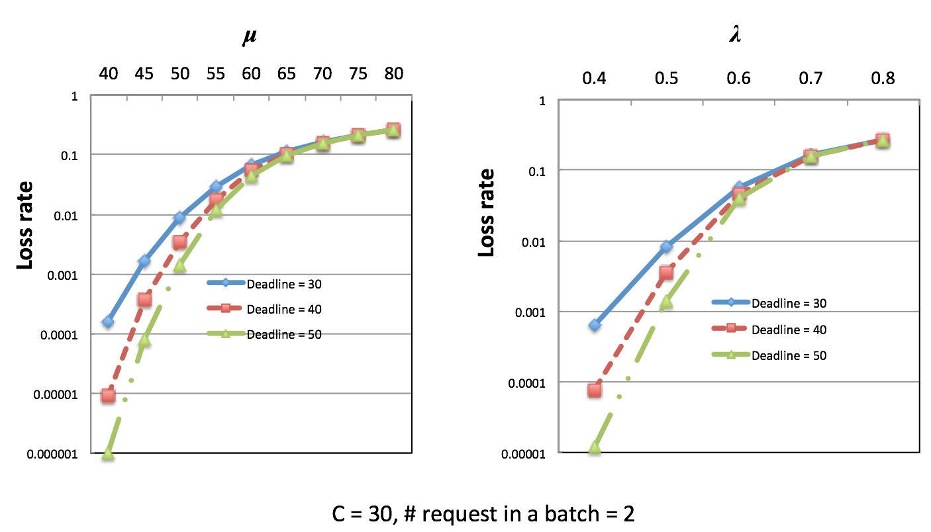
Loss Rate vs. Load

Slide 31
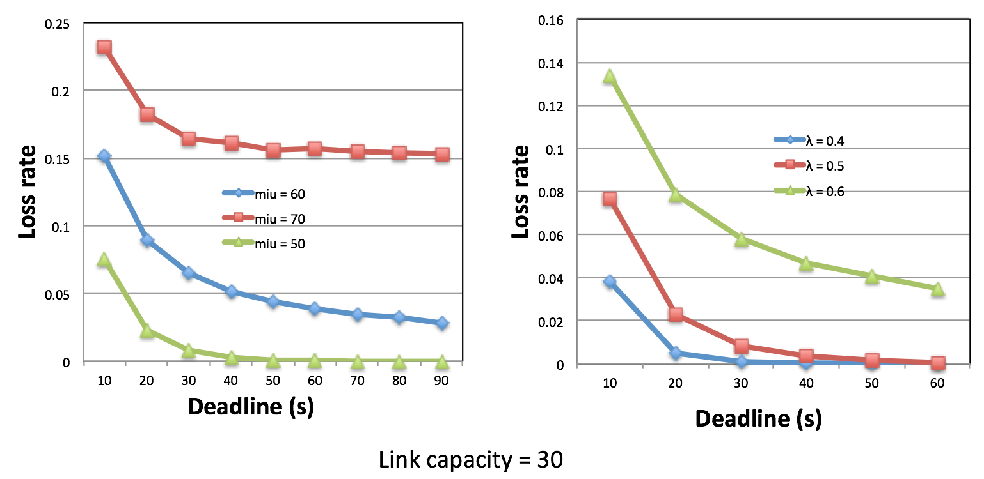
Loss Rate vs. Deadline

Slide 32
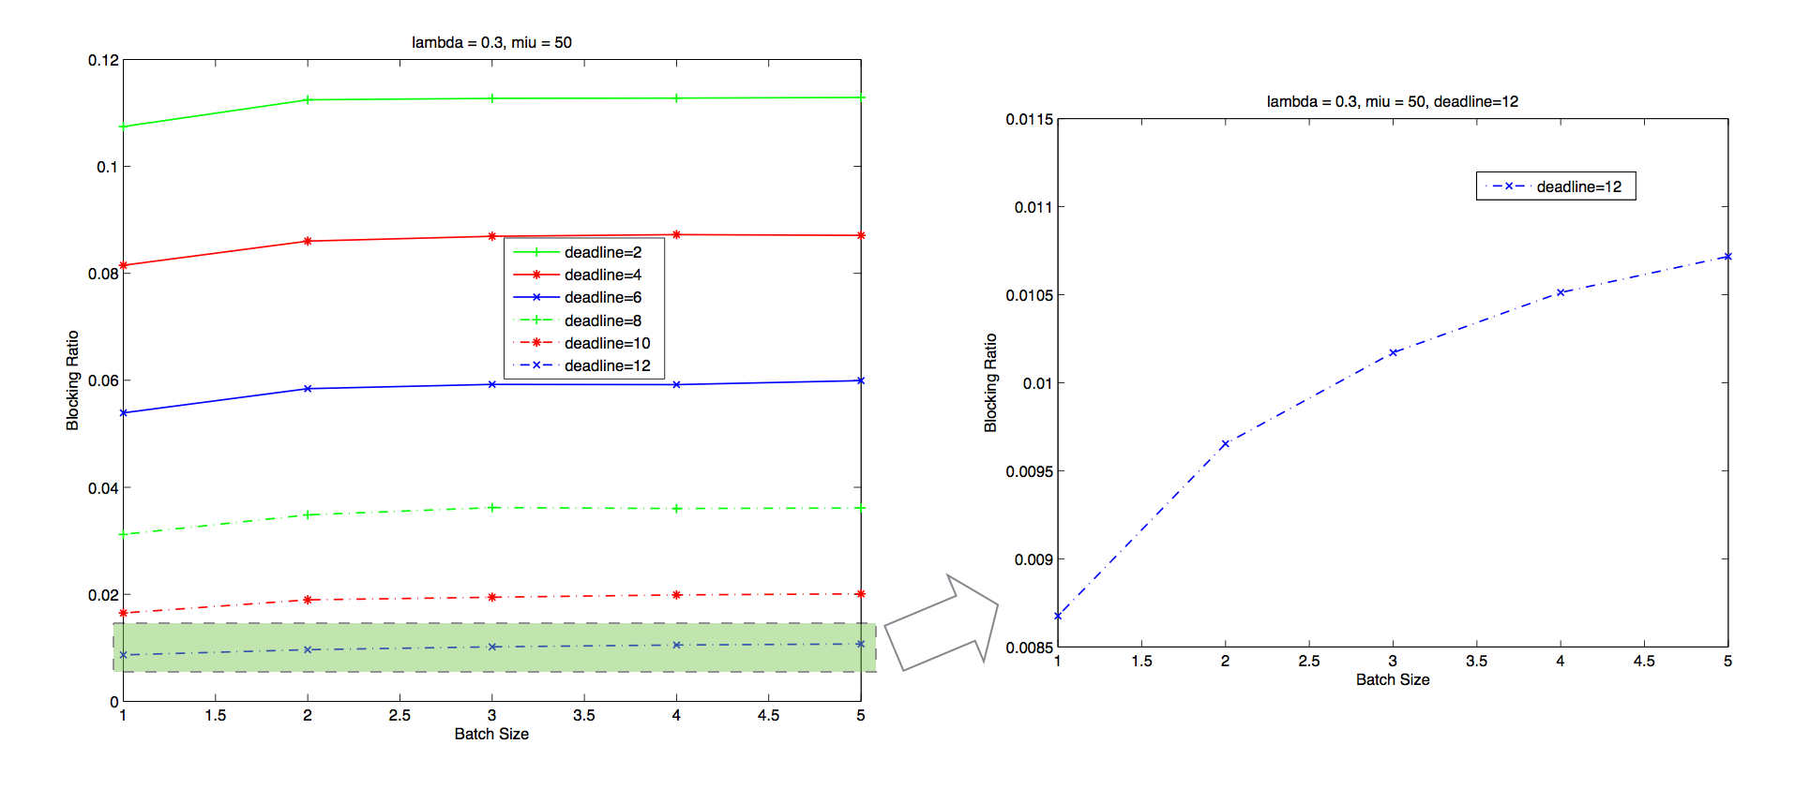
Loss Rate vs. Batch Size

Slide 33
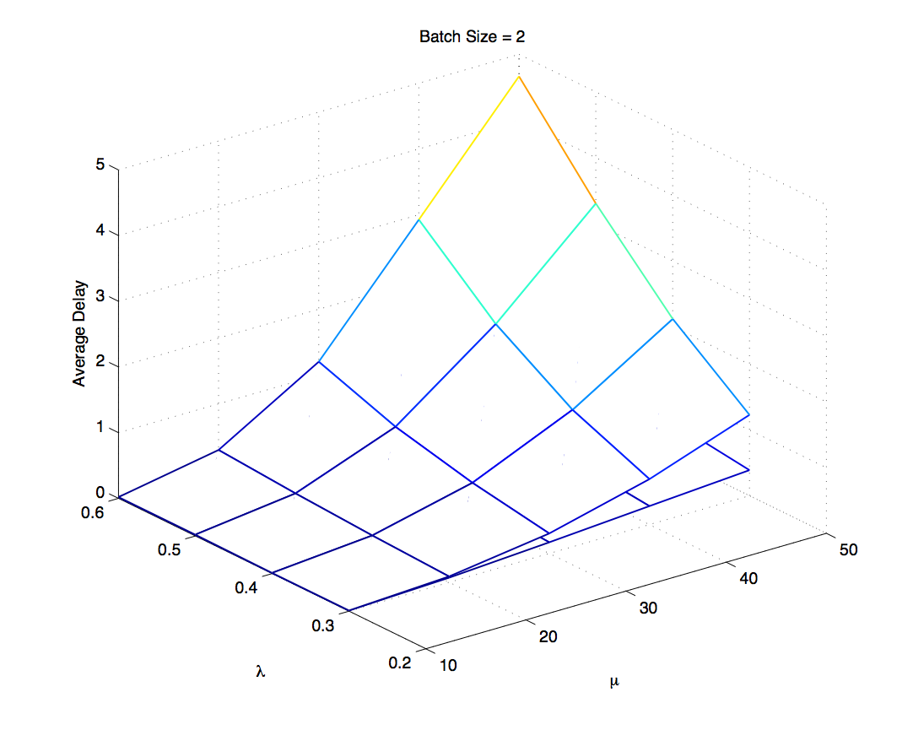
Average Delay vs. Load

Slide 34
Conclusions
Data increasing at an unprecedented pace
Data flows are bulky and delay tolerant
Innovations converge at the cloud age with flow switching and the SDN concept
We propose to use hybrid switching with built-in storage to support big data delivery

Slide 35
Thank you!
Weiqiang Sun and Weisheng Hu
Shanghai Jiao Tong University
{sunwq, wshu}@sjtu.edu.cn

Slide 36
The Big Data Initiative by NSFC
Date: 2015.1 - 2019.12
Coverage: Storage, Computing, Processing, Transporting of Big Data
Number of Projects: 12
Support Level: 3.0 ~ 3.5 M RMB/project
More to come in 2015…

Slide 37
Let Us Meet Again
We welcome all to our future group conferences of Omics group international
Please visit:
www.omicsgroup.com
www.Conferenceseries.com
http://optics.conferenceseries.com/

