Slide 1
Advanced molecular techniques to improve lignocellulase
activity and production
Weilan Shao
Jiangsu University, China
Spain, June 29, 2017

Slide 2

Contents
Contents
Enzyme systems and enzymes
01
02
Gene expression systems
Mutagenesis & directed evolution
03
04
High production & application
Summary
05

Slide 3
Enzyme systems and enzymes
01

Slide 4
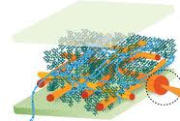
Types of Lignocellulases
Structure of lognocellulose
Hemicellulose (20~35%)
Cellulose (34~48%)
Lignin (13~28%)
Lignocellulases required for a complete digestion
Hemicellulases: Xylanase, xylosidase, arabinosidase, mannosidase, acetylesterase, glucuronidase and galactosidase, etc.
Cellulases: Endoglucanase, exogluconase, glucosidase
Ligninases: Laccase, lignin peroxidase, Mn peroxidase, and ferulic acid esterase

Slide 5
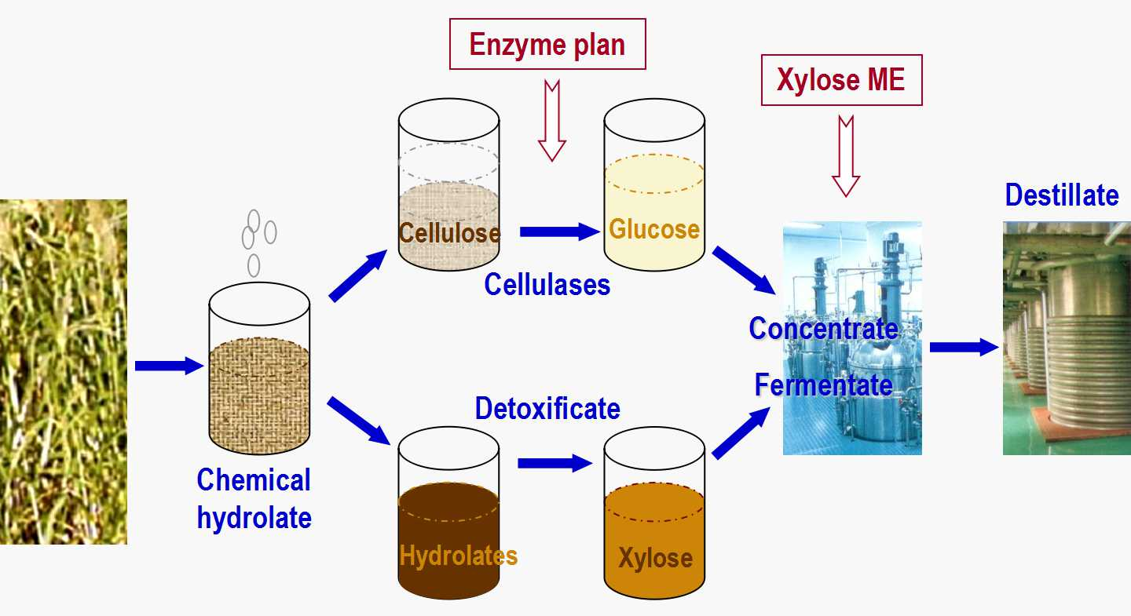
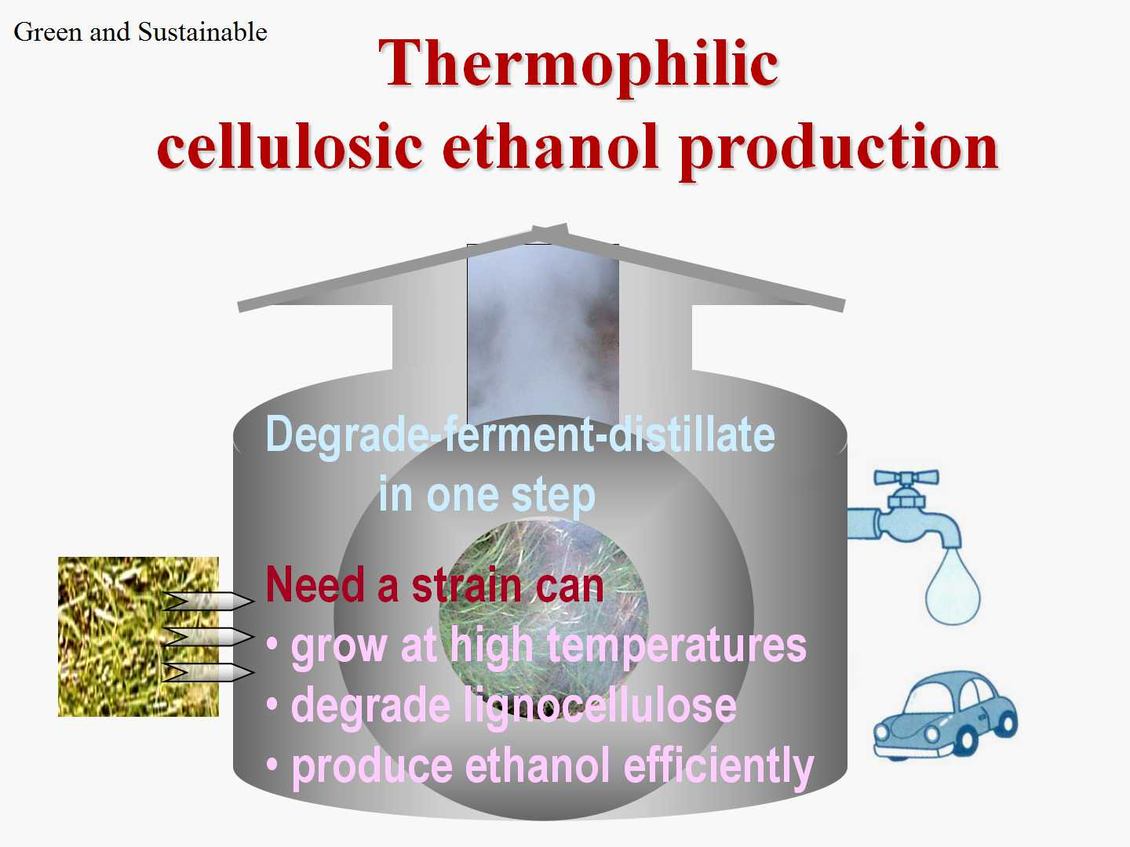
When is a complete digestion desired?
Traditional method
Chemical treatment of lognocellulose
Developing method
Biodegradation of lognocellulose

Slide 6
Microbes Having Enzyme Systems
Enzyme system: A mixture of series enzymes exhibits an advantage of synergistical functions (1+1 > 2).
Well known enzyme systems in these microbes:
Trichoderma reesei : A fungus attacking woody plants
Clostridium thermocellum : A thermophile forming cellularsome.
Thermotoga spp. : Hyper thermophles able to produce all kinds of cellulases and hemicellulases.
Caldicellulosirupter spp. : Extreme thermophles able to grow on heat-treated lignocelluloses.

Slide 7
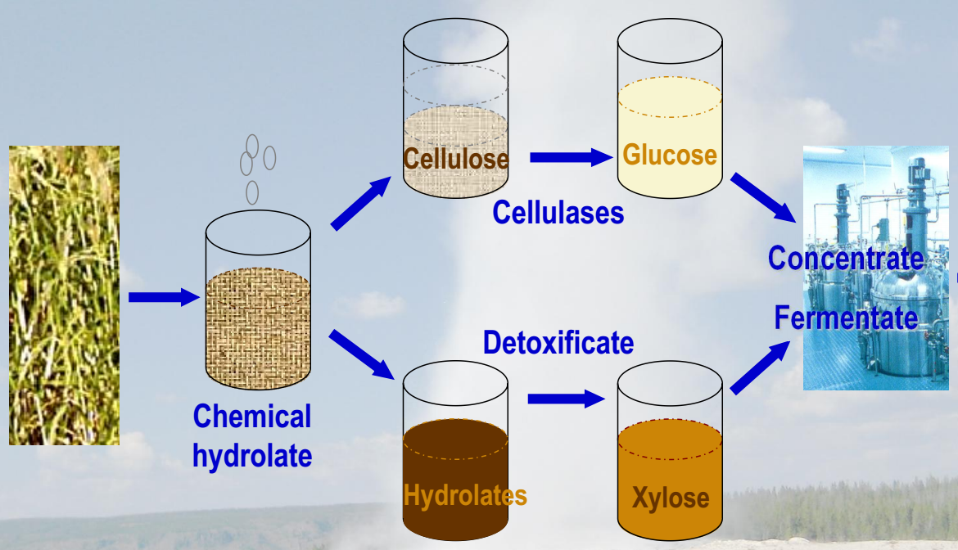
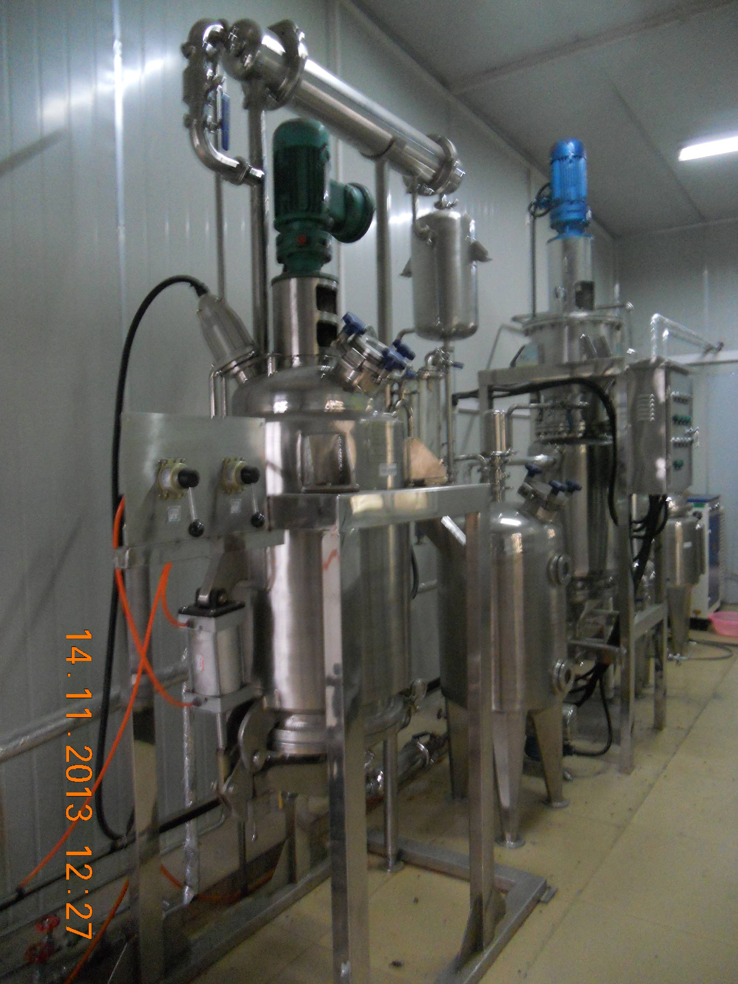

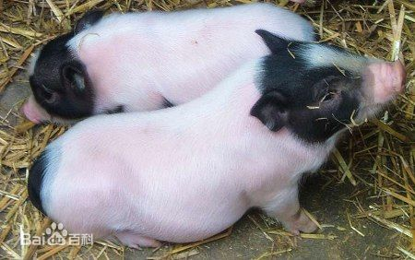
Enzymes for Industrial Application
Saccharifying
Pulping
Forage addictives

Slide 8
Select the Enzymes with Good Properties
Lignocellulases are widely distributed in microbes; their properties differ in broad ranges.
Comparison of some xylanases:
Microbal producer | pH_{opt} | T_{opt} (ºC) | U/mg | t_{1/2}
Bacillus pumilus | pH 6.6 | 50℃ | 63 | 1 h _{60℃}
Meiothermus ruber | pH 6.0 | 65℃ | 46 | 1 h _{73℃}
Thermoanaerobacterium sp. | pH 6.2 | 80℃ | 122 | 1 h _{70℃}
Thermomyces lanuginosus | pH 6.0 | 65℃ | 1,500 | 3 h _{65℃}
Thermotoga maritima | pH 6.0 | 95℃ | 800 | >2 h _{100℃}

Slide 9
Barriers in Production of Good Enzymes
Active and and stable enzymes from extremophiles.
Extremophiles grow at low cell densities,
need extreme conditions of fermentation,
and produce enzymes in mixtures.
Are the recombinant DNA techniques matured?
Hundreds genes can be expressed at high levels;
Our projects often stop at protein preparation; Enzymes are too expensive for industrial appl.
Common problems in recombinant expression:
Low gene expression levels;
Inclusion-body formation.

Slide 10
Three Steps to Get Industrial Enzymes
Characterize and select an optimal enzyme;
Choose an expression system with the best potantial;
Improve expression and activity by gene mutagenesis.

Slide 11
02
Gene expression systems

Slide 12

Inducible Gene Expression in A Vector
Prom +1 rbs mcs Term
A promoter is the key point for:
The rate of gene transcription
Efficiancy and cost of induction
Toxicity of target protein to host
Degradation of target protein in host cells
MCS
Selection
marker
Expession
vector
Ori

Slide 13
Widely Used E. coli Expression Vectors
These inducible gene expression systems of E. coli are well known and widely used:
The T7 system such as pET vectors;
The Lac/Tac system such as pTrc;
The pL system such as pJLA; and so on.
All them use repressor(s) to control gene expression !

Slide 14
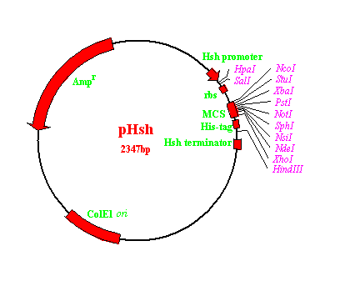
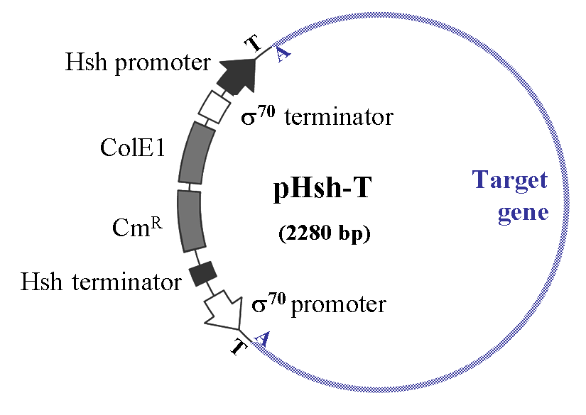
E. coli Expression Vector System, pHsh
US Patent: US 7,807,460 B2 (Oct. 5, 2010)
pHsh uses an alternative Sigma factor, σ³² , to control target gene expression.

Slide 15
Repressors Regulated Transcription
P_{lac} +1 rbs ORF Terminator
σ
Repressor
IPTG
σ
mRNA

Slide 16
Sigma factor σ³² Regulated Transcription
P_{lac} +1 rbs ORF Terminator
Heat Shock
σ
σ
σ
σ
σ
σ
σ
σ
σ
σ
mRNA

Slide 17
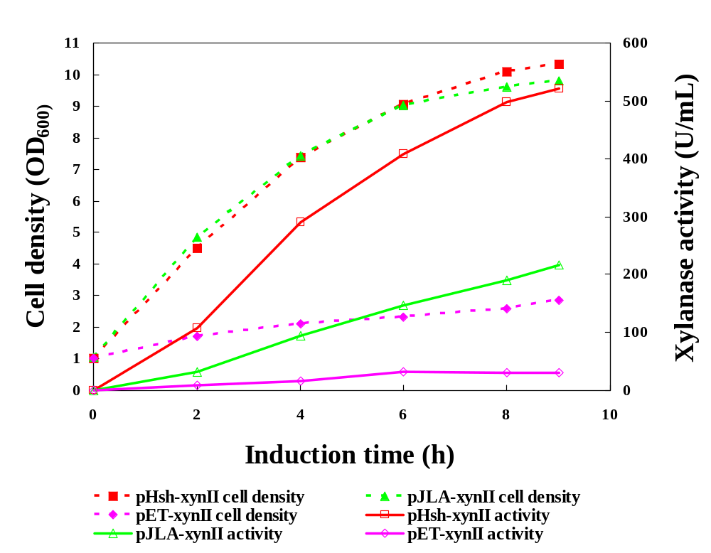
Comparison of Expression Systems
Expression of Thermotoga Xylanase
Hsh system
pL system
T7 system

Slide 18
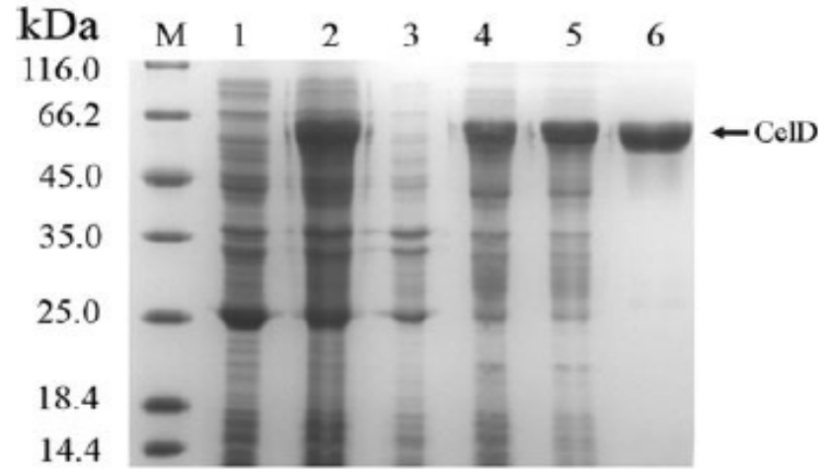
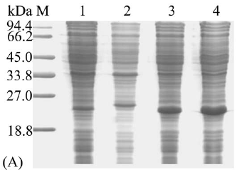
Soluble Expression of Target Protein
CelD of Clostridium thermocellum
expressed in E. coli
Xylanase of Thermomyces
lanuginosus
Lanes 2-3, soluble and insoluble CelD from pHsh–celDII;
Lanes 4-5, soluble and insoluble CelD from pET-celD.
Soluble xylanase expressed in
plasmids:
1, pHsh; 2, pET;
3, pHsh-ex.
Le et al., 2011, PLoS ONE, 6(4): e18489

Slide 19
03
Mutagenesis & directed evolution

Slide 20
Optimize Gene Sequence for Producyivity
To our knowledge , we perform site-directed mutagenesis to reduce:
The 2nd structure of mRNA at 5’ end;
The usage of rear codons of E. coli;
The CpG islands within coding regions.
We perform directed evolution when we do not know how further to improve a gene.
Randen mutation;
Selection.

Slide 21
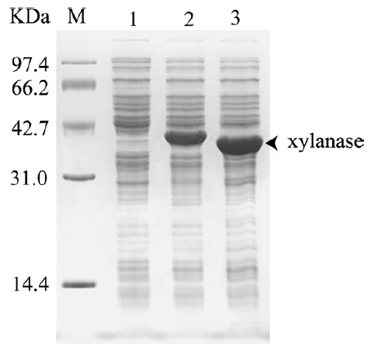
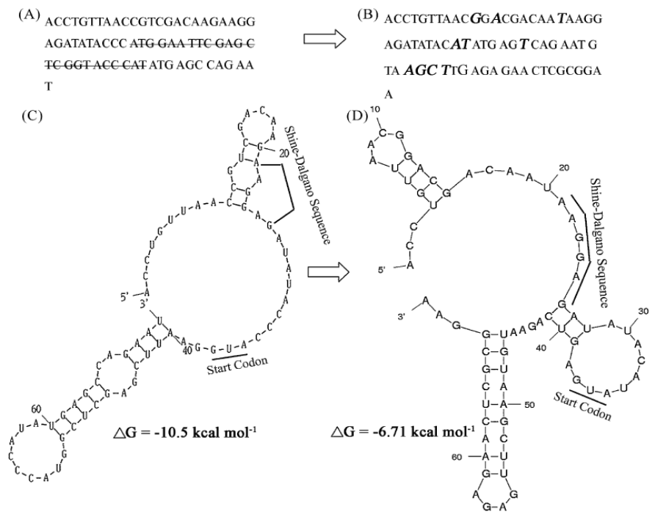
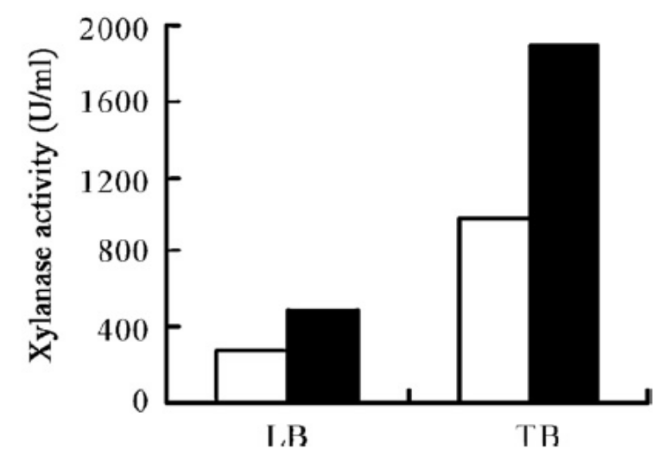
Reduce Hairpin Structures of mRNA
Xylanase B of Thermotoga

Slide 22
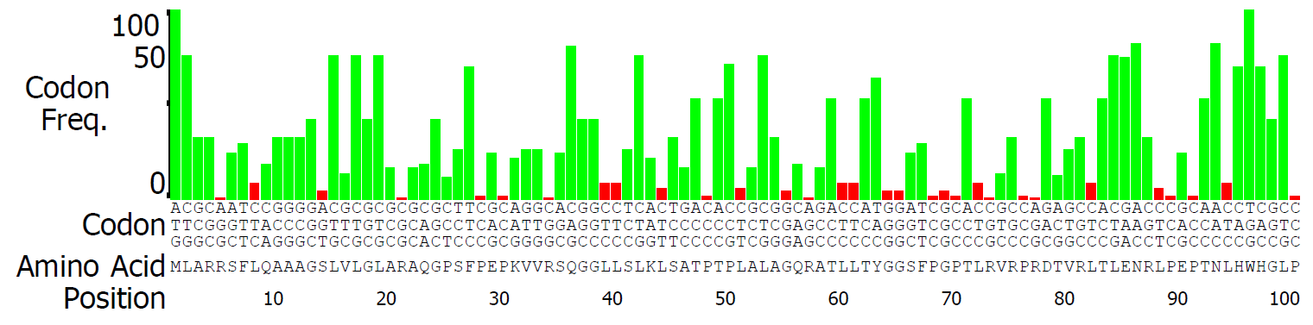
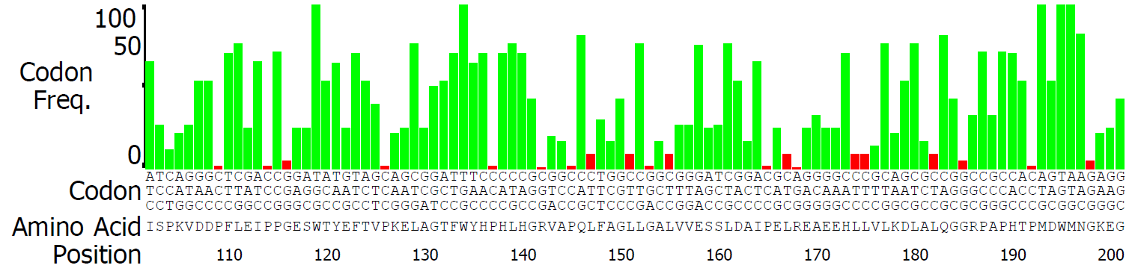
Reducing the Usage of Rare Codon
Thermus thermophilus HB27 laccase gene

Slide 23
Reducing CpG Islands in Coding Regions
Thermus thermophilus HB27 laccase gene
481 gacgccatcc ccgagctcag ggaggcggag gagcacctcc tcgtcctgaa ggacctggcc
541 ctccagggcg ggcgcccggc gccgcacacc cccatggact ggatgaacgg gaaggagggc
601 gacctggtcc tggtgaacgg ggccctgcgg cccaccctgg tggcccagaa ggccaccctg
661 aggcttcgcc tcctcaacgc ctccaacgcc cgctactacc gcctggccct gcaggaccac
721 cccctttacc tcatcgccgc cgatgggggc ttcctggaag agcccctgga ggtgtccgag
781 ctcctcctgg ccccaggaga gcgggccgag gtcctggtgc gcttgcggaa agagggccgc
841 ttcctcctcc aggccctgcc ctacgaccgc ggggccatgg gcatgatgga catggggggc
901 atggcccacg ccatgcccca agggccaagc cggcccgaaa cccttcttta cctcatcgcc
961 cccaagaacc ccaagccctt acccctgccc aaggccctaa gccccttccc caccctgccc
1021 gcccccgtgg tcacccgccg cctggtcctc accgaggaca tgatggccgc ccgcttcttc
1081 atcaacggcc aggtctttga ccacaggcgg gtggacctga aggggcaggc ccagacggtg
1141 gaggtctggg aggtggaaaa ccagggggac atggaccacc ccttccacct ccacgtccac
1201 cccttccagg tcctctccgt gggcgggagg cctttcccct accgggcctg gaaggatgtg
1261 gtcaacctga aggcgggcga ggtggccagg cttctggttc ccttgaggga aaagggccgg
1321 accgtttttc actgccacat cgtggagcac gaggaccggg ggatgatggg agtcctcgag
1381 gtgggttag
Identify CpG islands:
Observed/Expected ratio > 0.60
Percent C + G > 50.00
Length > 200
Base # Obs/Exp %GC
502—750 0.68 ≥71.5%
675—885 0.67 ≥70.5%
890—1120 0.65 ≥67.0%

Slide 24
Random Mutation & Directed Revolution
After our rational knowledge has been applied, how to achieve further improvements?
A 15% increase is important for industry ! Prosedures:
Random mutation library is created by error-prone PCR (epPCR) under error-prone conditions, e.g. in the presence of Manganese.
The PCR products with random mutations are digested with restriction enzymes, and cloned to an expression vector.
Transform E. coli, and select the mutants with desired property (or positive mutants).
Low efficient step!

Slide 25
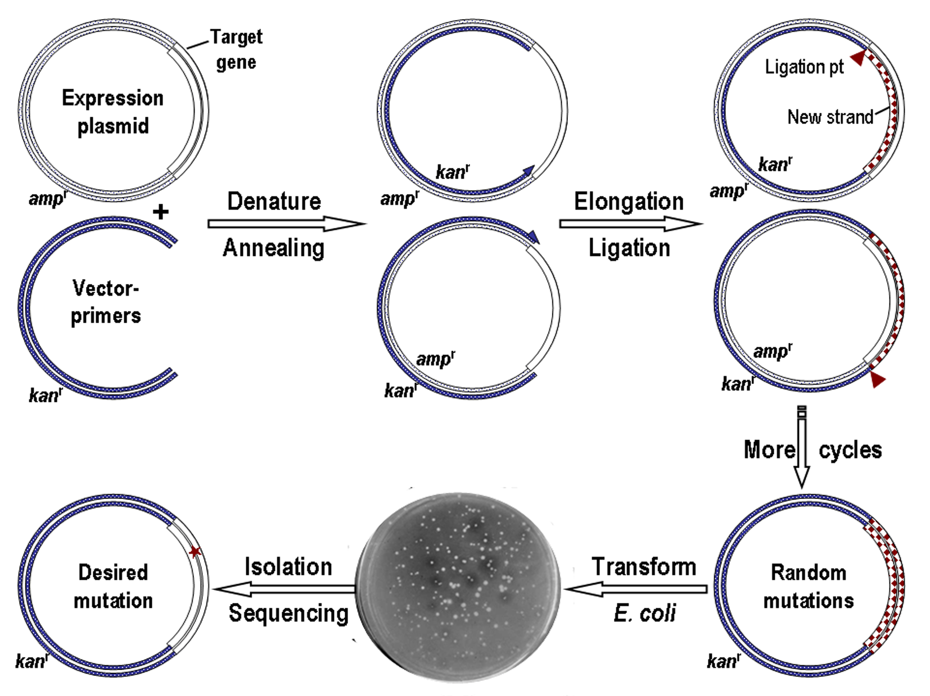
In situ Error-prone PCR (is epPCR)
US Patent: US 9,416,359 Β2 ( Aug. 16, 2016)

Slide 26
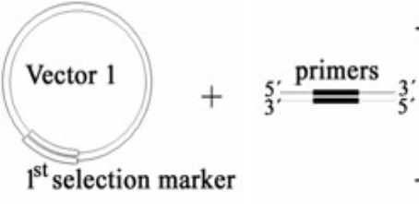
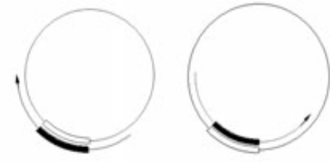
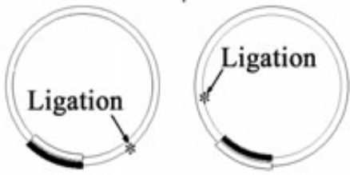

PPcP, PCR Production of Circular Plasmids
Regular PCR: -(-Denature—anneal—elongate-)-
PPcP： -(-Denature—anneal—elongate—ligate-)-
T. maritima DNA ligase

Slide 27
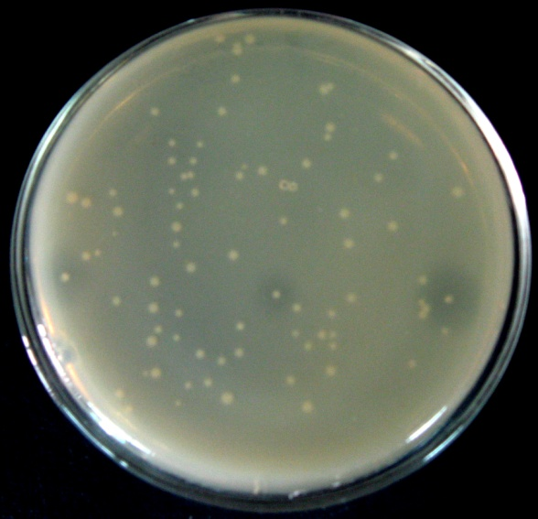
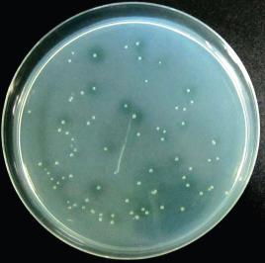
Screening Mutants after in-situ epPCR
Xylanase of Thermomyces
lanuginosus
Laccase of Thermus thermophilus
G180S
Detecting xylanase activity in xylan-LB plates
Glue¹⁸⁰—Ser¹⁸⁰
Xylanase activity increased by 12%
Detecting laccase activity on ABTS-LB plates
Arg⁴³²: CGG—CGT; Leu⁴³⁸: CGG—CGT
Laccase activity increased by 33.7%

Slide 28
High production & application
04

Slide 29
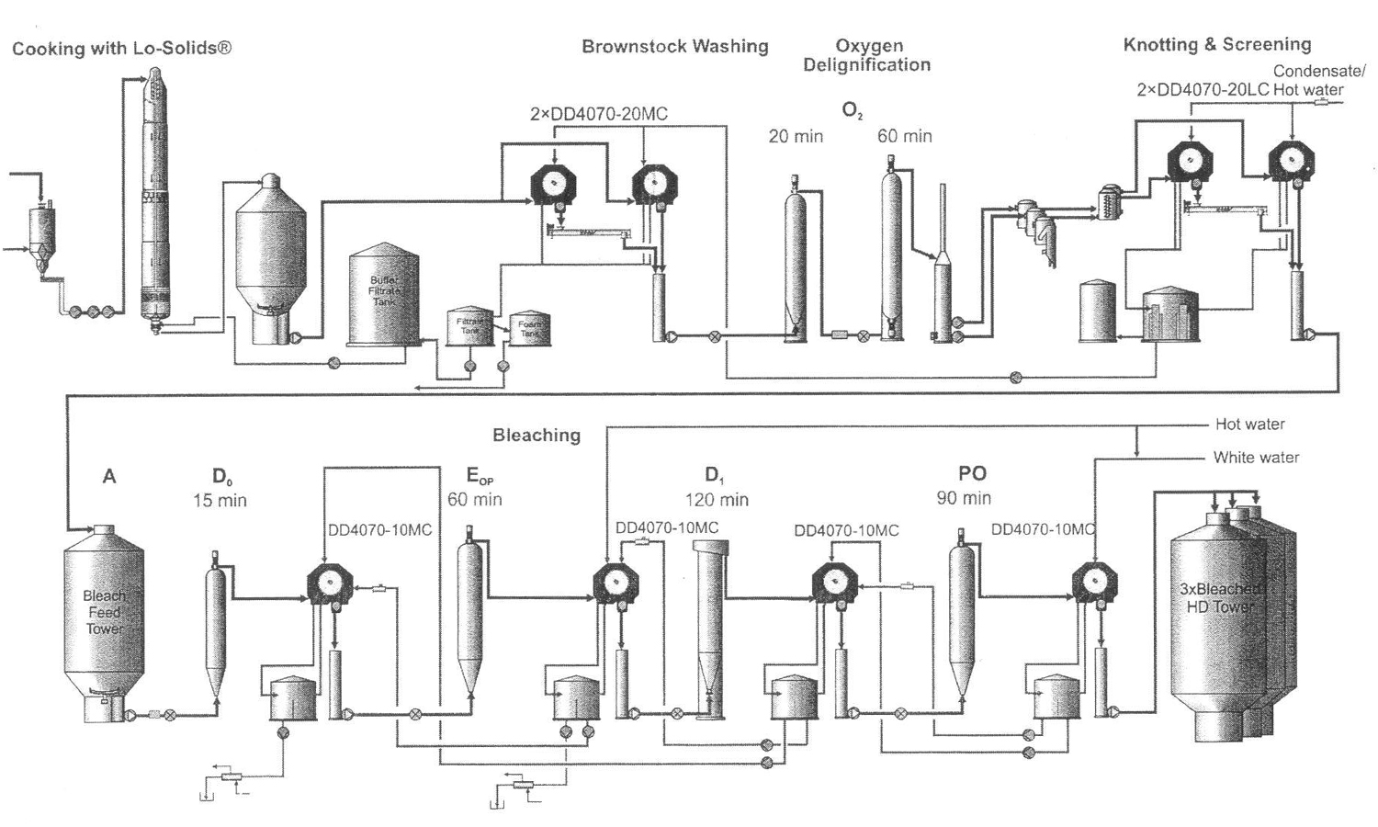
Pulp Bleaching Processes at 75℃ to 95℃
Cooking
75℃ to 95℃
75℃ to 95℃
75℃ to 95℃

Slide 30
Pulp Bleaching Processes at 75℃ to 95℃
Cooking
75℃ to 95℃
Laccase of Thermus, T_{opt} 85℃
Xylanase of Thermotoga, T_{opt} 95℃
75℃ to 95℃
75℃ to 95℃

Slide 31
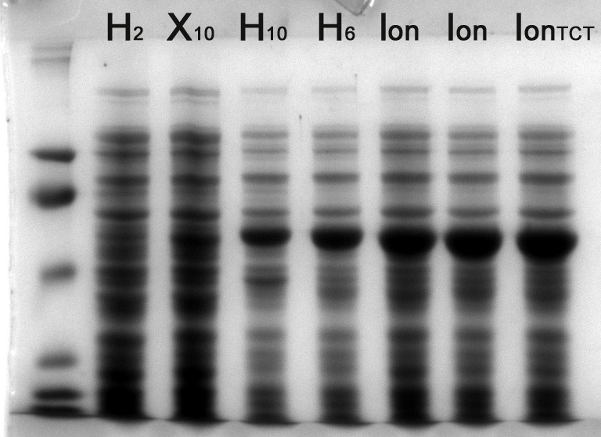
Improving Gene Expression of Laccase
M 1 2 3 4 5 6
# Activity (U/L) Increase
20.7±1.5 1
500±18 24
750±19 1.5
2083±46 2.8
3421±63 1.6
4080±38 1.2
Laccase
Final 1000 U/OD/L 197×
1, Wild-type laccase gene in pHsh; 2, Mutated at rear codons, CpG islands;
3, Mutagenesis of 2nd structure of mRNA; 4, N-terminal fusion;
5, Mutated promoter sequence; and 6, in situ error-prone PCR.
Chinese patent ZL 201010567825.3

Slide 32
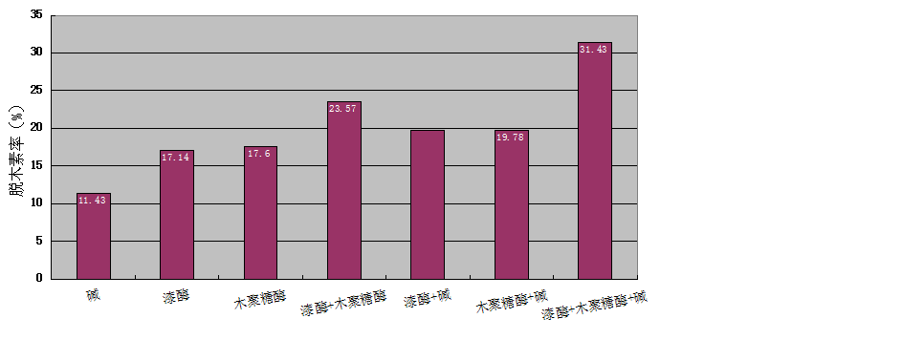
Replacing Alkaline Treatment with Enzymes
Laccase of Thermus, T_{opt} = 85℃, t_{1/2} = 2 h (90℃)
Xylanase of Thermotoga, T_{opt} = 95℃, t_{1/2} ≥ 2 h (100℃)
Delignification (%)
A, alkaline extraction;
L, laccase treatment;
X, xylanase treatment.
X
L
A
L
X

Slide 33
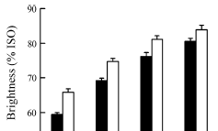
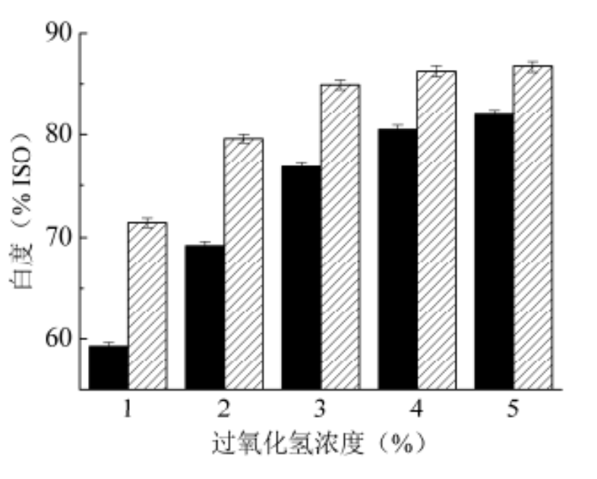
Reducing the Use of Bleaching Chemicals
Chemical bleaching after wheat straw pulp was treated by alkaline extracts (■), laccase (□), or treated by both xylanase and laccase ( ).
25%
50%
1 2 3 4 1 2 3 4 5
H₂O₂ Concentration (%)
Conditions: Laccase treatment, 3 U/g dry pulp, 85℃, pH 4.5; xylanase treatment, 20 U/g dry pulp, 85℃, pH 6.0; chemical bleaching, treat pulp for 2 h with H₂O₂ at 85℃, pH 11 after EDTA chelation.

Slide 34
Summary
05
1. Thermostable lignocellulases are demanded in:
  Saccharification of cellulose,
    Industrial processes,
  Feed addictives ... ...
Gene
expression,
mutation & evolution
2. A core platform is the key for the industrialization of a lignocellulase.
Finding enzymes of high activity &
stability
Enzyme
production &
application
3. It is hopeful to make super enzymes in the moden biotechnical games.

Slide 35
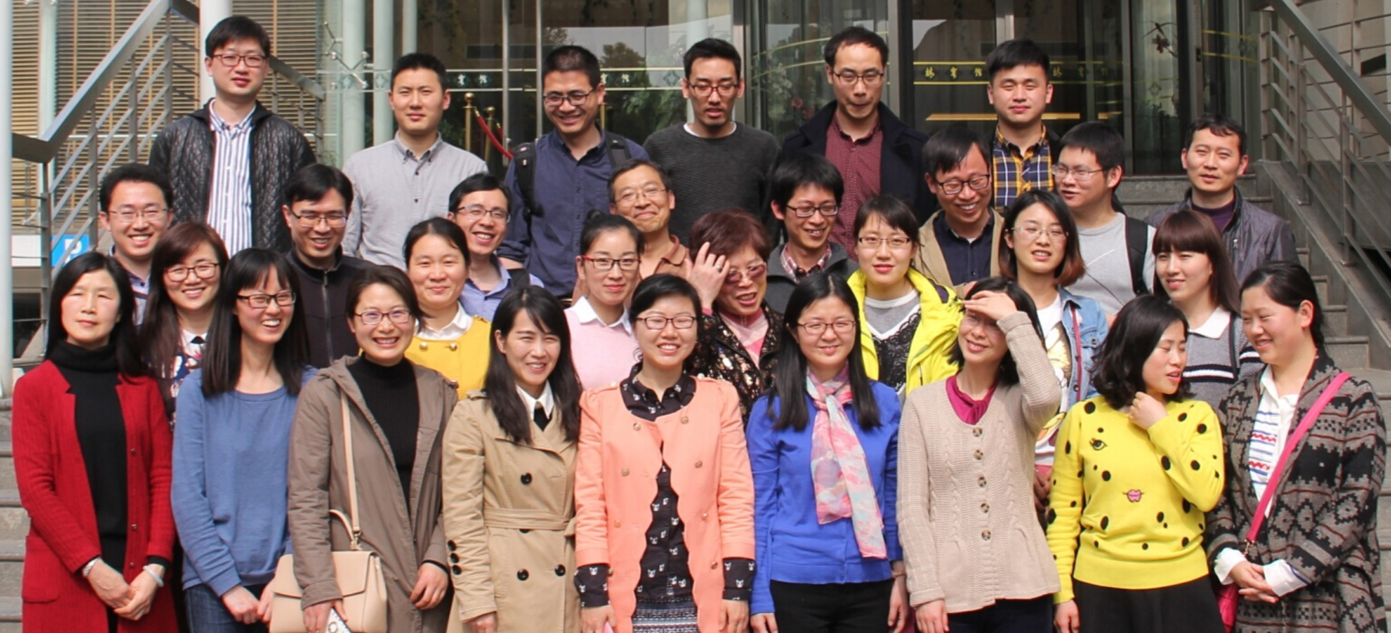
Acknowledgment
Thanks，my gratuate students!
These works are supported by the grants from
National Science Foundation, China

Slide 36
Thank you all!
We are seeking collaboration with industry !

Slide 37
Related Patents
A novel expression vector pHsh. US 7,807,460 B2
In situ error-prone PCR. US 9416359 B2,
Chinese patent ZL 200910025925.0.
Overexpression of laccase gene. Chinese patent
ZL 201010567825.3.
Biosynthesis of S-adenosylhomocysteine. Chinese patent application 2014102079592.
A drug resistant gene-free shuttle vector. Chinese patent application 201310191146.4.
Novel T-vector, heat-shock induced expression. Chinese patent application 201410061452.0.
Novel T-vector, cold-shock induced expression. Chinese patent application 201410501807.3.

