Slide 1
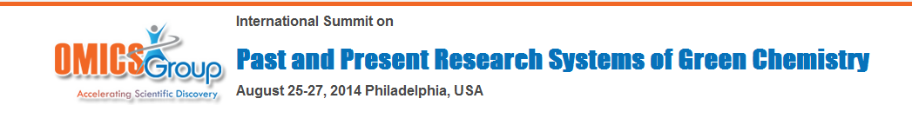
Recent structure activity relationship studies (SAR) on natural occurring sulfonium salts as potent α-glucosidase inhibitors
Weijia Xie
China Pharmaceutical University
2014-08-25

Slide 2
About OMICS Group
OMICS Group International is an amalgamation of Open Access publications and worldwide international science conferences and events. Established in the year 2007 with the sole aim of making the information on Sciences and technology ‘Open Access’, OMICS Group publishes 400 online open access scholarly journals in all aspects of Science, Engineering, Management and Technology journals. OMICS Group has been instrumental in taking the knowledge on Science & technology to the doorsteps of ordinary men and women. Research Scholars, Students, Libraries, Educational Institutions, Research centers and the industry are main stakeholders that benefitted greatly from this knowledge dissemination. OMICS Group also organizes 300 International conferences annually across the globe, where knowledge transfer takes place through debates, round table discussions, poster presentations, workshops, symposia and exhibitions.

Slide 3
About OMICS Group Conferences
OMICS Group International is a pioneer and leading science event organizer, which publishes around 400 open access journals and conducts over 300 Medical, Clinical, Engineering, Life Sciences, Phrama scientific conferences all over the globe annually with the support of more than 1000 scientific associations and 30,000 editorial board members and 3.5 million followers to its credit.
OMICS Group has organized 500 conferences, workshops and national symposiums across the major cities including San Francisco, Las Vegas, San Antonio, Omaha, Orlando, Raleigh, Santa Clara, Chicago, Philadelphia, Baltimore, United Kingdom, Valencia, Dubai, Beijing, Hyderabad, Bengaluru and Mumbai.

Slide 4
Introduction
Synthetic and Biological Studies on Neoponkoranol and its Epimers
Structure Modification and Biological Evaluation of Neosalacinol
Total Synthesis of Neokotalanol

Slide 5

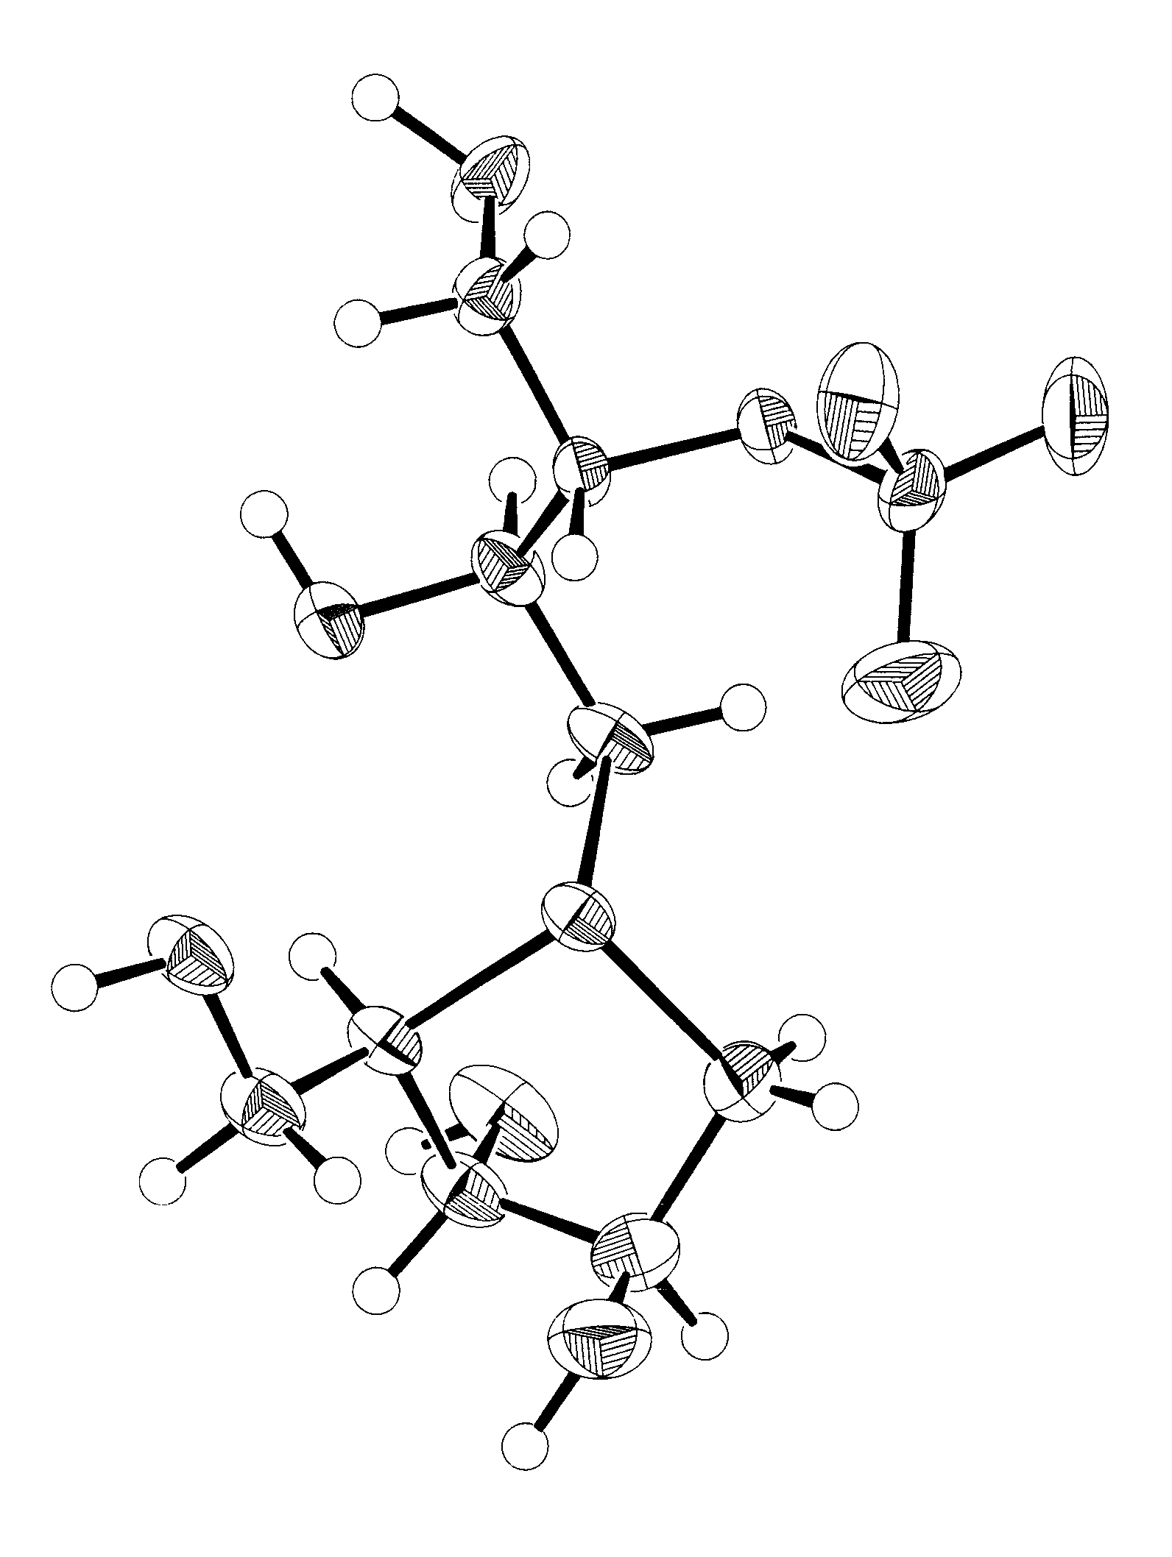
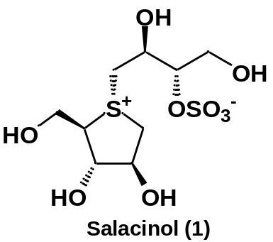
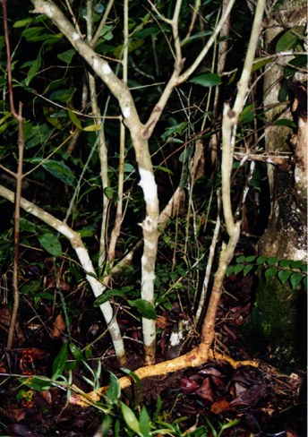

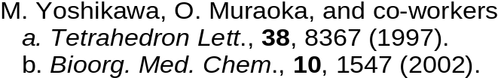
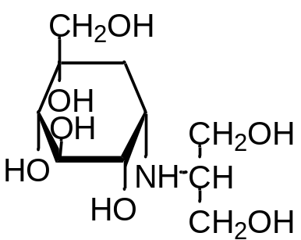
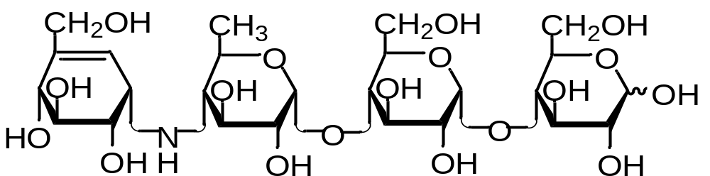
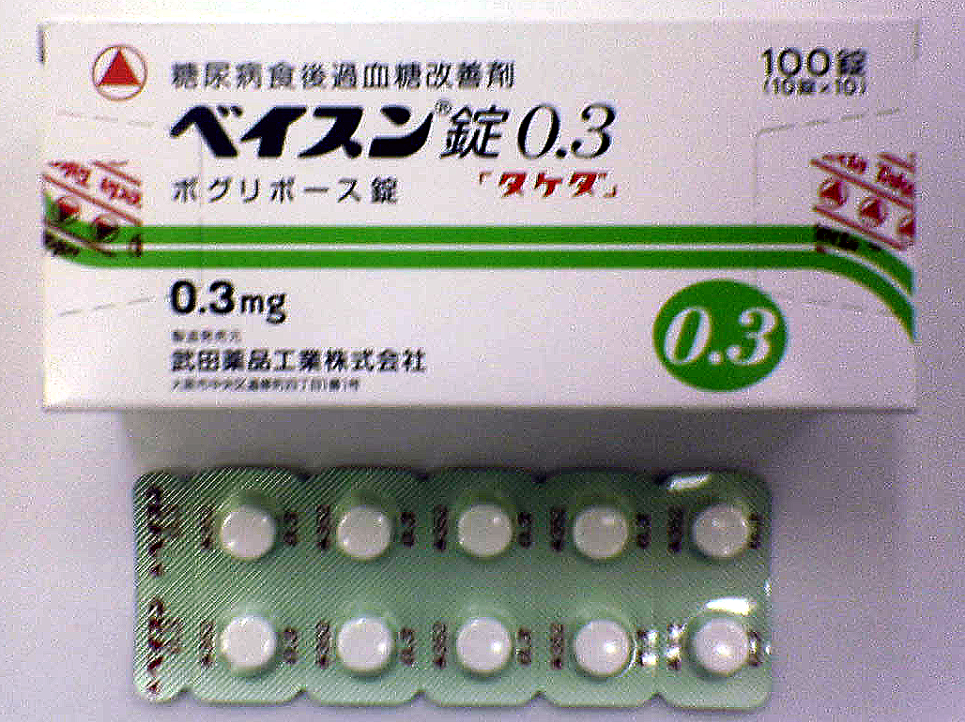
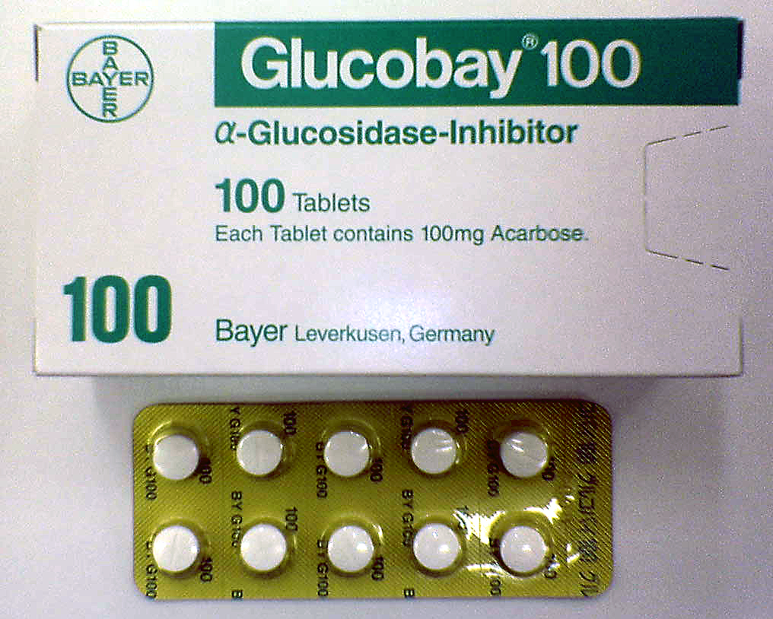
Introduction
Isolation and Structure
Determination:
from an antidiabetic
Ayurvedic traditional
medicine, Salacia reticulata
O3
O2
S
O1
S⁺
3.16 Å
Salacia reticulata
IC₅₀ Values (μM, in vitro)
Perspective view of 1
Maltase 5.2
Sucrase 1.6
Isomaltase 1.3
Acarbose
Voglibose
2.0
1.7
155
1.2
0.2
2.1

Slide 6
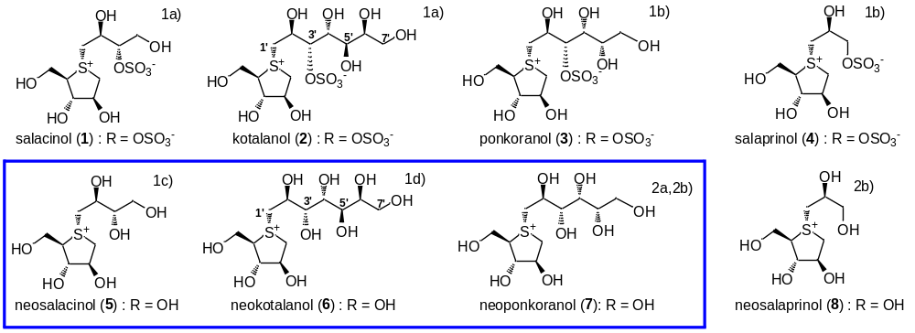
Introduction
a) Yoshikawa, M.; Murakami, T.; Yashiro, K.; Matsuda, H. Chem. Pharm. Bull. 1998, 46, 1339-1340; b) Yoshikawa, M.; Xu, F.; Nakamura, S.; Wang, T.; Matsuda, H.; Tanabe, G.; Muraoka, O. Heterocycles 2008, 75, 1397-1405; c) Minami, Y.; Kuriyama, C.; Ikeda, K.; Kato, A.; Takebayashi, K.; Adachi, I.; Fleet, W. J. G.; Kettawan, A.; Okamoto, T.; Asano, N. Bioorg. Med. Chem. 2008, 16, 2734-2740; d) Ozaki, S.; Oe, H.; Kitamura, S. J. Nat. Prod. 2008, 71, 981-984.
(a) Eskandari, R.; Kuntz, D. A.; Rose, D. R.; Pinto, B. M. Org. Lett., 2010, 12, 1632-1635; (b) Xie, W.; Tanabe, G.; Akaki, J.; Morikawa, T.; Ninomiya, K.; Minematsu, T.; Yoshikawa, M.; Wu, X.; Muraoka, O. Bioorg. Med. Chem., 2011, 19, 2015-2022.

Slide 7
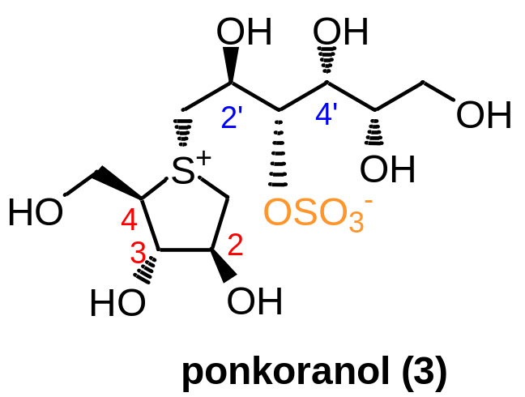
Important Structural Determinants for the Inhibitory Activity
2S, 3S, 4R configurations of the thiosugar moiety are important.
The α-orientation of the side chain is essential for the inhibition.
Polyhydroxylated side chain longer than four carbons does not enhance the inhibitory activity significantly.
(d) Cooperative role of 2’S-OH and 4’-OH is critical for strong inhibitions. Furthermore, it is of prime importance that R configuration of OH at C4’ is imperative to inhibitors bearing the side chain more than four carbons.
(e) Sulfate moiety might not contribute to inhibitory activity.

Slide 8
Introduction
Synthetic and Biological Studies on Neoponkoranol and its Epimers
Structure Modification and Biological Evaluation of Neosalacinol
Total Synthesis of Neokotalanol

Slide 9
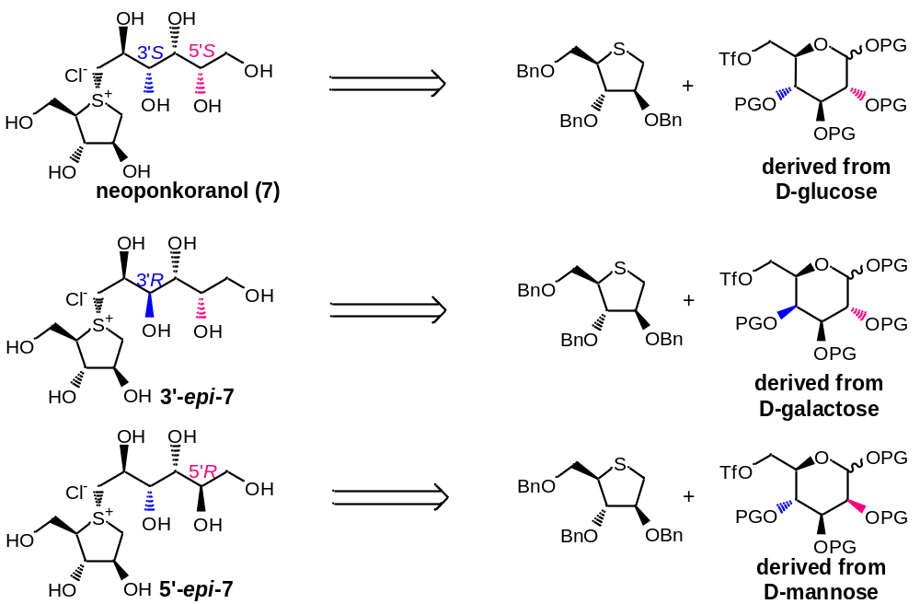
Synthetic and Biological Studies on Neoponkoranol and Its Epimers

Slide 10
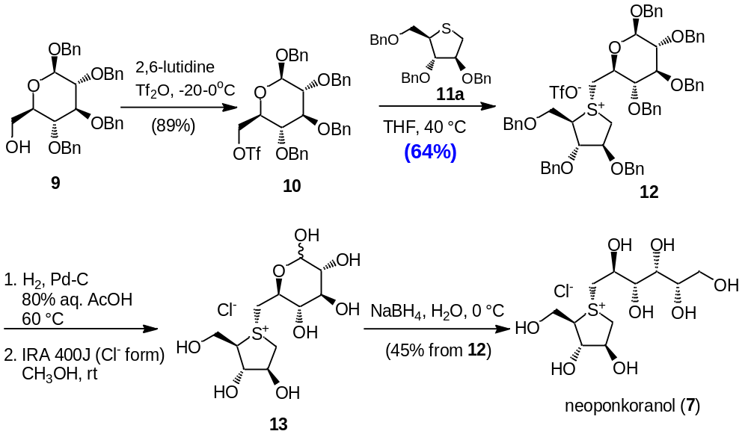
Synthesis of Neoponkoranol

Slide 11
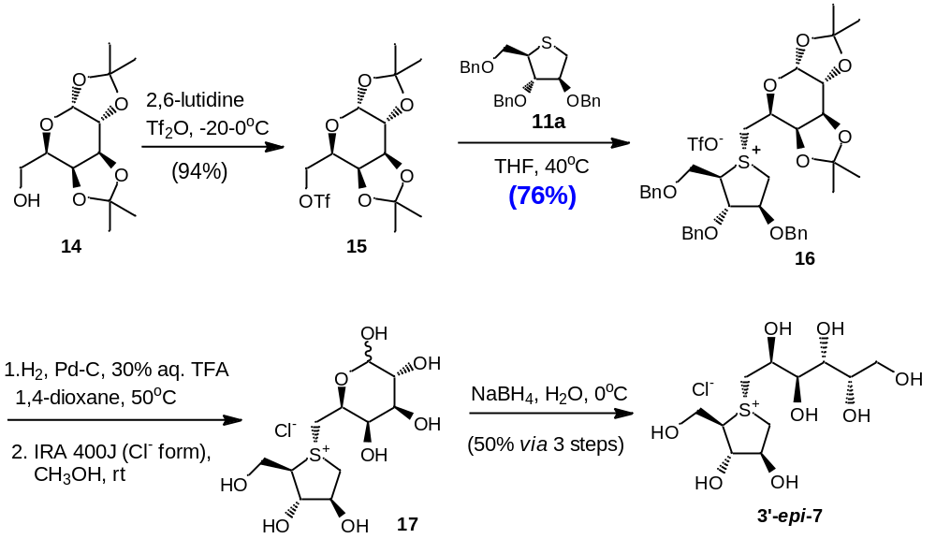
Synthesis of 3’-epi-Neoponkoranol

Slide 12
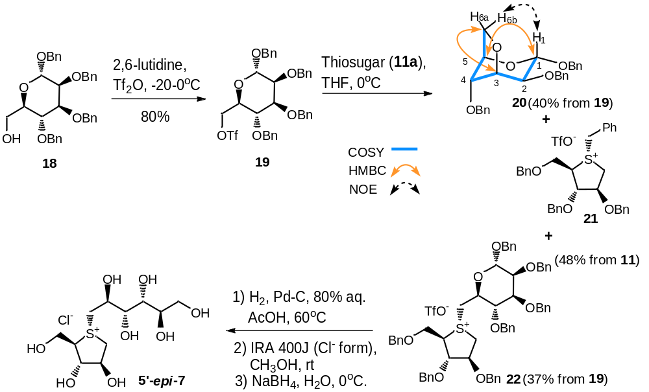
Synthesis of 5’-epi-Neoponkoranol

Slide 13
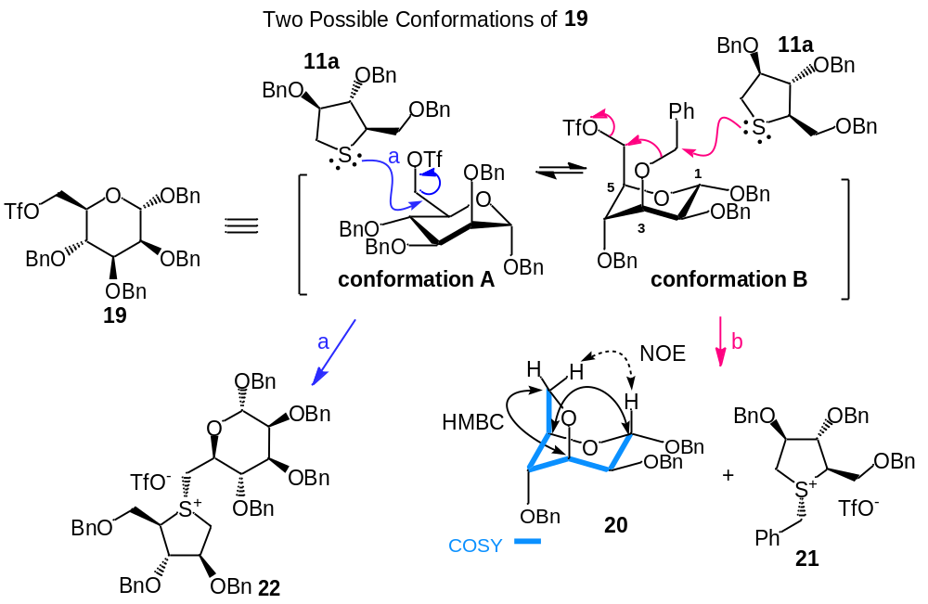
Plausible Coupling Reaction Mechanism of
Triflate (19) with Thiosugar (11a)

Slide 14
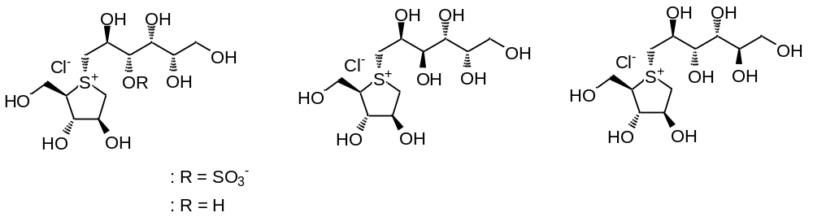
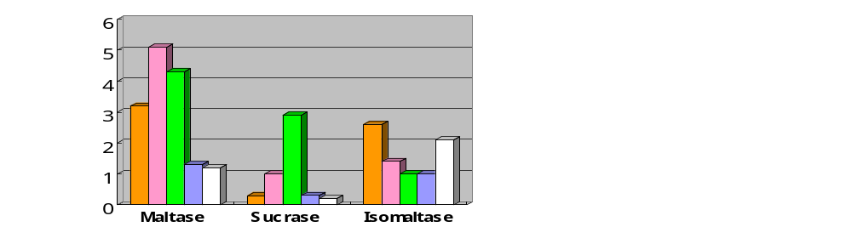
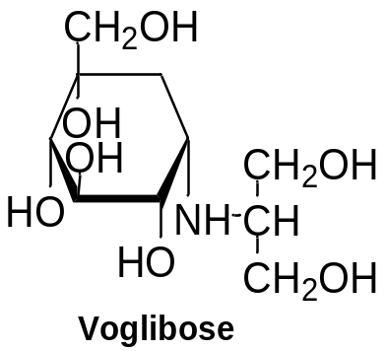
α-Glucosidase Inhibitory Activities of Neoponkoranol and Its Analogs
ponkoranol (3)
3'-epi-7
5'-epi-7
neoponkoranol (7)
IC₅₀ Values (μM)

Slide 15
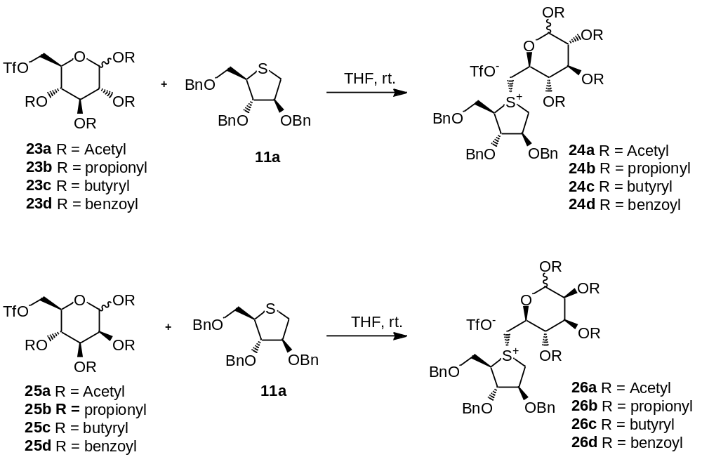
Synthetic studies on Neoponkoranol and Its 5’-Epimer

Slide 16
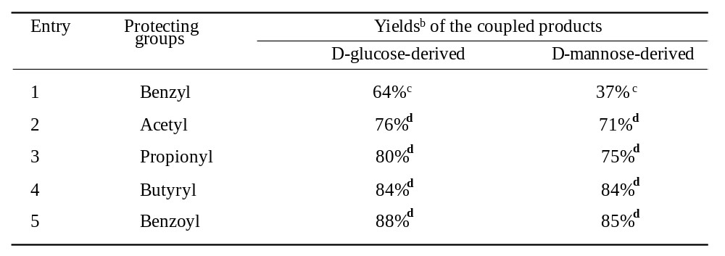
Synthetic studies on Neoponkoranol and Its 5’-Epimer
Table1. Yields of coupling reactionª between different triflates and thiosugar (11a)
ª All reactions were performed in 1.0 mmol scale in anhydrous solvents.
^{b} Isolated yield after column chromatography.
^{c} Xie, W.; Tanabe, G.; Akaki, J.; Morikawa, T.; Ninomiya, K.; Minematsu, T.; Yoshikawa, M.; Wu, X.; Muraoka, O. Bioorg. Med. Chem., 2011, 19, 2015-2022.
^{d} Liu, D.; Xie, W.*; Liu, L.; Yao, H.; Xu, J.; Tanabe, G.; Muraoka, O.; Wu, X. Tetrahedron Lett. 2013, 54, (47), 6333-6336.

Slide 17
Introduction
Synthetic and Biological Studies on Neoponkoranol and its Epimers
Structure Modification and Biological Evaluation of Neosalacinol
Total Synthesis of Neokotalanol

Slide 18
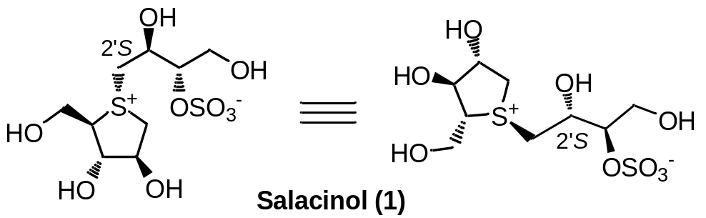
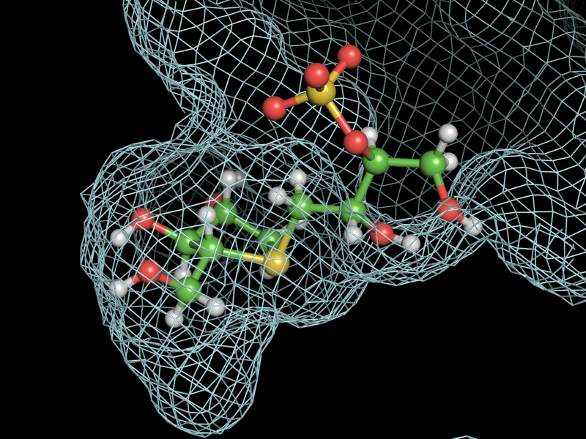
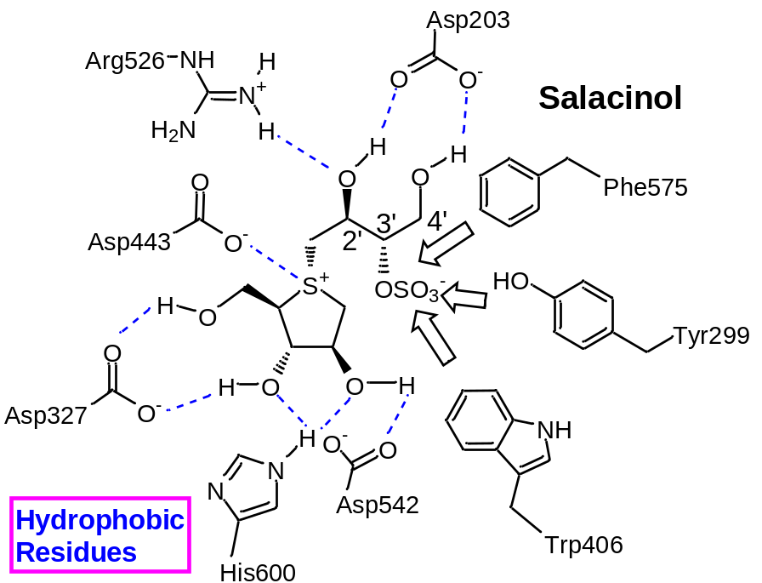
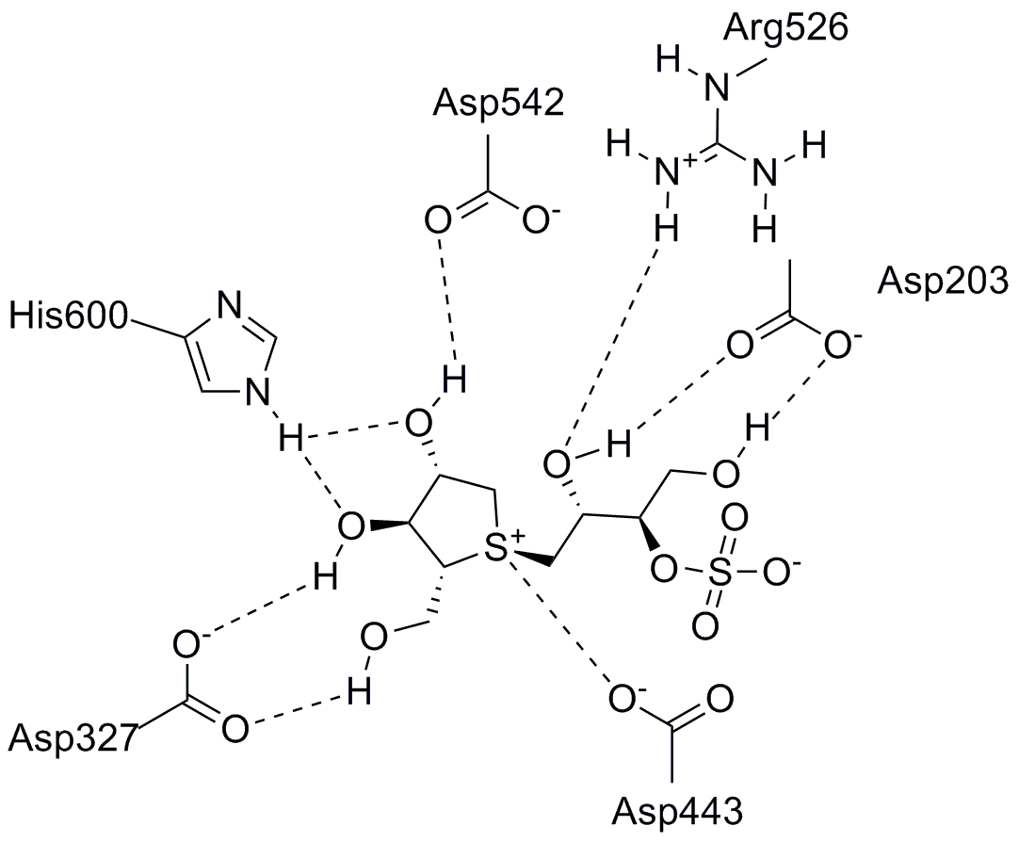
1. S. Nakamura, O. Muraoka, I. Nakanishi, et al. Bioorg. Med. Chem Lett., 2010, 20, 4420.

Slide 19
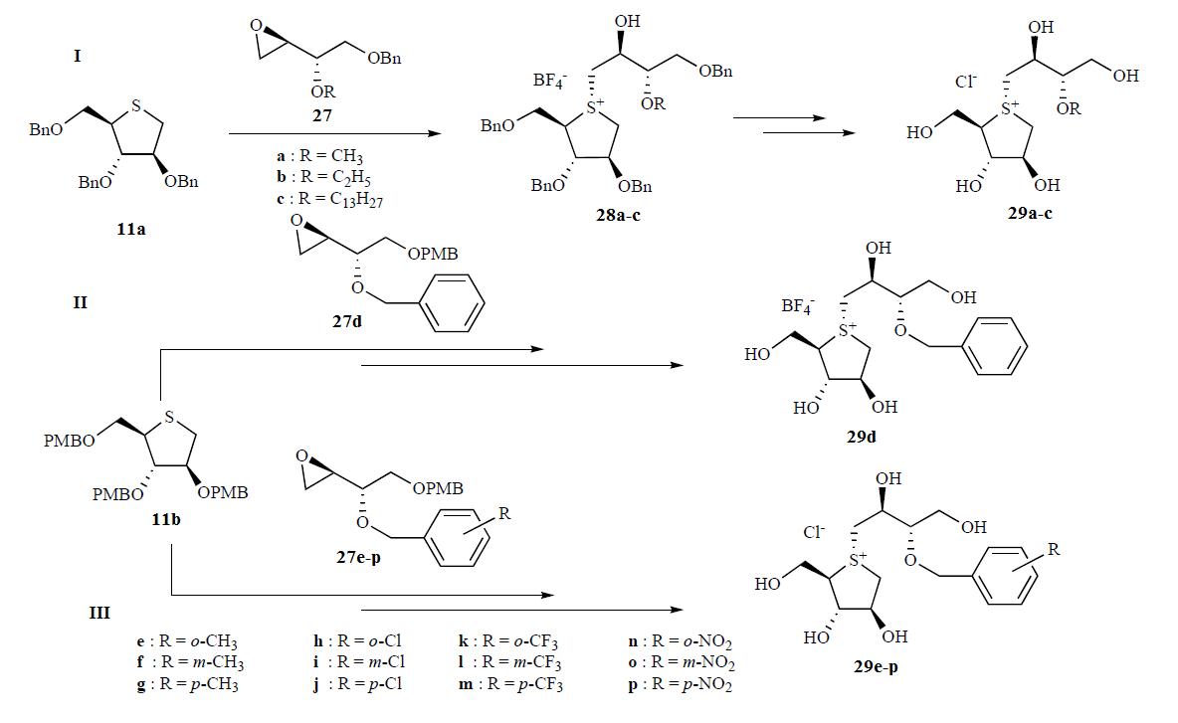
Structure Modification of Neosalacinol

Slide 20
Background of the project
Table 2. IC₅₀ Values (mM) of thiosugar sulfonium salts and related compounds against disaccharidases
Entry | Compound | Maltase | Sucrase | Isomaltase
1 | 29a (R = H) | 0.32 | 0.44 | 0.14
2 | 29b (R = CH₃) | 0.46 | 5.3 | 0.39
3 | 29c (R = CH₃) | 1.3 | 1.0 | 0.95
4 | 29d (R = C₂H₅) | 0.32 | 0.44 | 0.14
5 | 29e (R = o-CH₃) | 0.66 | 0.41 | 0.48
6 | 29f (R = m-CH₃) | 0.84 | 1.3 | 0.35
7 | 29g (R = p-CH₃) | 0.86 | 1.1 | 0.68
8 | 29h (R = o-Cl) | 0.31 | 0.09 | 0.26
9 | 29i (R = m-Cl) | 0.53 | 0.80 | 0.31
10 | 29j (R= p-Cl) | 0.89 | 0.72 | 0.48
11 | 29k (R = o-CF₃) | 0.33 | 0.15 | 0.19
12 | 29l (R = m-CF₃) | 0.98 | 0.82 | 0.25
13 | 29m (R = p-CF₃) | 0.98 | 0.72 | 0.38
14 | 29n (R = o-NO₂) | 0.13 | 0.042 | 0.21
15 | 29o (R = m-NO₂) | 0.94 | 0.49 | 0.23
16 | 29p (R = p-NO₂) | 0.68 | 0.38 | 0.23
17 | Voglibose | 1.2 | 0.2 | 2.1
18 | Acarbose | 2.0 | 1.7 | 155

Slide 21
Background of the project
Table 2. IC₅₀ Values (μM) of thiosugar sulfonium salts and related compounds against disaccharidases
Entry | Compound | Maltase | Sucrase | Isomaltase
1 | 29a (R = H) | 0.32 | 0.44 | 0.14
2 | 29b (R = CH₃) | 0.46 | 5.3 | 0.39
3 | 29c (R = CH₃) | 1.3 | 1.0 | 0.95
4 | 29d (R = C₂H₅) | 0.32 | 0.44 | 0.14
5 | 29e (R = o-CH₃) | 0.66 | 0.41 | 0.48
6 | 29f (R = m-CH₃) | 0.84 | 1.3 | 0.35
7 | 29g (R = p-CH₃) | 0.86 | 1.1 | 0.68
8 | 29h (R = o-Cl) | 0.31 | 0.09 | 0.26
9 | 29i (R = m-Cl) | 0.53 | 0.80 | 0.31
10 | 29j (R= p-Cl) | 0.89 | 0.72 | 0.48
11 | 29k (R = o-CF₃) | 0.33 | 0.15 | 0.19
12 | 29l (R = m-CF₃) | 0.98 | 0.82 | 0.25
13 | 29m (R = p-CF₃) | 0.98 | 0.72 | 0.38
14 | 29n (R = o-NO₂) | 0.13 | 0.042 | 0.21
15 | 29o (R = m-NO₂) | 0.94 | 0.49 | 0.23
16 | 29p (R = p-NO₂) | 0.68 | 0.38 | 0.23
17 | Voglibose | 1.2 | 0.2 | 2.1
18 | Acarbose | 2.0 | 1.7 | 155

Slide 22
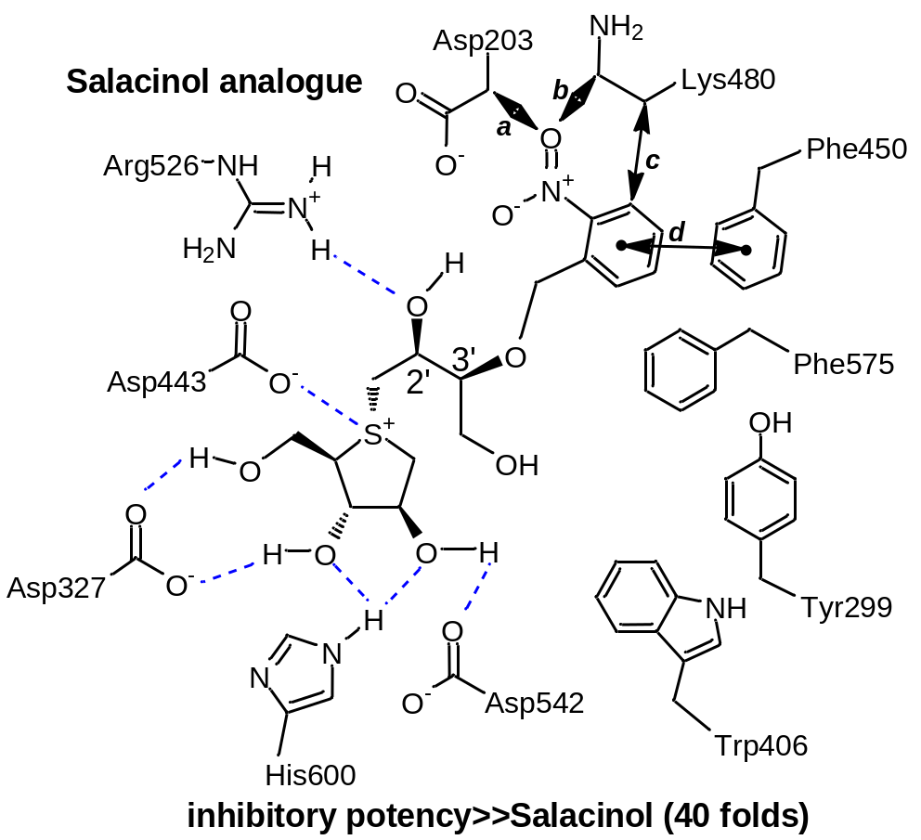
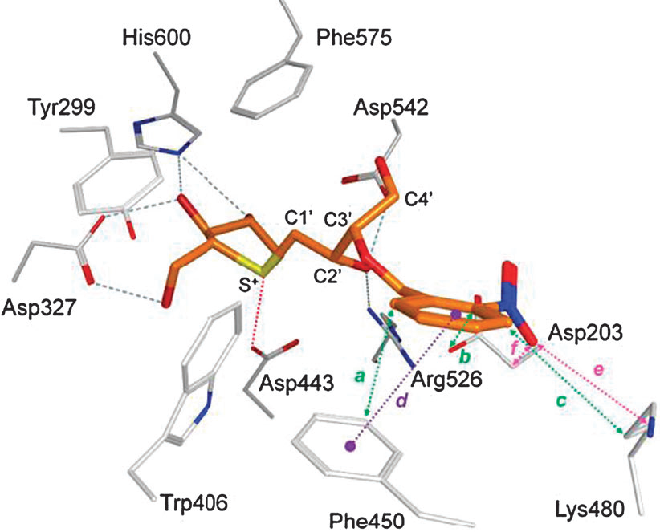
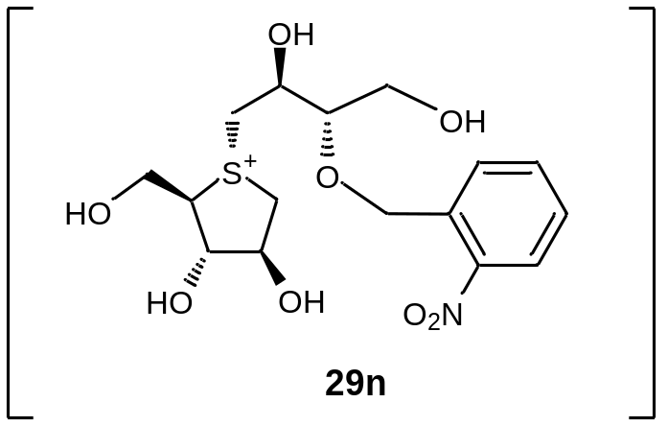
Molecular Docking of 29n with hNtMGAM active site
Reference: Tanabe, G.; Nakamura, S.; Xie, W.; Tsuchiya, S.; Akaki, J.; Morikawa, T.; Yoshikawa, M.; Muraoka, O. Chem. Commun. 2012, 8646–8648.)

Slide 23
Introduction
Synthetic and Biological Studies on Neoponkoranol and its Epimers
Structure Modification and Biological Evaluation of Neosalacinol
Total Synthesis of Neokotalanol

Slide 24
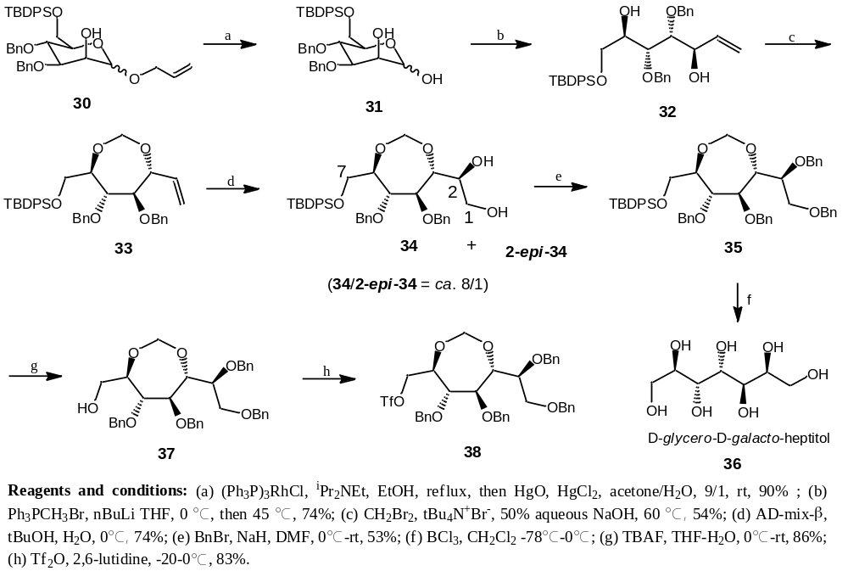
Total Synthesis of Neokotalanol (I)
Preparation of Side Chain Moiety

Slide 25
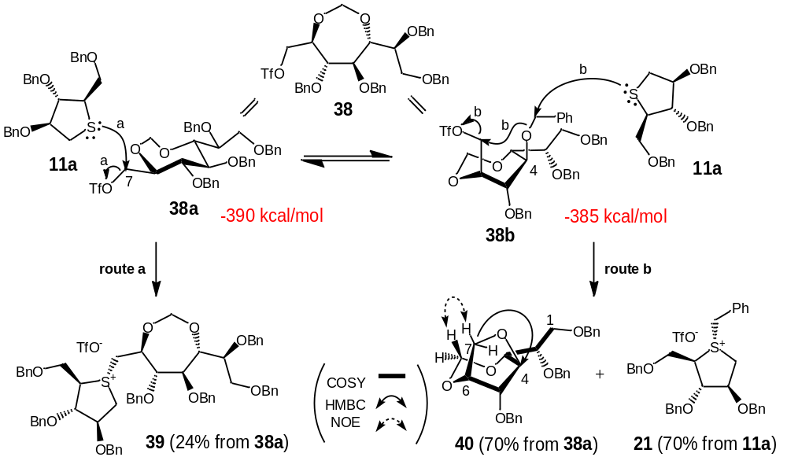
Total Synthesis of Neokotalanol (II)
Coupling Reaction Between Side Chain and Thiosugar

Slide 26
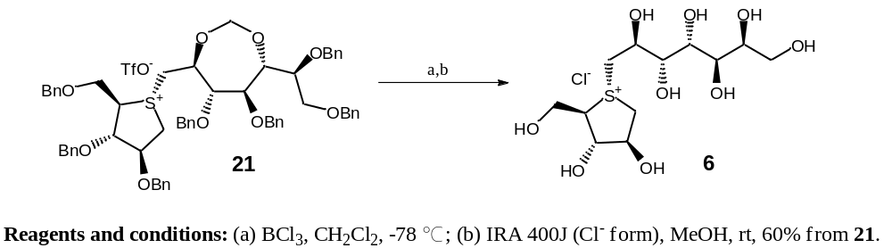
Total Synthesis of Neokotalanol (III)
Deprotection of Sulfonium Salt (21)
Reference: Xie, W.; Tanabe, G.;Tsutsui, N.;Wu. X.; Muraoka, O.* Chin. J. Nat. Med.11(6), 676, 2013.

Slide 27
Acknowledge
China Pharmaceutical University
Professor: Xiaoming Wu
Professor: Jinyi Xu
Professor: Hequan Yao
Dan Li (Dr.)
Long Liu (Ms.)
Chengqian Wang (Ms.)
Weigang He (Ms.)
Kinki University (Japan)
Professor: Osamu Muraoka
Associate Professor: Genzoh Tanabe
Thank you for
your attention!!!

Slide 28
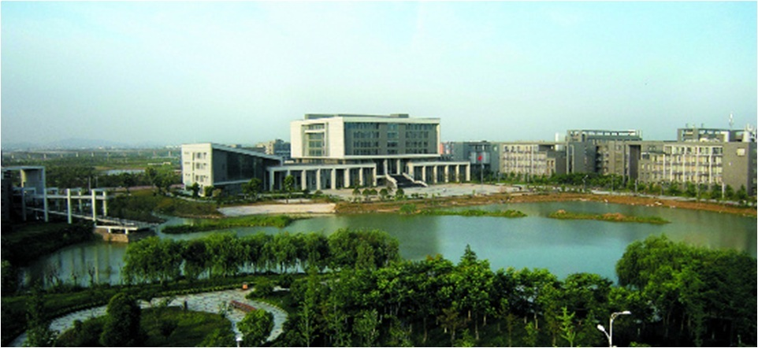
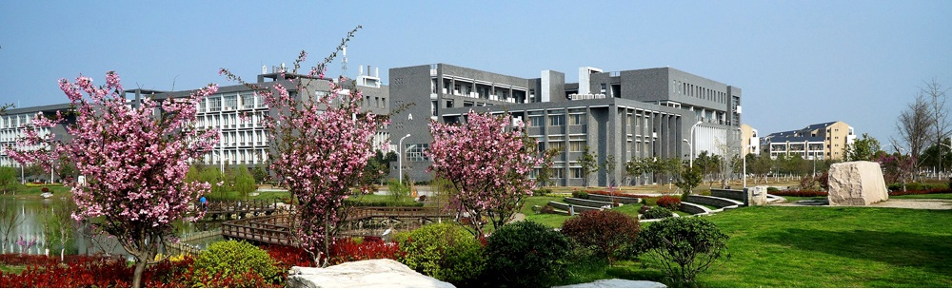
Welcome to China Pharmaceutical University !!!

Slide 29
Let Us Meet Again
We welcome you all to our future conferences of OMICS Group International
Please Visit:
www.omicsgroup.com
www.conferenceseries.com
www.pharmaceuticalconferences.com

